Slide 1


3D fault plane SGR(shale gouge ratio) calculation for fault sealing in Petrel software:
An example from Wenchang 9/8 area of the Pearl River Mouth Basin，China
Xu Lili
School of Geosciences
China university of petroleum
2022.05.26
Notes:
Hello, everyone, it’s my great honor to be here to do my presentation today. My name is Xu Lili, and I am a postgraduate from the School of Geosciences, China university of petroleum. The topic of my presentation is 3D fault plane SGR calculation for fault sealing in Petrel software: An example from Wenchang 9/8 area of the Pearl River Mouth Basin, China

Slide 2
Outline
1. Geological settings of the study area
2. Principles and quantitative evaluation methods of fault sealing
3. Results and evaluation of fault sealing in the study area
Notes:
My presentation will cover the following aspects.
Geological settings of the study area
Principles and quantitative evaluation methods of fault sealing and
Results and evaluation of fault sealing in the study area

Slide 3
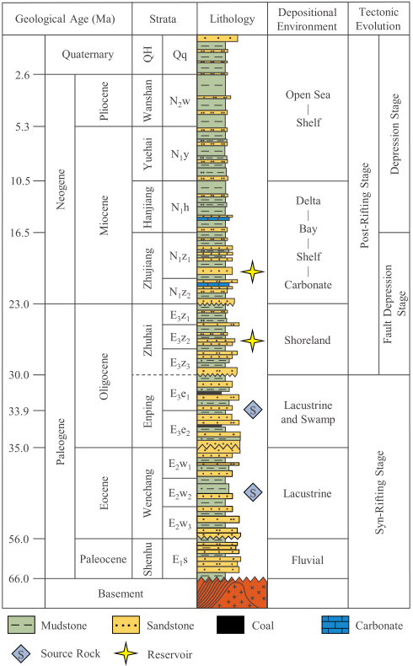
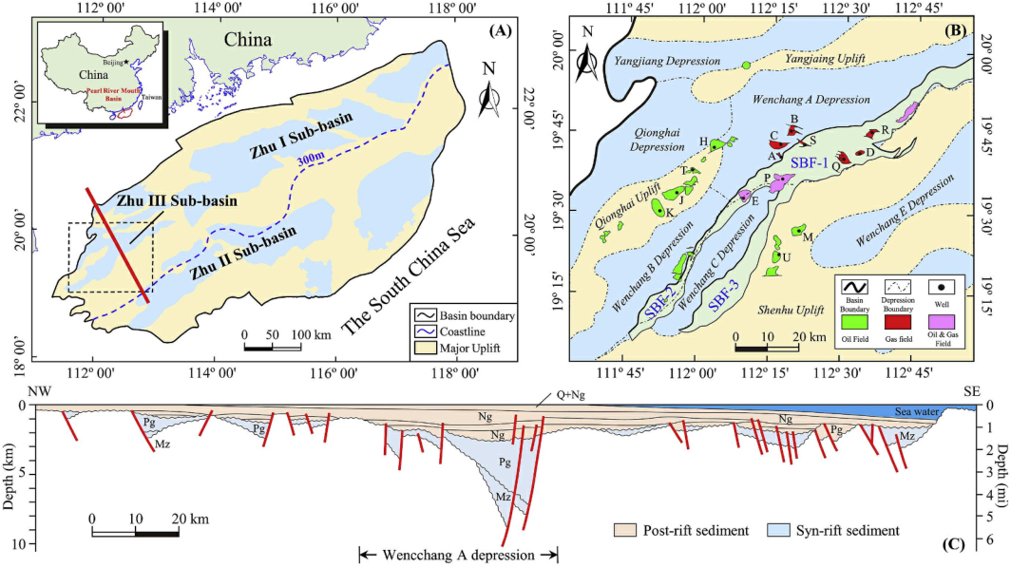
1.Geological settings of the study area
Stratigraphic sequence
Tectonic location
Hydrocarbon distribution
Wenchang 9/8 Area
Map showing the structural divisions of the Pearl River Mouth Basin, China and location of the Zhu III sub-basin
Location map showing the sub-units of Zhu III sub-basin, sampled wells and South Boundary Fault .
Structural framework
Cross-section showing the structural framework of the Pear River Mouth Basin （Quan et al., 2019）
Generalized stratigraphy of the Pear River Mouth Basin
（ Quan et al., 2019 ）
Notes:
Our study area called Wenchang 9/8 area, one of the most promising hydrocarbon accumulation zones in the western Pearl River Mouth Basin, offshore South China Sea, which has a double structural layers. In this area, oil and gas are mainly accumulated in the Zhuhai and Zhujiang formations.

Slide 4
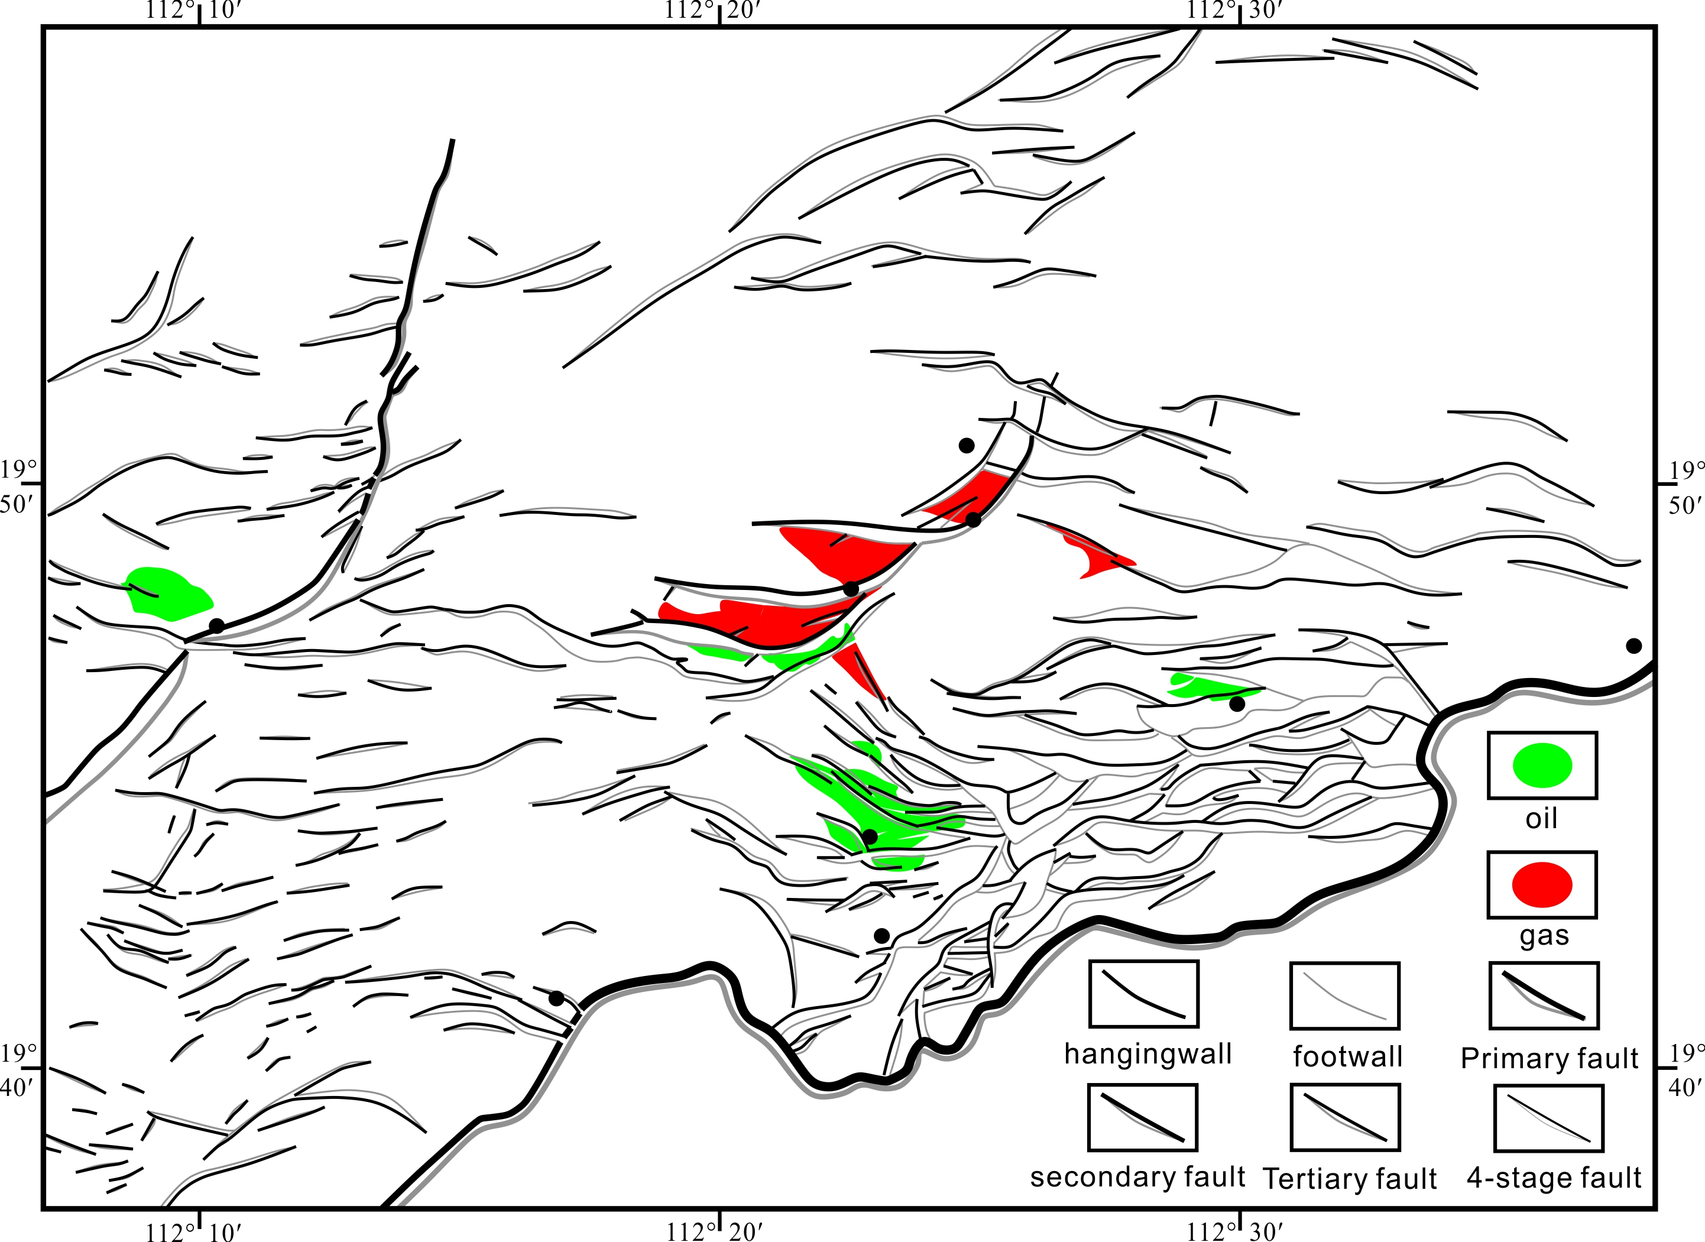
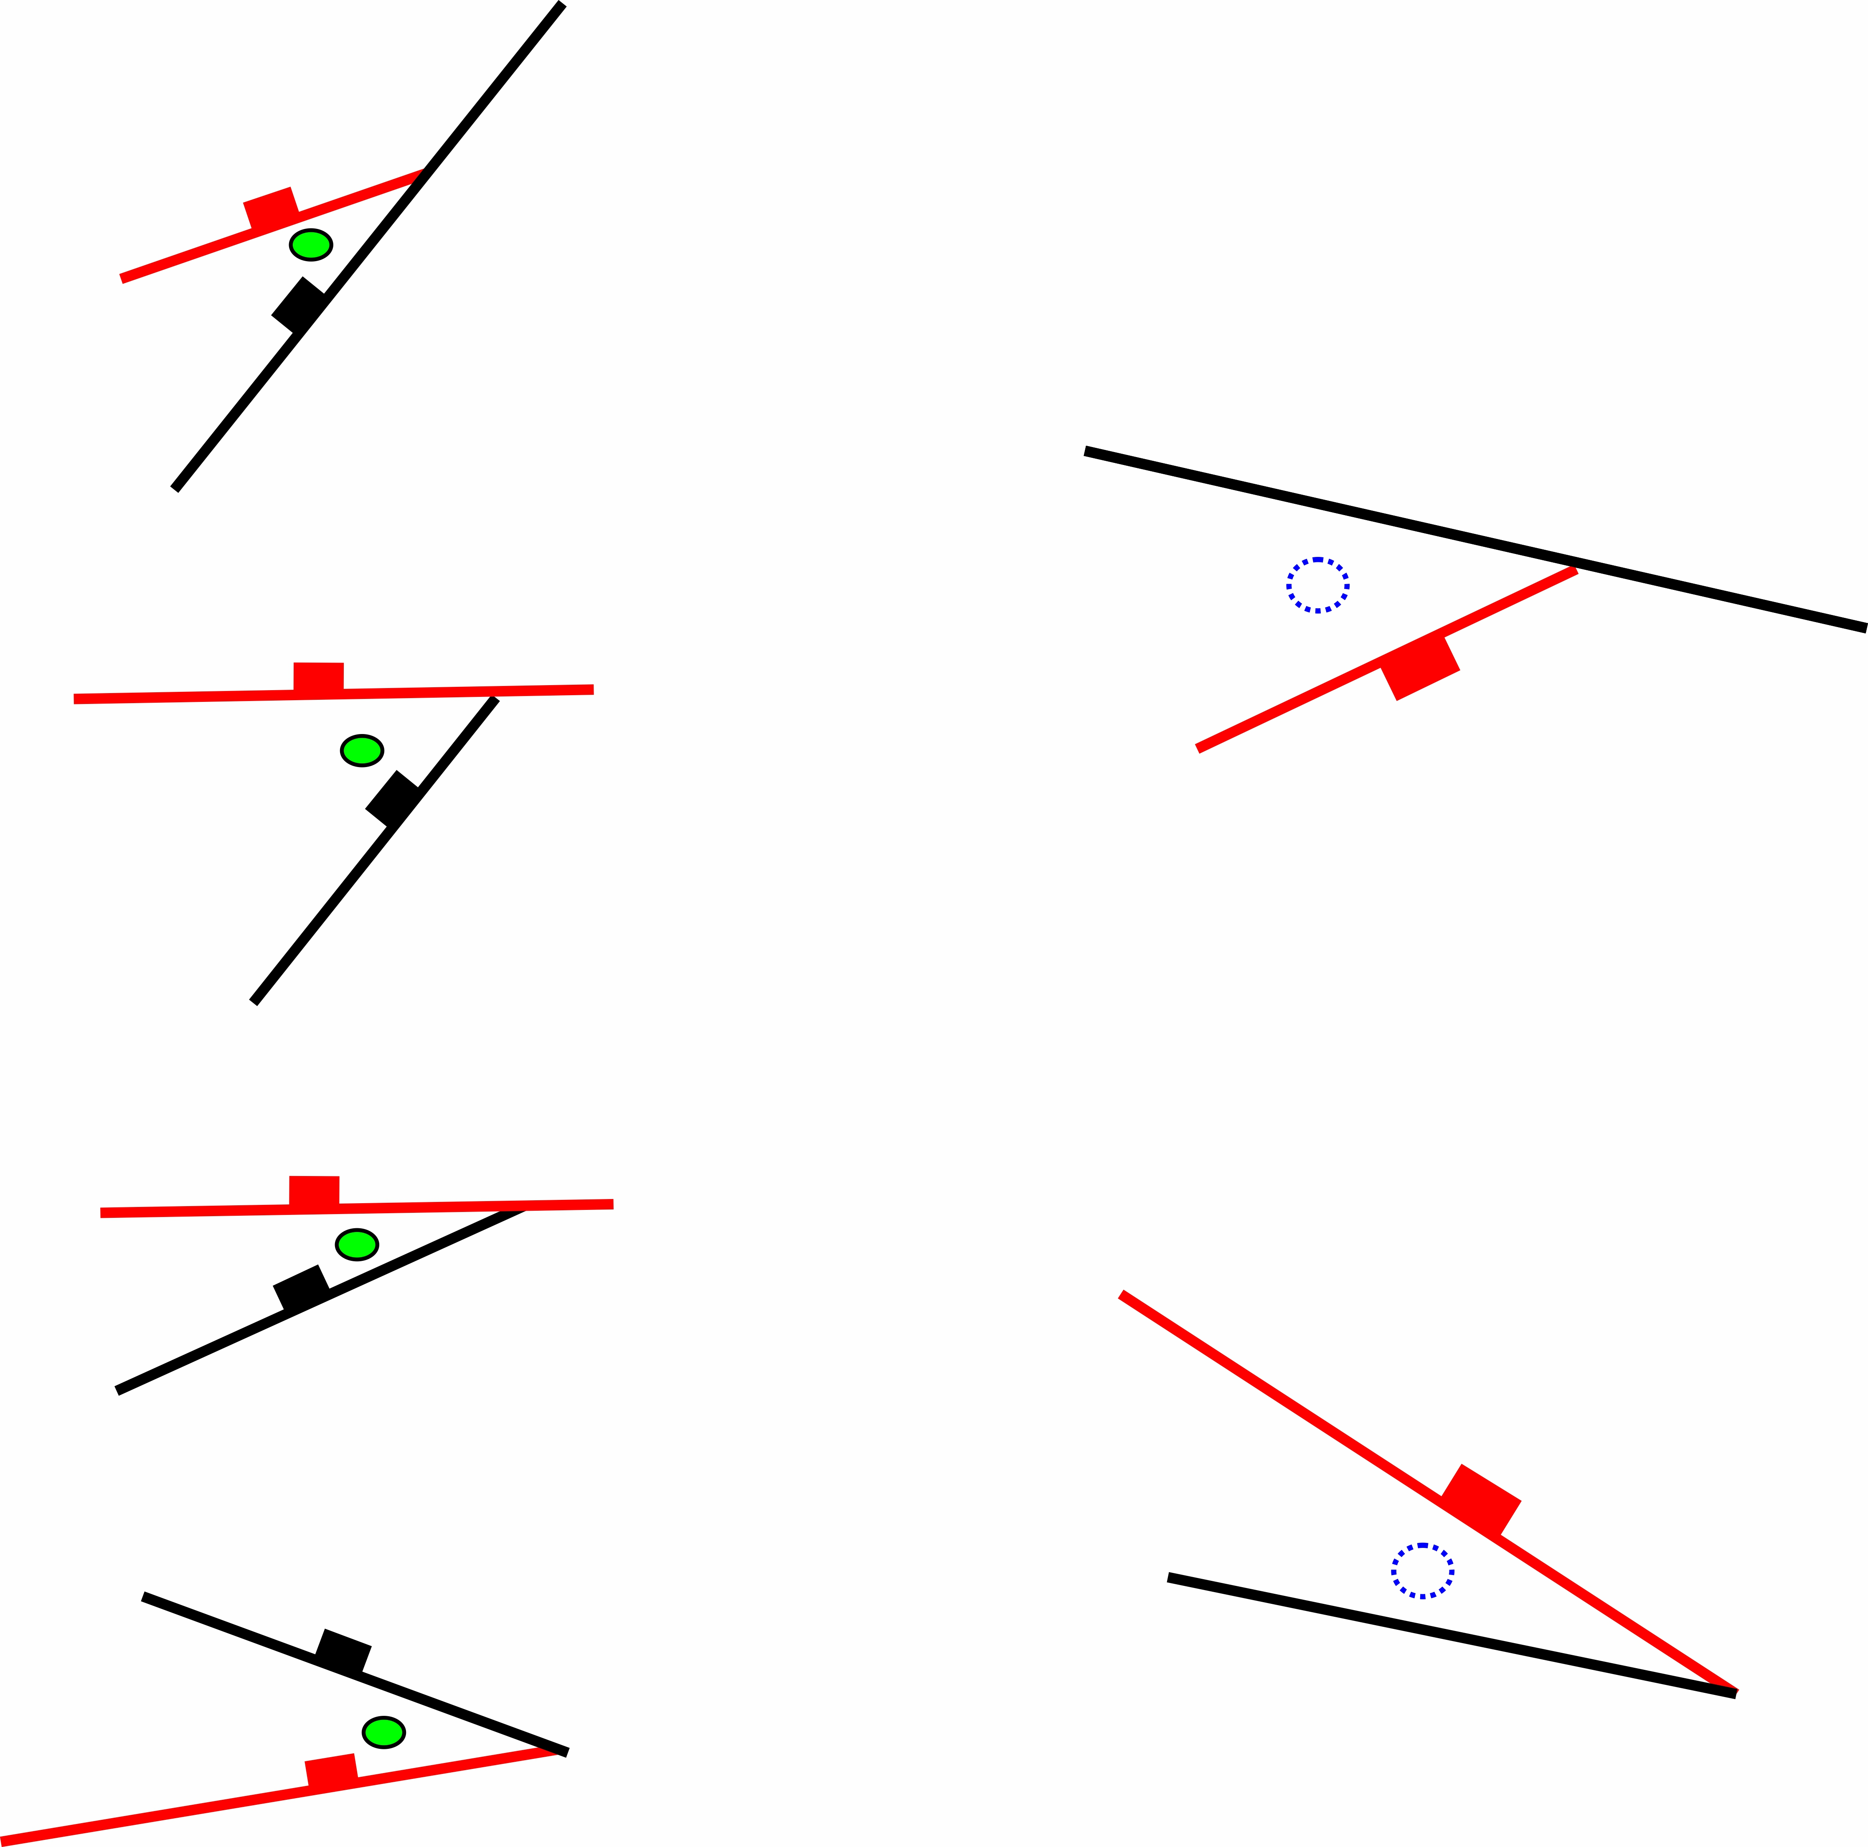
1.Geological settings of the study area
Oil and gas reservoir distribution
Located at the intersection area between the NW-striking faults and NE-striking faults
Oil-bearing structures:
Target structures:
WC9-2
Target 1
WC9-2
target 1
WC8-3
WC-A
WC9-3N
target 2
WC-A
WC10-8
WC-B
Target 2
WC10-8
target
WC-B
Distribution of fractures and oil and gas reservoirs in the Zhuhai formation of Wenchang 9/8 area
Hydrocarbon reservoirs are mainly laterally sealed by faults in study area
Notes:
Hydrocarbon reservoirs in Zhuhai formation are generally related to faults, which are mainly located at the intersection area between the NW-striking faults and NE-striking faults. Furthermore, previous petroleum exploration indicates that oil and gas are mainly laterally sealed by faults. Accordingly, we selected 2 target structures as the next exploration areas. Due to the complex development of fault, it is difficult to evaluate the lateral fault sealing in the study area. Therefore, high-resolution fault sealing calculation like shale-gauge-ratio (SGR) has a significant influence on further petroleum production. The key task of our study is to evaluate lateral fault sealing to help guide oil and gas exploration in Wenchang 9/8 area.

Slide 5
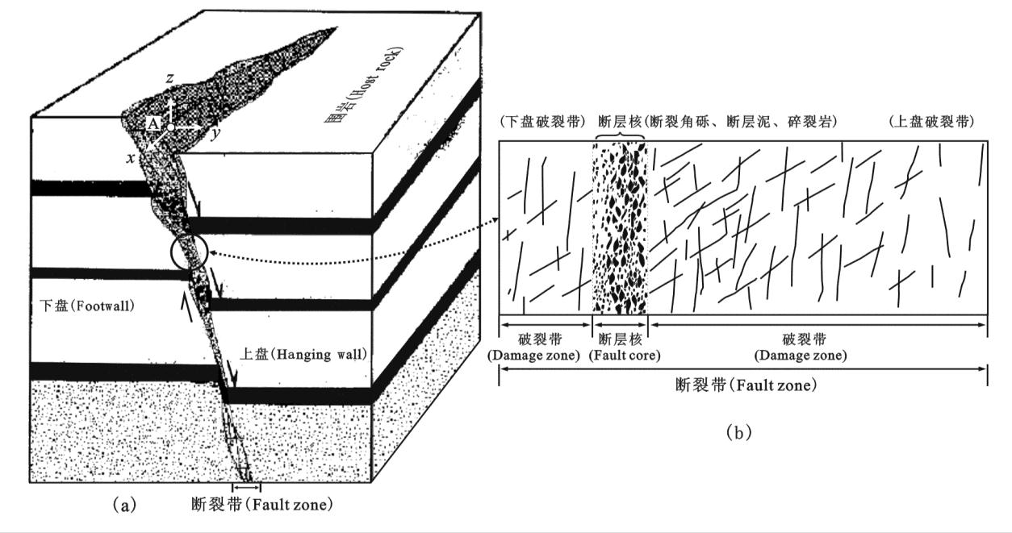
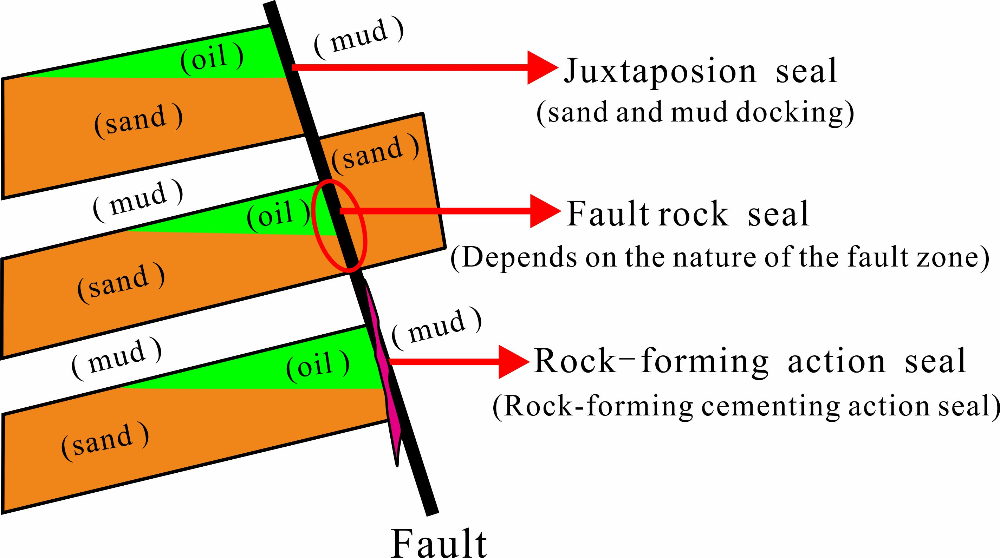
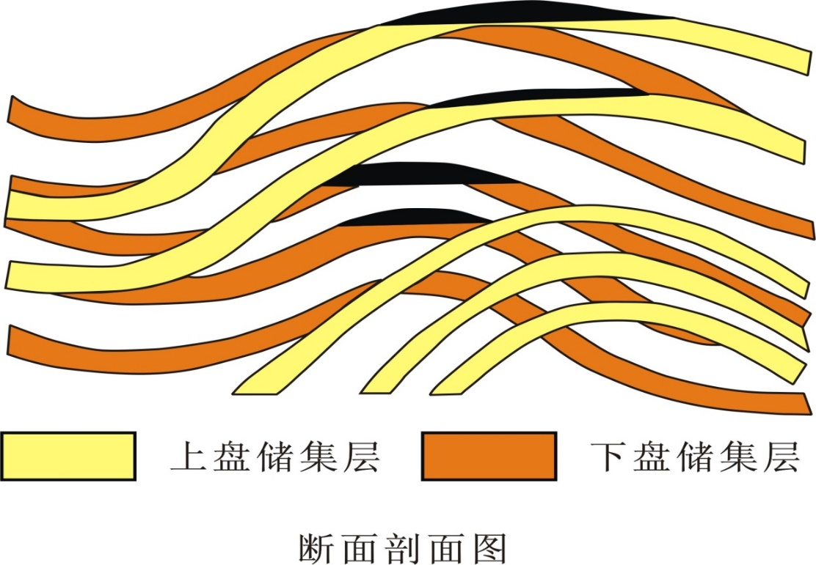
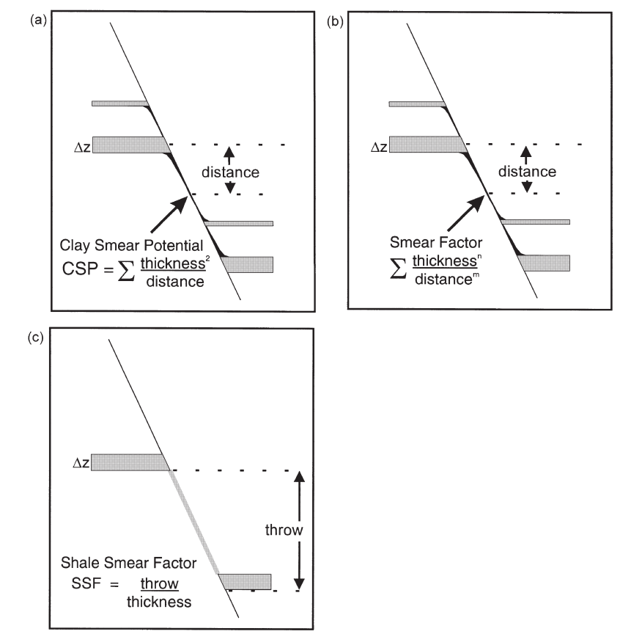
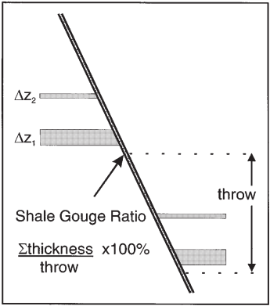
2. Principles and quantitative evaluation methods of fault sealing
Principles
Host rock
Footwall
Hanging wall
Damage zone
Fault core
Damage zone
Fault zone
Fault zone internal structural units
(modified by Wang, 2011)
Fault zone
Lateral fault sealing type(modified by Wang, 2017)
Methods
SSF CSP SGR
Sand
Sand
Oil and gas
Mud
Fault-plane section(modified by Allan,1989)
Algorithms for predicting clay smear prediction(Yielding et al.,1997)
Notes:
Since fault is a 3D geological body with a complex internal structure rather than a simple surface, there are many types of lateral fault sealing principles, such as Juxtaposion seal, fault rock seal and rock-forming action seal, and quantitative evaluation methods proposed by Allan, Yielding and others. We chose the quantitative characterization method of SGR value to evaluate fault sealing, which is the most suitable method for our study area.

Slide 6

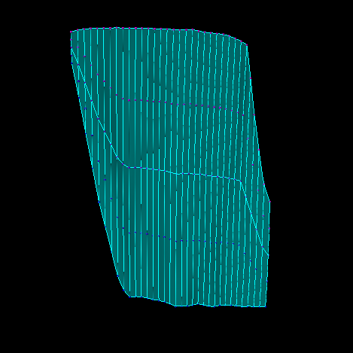
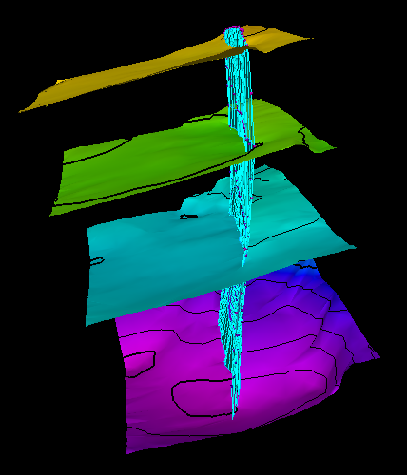
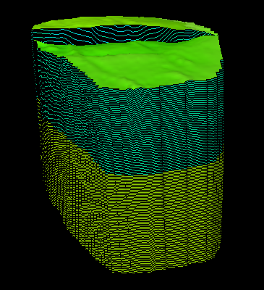
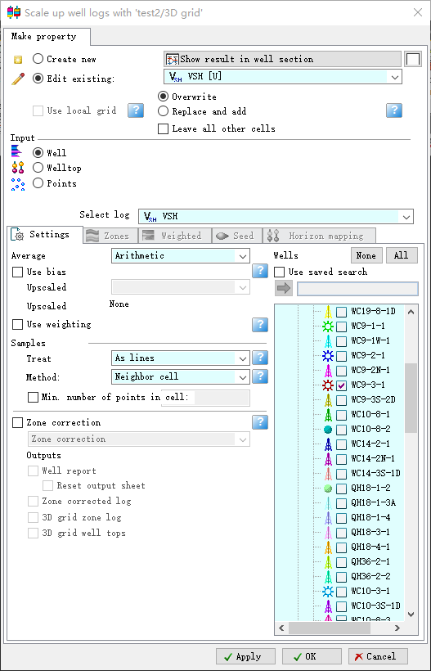
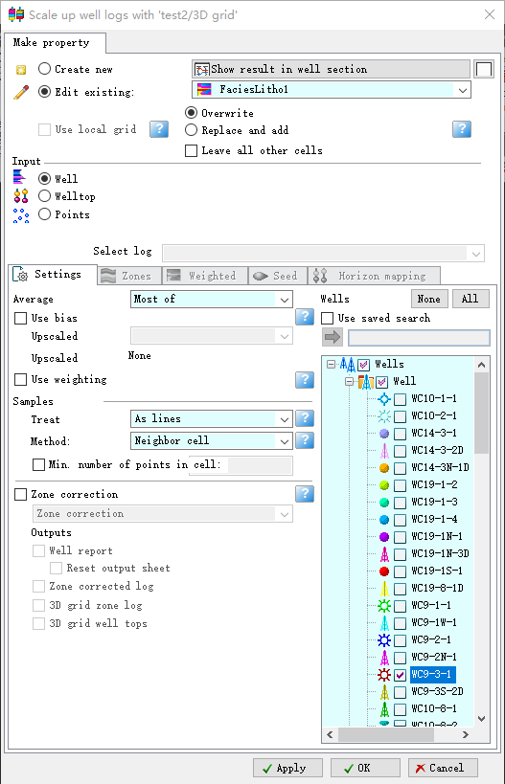
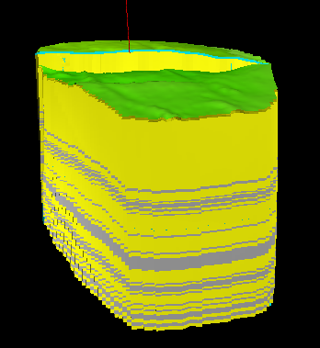
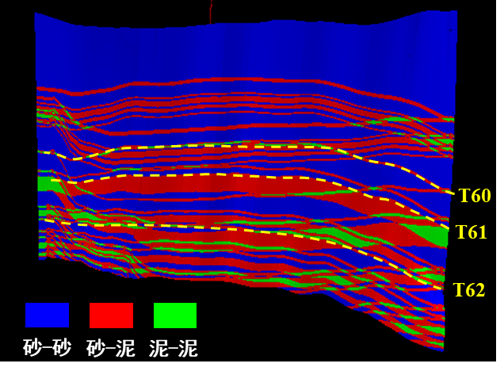
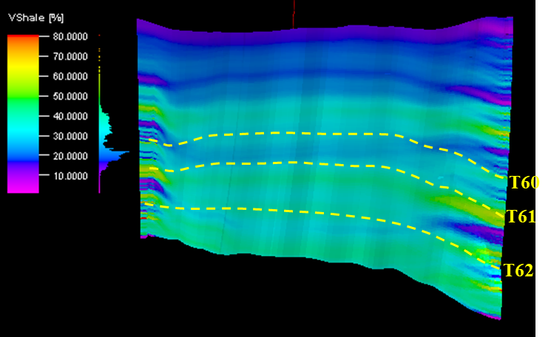
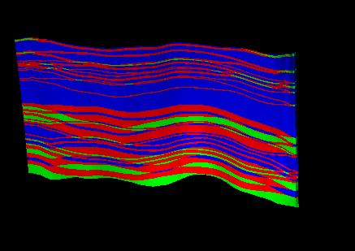
2. Principles and quantitative evaluation methods of fault sealing
Characterization methods and analytical processes
③Select the destination layer and generate the broken block model
①Generate a fault model
②Generate Stratigraphic models
④Generate VSH and lithology coarsening curves
⑤Assign values to the two disks of the fault
⑥Product a map of cross-sectional lithology
⑦Product a map of cross-sectional SGR distribution
sand-sand
sand-mud
mud-mud
Notes:
However, after testing several methods, we found that previous methods of SGR values can only characterize single or discontinuous points of SGR values for one fault rather than providing the SGR values for the entire fault plane, which could impact future petroleum exploration.
So we established the 3D fault plane SGR calculation method, which is based on the Petrel software platform.
Here are the analytical processes of this method, and the essence of this method is that it can evaluate the fault sealing by displaying the lithological opposition of the two plates of the fault and the SGR values of the mudstone coating of the entire fault.

Slide 7
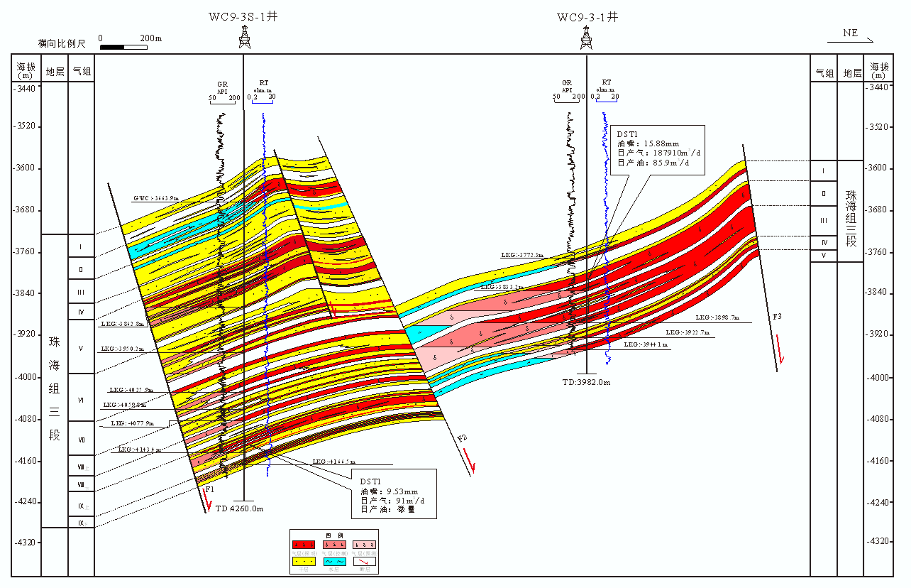
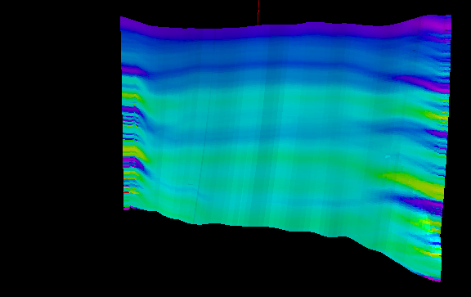
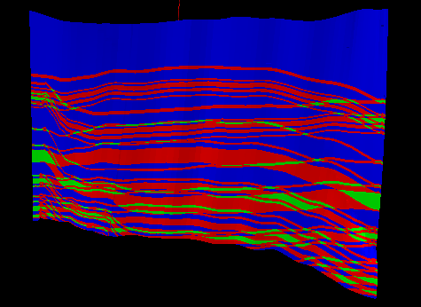
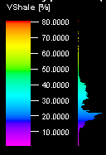
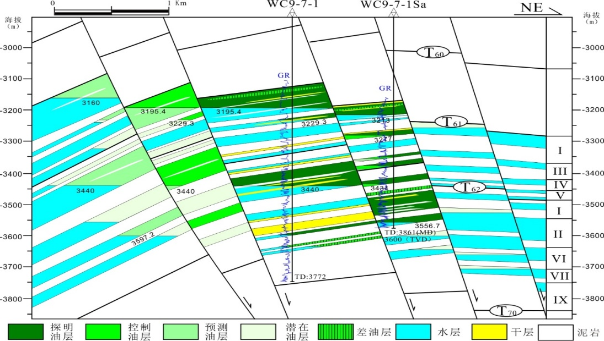
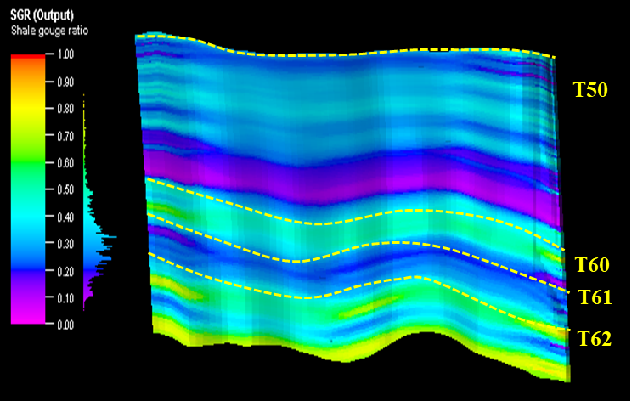

3. Results and evaluation in the study area
Analysis of examples of drilled oil-bearing structures
WC-A
oil-bearing structure
Result:
the 3D fault plane SGR of the Wenchang 9-3 oil-bearing structure reaches 35%-45%
T60
T60
T61
T61
T62
T62
sand-sand
sand-mud
mud-mud
T50
T50
WC-B
oil-bearing structure
Result:
the 3D fault plane SGR of the fault in Wenchang 9-7 oil-bearing structure reaches 40%-55%
T60
T60
T61
T61
T62
T62
sand-sand
sand-mud
mud-mud
Notes:
We then used this method on proven oil-bearing structures and target structures in Wenchang 9/8 area. The results show that: the 3D fault plane SGR of the Wenchang -A oil-bearing structure reaches 35%-45%, and Wenchang -B oil-bearing structure reaches 40%-55%, indicating that they have good fault sealing. Therefore, the 3D fault plane SGR in Wenchang A and B oil-bearing structures are generally consistent with the results of petroleum exploration.

Slide 8
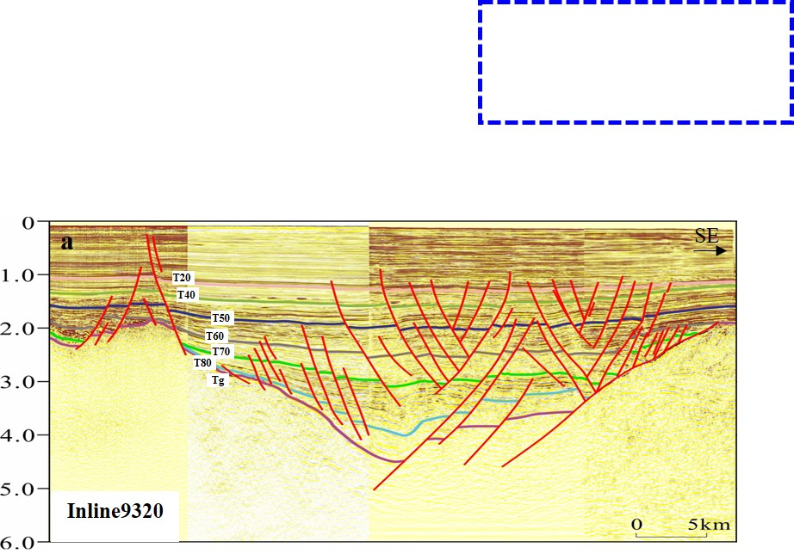
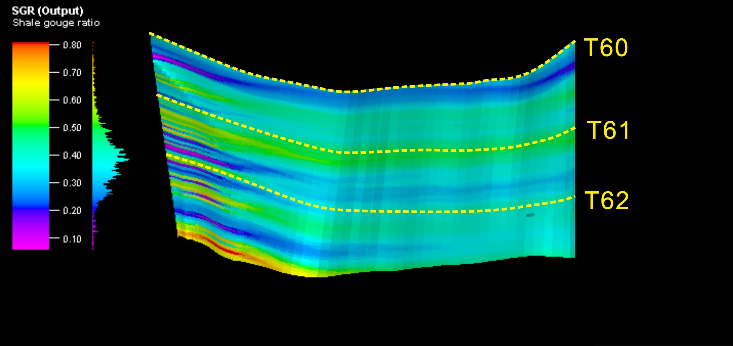
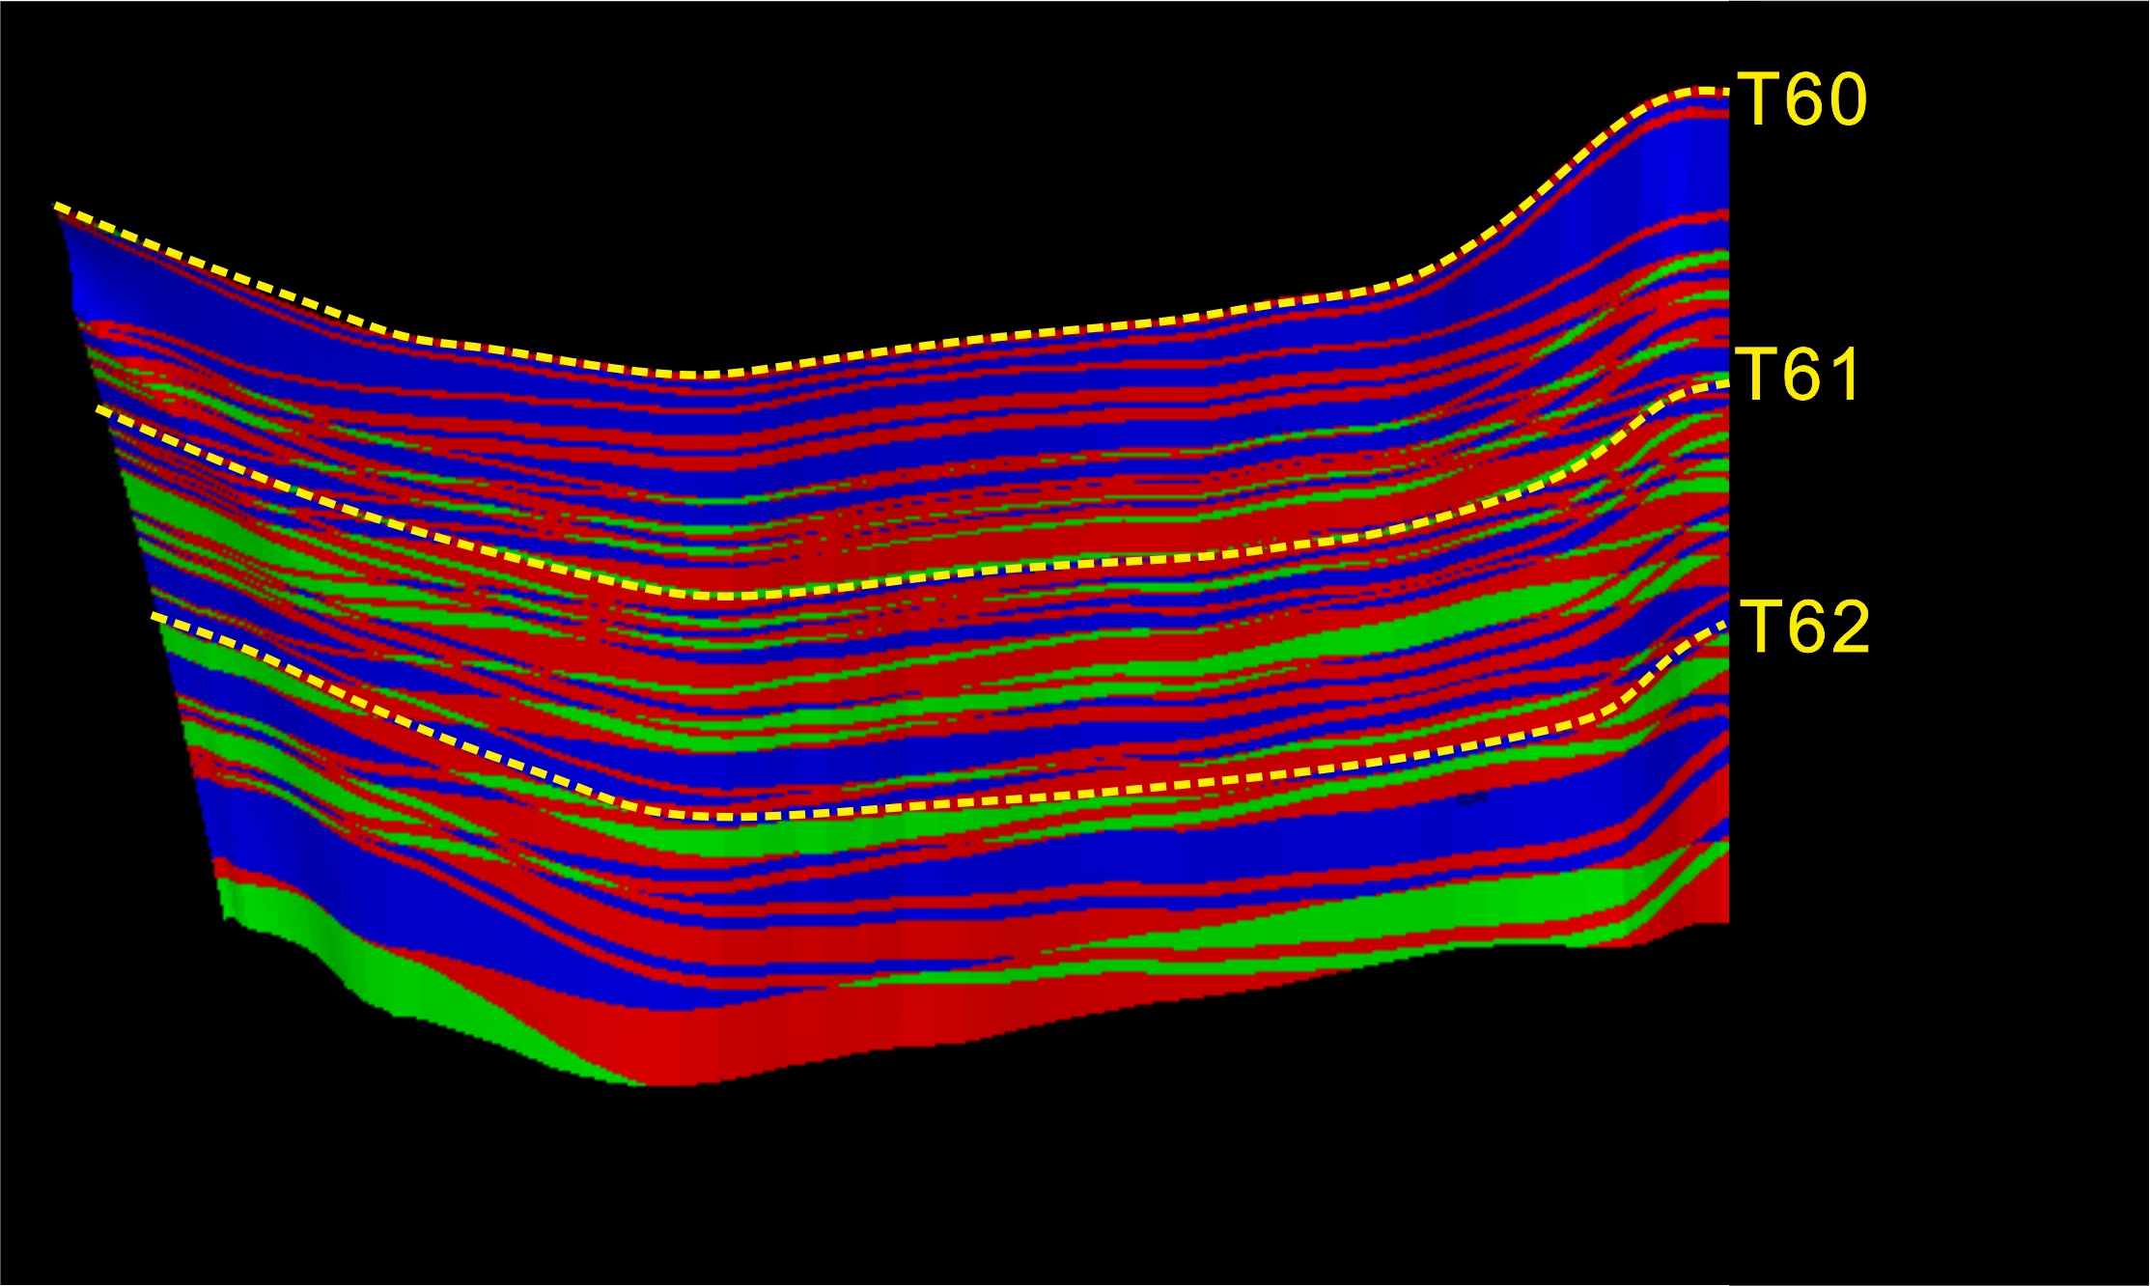
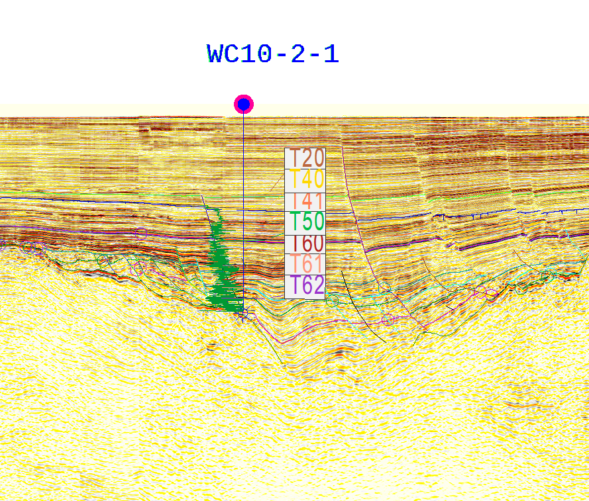
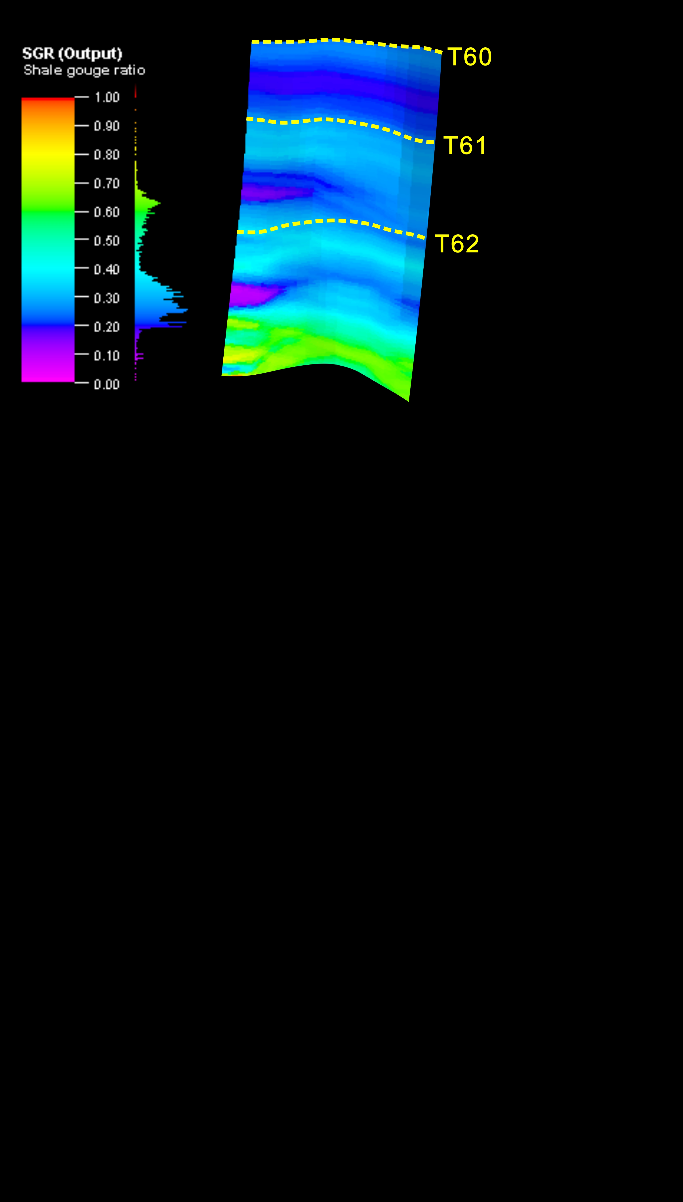
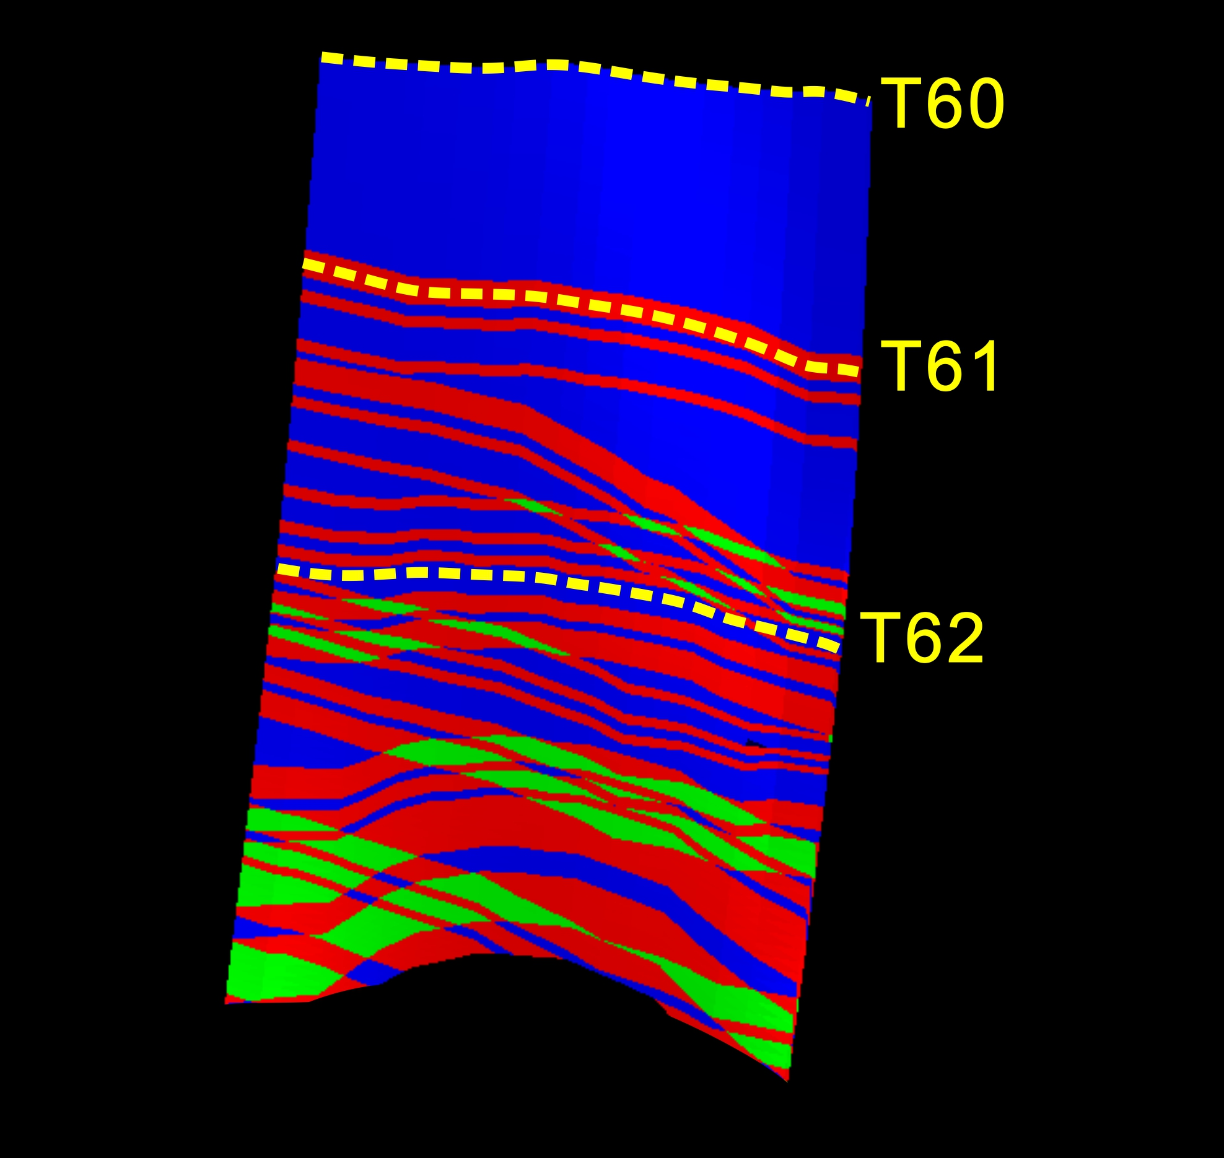
3. Results and evaluation in the study area
Assessing the riskiness of the target area to be drilled
Target-1 structure
Result:
the 3D fault plane SGR in target 1 reaches 35%-55%(high) , which is supposed to be the next promising area in the study area
sand-sand
sand-mud
mud-mud
Target-2 structure
Result:
the 3D fault plane SGR in target 2 is just 20-25%, which indicates high exploration risk at this target
sand-sand
sand-mud
mud-mud
Notes:
For the target structures, the 3D fault plane SGR in target 1 reaches 35%-55%, it is very high, so target 1 is supposed to be the next promising exploration area, while the target 2 is just 20%-25%, which indicates poor fault sealing and high exploration risk at this target area.

Slide 9

EGU 2022
Thank you
for listening !
Notes:
Ok. That’s all for my presentation, Thanks for your listening.

