Slide 1


Variability of the Weddell Gyre from a high-resolution numerical model
Julia Neme, Matthew England, Andrew McC. Hogg
Based on Neme, J., England, M. H., & Hogg, A. M. (2021). Seasonal and Interannual Variability of the Weddell Gyre From a High‐Resolution Global Ocean‐Sea Ice Simulation During 1958–2018. Journal of Geophysical Research: Oceans, 126(11), e2021JC017662.

Slide 2
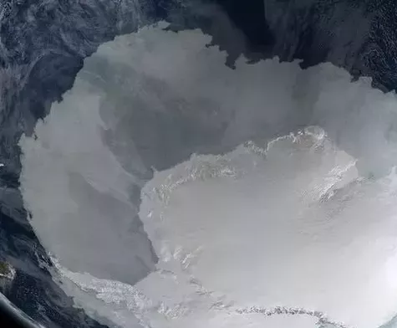
Introduction – The Weddell Gyre
One of the largest features of the circulation south of the ACC
Mediates how relatively warm waters from the ACC reach the Antarctic margin
Transports in between 30 and 100Sv
ACC
Inflow of CDW
Weddell Gyre
Filchner-Ronne Ice Shelf

Slide 3
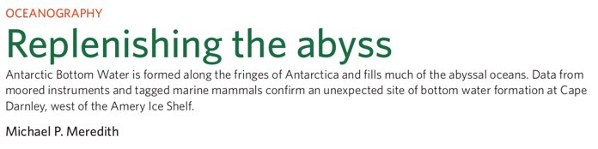
Introduction – The Weddell Gyre
Around 40% of the global ocean's bottom waters are produced at the FRIS
ACC
Inflow of CDW
Weddell Gyre
Filchner-Ronne Ice Shelf

Slide 4
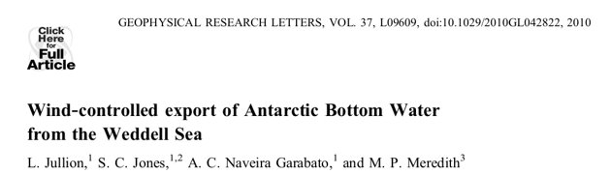
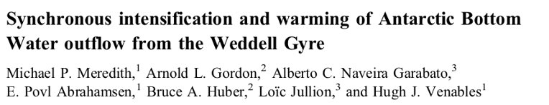
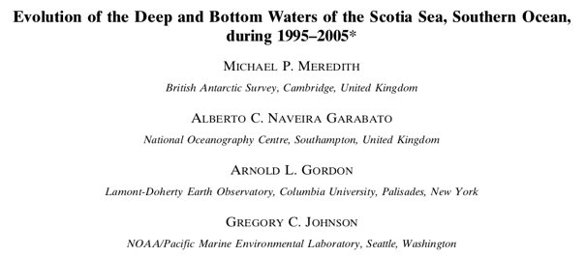
Introduction – The Weddell Gyre
Around 40% of the global ocean's bottom waters are produced at the FRIS
The properties of the exported deep waters are dependent on the gyre's circulation
ACC
Inflow of CDW
Weddell Gyre
Filchner-Ronne Ice Shelf

Slide 5
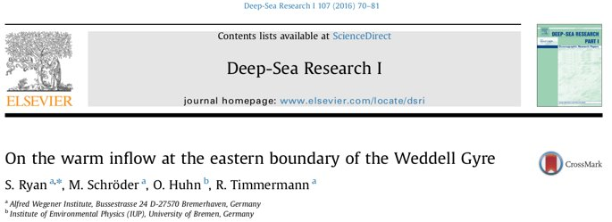
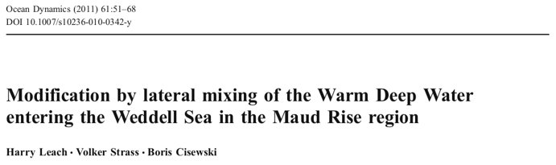
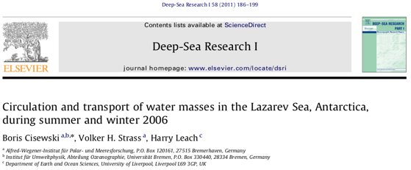
Introduction – The Weddell Gyre
Around 40% of the global ocean's bottom waters are produced at the FRIS
The properties of the exported deep waters are dependent on the gyre's circulation
One of the source waters is CDW, and the properties of CDW that reaches the FRIS are set within the gyre
How does CDW reach the region?
ACC
Inflow of CDW
Weddell Gyre
Filchner-Ronne Ice Shelf

Slide 6
Introduction – The Weddell Gyre
The region has sparse observations, with a large summer-time bias
ACC
Inflow of CDW
How does the gyre vary on seasonal and interannual time scales?
What are the driving mechanisms of this variability?
Weddell Gyre
Filchner-Ronne Ice Shelf

Slide 7
Data
Numerical model
ACCESS-OM2
Global, ocean/sea ice numerical model
Available at three different resolutions:
1° x 50 levels
0.25° x 50 levels
0.1° x 75 levels
Ocean component: MOM5 – Sea ice component: CICE5
Forced by JRA55-do from 1958 to present day, ran for two cycles to spin up

Slide 8
Data
Numerical model
Observations
ACCESS-OM2
Global, ocean/sea ice numerical model
Available at three different resolutions:
1° x 50 levels
0.25° x 50 levels
0.1° x 75 levels
Ocean component: MOM5 – Sea ice component: CICE5
Forced by JRA55-do from 1958 to present day, ran for two cycles to spin up
Satellite
Armitage et al. (2018): monthly composites of sea surface height from 2011 to 2016
Hydrographic observations
Obtained from Clivar and Carbon Hydrographic Data Office (CCHDO, https://cchdo.ucsd.edu/)
Gridded dataset from ARGO
Reeve et al. (2016): obtained from objective mapping of ARGO floats for the period 2001 to 2014

Slide 9
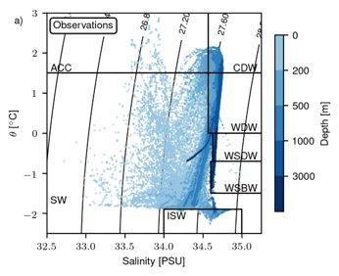
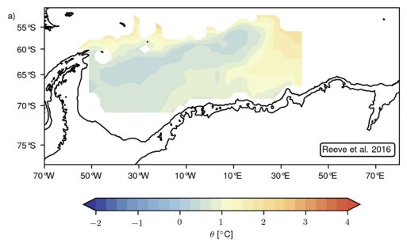
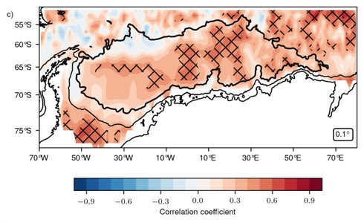
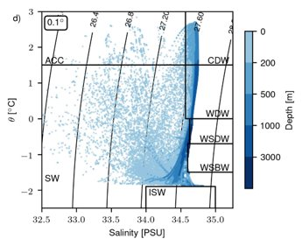
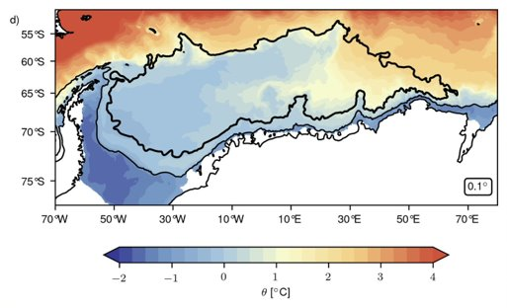
Model validation – hydrography / subsurface temperature maximum / SSH

Slide 10
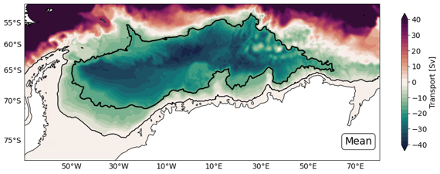
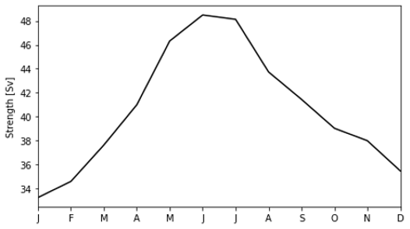
Weddell Gyre – mean state
Weddell Gyre – seasonal variability
Mean transport of 41 Sv
Double-lobed circulation structure
An eddying eastern boundary
Large seasonal cycle, accounting for most of the gyre's variability
Winter intensification, summer weakening

Slide 11
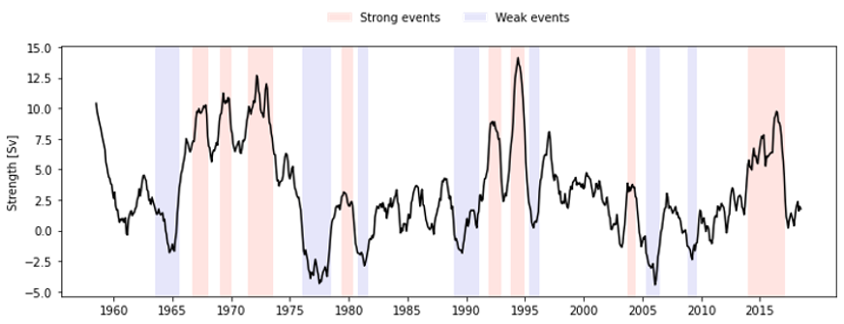
Weddell Gyre – interannual variability
Large interannual variability
In phase across model configurations indicates it is forced variability
No significant correlations with proposed driving mechanisms, such as:
Wind stress curl
Buoyancy fluxes
SAM
Albeit a weak correlation (0.51) with easterly winds along its southern rim

Slide 12
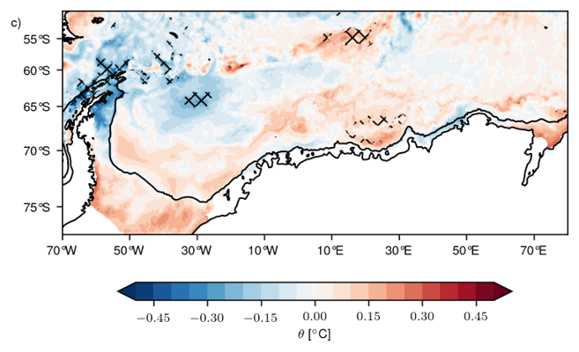
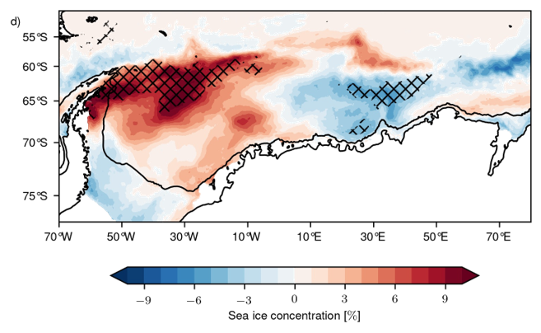
Weddell Gyre – interannual variability
Identify strong/weak events
Composite analysis shows:
Changes in subsurface temperature maximum
Large changes in sea ice concentration

Slide 13


THANK YOU
Based on Neme, J., England, M. H., & Hogg, A. M. (2021). Seasonal and Interannual Variability of the Weddell Gyre From a High‐Resolution Global Ocean‐Sea Ice Simulation During 1958–2018. Journal of Geophysical Research: Oceans, 126(11), e2021JC017662.

