Slide 1


Climate storylines for AMOC tipping in response to increasing greenhouse gases Richard Wood
¹Met Office Hadley Centre, UK

Slide 2
Abstract
Many generations of climate general circulation models (GCMs) have suggested that a radical reorganisation (tipping) of the Atlantic Meridional Overturning Circulation is unlikely in the 21st Century in response to the greenhouse gas emissions pathways considered by the Intergovernmental Panel on Climate Change (IPCC). Yet some studies suggest that GCMs as a class may represent an AMOC that is biased towards excessive stability. If this is the case then simply looking at AMOC response in the ensemble of current GCMs may give a misleading picture of the possible future pathways of the AMOC.
In this study we use a simple coupled climate model, including both the thermal and water cycle responses to greenhouse gas increase, to explore beyond the range of the current ensemble of ‘best estimate’ GCMs. What would the climate system need to look like in order for AMOC tipping to be a plausible outcome? We find that tipping behaviour would require key parameters controlling the response of the hydrological cycle to surface warming to be towards the edge of plausible ranges.
While AMOC tipping remains a ‘High Impact, Low Likelihood’ outcome, our results extend current knowledge by showing how AMOC tipping could occur in response to greenhouse gas forcing (as opposed to the common idealisation of ‘water hosing’ experiments). The results also show how monitoring key parameters of the climate system may over time allow the possibility of tipping to be more confidently assessed.

Slide 3
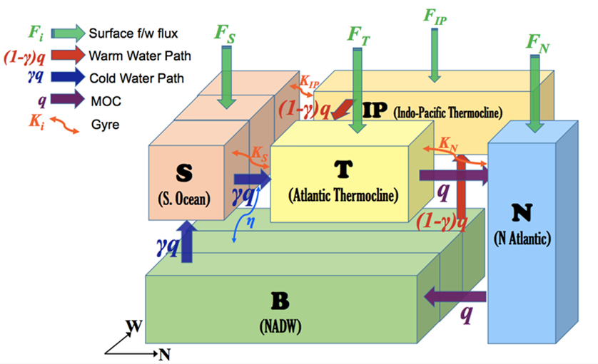
AMOC collapse: A High Impact, Low Likelihood (HILL) climate outcome?
What would the climate system have to look like for the AMOC to tip?
Traditional studies of AMOC tipping in response to fresh water ‘hosing’. What about a more realistic scenario driven by warming?
Thermal- and haline-driven box model. Captures GCM tipping in hosing scenarios. 3 key params:
Climate sensitivity
Hydrological sensitivity (% intensification of atmos water transports per degree warming)
Greenland ice sheet sensitivity (Sv of extra fresh water input per degree warming)
High Impact, Low Likelihood (HILL) outcomes represent some of the key risks from climate change
Traditional ensemble modelling approaches focus on the middle of the pdf (most likely outcomes), rather than the potentially most dangerous outcomes
HILL risks need different approach:
Storylines of plausible outcomes
Early warning indicators
Wood et al. Clim. Dyn., 2019

Slide 4
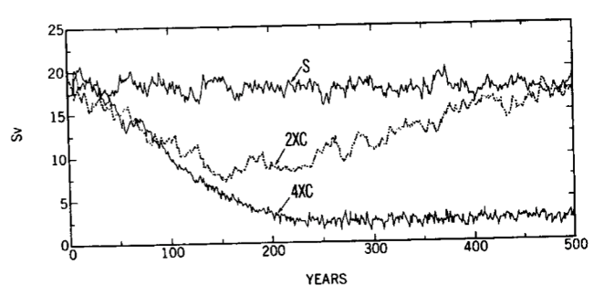
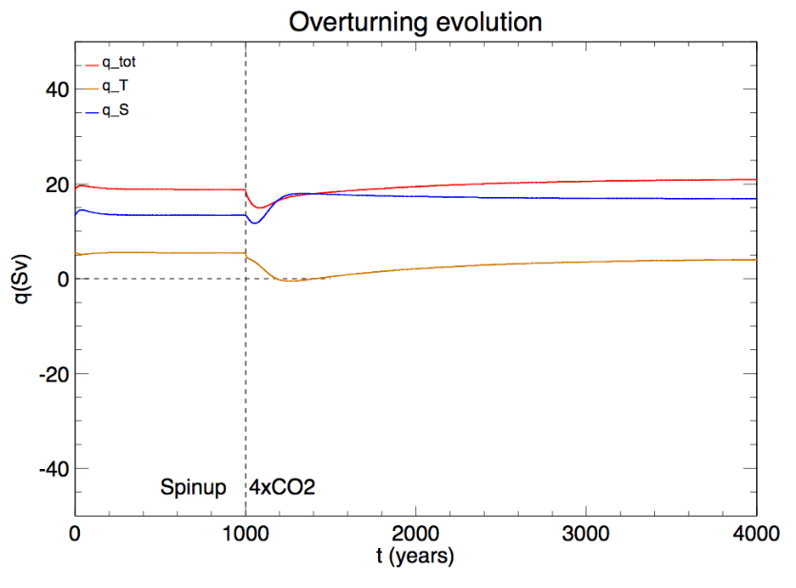
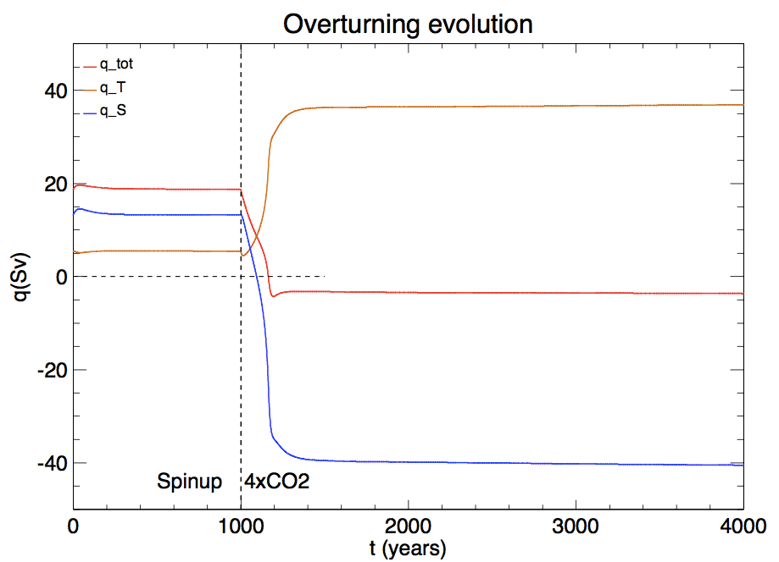
Instantaneous increase to 4xCO2: typical AMOC responses 1000 years spinup at 1xCO₂. Then instantaneously increase to 4xCO₂ and hold it there.
cf. many GCM results
ECS = 4 degC
Hydrol Sens = 0.06 per degC
Greenland Sens = 0.01 Sv per degC
AMOC weakens then recovers, sometimes to stronger than initial state
ECS = 4 degC
Hydrol Sens = 0.06 per degC
Greenland Sens = 0.06 Sv per degC
AMOC weakens then collapses
Manabe & Stouffer JClim 1994

Slide 5
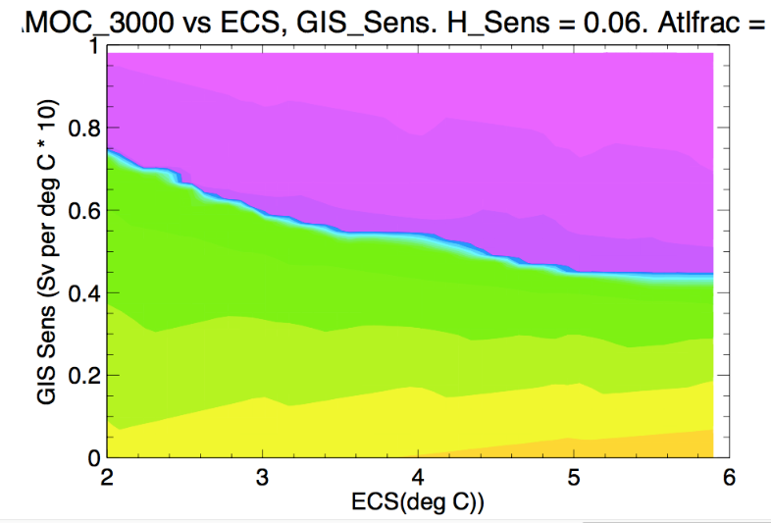
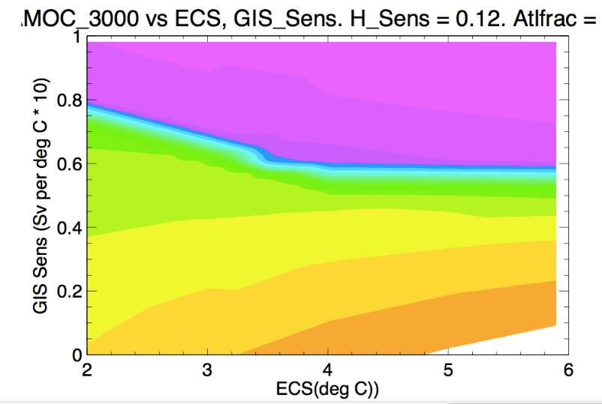
Sensitivity of tipping to Climate Sensitivity ; Hydrological Sensitivity ; Greenland Sensitivity
AMOC at year 3000 (Sv)
Within plausible parameter ranges:
Increasing Climate Sensitivity makes tipping somewhat more likely. Weak effect at high CS
High Hydrol Sens makes tipping somewhat less likely and favours overshooting recovery
Greenland sensitivity is the strongest control on tipping
Hydrol Sens = 0.06 per degC
Hydrol Sens = 0.12 per degC
-6
-6
18
12
6
0
12
6
0
18
24
95%ile derived from
Bamber et al
PNAS 2019

Slide 6
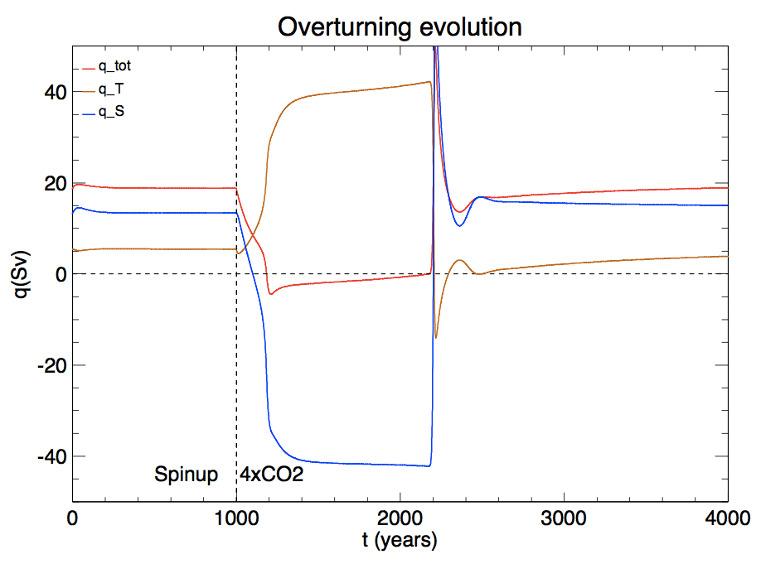
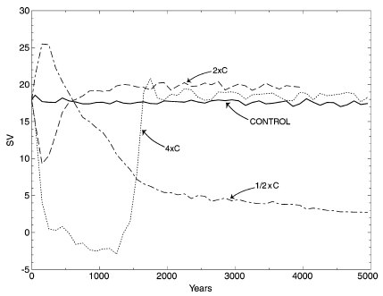
Instantaneous increase to 4xCO2: an atypical AMOC response (small region of parameter space)
ECS = 5 degC
Hydrol Sens = 0.12 per degC
Greenland Sens = 0.05 Sv per degC
AMOC weakens, then collapses, then spontaneously recovers after 1700 years in collapsed state
Mechanism:
In collapsed (weak reverse AMOC) state the N Atlantic (N box) is importing cool bottom water rather than warm thermocline water. Weak surface cooling continues despite the cooler SST. The net result is slow cooling of the N box.
The slow cooling gradually weakens the reverse overturning cell.
Meanwhile the salinity of the Atlantic thermocline (T box) is increasing due to enhanced hydrological cycle and only weak flushing of salinity anomalies by the AMOC
Eventually the overturning crosses zero and goes positive. At this point the N box begins to import the salty T box water → strong positive feedback, spins up strong AMOC
N.B. No convective process required!
2xCO₂
4xCO₂
0.5xCO₂
Stouffer & Manabe ClDyn 2003

Slide 7
A (partial) storyline of AMOC tipping What would the climate system have to look like for the AMOC to tip?
AMOC tipping can plausibly occur at high or low climate sensitivities
Competition between an intensifying atmospheric water cycle (which stabilises the AMOC by making the Atlantic basin more evaporative) and increasing fresh water input from Greenland (destabilises). Both these factors are greater with greater warming, which is why tipping is relatively insensitive to the amount of warming.
The key parameter affecting tipping is the sensitivity of Greenland water input to temperature (Sv per degC). In this model it needs to have a high value for tipping to occur (>95%ile derived from Bamber et al 2019).
A world with high Greenland sensitivity, low hydrological sensitivity and mid-to-high climate sensitivity would be the most likely to tip.
Such ‘climate science storylines’ point to where we most need to develop knowledge in order to understand HILL risks better.

Slide 8
References
Contact: richard.wood#metoffice.gov.uk
Bamber, J.L. et al. 2019: Ice sheet contributions to future sea-level rise from structured expert judgment. PNAS, https://doi.org/10.1073/pnas.1817205116
Manabe, S. and R.J. Stouffer, 1994: Multiple-Century Response of a Coupled Ocean-Atmosphere Model to an Increase of Atmospheric Carbon Dioxide. J. Clim., 7, 5-23.
Stouffer, R.J. and S. Manabe, 2003: Equilibrium response of the thermohaline circulation to large changes in atmospheric CO₂ concentration. Clim. Dyn., 20,759-773, doi: 10.1007/s00382-002-0302-4
This work. Box model, traceability to AOGCM, and response of threshold to increased CO₂:
Wood, R.A., J. Rodriguez, R.S. Smith, L.C. Jackson and E. Hawkins, 2019: Observable, low-order dynamical controls on thresholds of the Atlantic Meridional Overturning Circulation. Climate Dyn., 53, 6815-6834, https://doi.org/10.1007/s00382-019-04956-1

Slide 9
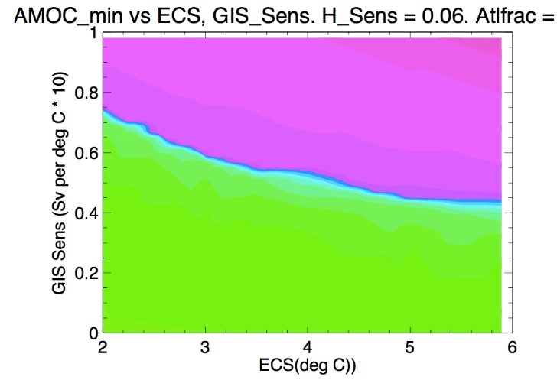
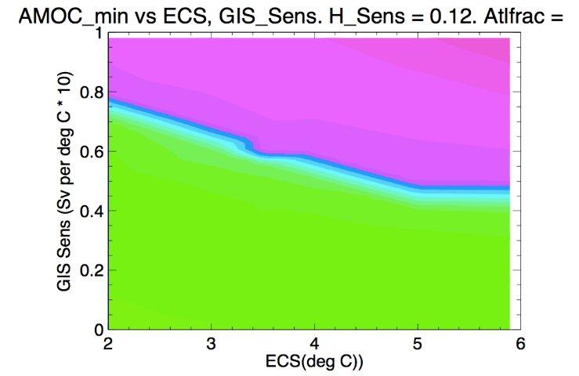


Sensitivity of tipping to Climate Sensitivity ; Hydrological Sensitivity ; Greenland Sensitivity
Hydrol Sens = 0.06 per degC
Hydrol Sens = 0.12 per degC
Within plausible parameter ranges:
Increasing Climate Sensitivity makes tipping somewhat more likely (weak effect at high CS)
High Hydrol Sens makes tipping somewhat less likely and favours overshooting recovery
Greenland sensitivity is the strongest control on tipping
-12
-12
-6
6
-6
AMOC_{min}
6
0
12
0
12
95%ile derived from
Bamber et al
PNAS 2019
-6
-6
12
18
12
6
0
AMOC₃₀₀₀
6
0
18
24

