Slide 1
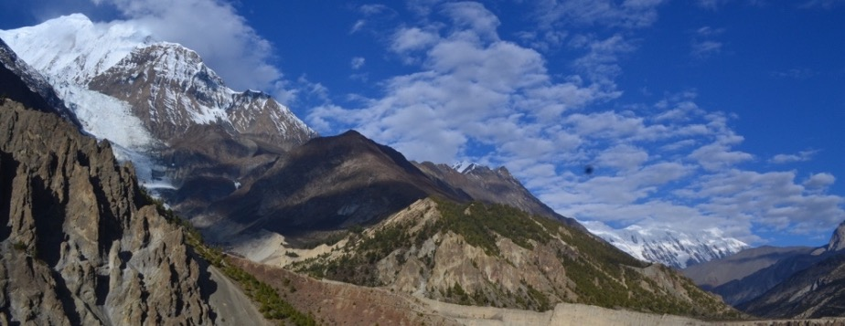



Assessing the geometry of the Main Himalayan thrust in central Nepal:
Insights from thermokinematic modeling
Ghoshal. S.^{1,4}, McQuarrie, N.¹, Robinson, D. M.², Huntington, K.³, Ehlers, T. A.⁴
¹University of Pittsburgh; ²University of Alabama; ³University of Washington; ⁴University of Tübingen

Slide 2
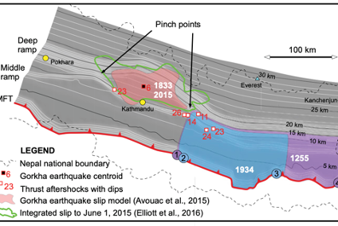
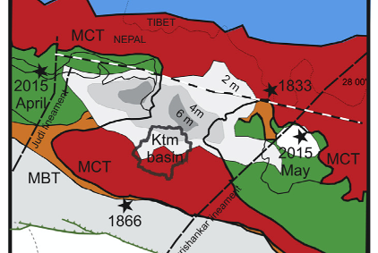
Geometric models for the Gorkha rupture
A: Hubbard et al., 2016
B: Mugnier et al., 2017
Proposed that the eastern and western boundaries of the rupture were controlled by changes in the location of ramps (i.e., at pinch points).
Proposed that the eastern and western boundaries of the rupture were controlled by lineaments.
Lineaments are surface expressions of more deep-seated structures (e.g., lateral ramps in this case)
Notes:
Models proposed for changes in geometry in the MHT that may have restricted/hemmed in the propagation of the rupture.
One important thing that is common to both models is that the rupture was controlled by changes in the geometry and location of the ramp. Can we assess whether such a geometric change occurs in the ramp?
So, we concentrated on the western boundary of the rupture.
Since ramps in the decollement control the location and magnitude of uplift/exhumation, they exert a first-order control on measured thermochronometers at the surface.
We can use the distribution of cooling ages at the surface to identify whether there is such a lateral boundary in the MHT that may have played a part in the rupture propagation.

Slide 3
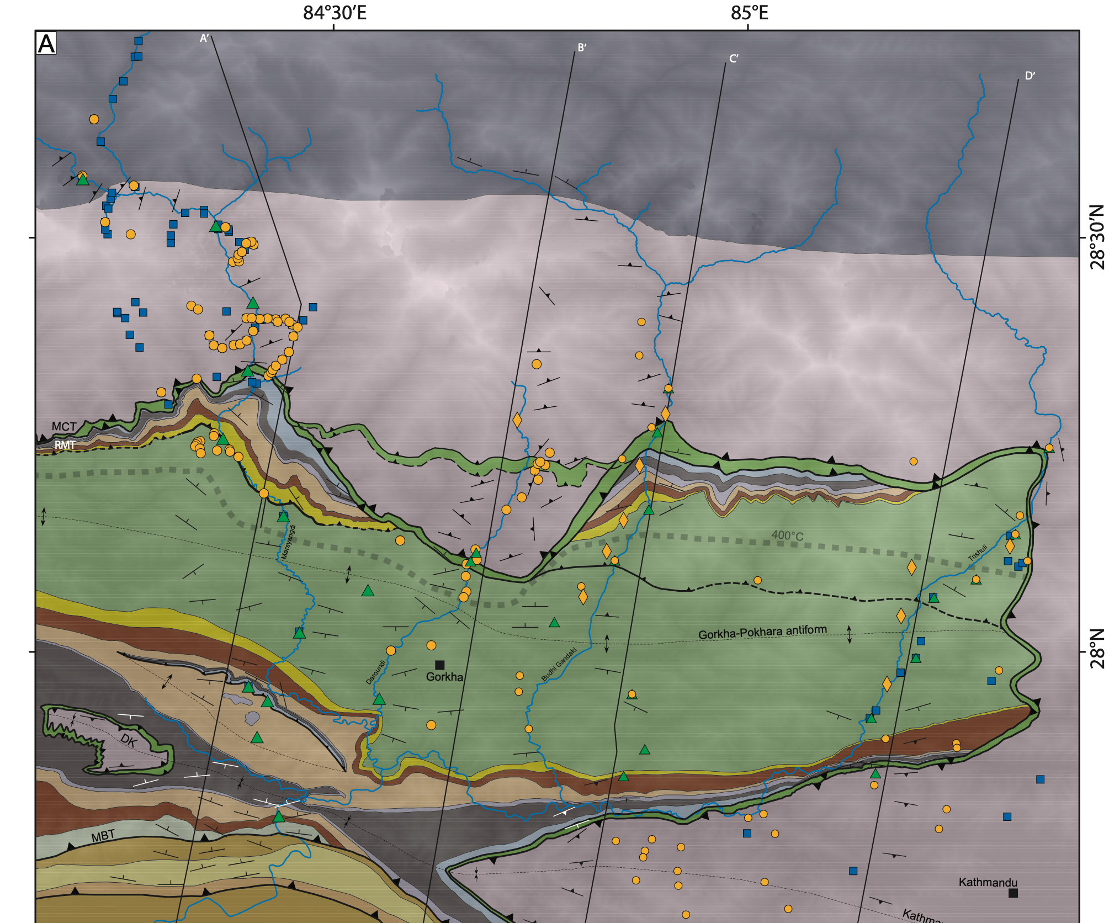
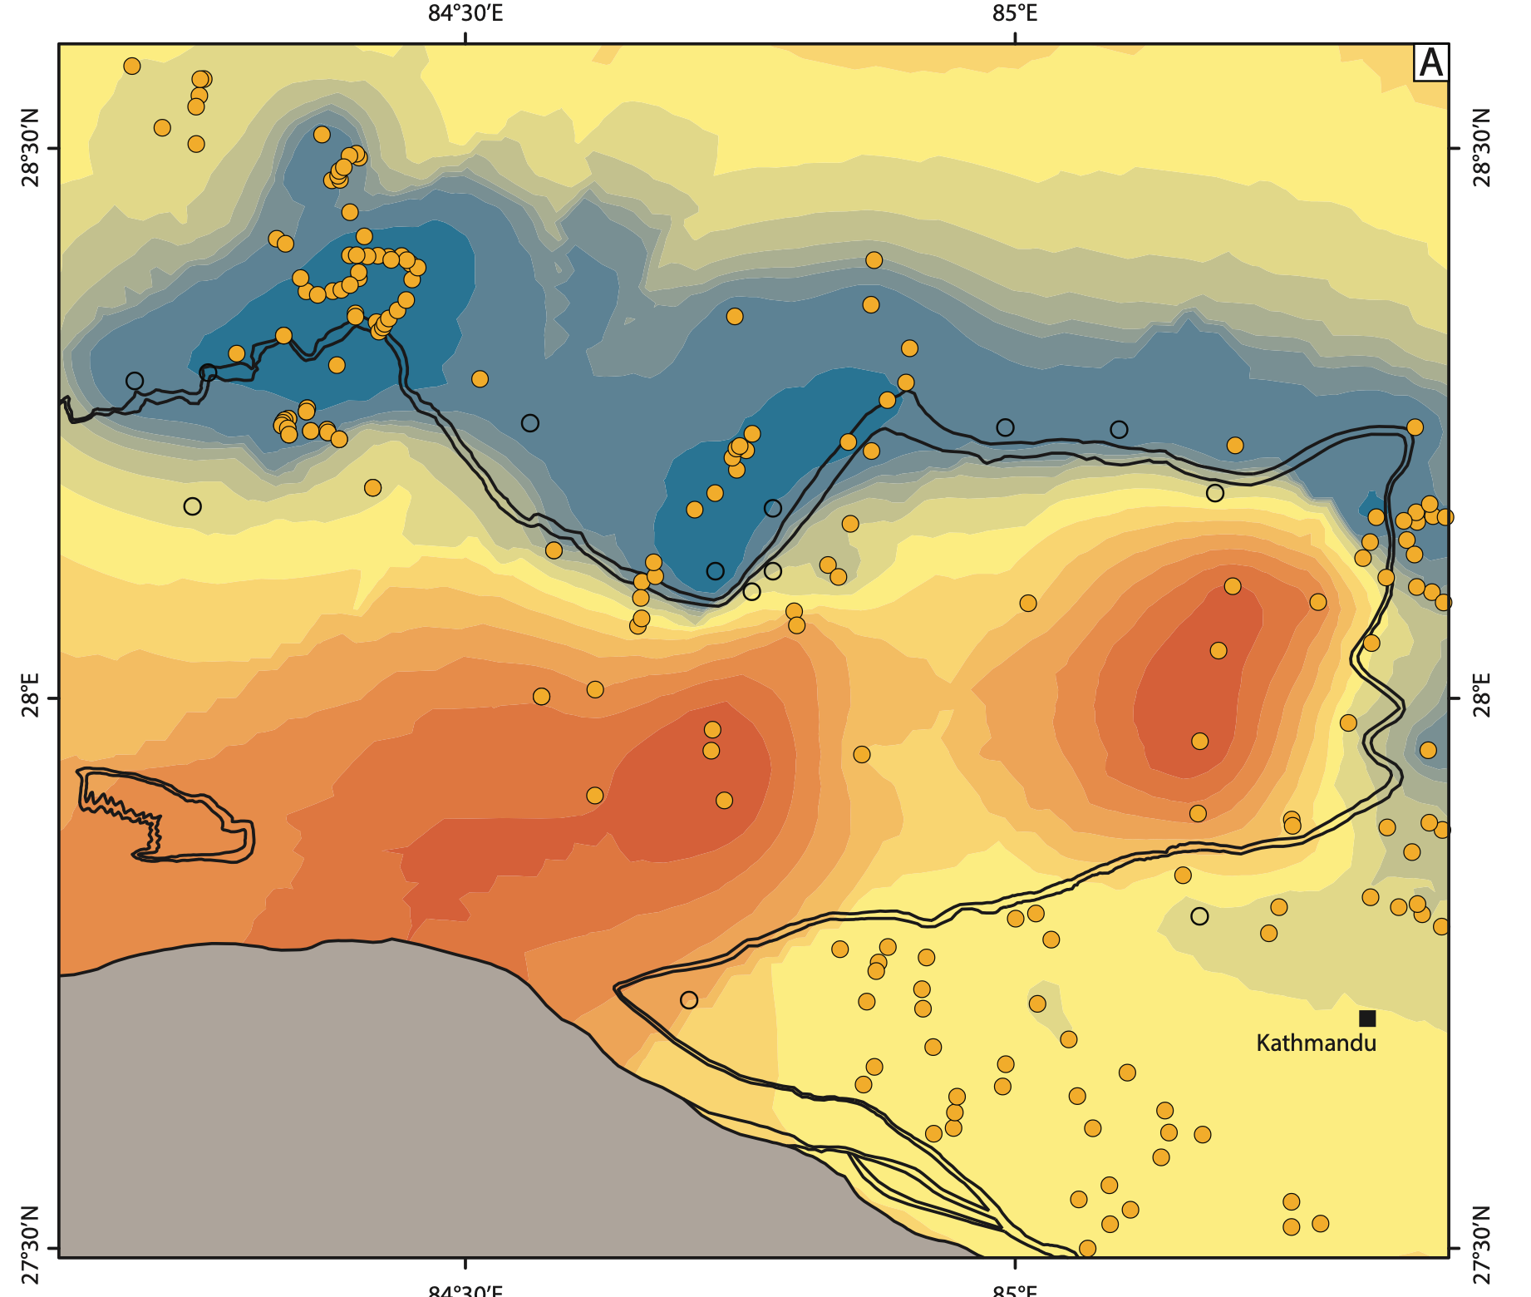
Evidence for a lateral structure in central Nepal
Evidence from mapping
Evidence from thermochronology
Notes:
Trace of the Main Central thrust abruptly steps ~30 km south from its location immediately east of the earthquake epicenter. The traces of the MCT and Ramgarh-Munsiari thrust sheets also cut across all the upper Lesser Himalayan units
The distribution of young MAr ages (blue = young) coincides with this southward step.

Slide 4
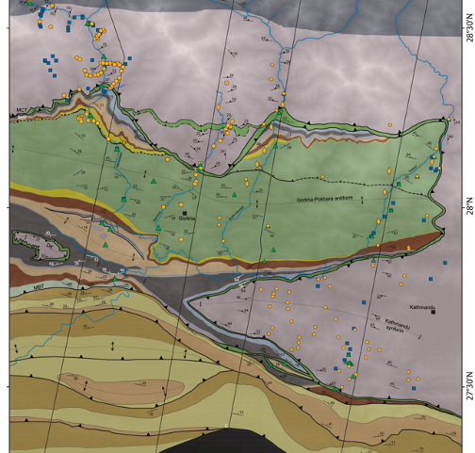

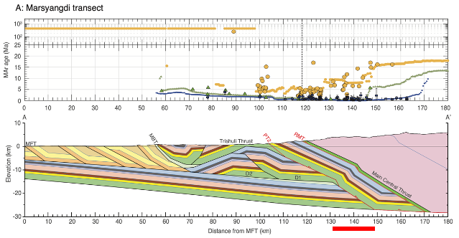
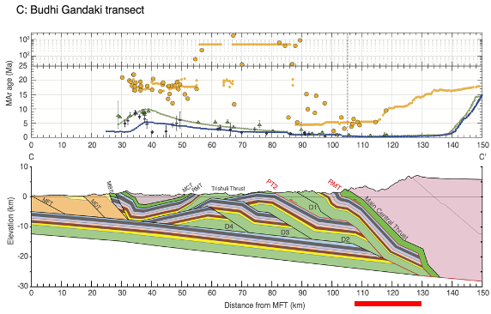
Across-strike geometries along central Nepal
We know, or can infer the best-fit locations for the ramp along the:
Budhi Gandaki
Marsyangdi
Trishuli
For the Daraundi valley, there are two primary options:
Ramp steps southwards
Ramp remains in the same relative location
Ghoshal et al. (2020); Tectonics
Ghoshal et al. (in prep)
Notes:
We know the locations of the ramp for the Budhi Gandaki valley, and the Marsyangdi. Based on the distribution of cooling ages and similarity of surface geology we can infer the location of the ramp for the Trishuli.
We can also assess the location of the ramp for the Daraundi valley by creating a cross-section that intersects this offset.

Slide 5
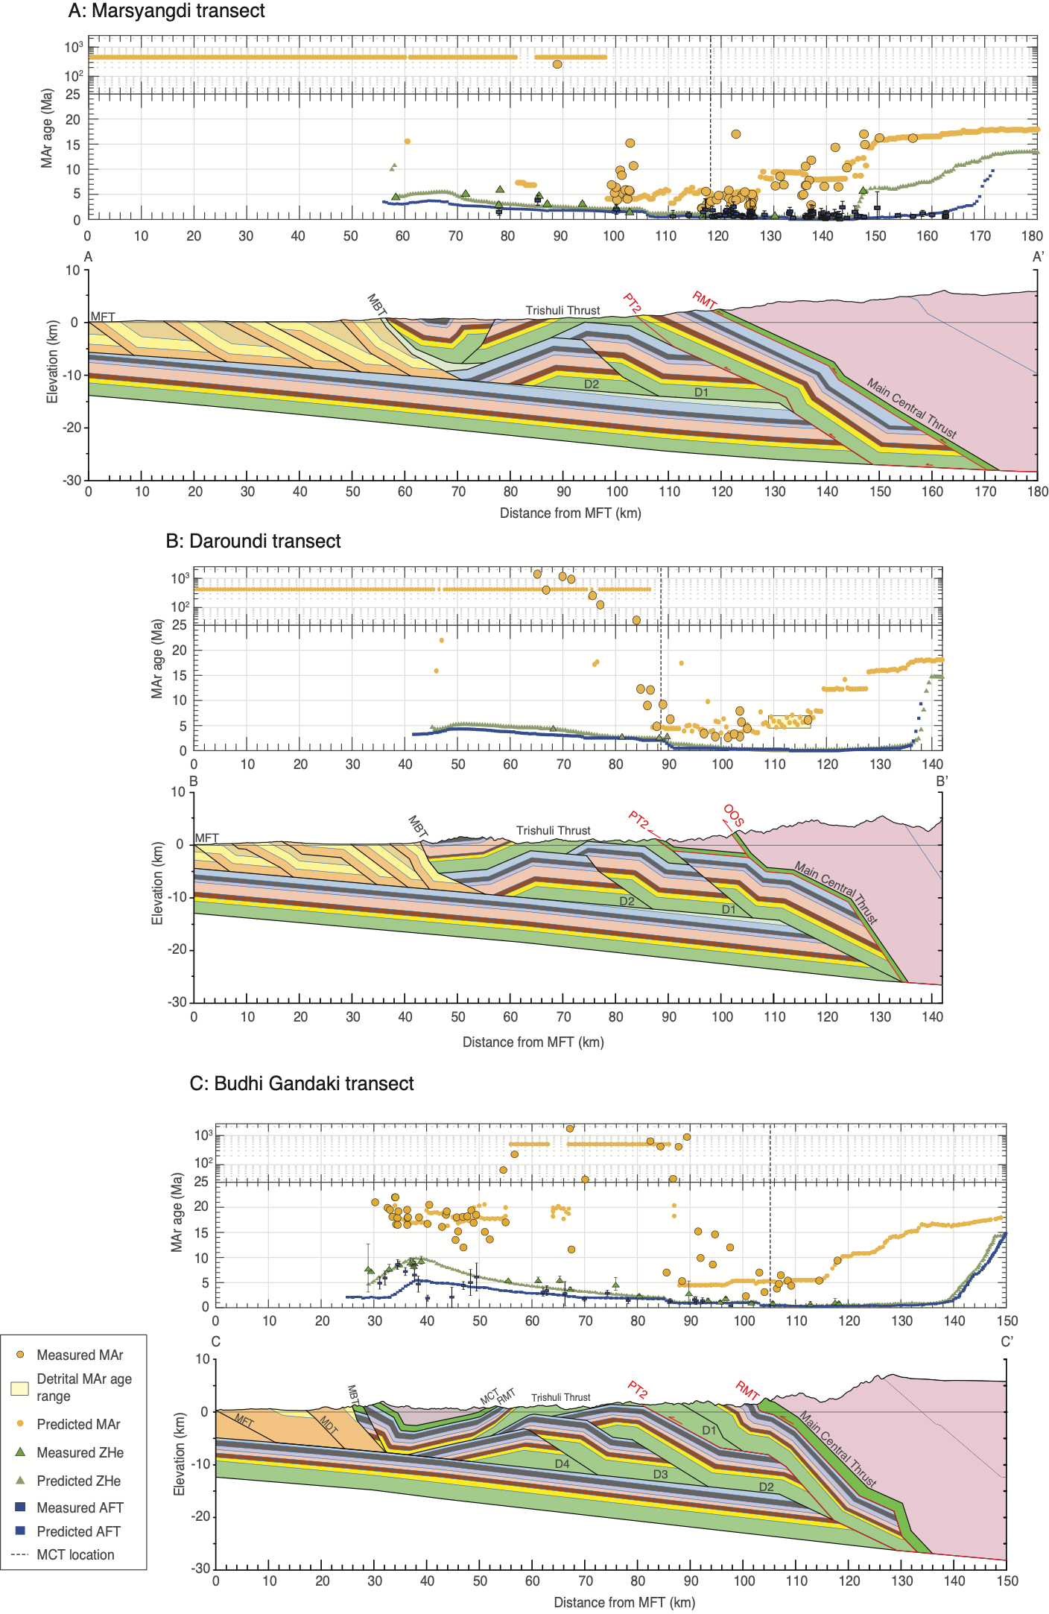
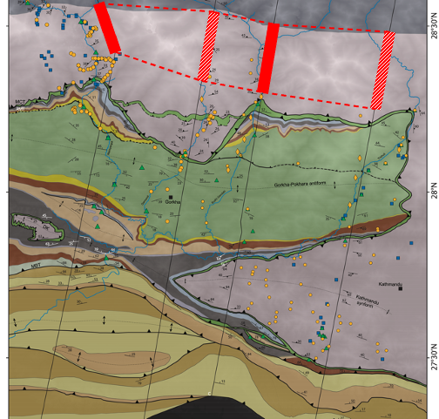

Geometry of the MHT ramp in central Nepal
Notes:
Now that we know that the ramps are in the same place, we can align the cross-sections at the ramp.
This is the location that we’re interested in
Importantly, we also find that the OOS fault planes all line up and follow paths that are consistent along-strike.
Combining the three kinematic models together provides a way of evaluating how this offset is formed through time.

Slide 6
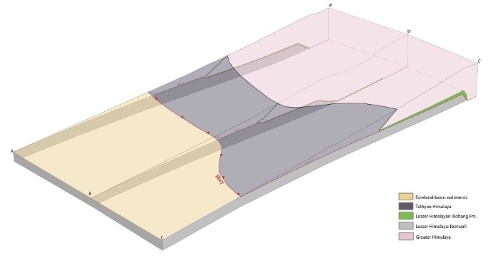


Kinematic sequence in central Nepal
How are these along-strike changes formed?
N
Emplacement of the RMT: 16 - 7 Ma
~100 km
Notes:
But what is so different about the transect in the middle?
Well, in the Daraundi, material is being moved southwards over a ramp that is between 80~110 km farther south than in the other two cross-sections.
We also find that there is a small lateral change in the ramp, compared to the others. This allows the placement of the RMT directly on top of the Kuncha formation

Slide 7
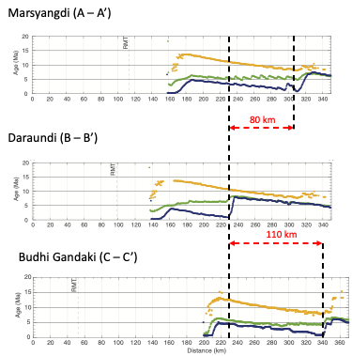
Kinematic sequence in central Nepal
How are these along-strike changes formed?
N
Emplacement of the RMT: 16 - 7 Ma
~100 km
Notes:
This shorter length also shows up in the reset ages, where the youngest AFT ages are predicted ~80 km farther to south here.

Slide 8
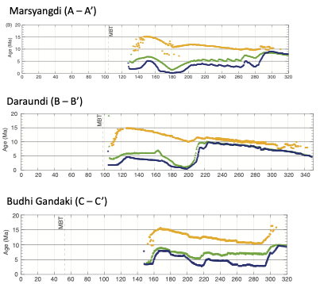
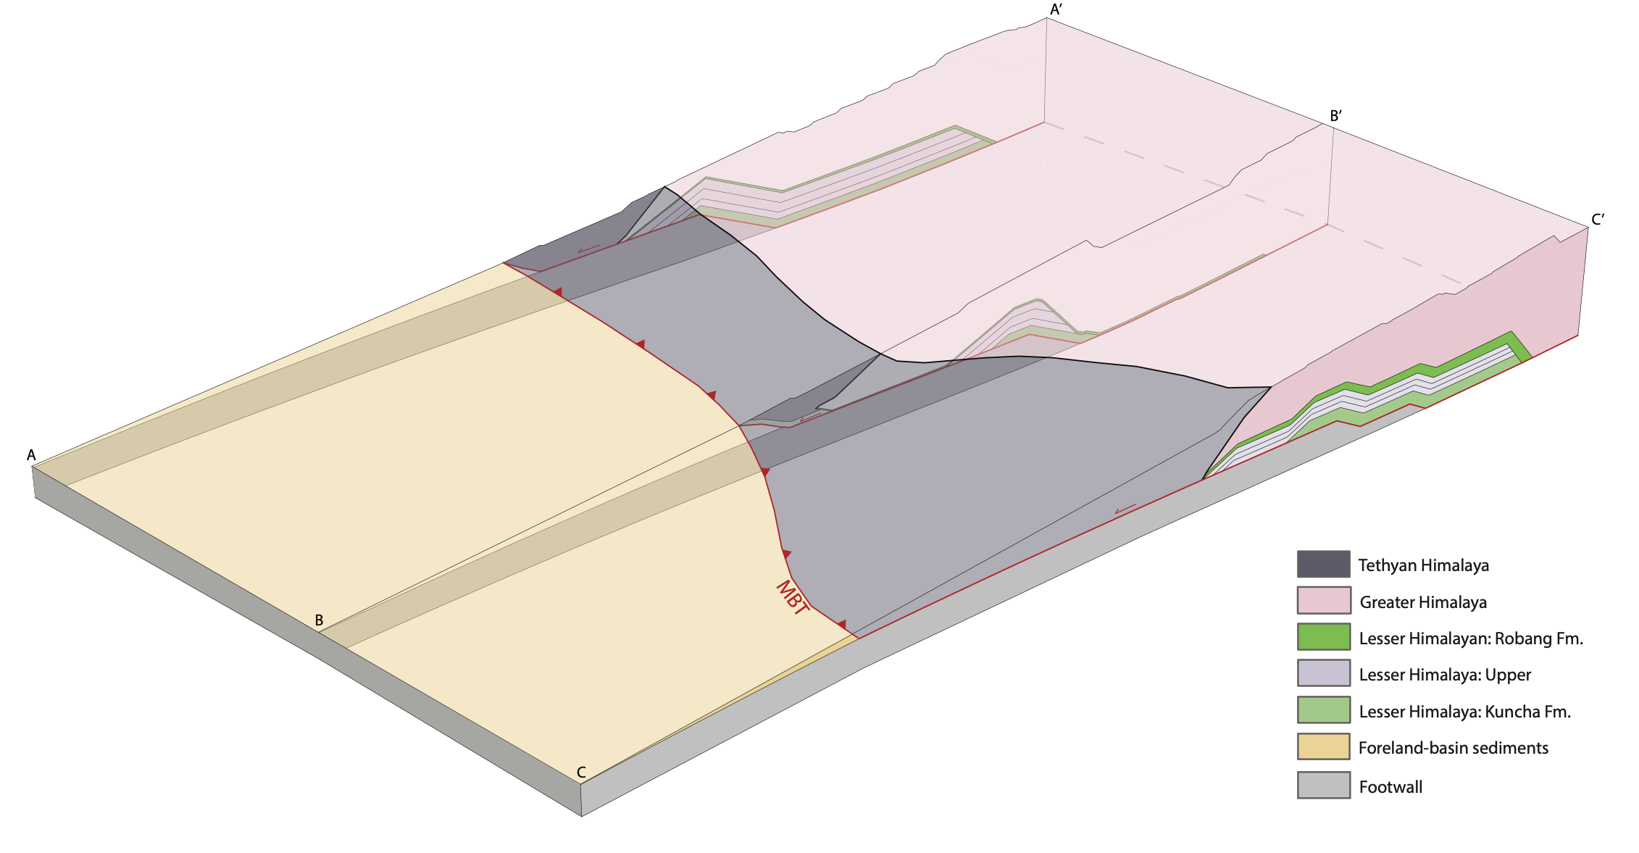

Kinematic sequence in central Nepal
How are these along-strike changes formed?
Translation of the Trishuli thrust sheet: 7 - 6 Ma
N
Notes:
Here, the Trishuli thrust moves southwards. You can see how much shorter the thrust sheet is compared to the other two. You can also see this difference coming out in the thermochron, with the reset AFT and ZHe ages north of 200 km in the eastern and western sections, whereas you get a sharp transition from young to older reset ages in the Daraundi

Slide 9
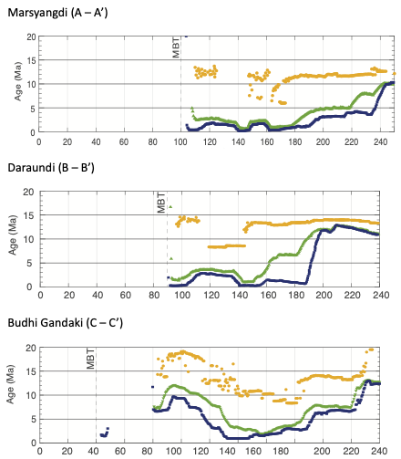
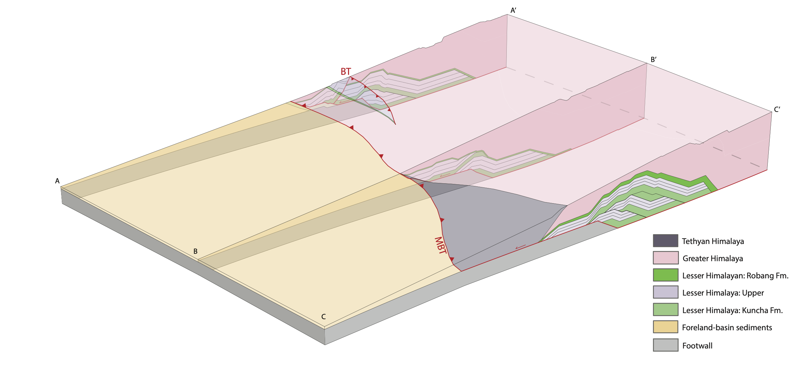
Kinematic sequence in central Nepal
How are these along-strike changes formed?
Initiation of the duplex: ~4.5 Ma
N
Notes:
Now for some of the major developments in the cooling ages
Initiation of the duplex in the two western sections begins and the Lesser Himalaya is first exposed at the surface. In the Daraundi, you can see the short Trishuli thrust sheet acting almost like a horse of the duplex being passively uplifted by the first true horse.
In the Budhi Gandaki section, the formation of the duplex actually starts earlier, because there are two extra horses to move. As motion and exhumation is distributed on the horses of the duplex, we start to get a more complex distribution of cooling ages
This also starts to show how a zone of unreset MAr ages begins to form as rocks that have not been heated enough to reset MAr ages is exposed in the Marsyangdi to the west. Most importantly, the shorter TT in the Daraundi starts to act like a horse itself, as its trailing edge gets passive lifted up to start creating a flat.

Slide 10
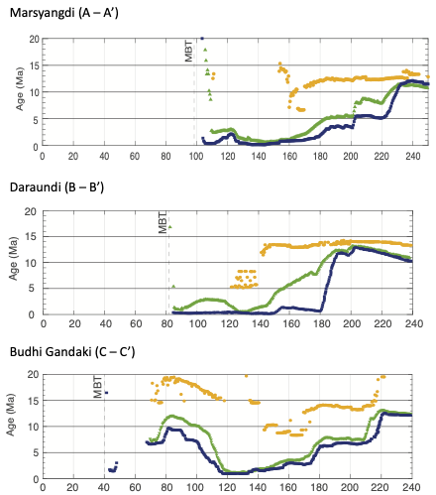
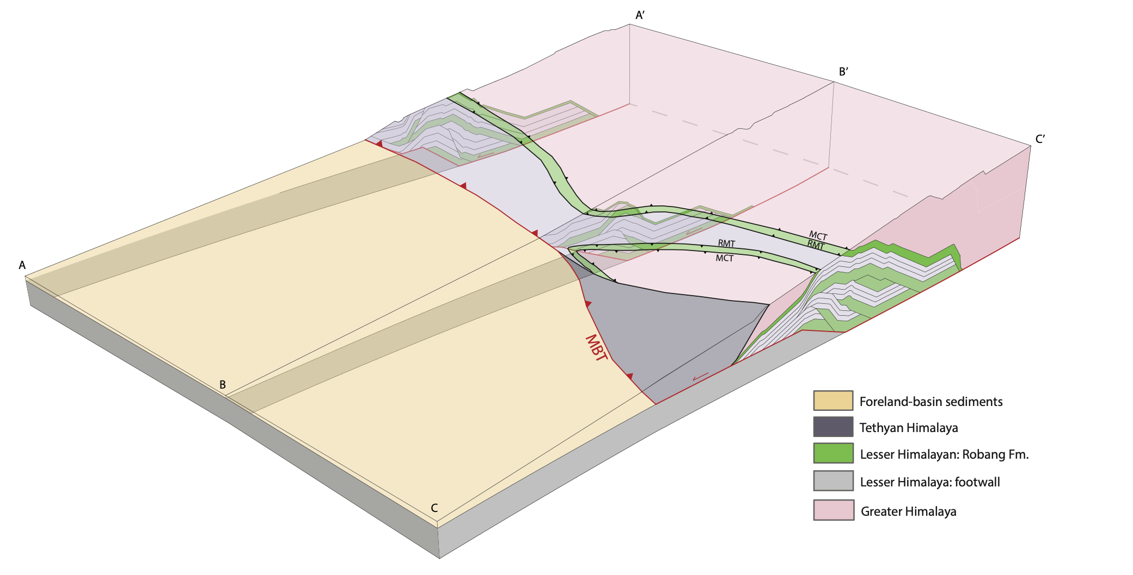

Kinematic sequence in central Nepal
How are these along-strike changes formed?
Translation of the duplex over the modern ramp: ~4.5 Ma
N
Notes:
With the duplex moving over the main ramp, all traces of the GH are eroded away from the front of the system along the two western sections, also predicting unreset MAr ages. You can also see that the shorter TT sheet in the Daraundi creates a flat portion over the horses of the duplex that exposes the GH farther south, along with younger ages.
As for the Budhi Gandaki, the southern location of the MBT, the GH is allowed to remain in this synform, which will later become the Kathmandu Klippe, retaining its reset MAr ages in the south.

Slide 11
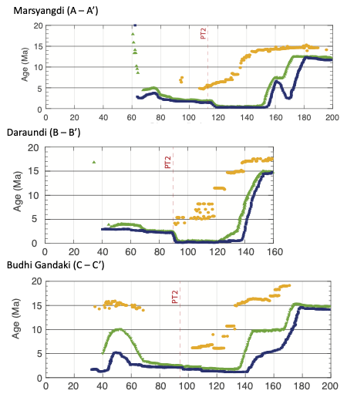
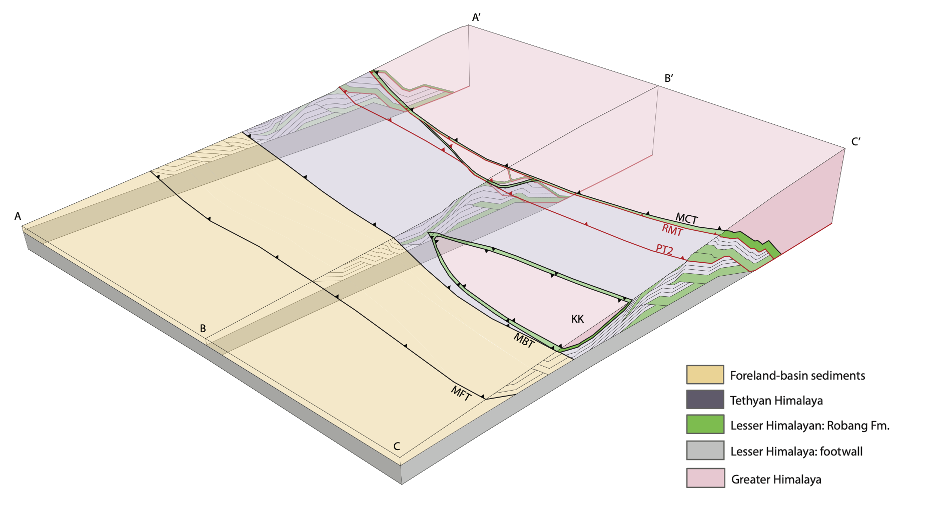

Kinematic sequence in central Nepal
How are these along-strike changes formed?
Out-of-sequence thrusting: 1.2 - 0.6 Ma
N
Notes:
And finally, motion on the Siwalik thrusts out in the south brings the rocks of the duplex up and over the ramp producing these reset ZHe and AFT ages, and steadily advecting the young MAr ages southwards, and then the initiation of out-of-sequence thrusting occurs.
These faults are back in the north, rather than following the southward stepping sequence that we were seeing up till now. The quick uplift and exhumation caused by the OOS thrusts create this inflection point in the cooling ages

Slide 12
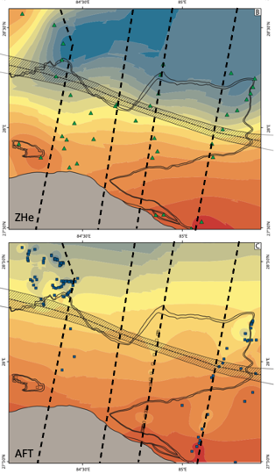

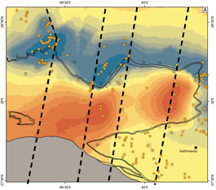
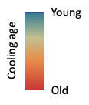
Geometry of the MHT ramp in central Nepal
MAr
Notes:
When we look at contour maps of the distributions of the ZHe and AFT systems (which are lower temperature) they show a significantly more linear relationship, with the youngest ages paralleling the location of the ramp. This suggests that the lower T cooling ages are actually more sensitive to the ramp than the MAr ages, which end up being advected over the ramp in the direction of transport

Slide 13

Conclusions
The along-strike variations that we see in the surface geology and measured thermochronology are not due to a major lateral ramp in the modern Main Himalayan thrust.
Rather, they are the result of past variations in the geometry of the MHT.
A significantly shorter Trishuli thrust sheet in the Daraundi transect.
A lateral ramp in the footwall of the shortened Trishuli thrust sheet also allows the RMT to place the Robang and GH directly on top of the Kuncha.
Notes:
This shows how lateral changes in the upper plate that we see today in the surface geology and distribution of cooling ages began life as significant changes to the geometry of the MHT in the mid- to late Miocene

