Slide 1


Seasonal forecasts for hydropower: downscaling of precipitation in
South American basins
Verónica Torralba¹ (veronica.torralba@cmcc.it)
Stefano Materia¹, M. Carmen Álvarez-Castro¹, Paolo Bonetti²,
Alberto Maria Metelli², Marcello Restelli², and Silvio Gualdi¹
¹CMCC- Centro Euro-Mediterraneo sui Cambiamenti Climatici
²Politecnico di Milano
CL2.1 Climate Services: Underpinning Science
Vienna, May 2022

Slide 2
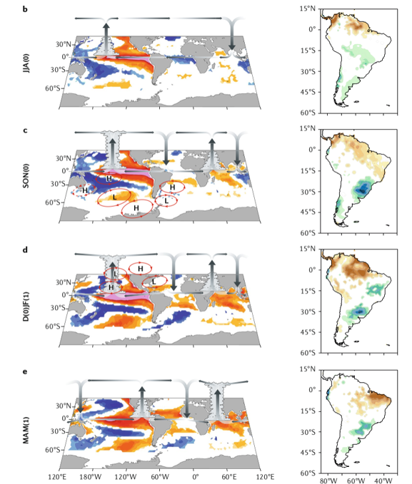
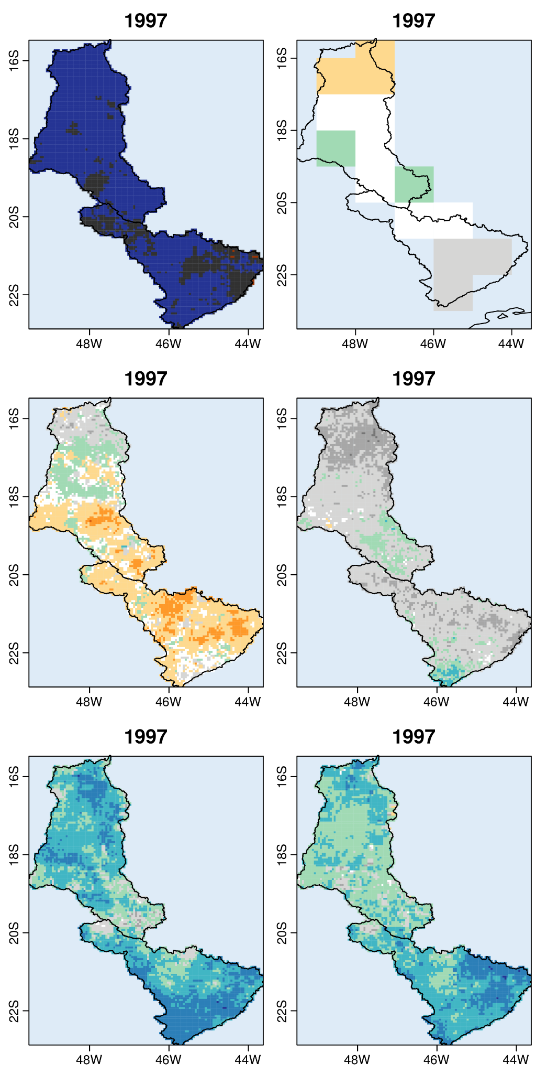
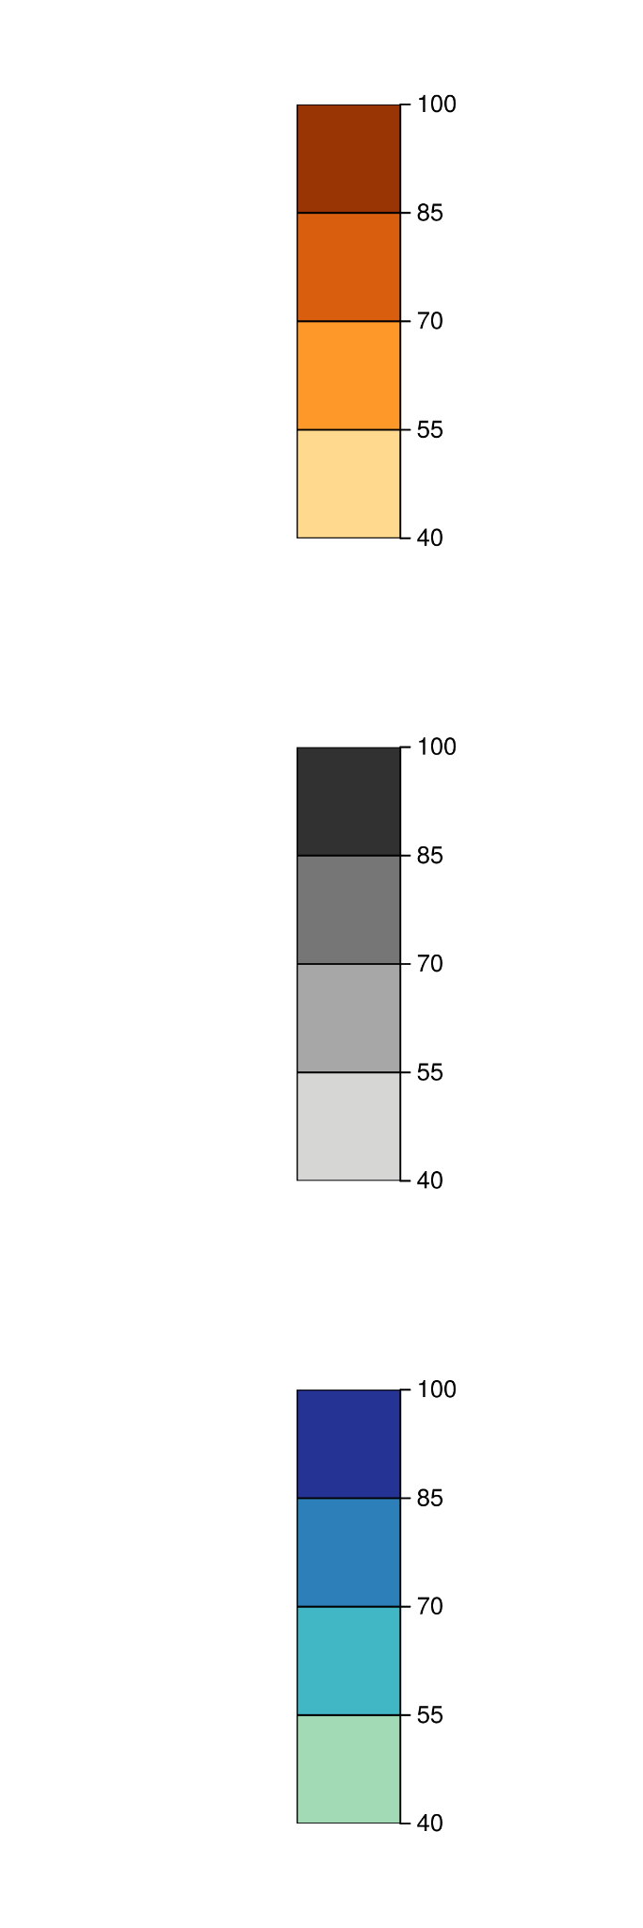
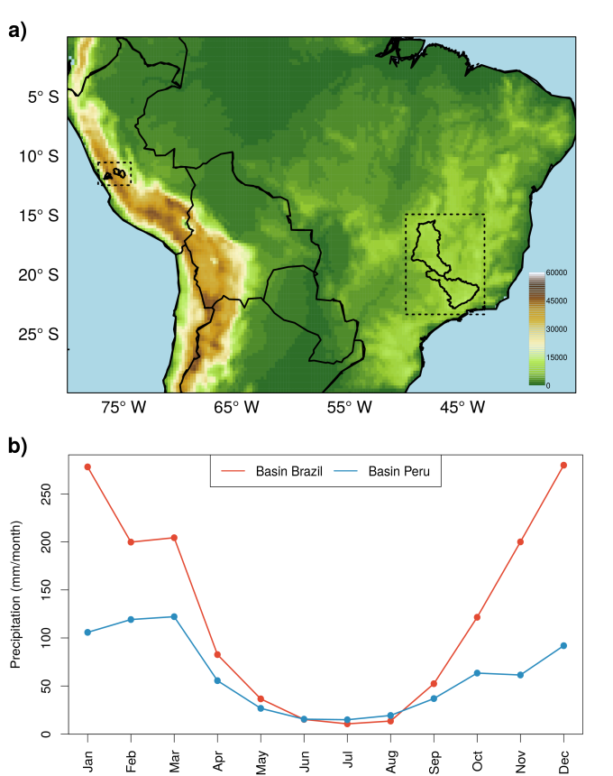
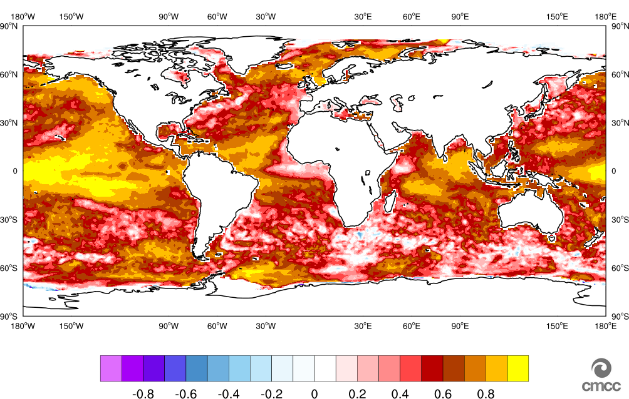
Climate services for hydropower and water management
Specific users’ needs
Current limitations
Previous knowledge
Hybrid model
The recent expansion of the hydropower capacity in South American regions has raised the interest of this sector in climate information at seasonal time scales that can be used to anticipate persistent precipitation anomalies (e.g. meteorological droughts) over specific basins.
State-of-the-art dynamical seasonal forecasts systems show limitations in producing seasonal forecasts precipitation of:
High spatial resolution
Sufficient forecast quality (systematic errors, skillful and reliable)
Precipitation in South America is strongly related to the SST conditions.
Seasonal forecast systems provide skilful SST predictions.
To exploit the empirical SST- precipitation relationship and the SST seasonal forecasts for the generation of high-resolution forecasts of precipitation seasonal forecasts in specific basins.
Cai et al. 2020
Drier (%)
Normal(%)
Wetter (%)
The probability corresponding to the most likely category (drier, normal or wetter).of the CMCC-SPS35 seasonal forecast of precipitation.
CMCCSPS35 Ensemble mean correlation for the SST seasonal forecasts in AMJ. (start date: March). .
Brazilian basin selected for this study.

Slide 3

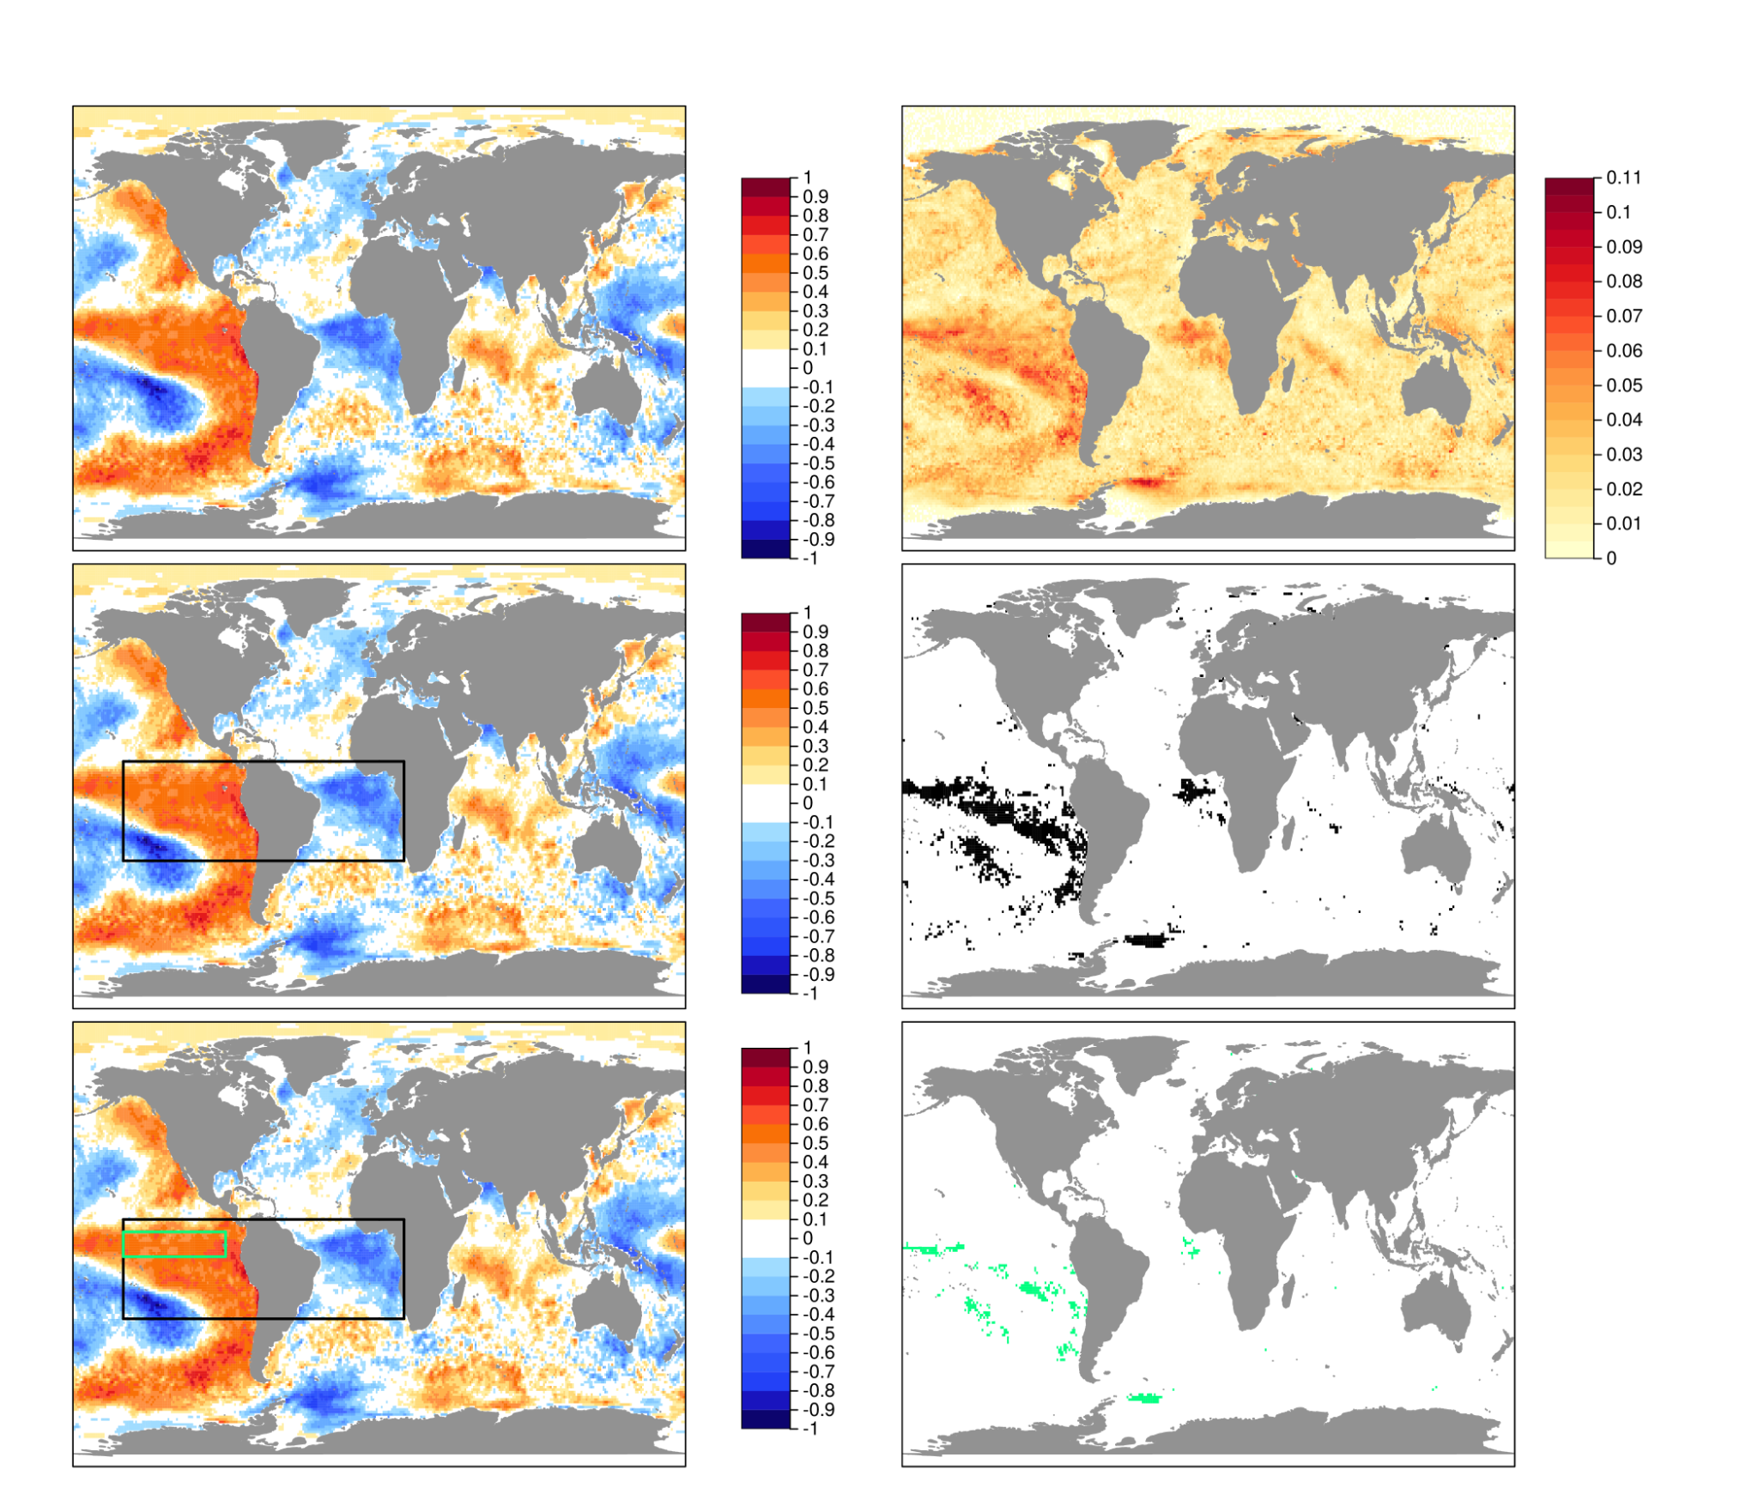
Observational references
Dynamical seasonal predictions
Precipitation
CHIRPS-V2 (0.05°)
SST
ERA5 (~ 0.25°)
SST
CMCC-SPS35 (1°)
Linear
Correlation
Non-linear
Mutual information
Link?
The strength of the linear relationship between two variables.
The amount of information obtained about one random variable by observing the other random variable.
Regions
Hybrid model approach
SST and precipitation in the Brazilian basin AMJ (1981-2020)
Non linear method
Based on observed values
Preserves the spatial covariance
Tropics
K-means 5
ANALOGS
Nino3.4
K-means 10
Hybrid seasonal forecasts
of precipitation

Slide 4
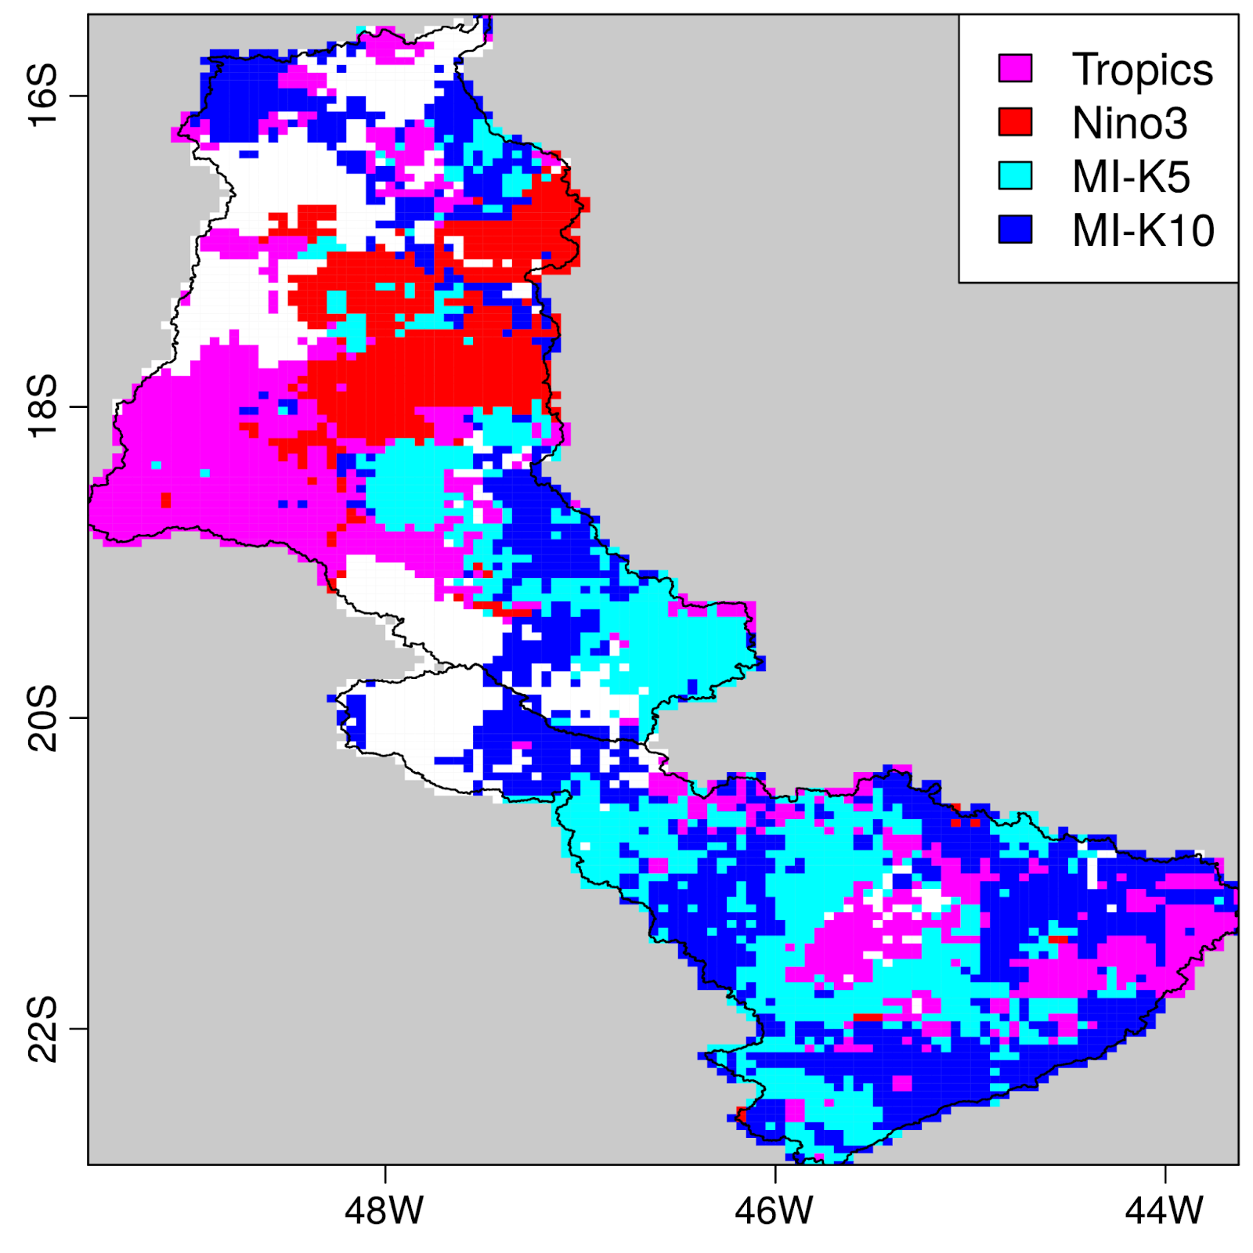
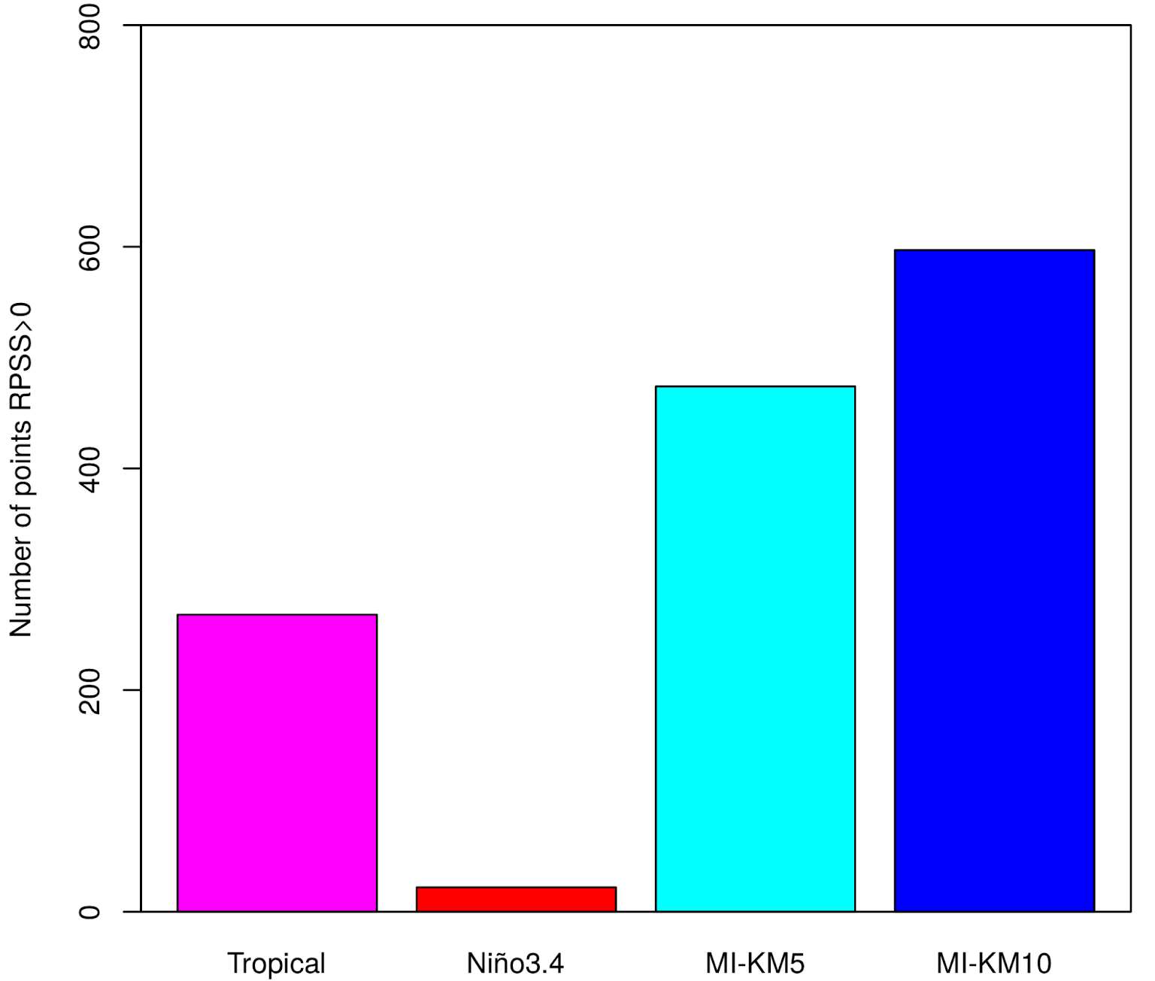
Hybrid model output
Example of the hybrid seasonal forecasts
Forecast quality assessment
CHIRPS-V2
Maximum ensemble mean correlation between the hybrid seasonal forecasts and the CHIRPS-V2 precipitation in AMJ (1993-2016).
CMCC-SPS35
Drier (%)
Normal(%)
Tropics
Nino3.4
MI- 5
MI-10
Number of grid points with positive RPSS (terciles) for hybrid seasonal forecasts and the CHIRPS-V2 precipitation in AMJ (1993-2016).
Wetter (%)
The probability corresponding to the most likely category (drier, normal or wetter).of the CMCC-SPS35 and the hybrid seasonal forecast of precipitation.

Slide 5
Key points
The combination of statistical relationships with dynamical forecasts through the analogues’ method produces seasonal forecasts of precipitation at a higher spatial resolution than the dynamical models with the advantage that they are not affected by biases.
State-of-the-art machine learning algorithms (such as mutual information) can be applied in the seasonal forecasting context. Mutual information allows to detect in a very systematic way the regions of influence between two different variables. Therefore this is a suitable framework for the climate services’ generation.
Other machine learning methodologies can be further exploited for the identification of new predictors (e.g. SLP, Z500, u, v, ...) that can enhance the forecast quality of the precipitation in specific locations.
1
2
3
Thank you
veronica.torralba@cmcc.it

