Slide 1



Optically stimulated luminescence dating of relic charcoal kilns using sand-sized quartz: a status report
Laboratory for Mineralogy and Petrology, Department of Geology, Ghent University, Belgium
Nasrin Karimi Moayed
PhD Student, Gent University
Nasrin.Karimimoayed@ugent.Be
Nasrinkarimi1025@gmail.Com

Slide 2
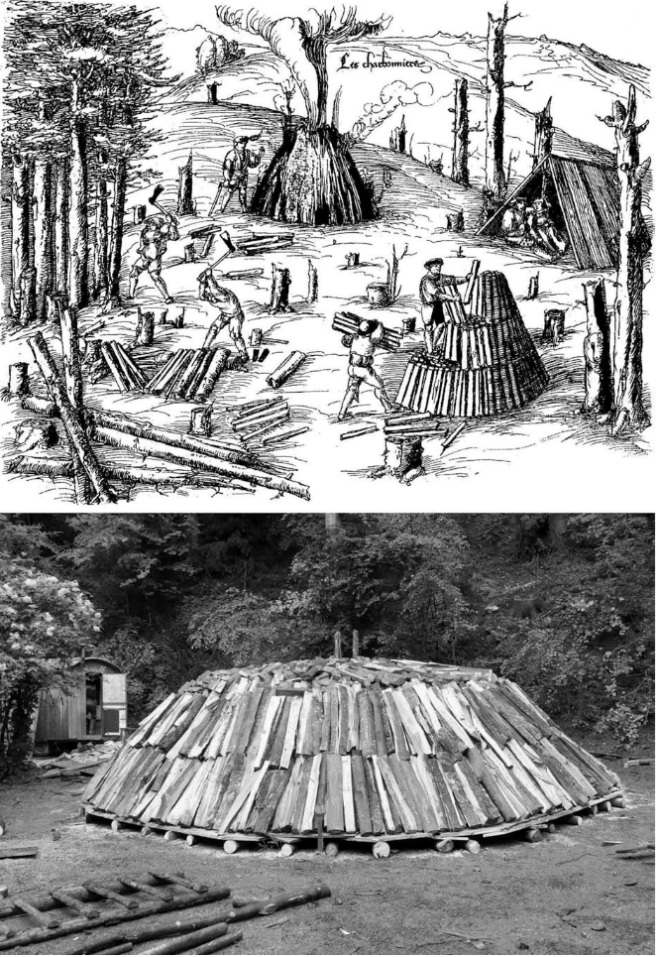
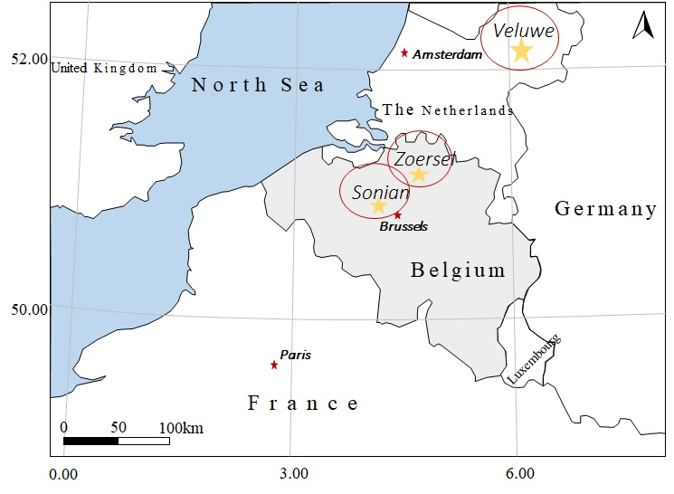
Introduction
what!?
Where?
Why?
-former forest composition
-changing soil properties
-carbon sequestration ,…

Slide 3
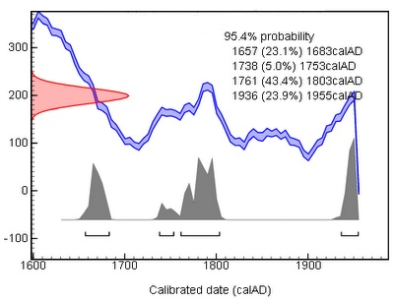
Challenges of age determination of charcoal kilns
Bronk-Ramsey, C. (2010)
¹⁴C (not useful for younger than 1650CE)
Can we date these features using OSL?
Can we date these feature using OSL more accurate than ¹⁴C?

Slide 4
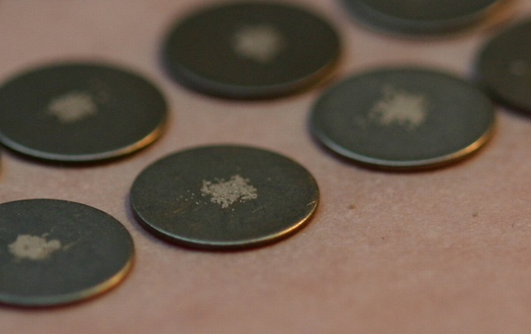
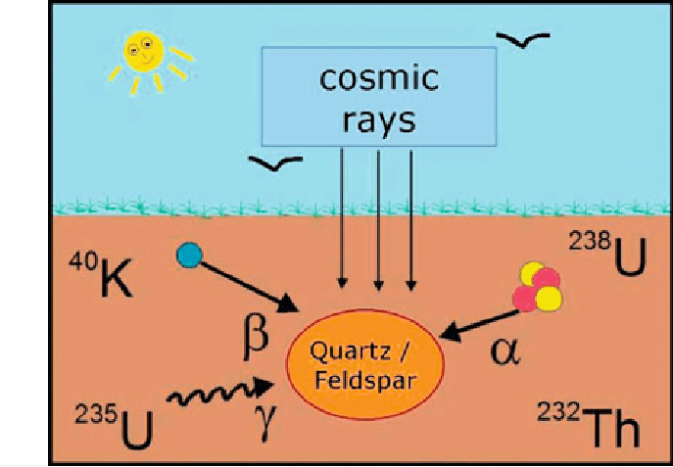
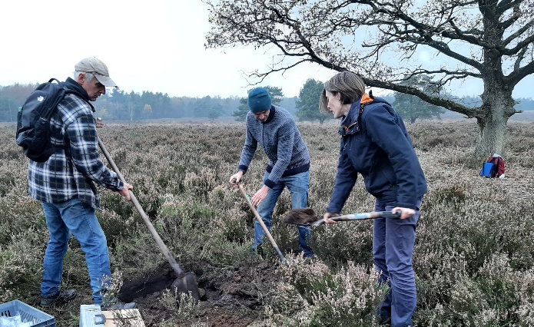
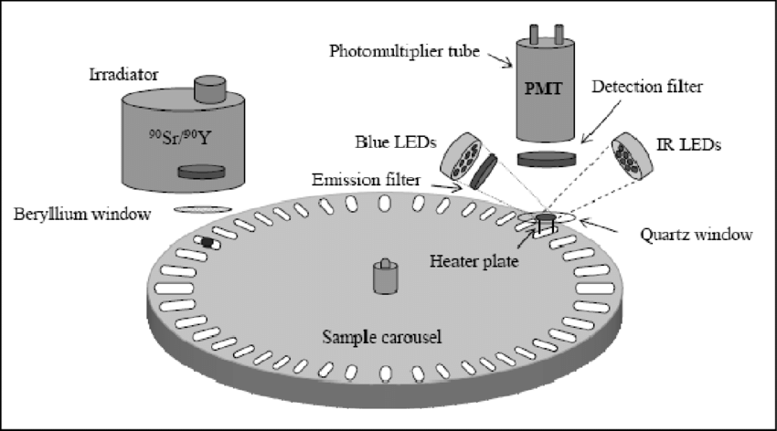
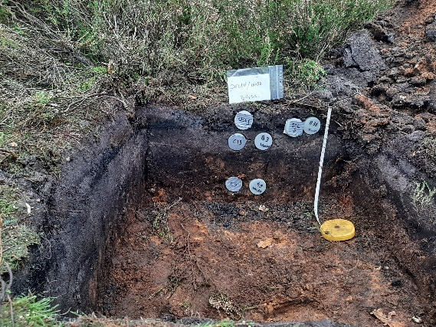
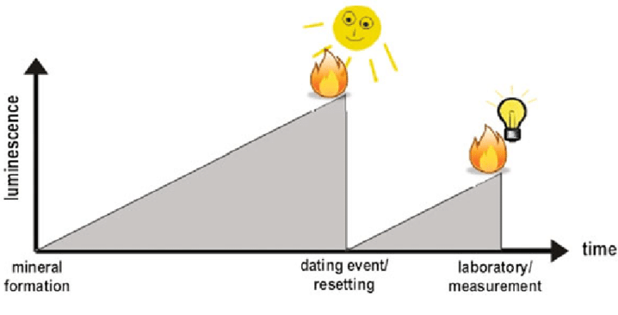
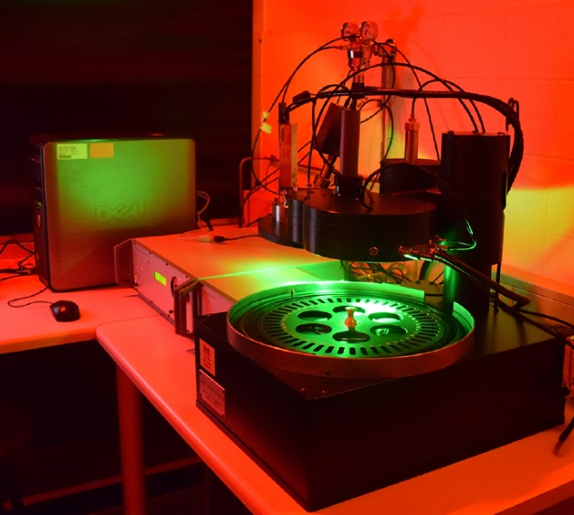
Lab work
Measurements
Method
Field work
SAR protocol
Small aliquots
Dose measurement
Liritzis et al., 2013
TL/OSL Risø reader

Slide 5
OSL vs ¹⁴C (Sonian/silty soil)
Karimi et al., 2019-published in Journal of Archaeological Science

Slide 6
OSL vs ¹⁴C (Zoersel/sandy soil)
Karimi et al., 2022-in press Quaternary Geochronology

Slide 7
OSL vs ¹⁴C (Veluwe/sandy soil)
Karimi et al., 2021-submitted in Archaeometry

Slide 8
Discussion
Sampling (charcoal-rich layer horizon)
Resetting (vertical/lateral thermal gradient)
Mixing (bio/pedoturbation)
Dosimetric aspects (water content, organic matter)
Different material in two dating methods

Slide 9
Conclusion
Luminescence ages from charcoal kilns mostly are consistent with ¹⁴C and possibly provide more accurate and precise ages (post 1650 AD).
Further research is needed into the dosimetry issue and organic matter.

Slide 10
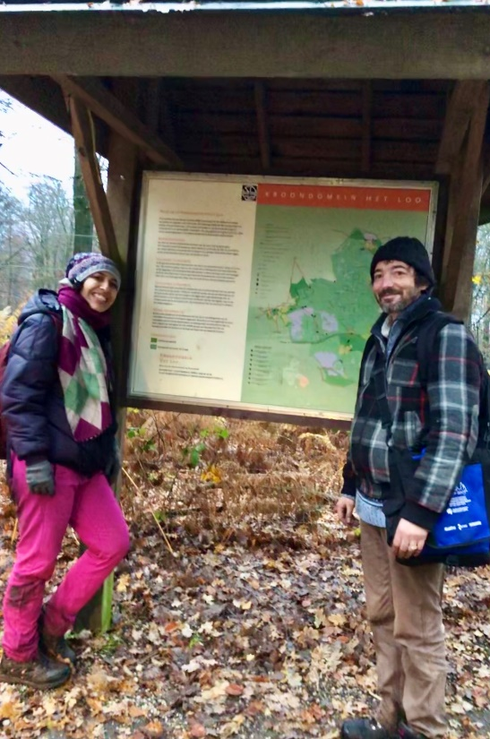
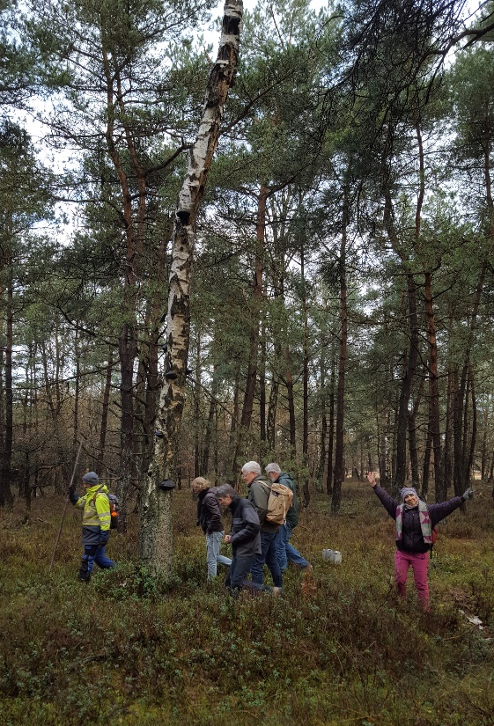
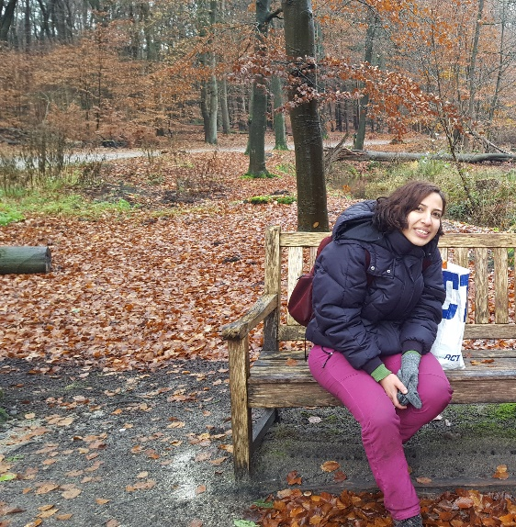
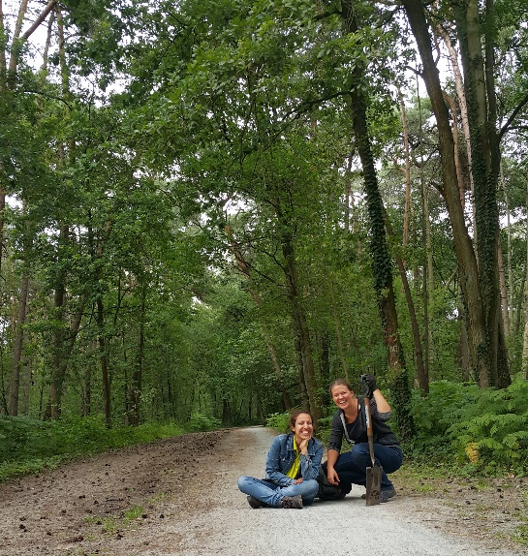
Thank you for listening!
Contact info:
Email address: Nasrin.karimimoayed@ugent.be
Gmail address: nasrinkarimi1025@gmail.com

