Slide 1
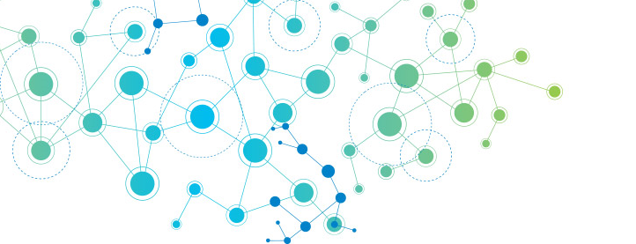





Developing a data-driven ocean forecast system
Rachel Furner
@rachelafurner
Supervisors: Peter Haynes (DAMTP), Brooks Paige (UCL), Dan Jones (BAS),
Dave Munday (BAS), Emily Shuckburgh (Computer Science)

Slide 2
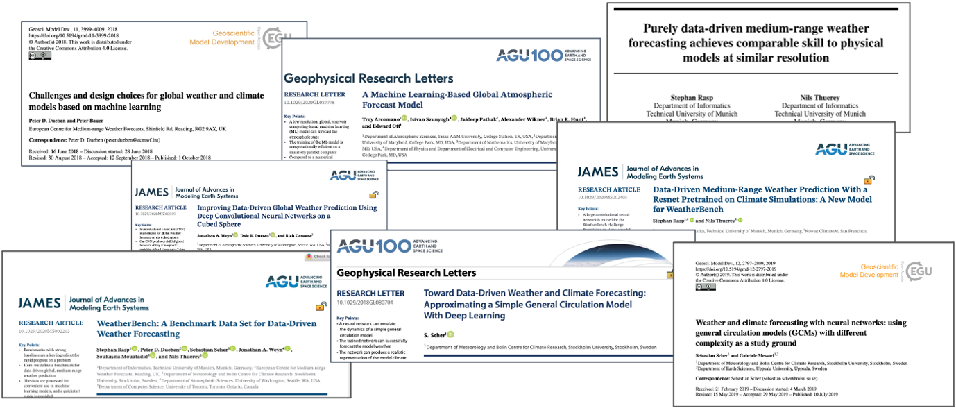
Data Driven Forecast systems
Growing field of interest, lots of examples of data-driven forecasts of atmospheric evolution

Slide 3
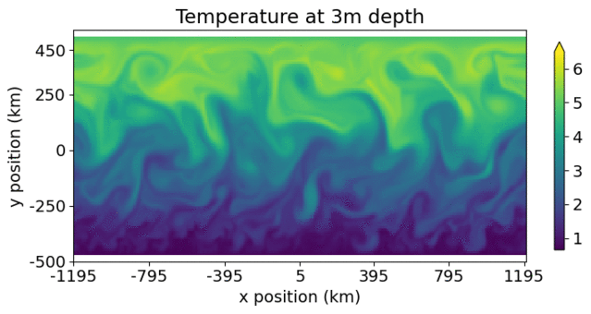
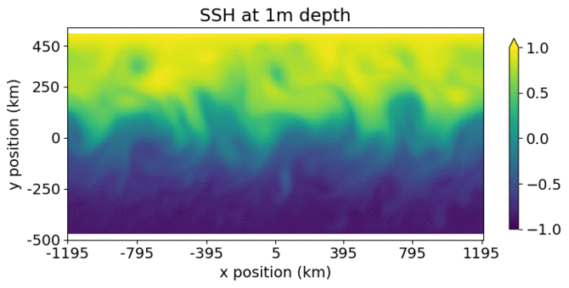
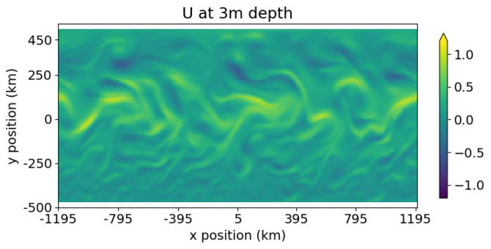
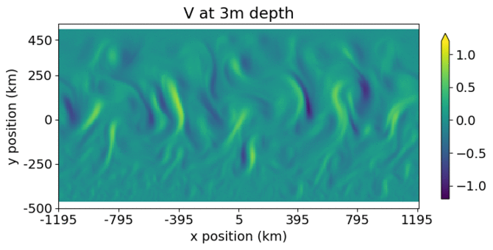
My problem - A simple oceanic channel configuration
We run an MITgcm configuration of a simple ocean channel, with wind forcing & periodic E&W boundaries.
We them train a network to emulate this, predicting the same 12 hour time steps as the simulator, and use the network iteratively to forecast further in time

Slide 4
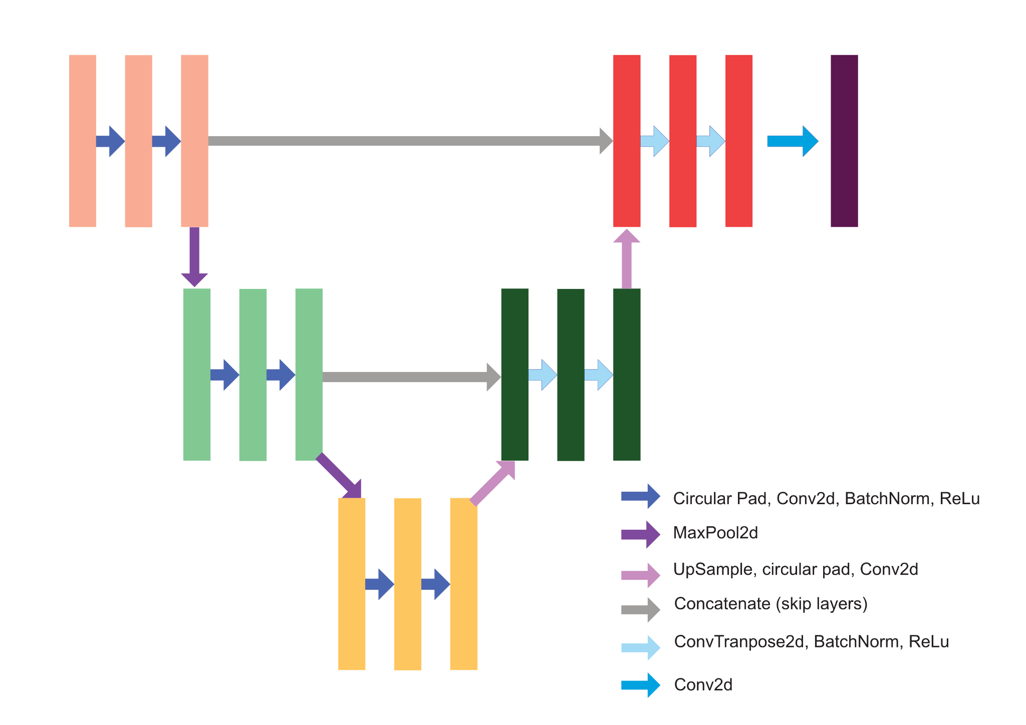
Approach with a U-Net style network
We only model ocean points giving input and output shapes of 96 x 240 ‘pixels’ per channel.
191 channels (each 3d variable at each of 38 depth levels, plus sea surface height, and land-sea masks)
Combination of convolutional, max pooling, upsampling, & convtranspose layers
Reduce resolution down to 17 by ~70 and increase number of channels to 1024
We apply circular padding at East & West boundaries. North & South boundaries aren’t padded.
Use Adam optimiser, learning rate of 1.e-4
2700 training samples, 540 validation samples

Slide 5
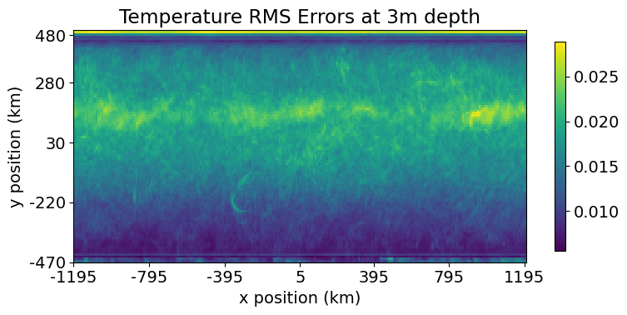
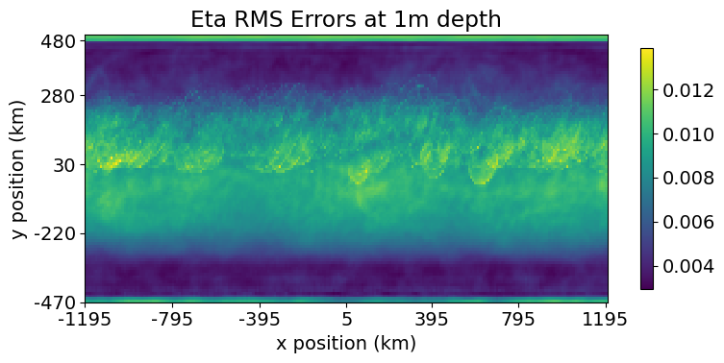
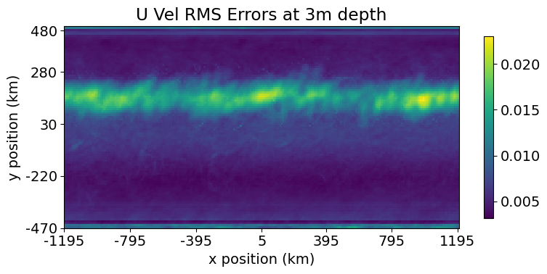
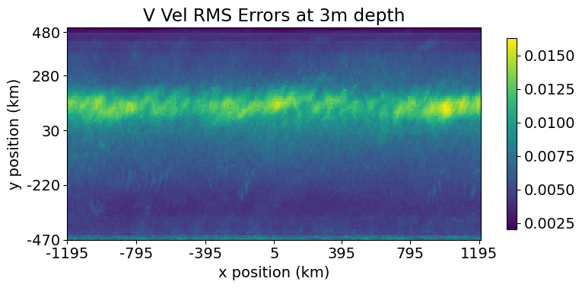
RMS errors just below the surface, averaged over validation dataset

Slide 6
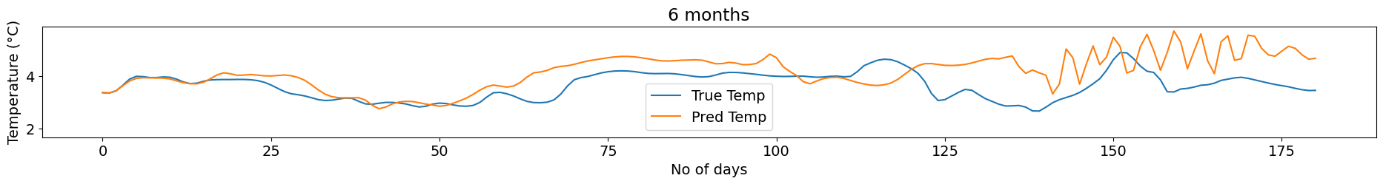
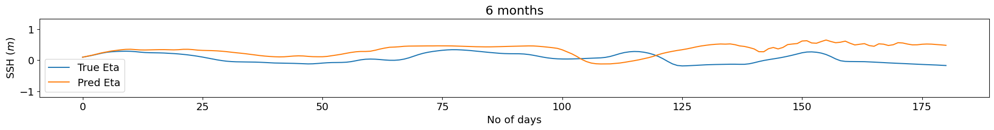
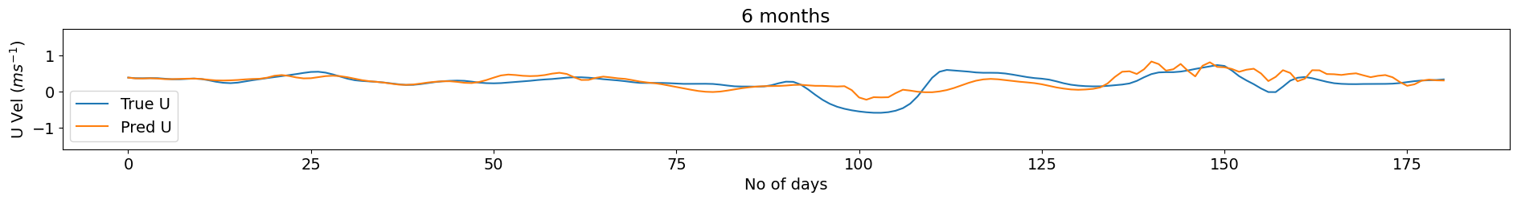
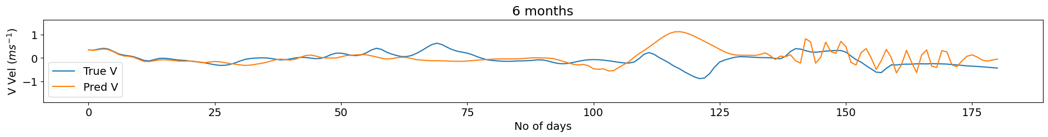
6 month timeseries at a point near the surface in the centre of the domain

Slide 7
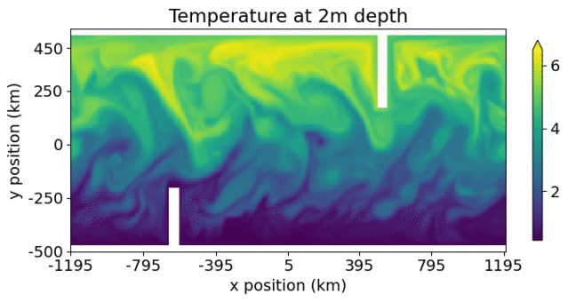
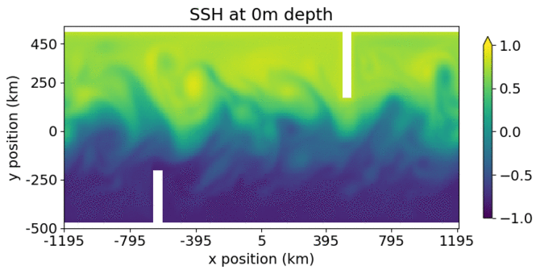
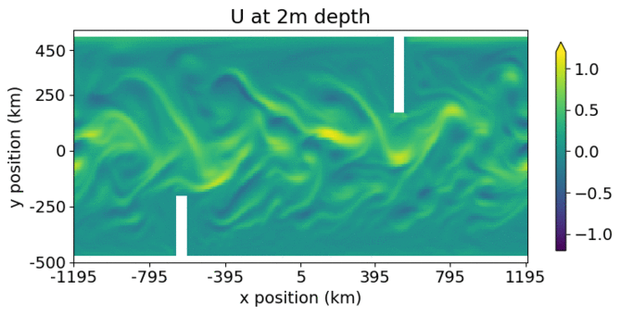
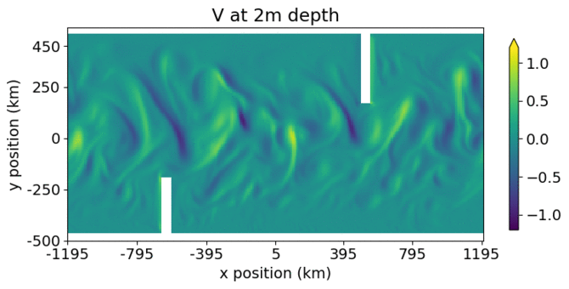
But what about land?
We rerun a more complicated configuration of MITgcm, including land, and train our network on output from this.
We calculate the loss function over ocean points only, as we’re not interested in what the network does over land

Slide 8
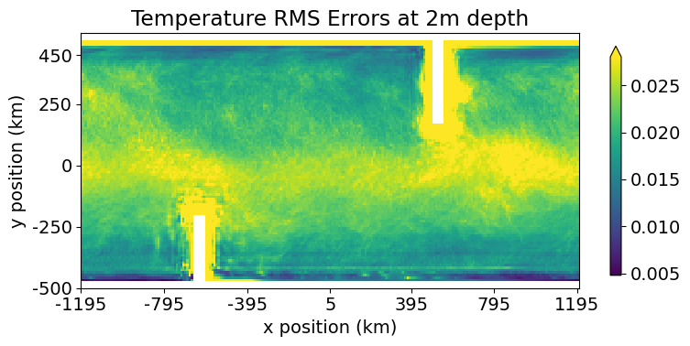
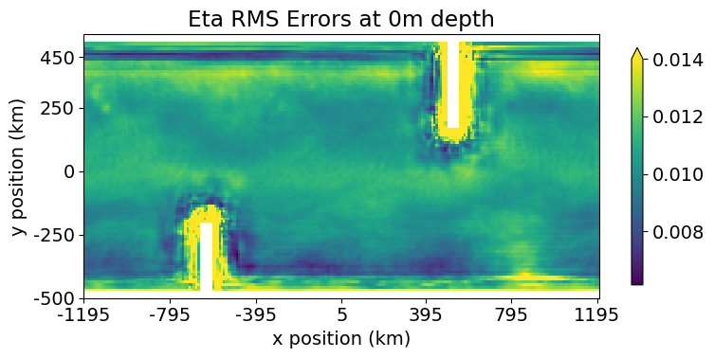
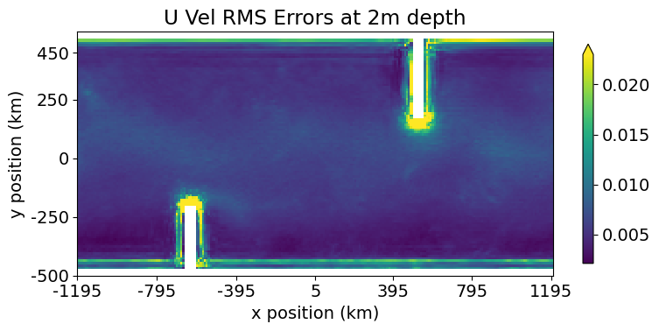
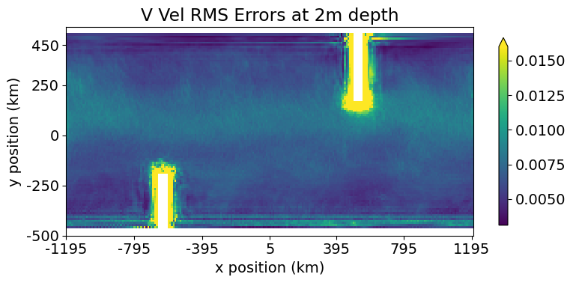
RMS errors just below the surface, averaged over validation dataset

Slide 9
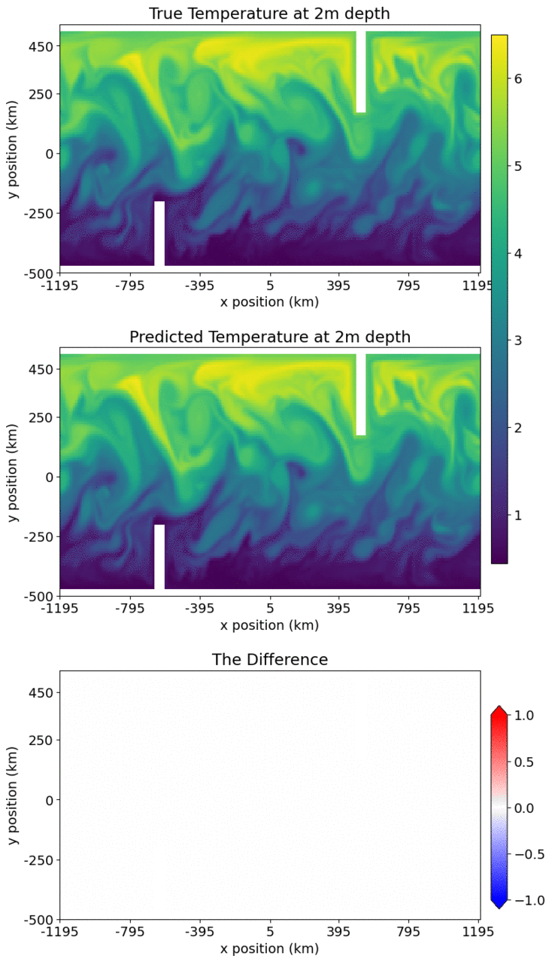
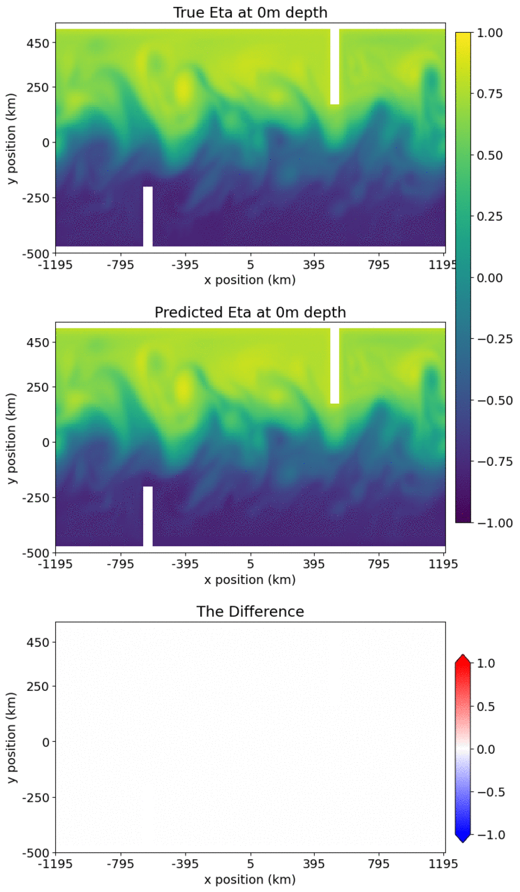
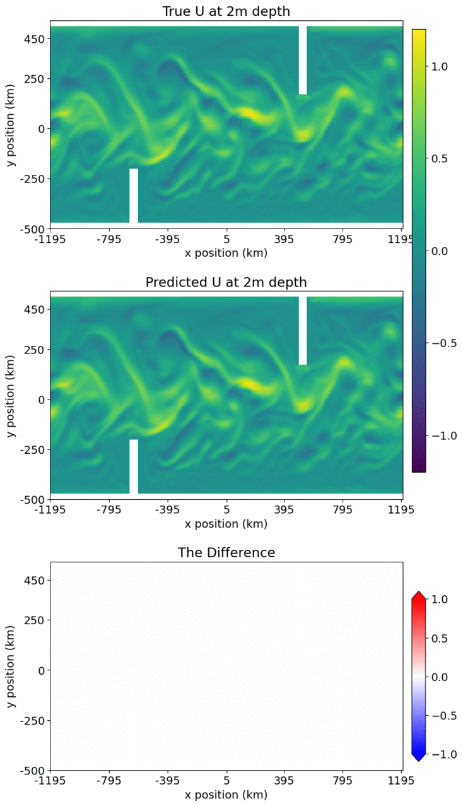
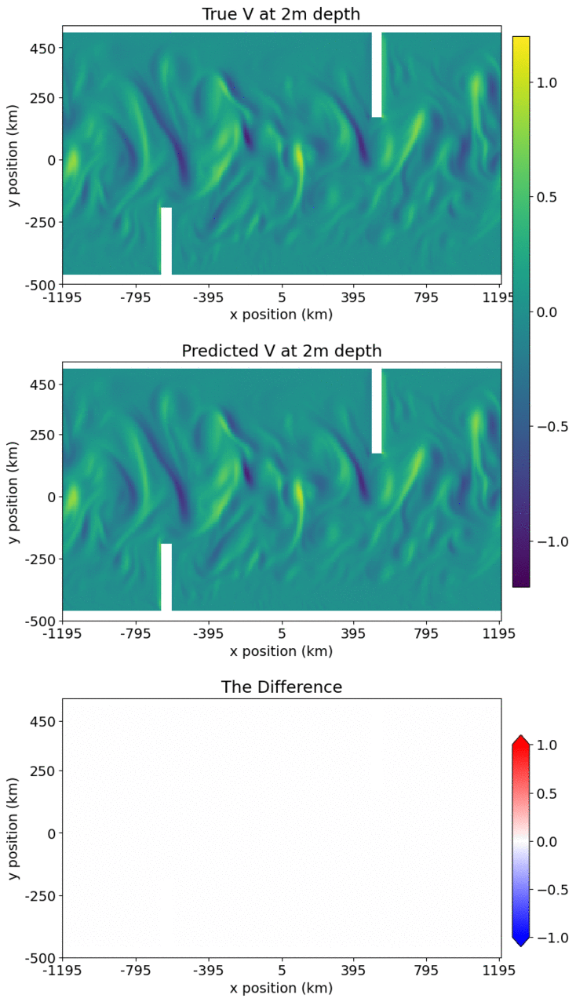
Results from iterating this model for 1 month
Temperature
Sea Surface Height
East-West Velocity
North-South Velocity

Slide 10
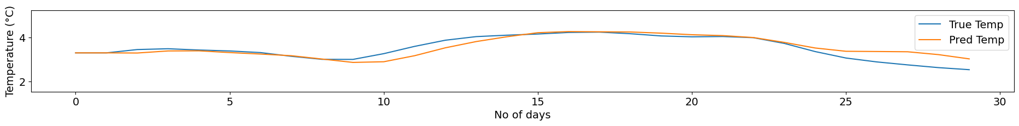
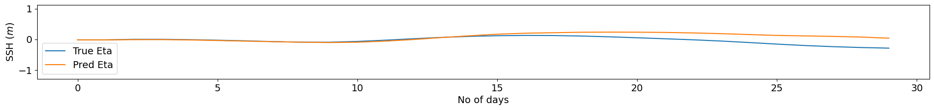
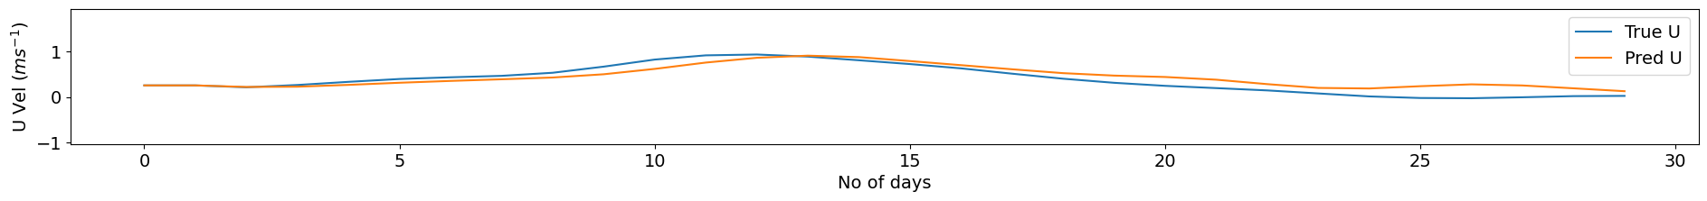
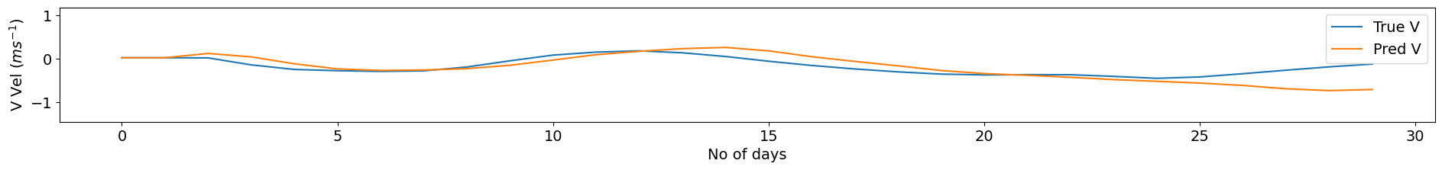
1 month timeseries at a point near the surface in the centre of the domain

Slide 11
Summary and further challenges
Training a network to emulate an ocean simulation model (MITGCM) shows promise, but with further development needed
The network replicates the internal ocean dynamics reasonably well, but…
The network struggles to learn the complex coastal dynamics
We see good predictions in the centre of the domain when iterating over a few weeks, but…
We see instabilities forming when we iterate over long periods of time
Moving to a more realistic ocean poses further additional challenges:
The ocean is not a cuboid - there are different depths, as well as more complicated coastlines and islands
The dynamics varies across space, perhaps additional input such as the latitude (for the coriolis effect) is needed, and/or consideration of how we scale the domain
Stability of iterations is key for usability
We also need to consider other issues such as conservation
@rachelafurner

