Slide 1

Seismic evidence for a 1000-km mantle discontinuity under the Pacific
Zhendong Zhang, Jessica C.E. Irving,
Frederik J. Simons, Tariq Alkhalifah
MIT, Princeton University, Bristol University, and KAUST
Hawaii
Notes:
Name+ affil.

Slide 2
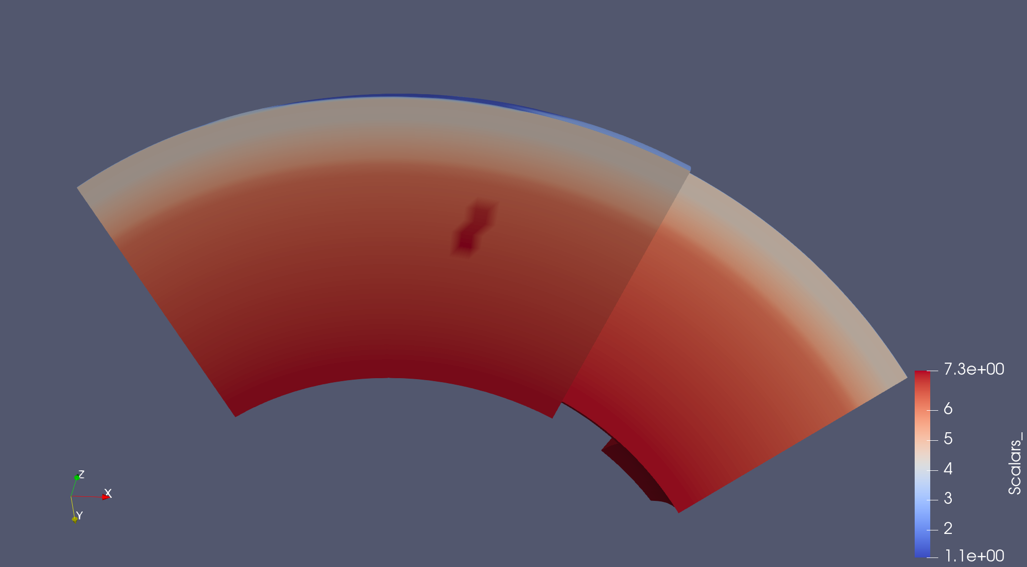
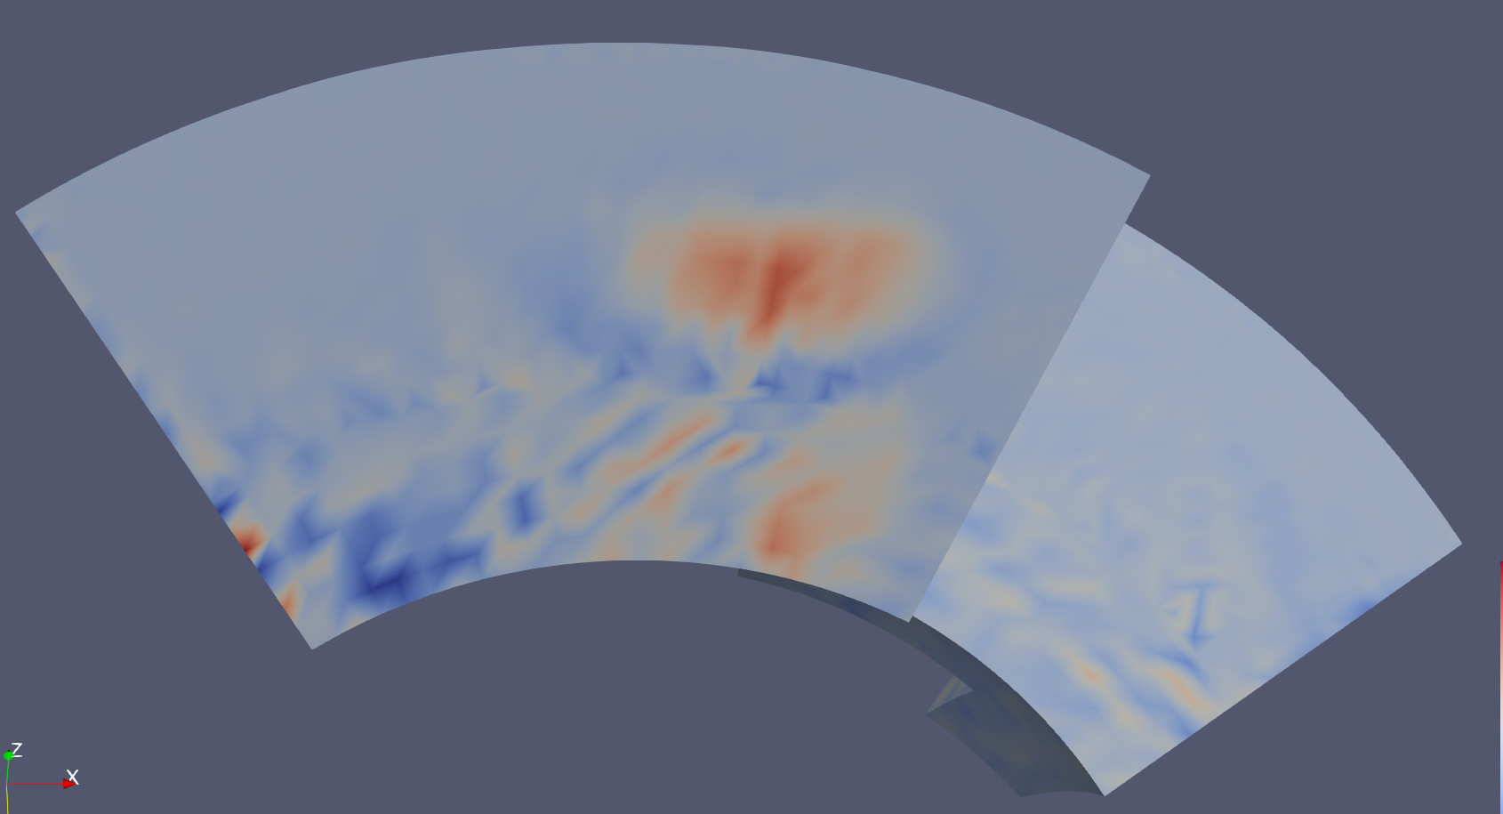
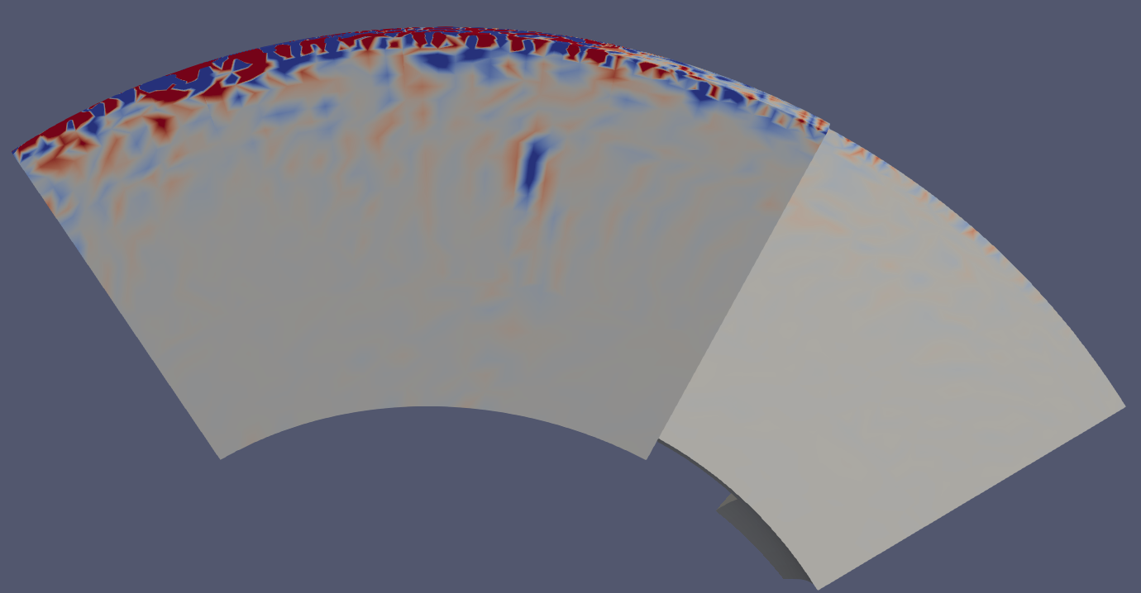
Motivation
Princeton, NJ
Vs
FWI tomography
RTM image
Notes:
vs model, 1,2,3 steps

Slide 3
Technic details of our RTM imaging
Precursors
Notes:
RTM image.

Slide 4
RTM Image below Hawaii seamount chain
Hawaii
Notes:
Here we show the reverse time migration image of mantle discontinuities along the Hawaii seamount chain. We imaged the known Mantle-transition zone discontinuities marked by yellow lines. There is a suppressed contrast at 410 near the main island. We also observed a local discontintinutiy at 1000km.

Slide 5
Mantle transition zone topography
Notes:
Mention the grey portion.

Slide 6
Comparison to model SEMUCB
?
French and Romanowicz, Nature 2015
Notes:
References

Slide 7
Comparison to model GLADM25
Lei et al., GJI 2020

Slide 8
Sensitivity test
Notes:
传统方法的缺陷和新方法的优势，不局限于1d层状模型假设。

Slide 9
Sensitivity test
Notes:
传统方法的缺陷和新方法的优势，不局限于1d层状模型假设。

Slide 10
Conclusions
We observed MTZ thinning southeast of Hawaii
We observed a mid-mantle discontinuity at ~1000 km depth
This 1000 km discontinuity indicates a S-impedance reversal
We demonstrate that our wavefield-based imaging method can be useful for global mantle discontinuity imaging

Slide 11
Acknowledgements
Wenjie Lei, Jeroen Tromp and Yike Liu
The Supercomputing Laboratory of KAUST
The Princeton Institute for Computational Science & Engineering (PICSciE)
SPECFEM_3D_GLOBE, SphModel and SubMachine
We acknowledge IRIS (iris.edu) and ORFEUS (orfeus-eu.org) for providing the data used in this study

