Slide 1
Determining the latitudinal extent of Energetic Electron Precipitation
E.M. Babu1, H.Nesse Tyssøy1, C. Smith-Johnsen1, V. Maliniemi1, J.A.
Salice1, R.M. Millan2,and I.G. Richardson3,4
1Birkeland Centre for Space Science, Department of Physics and Technology, University of Bergen, Bergen, Norway
2Department of Physics and Astronomy, Dartmouth College, Hanover, New Hampshire, USA
3Heliophysics Science Division, NASA Goddard Space Flight Center, Greenbelt, MD 20771, USA
4Department of Astronomy, University of Maryland, College Park, MD 20742, USA

Slide 2
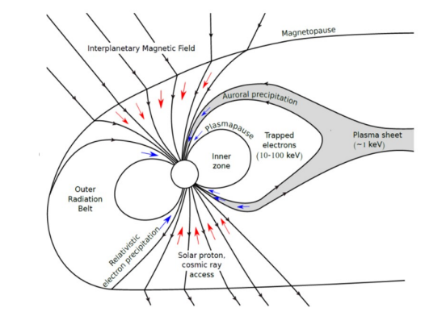
Thorne[1980], Ødegaard
Objective:
Identify the equatorward boundary
Create a geomagnetic index-based model to predict the boundaries

Slide 3
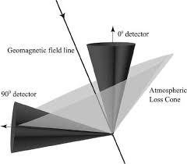
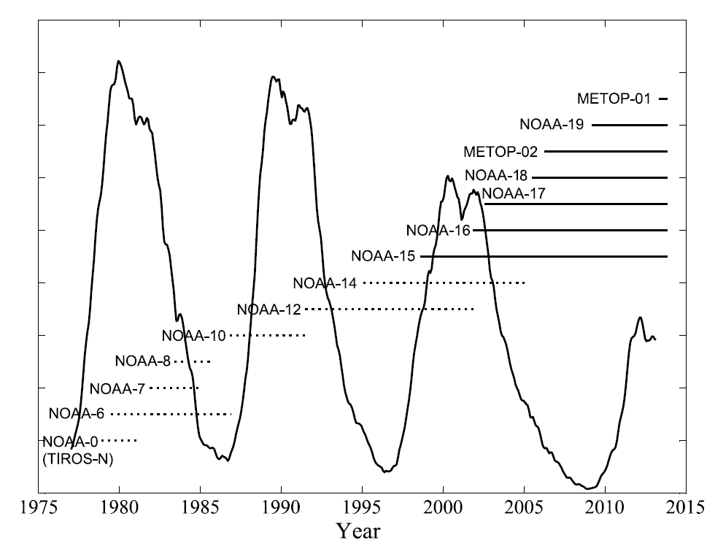
Magnetospheric Measurement
MEPED (Medium Energy Proton Electron
Detector) on NOAA/EUMETSAT in LEO
E1 > 43 keV
E2 > 114 keV
E3 > 292 keV
P6 > 756 keV
Coverage over 4 solar cycles
Søraas et al. (AGU 2018)

Slide 4
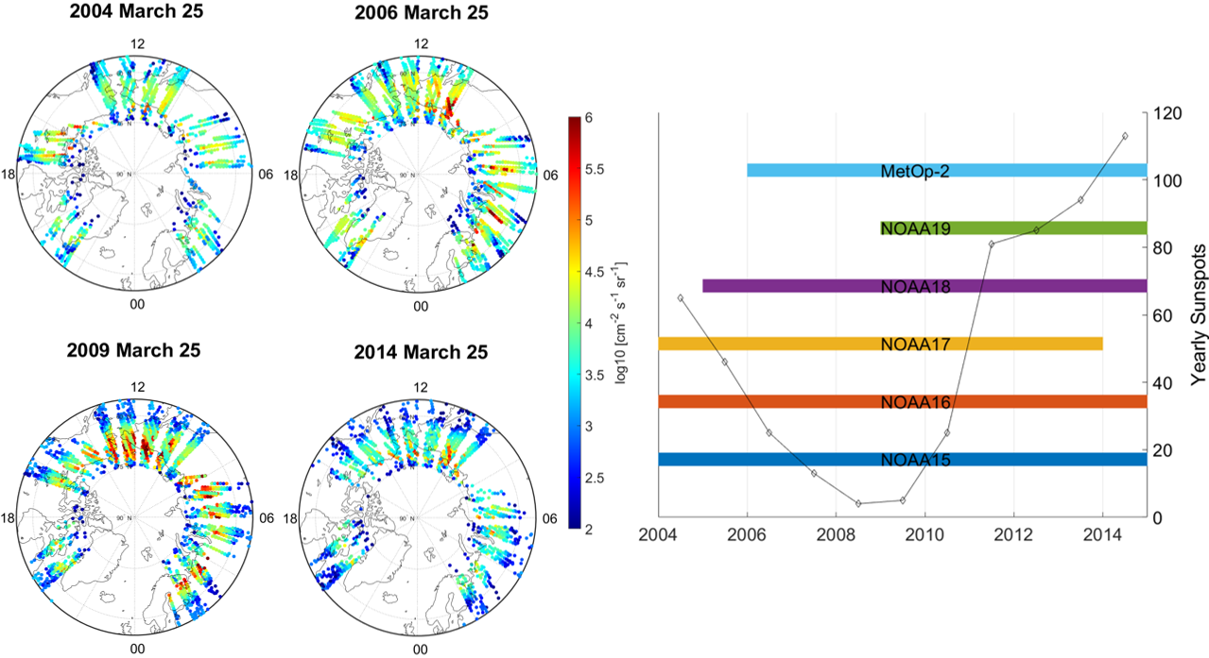
Satellite Coverage

Slide 5
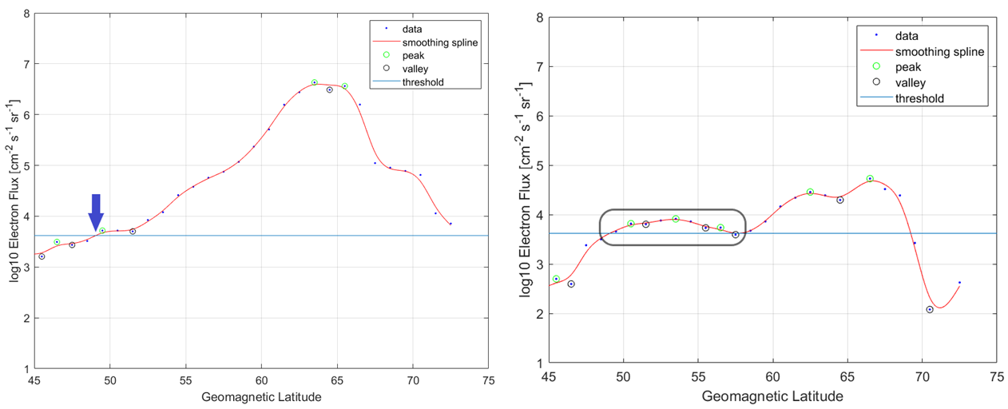
How the data look

Slide 6
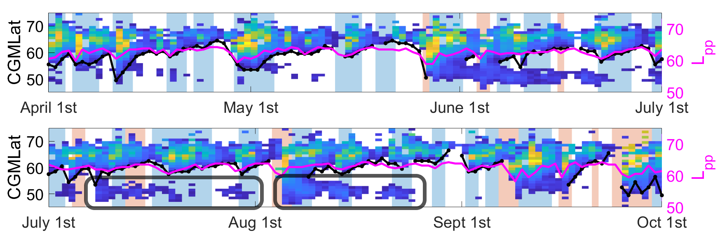
Identified Boundaries

Slide 7
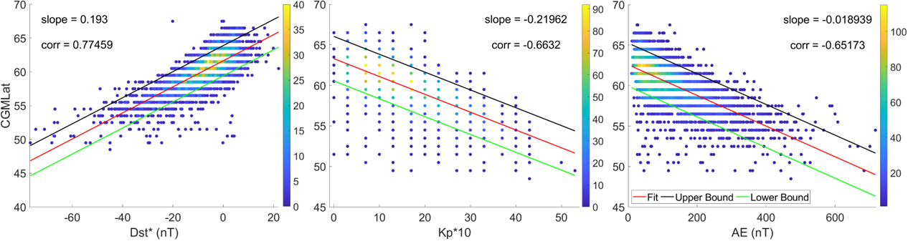

$$\text{Dst}\text{∗}= Dst −\left(15.8∗P^{0.5}\right)+20$$
Predicting the Boundaries
Parameters investigated: Dst*, Kp, AE, Ap, Bz, By, Ey, P, v

Slide 8
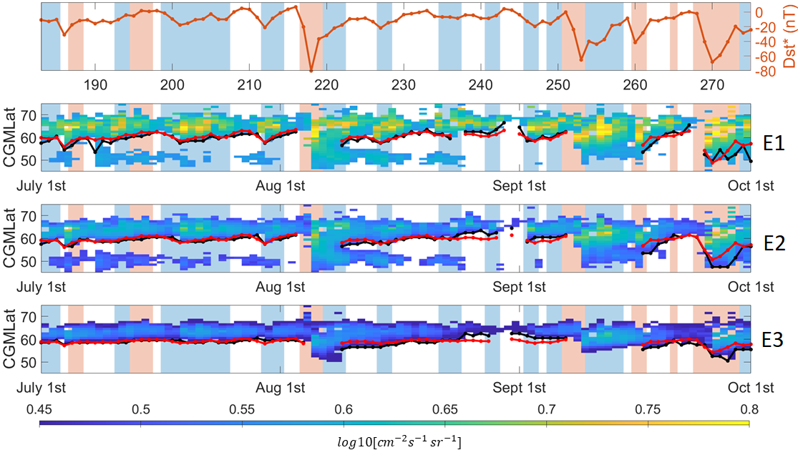
The Dst Model

Slide 9
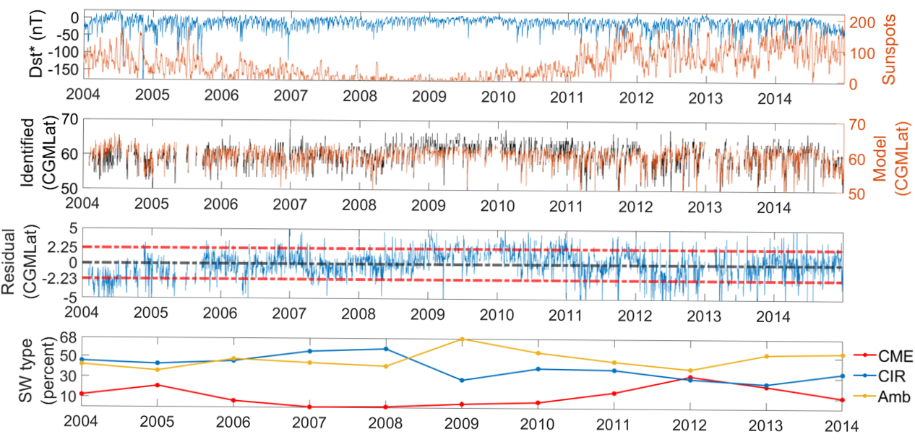
Accuracy of the Model

Slide 10
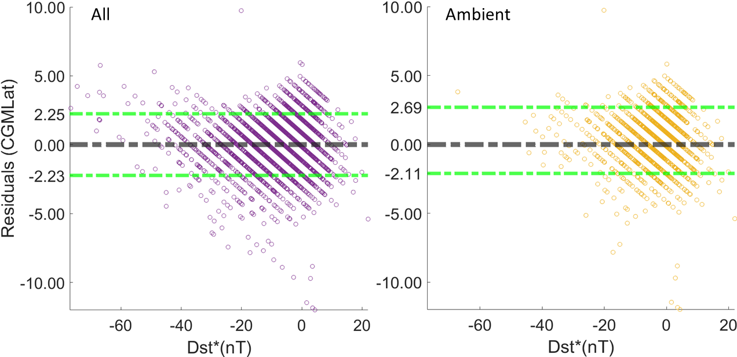

Slide 11
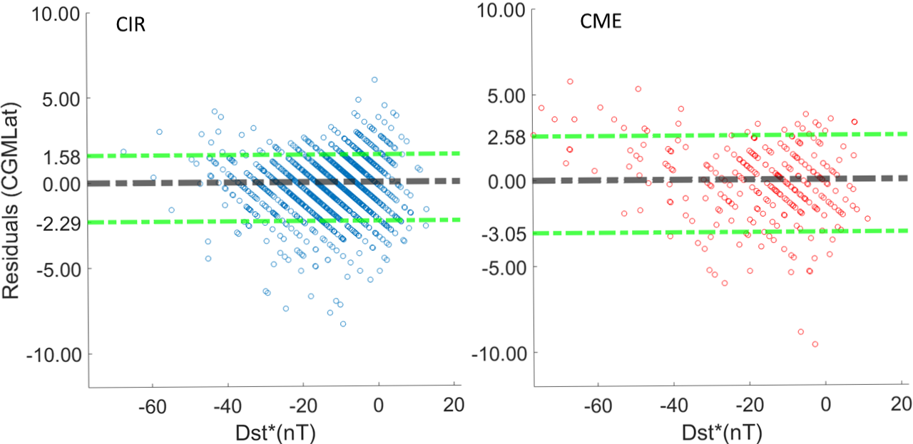

Slide 12
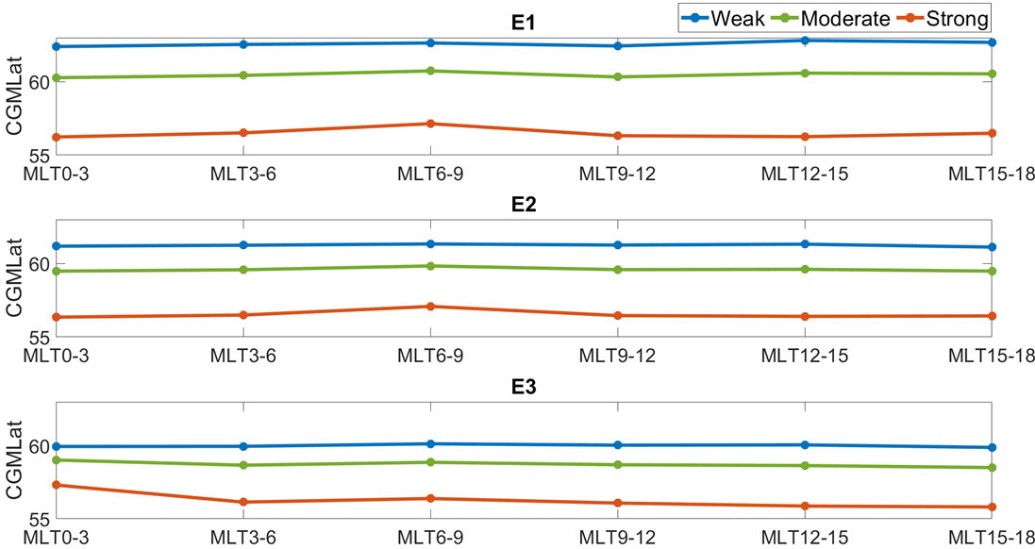
MLT variability

Slide 13
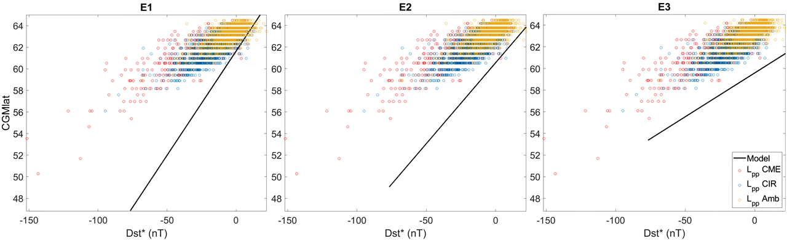
Comparison with Moldwin et al. (2002)’s plasmapause model

Slide 14
Conclusion
The equatorward extent of 43-1000 keV electron precipitation is best correlated with the pressure corrected Dst
The model has an error estimate of ±2.2° cgmlat over a full solar cycle (2004-2014)
The model has the highest accuracy during periods dominated by high-speed solar wind streams

