Slide 1
Intense mid-Holocene warming on highland Sumatra?
Insights from biomarker proxies
Petter Hällberg
A. Martínez Cortizas, A. Hapsari, H. Rifai, S. Eisele, C. Bouvet de Maisonneuve, M. Kylander, F. Schenk , R.H. Smittenberg.

Slide 2
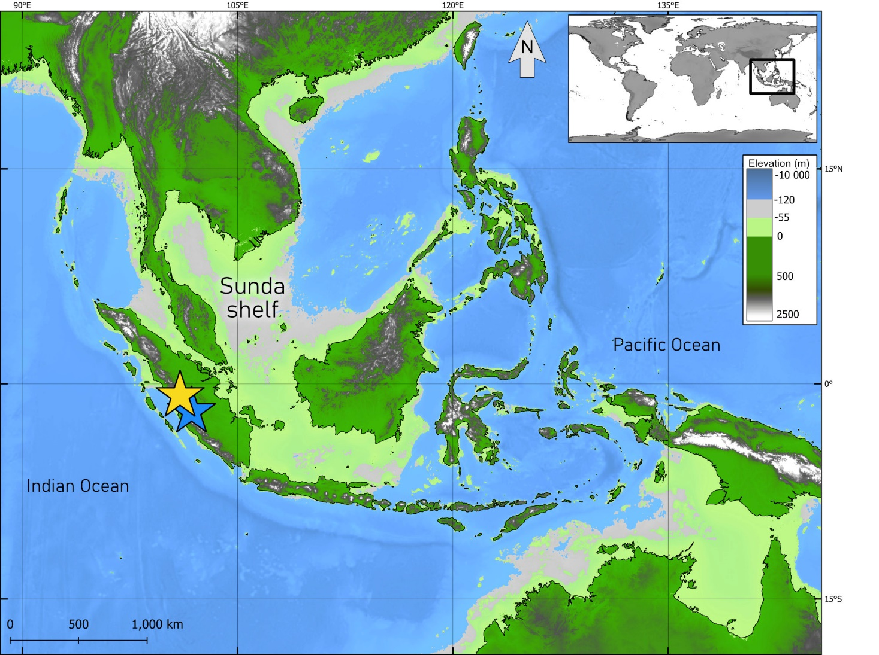
Introduction
Indo Pacific Warm Pool (IPWP)
  SSTs > 28 °C
  Monsoons, Walker Circulation and ENSO
No IPWP terrestrial temperature records in global databases for the Holocene (Kaufman et al., 2020)
Kaufman et al.,

Slide 3
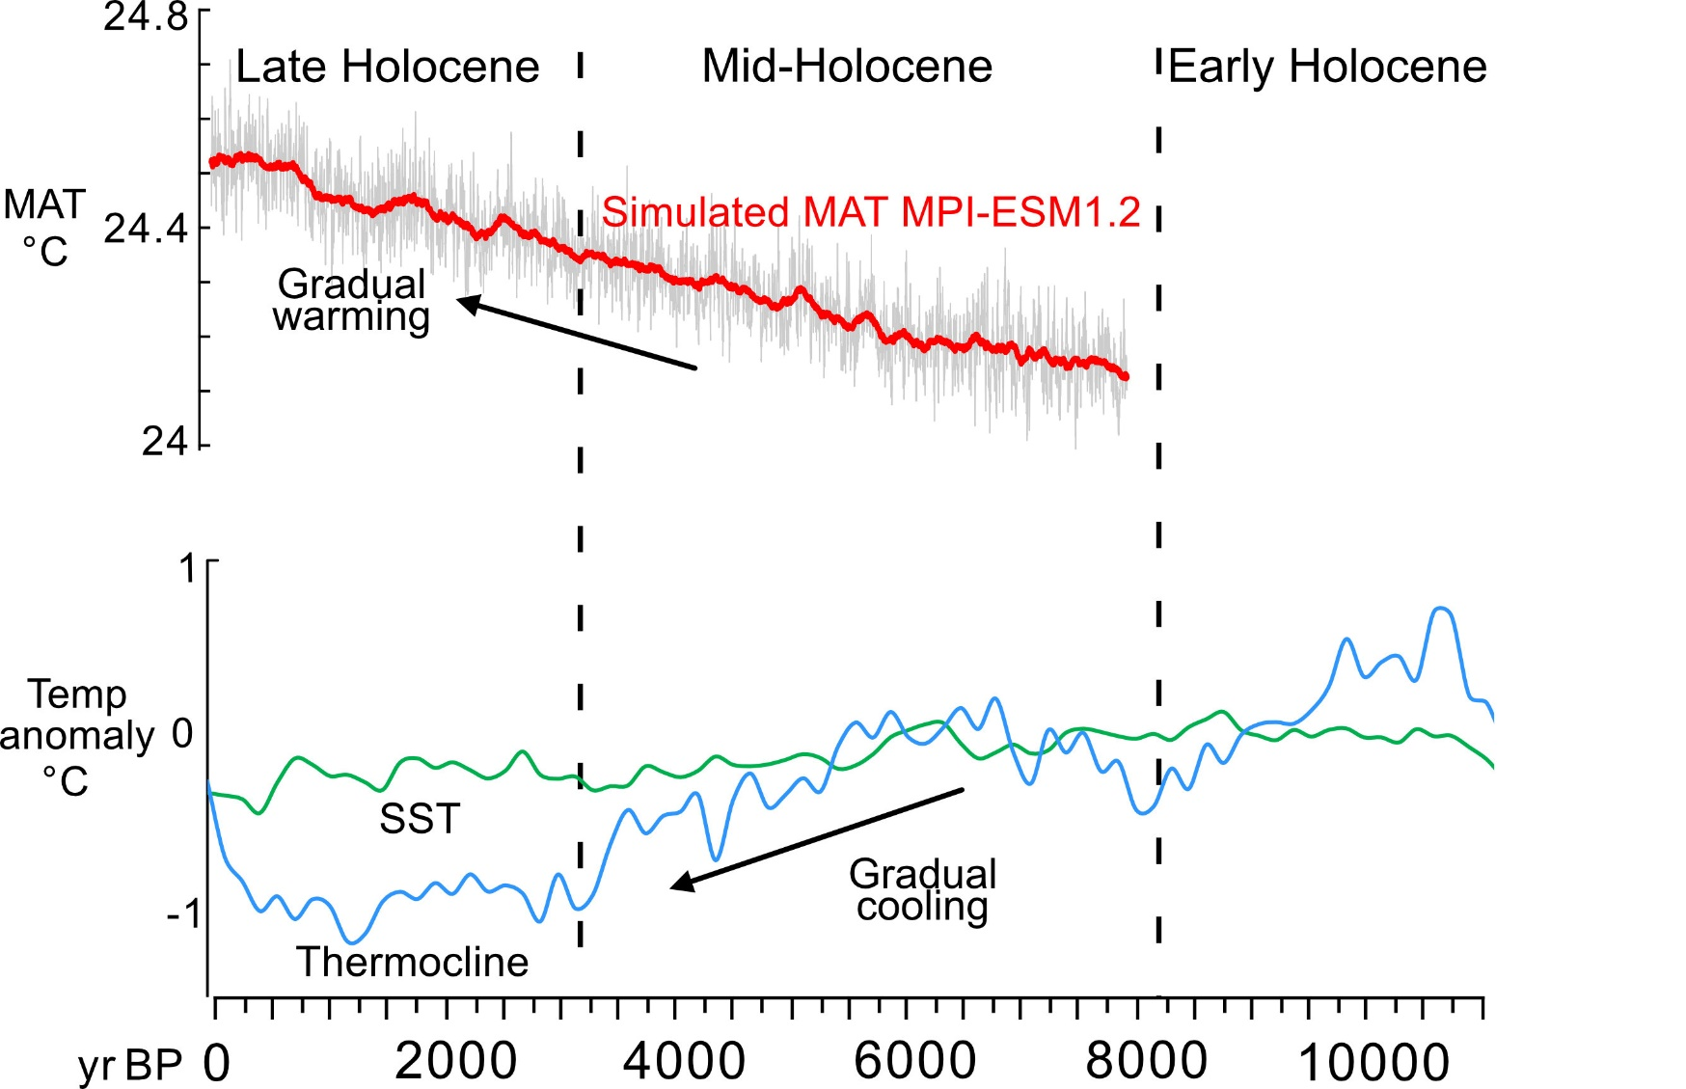

‘Holocene temperature conundrum’
Models and marine records disagree → seasonal bias?
Seasonal signal in land reconstructions? Different signal than SSTs?
Model: MPI-ESM1.2. Bader et al., Nature Communications (2020), 11:4726
Data provided by Johann Jungclaus (Max-Planck-Institut für Meteorologie, Hamburg)
Compiled marine records from Dang et al., 2020, based on Mg/Ca of foraminifera.

Slide 4
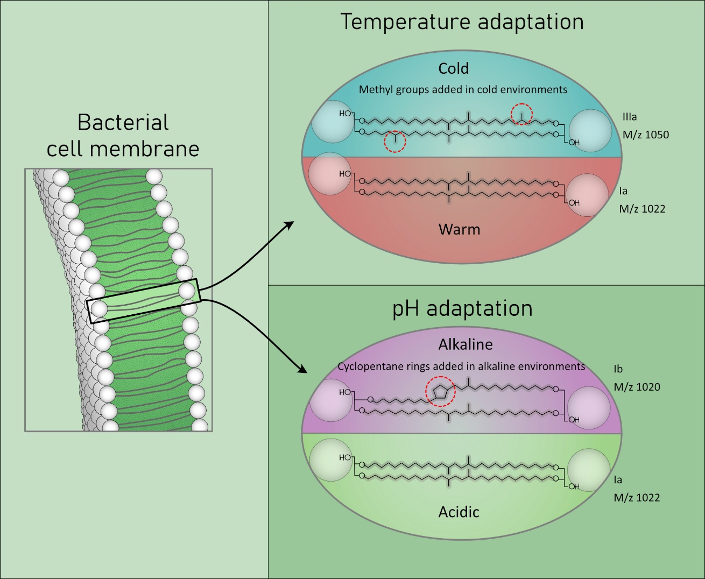
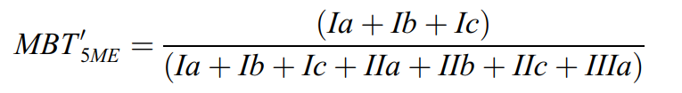

Method
Two peat cores: Diatas and Padang
Bacterial membrane lipids brGDGT
Produced differently depending on temperature and pH
Relative abundances → mean annual air temperatures or pH based on calibration datasets

Slide 5
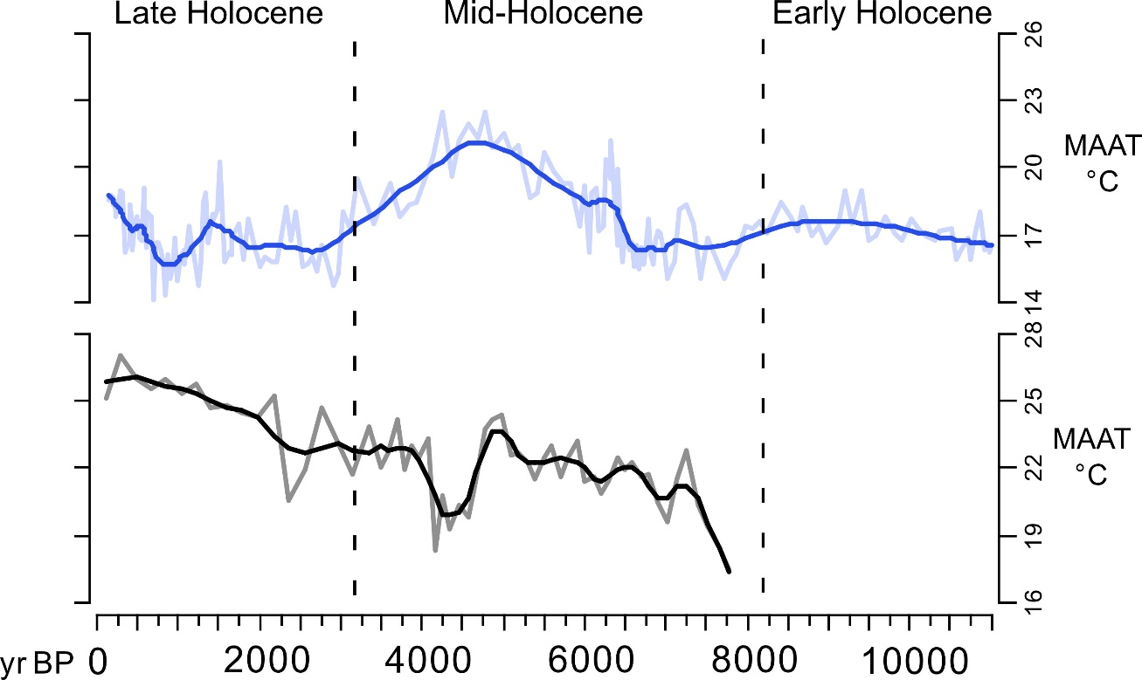
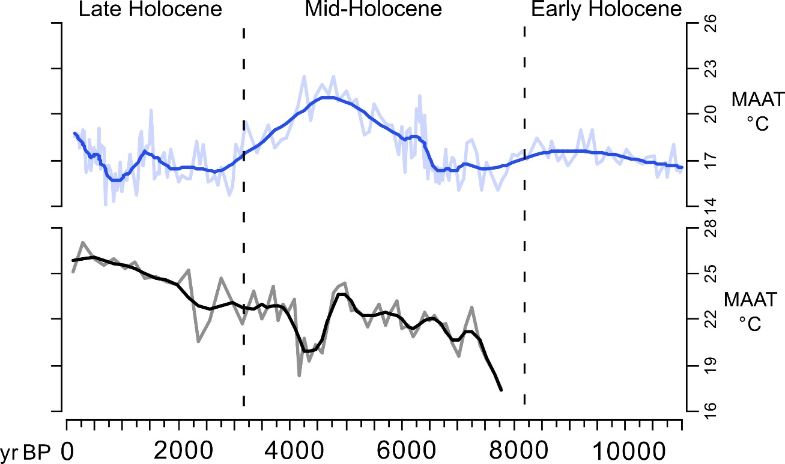
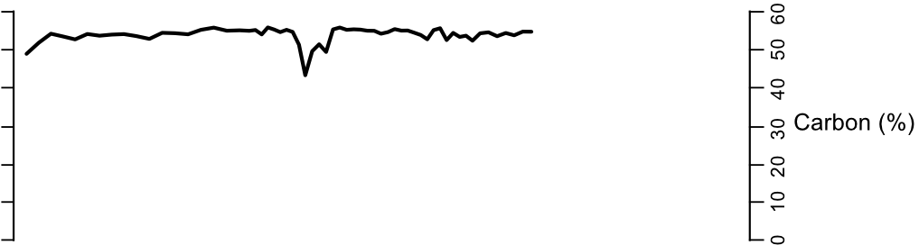
Padang peat core
Gradual warming
Homogenous, highly organic
4.3 ka cooling signal during mineral input
Mineral
input
Notes:
Core top temperatures same as local weather station
Data we have: d13Cbulk. dD. GDGTs. C%. C/N.
Makes sense that P and T would follow each other in this maritime setting, and supported by other wetness proxies (d13C indicates macrophytes/algal biomass, Paq indicate wetter, less crenarchaeol which require oxic conditions, more 1302 or Iso relative to branched= methanogens). So P checks out across independent proxies.

Slide 6
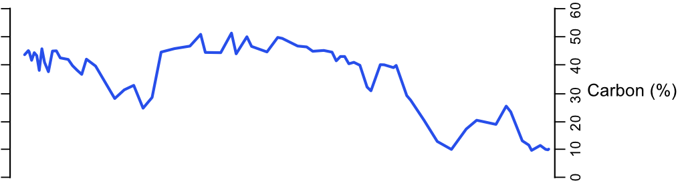
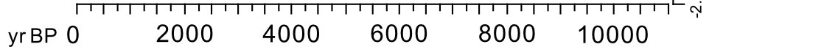
Diatas peat core
Intense warming in the mid-Holocene (~5°C)
Cooling signal occurs during
  Mineral input (erosion from surrounding soils)
  Local hydroclimate and vegetation changes
  Altered GDGT distributions (isomerization and cyclization, etc.)
Warming
Mineral input

Slide 7
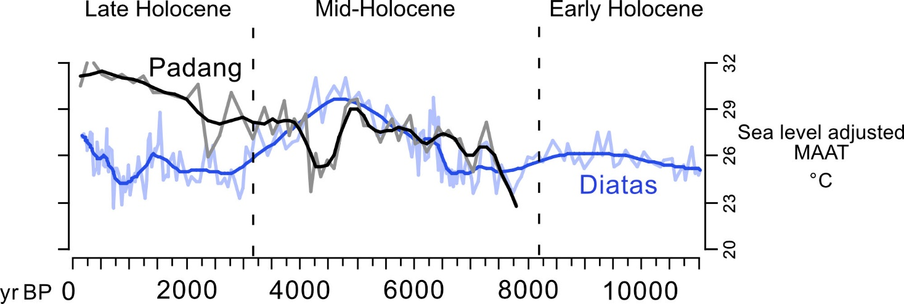
Comparison
Mid-Holocene:
  Pure peat and similar GDGT distributions

Slide 8
Divergence during erosion from surroundings
Mid-Holocene:
  Pure peat and similar GDGT distributions
Cooling signals during mineral input
  Real climatic signal would affect both cores simultaneuously
  Local erosion cooling signals not active at the same time
Potential causes
  microbial community shift
  pH effect on degree of methylation (used to derive temperatures)
Soil input

Slide 9
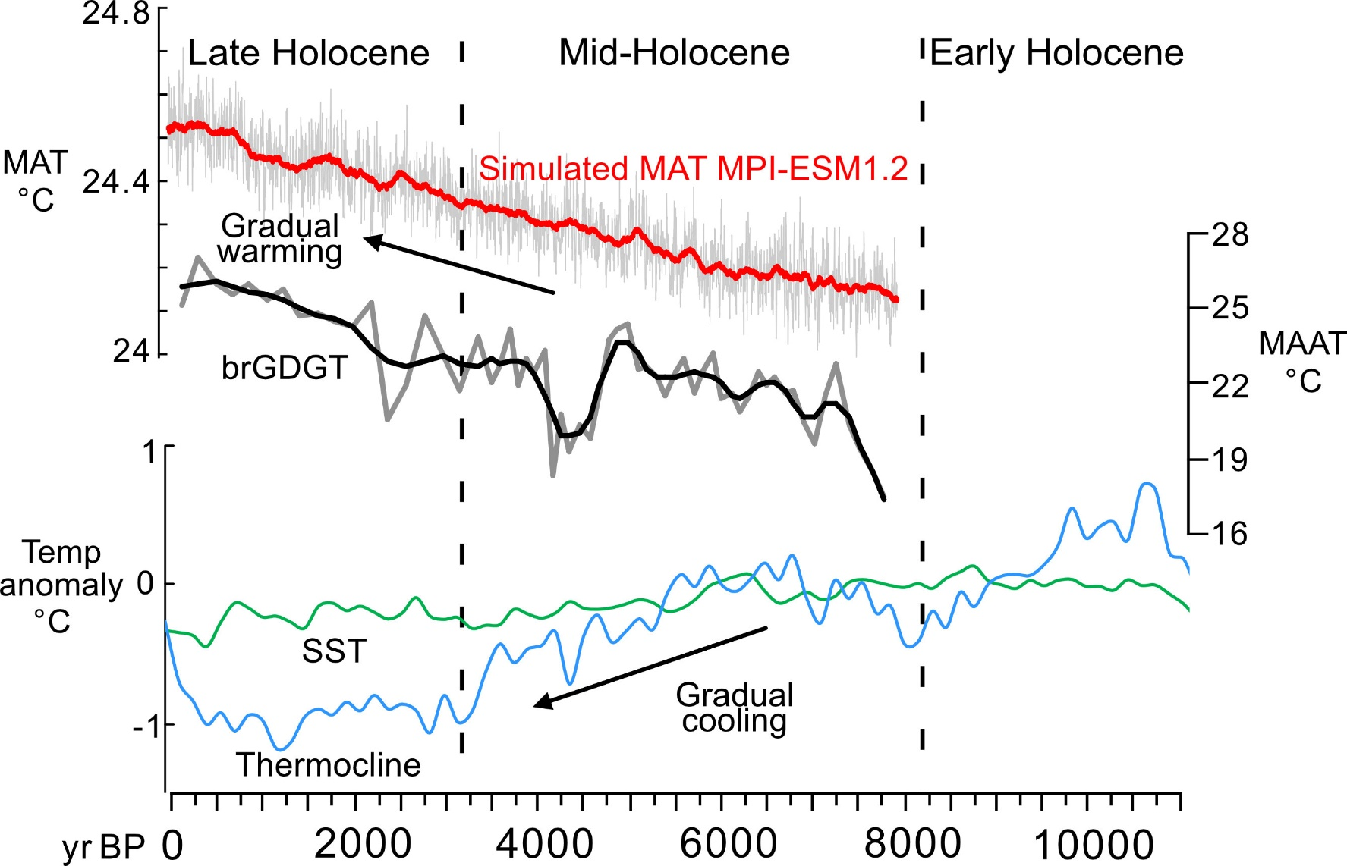
Comparison models and marine records
Models: agreement in trend
IPWP marine records: opposite trend
Model: MPI-ESM1.2. Bader et al., Nature Communications (2020), 11:4726
Data provided by Johann Jungclaus (Max-Planck-Institut für Meteorologie, Hamburg)
Compiled marine records from Dang et al., 2020, based on Mg/Ca of foraminifera.

Slide 10
Conclusions
Mineral input caused ”cooling” signal
  brGDGT temperature probably only robust if core lithology stays constant
Gradual warming over the mid-late Holocene
  Consistent with models
  At odds with marine reconstructions
  Proposed seasonal bias in marine records is not present in our Sumatran peat
Ongoing work
  Lake and soil GDGT comparisons
  Multiproxy hydroclimate δD_{wax}

Slide 11
Thank you for listening!
Petter Hällberg petter.hallberg@geo.su.se
A. Martínez Cortizas, A. Hapsari, H. Rifai, S. Eisele, C. Bouvet de Maisonneuve, M. Kylander, F. Schenk , R.H. Smittenberg
Acknowledgements:
Model data: Johann Jungclaus
Thesis students: Guillermo Jarne and Yolanda Schankat
Lab engineer: Julia Steinbach
Funding: Swedish research council
Supervisors: Rienk Smittenberg and Frederik Schenk
More display material online

Slide 13
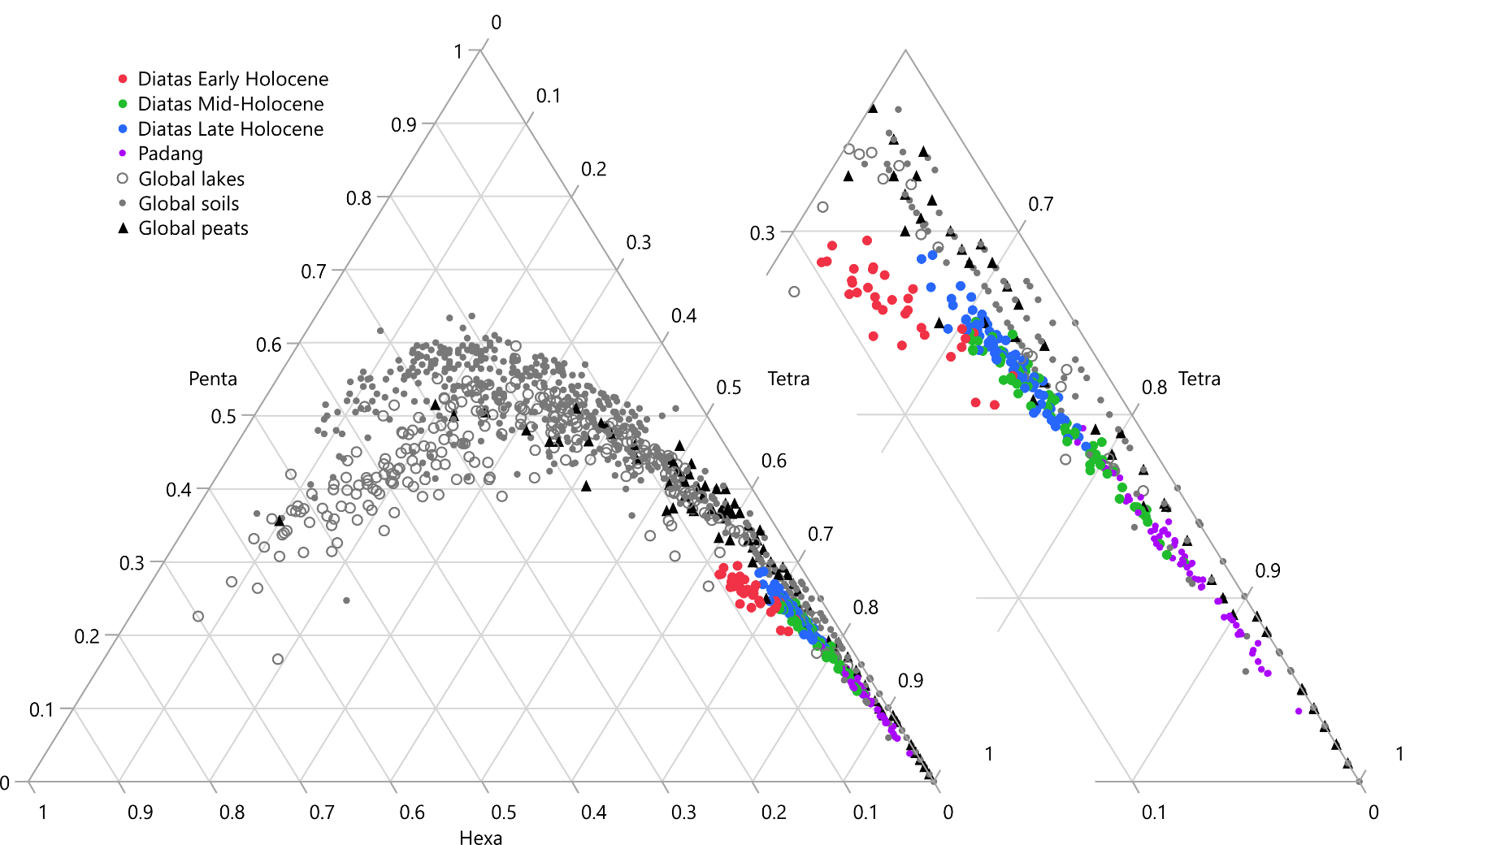
Triplots against global samplesets
Pure peat: Padang and mid-Holocene samples from Diatas are clearly the most similar.
Samples with increased mineral input are more similar to lakes and soils from global datasets

Slide 14
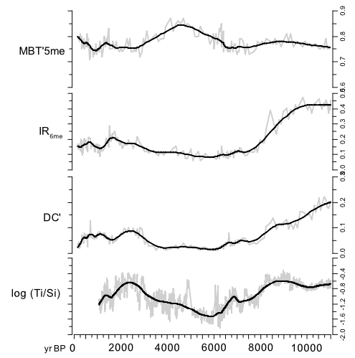
Diatas results
MBT’5me, isomerization and cyclization
  Increased isomerization (IR6me) and degree of cyclization (DC’) during high mineral input (Ti/Si)

Slide 15
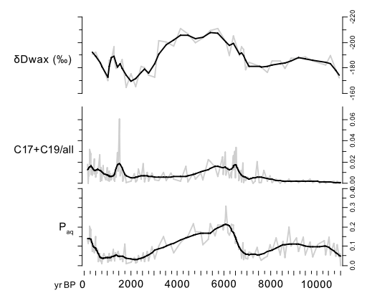
Diatas results
dDwax, algae, Paq
Wet conditions in the mid-Holocene

