Slide 1
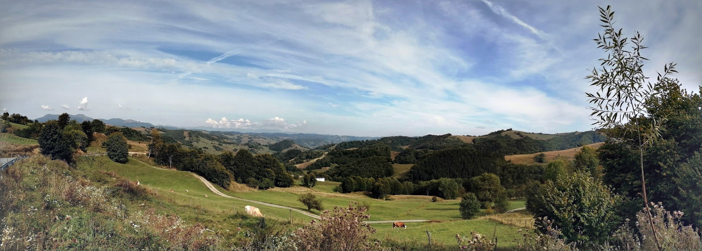





3D geophysical and thermal modelling of the northeast Carpathian lithosphere:
Implications for geothermal potential of the Baia Mare region
Alexander Minakov¹, Carmen Gaina^{1,2}, Liviu Matenco³,
Maik Neukirch¹, and Ionelia Panea⁴
¹ University of Oslo, Norway
² Queensland University of Technology, Australia
³ Utrecht University, Netherlands
⁴ University of Bucharest, Romania

Slide 2
We aim to evaluate the subsurface geothermal potential of the Baia Mare area, a region which has the highest values of heat flow recorded to date in Romania.
This assessment requires a joint interpretation of geological and geophysical data.
The final outcome, 3D lithospheric, hydro-geological and geothermal models, will be used further in geothermal energy exploitation, which will benefit the Baia Mare community.

Slide 3
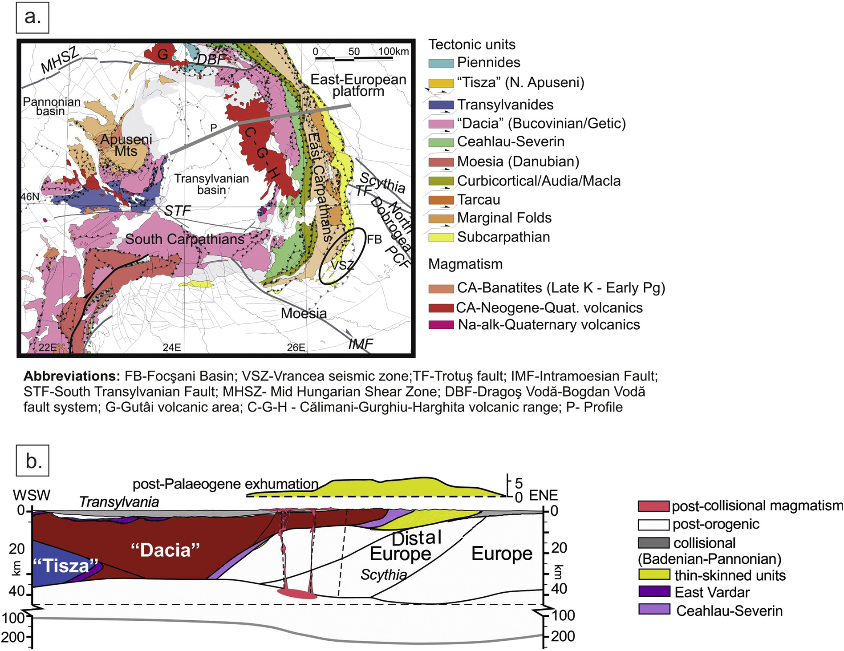
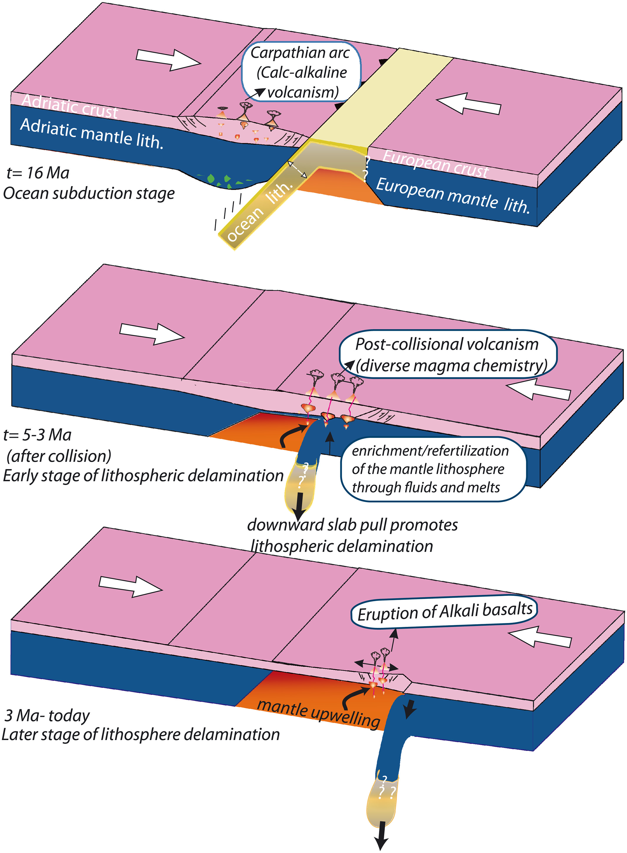
Tectonic map of the East Carpathian region
Conceptual model explaining the Neogene-Quaternary volcanism by lithosphere delamination
Seghedi et al. 2019; Matenco et al. 2010
Gogus 2016

Slide 4
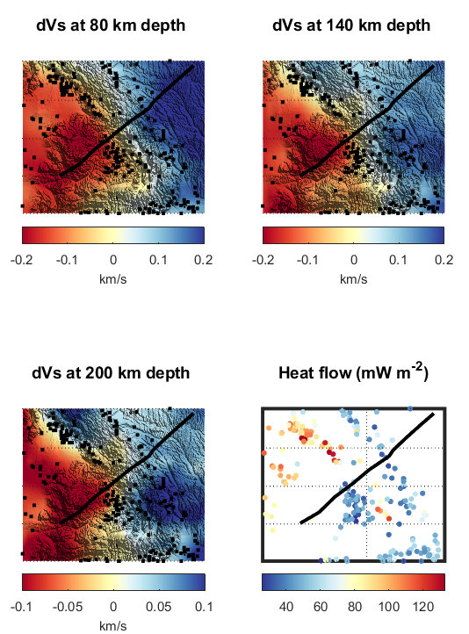
Distribution of surface heat flow and seismic velocity structure of the East Carpathian lithosphere
Very heterogeneous surface heat flow distribution!
Vs: El-Sharkawy et al. 2019; SHF: Fuchs et al. 2021
Starostenko et al. 2020

Slide 5
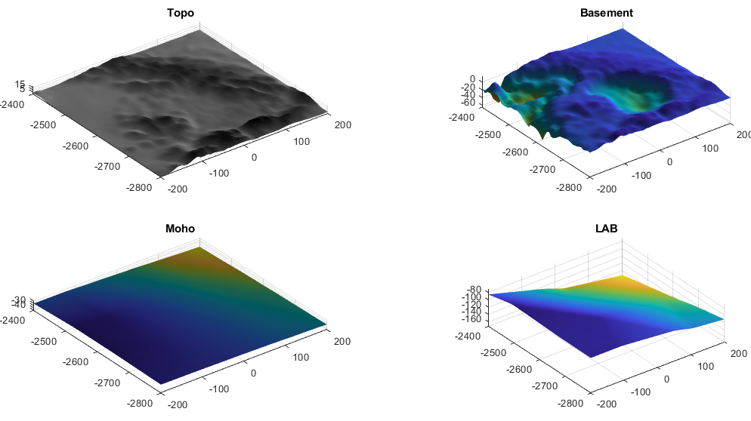
Datasets for 3D steady-state thermal model
x (km)
ETOPO1
x (km)
Matenco et al. 2016
z (km)
Szwillus et al. 2019;
Starostenko et al. 2020
Fullea et al. 2021;
El-Sharkawy et al. 2020

Slide 6
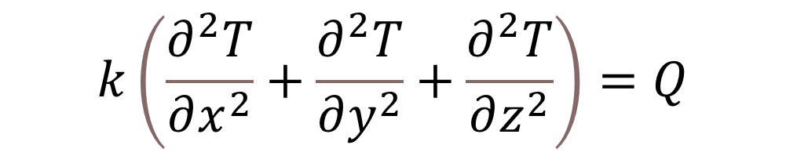
Steady-state heat conduction
3-D FEM lithospheric thermal modeling
$$k\left(\frac{∂^{2}T}{∂x^{2}}+\frac{∂^{2}T}{∂y^{2}}+\frac{∂^{2}T}{∂z^{2}}\right)=Q$$
props = ...% Physical properties for lithospheric layers
[...%sediments %crust mantle-lithosphere
1e-6 1e-6 0 ; ... % heat production (W/m3)
1.5 2.5 3 ; ... % conductivity (W/m/K)
];
%Boundary temperatures
T_SURF = 10;
T_L = 1400;

Slide 7
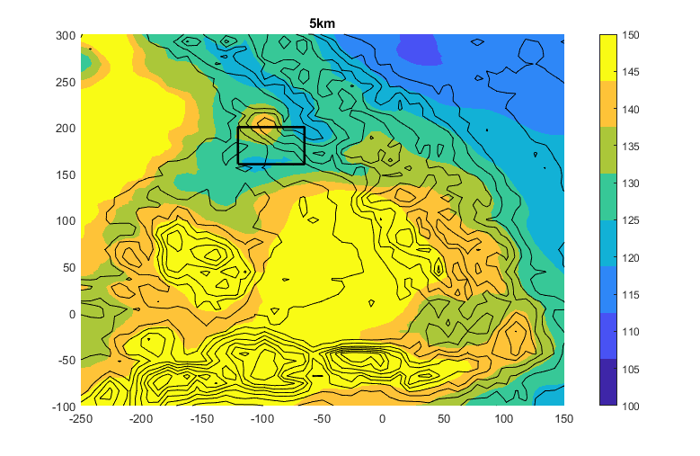
3D steady-state thermal modelling: Results
Temperature (ºC)

Slide 8
3D steady-state thermal modelling: Results
(ºC)
1200
1000
This study
Model predictions poorly match observed data!
WINTERC Global Model (Fullea et al. 2021)

Slide 9
The Tibles-Gutii extinct volcanoes and volcanic intrusions are well expressed in magnetic anomaly map. The Baia Mare region is crossed by regional Dragos-Voda Fault visible in potential field data. The high heat flow values correlate with intense magnetic anomalies.

Slide 10
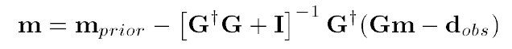
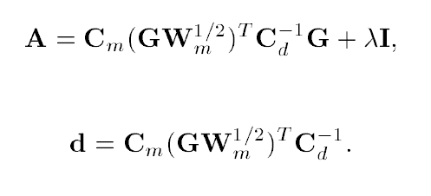
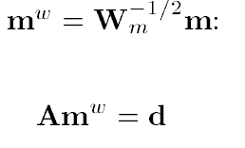

3-D Inversion of Magnetic Anomalies: Theory
Minimization in the space of weighted magnetization parameters using LSQR- algorithm
Zhdanov (2011)
Minakov & Gaina (2021)
Notes:
The minimization problem using the full normal equation is solved in the space of parameters weighted by the integrated data sensitivity. We apply the iterative LSQR method (Page and Saunders, 1984, 2013) which is similar to the conjugate gradient method of solving systems of linear equations.

Slide 11
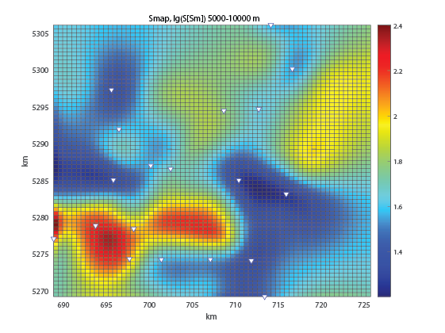
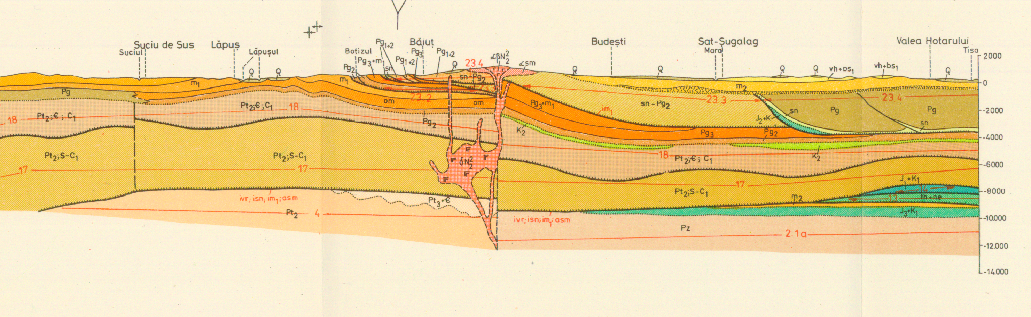
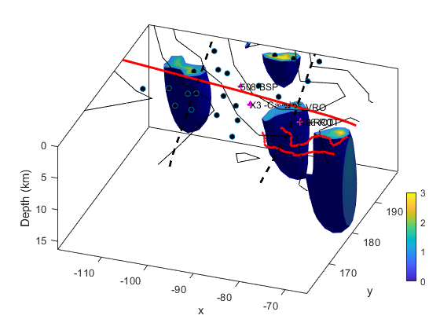
3-D Inversion of Magnetic Anomalies: Results
Stefanescu (1993)
Electrical conductivity (average at 5-10 km)
Neukirch et al.
EGU22-1034,
Tue, 24 May,
14:00–14:07
Magnetization [A/m]
(km)

Slide 12
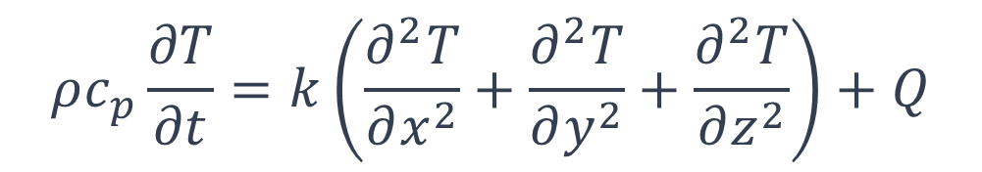
Transient heat conduction
3-D FEM lithospheric thermal modeling
$$ρc_{p}\frac{∂T}{∂t}=k\left(\frac{∂^{2}T}{∂x^{2}}+\frac{∂^{2}T}{∂y^{2}}+\frac{∂^{2}T}{∂z^{2}}\right)+Q$$
props = ...% Physical properties for lithospheric layers
[...%sediments %crust mantle-lithosphere
2.4e3 2.7e3 3.3e3; ... % density (kg/m3)
1e-6 1e-6 0 ; ... % heat production (W/m3)
1e3 1e3 1e3 ; ... % heat capacity (J/kg/K)
1.5 2.5 3 ; ... % heat conductivity (W/m/K)
];
%Boundary temperatures
T_SURF = 10;
T_L = 1400;

Slide 13
Initial temperature distribution assumed in 3D transient thermal model
Depth (km)
Temperature (ºC)
x (km)

Slide 14
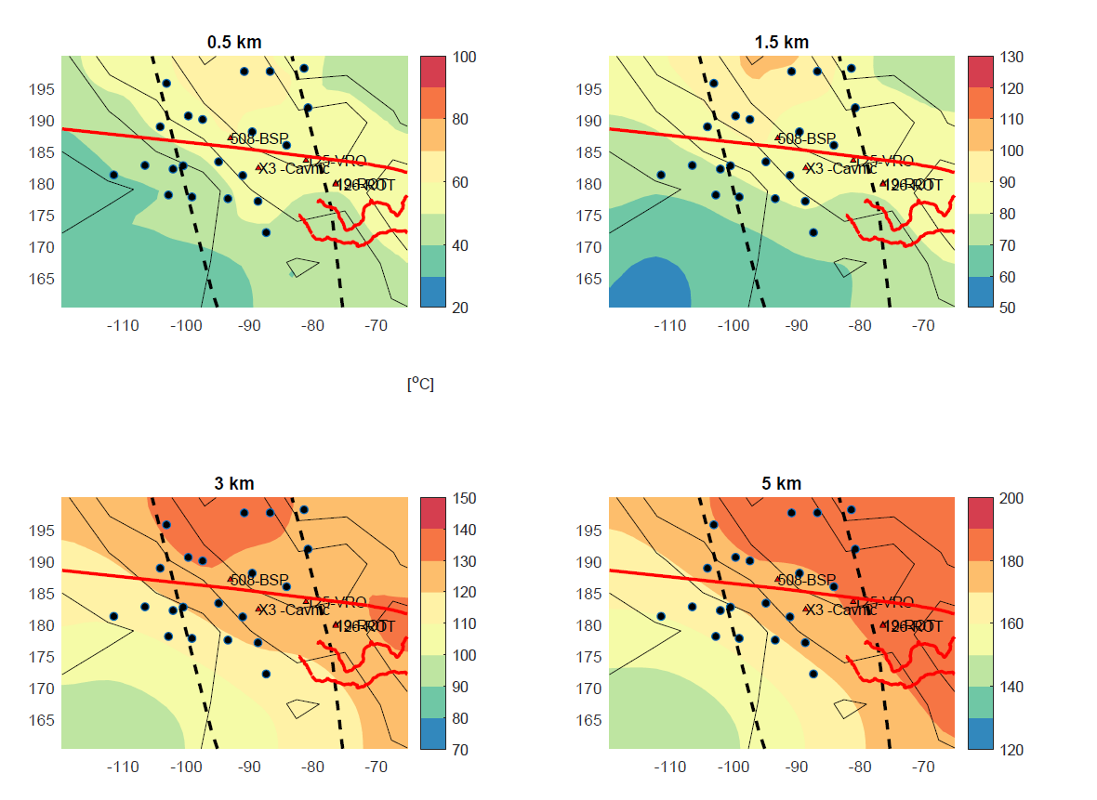
Transient thermal modelling results at 4 My of model evolution. Depth of 500 m, 1500 m, 3000 m and 5000 m.
Elevated temperatures (120-140 degrees at 3 km depth) are associated with magmatic intrusions.

Slide 15
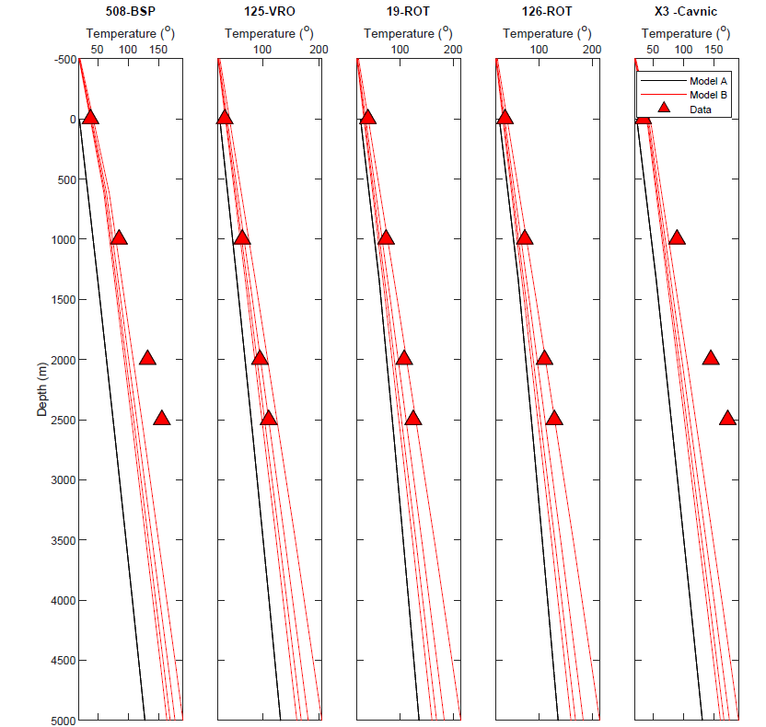
Steady-state (Model A) results and transient thermal model (Model B) results at 2 My, 4 My, 6 My and 8 My of model evolution versus bottom hole temperature data.
The elevated borehole temperatures
at hot springs sites as Baia Sprie (BSP) and Cavnic are not well matched by the model.
These localities are characterized by high electrical conductivity values that may indicate advection of heat by fluid from a deeper level.

Slide 16
Conclusions
We construct a 3D steady-state lithospheric temperature model of the northeast Carpathians lithosphere (Model A) and a transient thermal model of the Baia Mare region (Model B);
The distribution of measured surface heat flow cannot be explained by variations of the LAB depth and crustal thickness in Model A;
The shape of magmatic bodies predicted using 3D inversion of magnetic anomalies correlates with low electrical conductivity regions at 5-10 km depth based on 3D inversion of MT data;
We evaluate the thermal effect Neogene-Quaternary magmatic intrusions using transient temperature model and obtain a better fit to observed bottom hole temperatures;
At hot springs locations (Baia Sprie, Cavnic) the conductive heat transport model is too cold and fails to reproduce observations, implying a possible advection of heat with pore fluid sourced at a deeper level within the northern part of Pannonian Basin.

