Slide 1


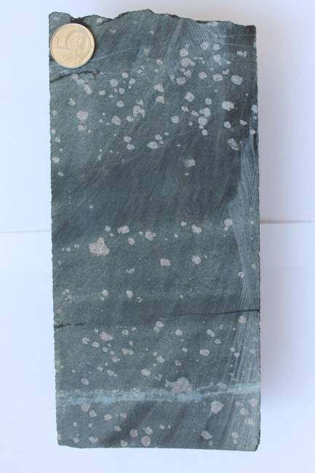
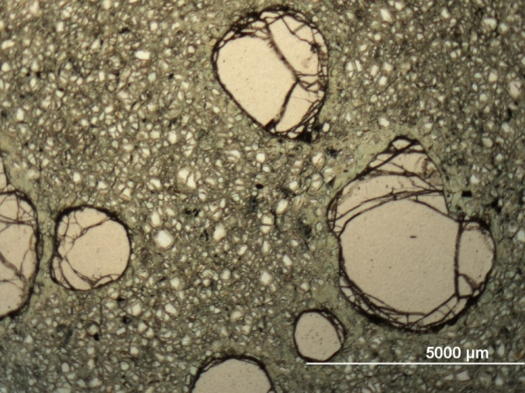
Source and evolution of metasomatizing liquids in orogenic peridotites: evidence from multiphase solid inclusions
Jana Kotková, Renata Čopjaková, Radek Škoda
Czech Geological Survey, Prague; Masaryk University, Brno, Czech Republic
lherzolite
Grt
5 mm

Slide 2
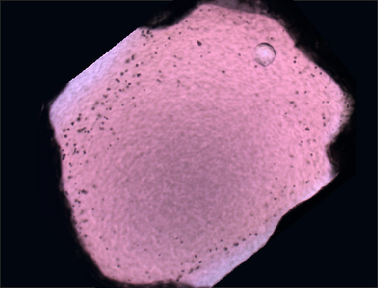
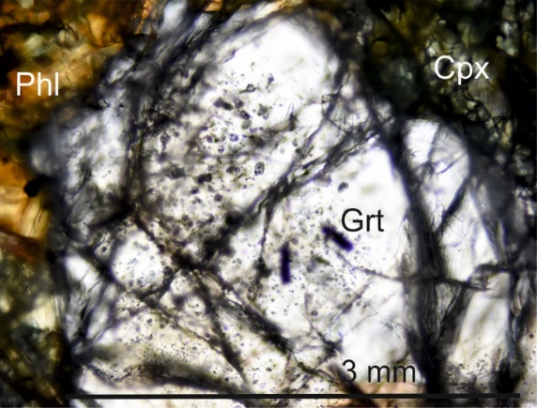
MSI distribution and mineral assemblages
peridotite
lherzolite
pyroxenite
harzburgite
pyroxenite

Slide 3
Mineral assemblages of MSI and their proportions
major minor acessory phases
Parg, Ba-mica, Dol + Mgs Spl, Cpx, GrtII Ap, Thr, Mz, Chr, Ptl
No | Rock | mineral assemblage in MSI
(m) |  | major | minor | accessory
256 | Prx | Hbl> Kns>Mgs=Dol | Ap | GrtII, Sp, Mnz, Thr, Sch
256 | Hrz | Hbl, Mgs = Dol | Kns, Ap | Mnz, Thr, Sch
282 | Lhrz | Hbl> Kns>Mgs>Dol | Gr, Sp | Ap, Thr, Pn, Ccp
313 | Lhrz | Hbl>Kns=Mgs>Dol | Sp | Ap, Thr, Pn, Sch, Gr, Ccp
332 | Lhrz | Kns=Hbl>Dol>Mgs=Nrs | Cpx | GrtII,Ba-Fs,Thr,Mnz,Ap, Pn
276 | Hrz | Hbl=Kns=Dol | Grt II | Mgs, Opx, Ba-Fs, Mnz, Pn
322 | Hrz | Kns>Dol> Cpx | Ba-Fs+wm,Opx, Mgs | GrtII, Mnz, Cr-Sp, Sch, Nrs
Hbl
Cpx, GrtII
Ba-phases
carbonates
systematic decrease/increase in mineral proportions
from the source pyroxenite towards more distal samples of Lhrz and Hrz

Slide 4
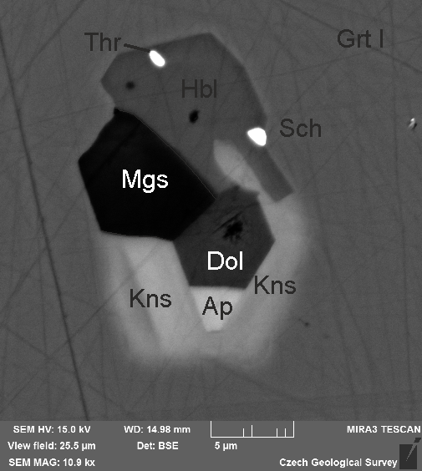
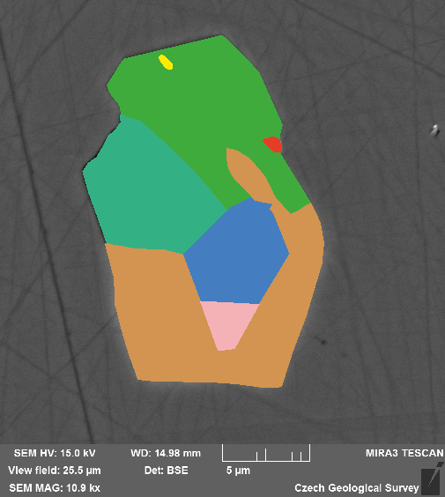
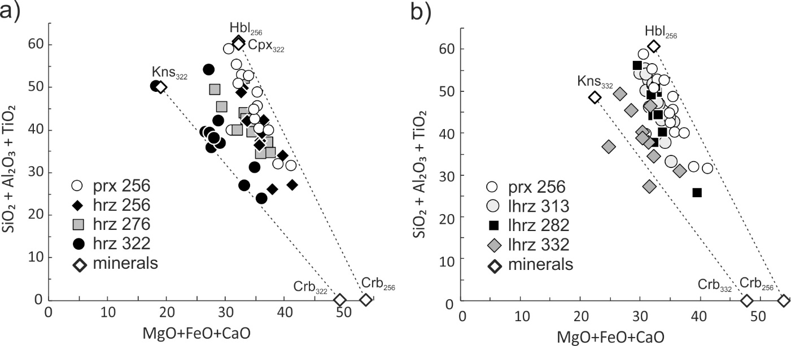
Bulk chemical composition of MSI
1. vol. % of different phases on manually traced grain boundaries from BSE images (SigmaScan)
2. bulk chemical composition of the MSI from mineral vol %, phase densities + mineral composition
lherzolite samples
harzburgite samples
major silicate proportion
silicate-carbonate
proportion
variable bulk MSI (cut effect); MSI for each sample plot along linear arrays Re silic/carb proportion
slope reflects variations in major silicate proportions
each sample approximated by average bulk composition

Slide 5
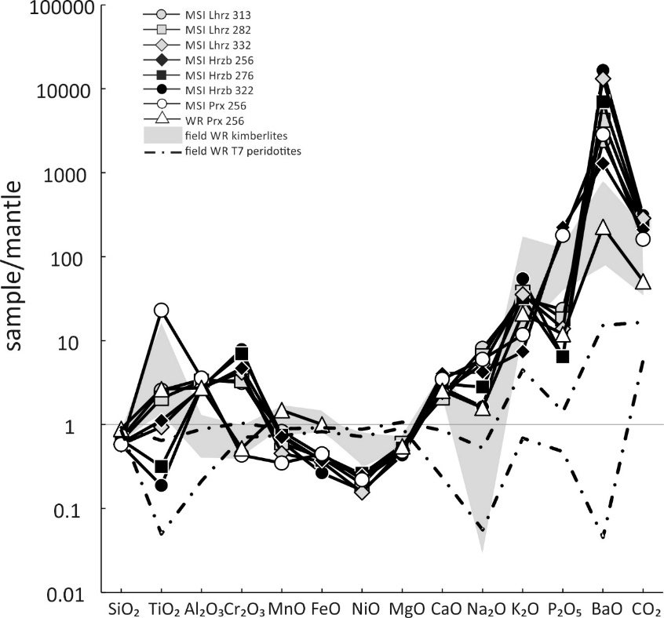
Bulk chemistry of garnet pyroxenite and its MSI
parental melt and source of metasomatizing liquids
carbonated peridotite melt
WR kimberlites
MSI Prx
WR pyroxenite
WR pyroxenite
compatible
incompatible
Prx composition = silicate-carbonate melt close to kimberlites and carbonated P melting products
MSI in Prx = residual solute-rich liquid after HP fractional crystallization
high LILE, Th, U, LREE, volatiles ≈ crustal component
MSI constitutent minerals: Th > U, steep LREE-enriched REE pattern, hi Ba, Sr, Ti
≈ supercritical melt (single continuous solution, HP) (exper. Kessel et al. 2005)
Notes:
Fig. 8. Variations in average bulk composition of MSI in peridotites (black and grey symbols) and pyroxenite (open circle). The bulk chemical composition of pyroxenite 256 (Medaris et al., 1995) is shown by the open triangle for comparison (where data available).
Single continuous solution in the phase of interest (s or L) is stable

Slide 6

Evolution of metasomatizing medium
1. chemical evolution of the metasomatizing medium itself
2. interaction with host mantle rocks
WR pyroxenite
HP fractional crystallization
MSI Pd
MSI Prx
evolution of metasomatizing medium
evolution from silicate to carbonate composition
and from melt to fluid
2. reactive infiltration into
peridotites

Slide 7
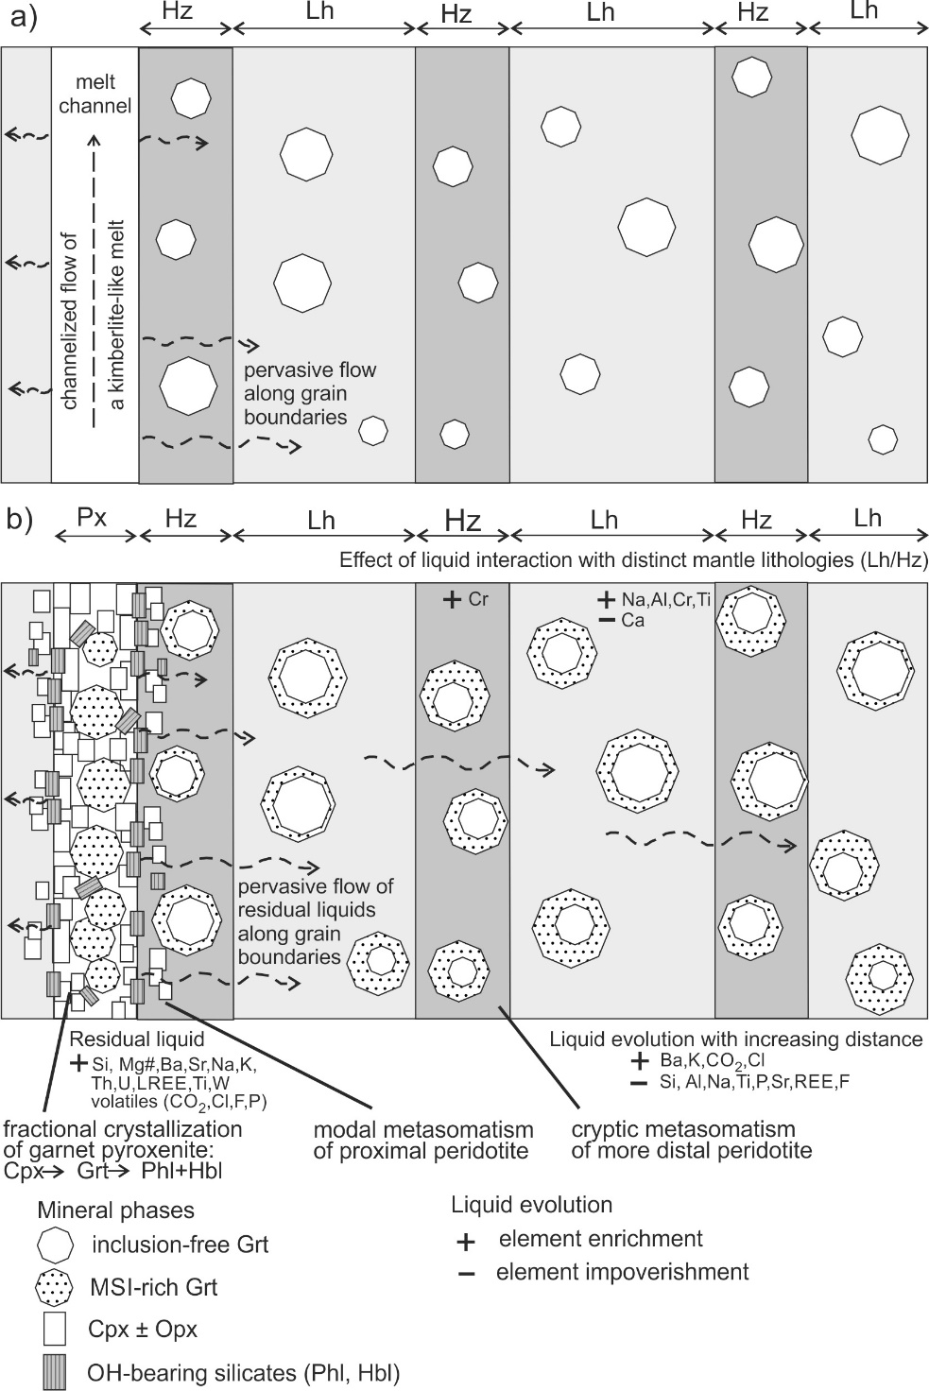
Summary
intrusion of a carbonate-silicate melt,
transport of liquids in mantle peridotite
evolution of residual liquids
after fractional crystallization of pyroxenite
due to their reactive infiltration into peridotite
Kotková et al. 2021, Lithos 398-399, 106309
Czech Science Foundation Projects 18-27454S, 22-33820S

