Slide 1

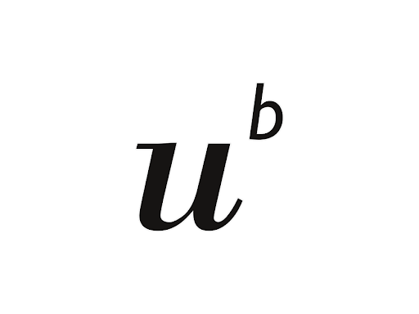



Quantifying the effect on shallow landslide activity of actual and potential poplar and pine stands in New Zealand hill country.
Feiko van Zadelhoff
Massimiliano Schwarz
Bettina Schaefli
Denis Cohen
Chris Philips
contact: Feiko.vanzadelhoff@bfh.ch

Slide 2
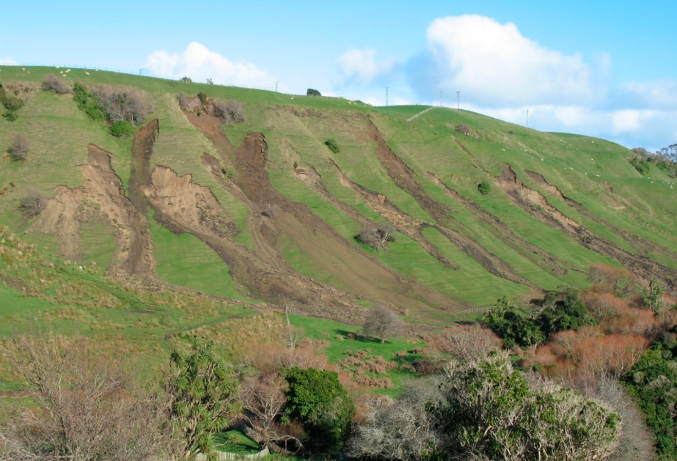
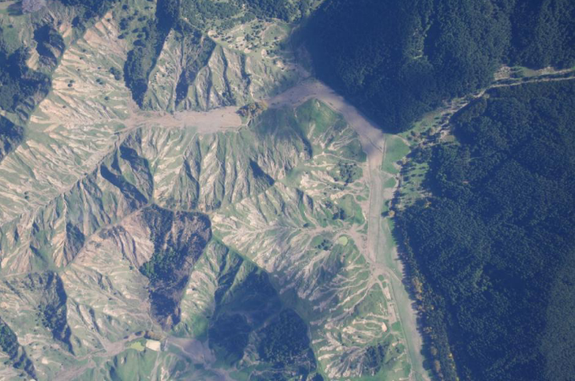
Shallow landslides in hill country
Natural hazard
Soil degradation
Water quality degradation
Amishev et al., 2012
Hoelbing et al., 2016; photo by Harley Betts
Notes:
Under: April 2012, near Wairoa, North Island
Both in the New Zealand North island

Slide 3
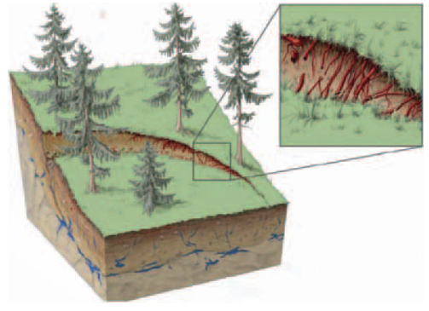
Vegetation
Mitigating factor that we can manage
Transpiration
Interception
Increase infiltration capacity
Anchor in regolith/bedrock –> Basal root reinforcement
Anchor in soil mantle –> Lateral root reinforcement
Lateral root reinforcement in a soil crack
Notes:
As you can see in the last picture vegetation seems to decrease. Why does this happen? 3 hydrological, 3 mechanical

Slide 4
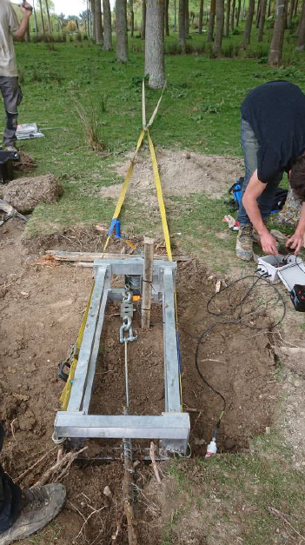
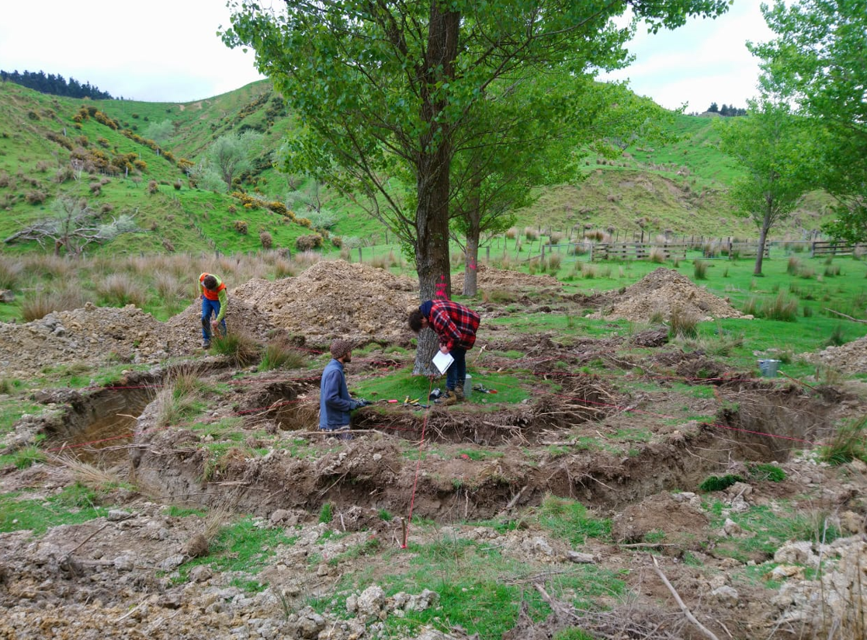
Fieldwork
Poplar
Populus Nigra
Notes:
Pullout test (get maximum force of a root in situ), counting, get root distribution of a single tree.

Slide 5
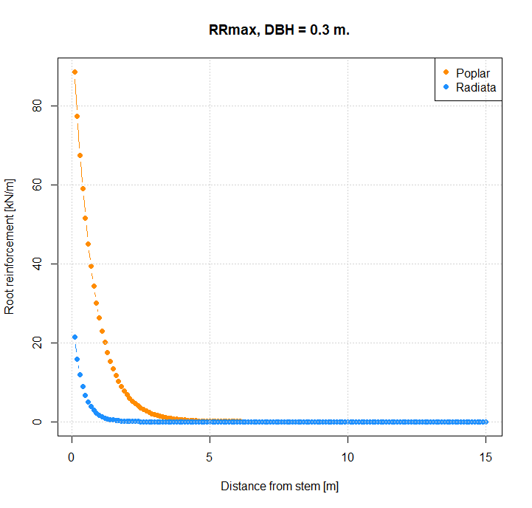
Parametrization
Lateral root reinforcement
4 poplars
64 in-situ root pullouts
Similar fieldwork on Pine (Pinus Radiata) by Giandrossich et al., 2020
Parametrization by Gamma distribution as in Gehring et al., 2019
Notes:
Unique in situ, different from laboratory experiments. Pinus Radiata, a pine tree. Basal root reinforcement dependent on Lateral and depth of the soil mantle.

Slide 6
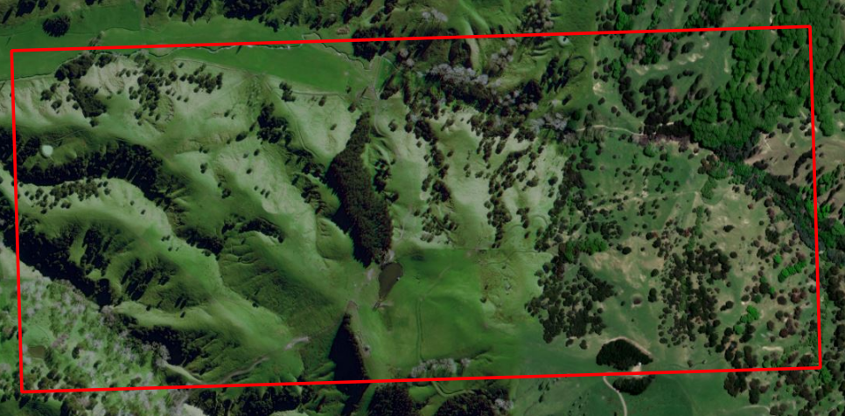
Slope stability
SlideforMap
(van Zadelhoff et al., 2022; in submission)
1.7 km² of hill county in New Zealand
(Courtesy of OpenStreetMap)
 | No vegetation | Optimal dispersion | Plantation
n trees | 0 | 2485 | 14274
Poplar | 0 % | 20.7 % | 47.9 %
Pine | 0 % | 11.6 % | 29.7 %
Modelled relative reduction of shallow landslides to the no vegetation scenario
Notes:
Waikoukou Study area, where we have information on soil, landUse and extreme precipitation (36 mm/hr).

Slide 7
Conclusion
A quantitative approach optimizes decisions in nature-based slope instability management
Tree species
Tree planting pattern
References
Amishev, D., Basher, L., Phillips, C., Hill, S., Marden, M., Bloomberg, M., & Moore, J. (2013). New Forest Management Approaches to Steep Hills (Vol. 7). Retrieved from http://www.mpi.govt.nz/news-resources/publications.aspx
Gehring, E., Conedera, M., Maringer, J., Giadrossich, F., Guastini, E., & Schwarz, M. (2019). Shallow landslide disposition in burnt European beech (Fagus sylvatica L.) forests. Scientific Reports, 9(1), 1–11. https://doi.org/10.1038/s41598-019-45073-7
Giadrossich, F., Schwarz, M., Marden, M., Marrosu, R., & Phillips, C. (2020). Minimum representative root distribution sampling for calculating slope stability in pinus radiata d.Don plantations in New Zealand. New Zealand Journal of Forestry Science, 50, 1–12. https://doi.org/10.33494/nzjfs502020x68x
Hölbling, D., Betts, H., Spiekermann, R., & Phillips, C. (2016). Identifying spatio-temporal landslide hotspots on North Island, New Zealand, by analyzing historical and recent aerial photography. Geosciences (Switzerland), 6(4), 1–15. https://doi.org/10.3390/geosciences6040048
van Zadelhoff, F. B., Albaba, A., Cohen, D., Phillips, C., Schaefli, B., Dorren, L. K. A., & Schwarz, M. (2021). Introducing SlideforMap; a probabilistic finite slope approach for modelling shallow landslide probability in forested situations. Natural Hazards and Earth System Sciences Discussions, 1-33.
Notes:
This can both increase slope stability and minimize costs related to the nature based solution

