Slide 1




Simulating seasonal dynamics of Jakobshavn Isbrae through advancing the Elmer/Ice calving model
Iain Wheel, Anna Crawford, Joe Todd, Doug Benn, Eef van Dongen and Tom Cowton
iw43@st-andrews.ac.uk

Slide 2

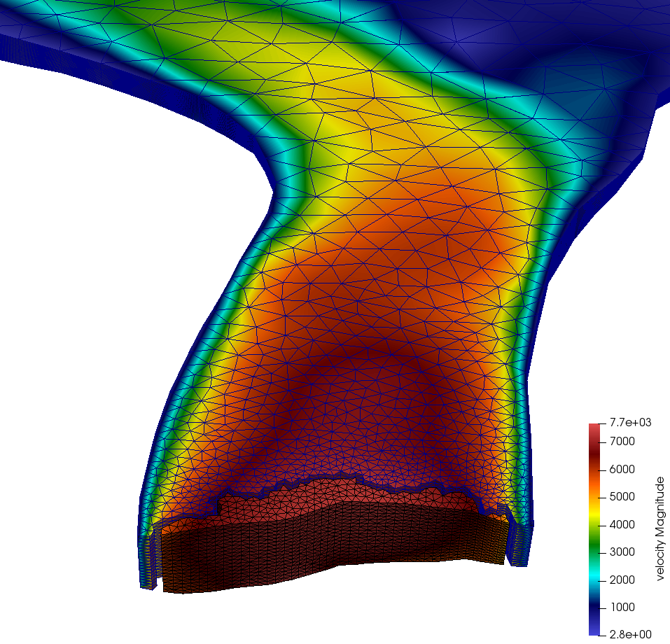

A new 3D calving model in Elmer/Ice
Solves full-Stokes equations (Gagliardini et al., 2013)
Massively parallel simulations
Previous calving model from Joe Todd
Full anisotropic remeshing using MMG (Dapogny et al., 2014)
Model fast flowing tidewater glaciers retreat and advance

Slide 3
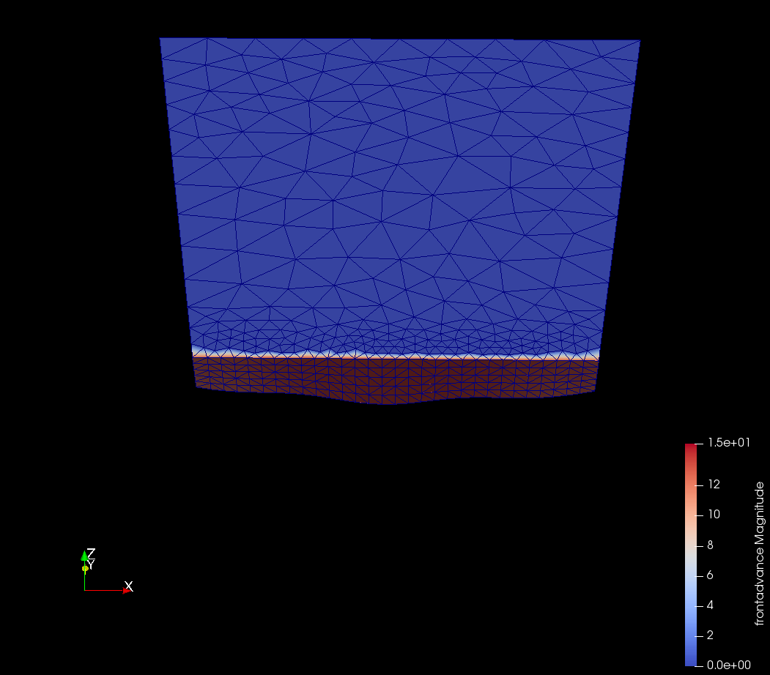
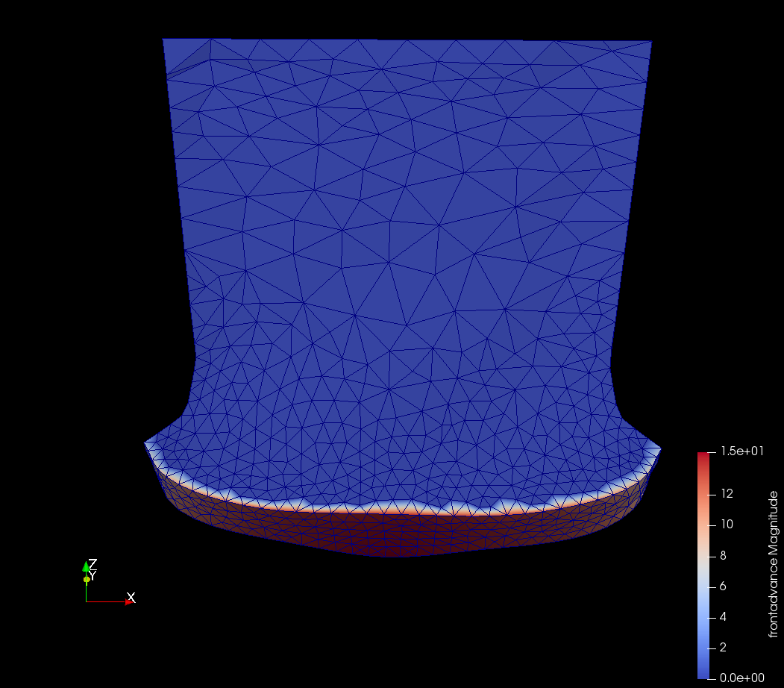
Terminus advance
Lagrangian movement across terminus
Except lateral margins which are prescribed along fjord boundaries
Elements can transfer between boundaries eg. narrowing fjord
Recent development - full mesh Lagrangian
Advection of variables

Slide 4
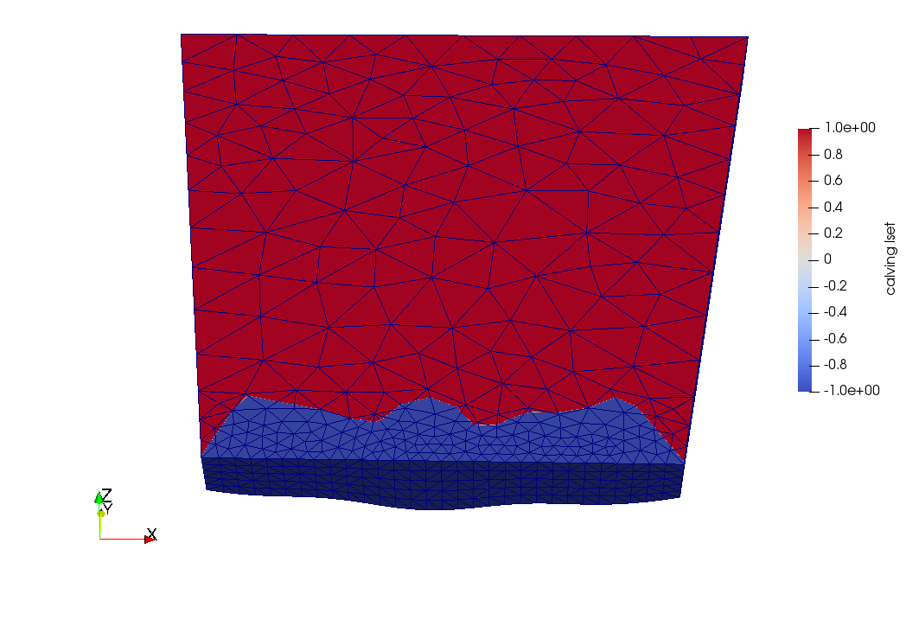
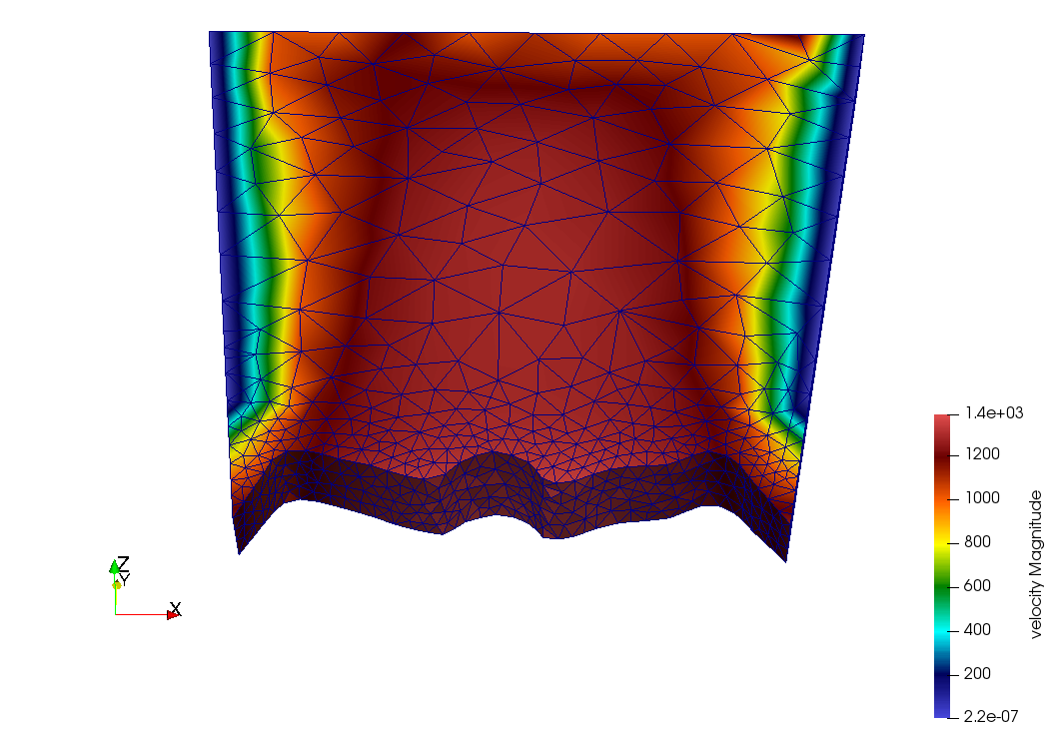
Calving
Crevasse depth law currently implemented
Vertical calving a limitation of the law not the algorithm
Calving algorithm
Calving law
Calving law = calving prediction
Calving algorithm = implementation of calving

Slide 5
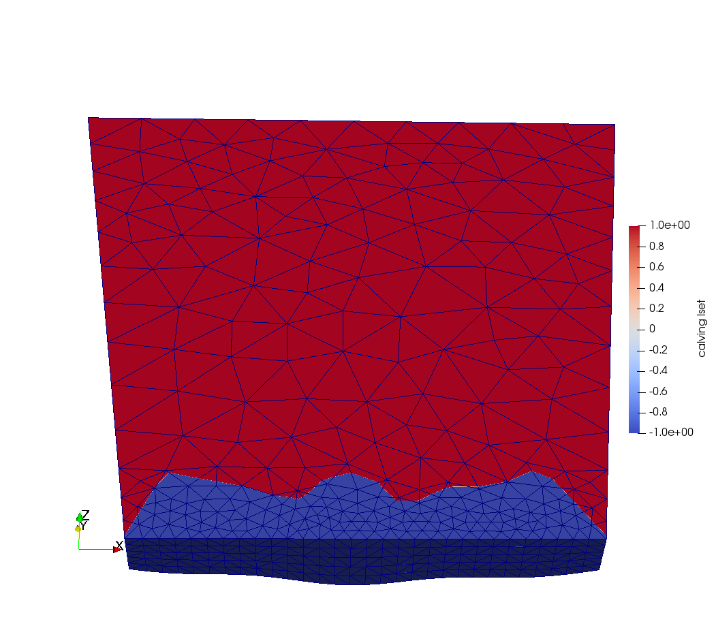
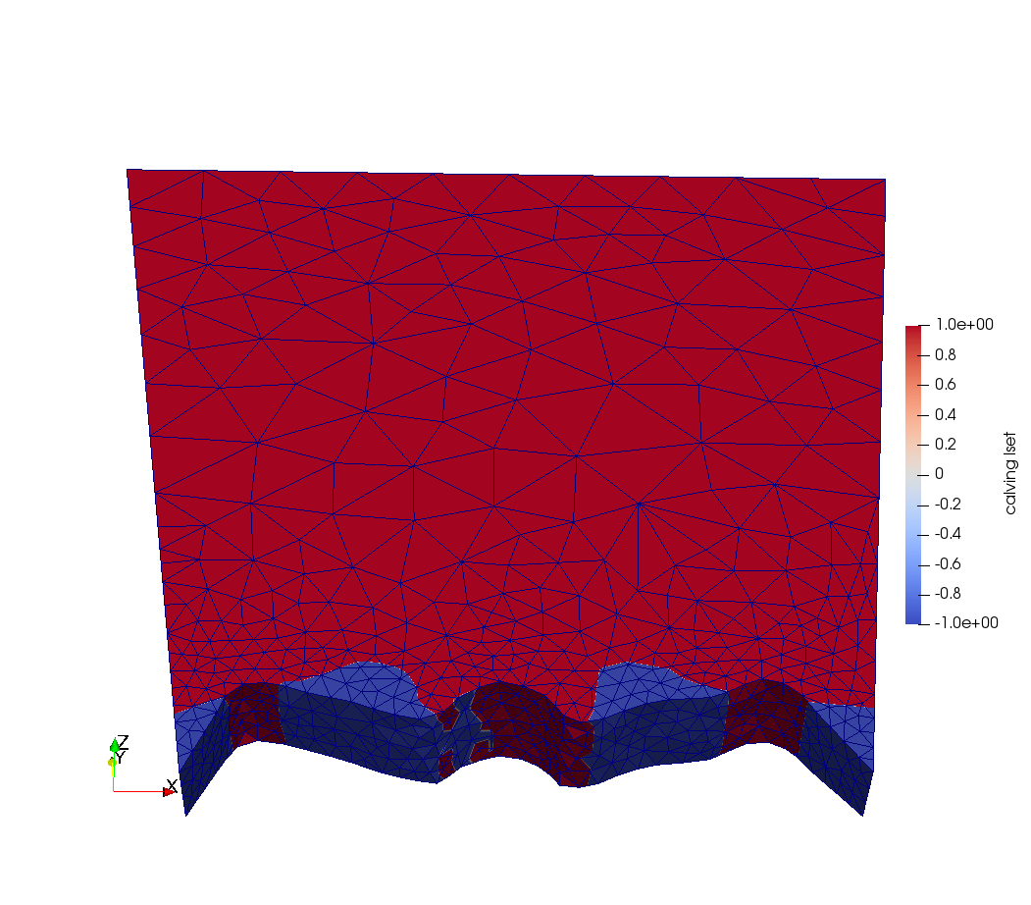
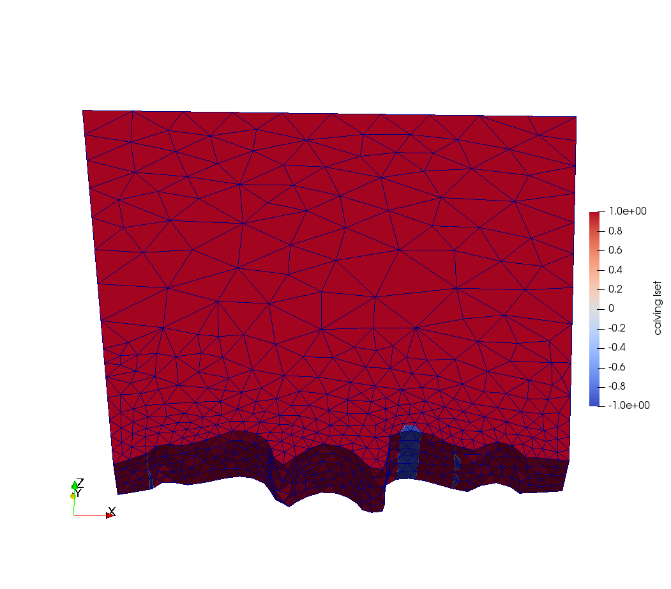
Calving
Any geometry can now be calving e.g. non projectible fronts
Adaptive time stepping
Time stepping paused
Time stepping resumed

Slide 6
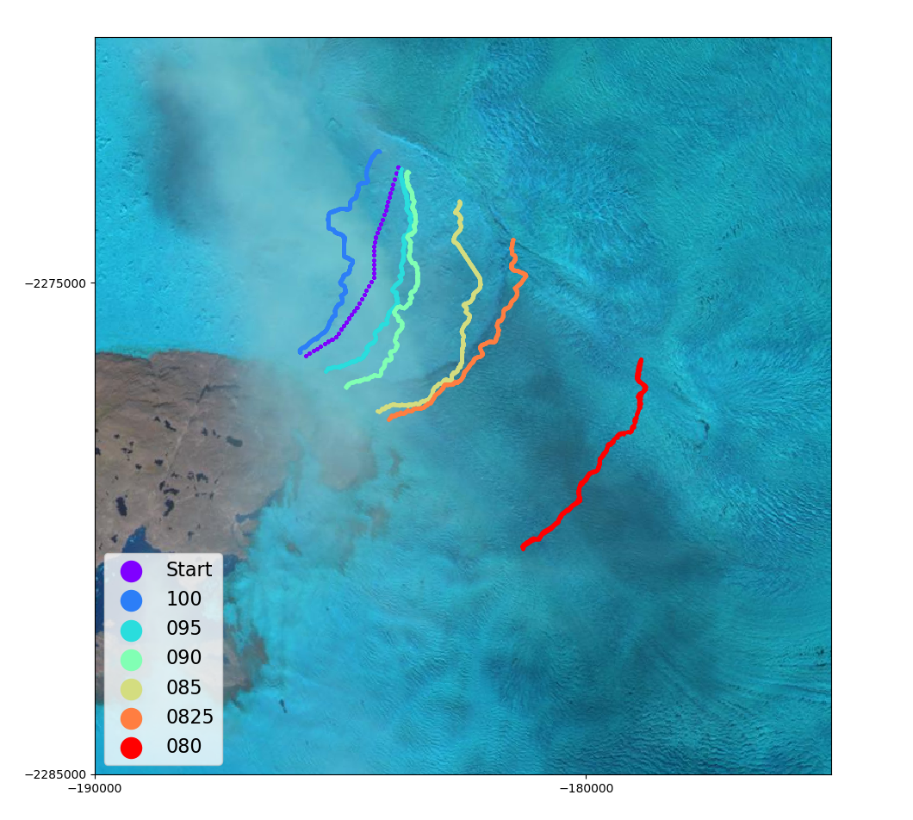
Application at Jakobshavn Isbrae
Summer 2017
Calving underestimated
If we reduce the percentage of vertical crevassing required to calve, we can replicate front position across the summer
82.5% of vertical ice column crevassed

Slide 7
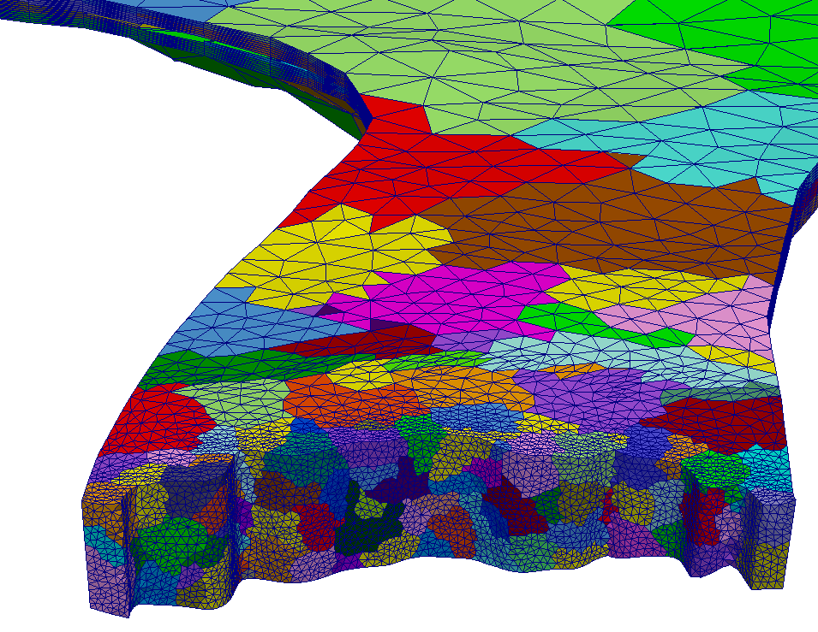
Current developments
Parallel remeshing using ParMMG – reduction of computational cost
Advection of damage
Refinement and improvement of calving laws
After some initial testing on established 2D/SSA calving laws, CDL still seems like the best option
I would welcome any questions or discussion of future model uses/development: iw43@st-andrews.ac.uk

Slide 8
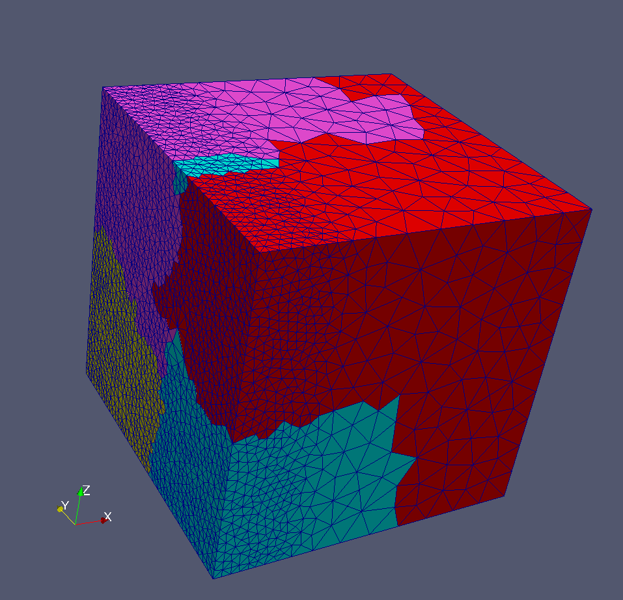
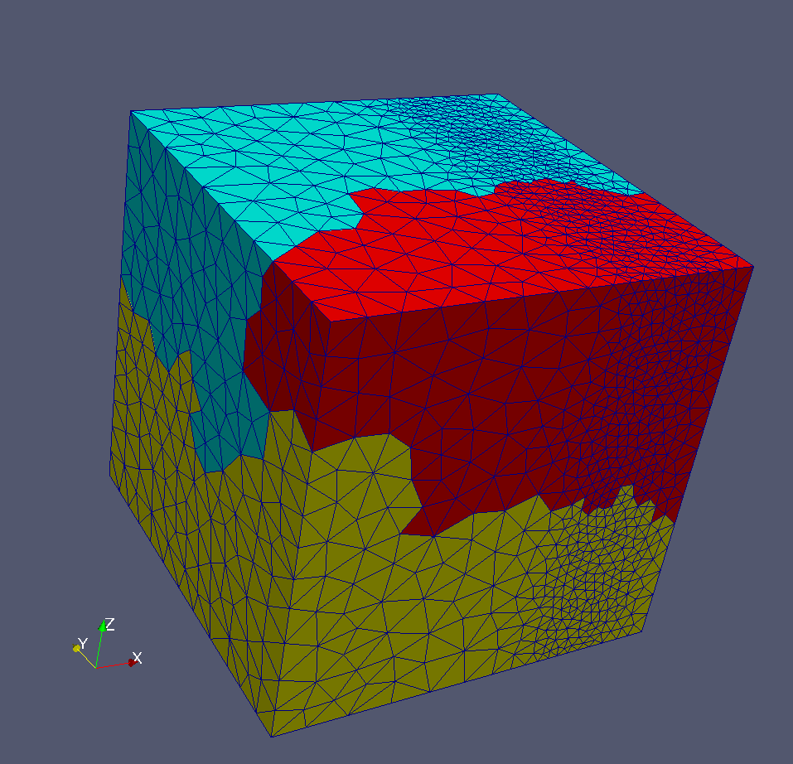
Potential uses
3D calving at any tidewater glacier
Advection of crevasses/damage opens up huge potential to model ice shelfs
Any problem requiring adaptive parallel remeshing e.g. temperate/cold ice boundary problems
I would welcome any questions or discussion of future model uses/development: iw43@st-andrews.ac.uk

