Slide 1





Investigation of the Magnetospheric–Ionospheric–Lithospheric Coupling during the 14 August 2021 Haitian Earthquake
D’Angelo G¹., M. Piersanti², R. Battiston^{3,4}, I. Bertello¹, A. Cicone², P. Diego¹, F. Follega³, R. Iuppa³, C. Neubuser³, E. Papini¹, A. Parmentier¹, D. Recchiuti^{1,3}, P. Ubertini¹
1) National Institute of Astrophysics - IAPS, Rome, Italy
2) University of L’Aquila, L’Aquila, Italy
3) University of Trento, Trento, Italy.
4) TIFPA - University of Trento, Trento, Italy.
(giulia.dangelo@inaf.it).

Slide 2


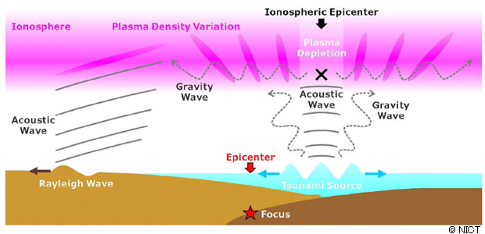
The MILC model
The Magnetospheric – Ionospheric – Lithospheric coupling (MILC) analytical model (Piersanti et al., 2020; Carbone et al., 2021) is based on the following steps:
The earthquake generates an AGW, propagating through the atmosphere;
The AGW interacts with the ionosphere generating local instability in the plasma distribution through a pressure gradient
The ionospheric plasma variation generates EM waves propagating through the magnetosphere that interact with the magnetospheric field
The interaction causes a FL eigen-frequency change. Specifically, since the FL is stretched, its eigen-frequency has to lower.
Change of the FLR
EM - Emission

Slide 3
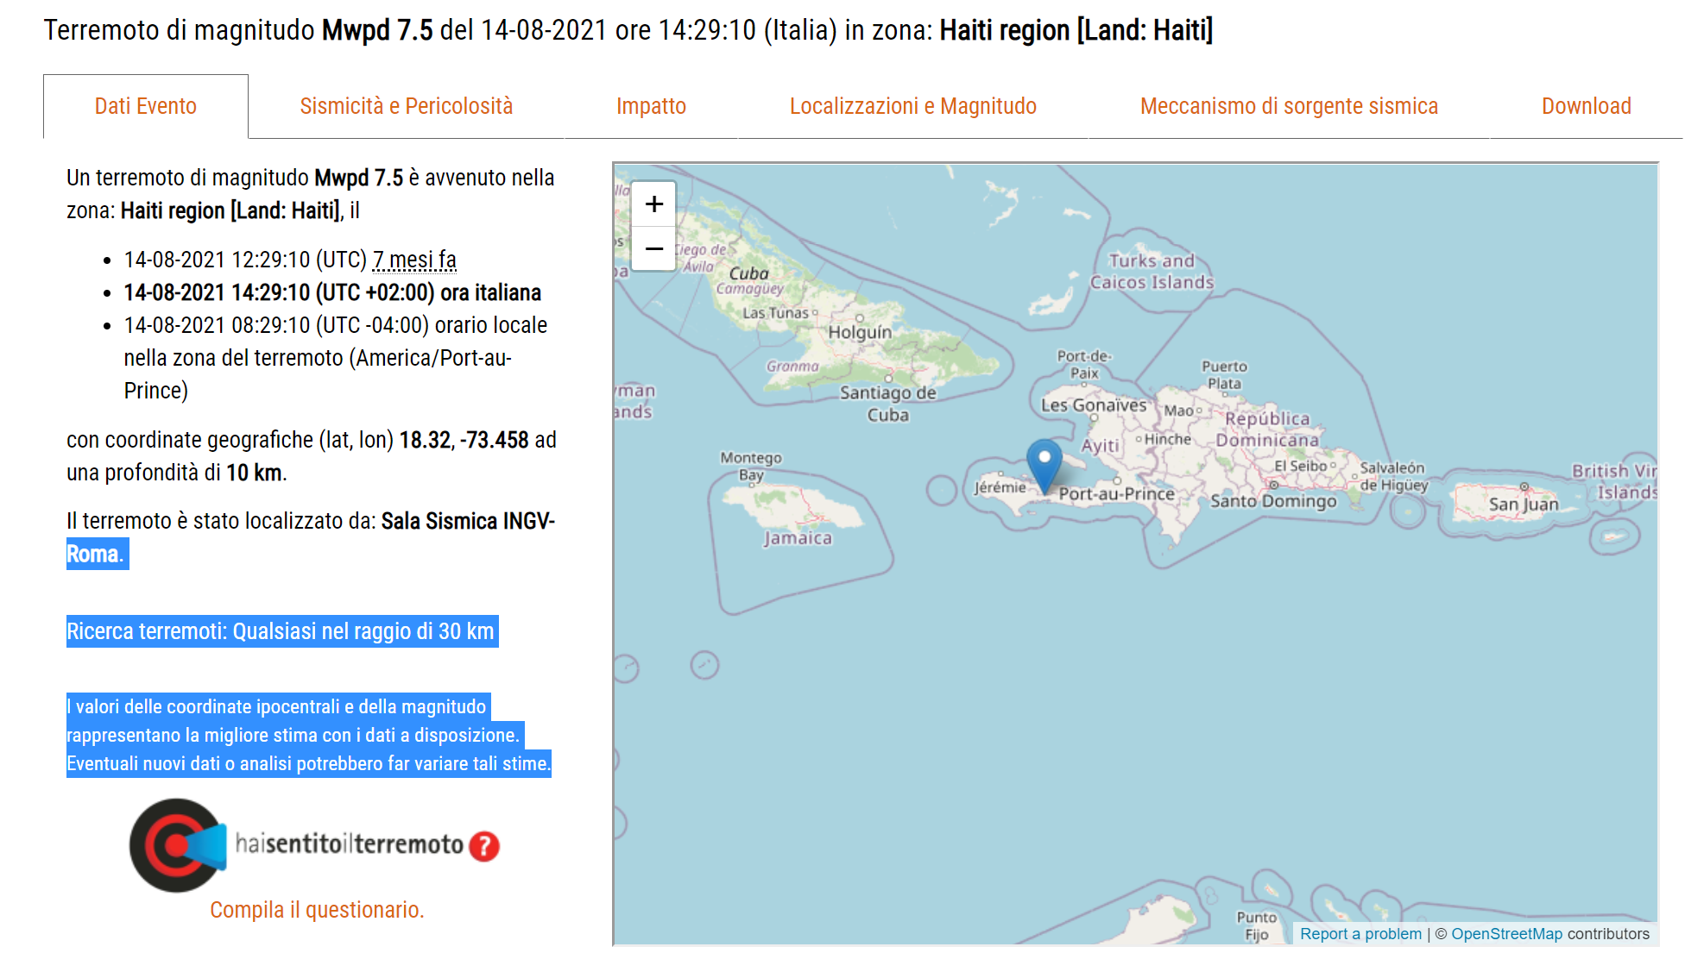
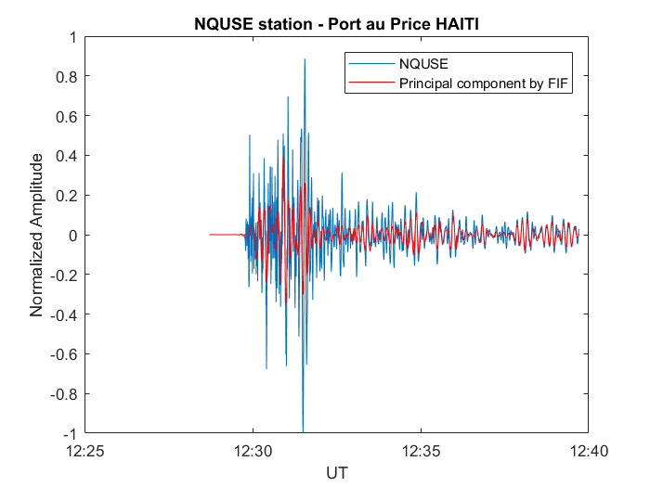
The Haiti Earthquake
August 14th, 2021
Mw= 7.5;
λ=18.32 °N φ= -73.458 °E;
UT=12:29:10.

Slide 4
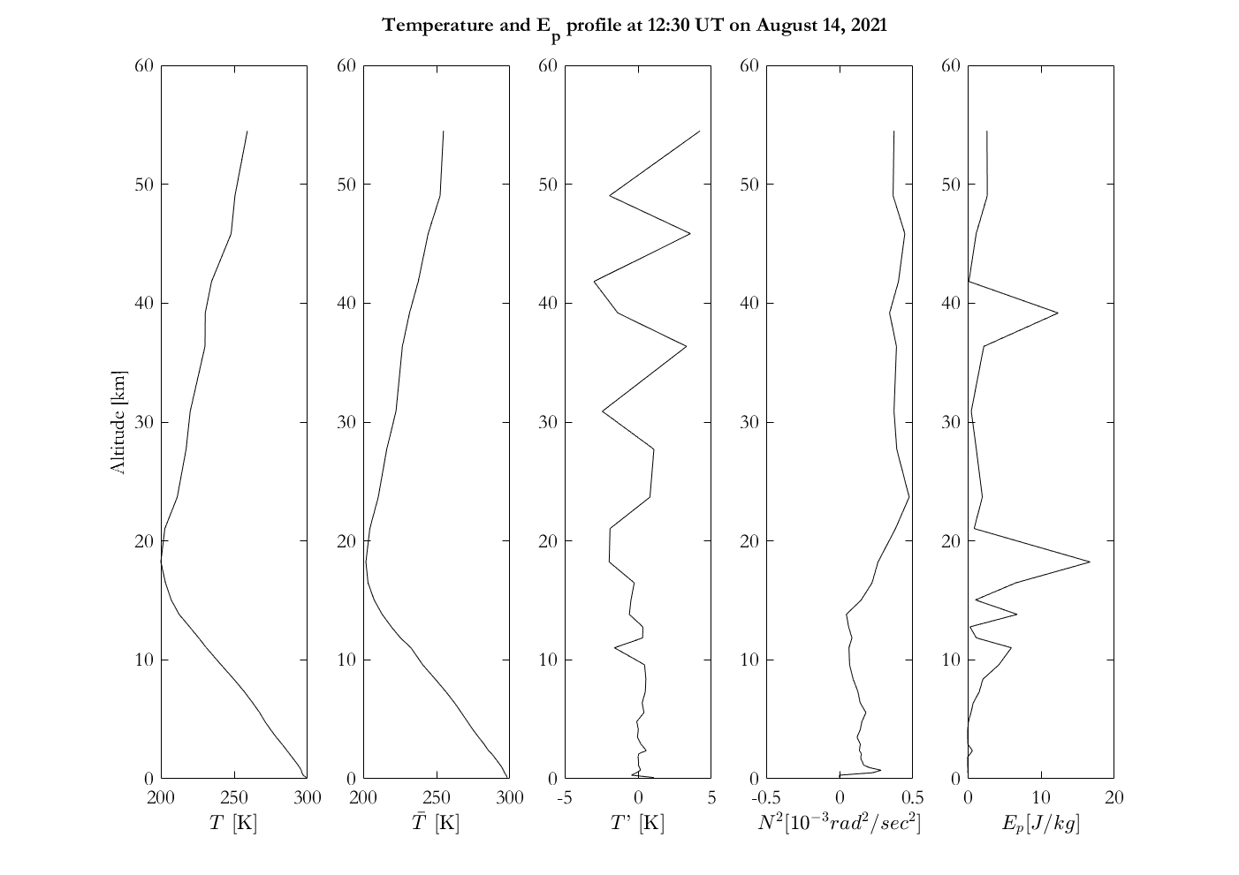
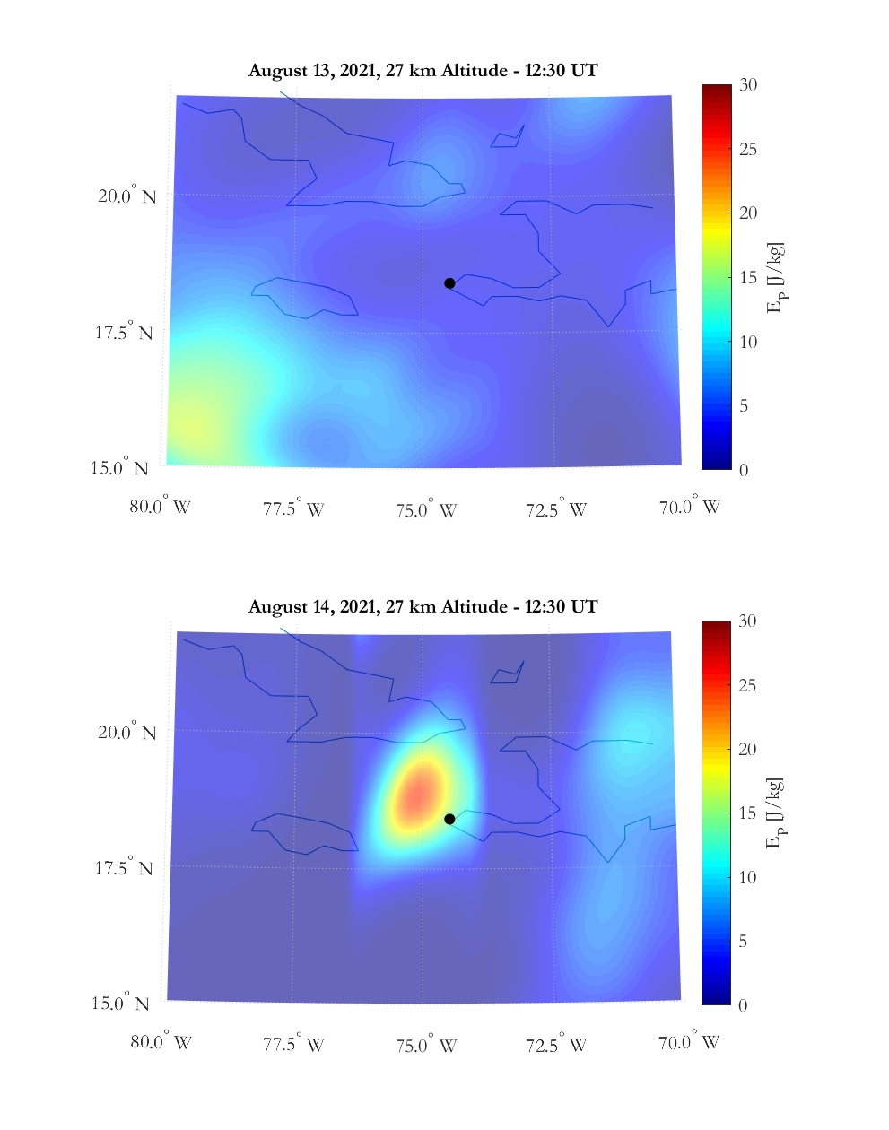
AGW evaluation – observations
Six wave crests are found in the temperature deviation profile at the altitudes of 10.6, 13.6, 27.6, 31, 37 and 45.8 km.
There exist two sinusoidal periods, whose corresponding vertical wavelengths are about 3 and 9 km, respectively.
But, since the EP profile maximizes only for the first wavelength.
There is only an AGW of about 3 km wavelength propagating in the atmosphere .

Slide 5
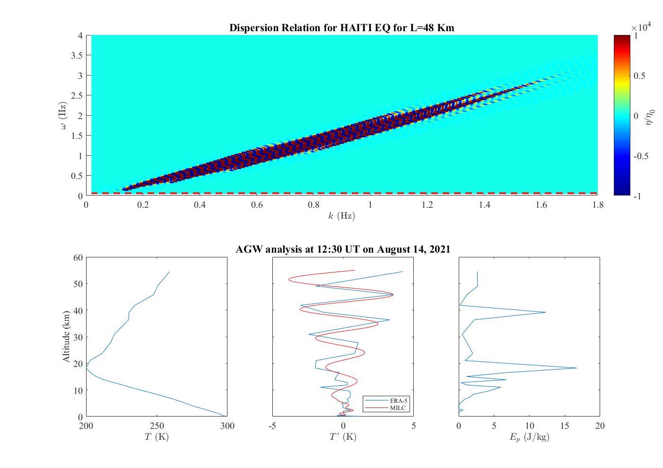
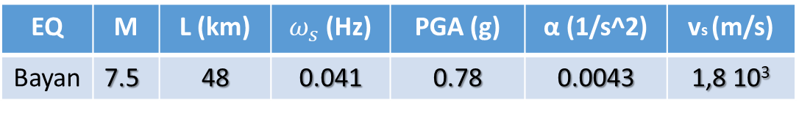
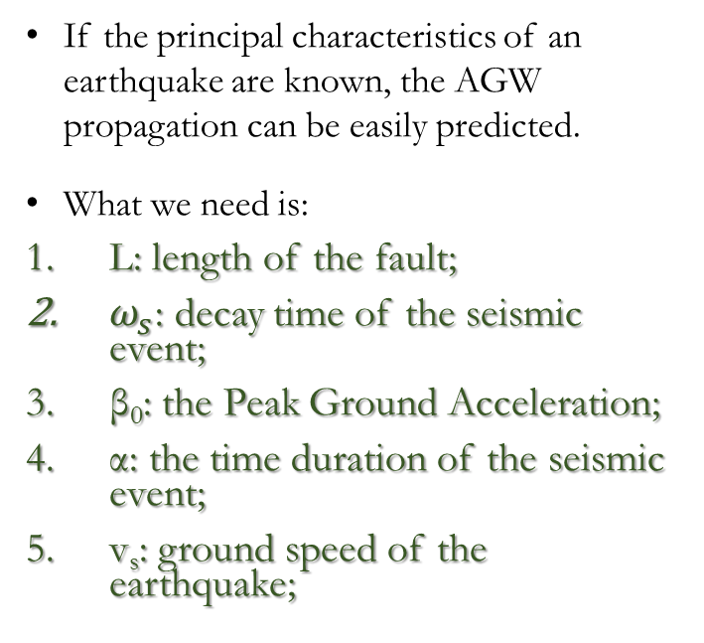
The MILC model
To confirm the seismic origin of the observed AGW we compared observation with MILC model predictions
If the principal characteristics of an earthquake are known, the AGW propagation can be easily predicted.
What we need is:
L: length of the fault;
$ω_{s}$: decay time of the seismic event;
β₀: the Peak Ground Acceleration;
α: the time duration of the seismic event;
v_{s}: ground speed of the earthquake;
Temperature fluctuations predicted by MILC agree very well with the observations (RMSE = 0.8 K ρ_{corr} = 0.86). In addition, the χ2 test gives 47.3, suggesting that our model is able to reproduce the observations with 85% probability.
In case of the Haiti Earthquake, the dispersion relation confirms the injection of AGW propagating till the ionosphere with periods between 5 and 9 min.
EQ | M | L (km) | $ω_{s}$ (Hz) | PGA (g) | α (1/s^2) | vs (m/s)
Bayan | 7.5 | 48 | 0.041 | 0.78 | 0.0043 | 1,8 10³
Notes:
Per ogni layer facciamo confronto tra osservato e modellato

Slide 6
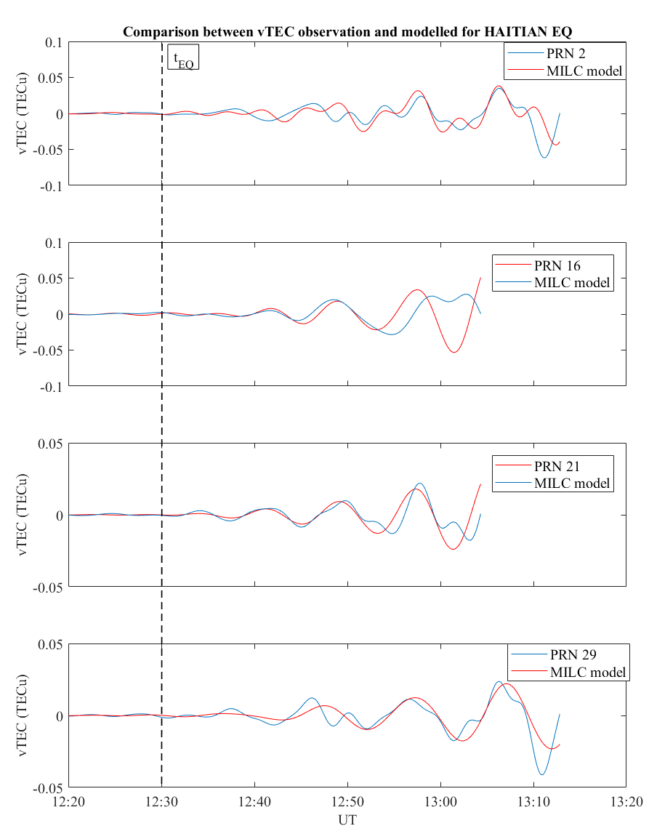
TID – MILC model results
The MILC model expects a plasma wave (TID) caused by the AGW injected by the EQ;
The comparison between the vTEC observations filtered with FIF and the model results is very good;
The χ2 test gives a 87% probability of our model to reproduce the observed signal.

Slide 7
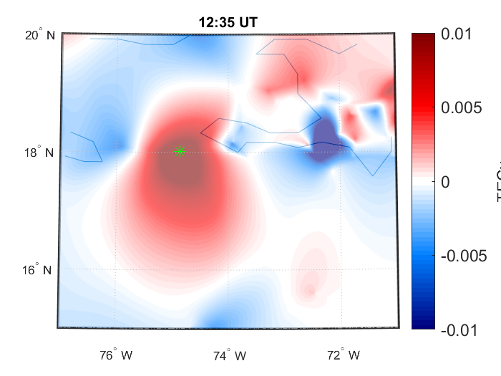
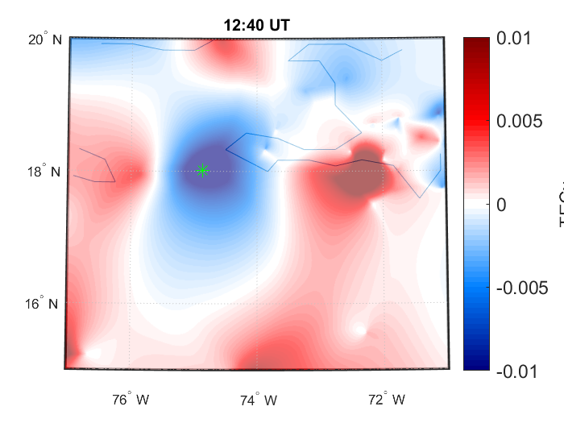
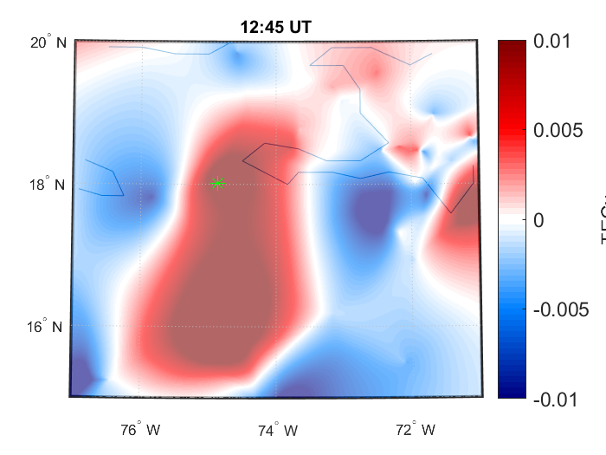
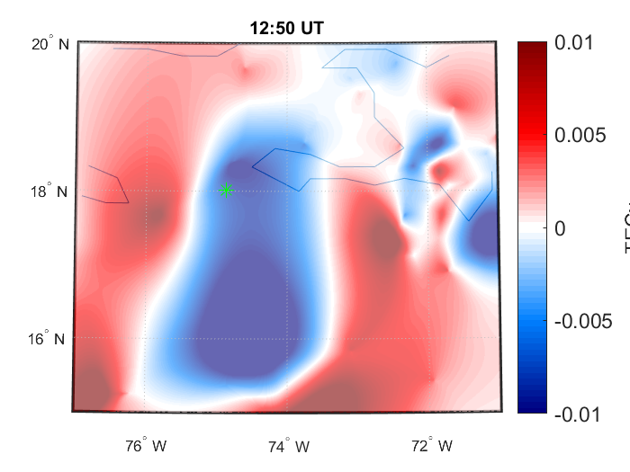
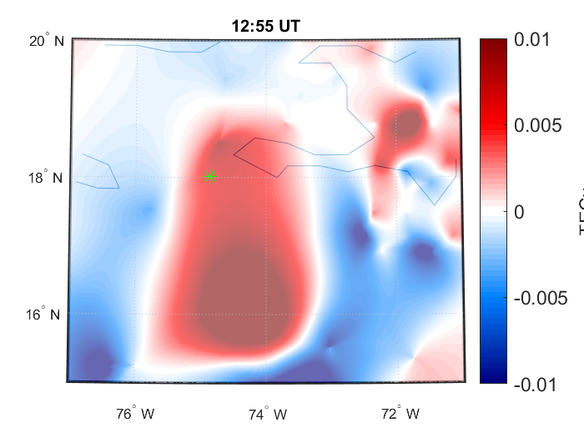
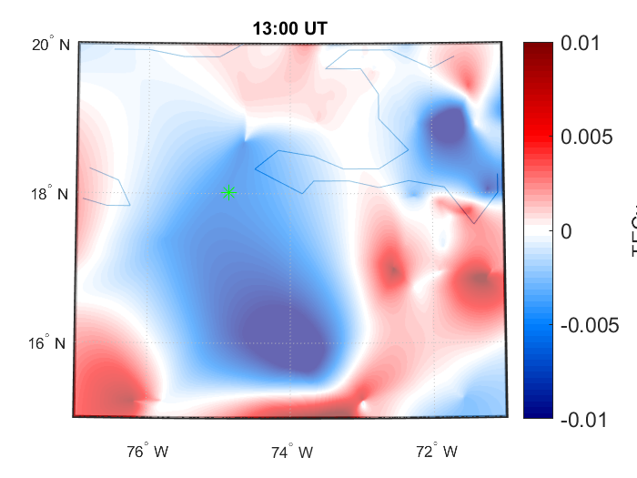
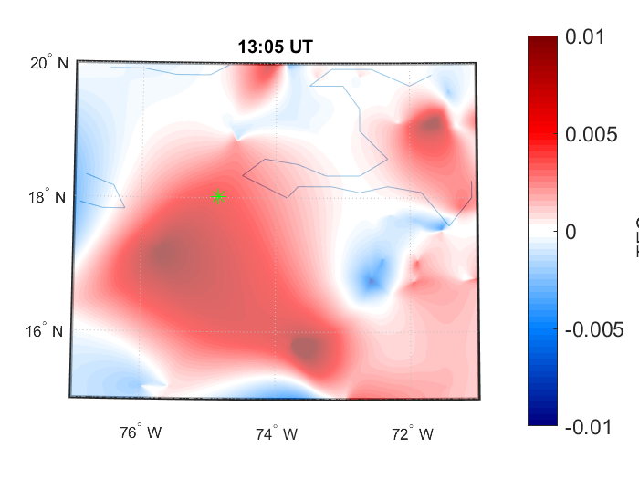
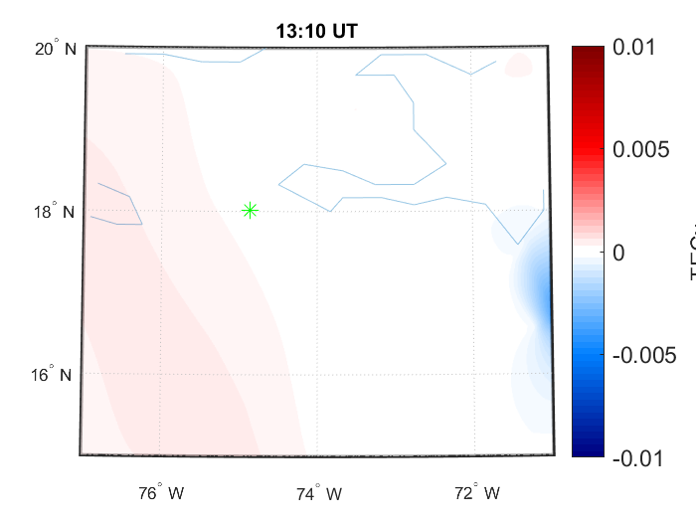
Ionospheric Plasma Waves - TID
Clear TID injection at the moment of the EQ occurrence.
It has a period of about 7 minutes and lasts for 30 minutes.

Slide 8
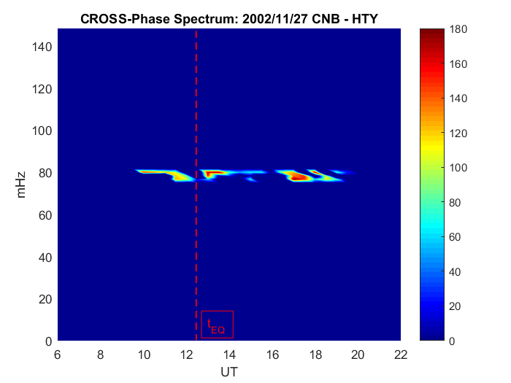
FLR evaluation over the EQ location
As expected, the eigen-frequency (f) is around 80 mHz (close equatorial station).
A clear decrease of the eigenfrequency detected at the moment of the EQ occurrence.
df=7 ± 2 mHz;
dt=32 ± 6 mins;

Slide 9
Conclusions
During the Haitian EQ there is an activation of the lithosphere - atmosphere - ionosphere - magnetosphere chain, which:
starting from the fault break, generates an AGW able to mechanically perturb the ionospheric plasma density, driving the generation of both TID and magnetospheric FLR eigen-frequency variation.
The EQ scenario presented here represents an optimal case event to be studied and understood since it happened during both solar quiet and fair weather conditions.
The observations was explained through the``M.I.L.C.'' analytical model, which confirms the causality link between the EQ occurrence and the atmosphere-ionosphere-magnetosphere observations.

Slide 10



Slide 11
BACK Up SLIDES

Slide 12
Introduction
In the last decades many study focuses on the potential EQ signatures in both the ionospheric/magnetospheric and atmospheric medium. Unfortunately none of them could strongly demonstrate the direct connection between EQ occurrence and detected anomalies
Two problems:
difficulty in identifying effects due to both Sun and atmospheric activity, which can be confused with EQ signature
the lack of a global analytical lithospheric-atmospheric-magnetospheric model able to explain and possibly forecast anomalous signal.

Slide 13
Introduction
In order to overcome these problems and contribute in the understanding of the physical mechanisms behind the coupling between lithosphere, lower atmosphere, ionosphere and magnetosphere during an earthquake
a seismic event occurred during both super solar quiet and fair weather conditions, representing an optimal case study to the attempt of reconstructing the seismic scenario in terms of the link between lithosphere, atmosphere, ionosphere and magnetosphere
a global Magnetospheric – Ionospheric – Lithospheric coupling (MILC) model, developed by Piersanti et al. in 2020;

Slide 14
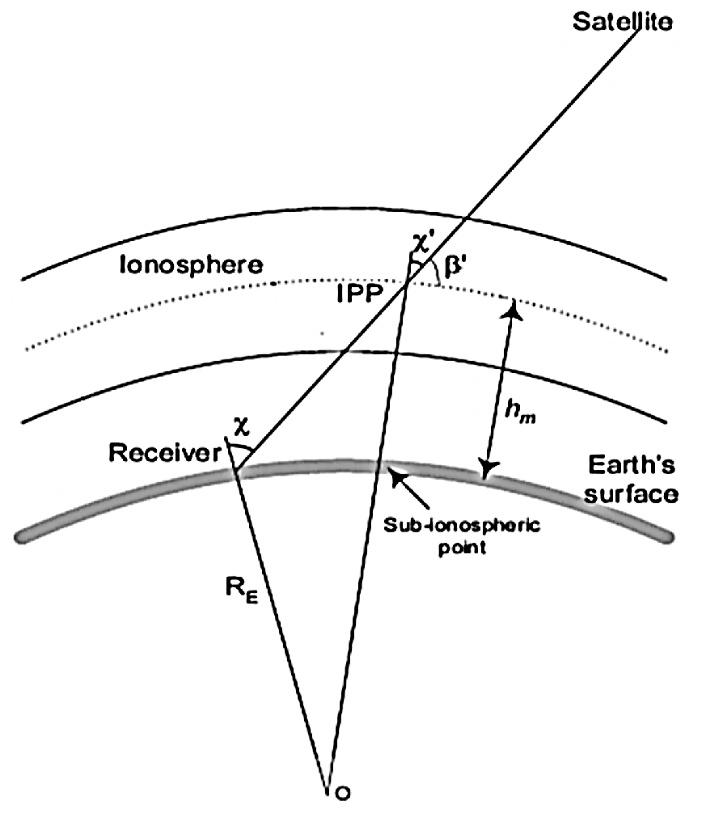
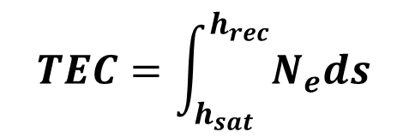
Total Electron Content (TEC)
Total number of electrons in a column
with cross section of 1m2 along the satellite-receiver path (1 TECU = 1016 electrons/m2)
$$TEC=\int_{h_{sat}}^{h_{rec}}{N_{e}ds}$$
1m²
As TEC measurements take place at different elevation angles and are related to different ionospheric sectors, in order to obtain TEC values independent on the geometry of the GNSS constellation and on the receiver’s network we verticalized TEC according to the following equation
By assuming the ionosphere as a single thin ionized layer, located between 300 and 500 km above the Earth’s surface, where the electron density maximizes
Notes:
14

Slide 15
The LAIC model – STEP 1 – Lithosphere
$$\frac{∂η}{∂t}=−\frac{∂}{∂x}[\left(H+η−β\right)u]$$
STEP 1.
A seismic event manifests itself through surface waves detected by seismograms, whose dispersion relation is described by Love-Reynolds.
the dynamics of the upper part of the layer (ground) can be roughly described within the shallow water approach
$$\frac{∂u}{∂t}=−\frac{∂}{∂x}\left(\frac{u^{2}}{2}+gη\right)$$
$η(x,t)$ is the fluctuation amplitude and u$(x,t)$ is the horizonthal velocity
H is the hight of the layer;
β is the batimetry that can be easily extracted from the seismogram.
Assuming $β\left(x,t\right)=β_{0}f\left(x,t\right)w\left(t\right)$, f(x,t) being the contribution of the seismic surface waves and w(t) is the decay time of the seismic event.
We modelled $w\left(t\right)=te^{−αt^{2}}$, $α^{−1/2}$ is the Strong Motion Duration (SMD) of the seismic event.
$f\left(x,t\right)\sim e^{i(k_{s}x−ω_{s}t)}$ describes a waveform where ${ω_{s}}/{k_{s}}=v_{s}$ is the phase speed of Love or Reylaigh surface wave.
The solution of the system 1 (via linearization) gives the surface perturbation at the first atmospheric layer H*, and the dispersion relation for the perturbation

Slide 16
We found the solution starting from the pressure gradient induced by the AGW injection at the moment of the EQ.
The LAIC model – STEP 2 – Plasma Waves TID
We started from the continuity equation
$$\frac{∂ρ_{e}}{∂t}+∇∙\left(ρ_{e}v_{e}\right)=𝒫_{fe}−ℒ_{fe}$$
where P_{fe} and L_{fe} are the electron production rate and loss rate by recombination, respectively.
Under AGW perturbation, both ρ_{e} and v_{e} can be splitted into a background (v₀, ρ₀ ) and a perturbation (w_{ef}, ρ_{ef}). We solved for perturbation under the assumption of production equal to loss rate.
In addition, since the AGW moves neutrals, we need to balance the Lorenz force which relates directly electron perturbation to neutrals.
$$e\left(w_{ef}×B\right)+m_{i}ν\left(w_{ef}−u\right)=0$$
where B is the geomagnetic field, m_{i} is the ion mass, u is the perturbation of neutrals speed and ν is the ion-neutral frequency collision.
$$ρ_{k,ω}=\frac{k}{ω}\left[\frac{1+Ω^{2}f_{k}(\overline{B})}{(1+Ω^{2}B^{2})k^{2}}\right]p_{k,ω}$$
where $Ω=\frac{e}{m_{i}ν},$ f_{k}($\overline{B}$) is a function of the of the geomagnetic field and of the wavevector and p is the AGW pressure.

Slide 17
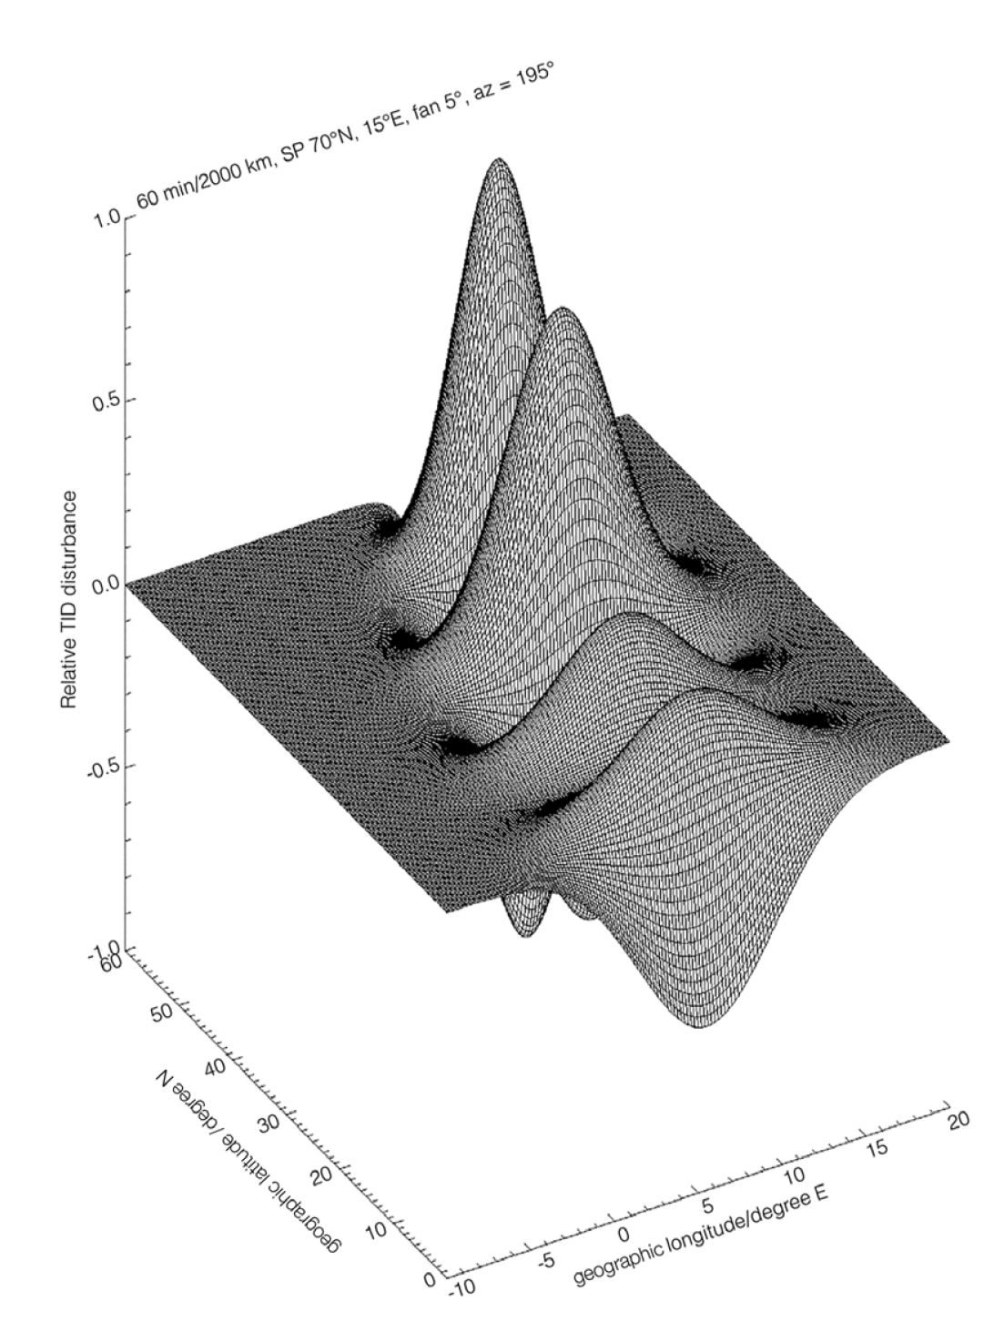
Example of Plasma wave induced by AGW

Slide 18
The LAIC model – STEP 3
$$\frac{∂^{2}E}{∂t^{2}}=K^{2}∇^{2}E$$
STEP 3.
We started from MHD equations related to stationary EM wave (FLR theory – Singer [1989]) to obtain the equation ruling the magnetospheric field line eigen-frequency.
It is needed to evaluate the variation of the FLR eigen-frequency under an EM wave perturbation.
$$K=\frac{B}{\sqrt{μ_{0}ρ}}$$
$$B=−\frac{i}{ω}∇×E$$
We linearized and considered a stationary condition (string).
We rotated into field aligned coordinate system
$$\frac{∂^{2}ξ}{{∂x}^{2}}+p\left(x\right)\frac{∂ξ}{∂x}+λ{\left[\frac{V_{a}(eq)}{V_{a}(x)}\right]}^{2}ξ=0$$
where $ξ$ is proportional to the electric field and x is the curvilinear coordinate moving along the field line.
ω* is proportional to $λ$: $ω^{∗}=\frac{B_{0}^{2}}{μ_{0}ρ_{0}}∙\frac{λ^{1/2}}{l}$ , where l is the length of the field line.

Slide 19

AGW – What?
Acoustic gravity waves are mainly caused by weather systems, synoptic‐scale atmospheric systems and circulations;
Those waves can disturb wind fields and temperature in the stratosphere;

Slide 20
Acoustic Gravity Waves - Detection
The common way to indirectly detect an AGW injection is to calculate the total wave energy (E0)
E0 is presented as a sum of kinetic (EK) and potential energies (EP), which correspond to the fluctuations in wind fields and temperature, respectively;
E0 and EP energies are proportional to each other (de la Torre et al., 1999; VanZandt, 1985), the wave activity can be easily evaluated by one of them;
Here we will use the potential energy as a proxy to estimate the wave activity which requires only the vertical temperature profiles.

Slide 21
Acoustic Gravity Waves - Detection
The potential energy density is defined as (VanZandt, 1985; Piersanti et al., 2020):
where g is the gravitational acceleration (constant), N is the Brunt-Vaisala frequency defined as:
where
is the potential temperature, z is the altitude, P₀ is the standard reference pressure (1 hPa), R is the gas constant of air and c_{p} is the specific heat capacity at a constant pressure. R/c_{p} = 0.286 for air (Piersanti et al., 2020).
T’ is the perturbation deviated from the background temperature $\overline{T}$ that are all function of the altitude. The variance term
is calculated within a layer of 2 km thickness as:
In order to be sure to detect an AGW we have to observe contemporary a temperature fluctuation and a maximum in the potential energy

Slide 22
AGW evaluation – observations
The vertical temperature profile (left) at the EQ epicentre retrieved from ERA5 is filtered by a moving average (2 km), to obtain the background temperature profile (second panel from left);
Then the temperature deviation (third panel) is computed by subtracting the background from the original temperature profile.
We also computed the Brunt-Vaisala frequency and the potential energy according to the previous equations.
Two maxima in E_{P} are around 17 km (the tropopause) and around 40 km (the stratopause).
The vertical wavelength of stratospheric AGW is expected to be about 2–10 km (Tsuda et al., 1994).
Gravity waves disturb the temperature profile, and their influence is revealed in the temperature deviation profile (third panel).
The wavelength is thus defined by a full period in the sinusoidal variation in the temperature deviation but not in the E_{P} profile.

Slide 23
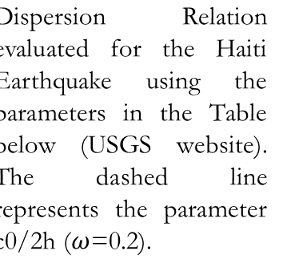
The MILC model
Dispersion Relation evaluated for the Haiti Earthquake using the parameters in the Table below (USGS website). The dashed line represents the parameter c0/2h ($ω$=0.2).
To confirm the seismic origin of the observed AGW we compared observation with MILC model predictions
If the principal characteristics of an earthquake are known, the AGW propagation can be easily predicted.
What we need is:
L: length of the fault;
$ω_{s}$: decay time of the seismic event;
β₀: the Peak Ground Acceleration;
α: the time duration of the seismic event;
v_{s}: ground speed of the earthquake;
Temperature fluctuations predicted by MILC agree very well with the observations (RMSE = 0.8 K ρ_{corr} = 0.86). In addition, the χ2 test gives 47.3, suggesting that our model is able to reproduce the observations with 85% probability.
In case of the Haiti Earthquake, the dispersion relation confirms the injection of AGW propagating till the ionosphere with periods between 5 and 9 min.
EQ | M | L (km) | $ω_{s}$ (Hz) | PGA (g) | α (1/s^2) | vs (m/s)
Bayan | 7.5 | 48 | 0.041 | 0.78 | 0.0043 | 1,8 10³
Notes:
Per ogni layer facciamo confronto tra osservato e modellato

Slide 24
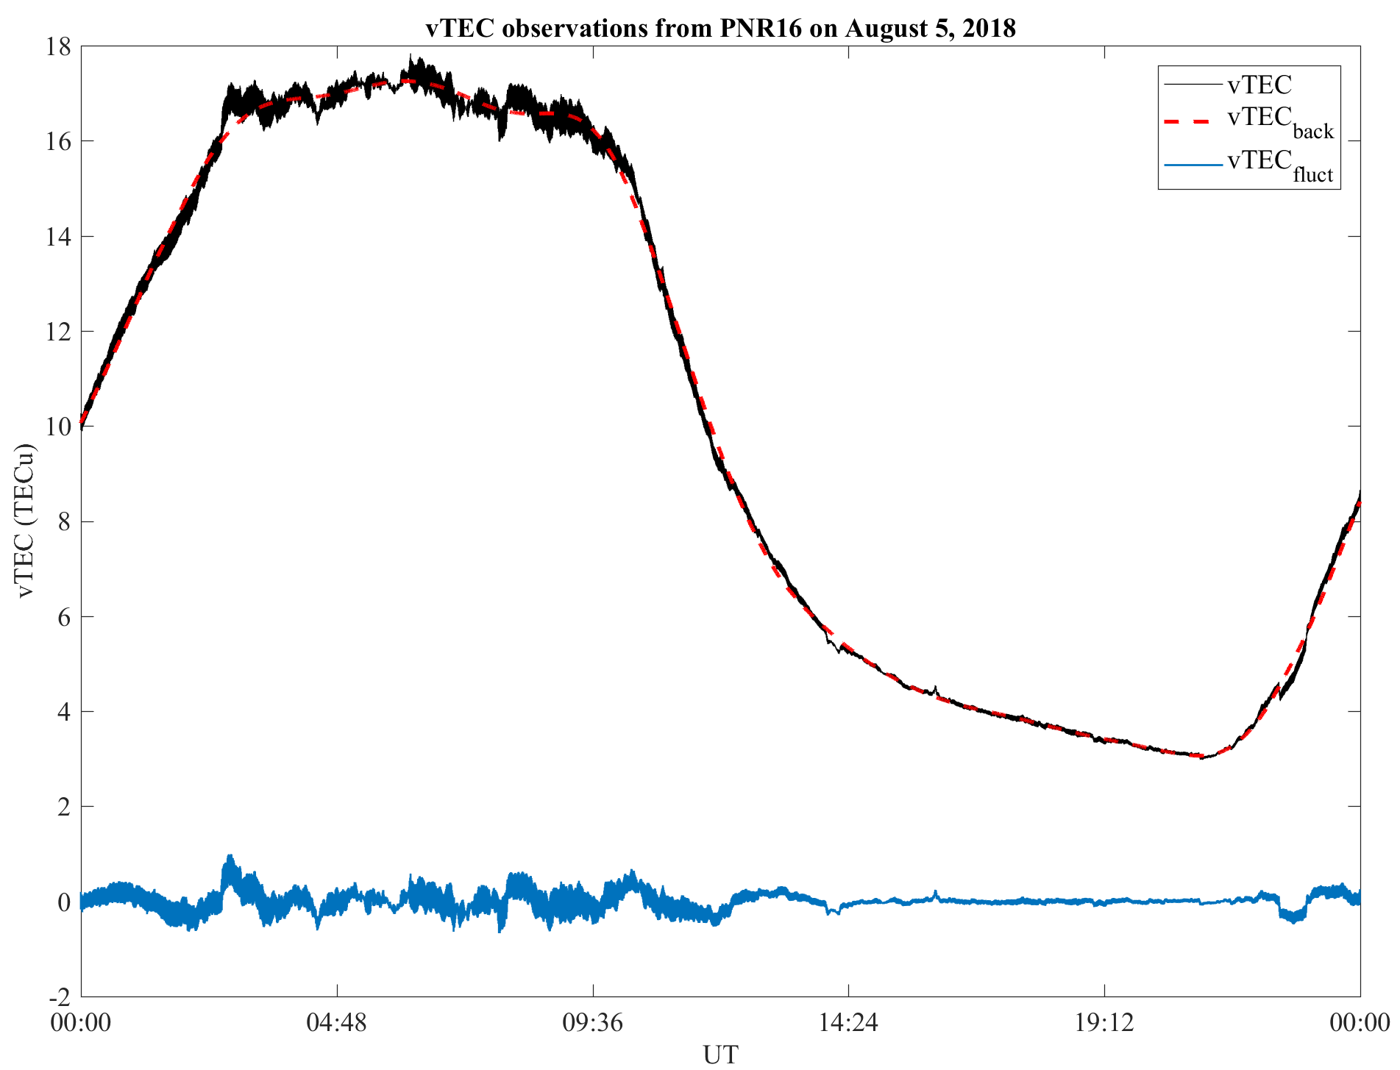
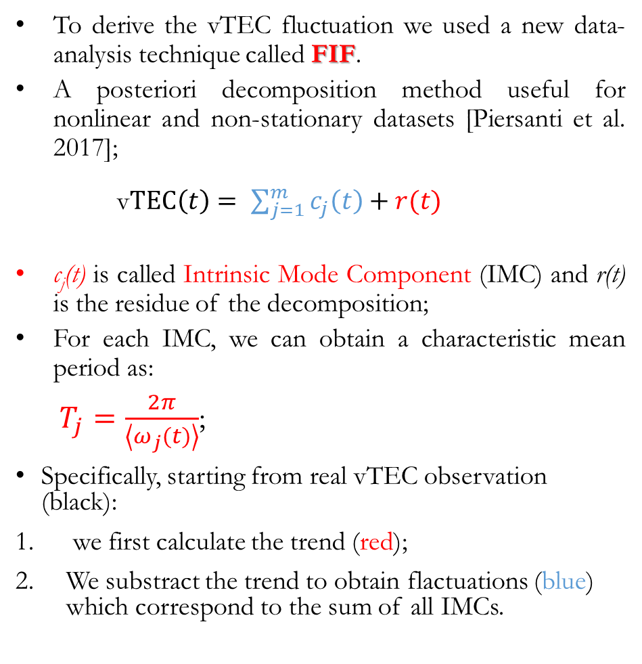
August , 2018 – vTEC
To derive the vTEC fluctuation we used a new data-analysis technique called FIF.
A posteriori decomposition method useful for nonlinear and non-stationary datasets [Piersanti et al. 2017];
v$TEC\left(t\right)= \sum_{j=1}^{m}{c_{j}\left(t\right)+r(t)}$
c_{j}(t) is called Intrinsic Mode Component (IMC) and r(t) is the residue of the decomposition;
For each IMC, we can obtain a characteristic mean period as:
$T_{j}=\frac{2π}{\left\langle ω_{j}(t)\right\rangle }$;
Specifically, starting from real vTEC observation (black):
we first calculate the trend (red);
We substract the trend to obtain flactuations (blue) which correspond to the sum of all IMCs.
Finally, we selected all the IMCs having a characteristic mean period between 5 and 9 minutes

Slide 25
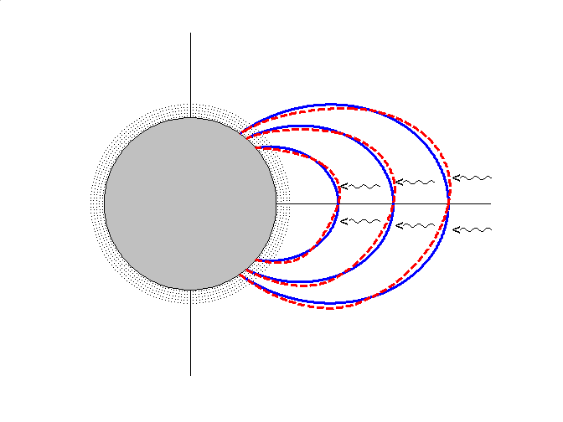
Geomagnetic Field Line Resonances (FLR)
IDEA: Assume the magnetic field line as a «string» whose nodes are the footprints of the field line in the ionosphere.
Every compressive perturbation, whose peculiar frequency matches the eigen-frequency of the field line, generates a standing wave
The eigen period of the magnetic field line depends on its geometry and on the Alfven speed
IONOSPHERE
STANDING WAVE
P₁
COMPRESSIVE
MHD WAVES
EARTH
V_{A}: Alfvén velocity
P₂

Slide 26
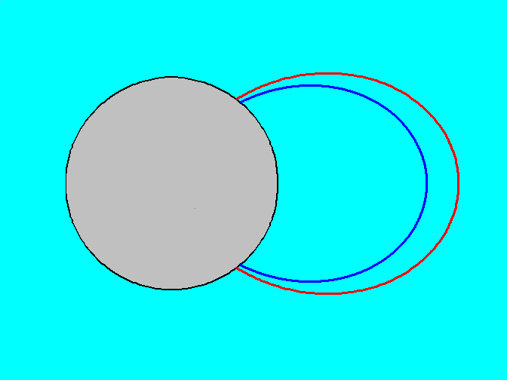
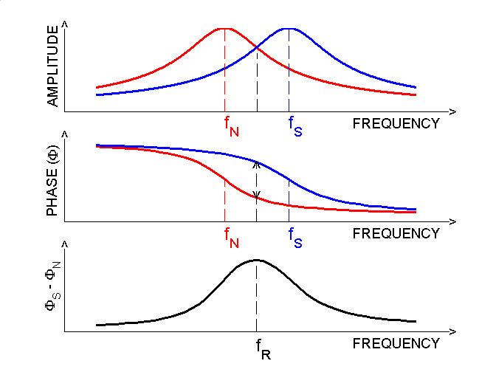
Gradient method for detecting FLR from ground-based ulf measurements
N
S
EARTH
FREQUENCY RESPONSE OF TWO OSCILLATORS
Separation: 1° - 3°
Higher latitude field line → Lower resonance frequency ( f_{N} )
Lower latitude field line → Higher resonance frequency ( f_{S} )
CROSS-PHASE TECHNIQUE
Resonance frequency at the middle point.
Identified by a maximum in the phase difference

Slide 27
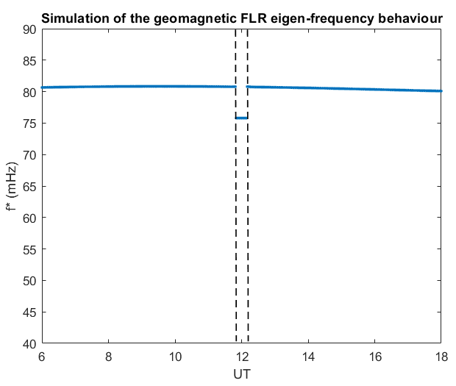

FLR – MILC model results
The result of the modeled eigen-frequency variation of a field line footprinted at λ=20°, under the assumption of real Earth's magnetic field, associated to a pressure gradient driven by the Haitian earthquake is reported in right figure.
The resonance frequencies of a geomagnetic field line depend on the field line length, and on the magnetic field intensity and plasma mass density ρ along the field line.
A change in the field line length and/or the Va, caused a variation of the FLR frequency ω
UT of $∇p$
IONOSPHERE
STANDING WAVE
P₁
COMPRESSIVE
MHD WAVES
V_{A}: Alfvén velocity
EARTH
P₂
A clear decrease of ω is visible in coincidence to the pressure gradient (𝜵p) driven by the AGW injected by the earthquake.

Slide 28
Discussion
According to MILC model, the Haitian EQ characterized by M=7.5, PGA=0.78 g, Vs=1800 m/s and ωs=0.041 Hz will excite AGW in the frequency range 0.002 Hz < ω < 0.2 Hz and wave vectors 3 km < k < 9 km.
The previsions completely agree with the observed AGW during the EQ occurrence.
The frequency range expected by MILC model applied to this EQ for the TID waves propagating from the Ionosphere is [0.002-0.006] Hz
The vTEC observations show a frequency of 0.0024 Hz lasting for 30 minutes
MILC model expected to observe a FLR frequency decrease.
Previsions agrees with the observed FLR frequency behaviour;
SW data shows no structures coming from the Sun;
Atmospheric synoptic map shows the absence of any weather systems ( synoptic‐scale atmospheric systems and circulations, and so on)

Slide 29
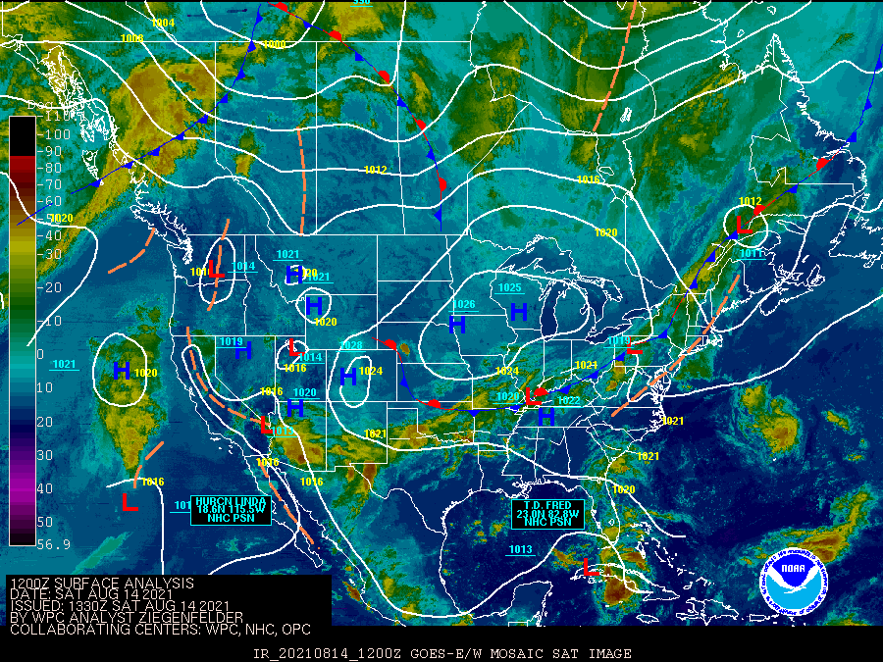
Discussion – Weather Reports
The direct association of AGWs to an EQ phenomena is not trivial.
AGW are generally induced by weather systems, by synoptic‐scale atmospheric systems and circulations and so on;
At middle and low latitudes AGWs are meteorologically excited by convective activities around the cold fronts;
We examined the weather reports (https://www.accuweather.com/) for the August 14, 2021 and we found:
a tropical cyclone passing the Caribbean Island around the 12:00 UT (far from the EQ).
In addition, a weather system occurred, at the same UT, in the north-east side of the Haitian Island (far from the EQ).
So, we are confident that the AGW detected at 12:30 UT can be associated to the seismic activity

Slide 30
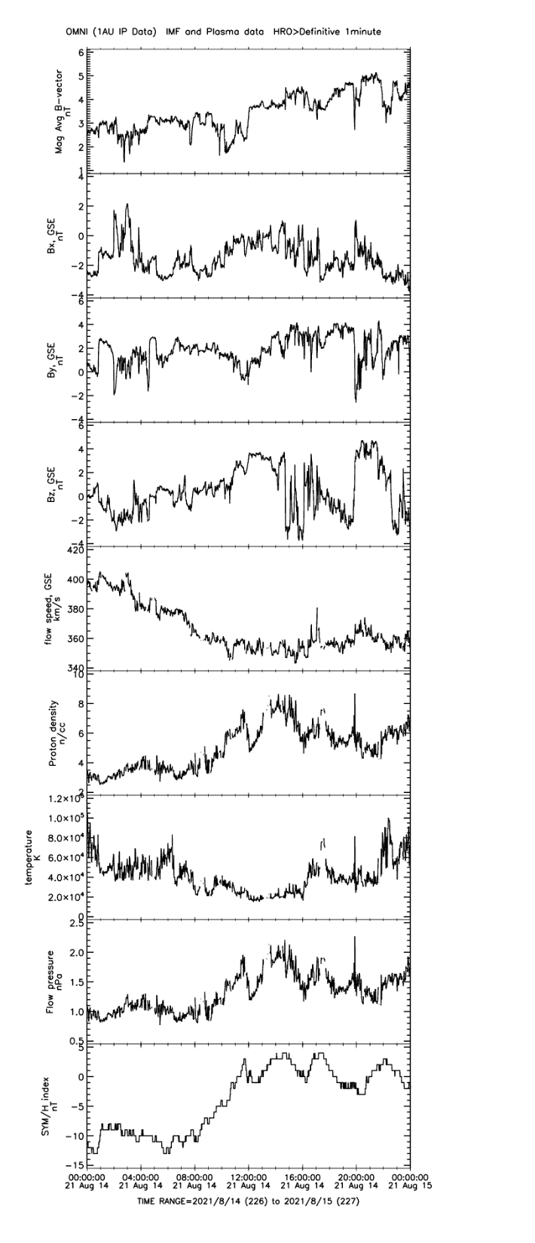
Discussion – Space Weather
Discrimination between ionospheric plasma density variations induced by internal and external origin sources is crucial
In general, both vTEC and plasma density irregularities are directly driven by the solar activity…
The solar wind (SW) parameters and the geomagnetic indices (i.e., Sym-H) confirms that the August 14, 2021 was a solar quiet day;
Absence of any structure coming from the Sun;
Low geomagnetic activity (Sym-H = [-10 nT ; 5 nT])
vTEC variations observed are not driven by the Sun and can be reasonably associated to the earthquake activity.
FLR frequency variation is linked to the seismic activity.

