Slide 1
The Critical Role of Unique Identification of Samples for the Geoanalytical Data Pipeline
Kerstin Lehnert, Jens Klump, Sarah Ramdeen, Kirsten Elger, & Lesley Wyborn

Slide 2

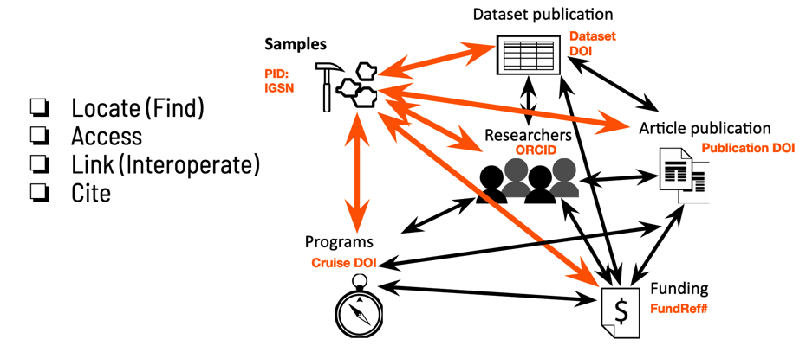
Setting the Scene
Globally unique, persistent, resolvable identifier (GUPRI) enable transparent and traceable connections between a sample or specimen and its sampling context to any related data, publications, people, organizations, instruments, and grants.
Since 2011, the IGSN (International Generic Sample Number) has provided a central registration system for users to apply a GUPRI to any physical specimen/sample/sampling feature related to any sampling procedure.

Slide 3
Unique Naming Throughout the Lifecycle of a Physical Sample
Archiving and
Museum Identifiers are usually assigned here
Collection
Dissemination
IGSNs can be assigned here
Lifecycle
of
physical samples
Publication
Transport and Storage
Preparation and Analysis

Slide 4
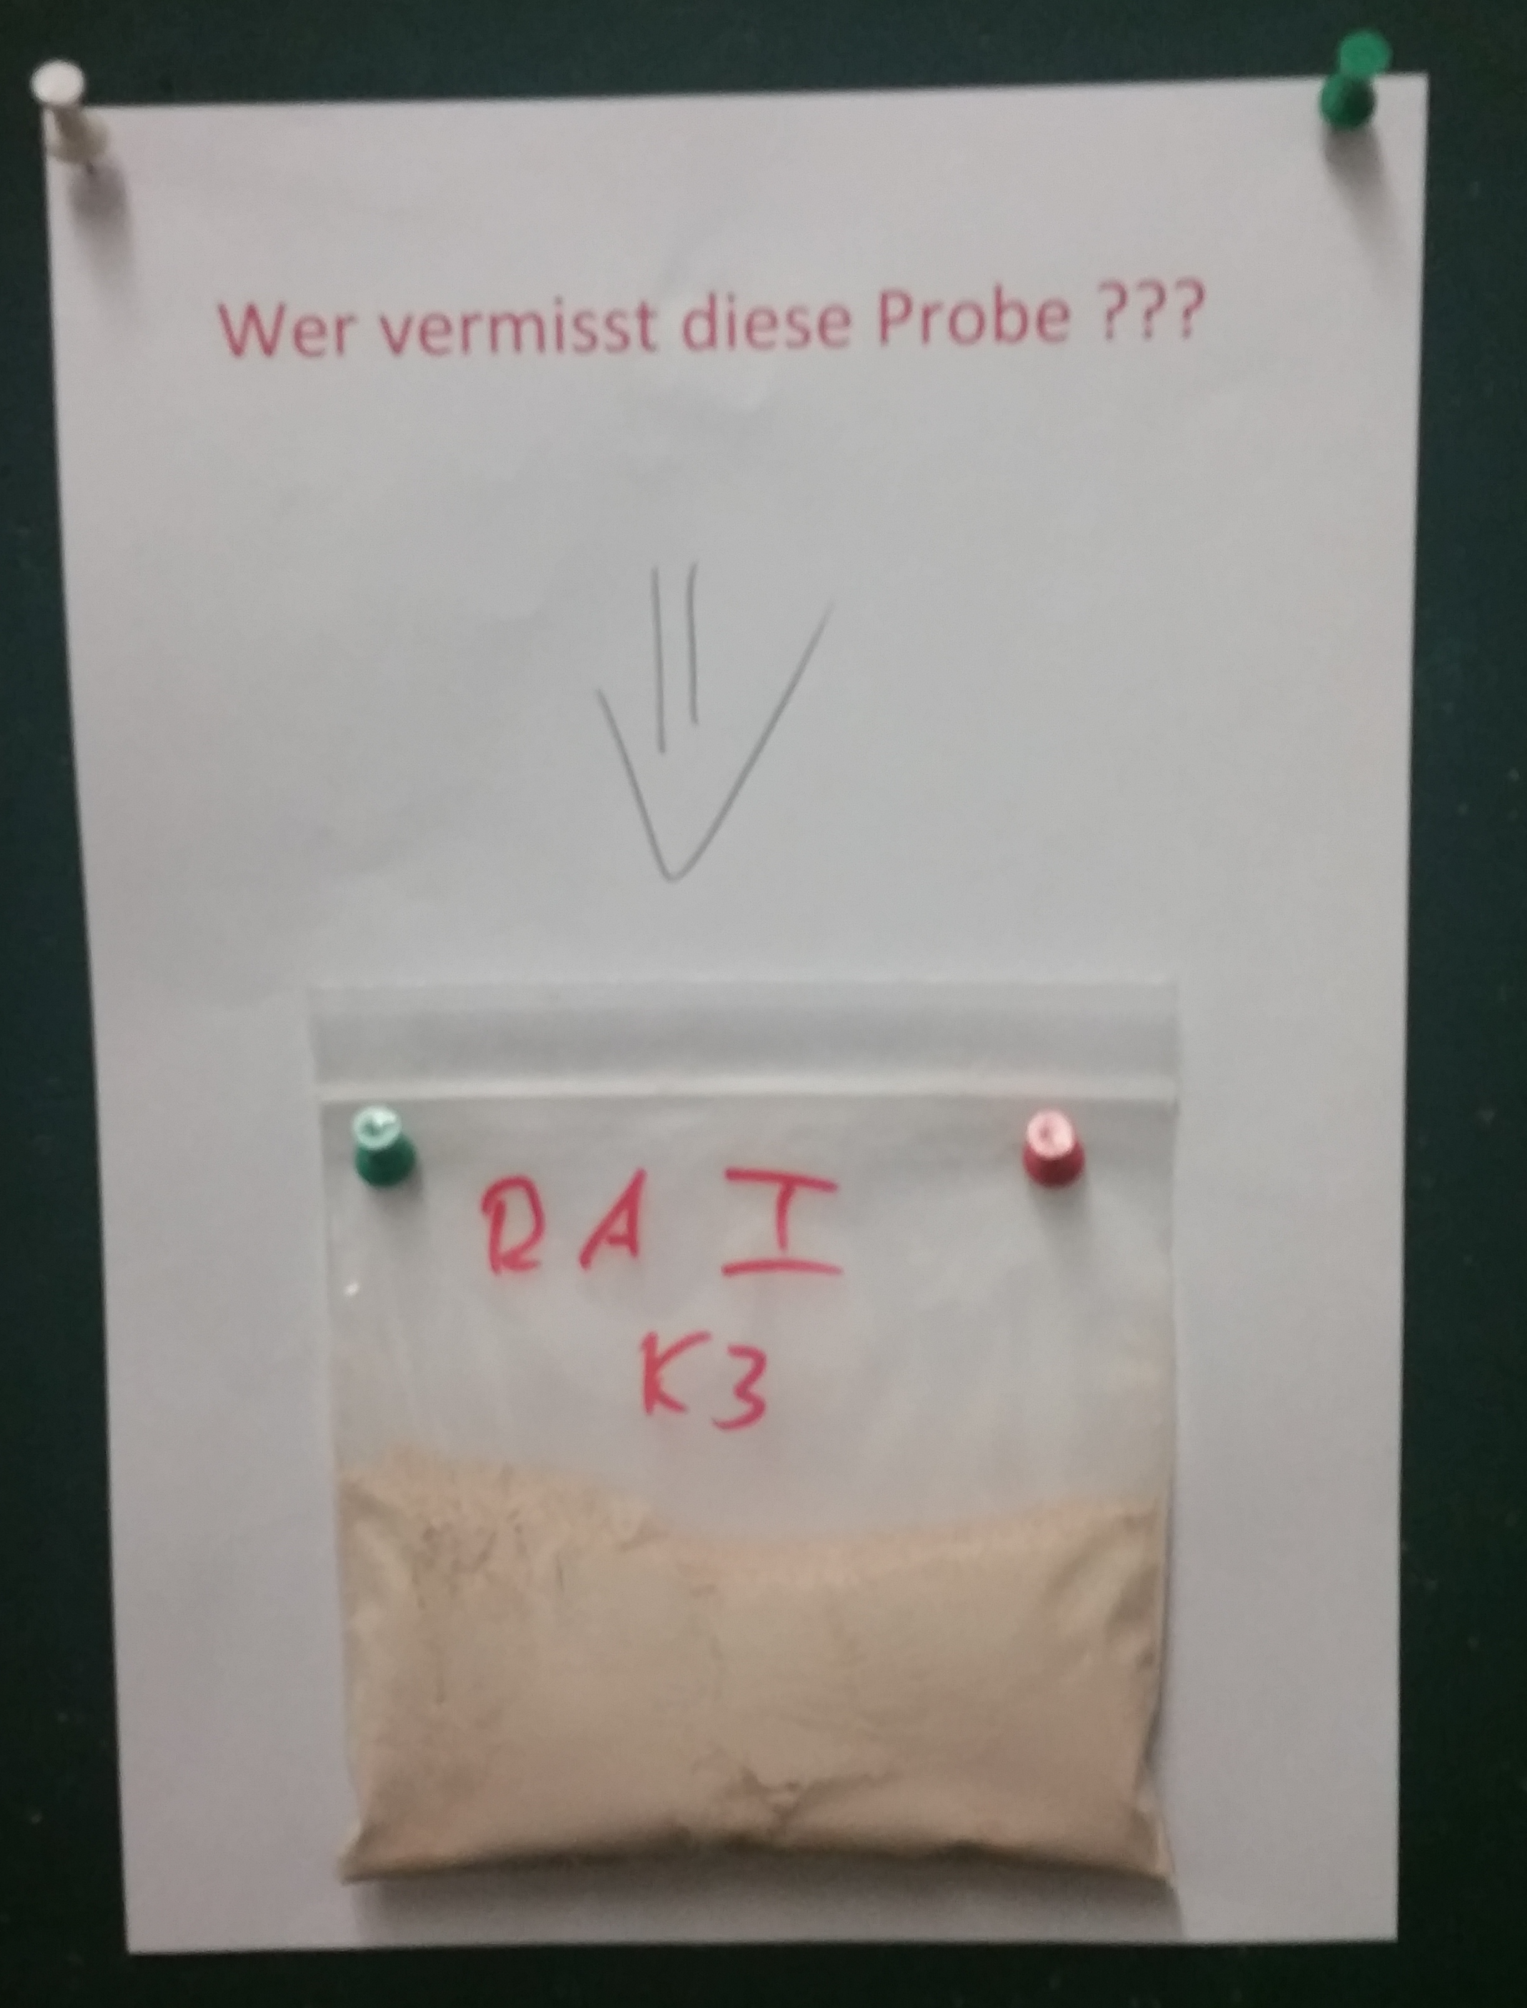
The Fate of a Sample Without a Globally Unique, Persistent, and Resolvable Identifier
“Who misses this sample?”

Slide 5
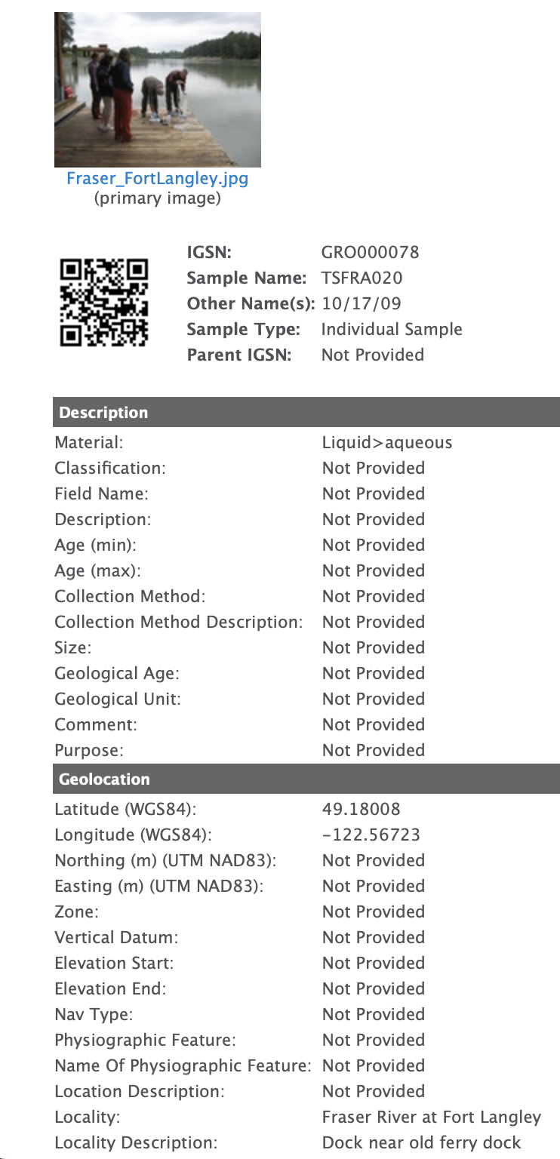
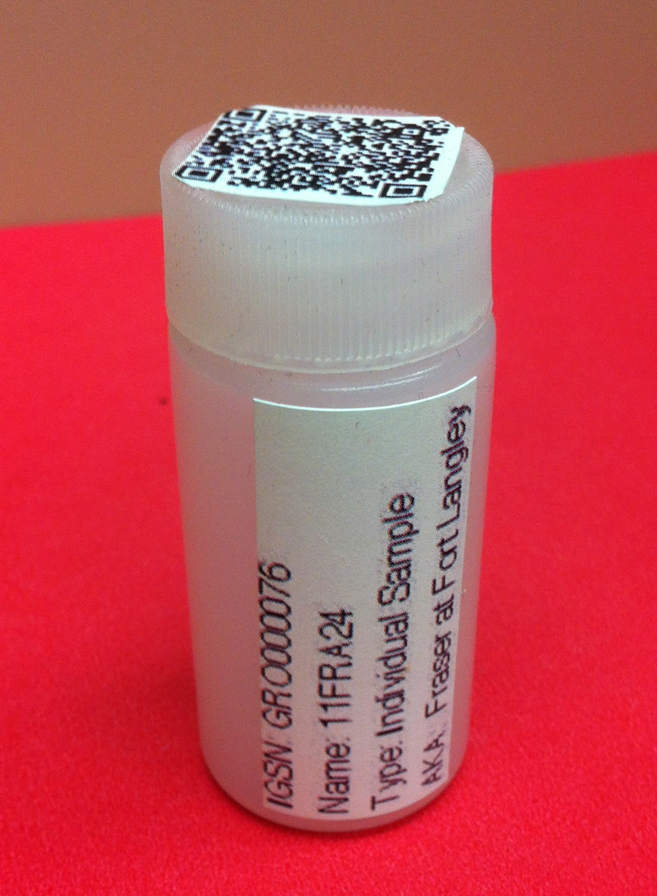
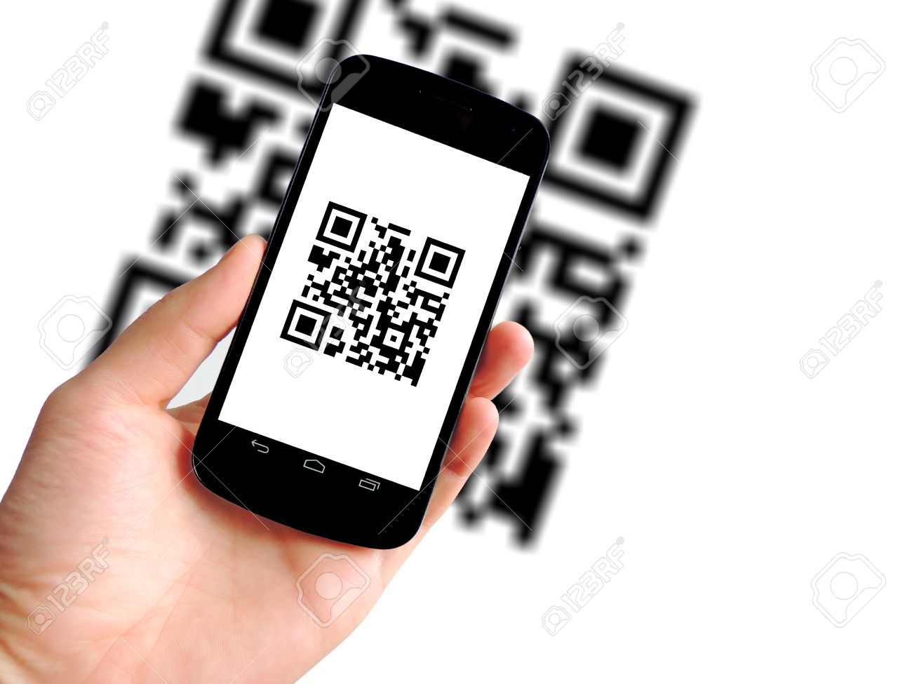
The Fate of a Sample with an IGSN

Slide 6
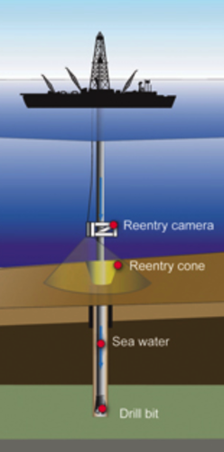
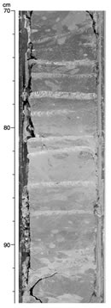







ASSIGNING DERIVATIVE SAMPLES FROM A BOREHOLE SAMPLING FEATURE
SPNCH 2022, Edinburgh
Sampling Feature
Child 1.0
Child 1.1
Child 1.1.1
Child 1.1.1.1
Core
Section
1.1
Sample 1.1.1
Fossil separate 1.1.1.1
Microprobe mount 1.1.1.2
IGSN:ODP000121
Sample 1.1.2
Whole
Core
Rock powder 1.2.2.1
Core
Section
1.2
Sample 1.2.1
Photo by IODP.org
Sample 1.2.2
Mineral concentrate 1.2.2.2
IGSN:ODP000119
IGSN:ODP000120
IGSN:ODP000124
Leachate 1.2.2.3
IGSN:ODP000122
Sample 1.2.3
IGSN:ODP000125
Core
Section
1.3
Sample 1.3.1
Sample 1.3.2
IGSN:ODP000123
Sample 1.3.3
An IGSN can be assigned to the ‘SamplingFeature, the ‘Sample’, as well as any subsamples taken from that Sample
© IGSN 2022

Slide 7
The Geoanalytical Data Pipeline
Illustration by Beck Strauss

Slide 8
Conclusions
IGSNs are a critical part of identifiers in the Scientific Research Ecosystem: they are not just for labels on boxes on shelves in museums
IGSNs should be assigned to the specimen/sample and the sampling feature it comes from when it becomes a standalone identifiable ‘thing’.
Where any subsamples are derived, they, and any data generated on them, can also be linked back to the parent identifier.
This IGSN then anchors the specimen through the progressive stages of its subsequent ‘life-cycle’ including laboratory analysis, generation of further data, images, publication, and ultimately curation and preservation.

