Slide 1

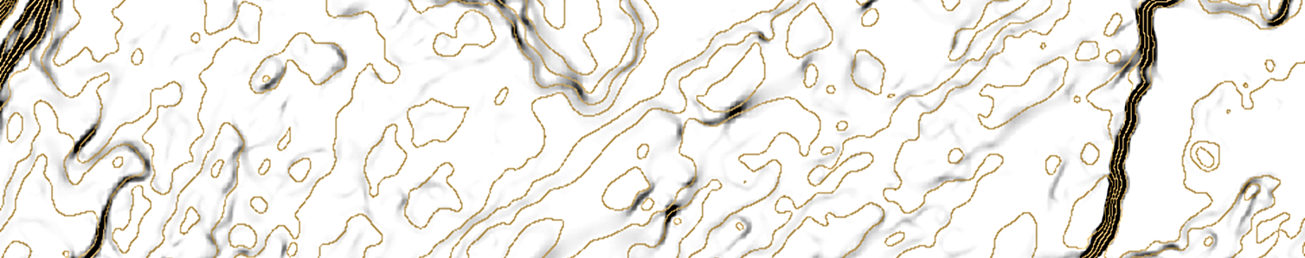



Vienna, Austria & Online | 23–27 May 2022
Evaluating Geomorphometric Variables to Identify Groundwater Potential Zones in Sahel-Doukkala, Morocco
Adnane Habib (1)*, Aziz El Arabi (2) & Kamal Labbassi (2)
MAScIR, University Mohammed VI Polytechnic (UM6P), Rabat, Morocco. * Email: a.habib@mascir..ma / adnanehabib@gmail.com
Chouaib Doukkali University, El Jadida, Morocco
Session GM2.3
Novel Data, Methods and Applications in Geomorphometry

Slide 2
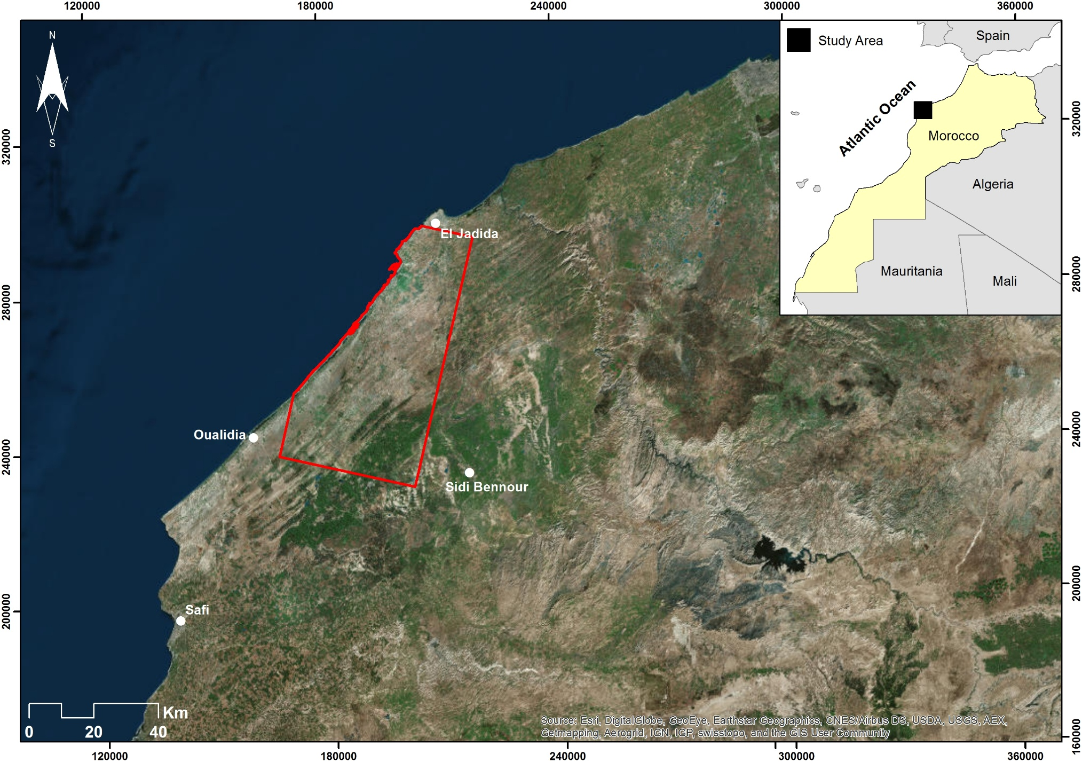
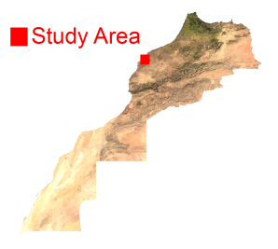
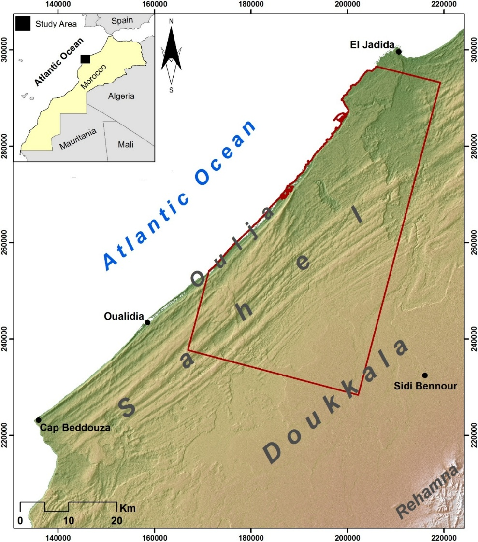
Datasets
Legend
Study Area
ALOS PRISM Footprint
Topographic Maps Footprint (1:25000)
Geologic Maps Footprint (Gigout 1965)
Structural Map Footprint (Ferré 1969)

Slide 3
Methodology
Generation of factors
Weight Assignment & Normalization
* Habib, A., Khoshelham, K., Akdim, N. et al. Impact of spatial resolution, interpolation and filtering algorithms on DEM accuracy for geomorphometric research: a case study from Sahel-Doukkala, Morocco. 2018. Model. Earth Syst. Environ. 4, 1537–1554
* Habib, A., Akdim, N., El Ghandour, Fe. et al. Extraction and accuracy assessment of high-resolution DEM and derived orthoimages from ALOS-PRISM data over Sahel-Doukkala (Morocco). 2017. Earth Sci Inform 10, 197–217
Mapping of GWPZs

Slide 4
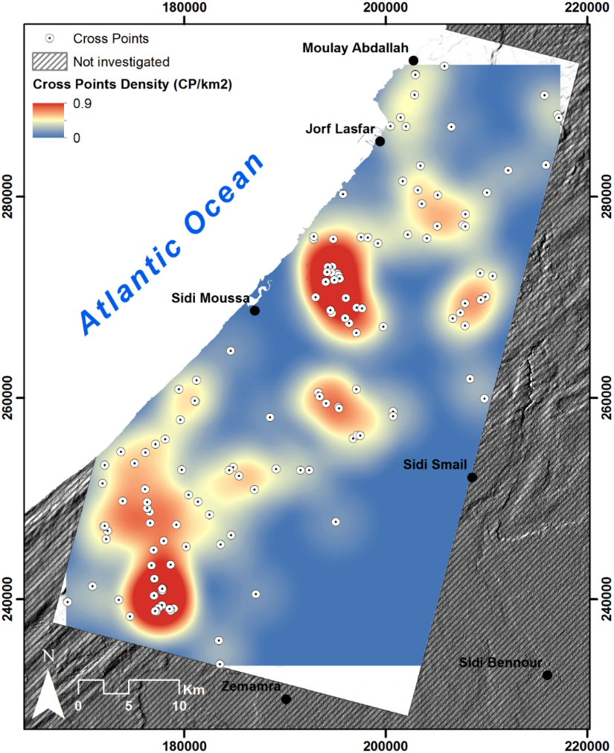
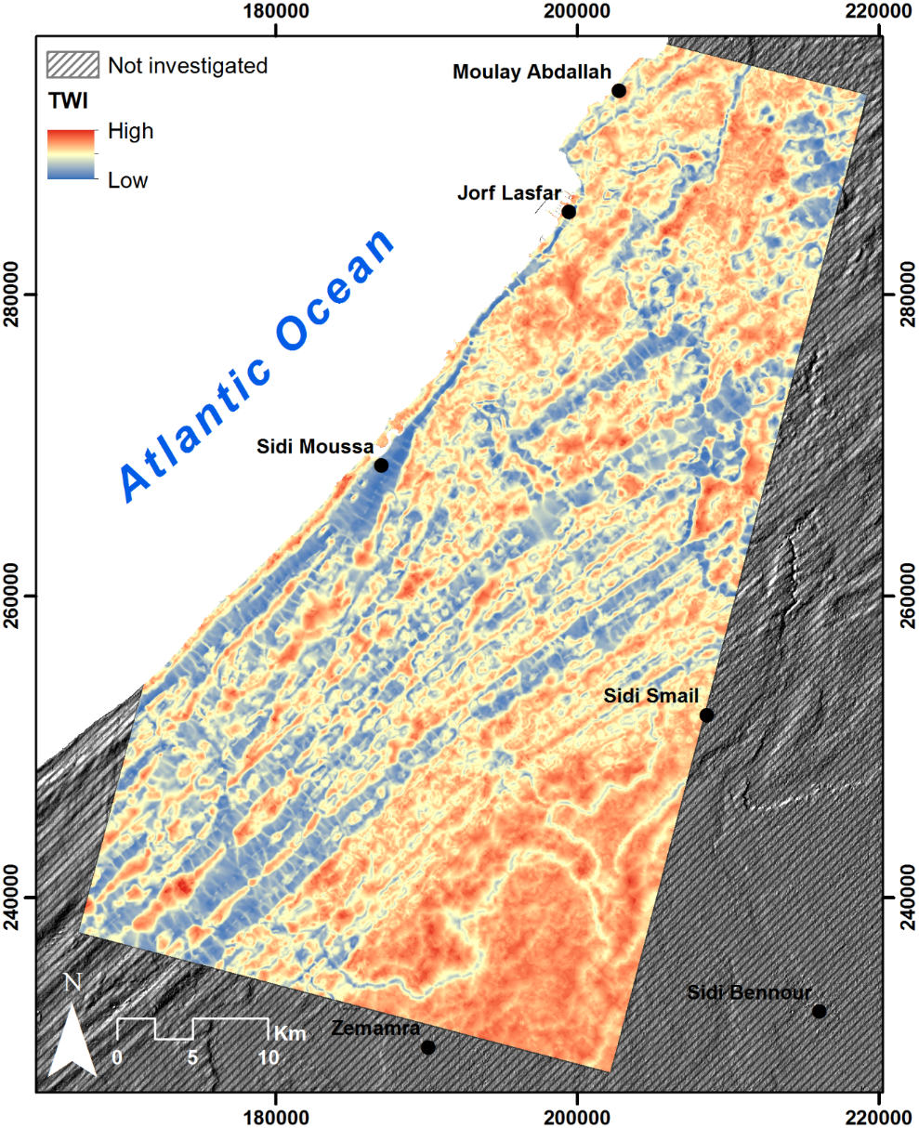
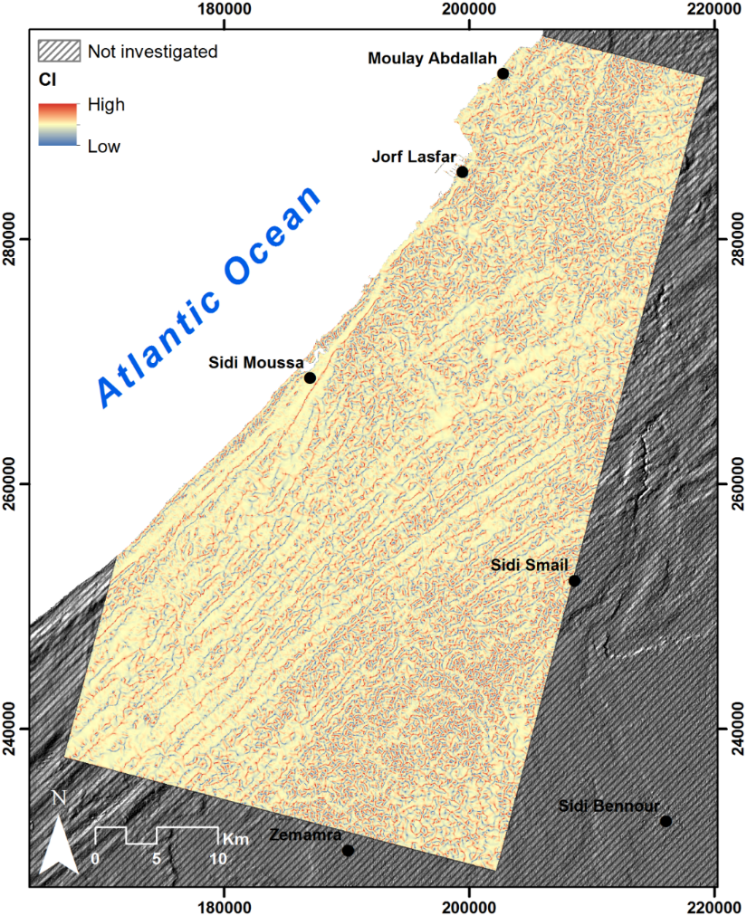
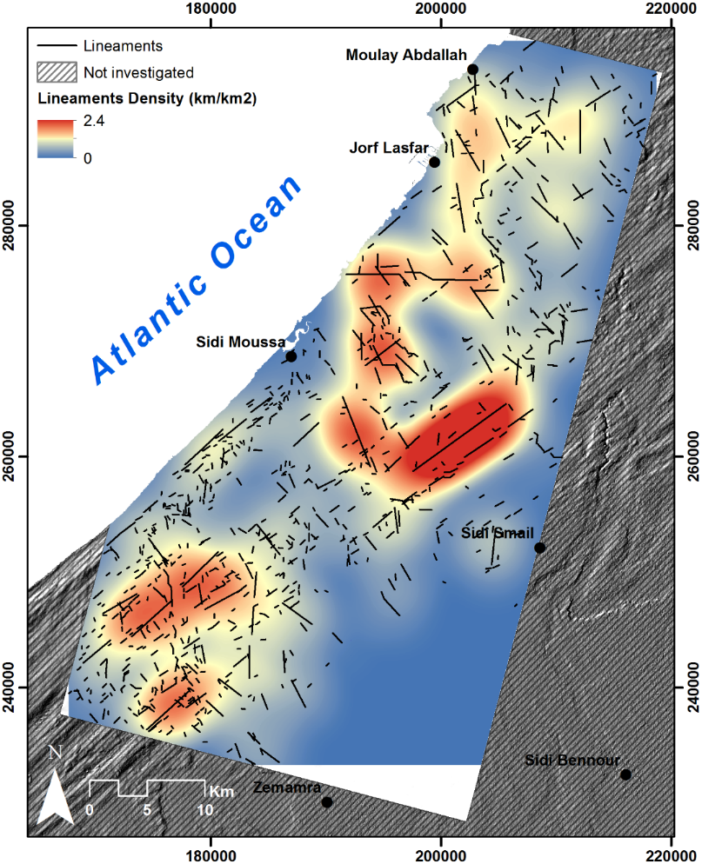
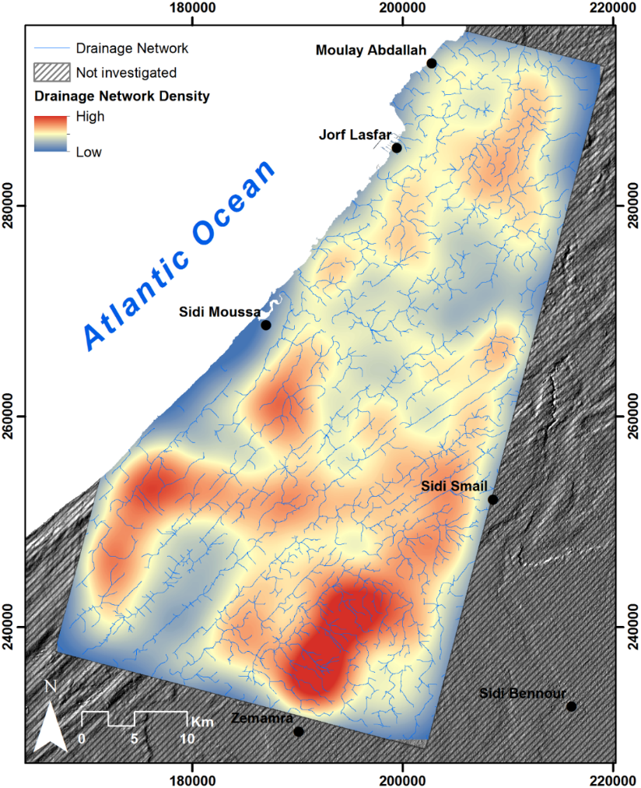
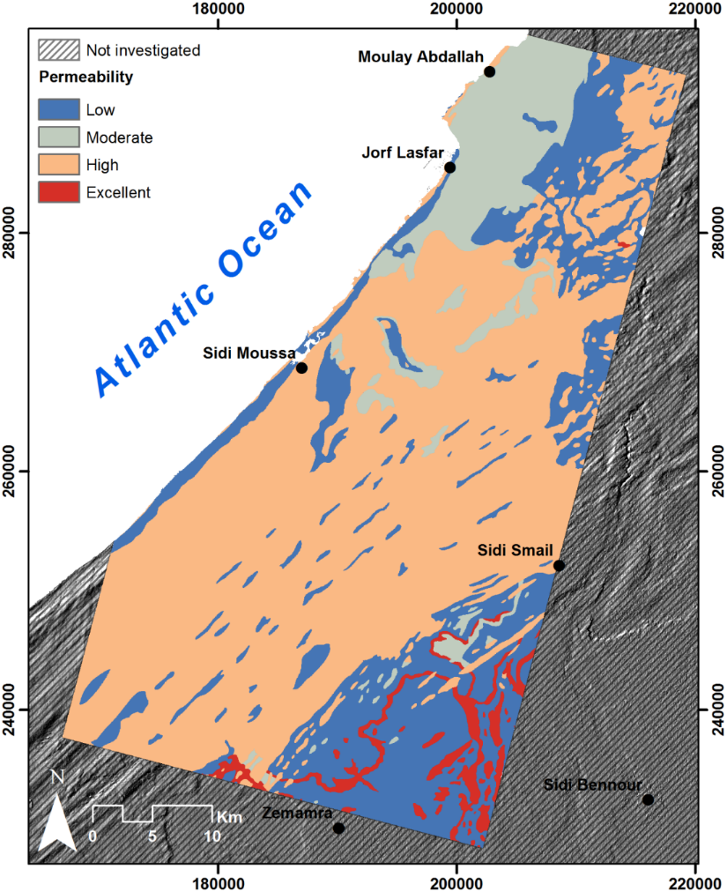
Results - Generation of factors
Drainage Network Density (DN_{d})
Topographic Wetness Index (TWI)
Cross Points Density (CP_{d})
Curvature Index (CI)
Permeability (L)
Lineament Density (L_{d})

Slide 5
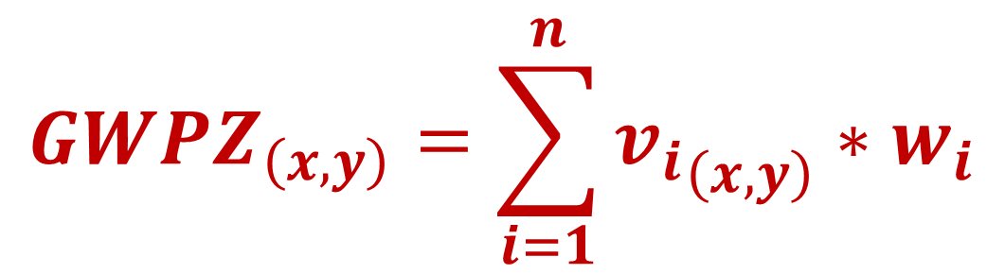
Results - Weight Assignment & Normalization
Table: Main potential groundwater factors and cumulative effect matrix
 | L_{d} | CP_{d} | L | DN_{d} | TWI | CI | Sum | Weight (%)
L_{d} | 1 | 1 | 1 | 1 | 1 | 1 | 6 | 24
CP_{d} | 0 | 1 | 1 | 1 | 1 | 1 | 5 | 20
L | 1 | 1 | 1 | 1 | 0 | 0 | 4 | 16
DN_{d} | 0 | 0 | 1 | 1 | 0 | 1 | 3 | 12
TWI | 0 | 0 | 1 | 1 | 1 | 1 | 4 | 16
CI | 0 | 0 | 0 | 1 | 1 | 1 | 3 | 12
$${GWPZ}_{\left(x,y\right)}=\sum_{i=1}^{n}{{v_{i}}_{\left(x,y\right)}{∗w}_{i}}$$

Slide 6
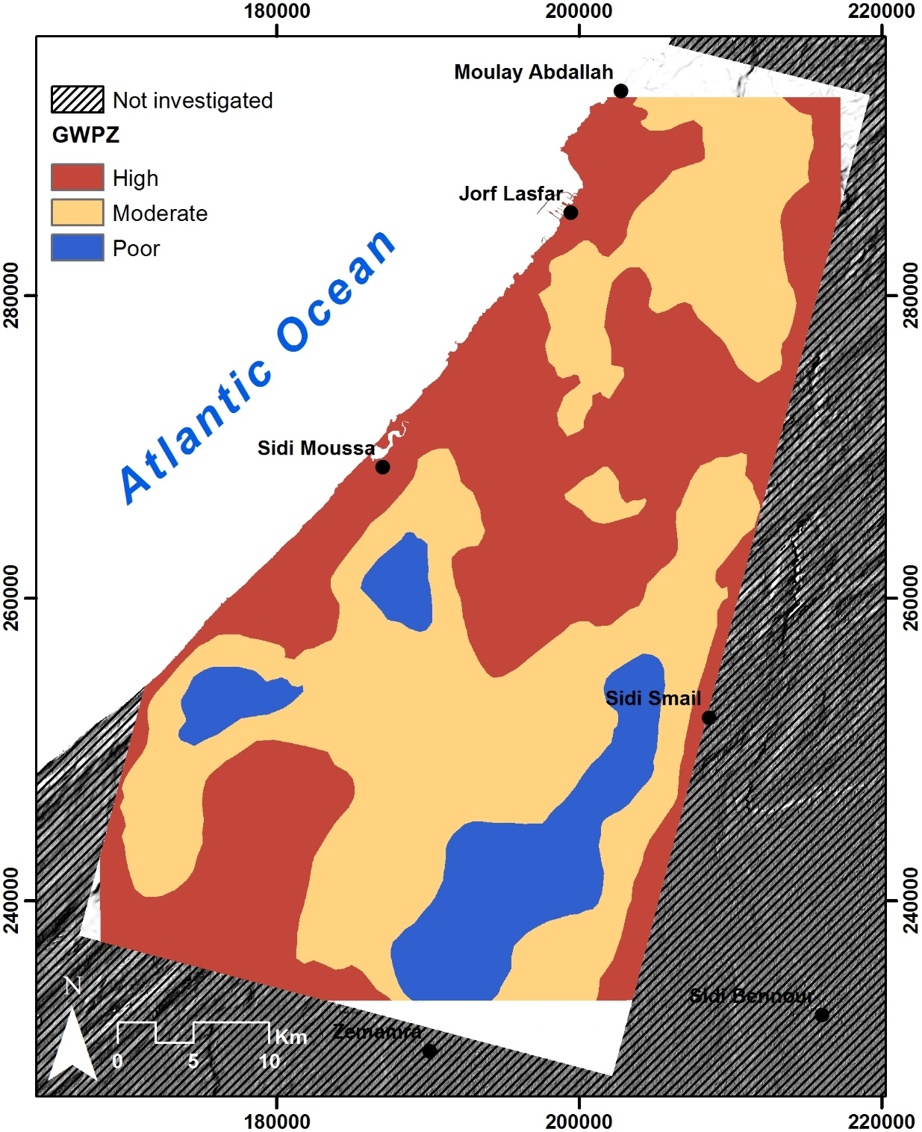
Results – GWPZs Mapping
‘‘ Good’’ ⇨ 43 %
‘‘Moderate’’ ⇨ 46 %
‘‘Poor’’ ⇨ 11 %
GWPZ map

Slide 7
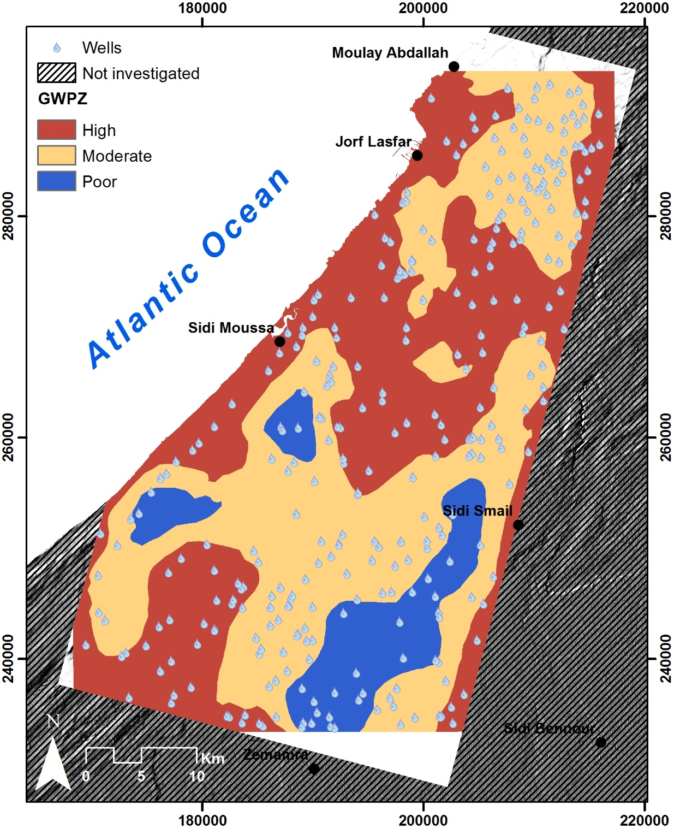
Results – GWPZs Mapping
‘‘ Good’’ ⇨ 39 % (127 wells)
‘‘Moderate’’ ⇨ 52 % (169 wells)
‘‘Poor’’ ⇨ 9 % (29 wells)
GWPZ map showing location of verified wells

Slide 8
Results – GWPZs Mapping
Statistical parameters of GWLP of in the three delineated GWPZs
 | Min | Max | Mean | SD | Count
Good | 0 | 104 | 37 | 25 | 68
Moderate | 2 | 97 | 31 | 20 | 169
Good | 2 | 105 | 27 | 22 | 127
Cumulative frequency of GWLP in the three delineated GWPZs

Slide 9
Vienna, Austria & Online | 23–27 May 2022
Thank you
Session GM2.3
Novel Data, Methods and Applications in Geomorphometry

