Slide 1
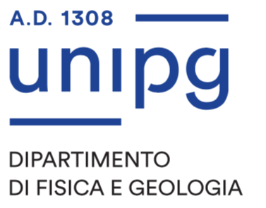


A scale-independent model for the analysis of geomorphodiversity index
L. Melelli ¹, M. Burnelli ¹, M. Alvioli ²
1 - Department of Physics and Geology, University of Perugia 2 - Istituto di Ricerca per la Protezione Idrogeologica, Italian National Research Council (CNR)

Slide 2
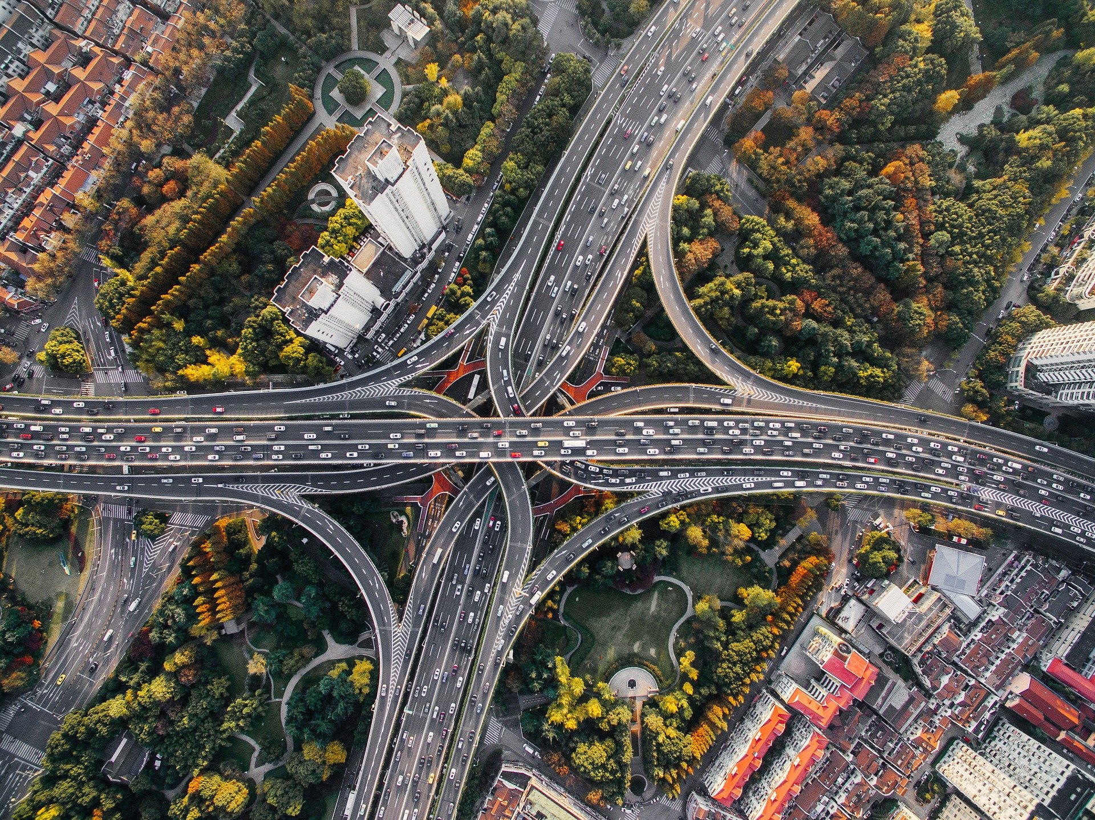

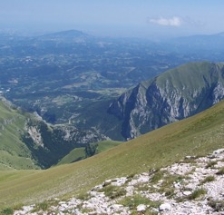
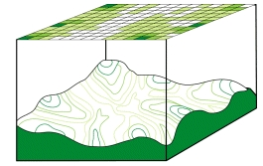
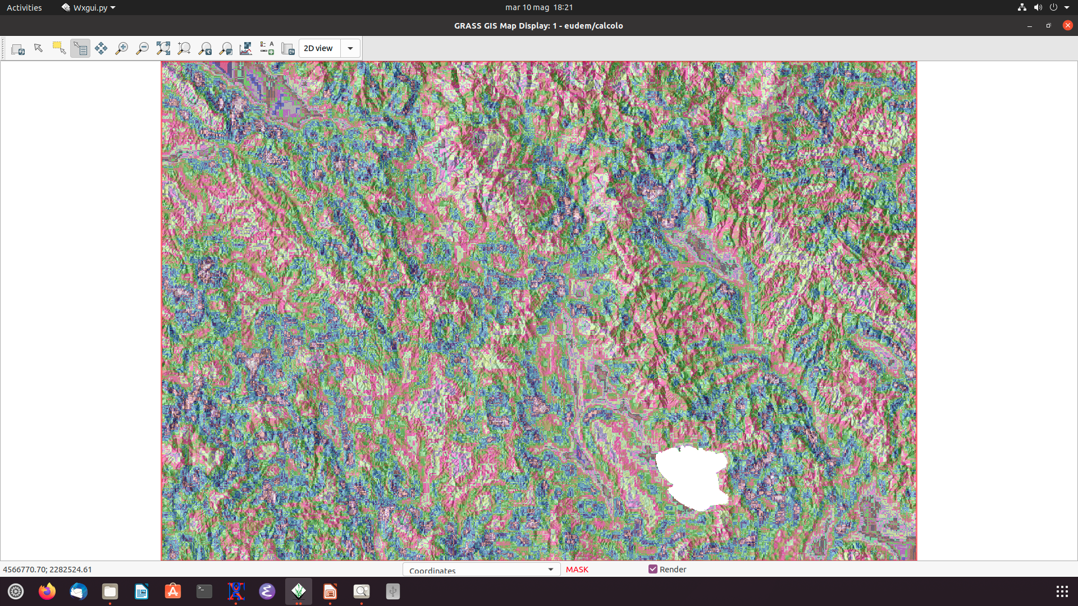

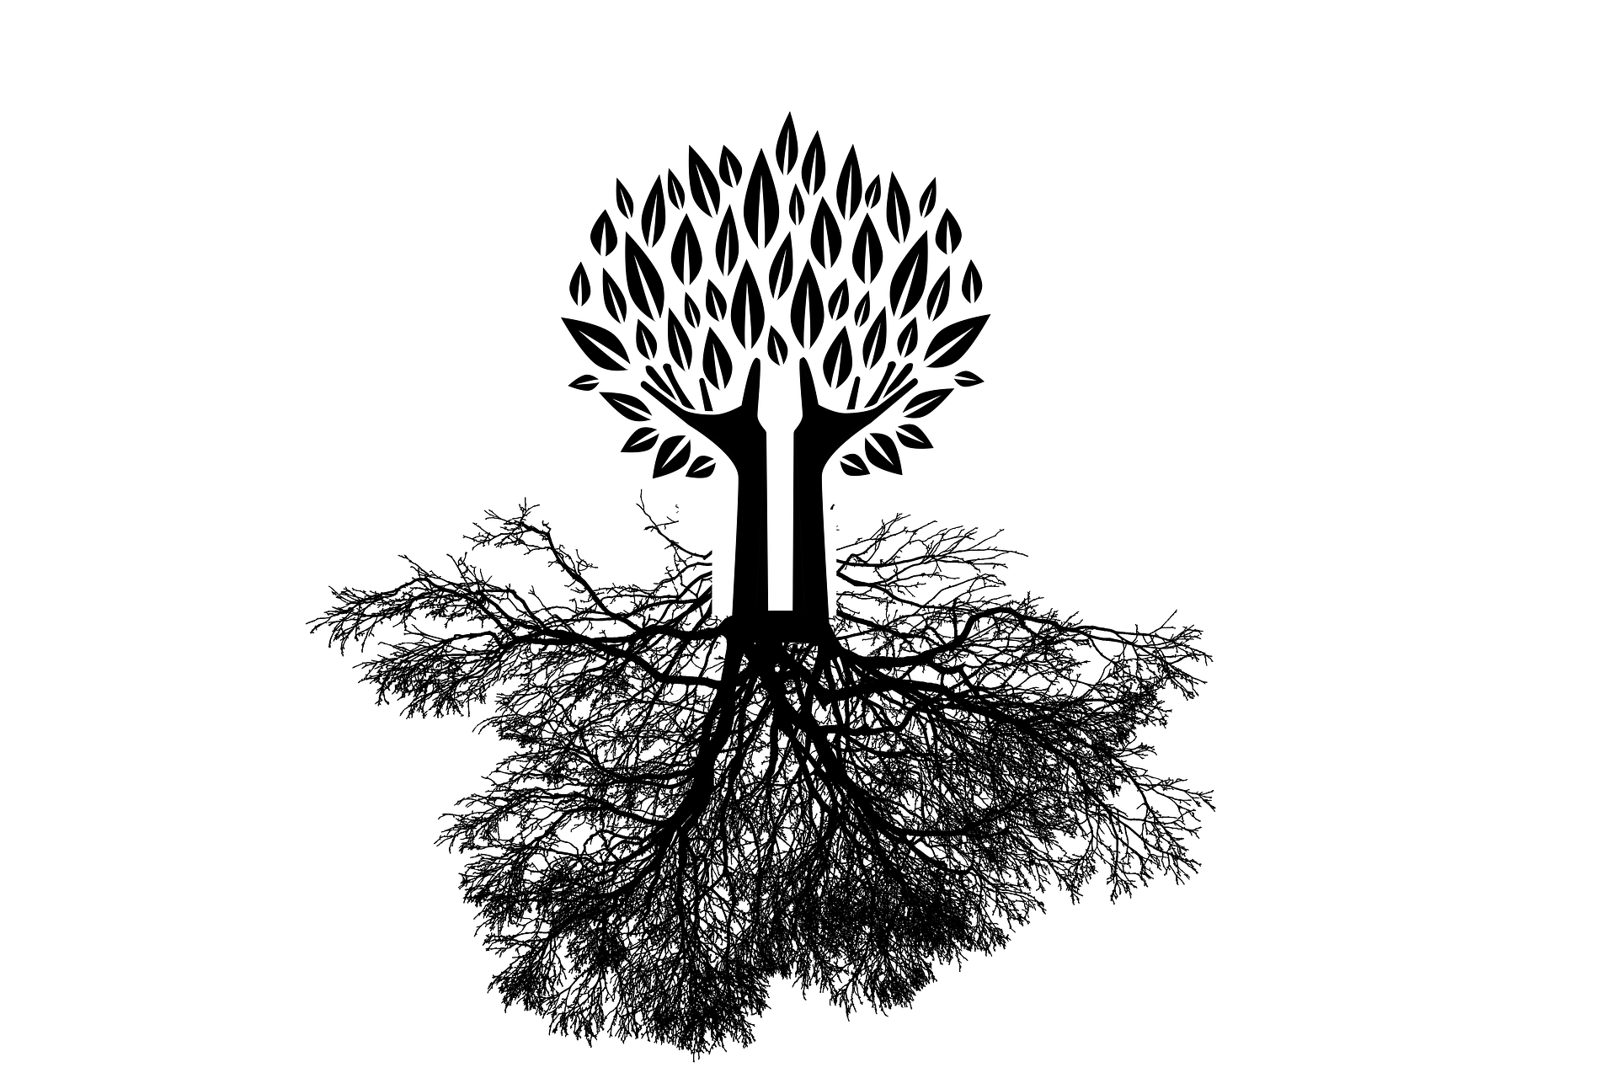

2050
70% world population will live in the cities
10% landmasses will be urbanized
World Urbanization Prospects (2018)
Geo-morphodiversity Index
Geo-morphodiversity index
as a starting point for the safeguard of urban ecosystems
ECO-DIVERSITY
BIOsphere
Landscape
Landforms
GIS
analysis
Mapping
Geomorphodiversity
GEOsphere
Melelli et al. (2017)

Slide 3
Geo-morphodiversity Index (GmI)
DEM (25m)
Drainage network
Geological complexes
Slope
Roughness
Geomorphons
Drainage Density
Input parameters
Lithology
Variety: number of different values within a moving window
GmI
Notes:
litologia e SU come punto di partenza

Slide 4
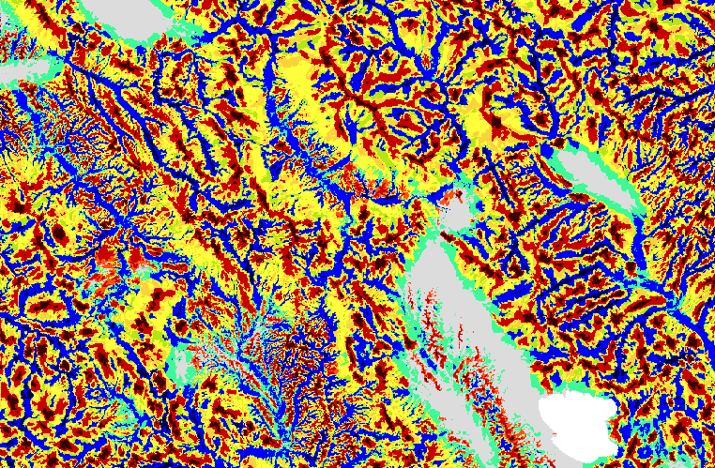
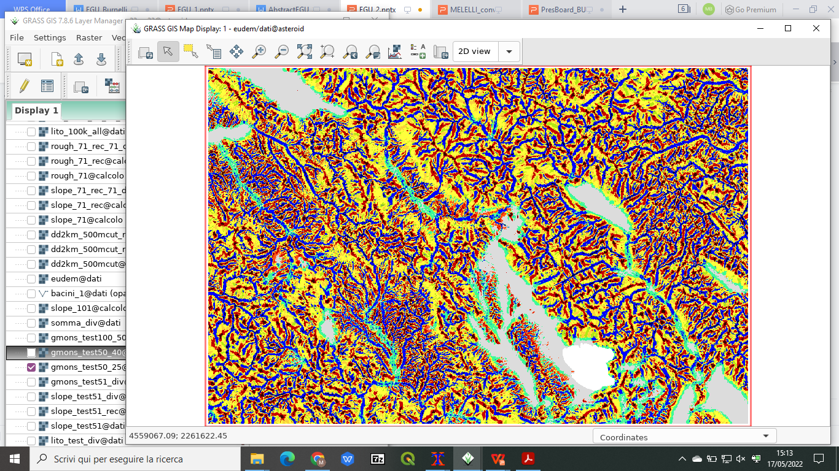
Geo-morphodiversity Index (GmI)
Goal: definition of a new objective, quantitative and scale-independent model
Different input parameters,
different output layers
Roughness
Landforms
(geomorphon)
Jasiewicz & Stepinski (2013)
Grohmann (2006)
Question: how should we set the input parameters of each feature?

Slide 5
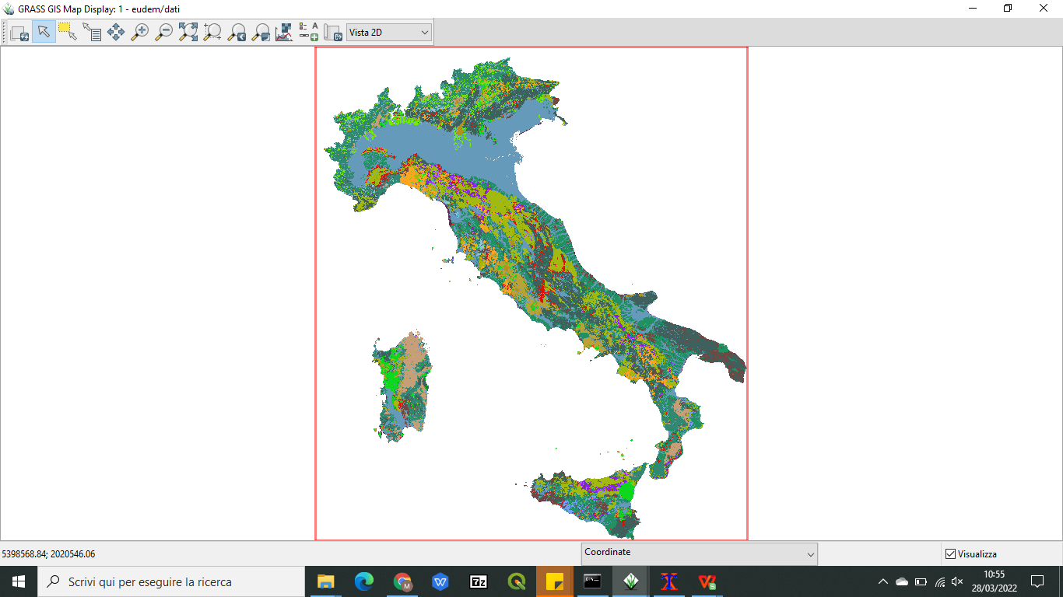
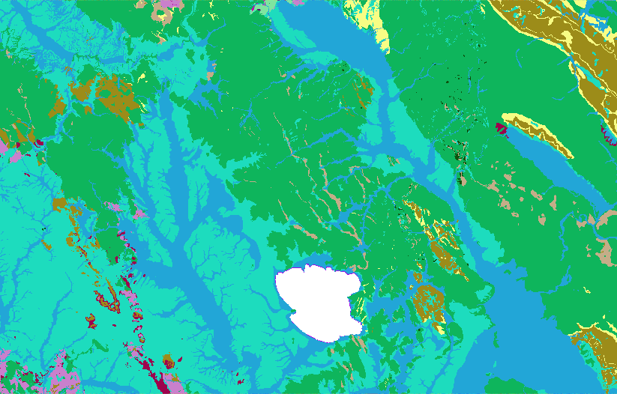
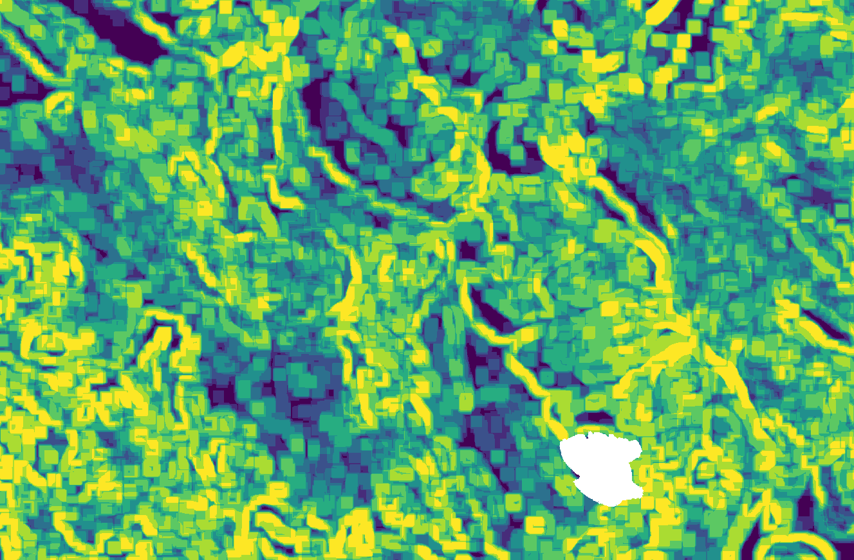
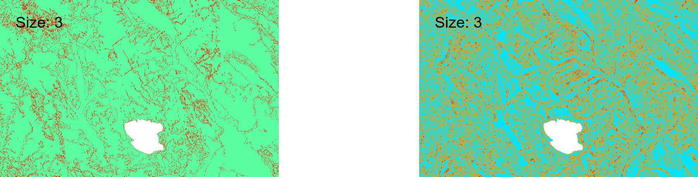
Geo-morphodiversity Index (GmI)
1
Lithology as driving feature
Bucci et al. (2022)
Lithology variety with different mw
Roughness variety with different mw
The best moving window for the lithology has been applied to the topographic features

Slide 6
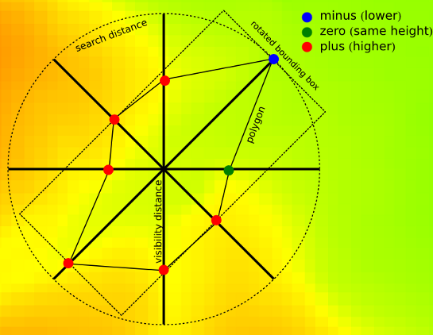
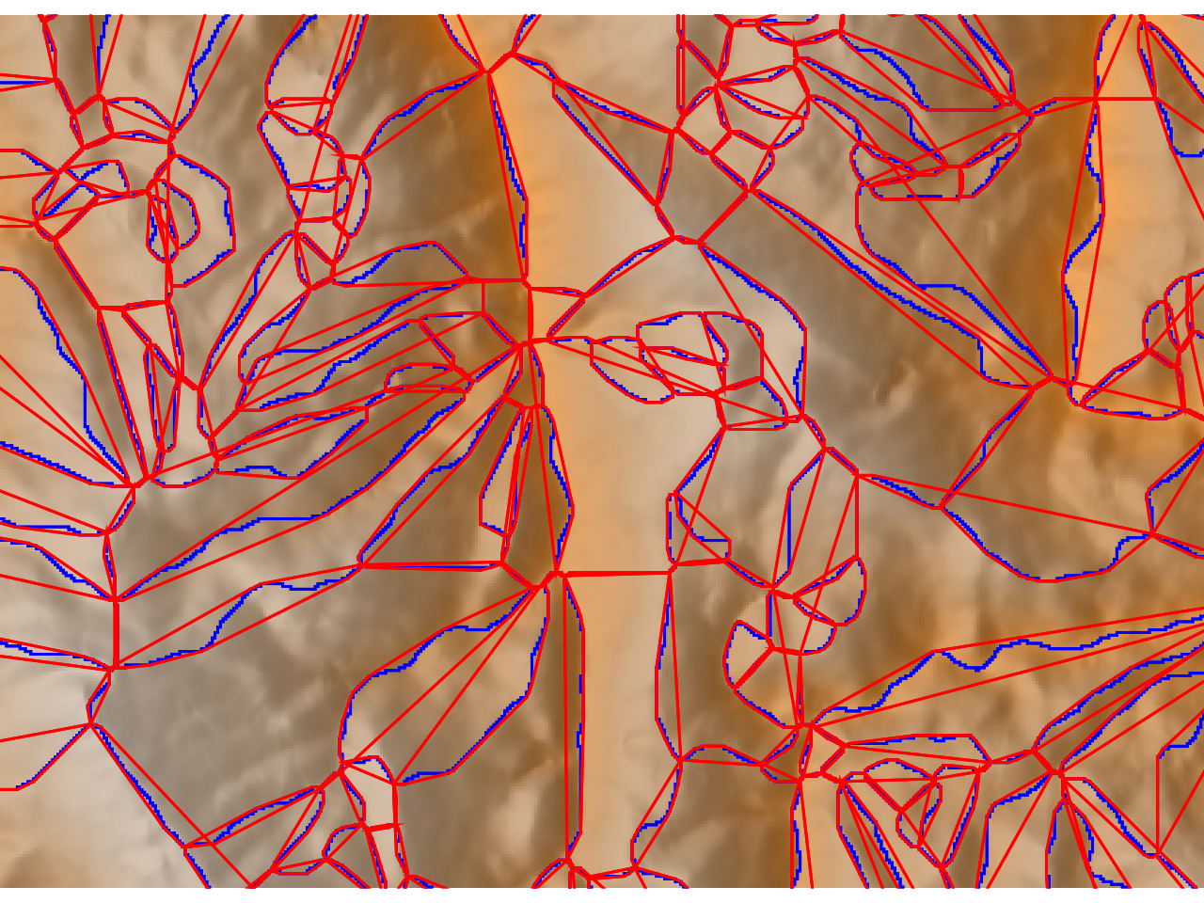
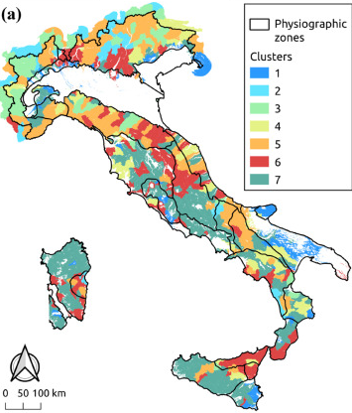
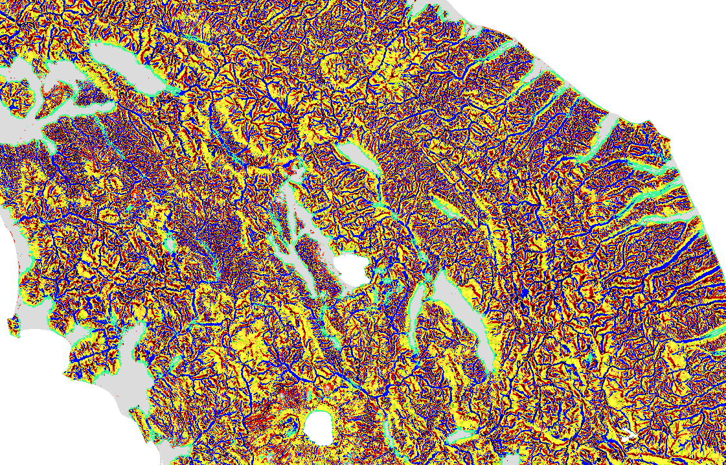
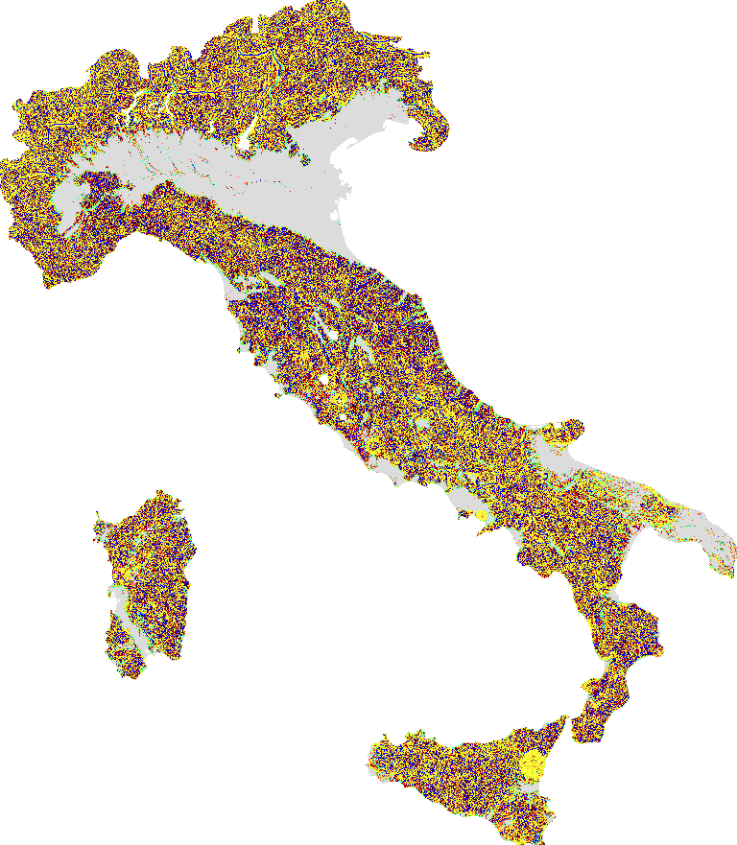
Geo-morphodiversity Index (GmI)
2
Geomorphon - terrain forms and associated geometry
Slope Units: terrain units delimited by drainage and divide lines, using exclusively information obtained from a DEM
Average size of slope units determines parameters for geomorphons
Alvioli et al. (2020)

Slide 7
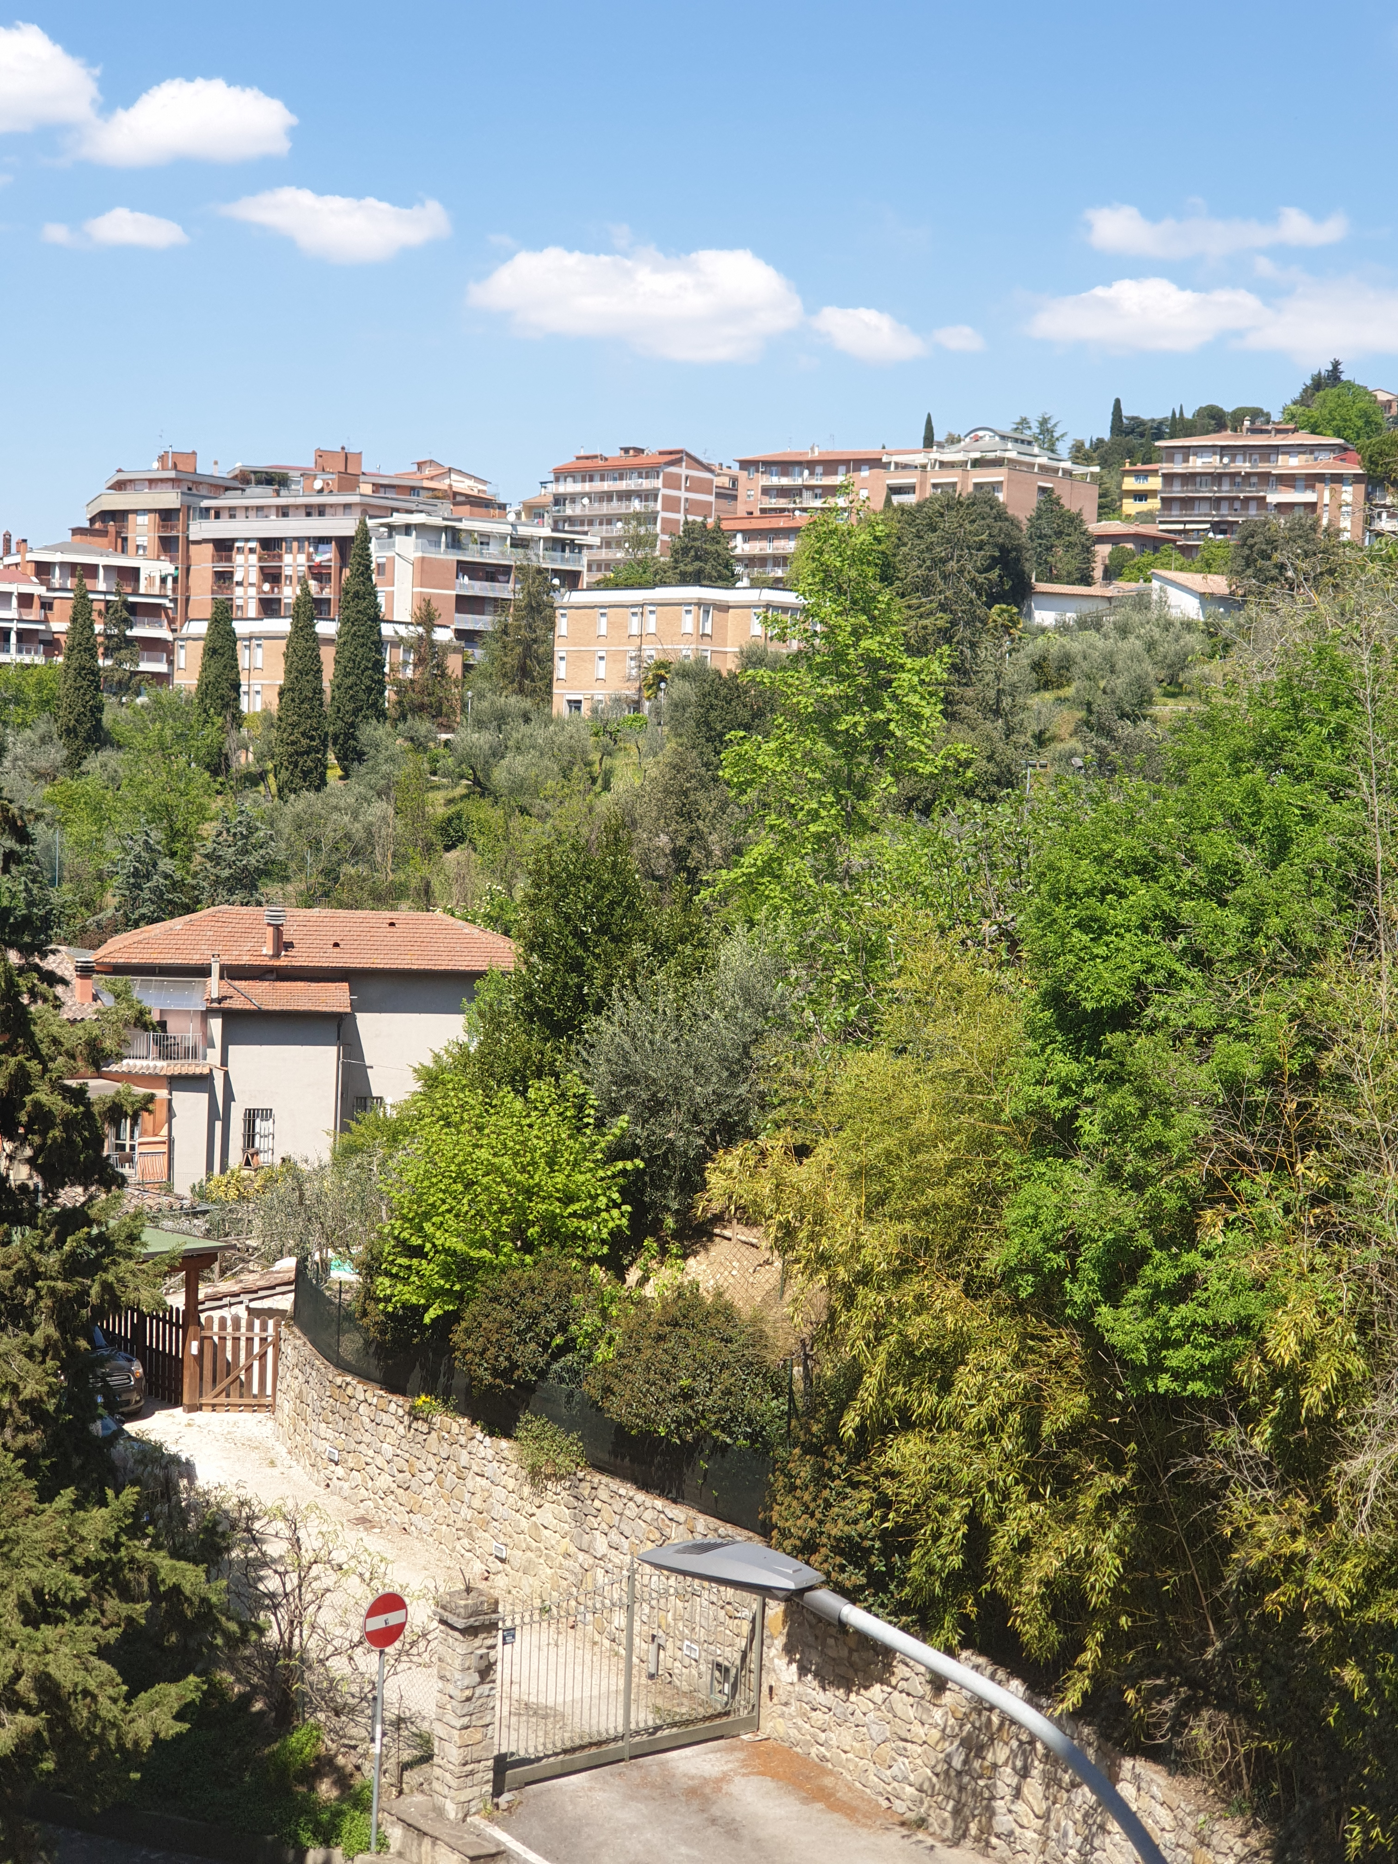
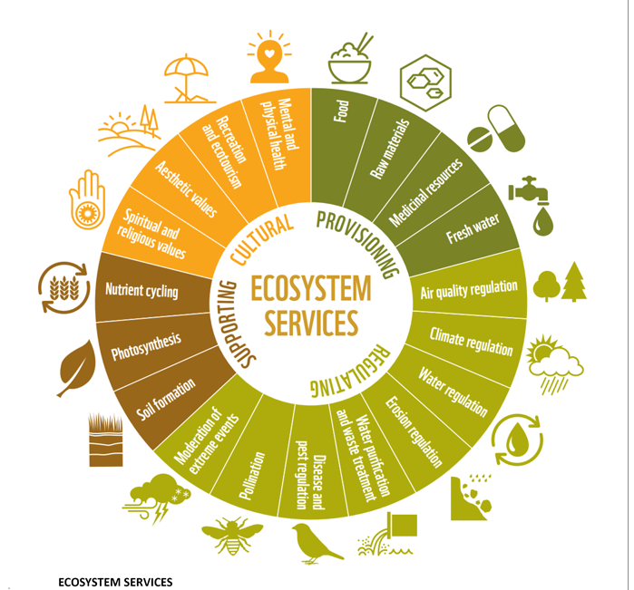
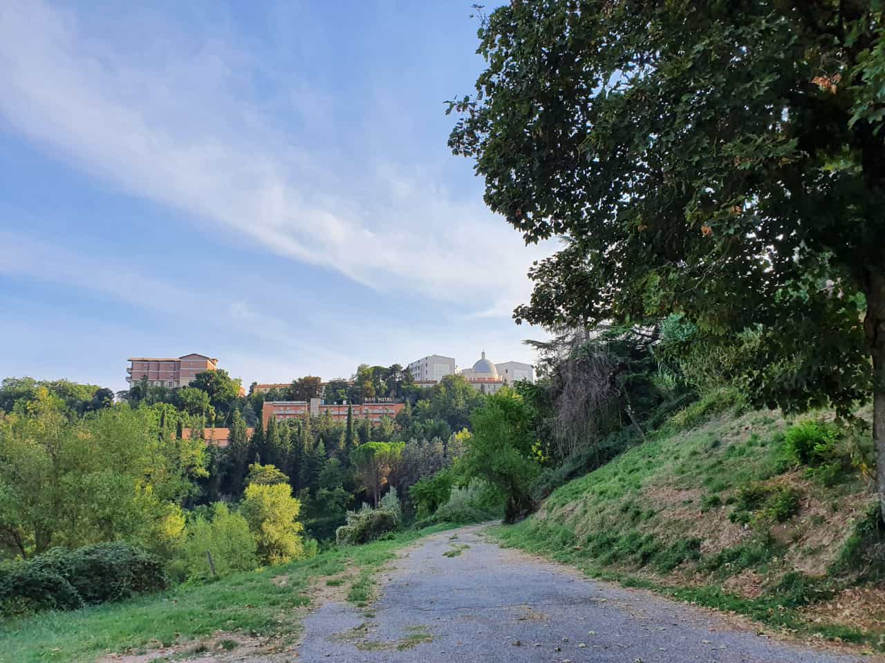
Further application and perspective
GmI
Natural cities
Urban GmI
Bio index
Urban Analysis
GM Index as a potential new model in the Urban Geomorphology

Slide 8
Thanks for your attention!
Martina Burnelli martina.burnelli@studenti.unipg.it

