Slide 1

A novel approach to systematically analyze the error structure of precipitation datasets using decision trees
Xinxin Suiª (suixinxin@utexas.edu), Zhi Li^{b}, Guoqiang Tang^{c}, Zong-Liang Yang^{d}, Dev Niyogi^{a, d}
ª Department of Civil, Architectural and Environmental Engineering, Cockrell School of Engineering, The University of Texas at Austin, Austin, TX 78712, USA
^{b} School of Civil Engineering and Environmental Science, University of Oklahoma, Norman, OK 73072, USA
^{c} Centre for Hydrology, University of Saskatchewan, Canmore, Alberta, Canada
^{d} Jackson School of Geosciences, The University of Texas at Austin, Austin, TX 78712, USA

Slide 2
Background: Machine Learning (ML) in Precipitation Field
1. Precipitation retrieval from satellites (PERSIANN-CCS, Hong et al., 2007);
2. Precipitation product improvement by correcting product errors (Bhuiyan et al., 2019, 2020)
Precipitation product + DEM -> reference data
Work undertaken By data mining from 60 decision trees (DTs), we evaluate three precipitation products (IMERG, SM2RAIN-ASCAT, and ERA5-Land) across Continental United States (CONUS). We analysed the spatiotemporal pattern of errors and their links with geographical factors.
Topic | Tool | Main concern | Central issue
Previous ML research | Black-box methods | Model result | Prediction of model
This research | White-box decision trees | Model structure | Interpretation of model

Slide 3
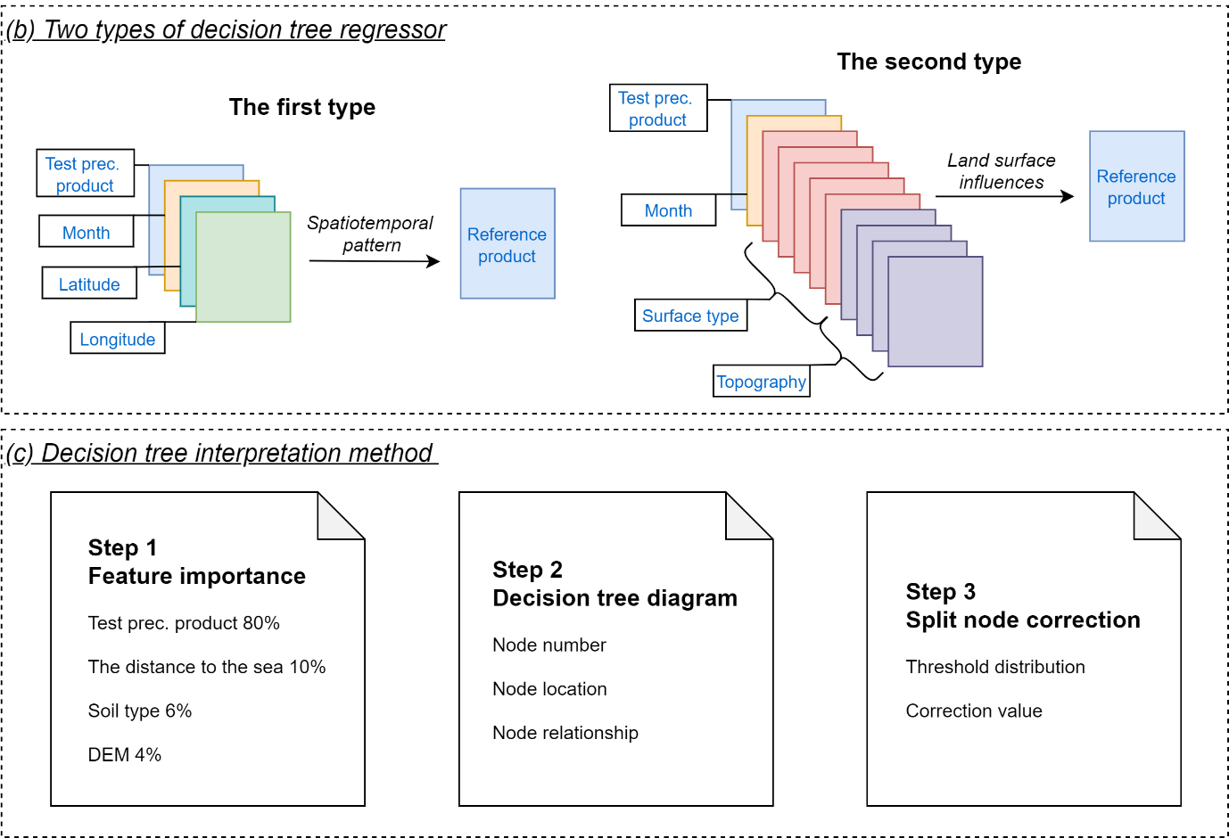
Methodology

Slide 4
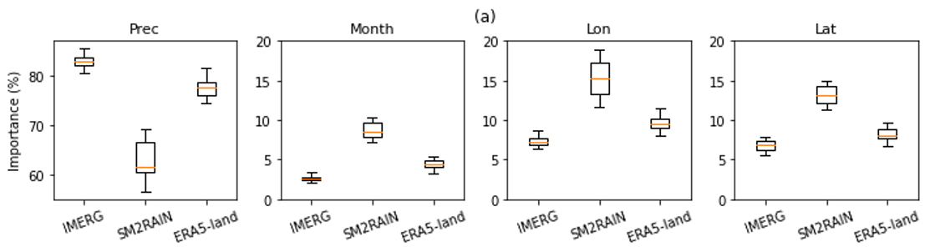
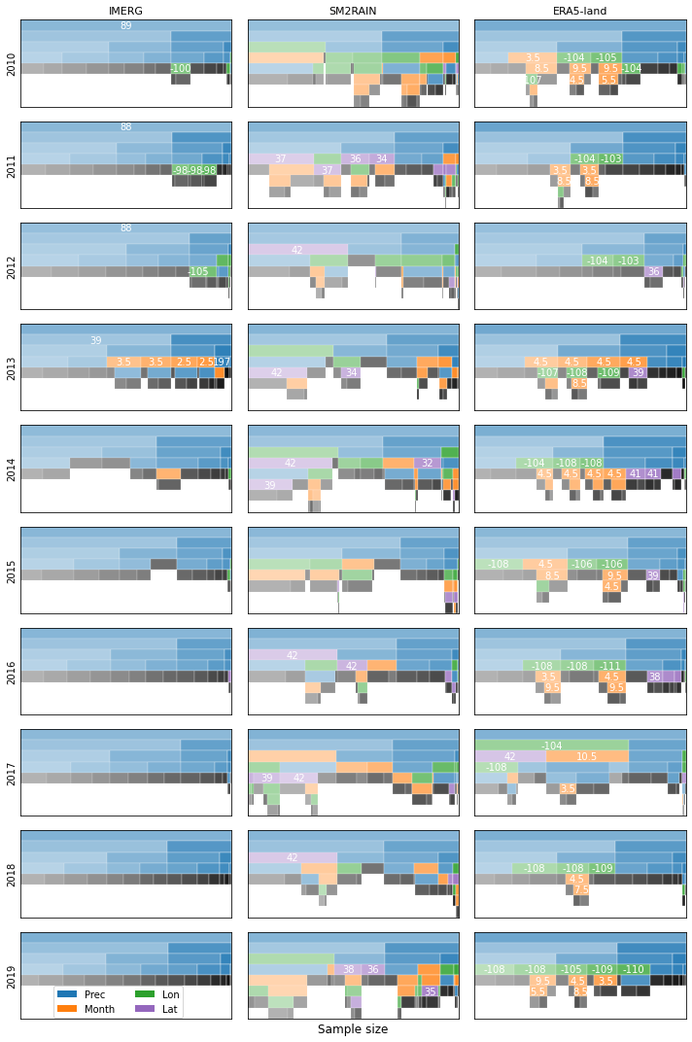
Result 1: Spatiotemporal patterns (DT1) Step 1: Feature importance (FI): Value and Variance of FI Step 2: Decision tree diagram
IMERG: Good performance.
ERA5-Land: Summer and non-summer correspond to under and overestimation.
SM2RAIN: Underestimation in cold high latitude areas in winter.

Slide 5
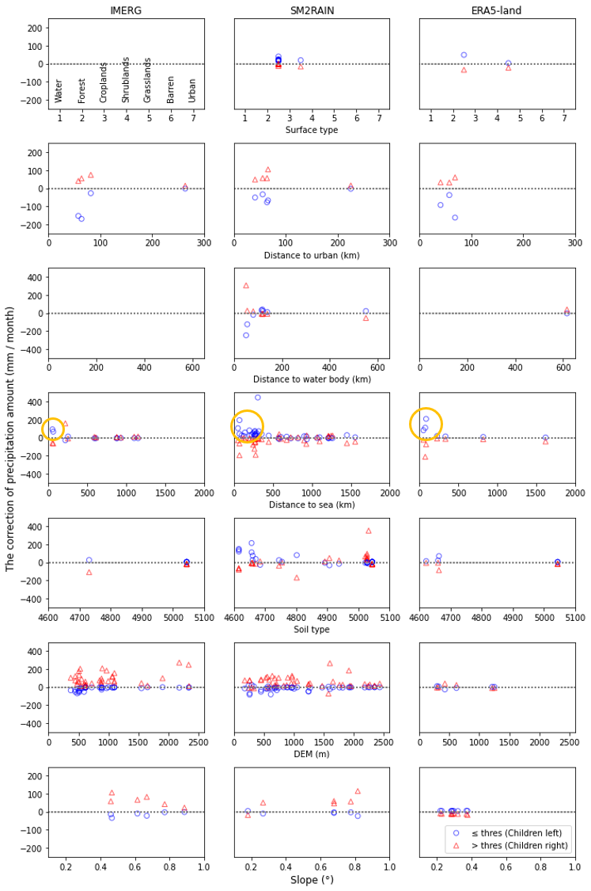
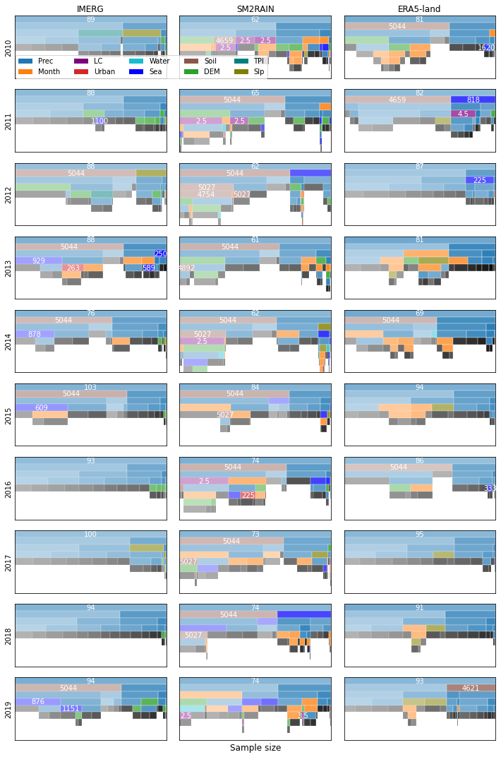
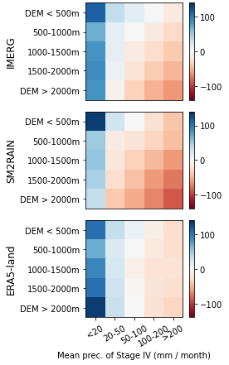
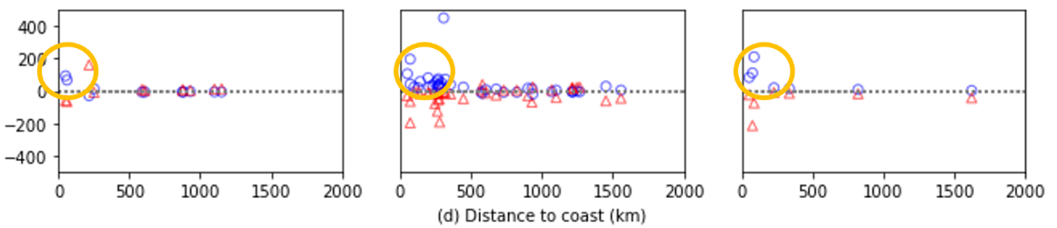
Result 3: Surface type influences (DT2) Step 3: Split node correction
Distance to coast: Underestimation in offshore
DEM: Underestimation in higher altitude for IMERG and SM2RAIN

Slide 6
Conclusions
IMERG performs better than ERA5-Land and SM2RAIN-ASCAT.
ERA5-Land underestimates precipitation in summer, and SM2RAIN-ASCAT underestimates precipitation over high latitudes in winter.
Three products overestimates in offshore areas.
Study significance
We promote a way to interpret decision trees and understand what is inside the machine learning box. This novel approach can provide additional insights out of our current understanding.
Acknowledgements
This work is supported by the National Aeronautics and Space Administration (NASA) Interdisciplinary Science (IDS) and National Science Foundation (NSF) Grants for Rapid Response Research (RAPID). Guoqiang Tang is supported by Global Water Futures (GWF).

