Slide 1
Tectonic and climatic controls on the stratigraphic architecture of the late Mesozoic Xuanhua basin, North China
Presenter: Chengfa Lin
Co-authors: Shaofeng Liu Cheng Tian Qitian Zhuang
Ruiwei Li Ronald J. Steel
2022-5-27
Notes:
Thank you Dr. Cheng and Good morning everyone!
I’m Chengfa Lin, from China University of Geosciences at Beijing. This talk is about decoding tectonic and climatic signals in terrestrial records of an late Mesozoic intramontane basin in North China.

Slide 2
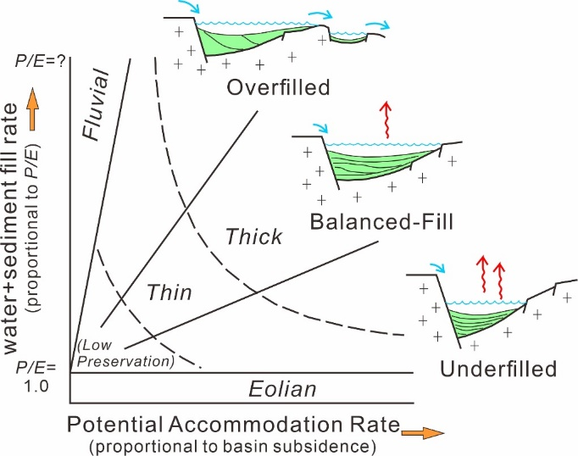
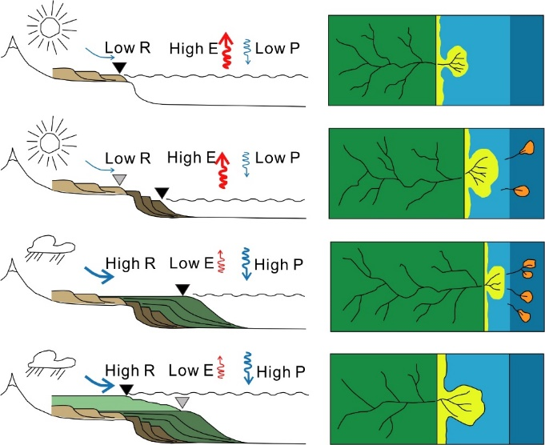
Goal of this talk
How tectonic activity and paleo-climate change, which are mutually independent, control the formation and evolution of strata in a lake basin?
Carroll and Bohacs, 1999, Geology
How to disentangle tectonic and climate signals from terrestrial records?
Zhang et al., 2019, Basin Research
Notes:
In nonmarine basins, tectonism and climatic changes are two most important allogenic controlling factors on sedimentology and strata patterns, because they determine the potential accommodation space, water discharge, and sediment supply. So, it has been a long-lasting, significant question that how to disentangle tectonic and climatic signals from terrestrial records.

Slide 3
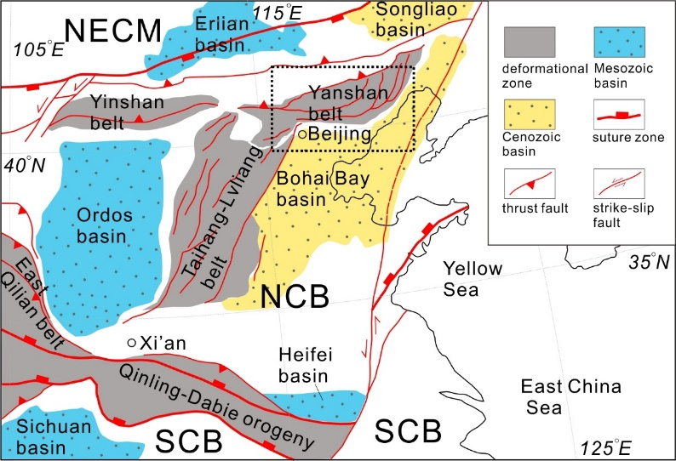
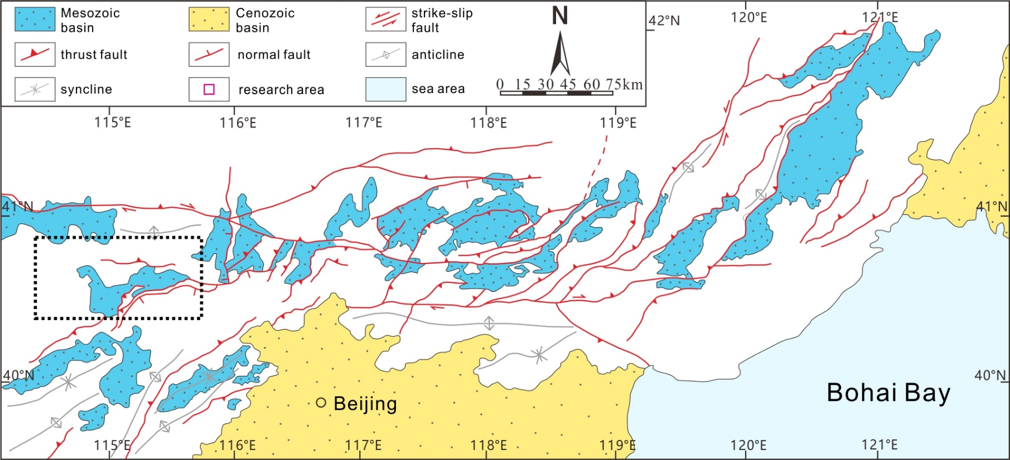
Yanshan fold-and-thrust belt
A Mesozoic intraplate deformation zone located in the northern North China Block
Development of numbers of Mesozoic, fault-bounding sedimentary basins
Underwent semiarid to arid palaeoclimatic condition during late Mesozoic period
Notes:
To answer this question, we need a terrestrial basin that not only has undergone specific structural activities, but also be sensitive to climatic changes. In this consideration, the Yanshan fold-and-thrust belt should be an idealistic area for our research. It is a Mesozoic intraplate deformational zone experiencing multi-stage faulting and has developed a series of small, fault-bounding basins, which are sensitive to both tectonisms and climatic changes.
The Xuanhua basin, locates in western Yanshan belt, offers a great opportunity for answering our question.

Slide 4
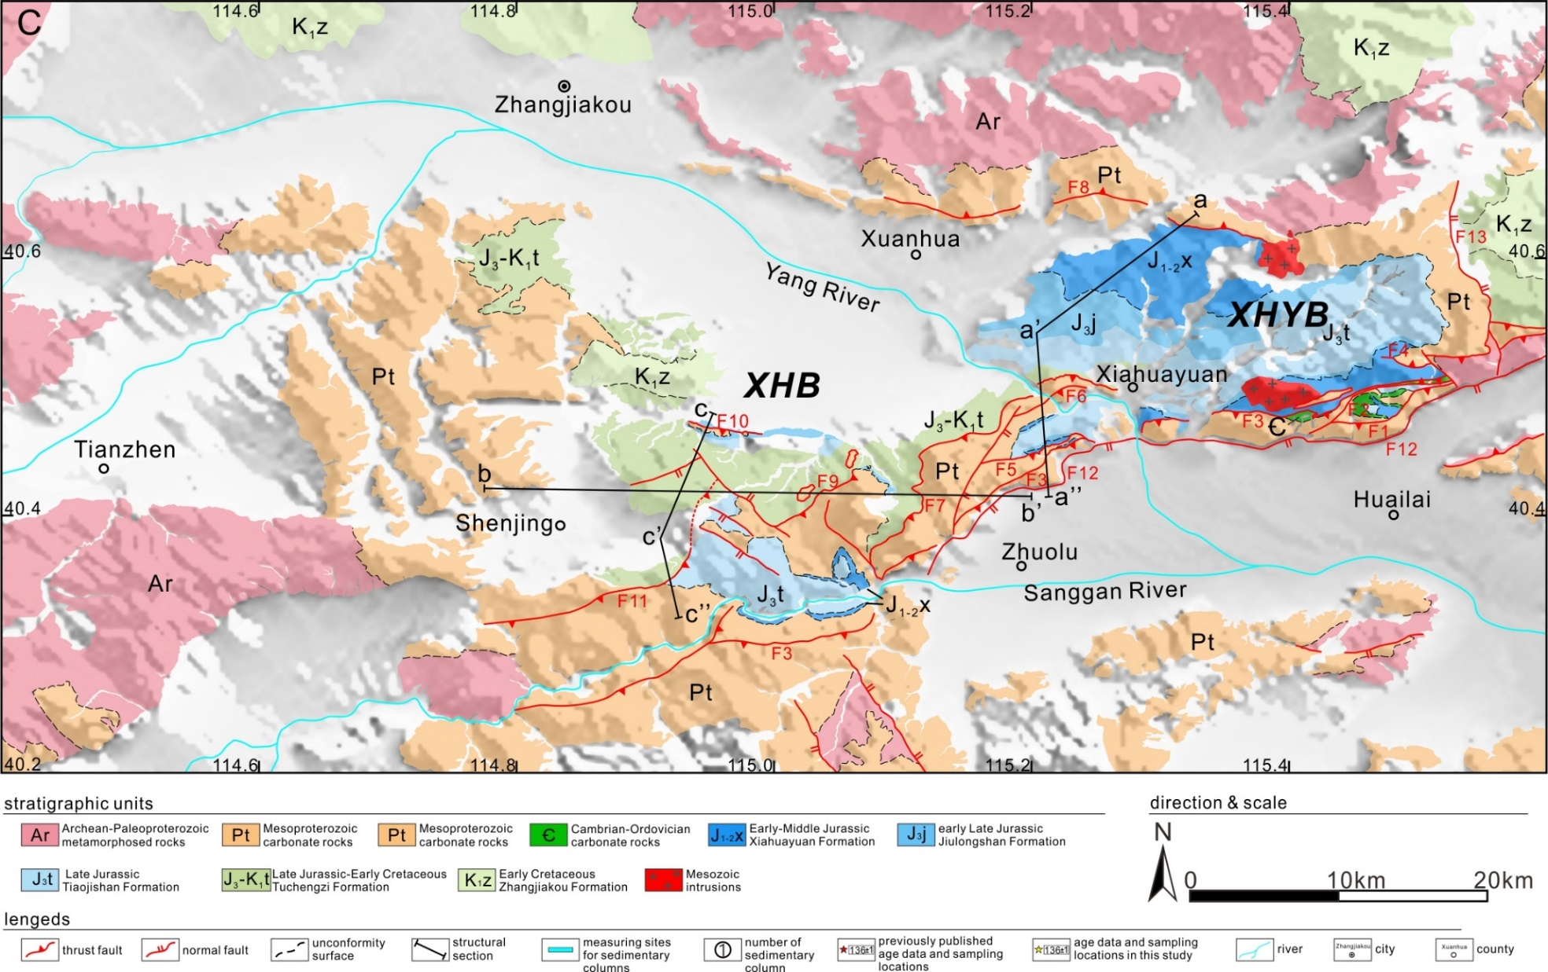
Why the Xuanhua basin?
A Late Triassic-Early Cretaceous, fault-bounded, intramontane basin
Notes:
The Xuanhua basin is the southern part of a greater basin, is confined by thrusting faults to its east and south and overlaps westward on Mesoproterozoic basement.

Slide 5
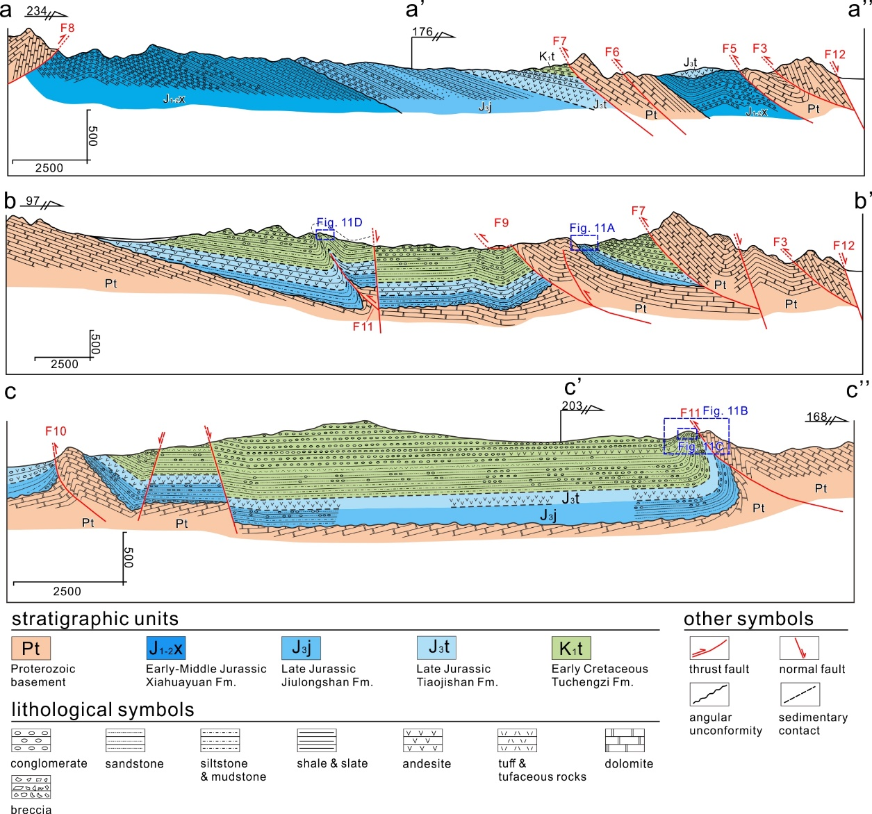
the Xuanhua basin-structures
Structural framework:
Thrust belt to the east and north, including Huangyangshan thrust fault (F7), Likouquan thrust fault (F9), Mapu thrust fault (F11) , North Xuanhua thrust fault (F8)
Mainly northwestward thrusting, displacing Mesoproterozoic basement atop Mesozoic basin –fillings;
NNE- or NWW-trending normal faults not earlier than Early Cretaceous
Notes:
These diagrams clearly show the thrust faults in eastern and southern margins of the Xuanhua basin.

Slide 6
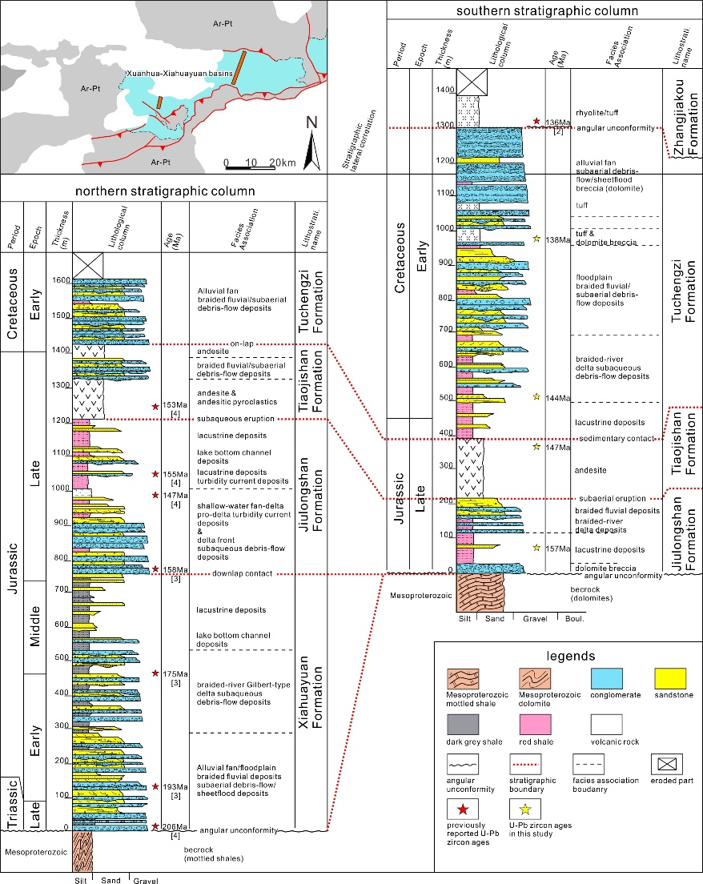
the Xuanhua basin-stratigraphy
Lithological features:
Alternation of sedimentary and volcanic successions
Rest on Mesoproterozoic rocks with angular unconformity surfaces
Geochronological framework:
Jiulongshan Fm (J3j): 161-155 Ma
Tiaojishan Fm (J3t): 155-147 Ma
Tuchengzi Fm (J3-K1t): 147-136 Ma
Zhangjiakou Fm (K1z): <136 Ma
Notes:
The left column shows that the basin-fillings are mainly composed of complete late Mesozoic strata, including 4 lithological units.

Slide 7
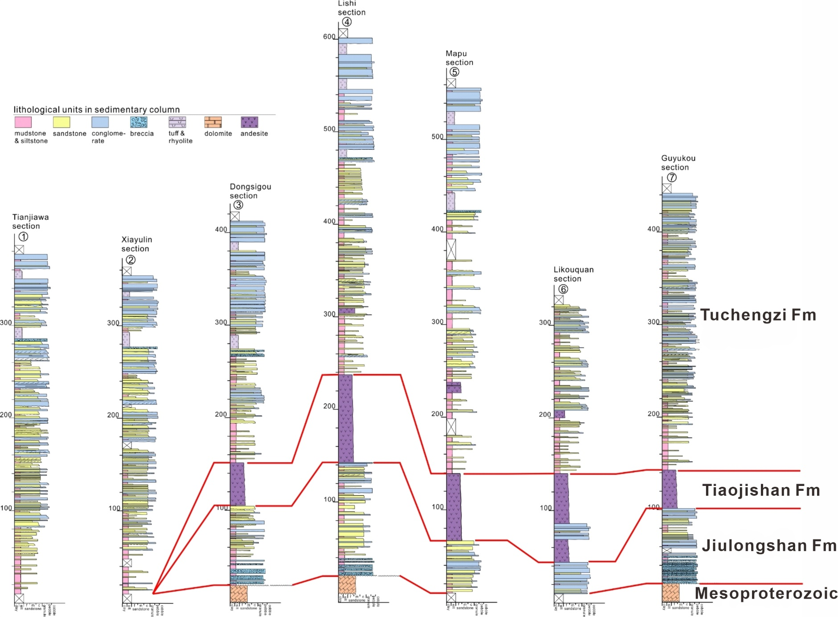
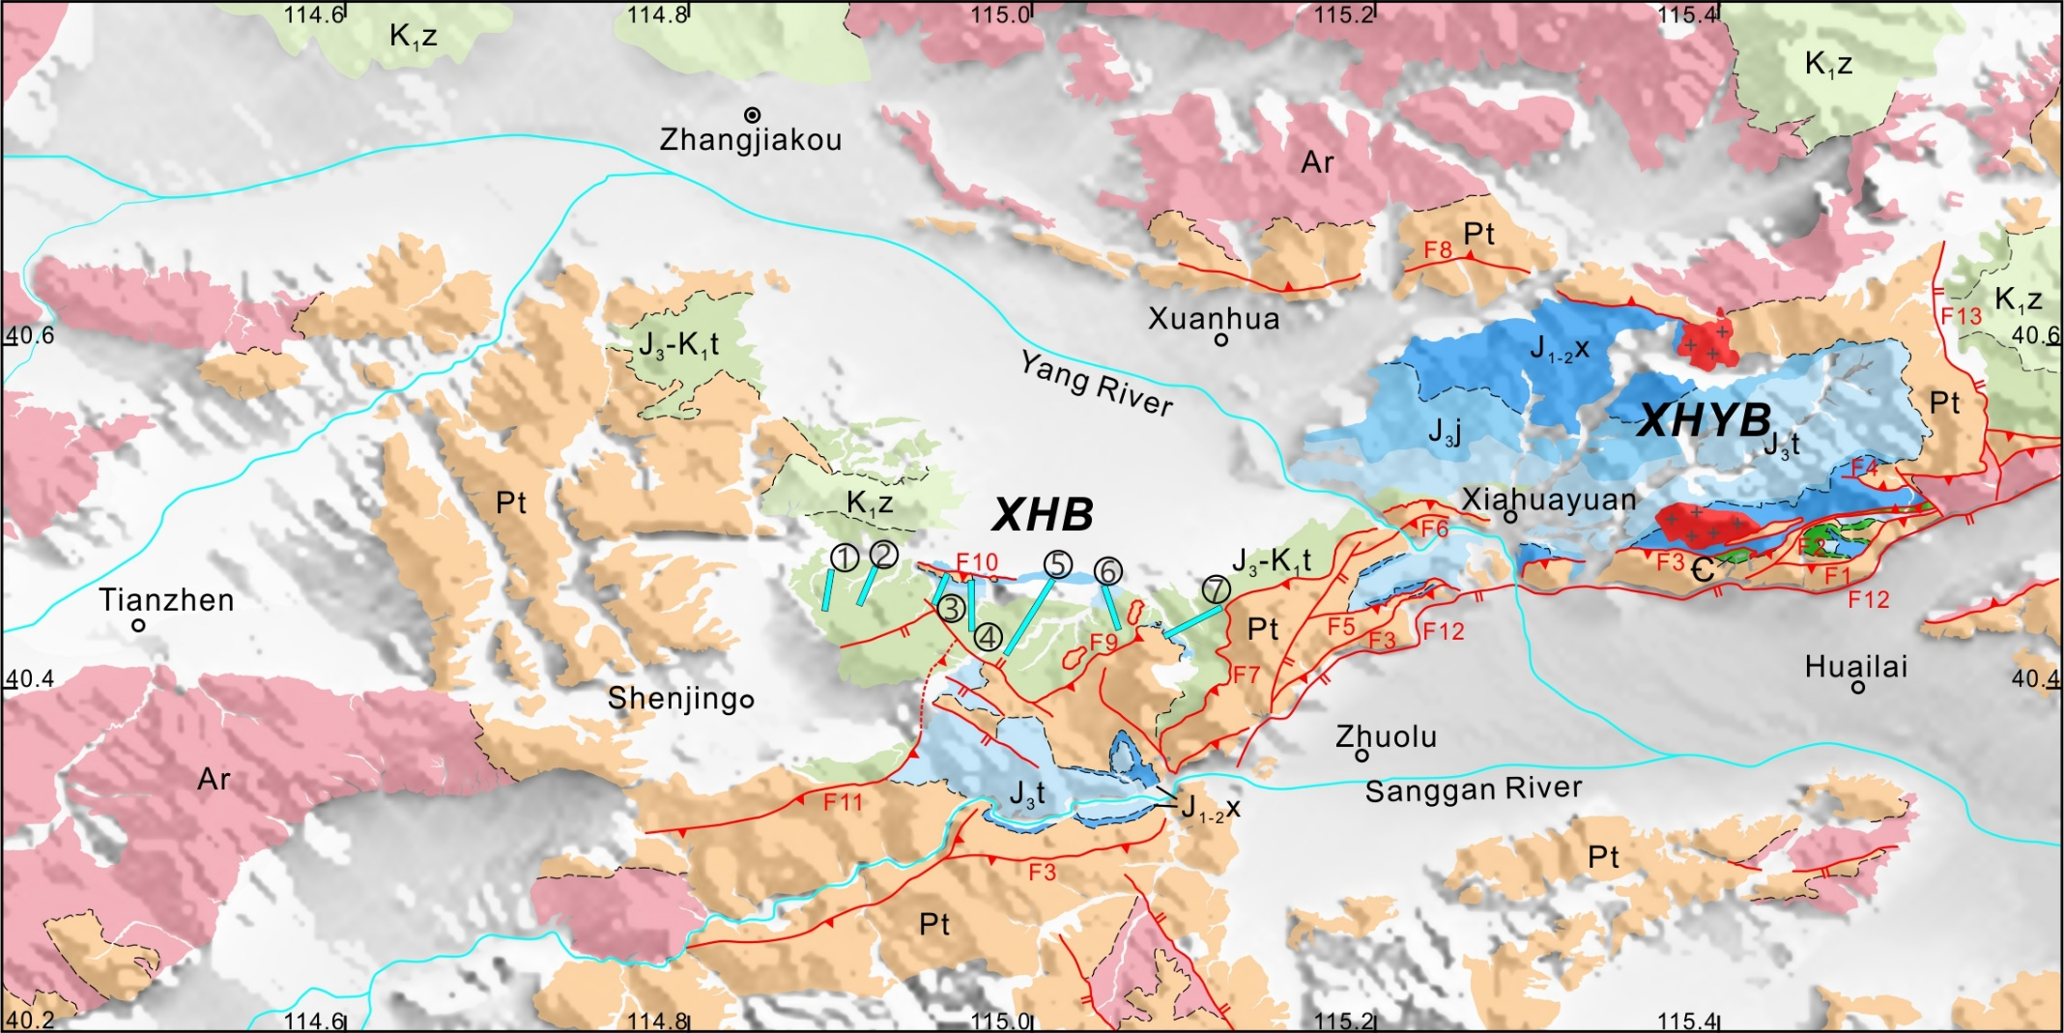
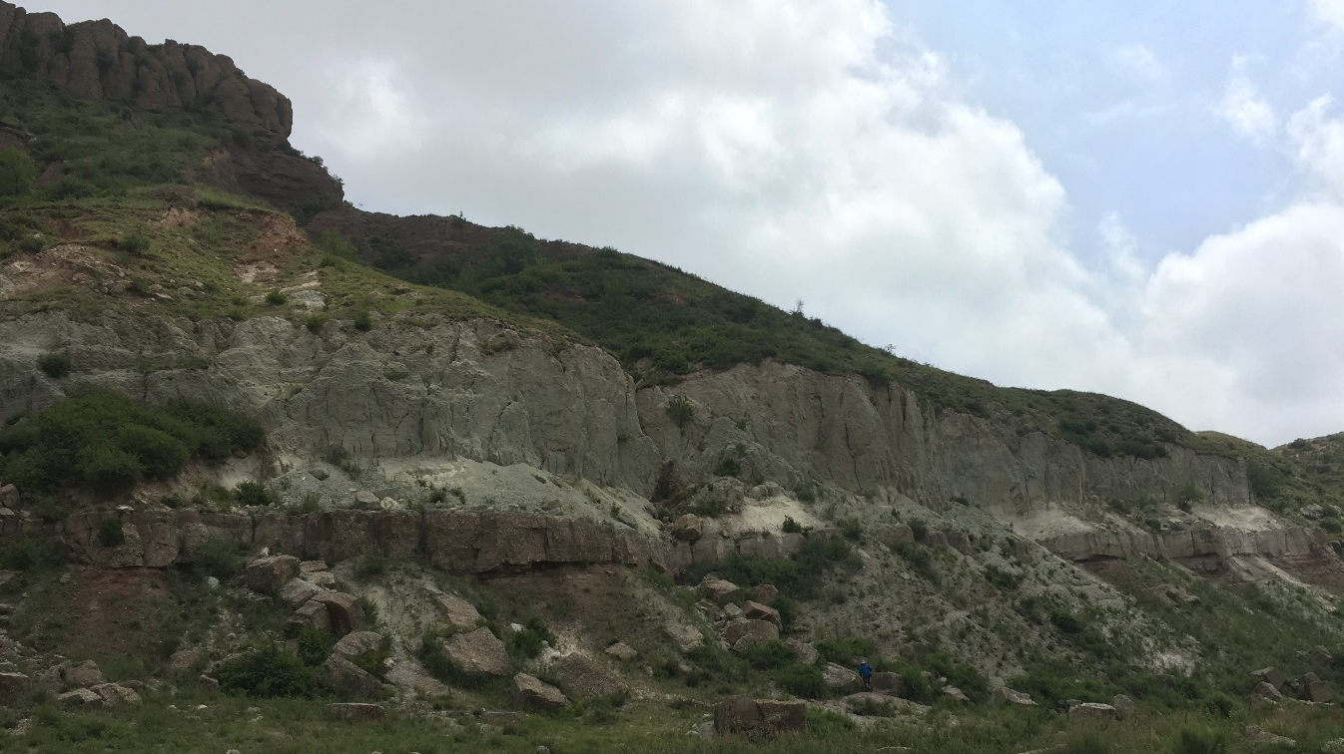
Field works-stratal pattern
Sedimentary analysis:
“bed-by-bed” logging
Detailed sedimentary facies analysis
Sedimentary section and 2-dimensional distribution of palaeoenvironment
Tuff & breccia package
tuff
breccia
Notes:
Our works are generally based on field investigations of stratigraphy, sedimentology, and provenance for the Tuchengzi Formation. 7 sedimentary columns are logged from west to east. A tuff & breccia package could be used as maker bed through the entire basin.

Slide 8
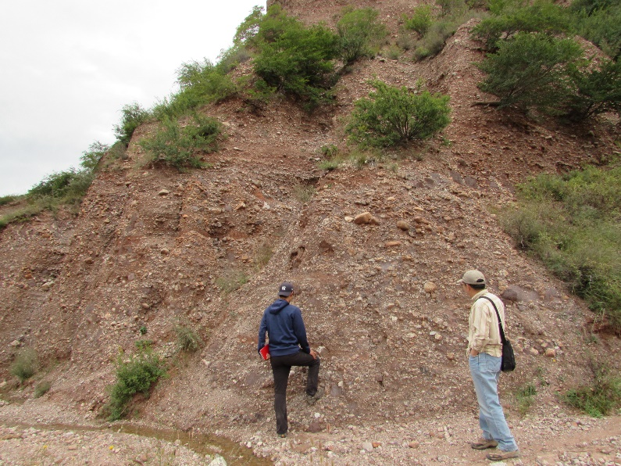
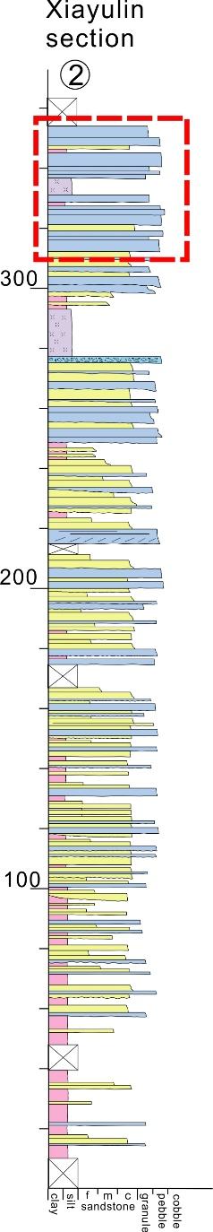
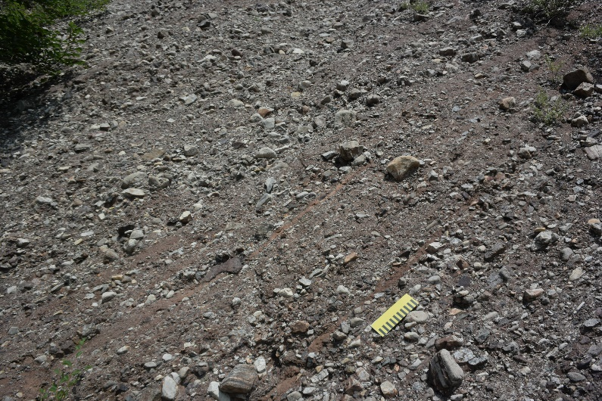
Field works-sedimentary facies analysis
Alluvial fan deposits
Facies association | Sub-facies association | Facies | Main depositional characteristics | Depositional process
Alluvial fan (AF) | Proximal channel complex | Gmm | Structureless, sheet-like or broadly lenticular, red muddy matrix-supported pebble-boulder conglomerate beds. Clasts are poorly sorted and mostly subangular-angular. Out-sized clasts of diameter over 45 cm generally extend across different beds. Single beds are paved with nonerosional surfaces. Amalgamated beds of meters thick commonly occur as lenticular fills in troughs scouring down into underlying beds. | subaerial cohesion debris-flows in confined channels in the fan head setting (Steel and Gloppen, 1980; Nemec and Steel, 1984),
 |  | Fm | Structureless or faitly laminated pebbly siltstone or mudstone with thickness over 10 cm. Sporadically occurred as erosional relics on top of facies Gmm conglomerate beds. | slack-water deposition of wanning floods in channels (Steel and Gloppen, 1980).
 |  | Sh | Stratified, pebbly sandstone beds generally rest upon Gmm conglomerates. Normal gradings are well developed. At locations, planar cross-bedding develops. | waning traction currents/stream flows evolved from debris flows in channels. (Nemec and Steel, 1984)
 | middle fan slope | Gms | Structureless or crudely stratified, clast- or matrix-supported pebble-cobble conglomerate beds with non-erosional bases. Single beds are generally tabular or broadly lenticular with thickness of 20 to 60 cm. Inverse-grading commonly develops in the basal part of single bed. Clasts are generally randomly aligned. | sheetflood deposition in the slope surface of alluvial fan without confinement of channel (Blair, 1999, 2000).
 |  | Go | Tightly packed, well sorted but poorly rounded pebble accumulations in between thick Gms conglomerate beds. These pebble accumulations are characterized with bimodal texture of pebble-cobble and silt-coarse sand. | Sieve sediments from rework of previously deposited Gms by subsequent floods or stream flows beyond intersection point in fan surface (Gloppen and Steel, 1981).
 |  | Gh | Horizontally stratified pebble conglomerate bed of broad lenticular geometry. Basal surfaces are erosional and accumulate large pebbles and cobbles. Flat pebbles show imbricate structure. | Lag deposits in bottom of channel by tractional flow (Steel and Gloppen, 1980).
 |  | Sm | Structureless pebbly sandstone beds with lenticular geometry. Normal grading is well-developed. | Deposition of wanning sheetflood om slope surface beyond intersection point (Blair, 2000).
 |  | Sh | Laminated pebbly medium- to coarse-grained sandstone beds of lenticular geometry, with highly eorosional bases. Normal-grading textures are common. Sometimes show planar or trough cross-beddings. | Tractional stream deposited sandstone in fan surface (Gloppen and Steel, 1981).
 |  | Fm | Thin-bedded, structureless mudstone with scattered pebbles, generally less than 5 cm thick. Occurred between Gms or Sm. | Relics of slack-water deposition of wanning floods in fan slope surface (Blair and McPherson, 1992).
debris-flow deposits
sheetflood deposits
Notes:
Detailed facies analyses recognized alluvial fan deposits in upper Tuchengzi Fm

Slide 9
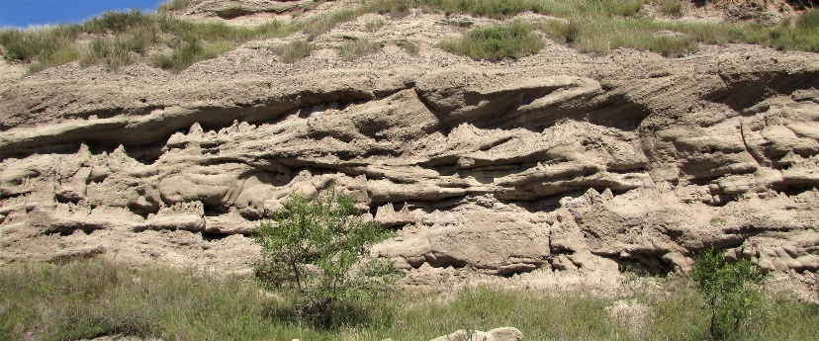
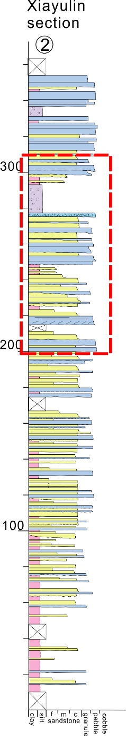
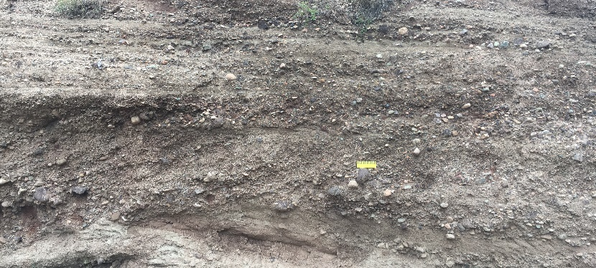
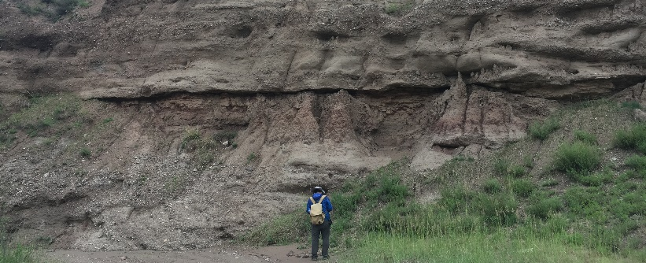
Field works-sedimentary facies analysis
braided river deposits
Facies association | Sub-facies association | Facies | Main depositional characteristics | Depositional process
Braided river (BR) | channel | Gt | Trough cross-bedded pebble-cobble conglomerate beds of lenticular geometry. Basal surfaces are highly erosional. | Gravelly bedform by tractional stream in channels of braided system (Miall, 2006).
 |  | St | Trough cross-bedded pebbly coarse-grained sandstone of lenticular geometry. Single beds in cross-bedded set are normally graded and inclined of 5-20 degree. Basal surfaces are highly erosional. | Sandy bedform by tractional stream in channels of braided river system (Miall, 2006).
 |  | Gmc | Isolated lobates or lenses of clast-supported, structureless pebble to cobble conglomerate, accummulating in highly erosional troughs. Normal gradings are common in uppermost part of these lobates or lenses. Generally, the Gmc conglomerates are thin and occur right beneath Gt conglomerate or St sandstone wedges. | lag deposits accummulate in erosional troughs of braided channels by tractional stram (Steel and Thompson, 1983).
 | gravel bar | Gp | Tabular cross-stratified pebble-cobble conglomerate of lenticular geometry. Cross-bedding sets are 45 to 120 cm high and the basal surfaces are erosional. Imbricated fabric is commonly developed in clasts. | Downstream migration of longitudinal and transverse, gravelly bars in braided river system (Steel and Thompson, 1983; Miall, 2006).
 |  | Gh | Horizontally stratified, clast-supported pebble-cobble conglomerate. Erosional bases and internally normal gradings are common. Generally overly Gp conglomreate beds. | Highest portion of longitudial or transverse bars during high-discharge flooding (Steel and Thompson, 1983).
 | sandier bar | Sp | Tabular cross-bedded pebbly coarse-grained sandstone beds of lenticular geometry. Basal surfaces are erosional. Flat pebbles aligned along beddings. | Migration of longitudial and transverse sandy bars in lower reaches of braided river system during low-discharge stage (Miall, 1977).
 |  | Sh | Horizontally stratified or low-angle cross-bedded pebbly sandstone beds with erosional bases. | Highest portion of sandy longitudial or transverse bars during high-discharge flooding (Miall, 1977; Steel and Thompson, 1983).
 | flood-plain | Fm | Red, structureless or faintly laminated mudstone and siltstone beds. Abundant in root casts. | Slack-water deposition of fine-grained sediments in abandont channels or in flood plain setting (Gobo et al., 2015).
 |  | Sr | fine- to medium-grained sandstone with wavy ripple or climb ripple beddings. Gnenerally overlying Fm red mudstone beds with erosional bases. Normal gradings are common. | Over-bank deposition in flood plain setting during high-discharge flooding events (Miall, 1978).
tractional stream deposits in braided channel
gravelly bar migration
slack-water deposits
Notes:
Braided river in middle parts

Slide 10
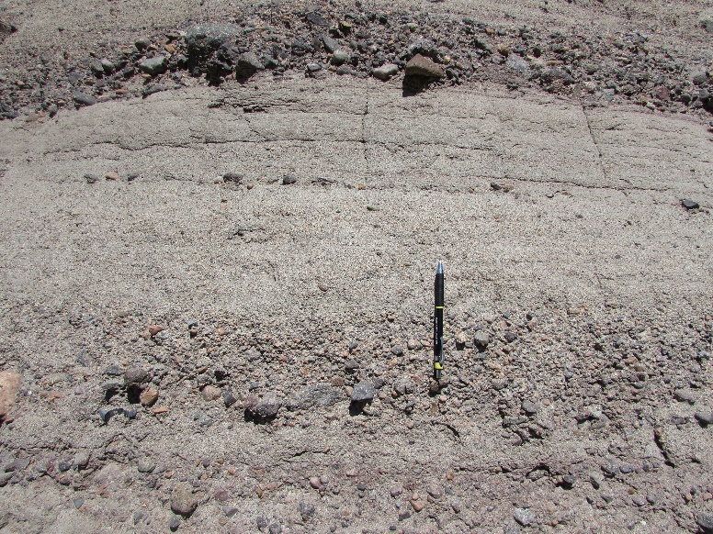
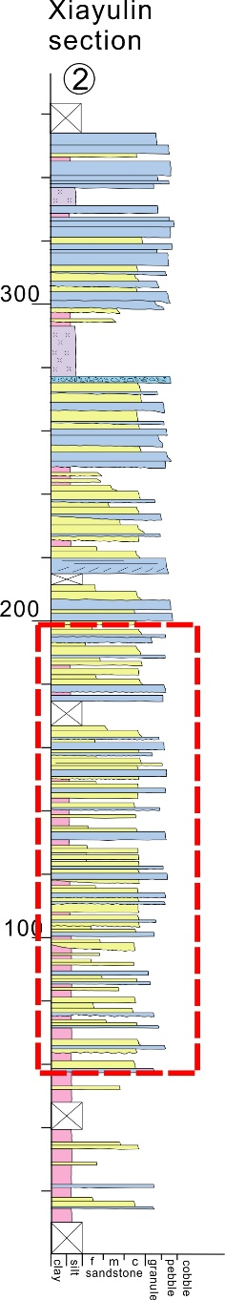
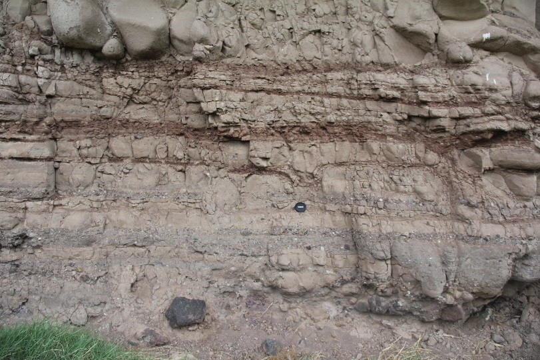
Field works-sedimentary facies analysis
river delta deposits
Facies association | Sub-facies association | Facies | Main depositional characteristics | Depositional process
River delta (RD) | delta front (DF) | Gn | sand- to granule-supported, well-stratified pebble conglomerate; normally graded upward into Sm gravelly sandstone; paved with non-erosional or low-relief erosive bases; lack of fine-grained sediment in matrix | depositions from high-density gravel trubidity current in delta slope (Lowe, 1982).
 |  | Gmc | Structureless, clast-supported pebble conglomerate. Matrix material is composed of well-sorted coarse-grained sands. Flat clasts show bed-parallel alignment. Single beds are tabular or broad lenticular and are paved with non-erosional bases. Lowermost centimeters of single beds are inversely graded. | deposition of cohesionless debris-flows in delta surface driven by flood surges or gravity (Lowe, 1982).
 |  | Gmm | Structureless, sheet-like pebble-small cobble conglomerates with muddy matrix-supported texture. Generally occurred as thin (15-40 cm thick) intercalation in Fm segment in DF facies association. Clasts are randomly scattered within muddy matrix, showing no fabric. | Deposition of subaqueous debris-flow, which originating from mixture of debris-fall clasts with unsolidated clay in delta slope (Nemec and Steel, 1984).
 |  | Gos | Isolated, lenticular units consist of openwork pebble to cobble conglomerate, up to 50 cm thick with upslope tail and downslop head; also occurred as isolated or clustered outsized large cobbles or boulders crossing beddings. | Deposition from debrisfall processes as gravels rolling down on delta slope under effect of gravity, either individually or in groups (Gobo et al., 2014, 2015).
 |  | Gp | Large-scale (over 80 cm high) tabular cross-bedded pebble-cobble conglomerate or pebbly coarse-grained sandstone beds of wedge shape. Basal surfaces are erosional, cutting down deep into underlying Gn and Gmc conglomerates. Generally occurred in upper part of DF facies association. | Deposition from migraiton of river-mouth bars or from bedform migration in subaqueous distributary channles in upper delta slope setting （Schomacker et al., 2010).
 | pro-delta (PD) | Sm | Structureless fine- to medium-grained sandstone beds of tabular or lenticular geometry with thickness varies from 20 cm to over 140 cm, some amalgamated beds can exceed 3 m thick. Abundant in burrows and crawling traces of worms. Basal surfaces contacting with underlying Fm mudstones are flat and non-erosional. | Deposition of sandy debris-flows in delta toe setting (Talling et al., 2012).
 |  | Sc | Medium- to coarse-grained sandstone beds with convolute beddings. Sandstone beds generally highly deformed and even teared apart. | Soft-sediment deformation by gravity in lower reach of delta slope setting (Cope et al., 2010).
 |  | Fm | Structureless sandy mudstones and siltstones with prominent bioturbational structures. Fossils of burrow and crawling trace are also common. | Deposition of fine-grained sediment settling from suspension and was subsequently modified by frequent mass-flows and activities of creatures (Deynoux et al., 2005).
high-density turbidite
sandy turbidite
Notes:
river delta deposits

Slide 11
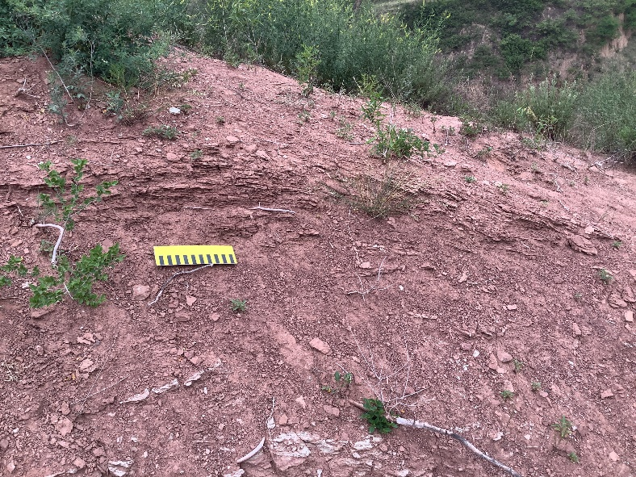
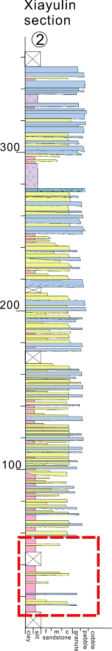
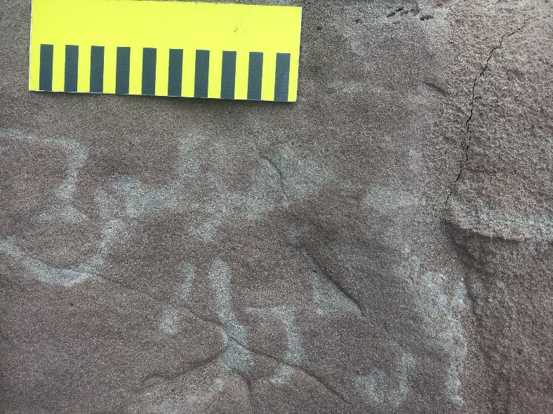
Field works-sedimentary facies analysis
open-lake deposits
Facies association | Sub-facies association | Facies | Main depositional characteristics | Depositional process
Open lacustrine (OL) | offshore lake | Fl | Laminated mudstone and siltstone form several meters to tens of meters thick amalgamated beds with thin bedded Sm interlayers. Calcareous nodules, root traces, and mudcracks are common in uppermost of these thick mudstone beds. | Deposition of fine-grained sediment settling from suspension in offshore area of lake (Benvenuti, 2003; Cope et al., 2010). Lake experienced periodic wetting and drying processes.
 |  | Sm | Thin-bedded (5-15 cm thick), structureless medium- to coarse-grained sandstone beds of sheet-like geometry, lateral extending for less than 5 m. Sandstoen beds have flat, non-erosional bases. | Deposition of unconfined sandy turbidity currents in lake bottom, originating from delta slope.
suspension settle
deposits in off-shore setting
low-density
turbidite in off-shore setting
Notes:
And lacustrine deposits in lower-middle parts

Slide 12
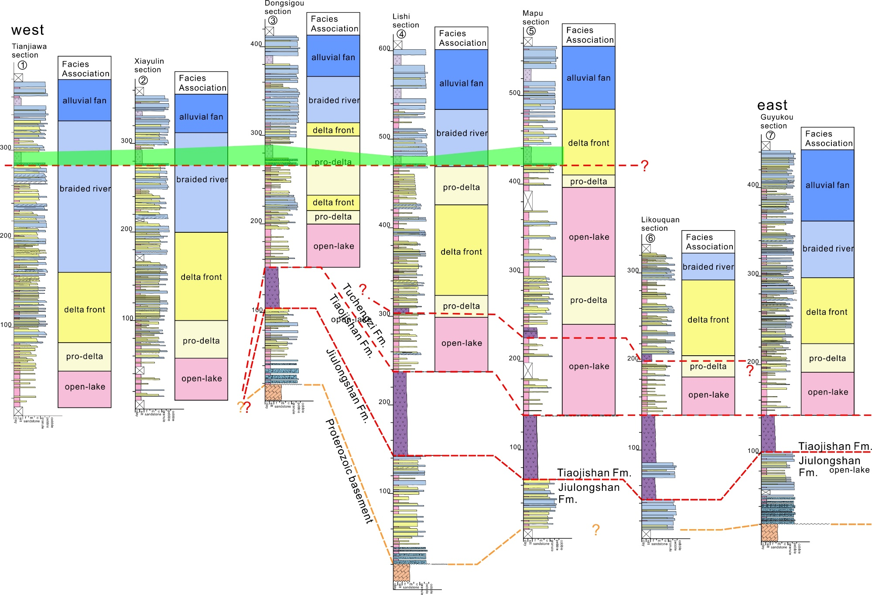
Field works-sedimentary facies analysis
General progradation
upward
Notes:
Using tuff & breccia package as marker bed (green band here) of lateral correlation, a vertical progradation trend was recognized throughout the Xuanhua basin. From lacustrine, through delta, to river and alluvial fan deposits.

Slide 13
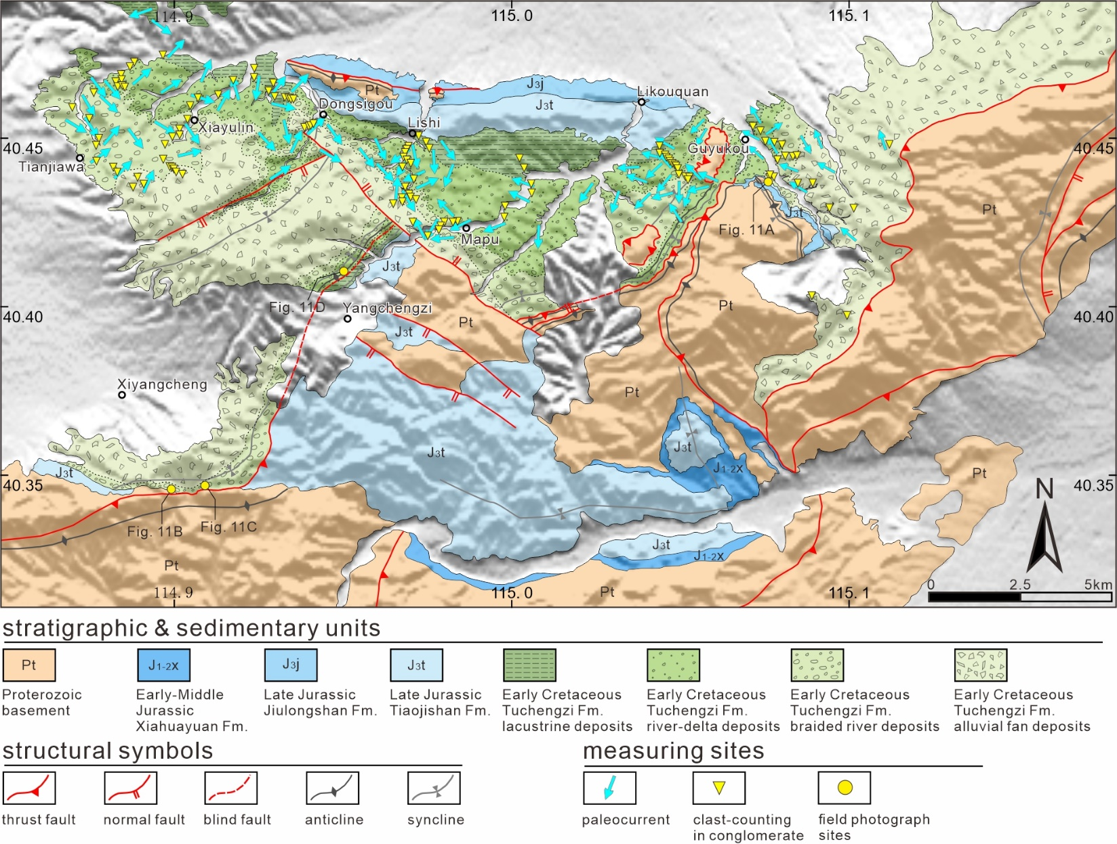
Field works-provenance analysis
Notes:
Provenance analyses, including paleocurrent measurements in sandstones and clast-counting in conglomerates, were conducted in over 200 spots across the basin.

Slide 14
Field works-provenance analysis
provenance
Paleocurrent pattern
transition
Notes:
Paleocurrent pattern shows a distinct transition near the tuff & breccia package. Below it, sediment supply mainly from east and west, above it, sediments all from south and southeast.

Slide 15
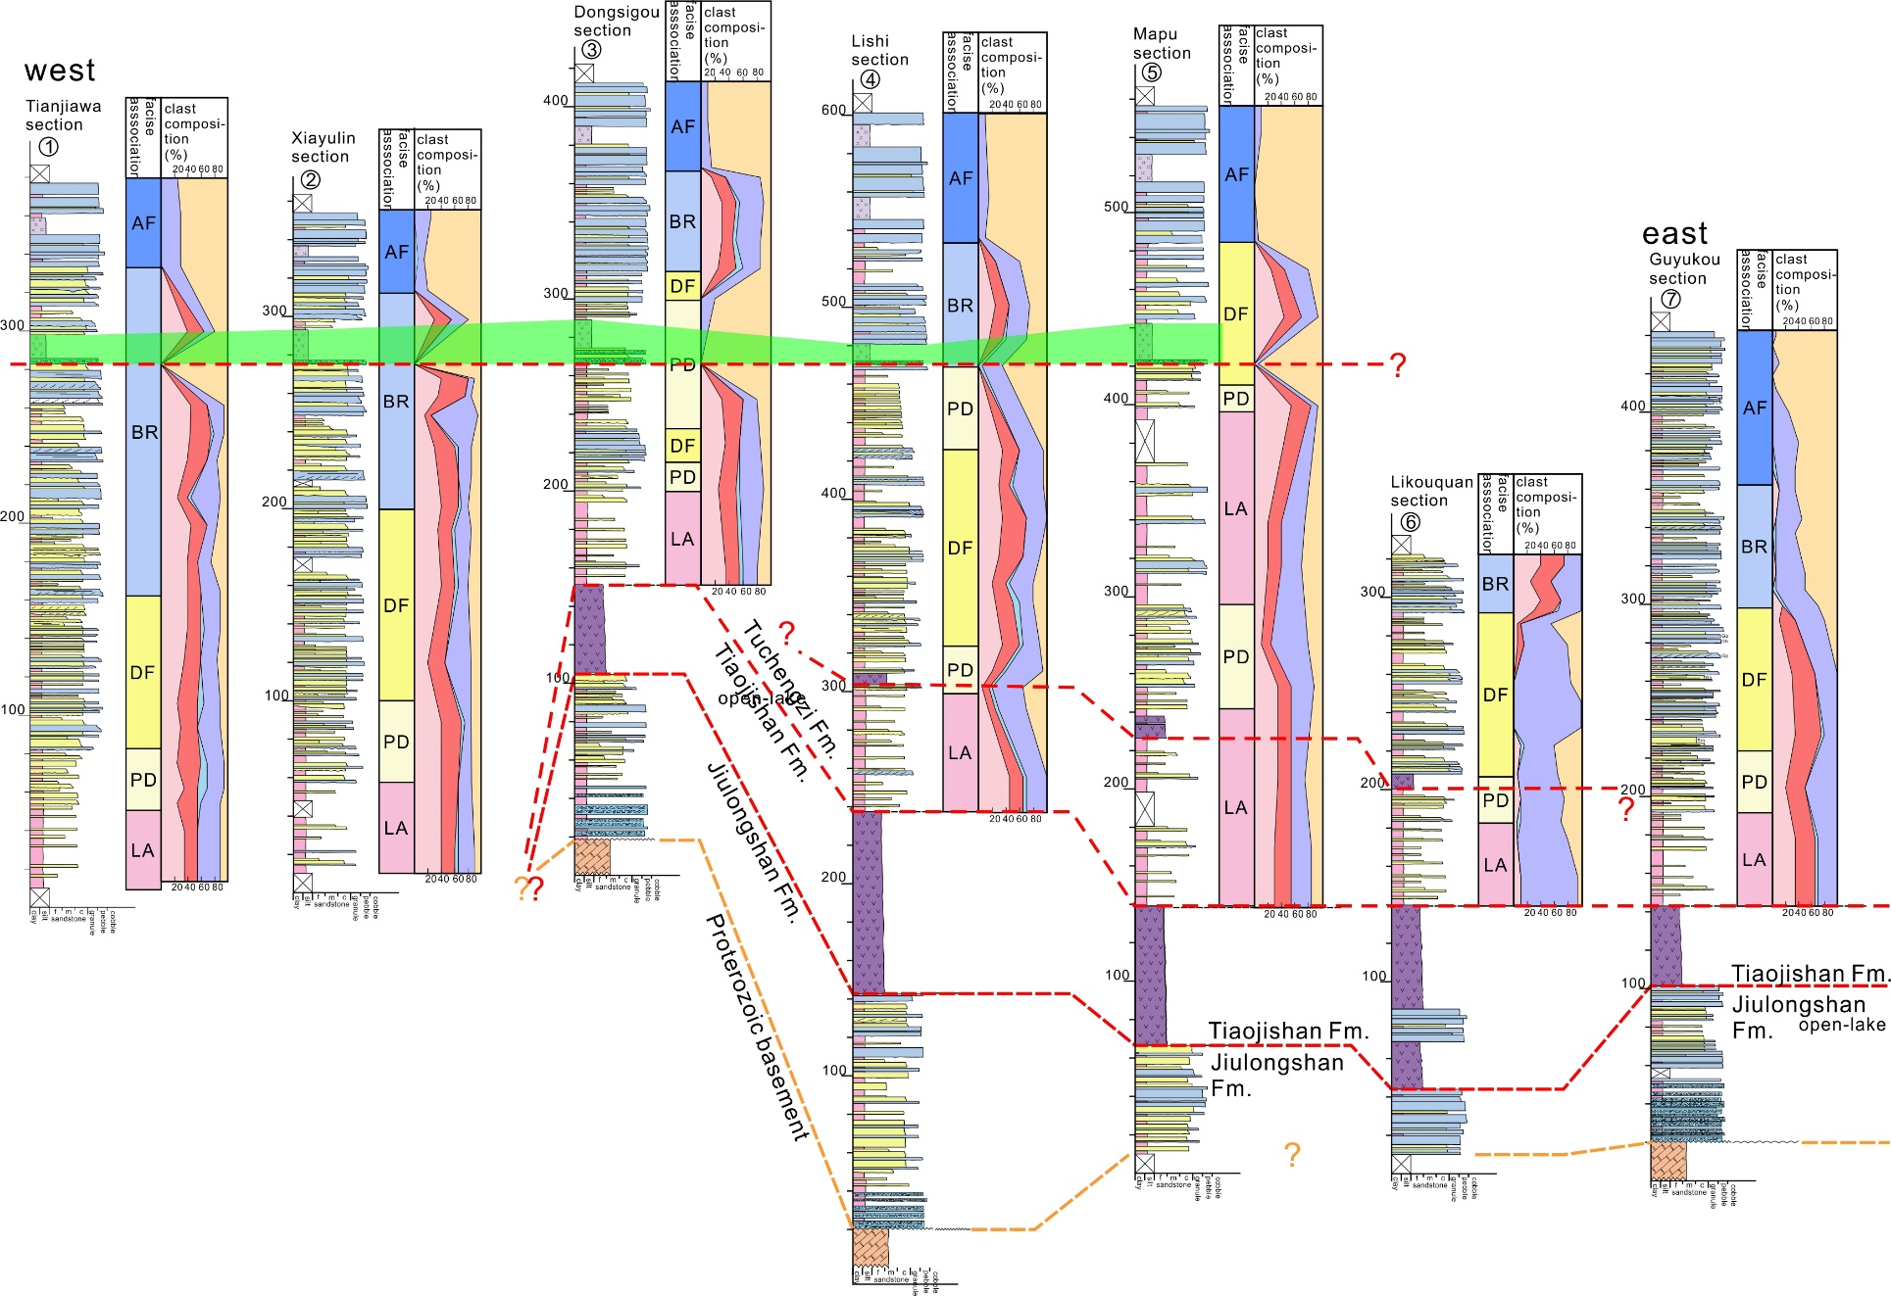
Field works-provenance analysis
provenance
Clast composition
transition
Notes:
Clast composition analyses also show a similar transition near the marker bed.

Slide 16
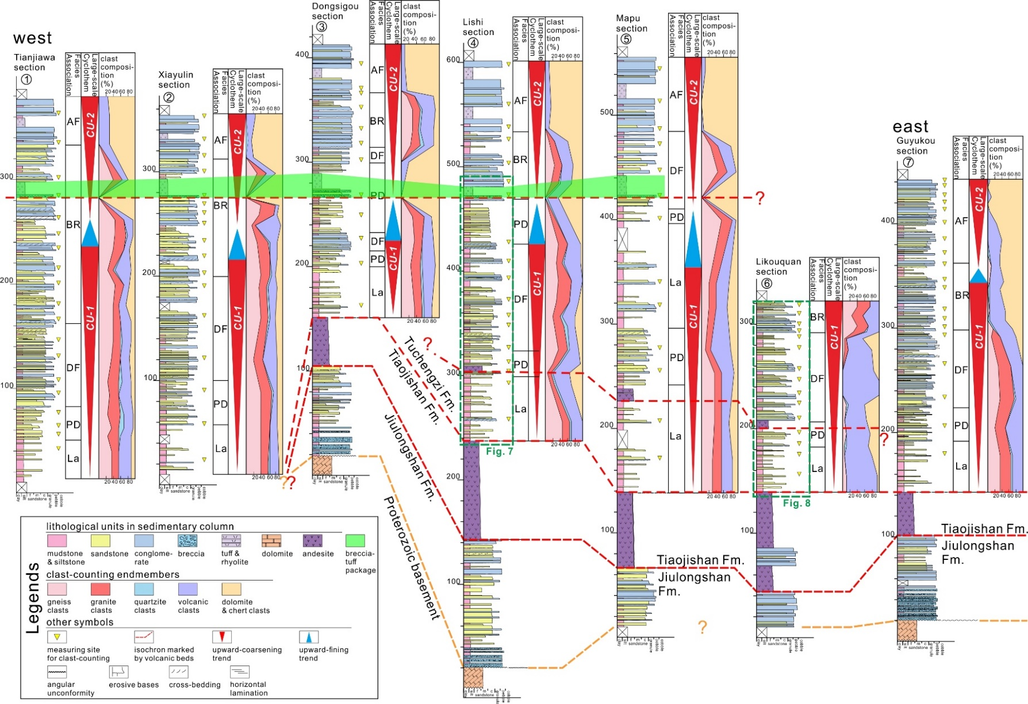
Field works-stratigraphic architecture
Large-scale upward-coarsening cyclothem (CU cyclothem)
Notes:
Based on stratigraphic correlation, sedimentary facies and provenance analyses, two large-scale upward-coarsening cyclothems were revealed across the basin.

Slide 17
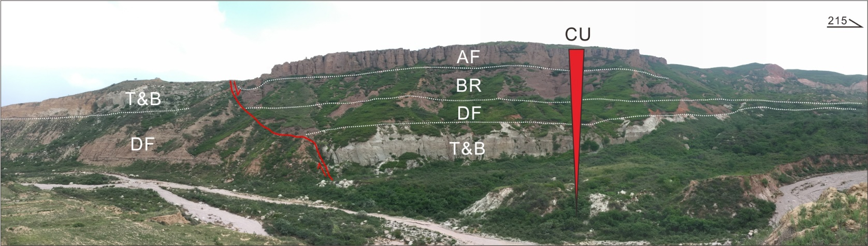
Field works-stratigraphic architecture
CU cyclothem in the upper Tuchengzi Fm near Guyukou village
Notes:
AF: alluvial fan deposits
BR: braided river deposits
DF: delta-front deposits
T & B: tuff and breccia interlayer
At least 2 CU cyclothems in the Tuchengzi Fm
Each 80-240 m thick
Upward-increasing of coarse-grained deposits
Recording facies changes from lacustrine through delta to fluvial deposits or from fluvial to alluvial deposits
With a relatively thin fining-upward interval (ca. 25-40 m thick) in between two CU cyclothems
Notes:
CU cyclothems are 80-240 m thick, recording upward facies changes.

Slide 18
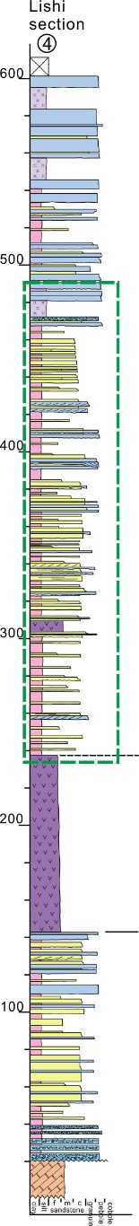
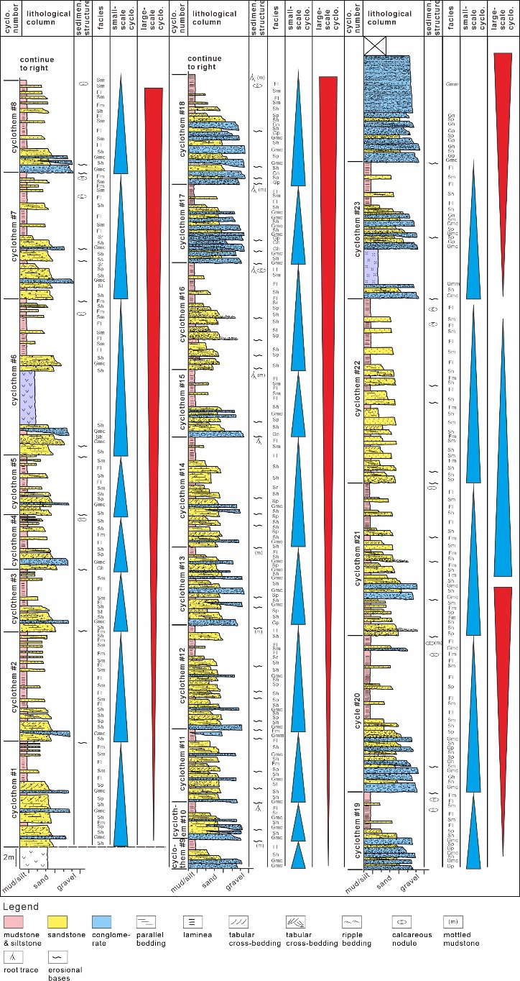
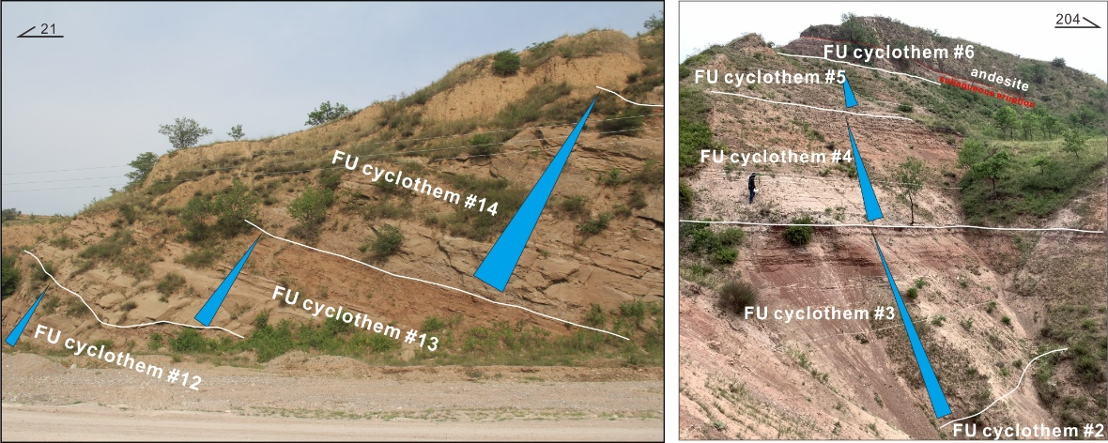
Field works-stratigraphic architecture
Small-scale upward-fining cyclothem
(FU cyclothem) in CU-1 cyclothem of Lishi section
At least 31 FU cyclothems in CU-1 cyclothem
Each 3-16 m thick
Erosional bases
Sandy/gravelly lower part & muddy upper part
Subaerial exposure of the uppermost part
Rapid facies change from subaqueous to subaerial settings
Notes:
Within the large-scale cyclothems, some small, regularly repeated upward-fining successions were also recognized.

Slide 19
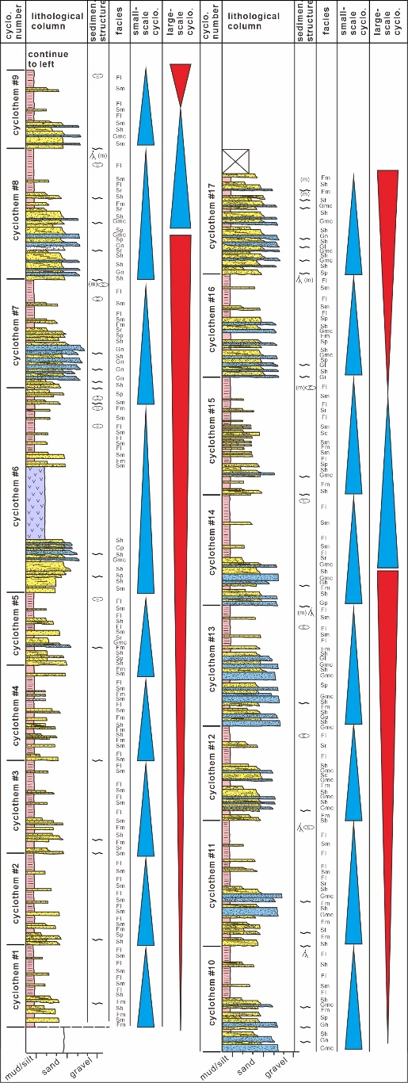
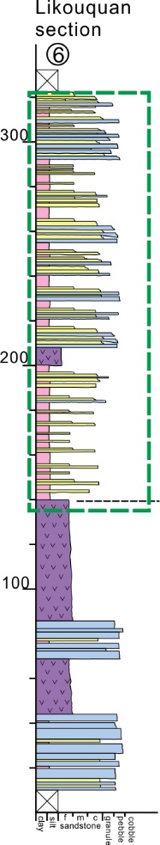
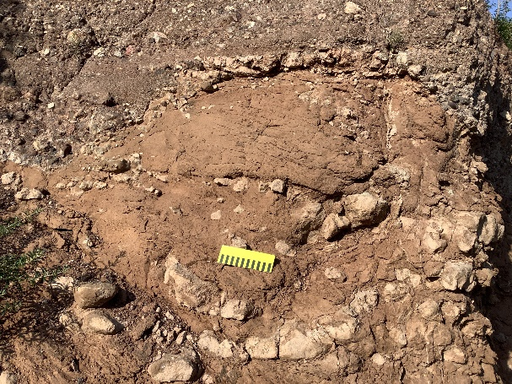
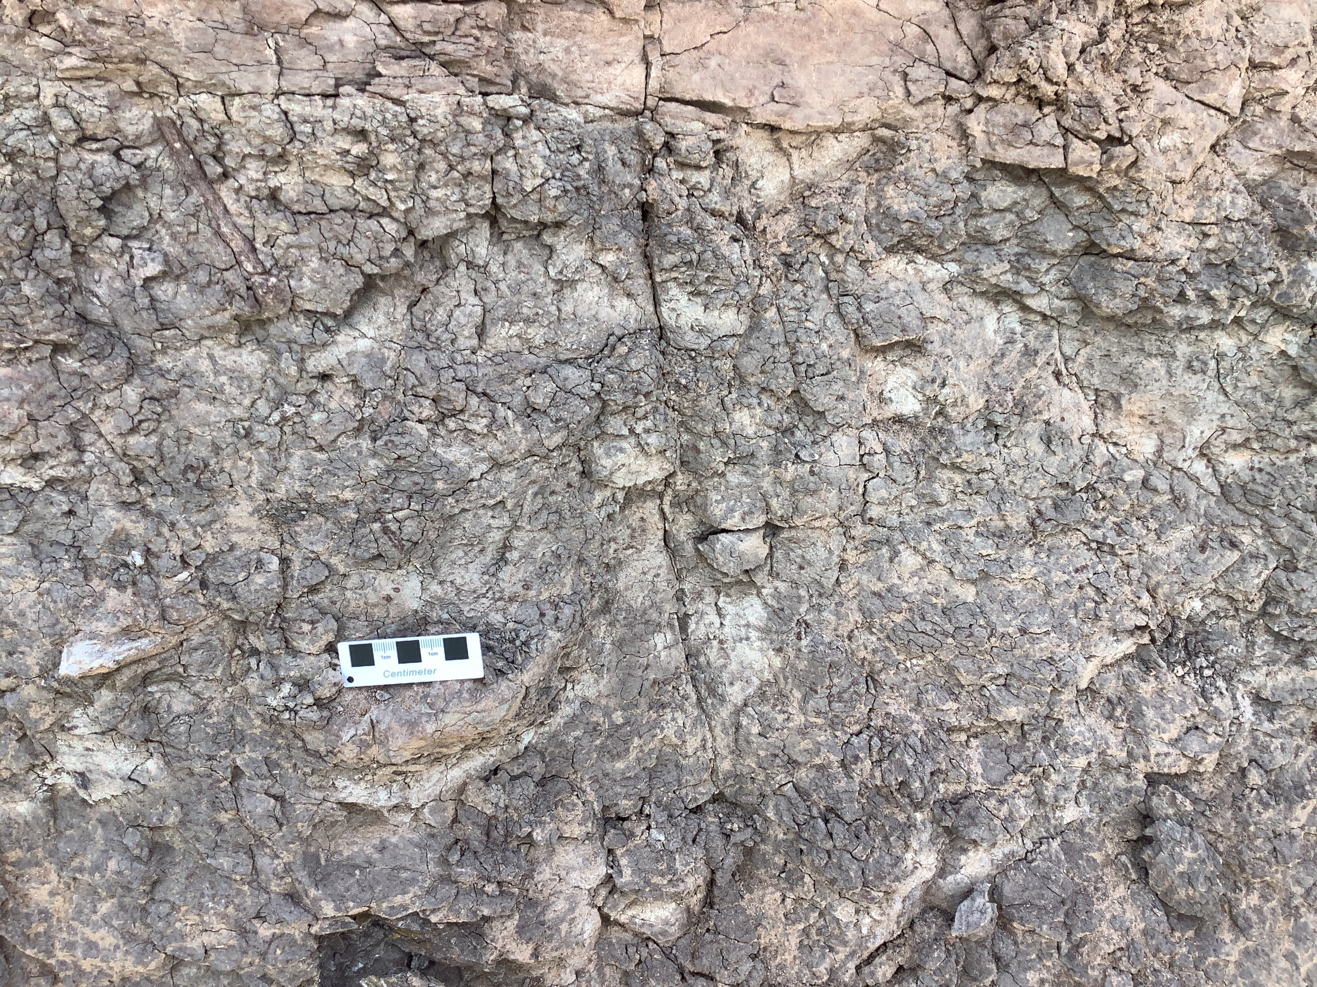
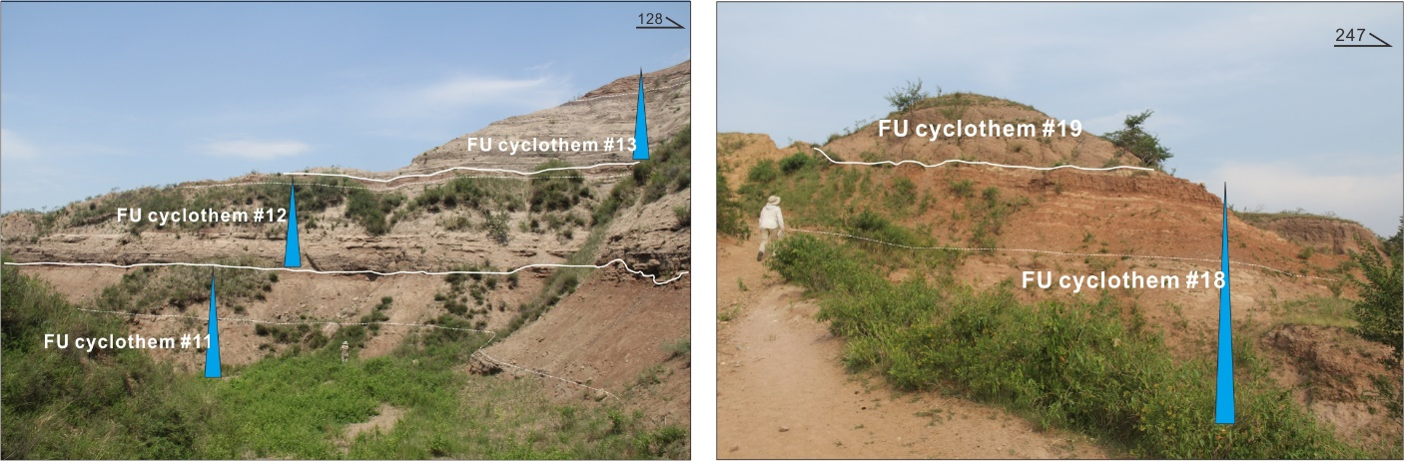
Field works-stratigraphic architecture
Small-scale upward-fining cyclothem
(FU cyclothem) in CU-1 cyclothem of
the Likouquan section
Notes:
In the uppermost part, subaerial exposures, like calcareous nodules, root traces, mottled mudstones, were commonly developed.

Slide 20
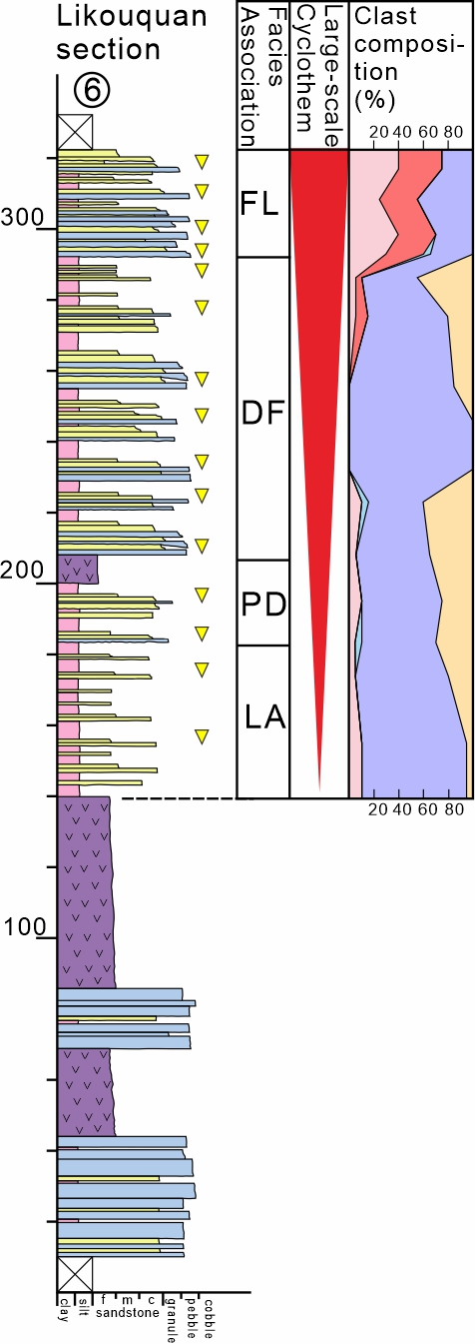
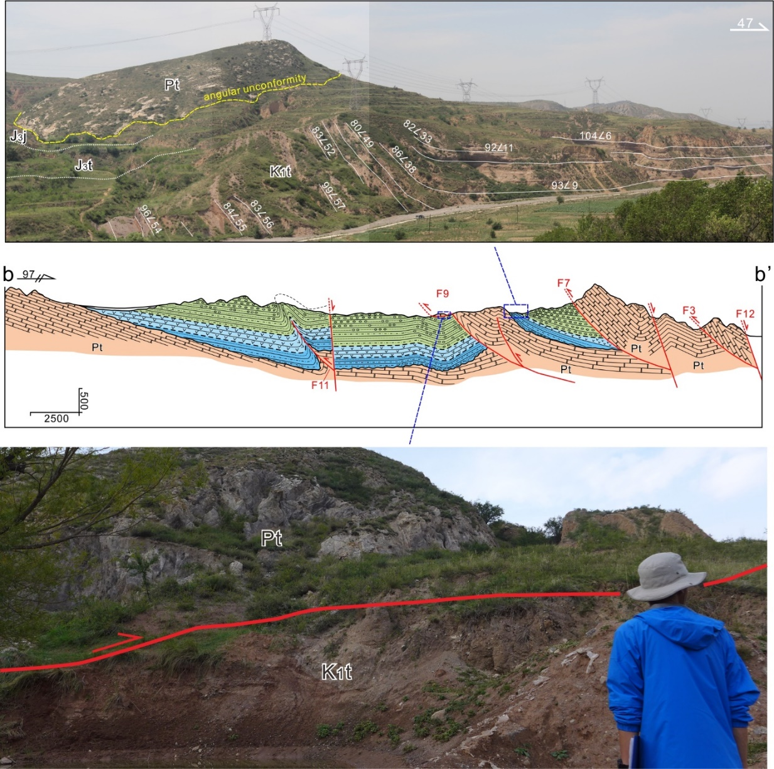
Discussion-CU cyclothem & growth strata
Likouquan thrust fault and its related growth strata in the Lower Tuchengzi Fm: CU-1 cyclothem
CU-1
Notes:
For CU cyclothems, our field investigations suggested that they are closely related to thrust faulting in eastern and southern margins.
In CU-1, which is the lower part of the Tuchengzi Fm, growth strata related to thrusting of the Likouquan thrust fault were recognized in the hangingwall.

Slide 21
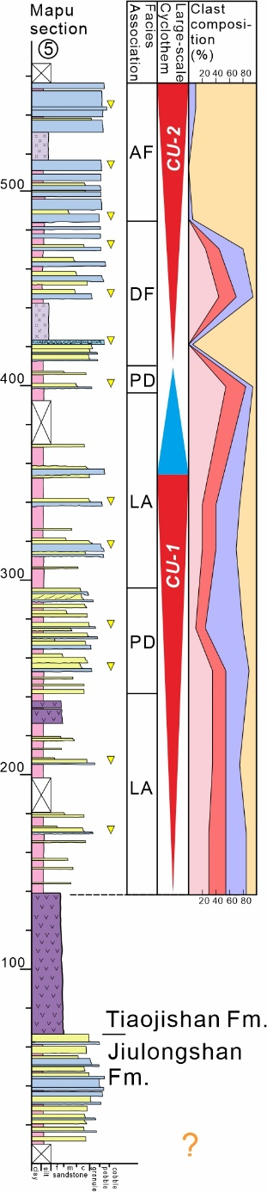
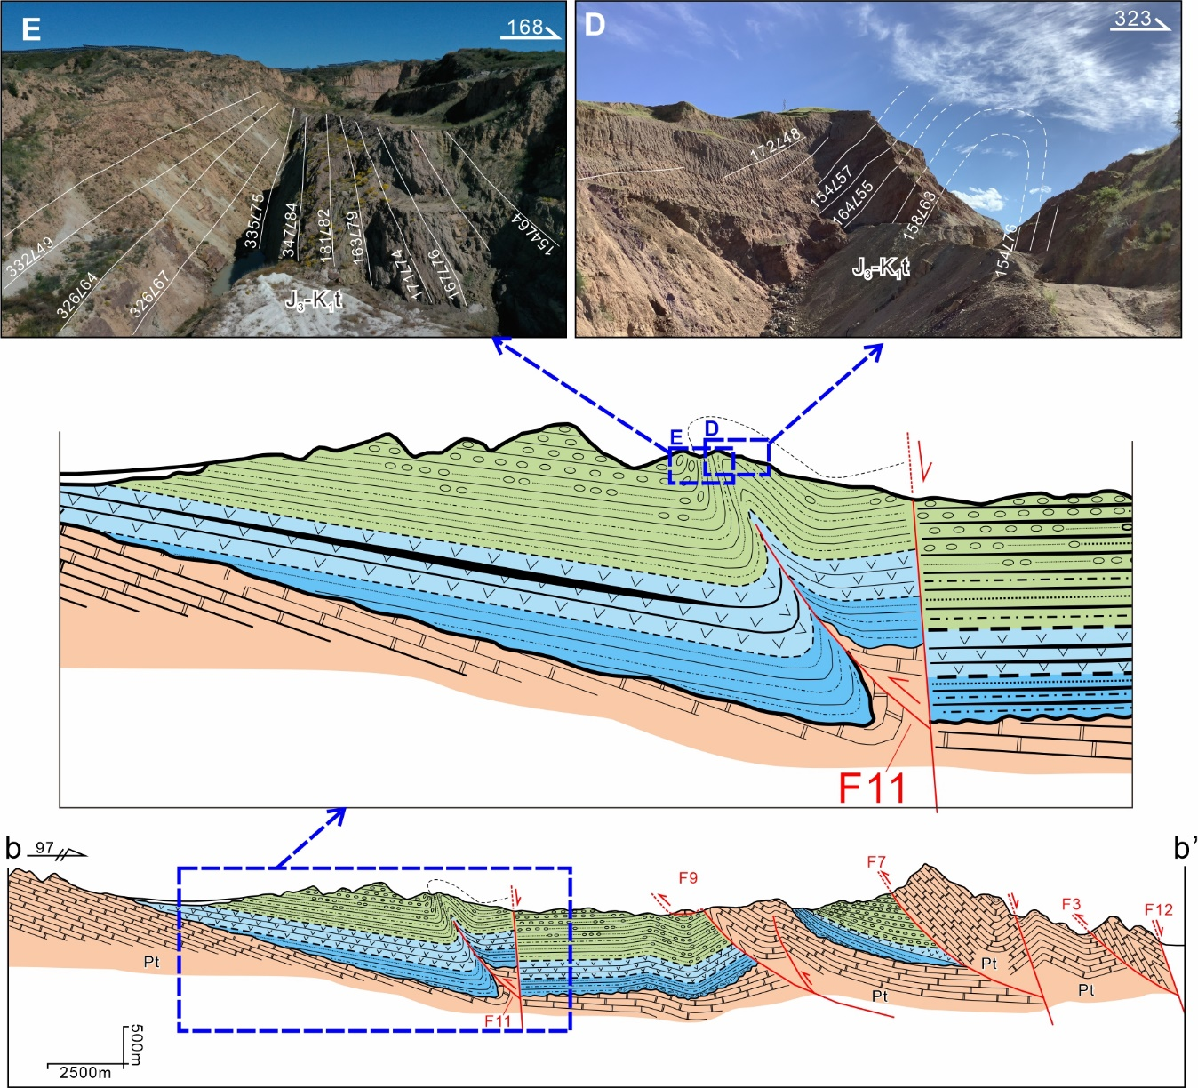
Discussion-CU cyclothem & growth strata
Mapu thrust fault and its related growth strata in the upper Tuchengzi Fm: CU-2 cyclothem
Notes:
In CU-2, upper Tuchegnzi Fm, growth strata related to the Mapu thrust fault were recognized in the forelimb of fault-propagation fold, comprising a growth syncline.

Slide 22
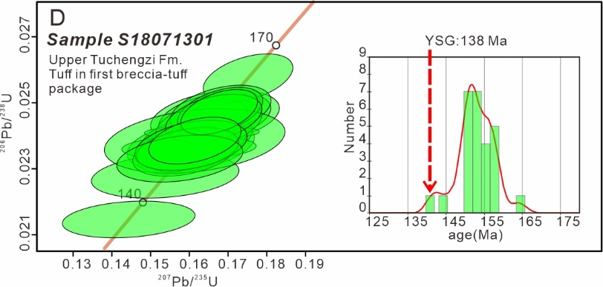
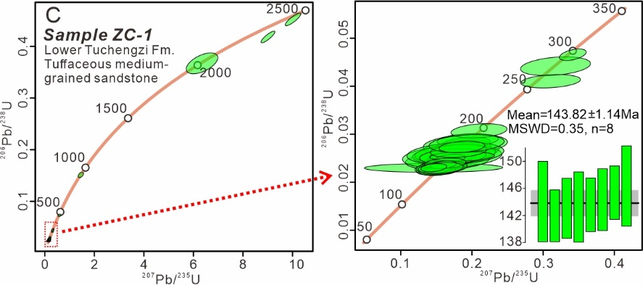
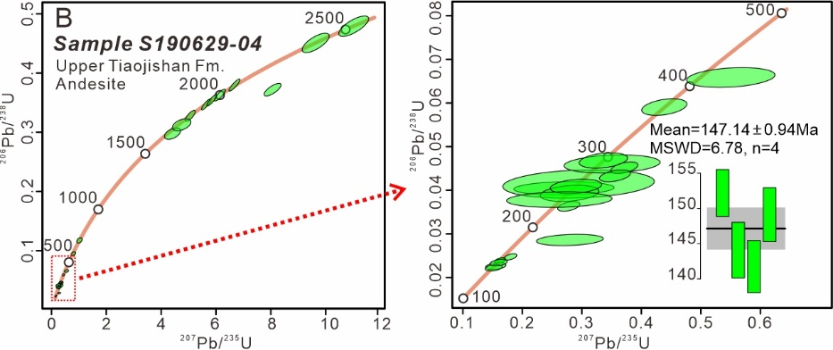
Discussion-timing of deformation
138 Ma
CU-1
144 Ma
147 Ma
Notes:
Zircon U-Pb geochronology was used to constrain the timing of thrusting along basin margin.

Slide 23
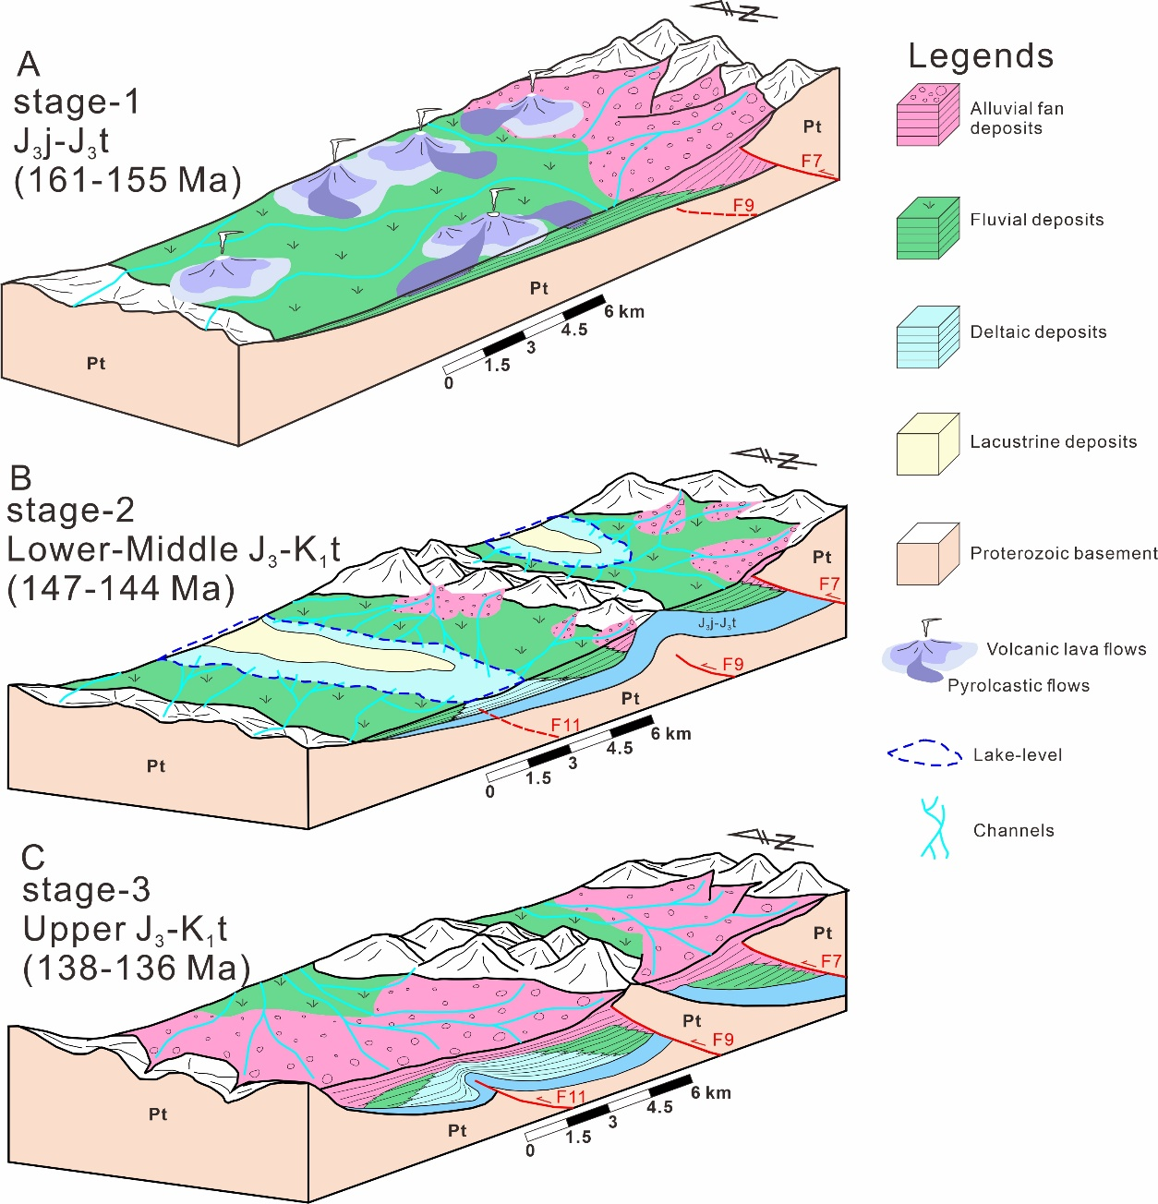
Discussion-basin evolution
Three stages eovlution of the Xuanhua basin:
Stage-1(161-155 Ma): activity of the Huangyangshan thrust fault and formation of the Xuanhua basin;
Stage-2 (147-144 Ma): activity of the Likouquan thrust fault and lake expansion;
Stage-3 (138-136 Ma): activity of the Mapu thrust fault and progradation of the alluvial fan systems.
Notes:
Combining results of this study with previous works, a three-stages evolution model was proposed for this basin during late Jurassic-early cretaceous, suggesting northwestward progradation of the marginal thrust belt into basin center.

Slide 24
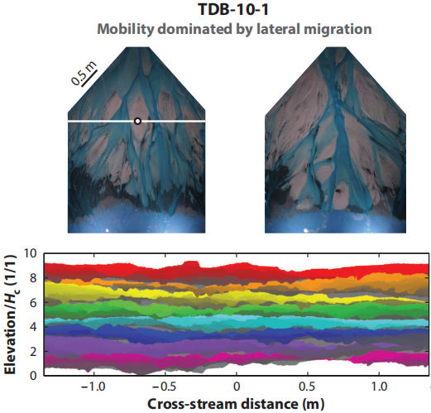
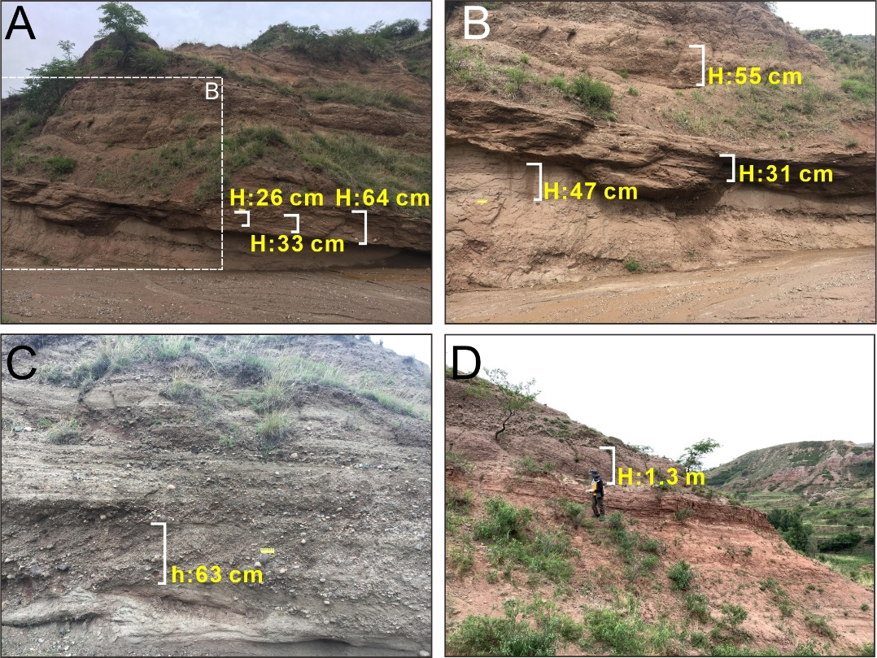
Discussion-interpretations of FU cyclothems
Autogenic control on repeated FU cyclothems
FU cyclothems could represent self-organized autogenic responses in stratigraphy, such as lateral shifting of delta lobes.
Hajek & Staub, 2017, Annual Reviews
H: bar clinoform relief and height of dune cross-strata sets in fluvial-deltaic successions.
Representing maximum scale of autogenic dynamics.
Average H values of 65 cm and maximum of 143 cm with 32 measurements.
Much less than average thickness of 7.5 m for FU cyclothems.
Notes:
There are three possible interpretations for the formation of FU cyclothem.
The first is autogenic processes, such as lateral shifting of delta lobes. They would also produce self-organized, regularly repeated stratal pattern. however, scale of their production is not more than 1.5 m in this basin, much less than average thickness of the FU cyclothems. So this option could be ruled out.

Slide 25


Discussion-interpretations of FU cyclothems
Unsteady allogenic explanation from tectonism in drainage area
High-frequency tectonic movements in the catchment areas could result in drainage rearrangement by river capture or tectonic-related surface uplift, blocking the water and sediment supply and subsequent lake-level decrease or retrogradation.
But the river capture or tectonic barrier ‘events’ should be random in both space and time, not as regularly repeated at short time scale of the FU cyclothems.
Notes:
Another interpretation is of allogenic, it is the tectonism in drainage area. High-frequency tectonism would result in drainage rearrangement, blocking water and sediment supply, producing FU successions. However, these river capture or barriers by tectonism should be random and not in basin-wide range. In this case, we consider this interpretation as impossible.

Slide 26
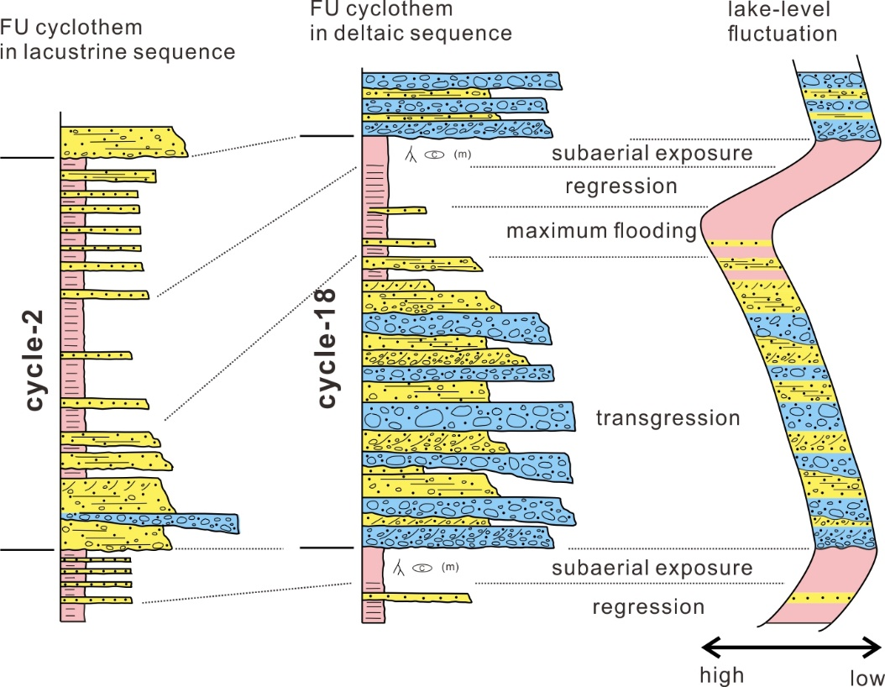
Discussion-interpretations of FU cyclothems
Unsteady allogenic explanation from wet-dry climate cycles

Slide 27
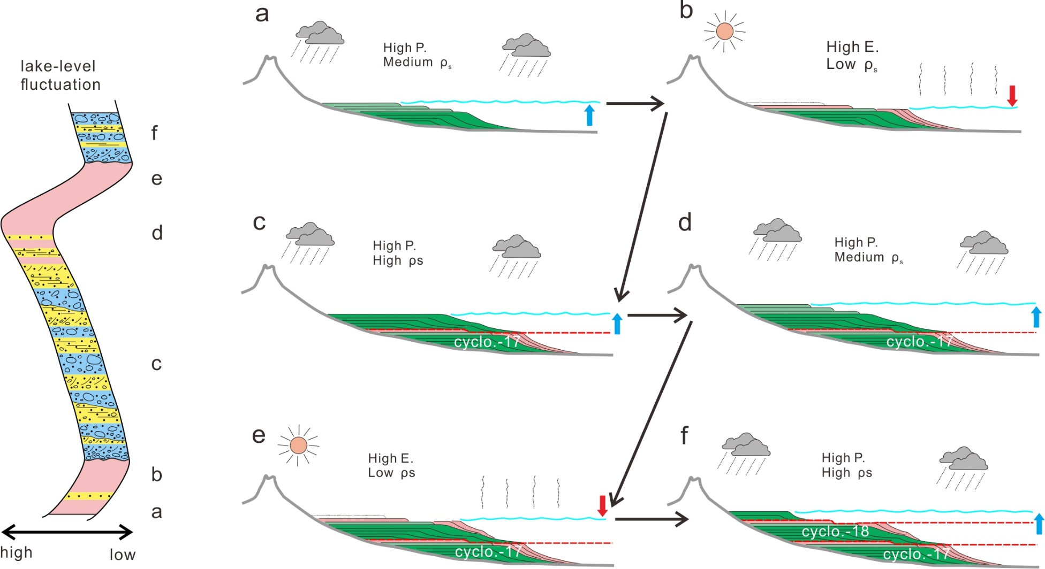
Discussion-interpretations of FU cyclothems
Wet-dry cycle model for deposition in the Xuanhua basin during Late Jurassic-Early Cretaceous
Notes:
We constructed a wet-dry cycle model to interpret the FU cyclothems. Short-term variation in precipitation induce high-frequency lake-level fluctuation, forcing progradation and retrogradation of marginal sedimentary systems and production of the FU cyclothems.

Slide 28
Thank you！
Notes:
Thank you

