Slide 1
Exploring links between precipitation extremes and land use types through the UK Convection-Permitting Model
K. P. Chun, P. Fan, Q. He, B. Dieppois, L. Danaila,
N. Quinn, J. Klaus, E. Toker and O. Yetemen

Slide 2
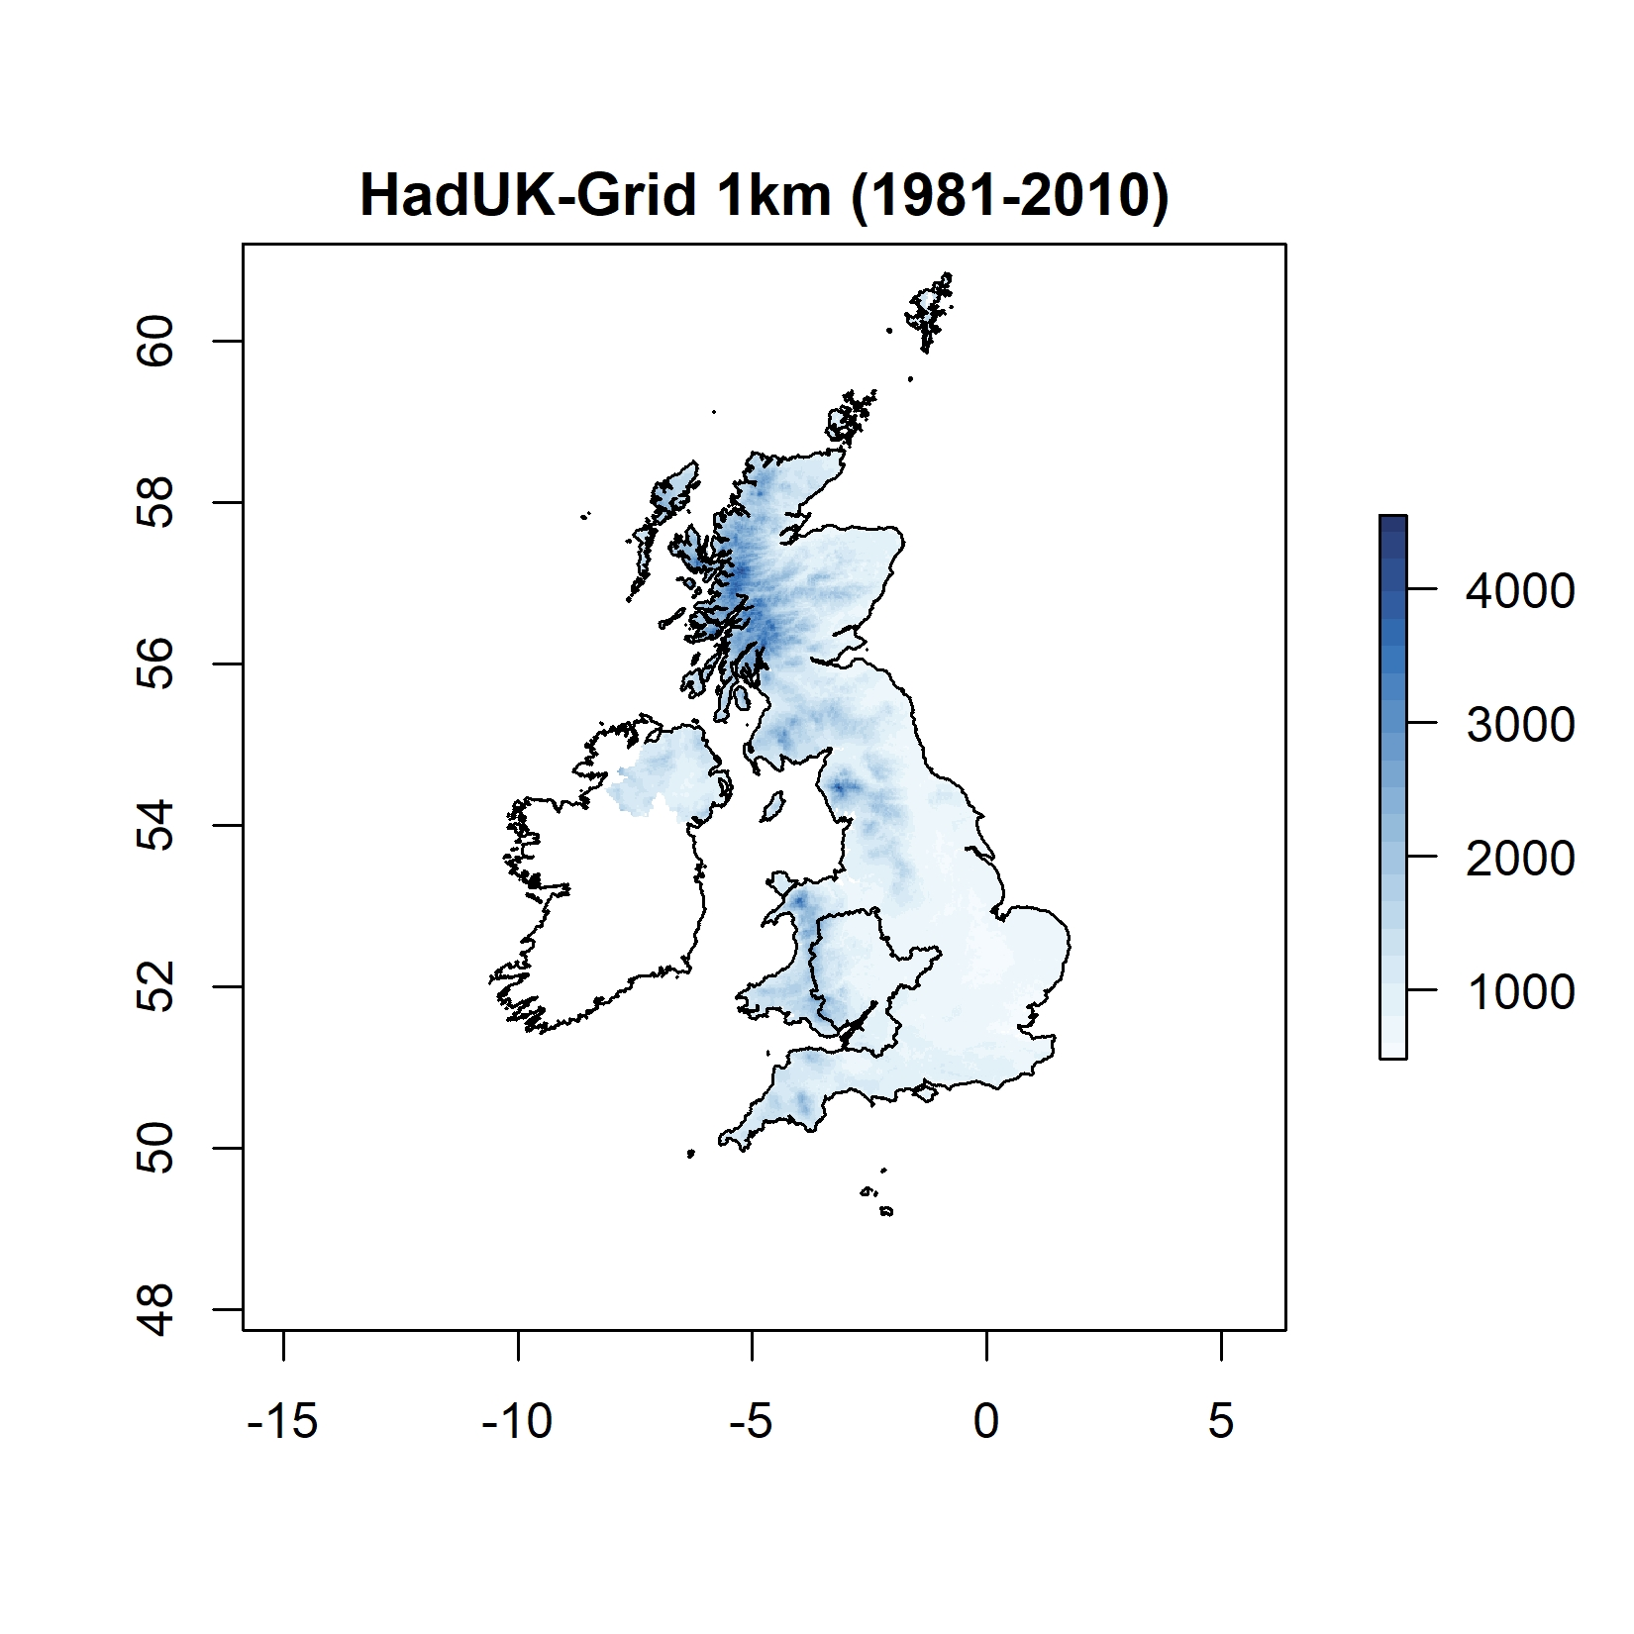
Outlook
Using the Severn River Basin as a case study, changes in extreme precipitation events are investigated based on landscape characteristics
Gridded Observations and the UKCP18 Convection-Permitting Model (CPM) Projection Outputs
Land use maps
The results are used to generate
possible hypotheses to run different CPM models based on the land use scenarios
more informative precipitation extreme estimations related to regional planning, for the high greenhouse gas emissions scenario RCP8.5

Slide 3
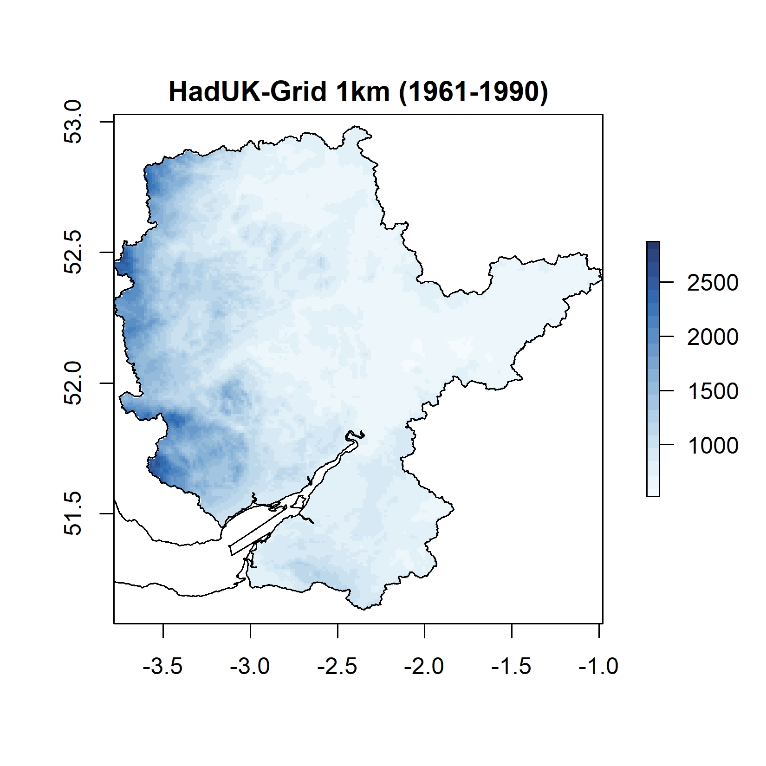
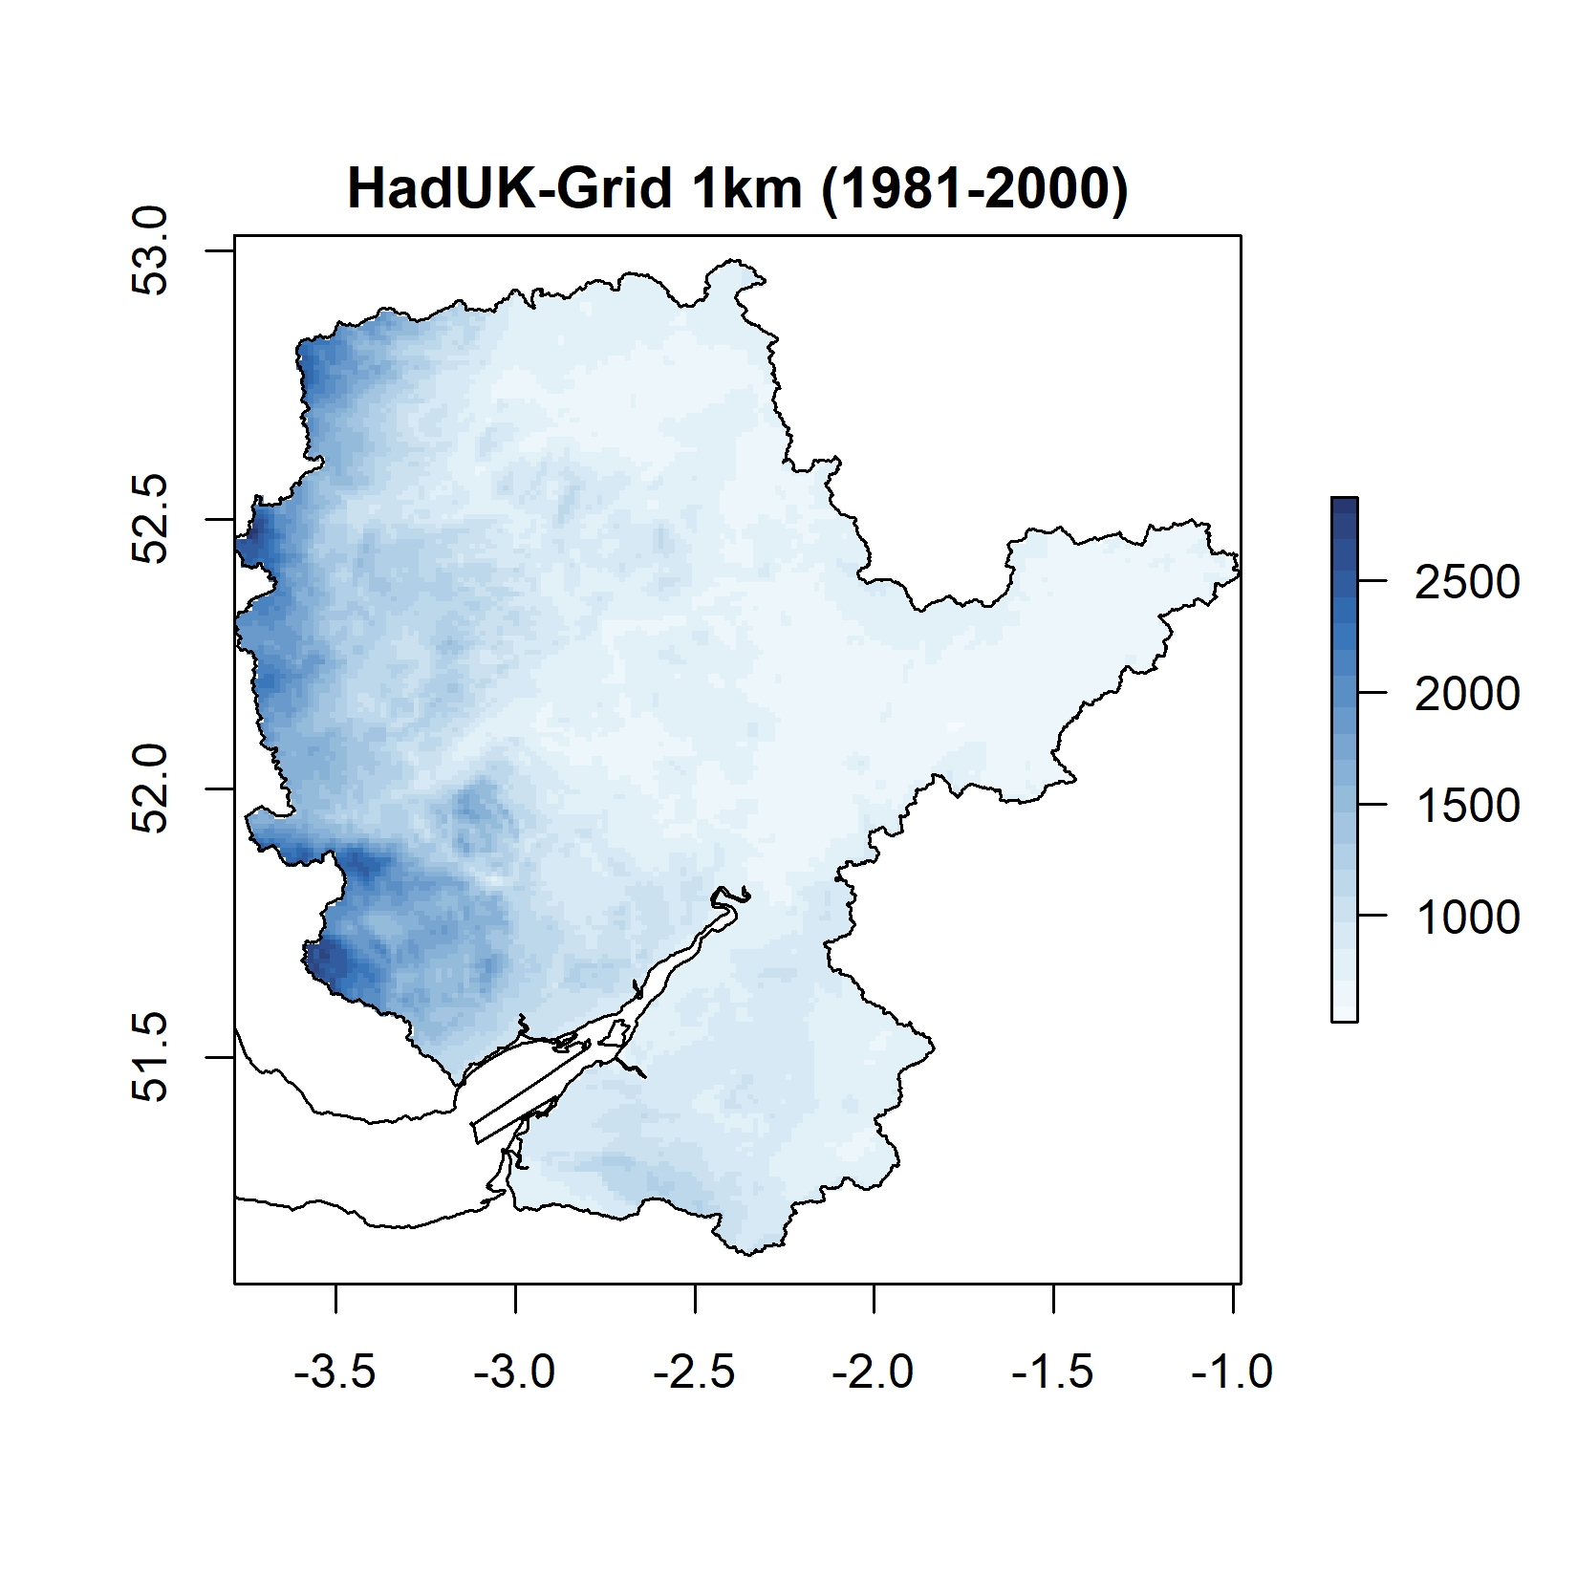
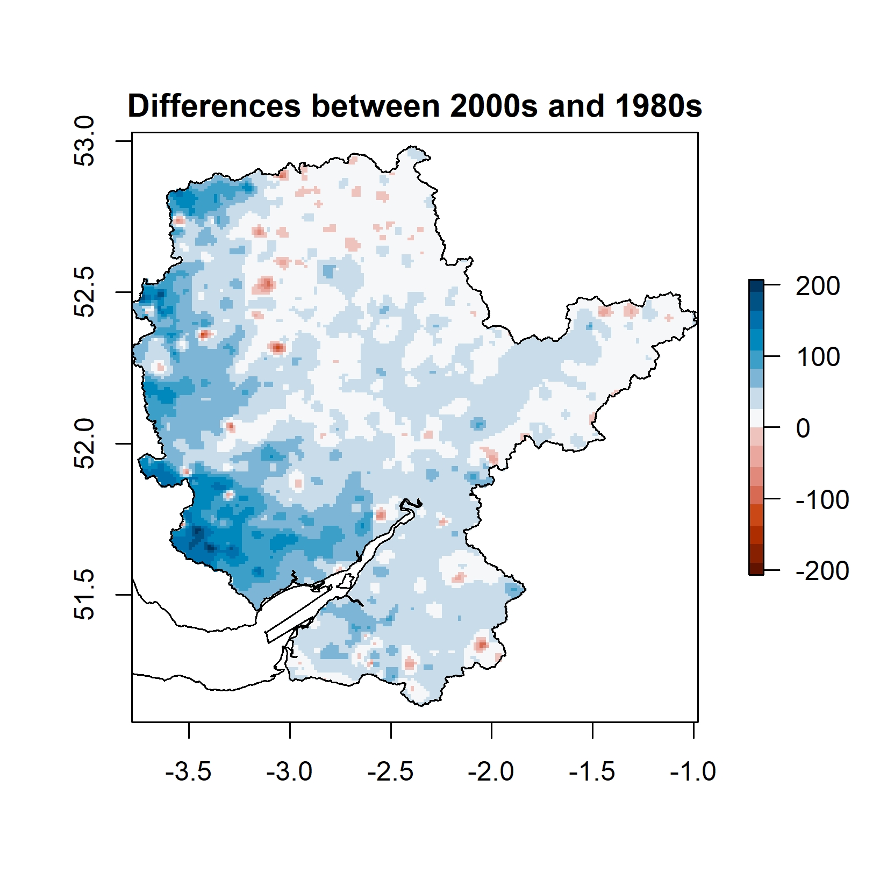
Precipitation fields
Different periods
Differences between maps

Slide 4
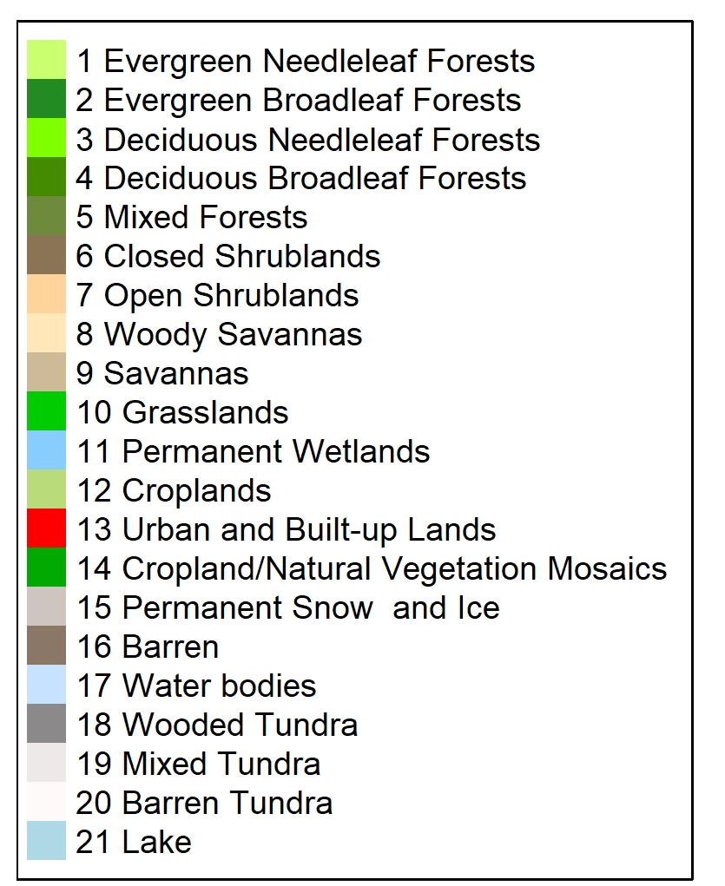
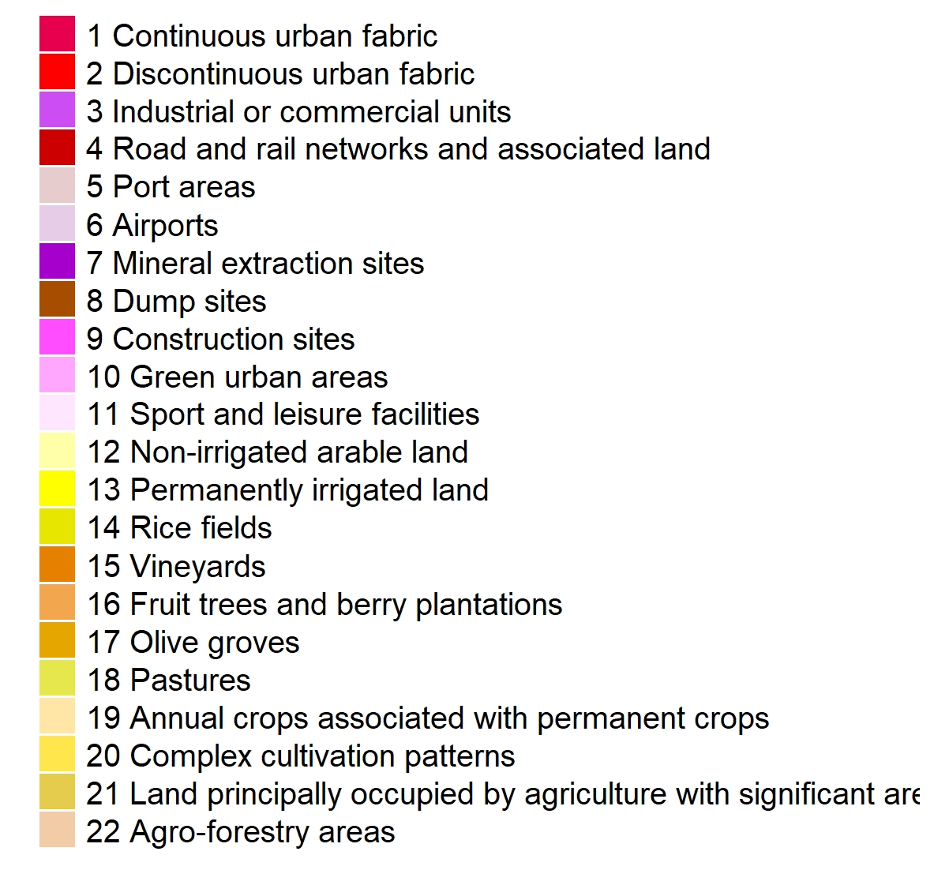
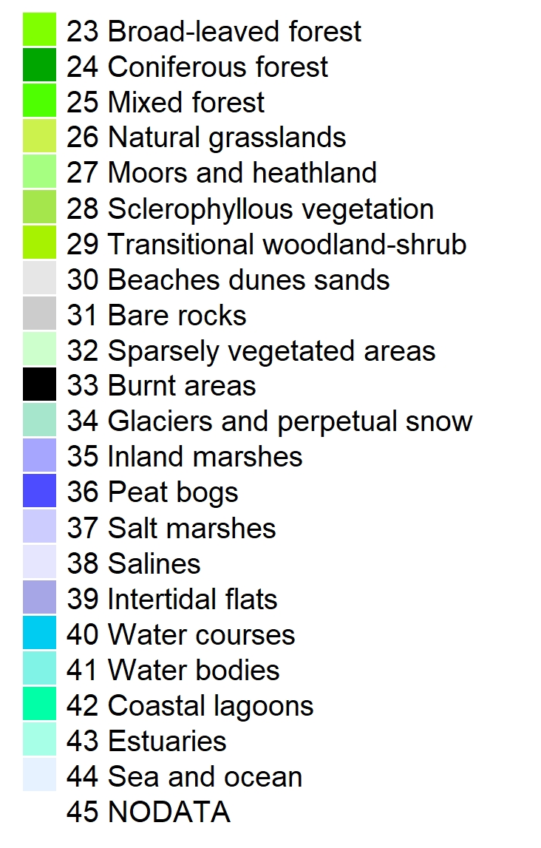
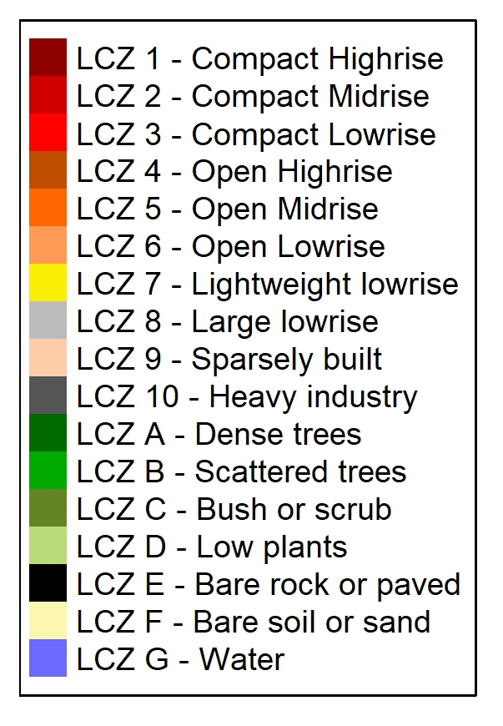
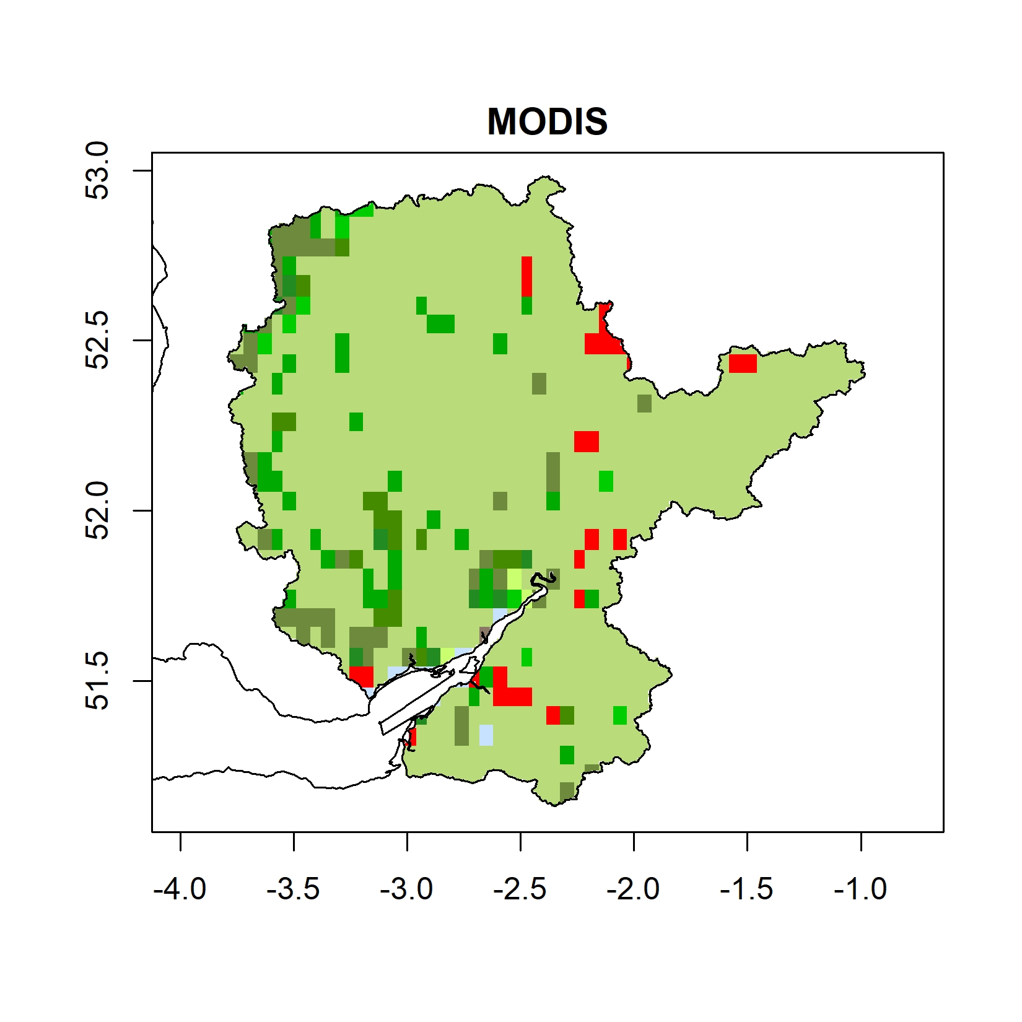
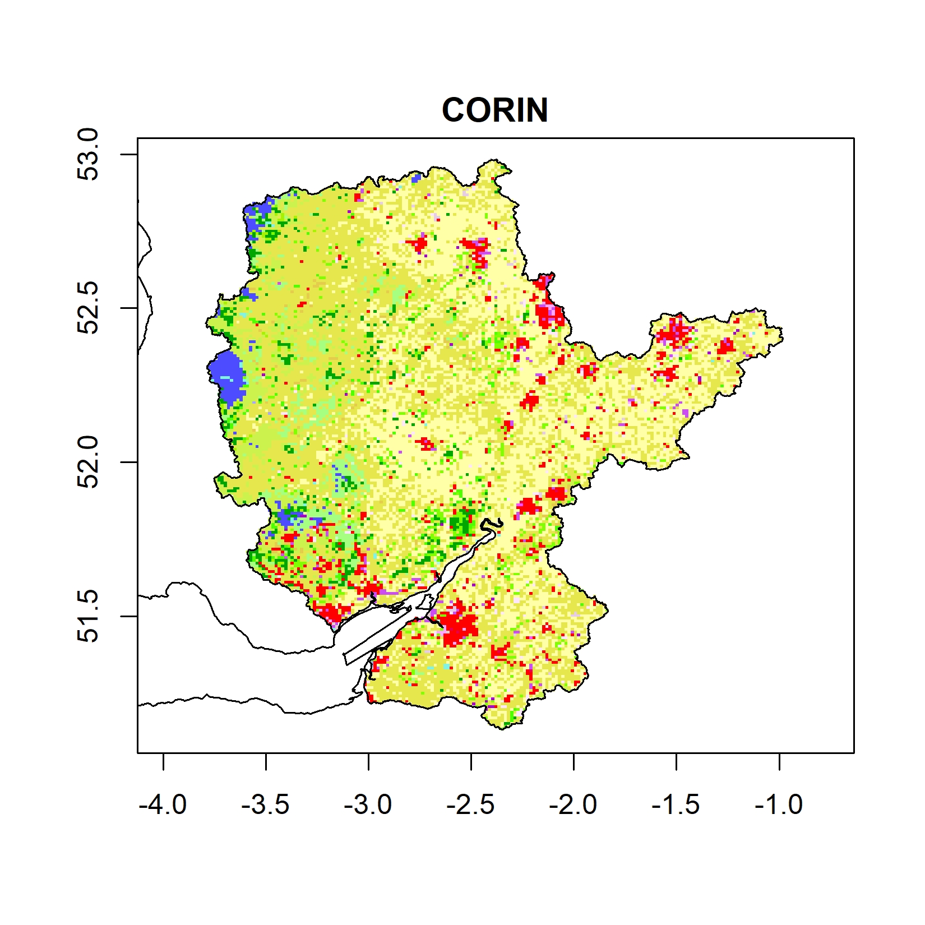
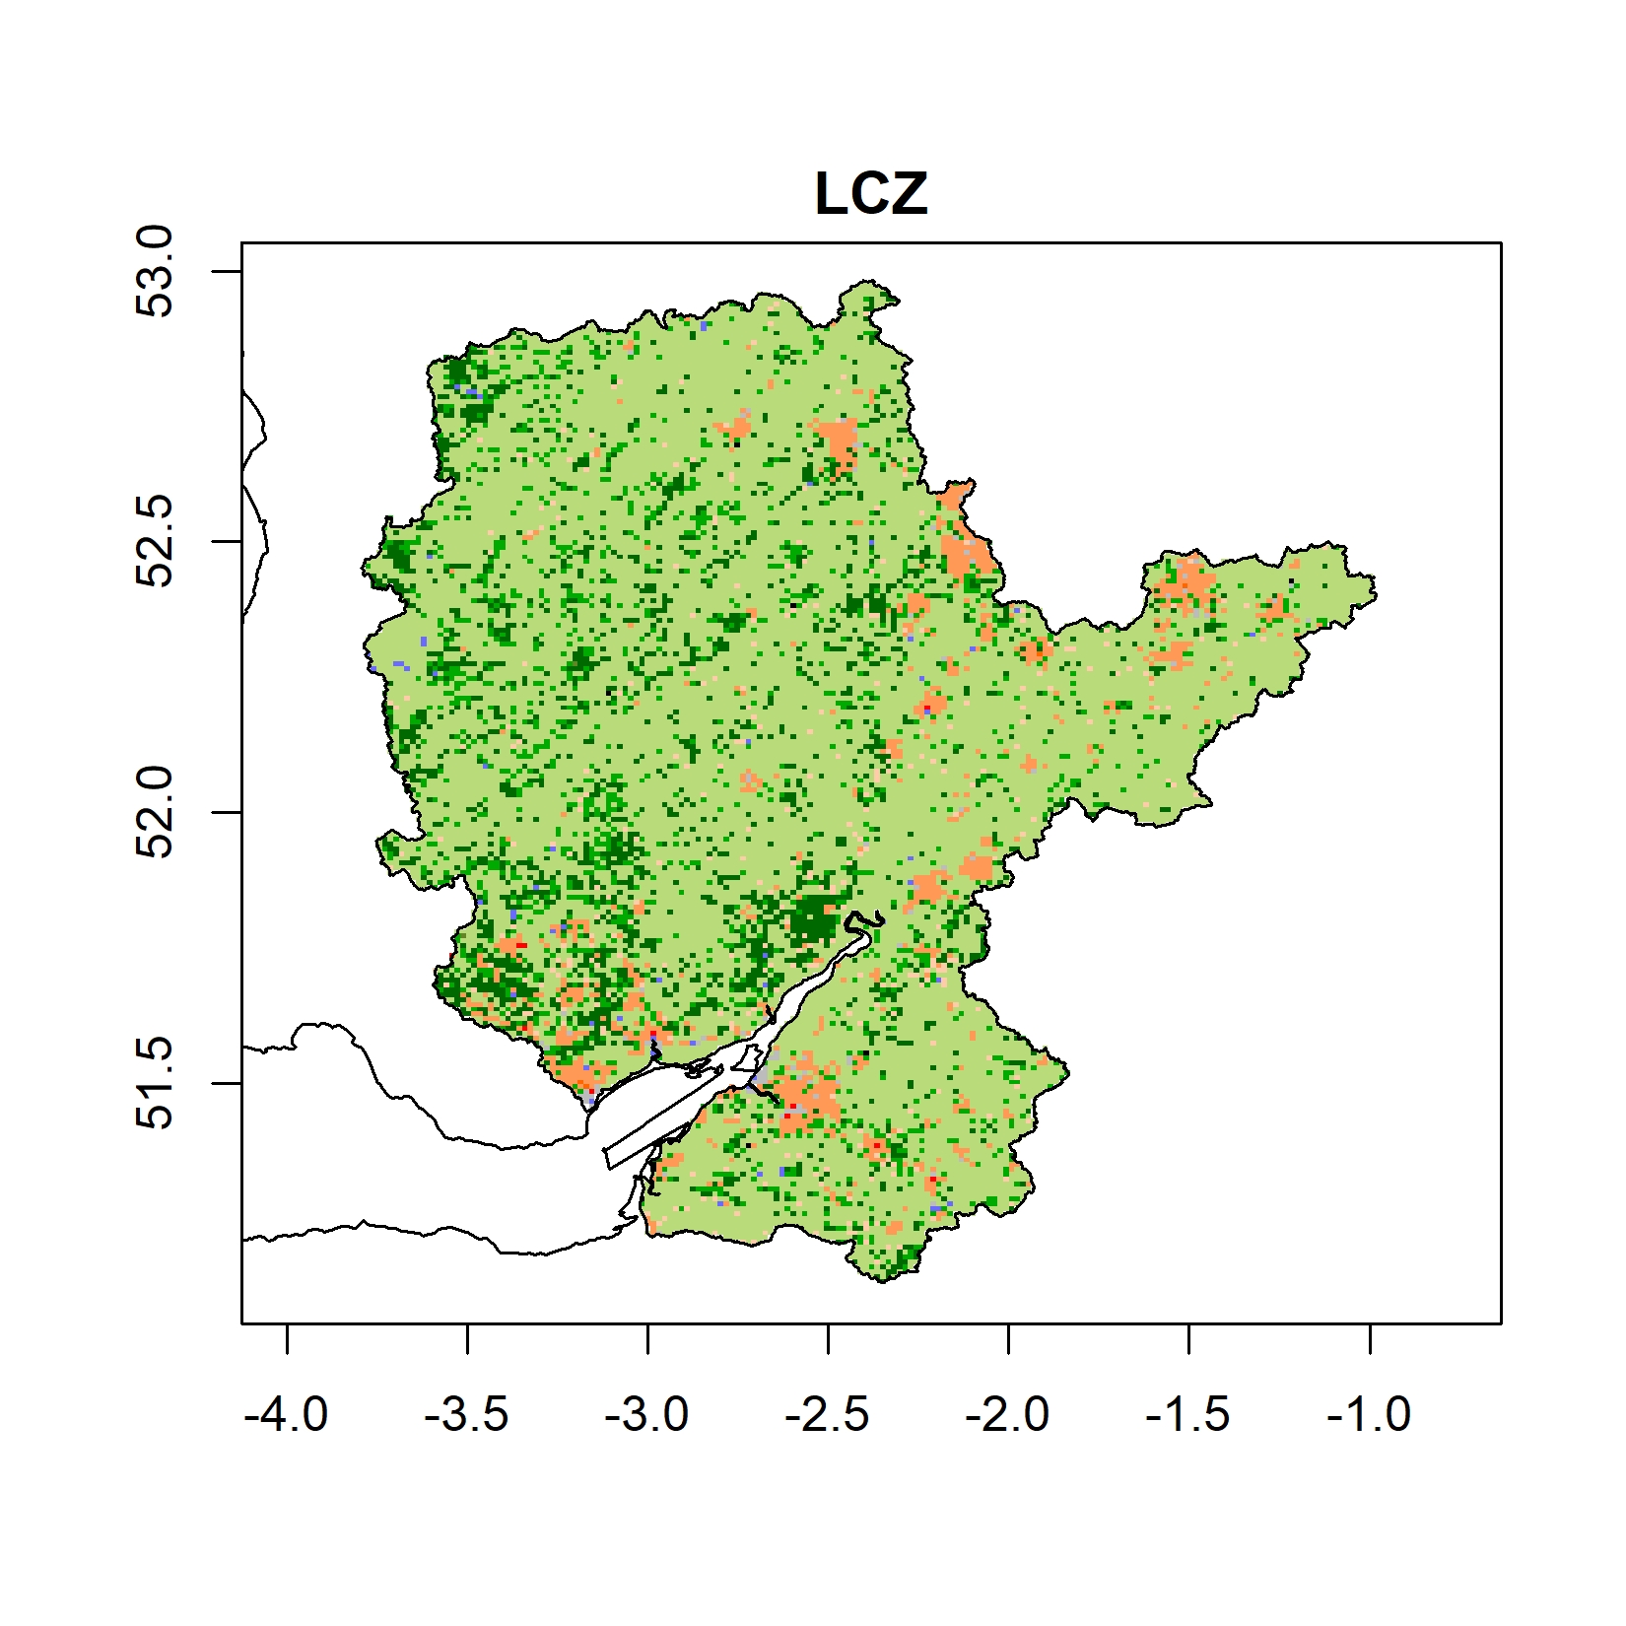
Land use
Maps

Slide 5
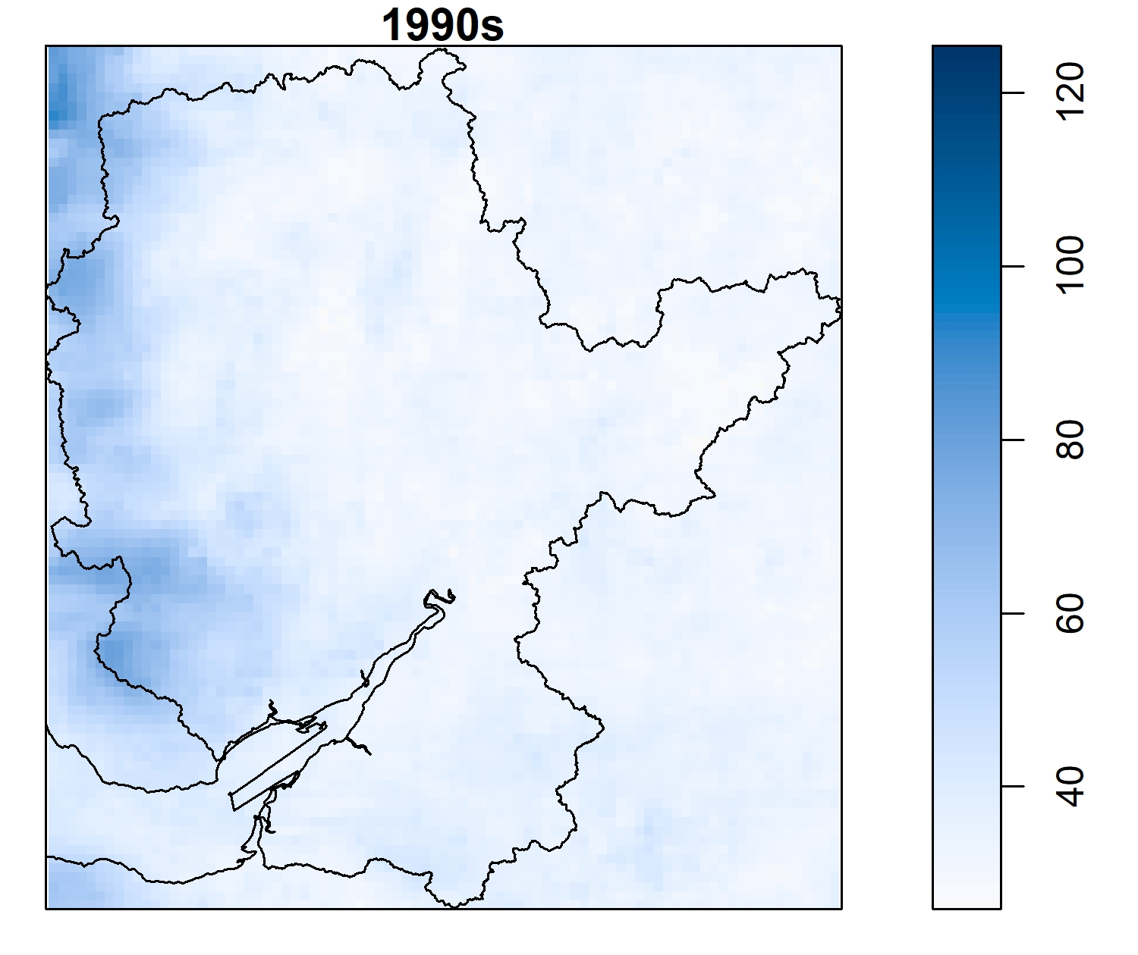
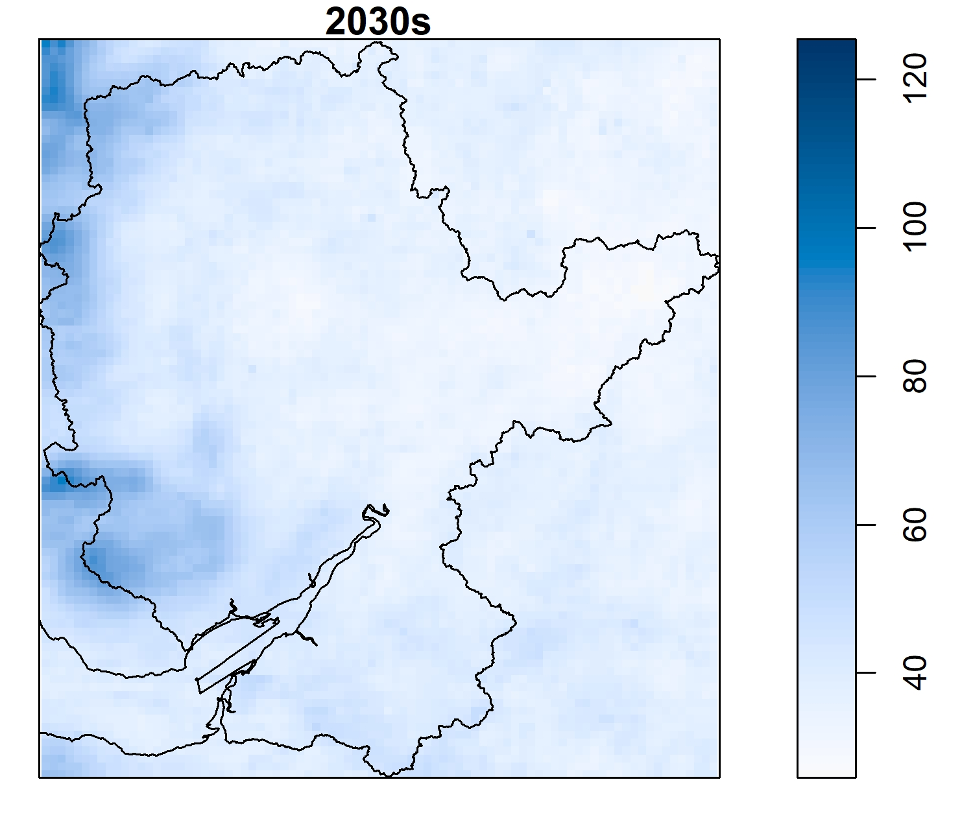
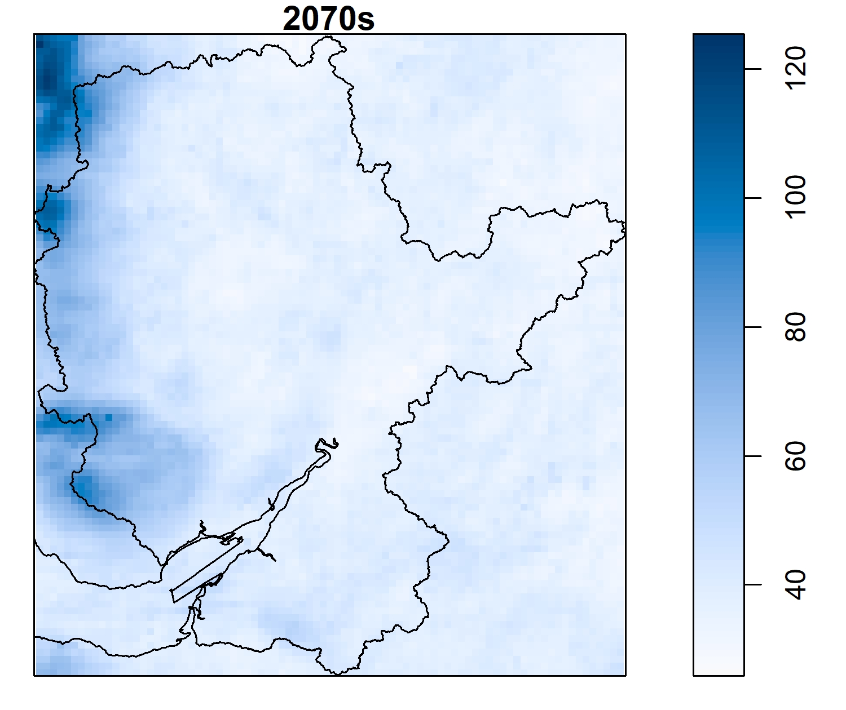
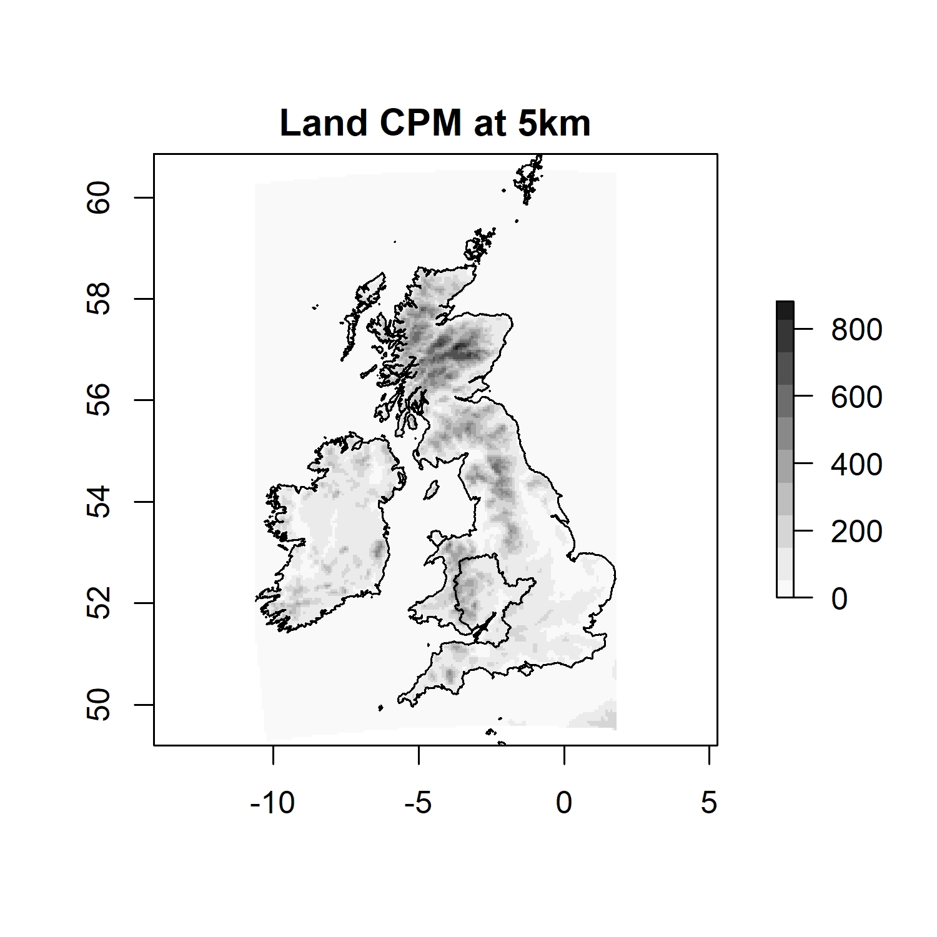
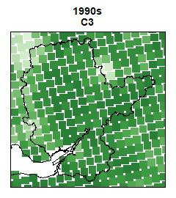
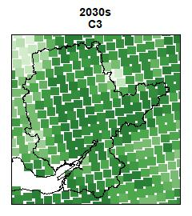

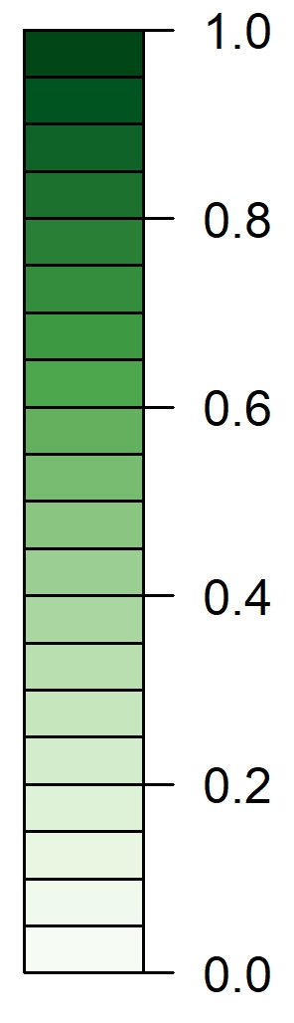
UKCP18
5km gird CPM precipitation maps
1990s
2030s
2070s
the UKCP18 Convection-Permitting Model (CPM) Projection Outputs
Elevation
12km gird only for fraction maps

Slide 6
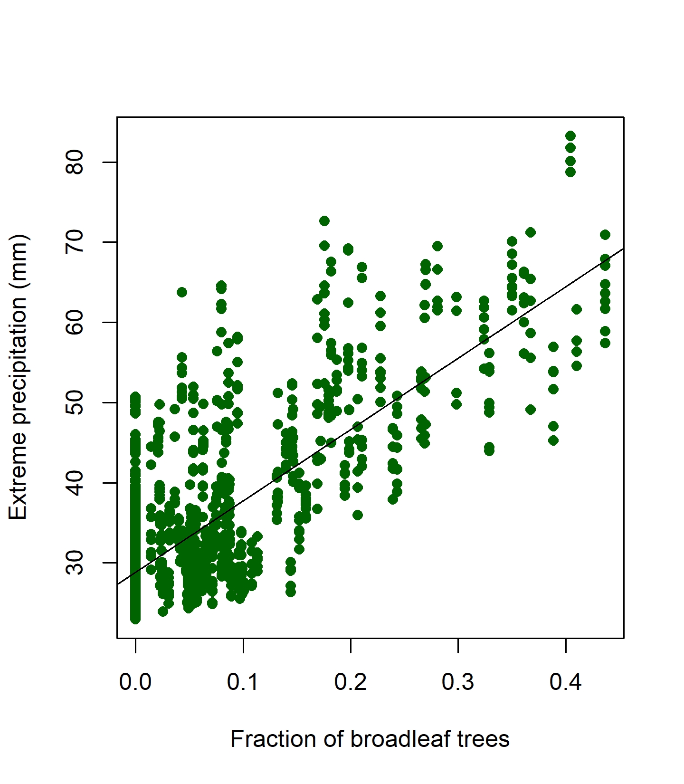
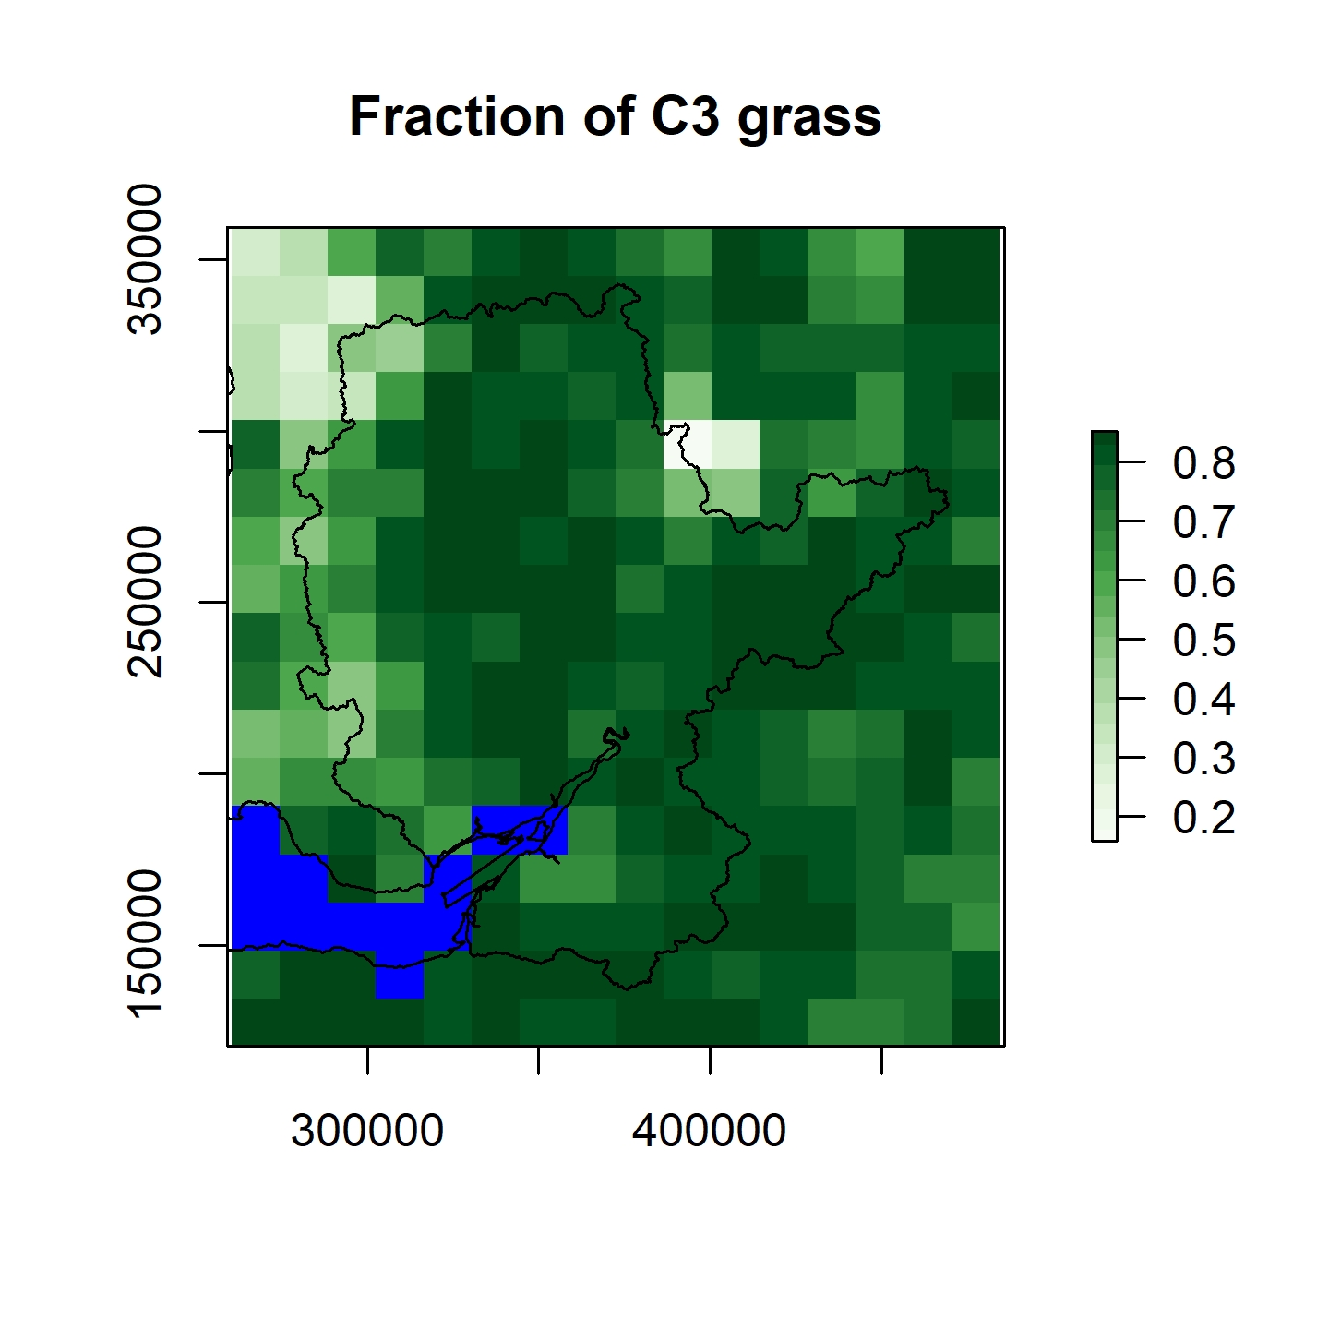
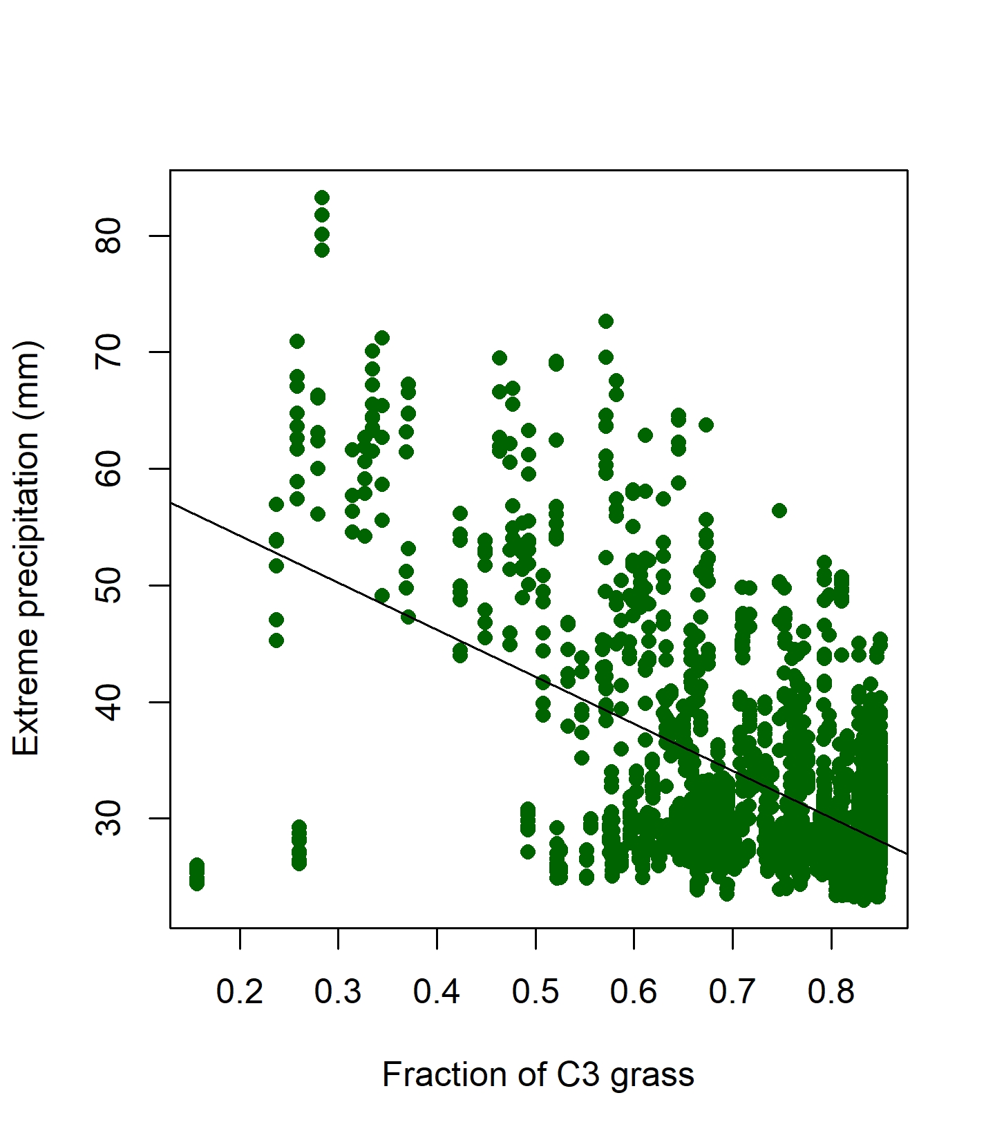
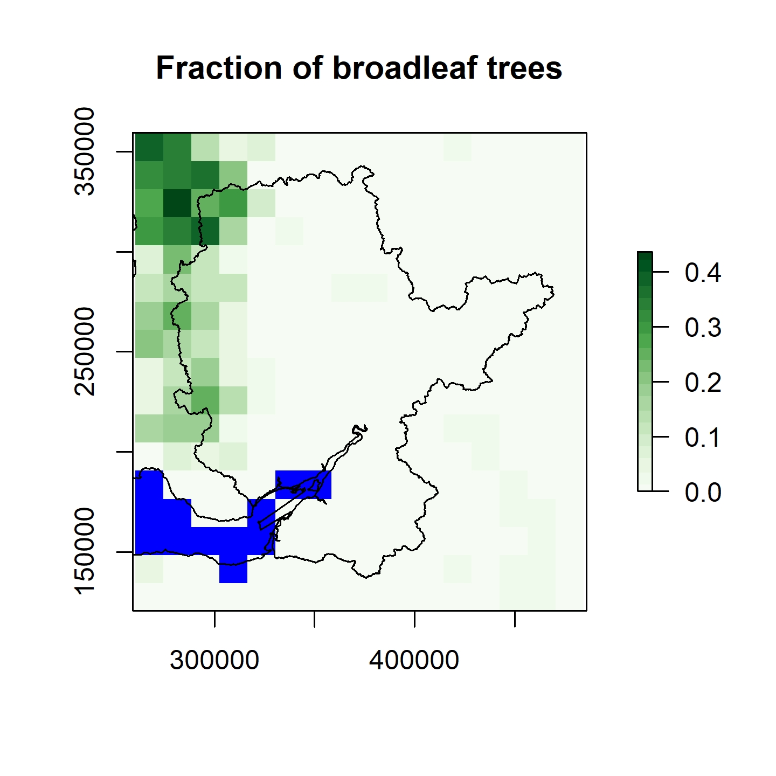
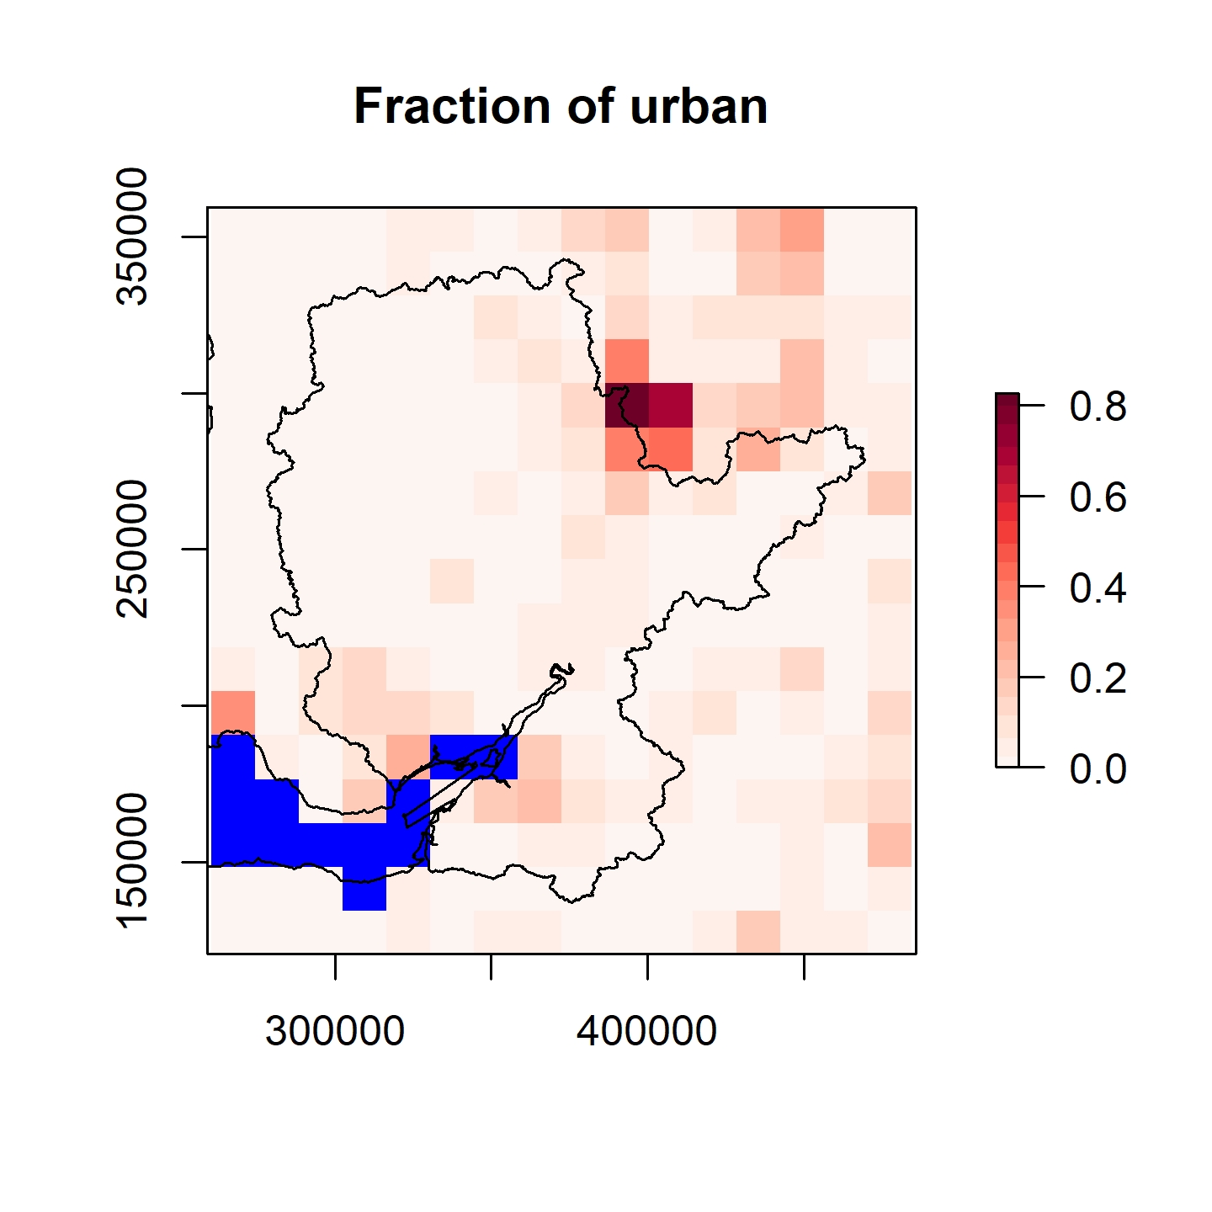
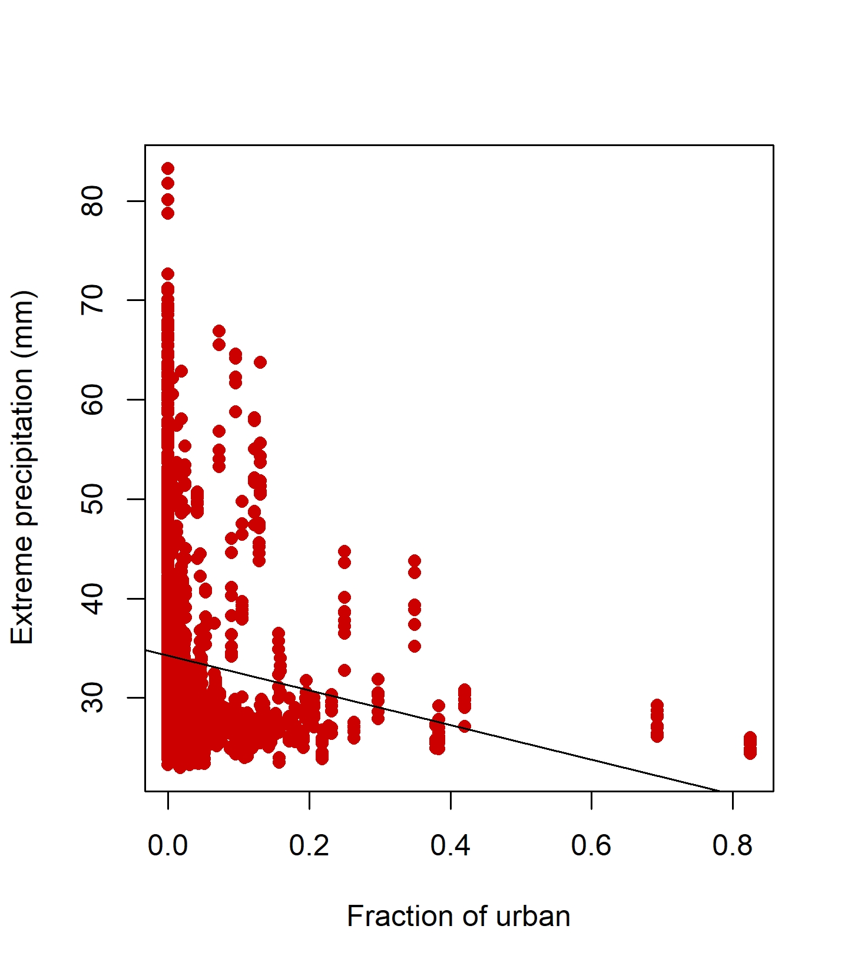
Land use and precipitation
Fraction maps of land use from UKCP18
Gridded precipitation map from HadUK
New hypotheses
Grassland/Cropland
Trees
Urban

Slide 7
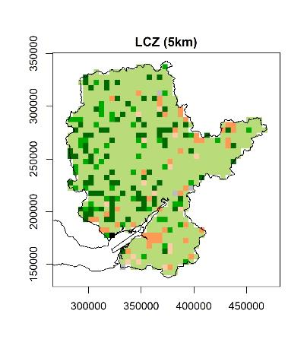
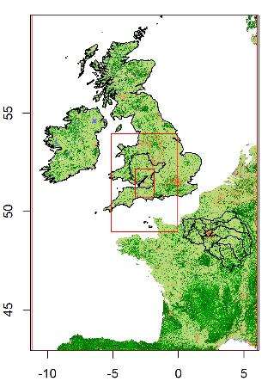
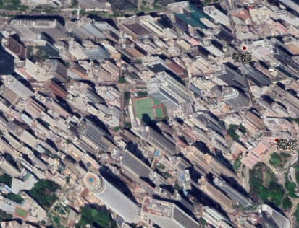
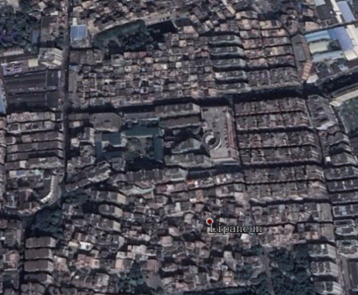
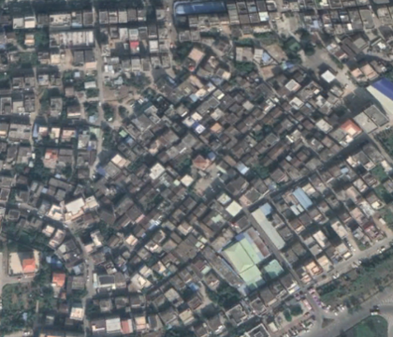
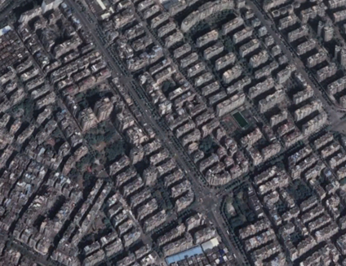
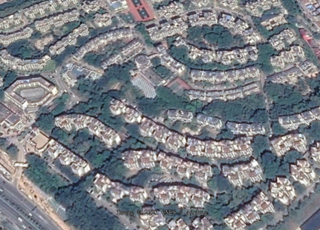
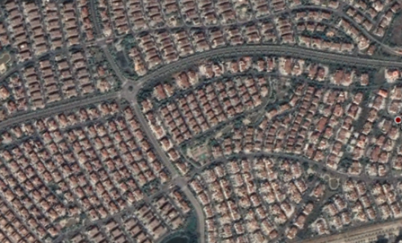
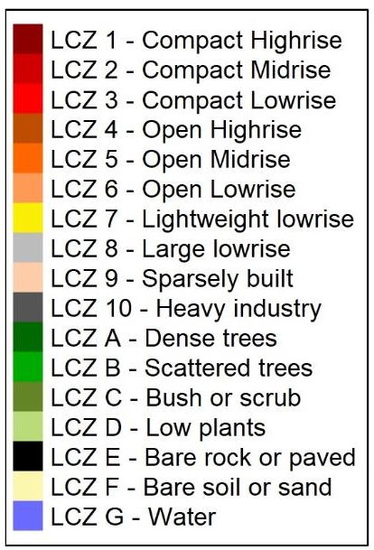
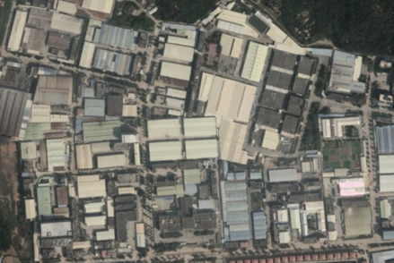
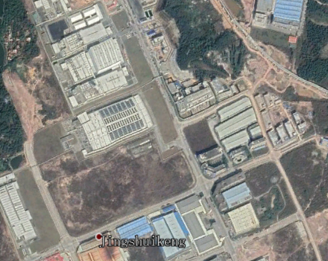
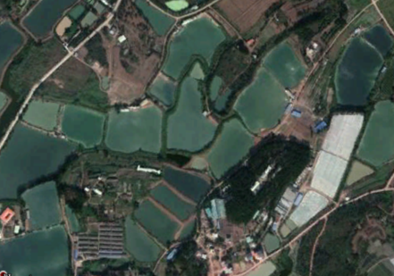
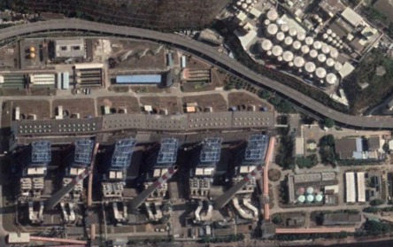
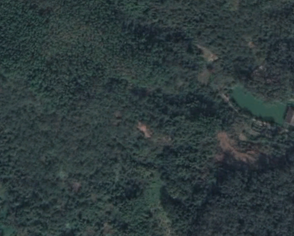
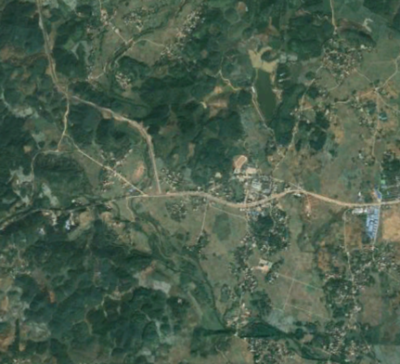
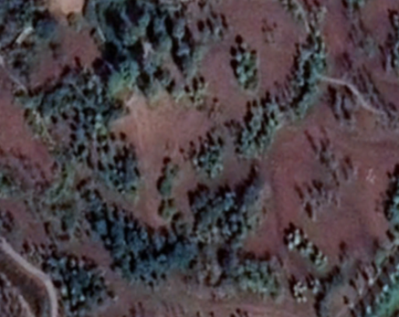
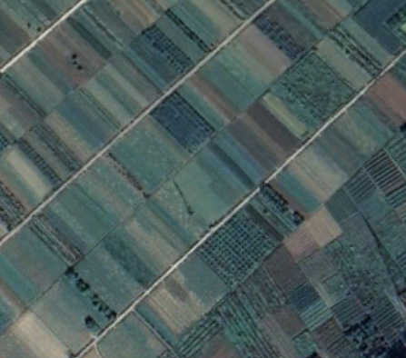
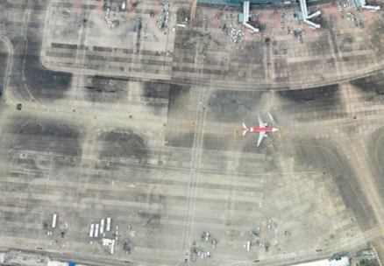
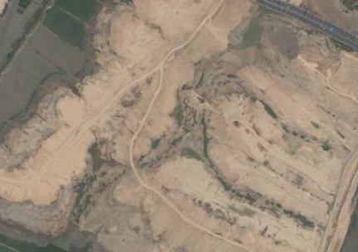
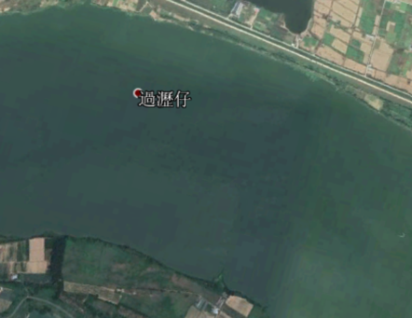
Local Climate Zone (LCZ)
Land use types for urban planning
LCZ 1
LCZ 2
LCZ 3
LCZ 4
LCZ 5
LCZ 6
LCZ 7
LCZ 8
LCZ 9
LCZ 10
LCZ A
LCZ B
LCZ C
LCZ D
LCZ E
LCZ F
LCZ G
Fan, P.Y., Chun, K.P., Mijic, A., Mah, D.N.Y., He, Q., Choi, B., Lam, C.K.C. and Yetemen, O., 2022. Spatially-heterogeneous impacts of surface characteristics on urban thermal environment, a case of the Guangdong-Hong Kong-Macau Greater Bay Area. Urban Climate, 41, p.101034.

Slide 8
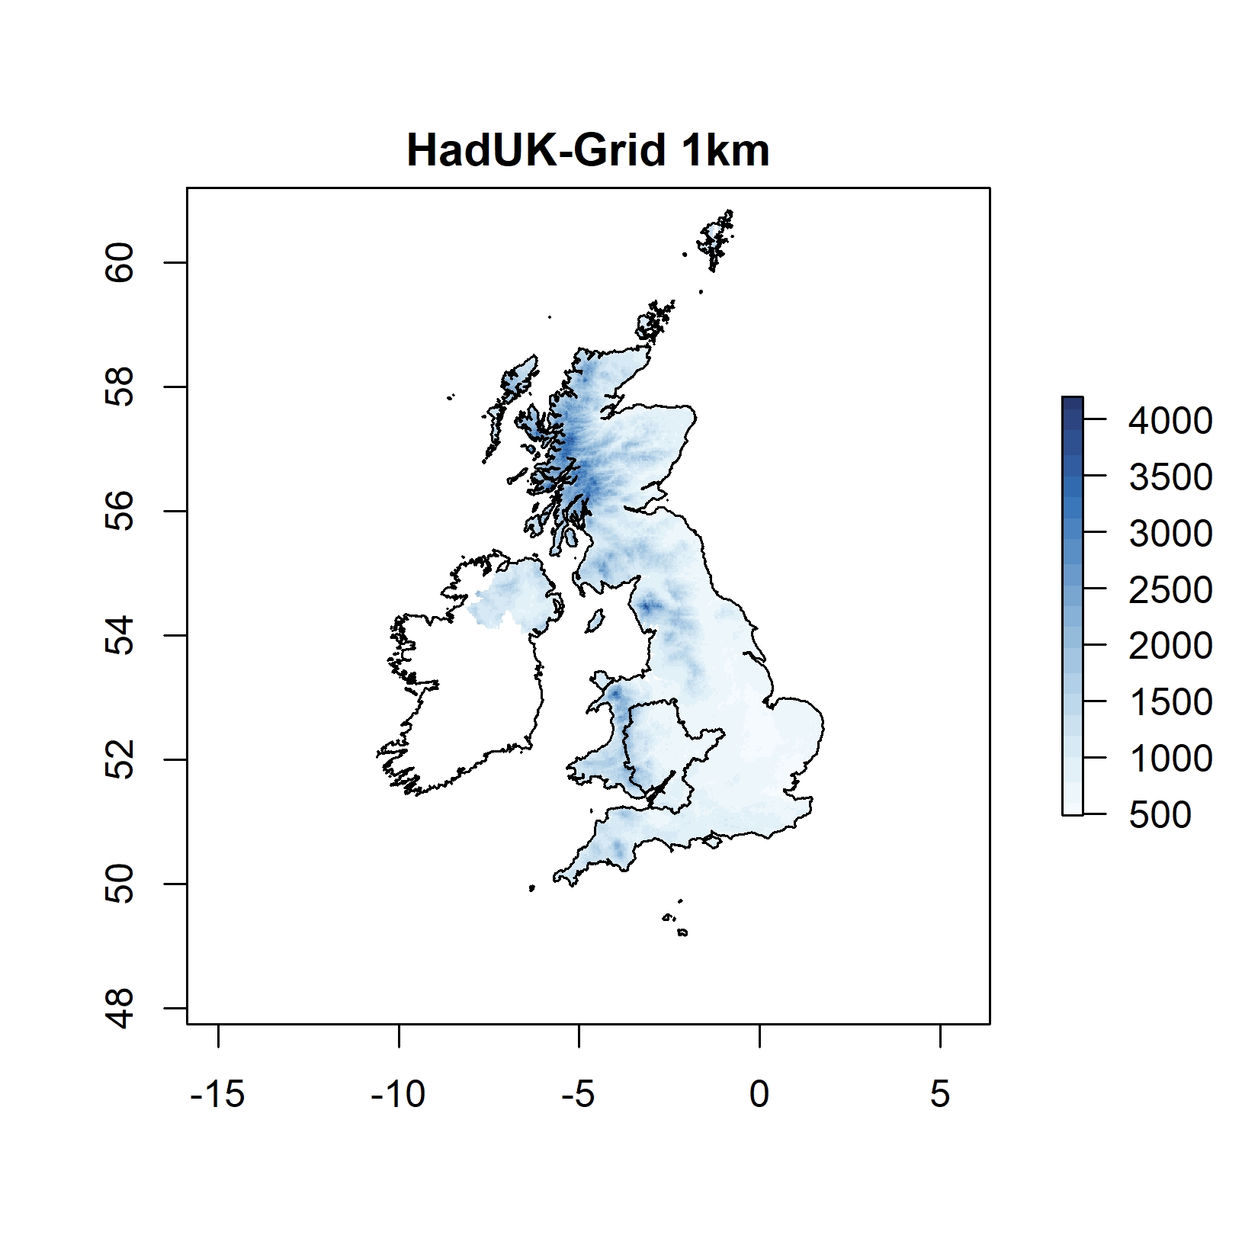
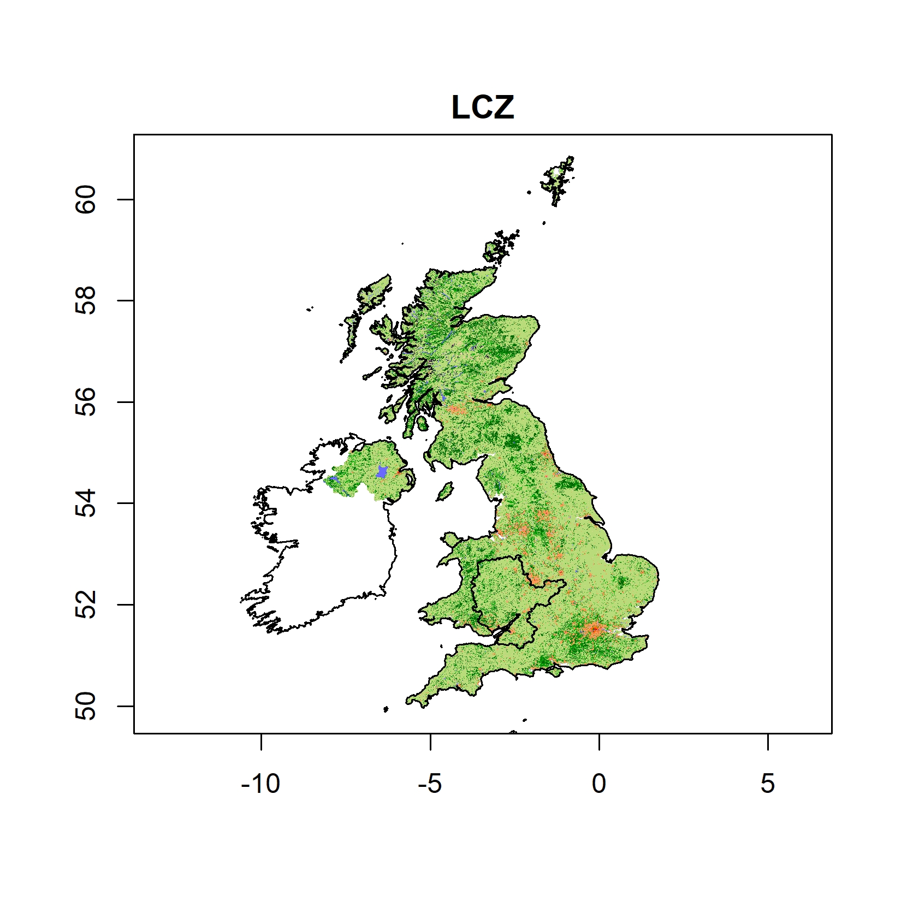
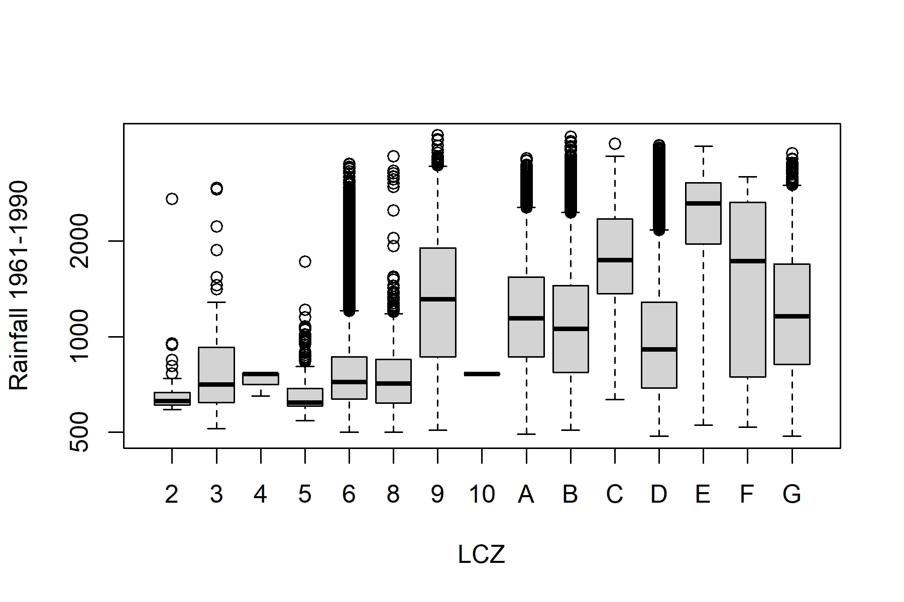
LCZ and Precipitation (Over UK)
LCZ 1-LCZ 6 are main urban land forms
LCZ A and LCZ B are higher plants (tree types)
LCZ C and LCZ D are lower plants (bush, scrub or cropland types)
LCZs with plants has higher precipitation than LCZs with urban land use types

Slide 9
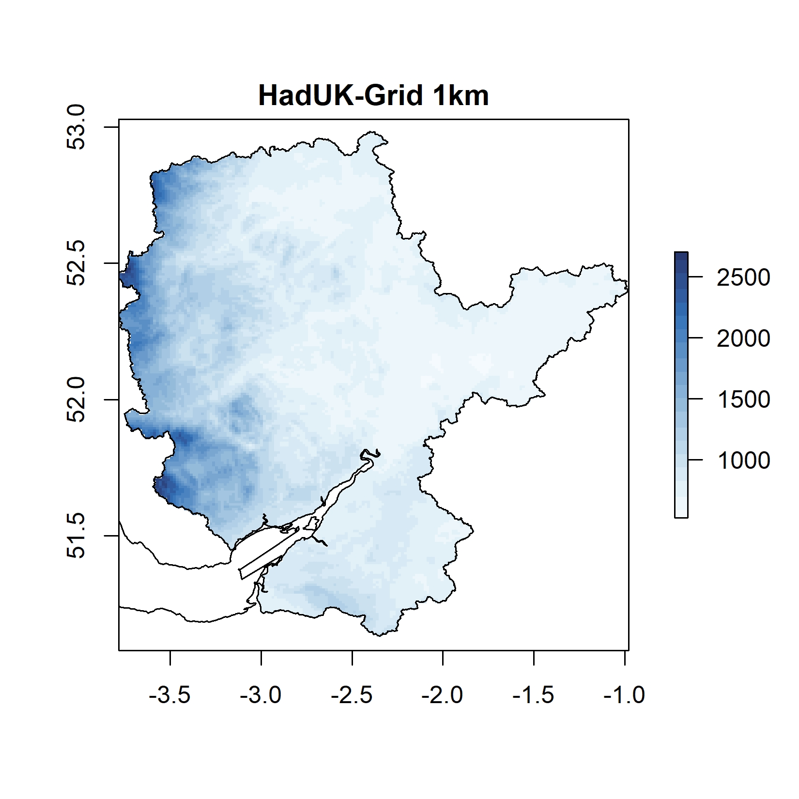
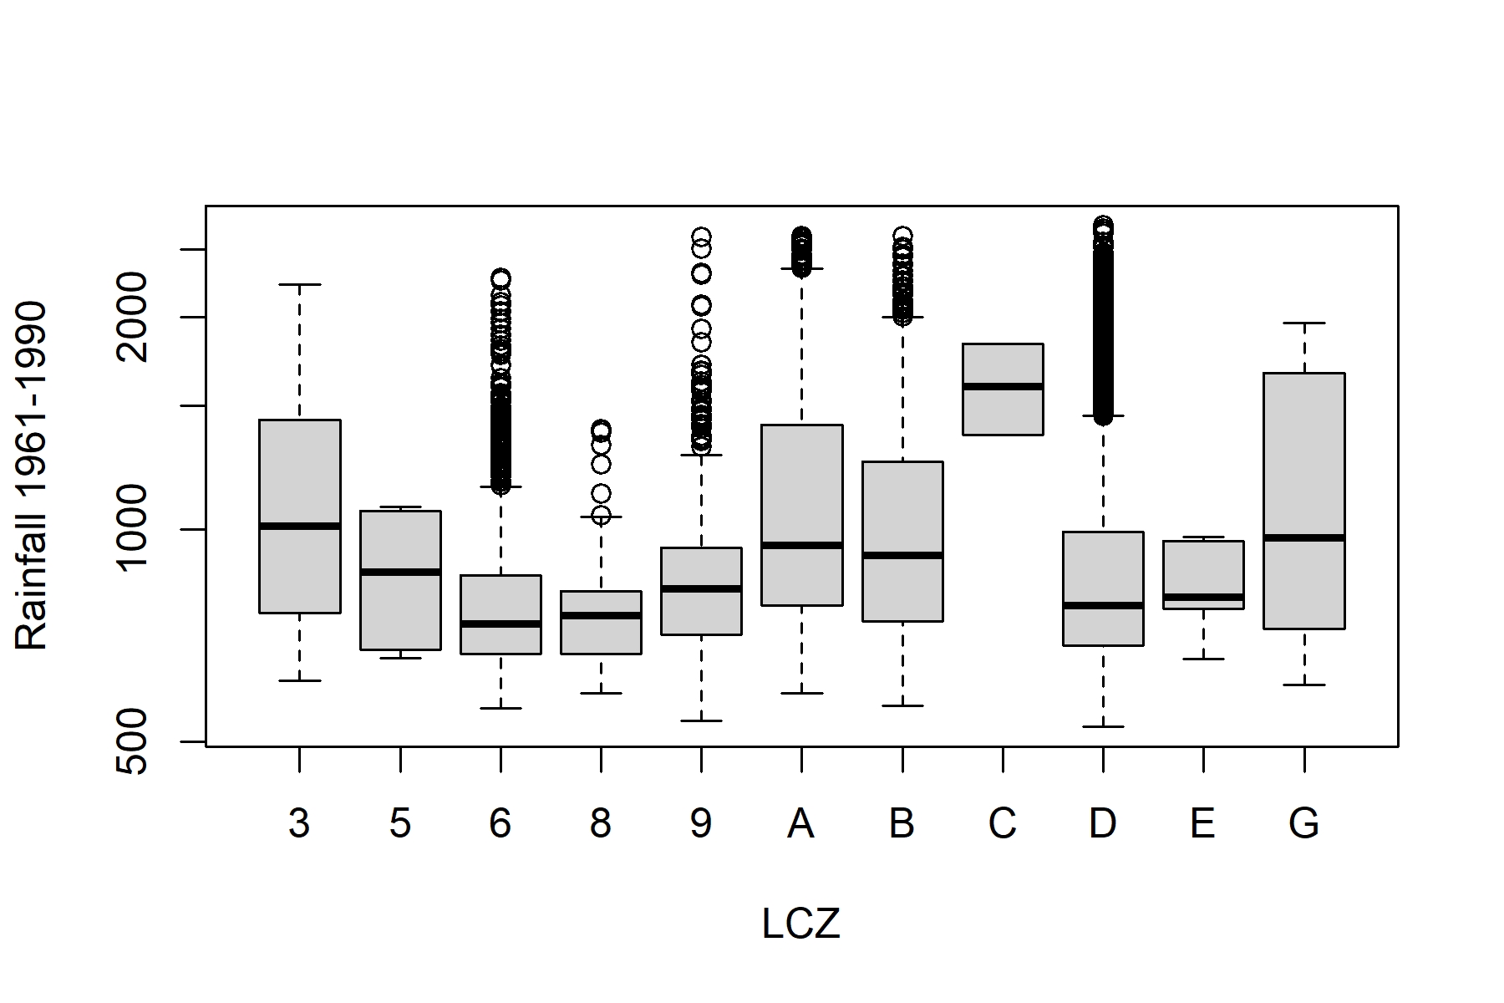
LCZ and Precipitation (Over Severn)
LCZ 1-LCZ 6 are main urban land forms
LCZ A and LCZ B are higher plants (tree types)
LCZ C and LCZ D are lower plants (bush, scrub or cropland types)
LCZs with plants has higher precipitation than LCZs with urban land use types

Slide 10

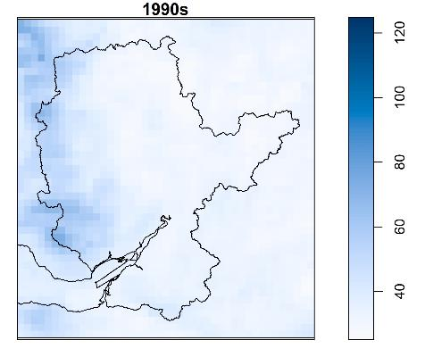



UKCP18
Emissions scenario RCP8.5
5km
1990s
LCZ 6
LCZ A
LCZ D
Open low-rise
Dense trees
Low plants

Slide 11

UKCP18
Emissions scenario RCP8.5
5km
2030s
LCZ 6
LCZ A
LCZ D
Open low-rise
Dense trees
Low plants

Slide 12

UKCP18
Emissions scenario RCP8.5
5km
2070s
LCZ 6
LCZ A
LCZ D
Open low-rise
Dense trees
Low plants

Slide 13



UKCP18
1990s

Slide 14


UKCP18
2030s

Slide 15


UKCP18
2070s

Slide 16







Our framework of land-use-based approach
Regional CPM model for water hazard management

Slide 17
Looking back
Using the Severn River Basin as a case study, changes in extreme precipitation events are investigated based on landscape characteristics
Gridded Observations and the UKCP18 Convection-Permitting Model (CPM) Projection Outputs
Land use maps
The results are used to generate
possible hypotheses to run different CPM models based on the land use scenarios
Trees increase extremes, whereas urban areas and croplands decrease extremes
more informative precipitation extreme estimations related to regional planning, for the high greenhouse gas emissions scenario RCP8.5
Extreme precipitation increases along with its uncertainty
Land-use-based approach using regional CPM model outputs for water hazard management

Slide 18

We look forward to having some questions and suggestions

