Slide 1
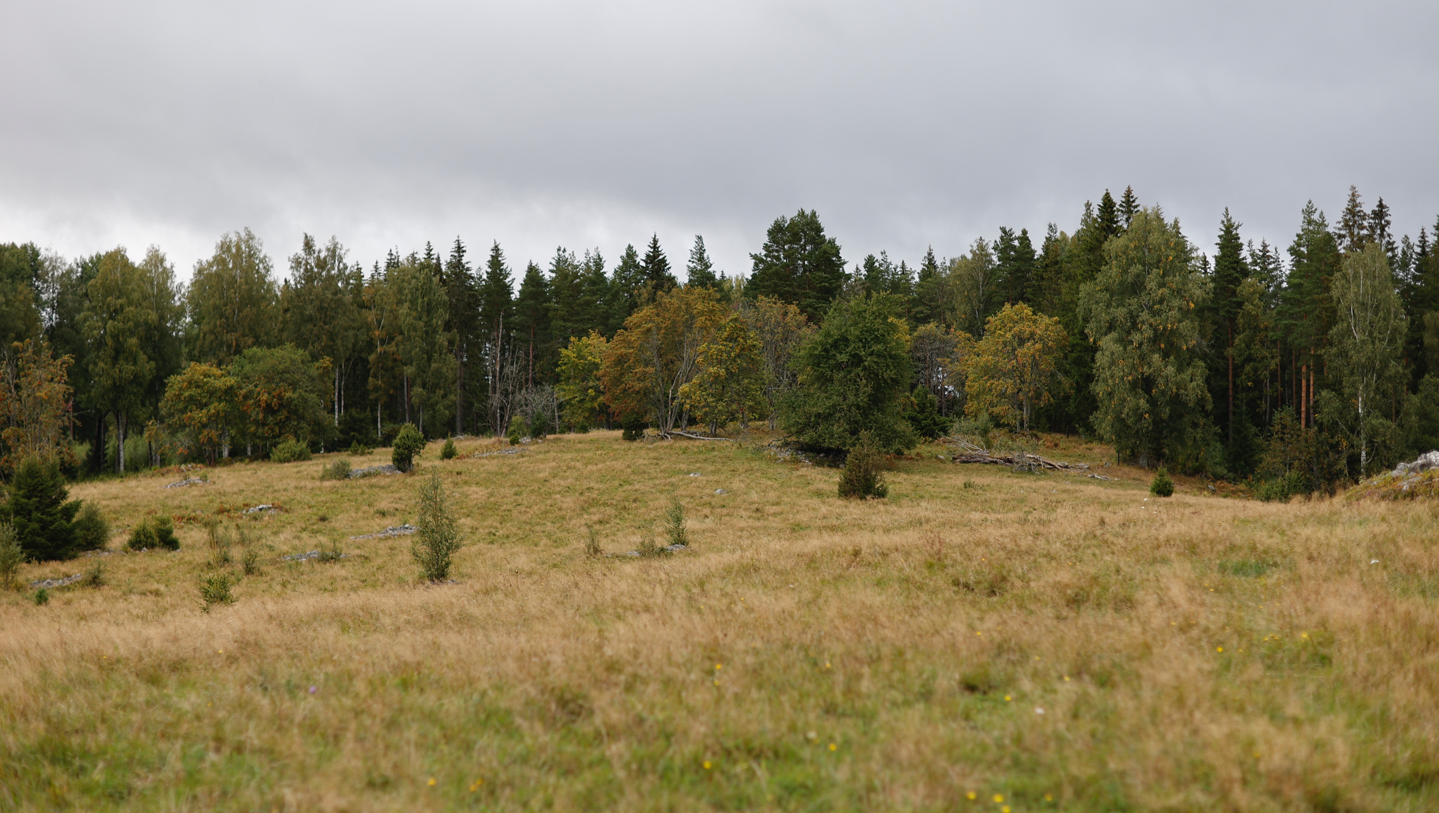
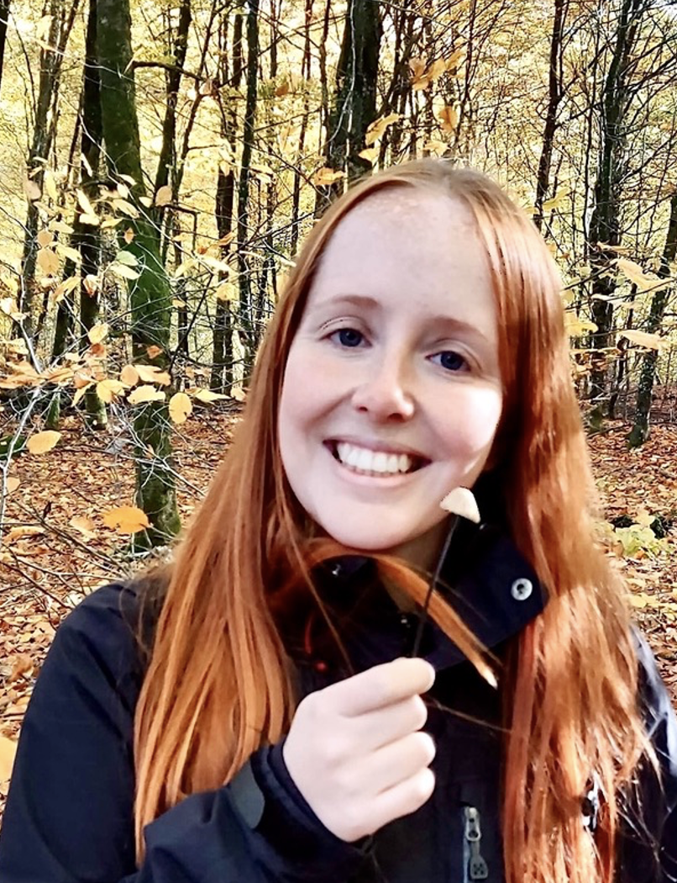
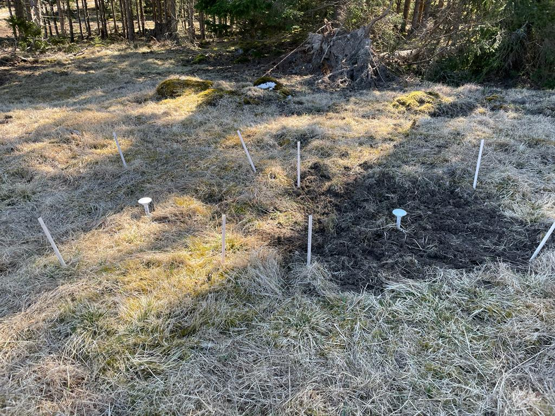
Microbial responses to drying and rewetting: The interaction between soil structure and precipitation
Sara Winterfeldt, Yuqian Tang, Lettice C. Hicks,
Albert C. Brangarí, and Johannes Rousk
@AlbertBrangari

Slide 2
What did we do?
We investigated how both the precipitation history and the disruption of soil structure affect microbial growth and respiration during drying-rewetting

Slide 3

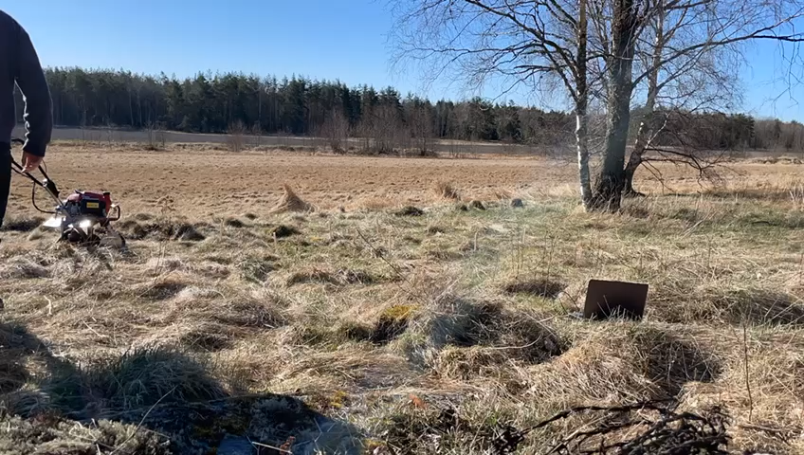
What did we do?
We investigated how both the precipitation history and the disruption of soil structure affect microbial growth and respiration during drying-rewetting

Slide 4
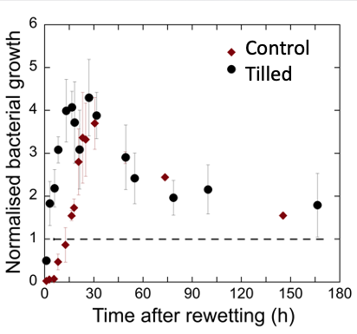
Results: Resilience to soil structure disturbance
Tilled soils exhibit higher bacterial resilience (faster recovery) after DRW
Tilled soils exhibit higher fungal resilience (faster recovery) after DRW
No differences in respiration

Slide 5
Results: Resilience along the precipitation gradient
Resilience
Dry Wet
Dry Wet
Higher bacterial resilience (faster recovery) after rewetting in sites with lower precipitation
No patterns in fungal resilience across the precipitation gradient

Slide 6
Conclusions
C1 – Bacterial communities in sites with lower precipitation are used to drier conditions, and then exhibit a faster recovery after rewetting (higher resilience).
C2 – Physical disruption of soil accelerates microbial recovery (higher resilience).
C3 – Physical disruption would affect less microbial communities from drier sites (already adapted to disturbances).
C4 – Tilled soils are exposed to more extreme drying-rewetting events

Slide 7

Thank you !!!

