Slide 1


A study of water vapor within and in the vicinity of cirrus clouds at mid-latitudes
Georgios Dekoutsidis, Silke Groß, and Martin Wirth
Institute of Atmospheric Physics, German Aerospace Center (DLR)

Slide 2
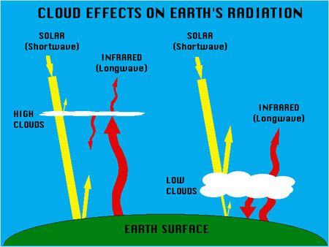
Motivation
Cirrus clouds greatly affect the earth’s climate system
Net warming effect
Effects vary for individual clouds
Source of uncertainties in climate change predictions
Scientific Questions
Credit: NASA
Scientific questions:
What are the characteristics of ice saturation in mid-latitude cirrus clouds and their adjacent cloud-free air?
What is the vertical structure of ice saturation within these clouds?
How does the formation process affect the relative humidity?
How does the relative humidity change during the life cycle of a cloud?
Notes:
primarily through their impact on the radiation budget
.
Depending on their microphysical properties and their initial freezing mechanism and ambient conditions
Modelling of these small-scale microphysical processes -for which much still remains unknown- proves to be a challenge leading to inaccuracies in the prediction of cirrus clouds, their radiative effects and interactions with aerosols
to improve on that

Slide 3

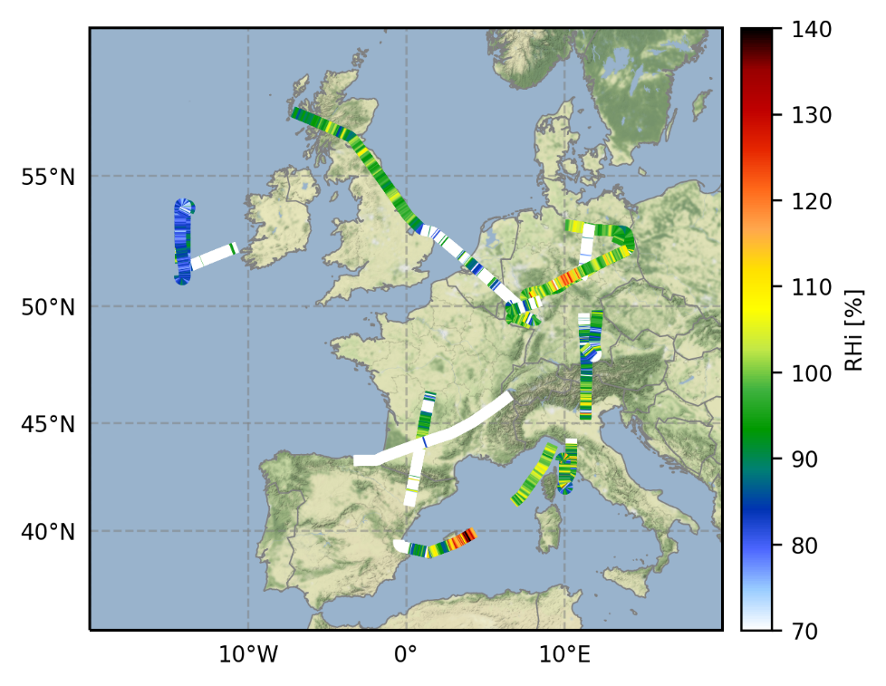
Data & Method
ML-Cirrus Campaign
March / April 2014
Research flights performed over C. Europe and the NE Atlantic Ocean
German research aircraft HALO
WALES LIDAR system
water vapor differential absorption lidar (DIAL)
high spectral resolution lidar (HSRL).
Relative Humidity with respect to ice (RHi) calculated from
WALES water vapor measurements
ECMWF temperature data
Cloud Mask
backscatter ratio >= 3
linear depolarization ratio >= 20%
temperature < 235 K
Credit DLR (CC-BY 3.0)
Cloud Classification
in-situ formed clouds
liquid-origin clouds
Notes:
.
.
.
In-situ and remote sensing instrumentation
are capable of measuring water vapor and deriving optical properties of cirrus clouds with great resolution and accuracy.
We combine the water vapor measurements taken by WALES during the ML-Cirrus campaign with model temperatures from ECMWF and calculate the relative humidity over ice (RHi) for these clouds.
.
Based on formation process

Slide 4
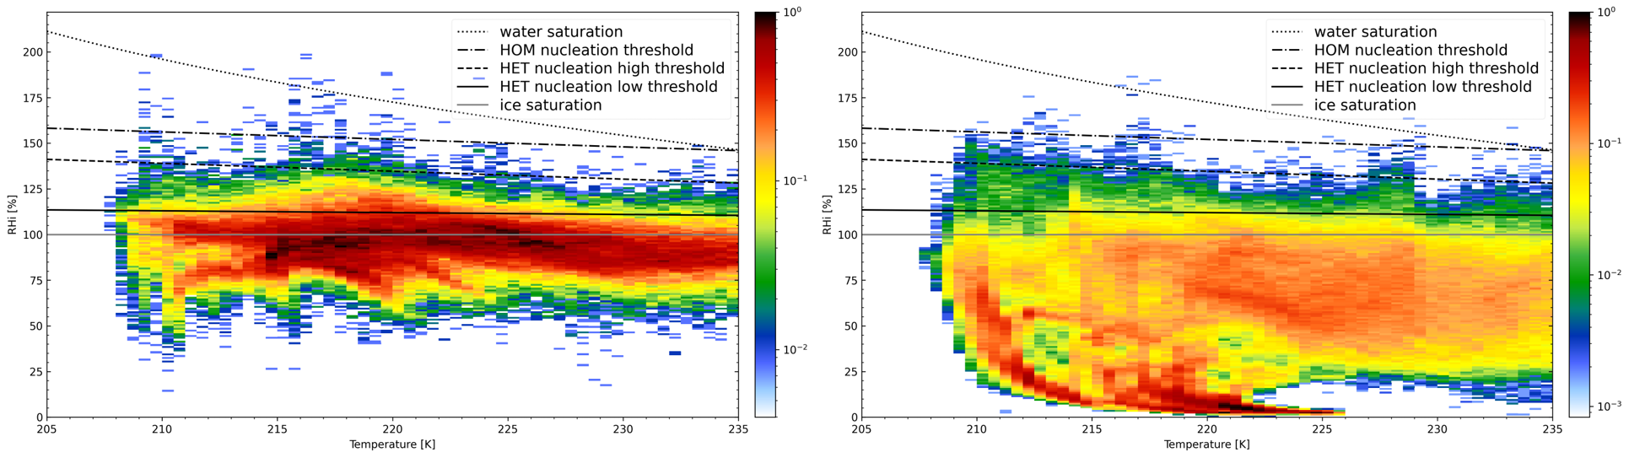
Results – Distribution of RHi
In-Cloud
Cloud-free
34.1% of in-cloud data points with RHi >100%
Bimodal distribution
225K and close to saturation, RHi=100%
215K and subsaturated, RHi = 90%
Heterogeneous nucleation regime
6.8% of the cloud-free data points with RHi >100%
Most data points below ice saturation
Heterogeneous nucleation regime
Notes:
Answering the 1st scientific question: What are the characteristics of ice saturation in mid-latitude cirrus clouds and their adjacent cloud-free air?
In-cloud: 30.3% RHi <120%, 3.3% RHi >120% and <140% and 0.5% RHi >140%.
Cloud-free: 5.7% RHi <120%, 1% RHi >120% <140% and 0.2% RHi >140%
Probability densities of the Relative Humidity over Ice (RHi) with respect to ambient temperature. The gray line depicts the ice saturation threshold at RHi = 100%. The black line is the low threshold for heterogeneous nucleation (HET). The ice nuclei (IN) for this threshold are mineral dust, which is efficient as an initiator of ice formation. The dashed line represents the high threshold for HET nucleation. Here the IN is coated soot which is not activated as easy as mineral dust. The dot-dashed line indicates the threshold over which homogeneous nucleation (HOM) can take place. During HOM, ice crystals from without the need of IN. The dotted line is the water saturation threshold.
The in-cloud data points reach temperatures down to 207K and are most frequently detected close to the ice saturation threshold (RHi = 100%) for the entire temperature range. Their distribution is bimodal. One peak can be seen around 225K and close to ice saturation, and a second one around 215K and below saturation at RHi around 90%. An increase in supersaturated points can be seen for temperatures between 215K and 225K.
Regarding the nucleation processes, most of the supersaturated data points are in the HET regime, with the highest probabilities close to the low HET threshold. The probability density drops significantly over the high HET threshold. Very few data points are found above the HOM threshold. Interestingly there is also a very small probability of detection over the water saturation threshold.
The majority of the cloud-free data points are detected below the lower threshold for HET nucleation. Some data points reach up to the high HET threshold. The probability for detection up to the high HET threshold is higher for colder temperatures. The probability of data points exceeding the high HET and HOM thresholds is very low.

Slide 5
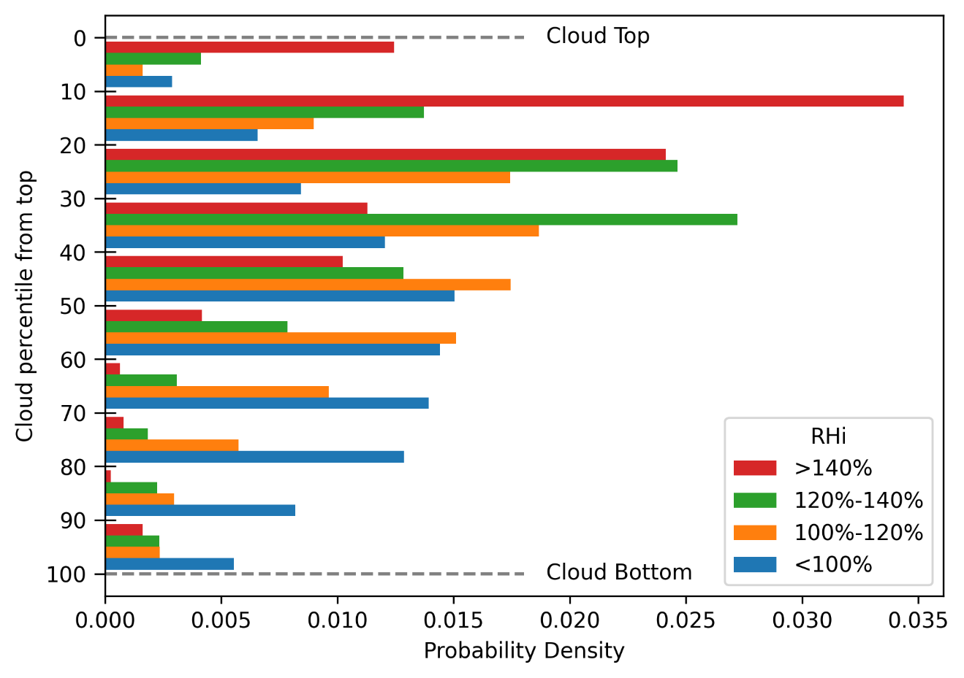
Results – Vertical Distribution of RHi
Cloud Top
Very high supersaturations
Ice crystal formation
Cloud middle
Lower supersaturations
Ice crystal growth
Cloud Base
Subsaturated
Sublimation or sedimentation of ice crystals
Notes:
Answering the 2nd scientific question: What is the vertical structure of ice saturation within these clouds?
Probability densities of RHi in relative location to cloud top. RHi values of in-cloud data points are grouped into four groups approximately representing subsaturation (blue), low HET regime (orange), high HET regime (green) and HOM regime (red). For every group the probability density in bins with respect to relative location to cloud top is plotted. Example: the bin from the 20th to the 30th percentile contains the probability of occurrence of the four RHi groups in a slice of the cloud located 20% to 30% of the distance between cloud top and cloud base.
In some individual cases the uppermost layer has lower supersaturation than deeper layers or is even undersaturated

Slide 6
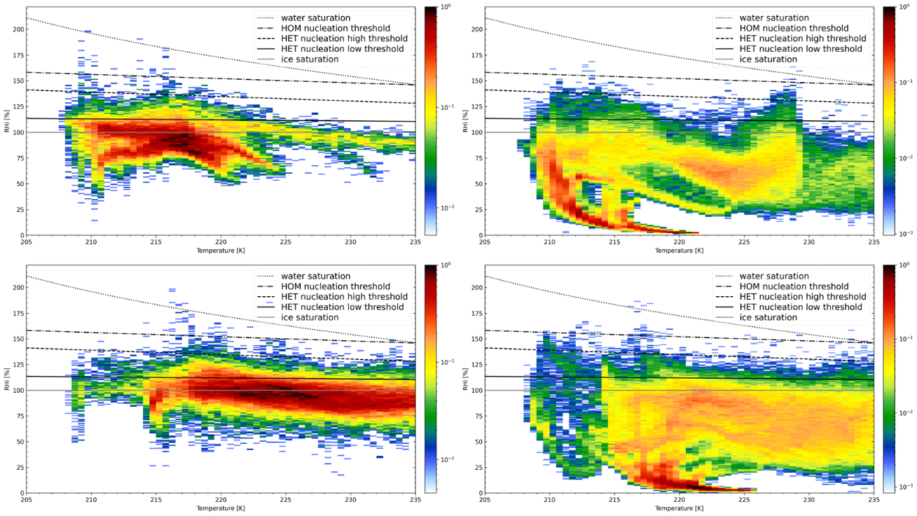

Results – In-situ vs Liquid origin
 |  | In-cloud |  | Cloud-free
In-situ |  | 31% RHi Supersaturation Mostly below 225K Peak at 217K, 90% RHi |  | 6% RHi Supersaturation Reach down to 208K
Liquid Origin |  | 36% RHi Supersaturation Mostly over 215K Peak at 225K, 100% RHi |  | 7,5% RHi Supersaturation Mostly over 215K
Notes:
Answering the 3rd scientific question: How does the formation process affect the relative humidity?
These two regions seem to represent the two cirrus cloud categories mentioned above
Around 31% of the data points are supersaturated with respect to ice. 26.8% have low supersaturation, RHi up to 120%, 3.4% have RHi values between 120% and 140% and 0.6% have high supersaturations with RHi being above 140%.
Supersaturation has an occurrence frequency of 36%, which is higher than for the in-situ clouds. 32.3% of the in-cloud data points have low supersaturations, RHi<120%, 3.3% have RHi values between 120% and 140% and 0.5% have higher supersaturations with RHi exceeding 140%.
Supersaturation occurs for 5.7% of the data points. 4.5%, have RHi between 100% and 120%, 1.1% have RHi values from 120% to 140% and finally 0.2% have high supersaturations with RHi higher than 140%. Supersaturation has an occurrence of 7.5%. 6.3% in the low supersaturation regime, RHi up to 120%, 1% between for RHi between 120% and 140% and 0.2% higher than 140%.
Vertical structure similar.
In-situ formed clouds are mostly cold and unsaturated, with RHi values below the lower threshold for heterogeneous nucleation.
Liquid-origin clouds are usually warmer and supersaturated, with RHi values commonly up to the high threshold for heterogeneous nucleation.

Slide 7
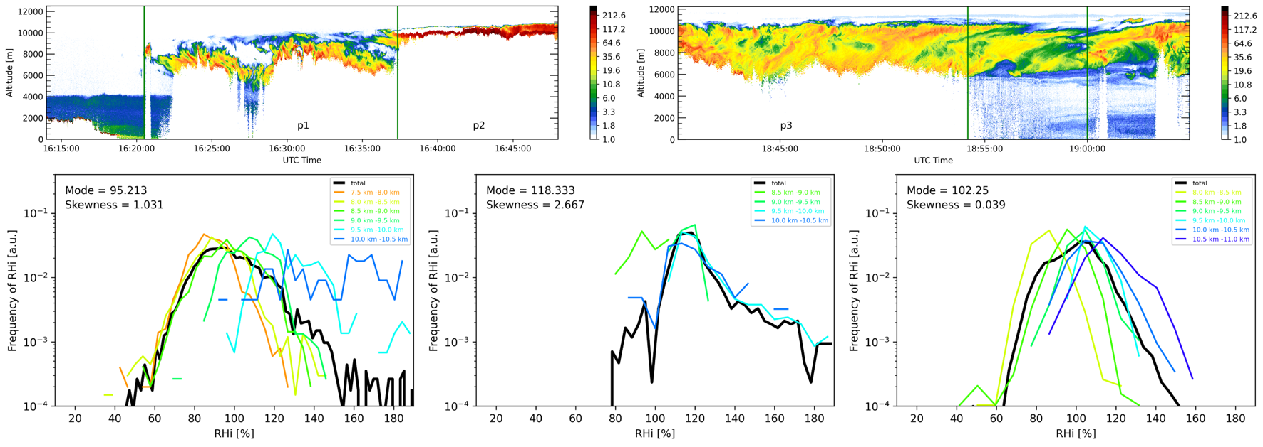
Results – Temporal Evolution
Mission 6 of ML-Cirrus
29/03/2014
West Mediterranean
Multicell thunderstorm evolving into a Mesoscale Convective System (MCS)
 | Young Cells |  | Mature Cell |  | Stable/Dissipating Cell
RHi Mode [%] | 95 |  | 118 |  | 102
RHi Skewness | 1 |  | 2.7 |  | 0
RHi Vertical structure | Rayleigh Higher RHi at cloud-tops |  | Rayleigh Uniform throughout cloud |  | Gaussian RHi mode reducing for lower layers
Notes:
Answering the 4th scientific question: How does the relative humidity change during the life cycle of a cloud?
P1 contains two towering convective cells. P2 contains the main convective cell. P3: depicts the outflow of the system. The white regions at cloud top are a result of saturation of the detector. The clouds in p1 and especially p2 are not fully depicted and only the top portions of the cloud could be measured by the lidar system.

Slide 8
Summary
High supersaturations in mid-latitude cirrus clouds and their surrounding cloud-free air
Vertical structure of RHi within clouds
High supersaturations near cloud top
Lower supersaturations near cloud middle
Subsaturated cloud base
Two cloud regimes
In-situ formed clouds
Peak at 217K, 90% RHi
31% RHi Supersaturation
Liquid-origin clouds
Peak at 225K, 100% RHi
36% RHi Supersaturation
Temporal Evolution of RHi
Shape of RHi distribution
Mode of distribution
Vertical Structure
Thank you for your attention!
Questions?
Notes:
.
.

