Slide 1
Climate-driven deterioration of long-life, long-linear geotechnical infrastructure
The ACHILLES Programme Grant
Helen Brooks, Newcastle University
Notes:
This is a short presentation so I’m mainly giving an overview of the programme grant, but I am really keen to chat to anyone who is interested to find out more afterwards

Slide 2
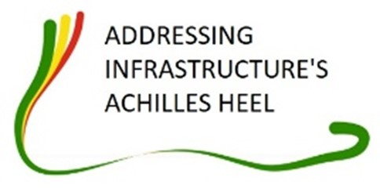







ACHILLES Programme Grant
Funded by EPSRC (UK)
Working on long-linear infrastructure assets:
  Deterioration processes
  Asset performance
  Forecasting and decision support
Notes:
-In collaboration with (LIST UNIVERSITIES)
-Road, rail and flood embankments provide vital transport and flood defence infrastructure.
-Slope failures can close transport networks and cause delays, or can reduce the protection provided against flood hazards.
-This creates huge economic cost and can cause a risk to life for those using affected transport networks or resident on the floodplain.
-Where emergency repair is needed, the estimated cost of this is 10 times that of scheduled maintenance making effective asset management an industry priority (Glendinning et al., 2009).

Slide 3
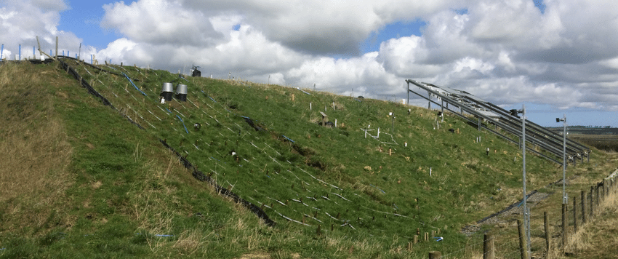
BIONICS
Full-scale trial embankment near Hexham, Northumberland, UK
Durham lower boulder clay
4 panels on N and on S slope
Well vs. poorly compacted
Weather station, water content, pore water pressure, slope movement/deformation, soil temperature
Data all openly available (https://data.ncl.ac.uk/articles/dataset/Data_from_BIOINCS_research_embankment/15506019 )
Photo: Ross Stirling
Notes:
-90 m long, 29 m wide, 6 m high with a 5 m crest, and 1:2 slopes
-Planted with grass seeds representative of UK embankments
-Understand shrink-swell cycles by measuring rainfall, water content
-Understand suction generation by measuring pore water pressure (TENSIOMETER)
-Slope movement (EXTENSOMETERS)-this may reflect-strain softening and progressive failure
-cracking and successive creep downslope as the cracks close over winter
-Data is openly available so please feel free to browse and use for your own research

Slide 4
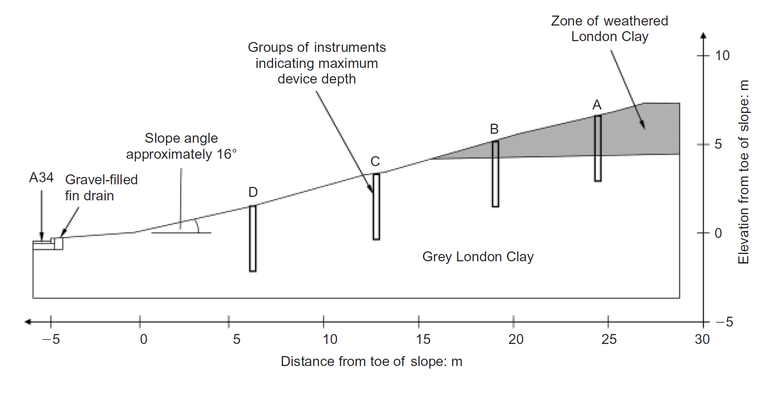
Newbury
Highway cutting
Built in 1997, London Clay
Water content (theta probe), PWP and suction (tensiometer/piezometer), soil temperature, runoff
Potential evapotranspiration (from weather station measurements)
From: Smethurst et al. (2012)
Notes:
-This is a highway cutting which has been instrumented since it was built in 1997
-Composed of London clay
-Measured a variety of soil properties (see slide)
-Potential evapotranspiration can be estimated based on weather station measurements. This gives an indication of the soil moisture deficit throughout the year (see Smethurst et al 2012)

Slide 5
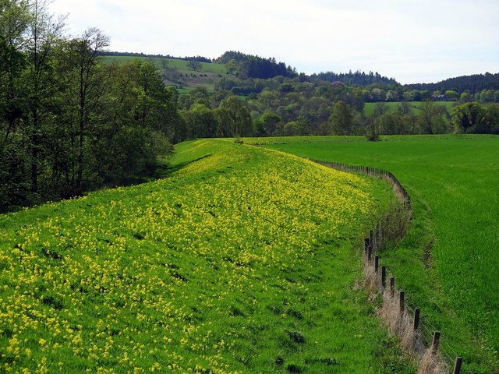
Warden
Flood embankment
Confluence of N Tyne and S Tyne
PWP monitoring, weather station, ERT (permanently installed), slope deformation
Data since Nov 2021 tbc!
From: https://www.geograph.org.uk/photo/5766023
Notes:
-This is the newest addition to our field monitoring sites
-Located at the confluence of the River North Tyne and South Tyne , just west of Newcastle
-Flood embankment which had previously breached, flooding the nearby village of Warden
-As with BIONICS and Newbury, measuring PWP to look at suction generation and impact of weather
-ERT permanently installed and monitoring based on the PRIME system developed by the British Geological Survey

Slide 6
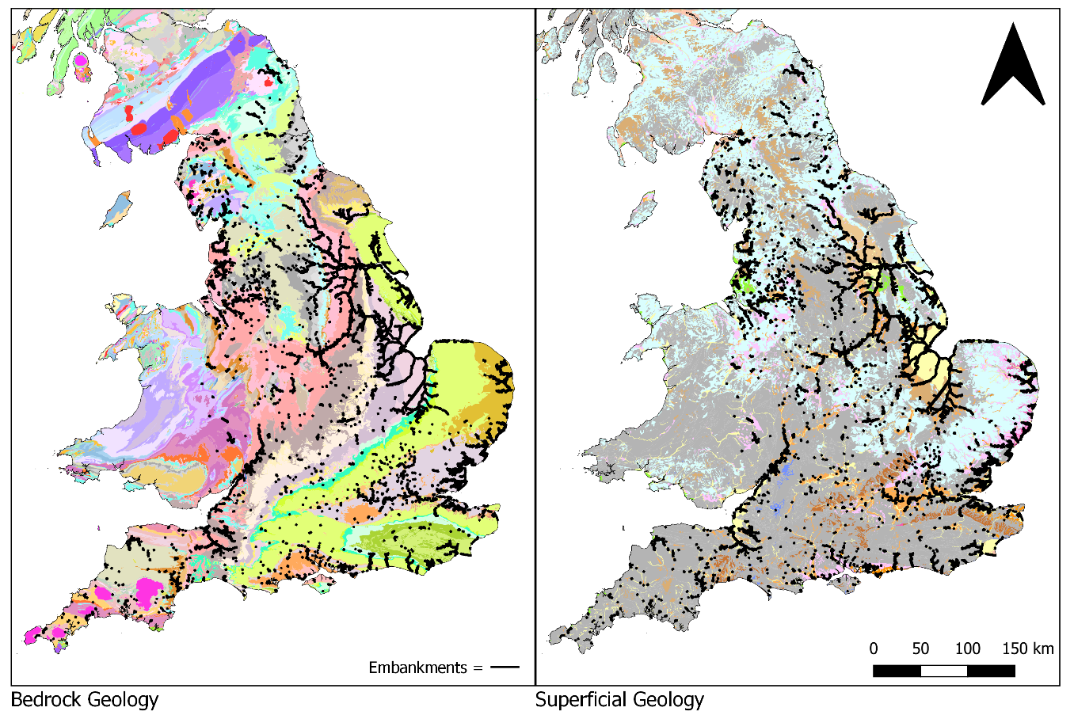
Impact and Engagement
Less clarity on flood embankments (compare to road/rail)
Working with the EA to learn from our results
Notes:
-Project is adding to understanding of how best to monitor and manage flood embankments
-While Network Rail and Highways England publish clear guidance on how they monitor and manage deterioration in embankments on the rail and road networks, it is more difficult to find this information for flood embankments.
-Environment Agency are responsible for flood embankment monitoring and maintenance, in most cases
-Most of the work from ACHILLES focuses on highly plastic substrates. Here we have started to look at which areas of the country our work might be most applicable, by underlaying bedrock geology (left) and superficial geology (right) with flood embankments in the UK

