Slide 1


EGU 2022
MiniPINS – Design status and the latest activities
Maria Genzer¹, Maria Hieta¹, Antti Kestilä¹, Harri Haukka¹, Ignacio Arruego², Victor Apéstigue², Alejandro Gonzalo Melchor², Miguel González-Guerrero², Javier Martínez Oter², Álvaro de Pedraza², Almudena García-Llases², Gustavo Rodríguez² Jose Antonio Manfredi³, Cristina Ortega⁴, Carmen Camañes⁴, Manuel Dominiguez-Pumar⁵,Servando Espejo⁶, Héctor Guerrero⁷, Matti Palin¹, Jarmo Kivekäs¹, Petri Koskimaa¹, and Matti Talvioja⁸
The contract is carried out under a programme of and funded by the European Space Agency
Affiliations on next page

Slide 2
Background
MiniPINS is an ESA study led by the Finnish Meteorological Institute (FMI) to develop and prototype miniaturized surface sensor packages (SSPs) for Mars and the Moon. Phase 0 of the study ending in Mission Definition Review was completed in 2020, and phase A ending in Preliminary Requirements Review in 2021.
The other partners of the study are: Instituto Nacional de Técnica Aerospatial (INTA), Centro de Astrobiología (CAB, CSIC-INTA), Added Value Solutions (AVS), Universitat Politècnica de Catalunya (UPC), Instituto de Microelectrónica de Sevilla (IMSE), and IMDEA Nanociencia. Also Talvioja Consulting Oy participates in the work.
Mars SSP MINS is a penetrator with approx. 25 kg mass, piggy-backed by another Mars mission spacecraft to the Martian orbit and deployed from there. The design of MINS has significant heritage from FMI’s MetNet mission design *
Moon SSP LINS is a 7 kg station deployed by a lunar rover. The reference carrier mission for LINS is ESA EL3 lander.
* Harri et al. (2017), The MetNet vehicle: a lander to deploy environmental stations for local and global investigations on Mars, Geosci. Instrum. Method. Data Syst., 6, 103-124

Slide 3
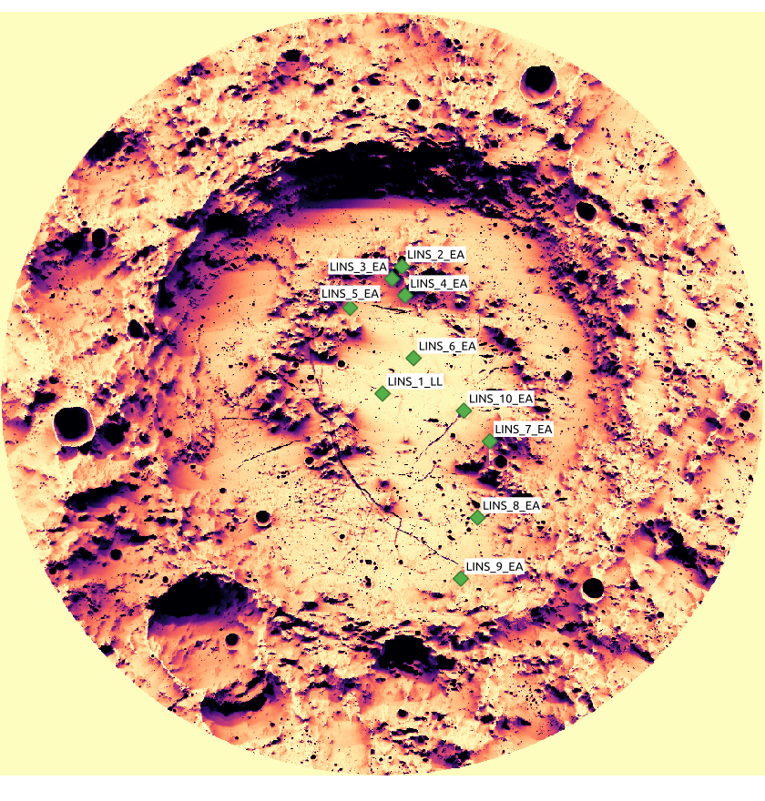
Mission overview - LINS
LINS packages will be a contribution by ESA to another Lunar mission. The baseline carrier mission for LINS is European Large Logistics Lander (EL3).
Up to 4 LINS packages will be placed on the Moon surface by a rover. LINS will have an interface for the rover robotic arm.
From 7 kg total mass, 1.5 kg is reserved for the payload
Once placed, LINS will perform environmental measurements for a minimum of 2 years
Preliminary LINS deployment sites in Schrödinger crater

Slide 4
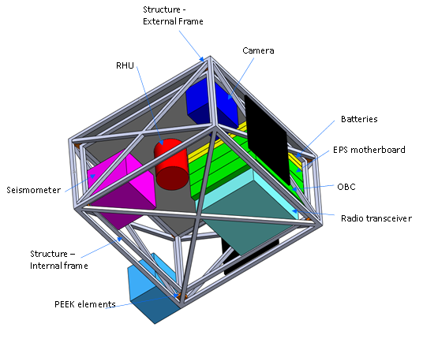
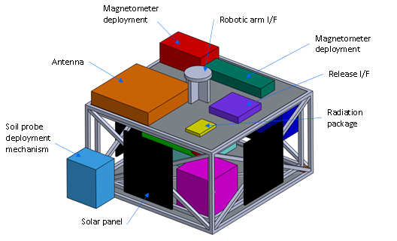
LINS mechanical design, status at phase B1
Outer wall structure and some of the solar panels not shown in the drawing
The structure is divided in two parts, the external frame, that holds in position the solar panels and the external payloads, and the internal frame, that contains the RHU, the electronics and some sensors that do not require direct exposition or need to be protected from the thermal environment.

Slide 5
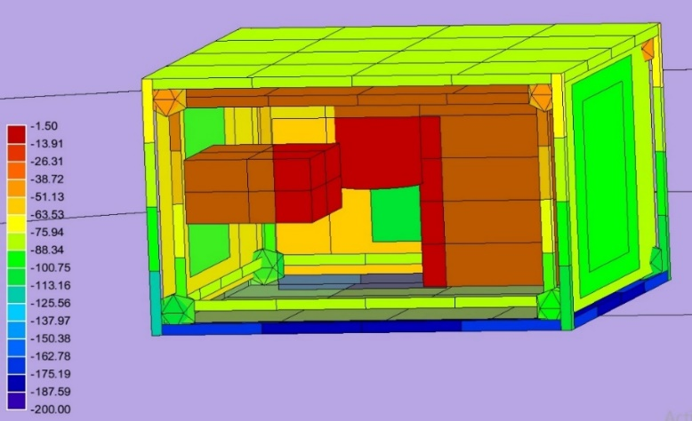
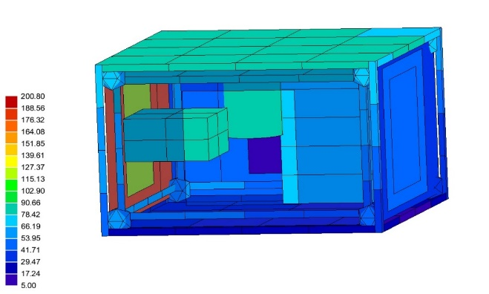
LINS thermal design
One of the most challenging aspects of LINS design is thermal design, as LINS needs to survive 14-day long, cold lunar nights when temperature drops down to -170°C. LINS design consists of a double structure, an internal and an external one. The external one acts as an exoskeleton for the internal and is separated from it by 8 PEEK blocks.
The lower cover of the module can completely contact the lunar regolith, since it would not provide a significant thermal path as it is isolated from the internal one. In addition, the separation between the two structures provides some space to accommodate additional thermal insulation if necessary.
LINS cannot survive Lunar nights on solar cells and batteries alone, so an RHU (3W) is needed to provide extra heating. During the day, extra heat is evacuated through the cold wall with a heat switch.
LINS Temperature field [°C] during Lunar Night (worst cold case).
LINS Temperature field [°C] during Lunar “noon” (worst hot case).

Slide 6
Suggested LINS Payload
Panoramic camera
Adaption of the MASCOT camera from DLR.
Soil thermoprobes
3D heat flux sensor, based on the structure of a wind sensor for Mars. Provided by UPC.
Tilt accelerometer
COTS component from Analog Devices. Qualified for ExoMars 2016 mission.
Magnetometer
MOURA, developed for MetNet Precursor by INTA
Seismometer
MEMS short period seismometer from Imperial College. InSight heritage.
Dosimeter
MOSFET dosimeter from Dyndall National Institute, heritage from NANOSAT 1B mission.

Slide 7
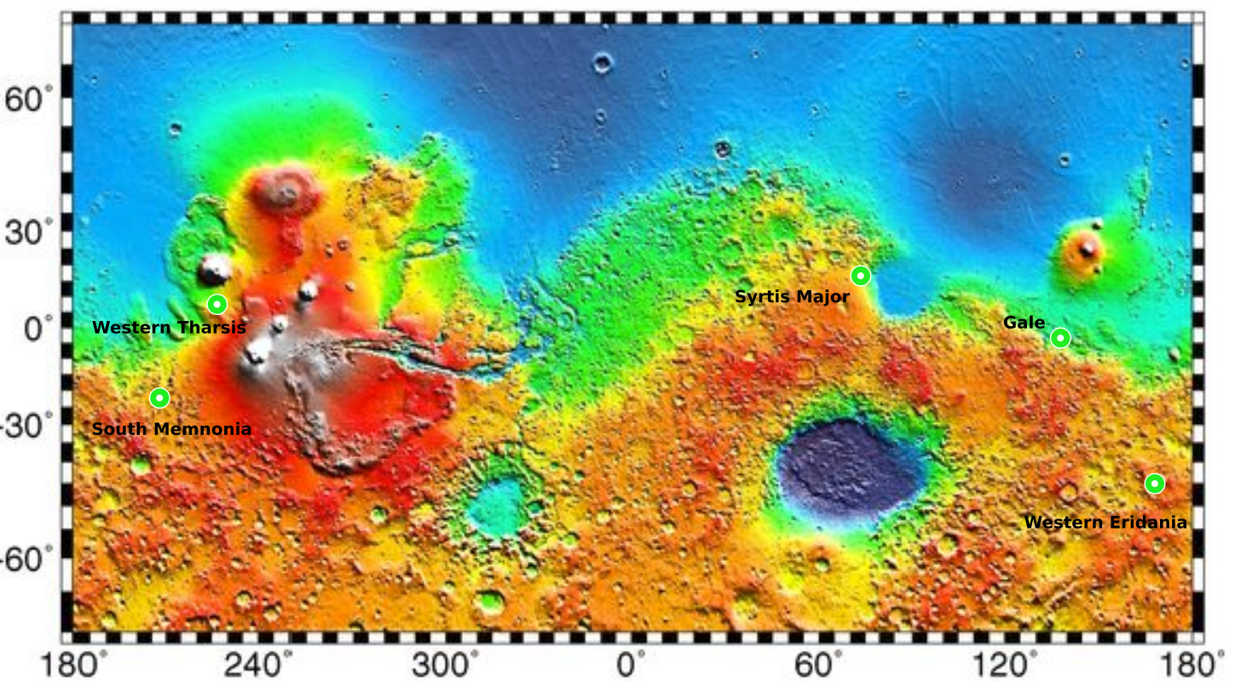
Mission overview - MINS
MINS is a contribution by ESA to another Mars mission, or other mission of opportunity
4 penetrators are deployed hyperbolically from Mars approach orbit to various landing sites on Mars. The landers perform fully autonomous aerodynamic braking with inflatable braking units (IBUs) and land with 60-80 m/s velocity, penetrating the soil up to 0.5 m.
From 25 kg total mass of the lander, up to 4.5 kg is reserved for the payload
Once landed, MINS will perform surface and sub-surface environmental measurements, for a minimum of 1 Martian year (2 Earth years)
Name | Location | Elevation | Crustal magnetic field | Soil penetrability
Gale Crater | 5S, 140E | -4 km | Not active | Sand and duricrust (cemented regolith), not much dust
Western Tharsis, South of Olympus Mons | 10N, 135W | -1 – 0 km | Not active | Thick covering of dust (2-6 m)
Syrtis Major | 15N, 70E | 0 – 1 km | Slightly active | Coarse sand and duricrust, little dust
Western Eridania (Crater) | 45.5S, 169.5E | 0 – 1 km | Active | Sand and duricrust, not much dust, possibly subsurface ice
South Memnonia (Bernand Crater) | 23S, 154W | 0 km | Active | Mixture of dust and sand
Preliminary landing site candidates for MINS penetrators

Slide 8
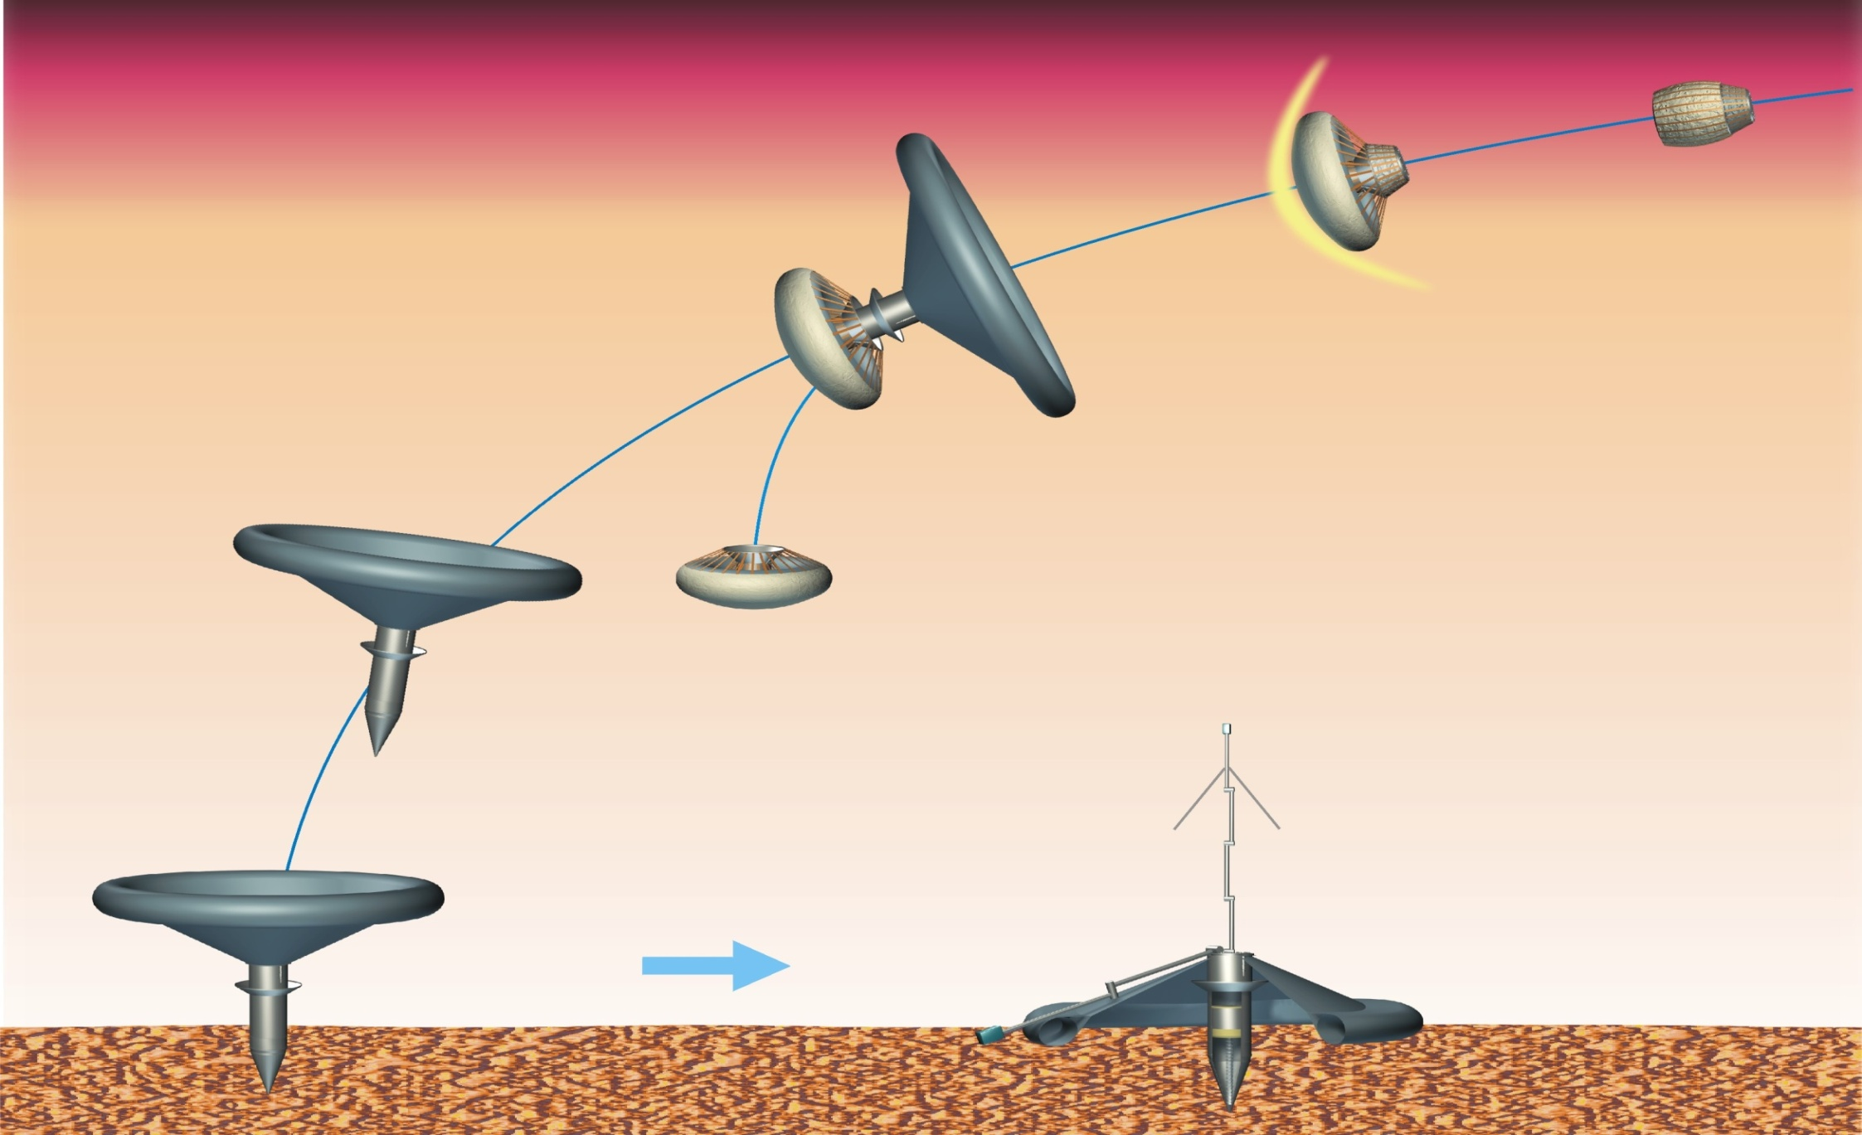
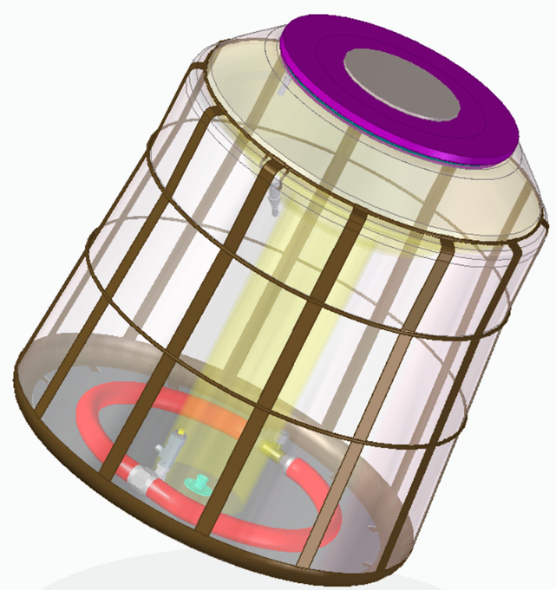
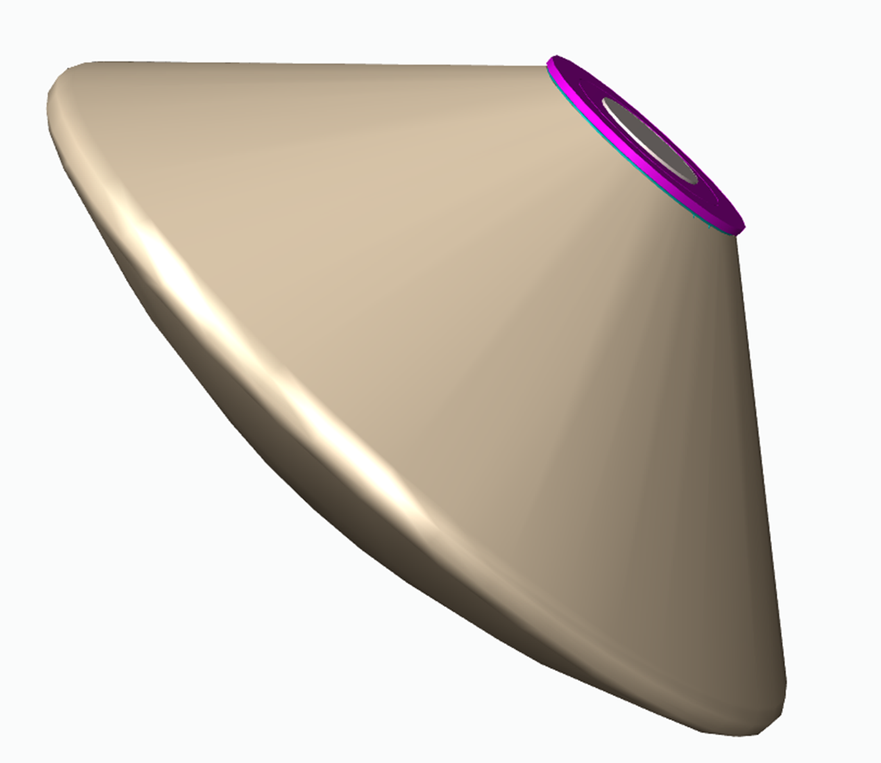
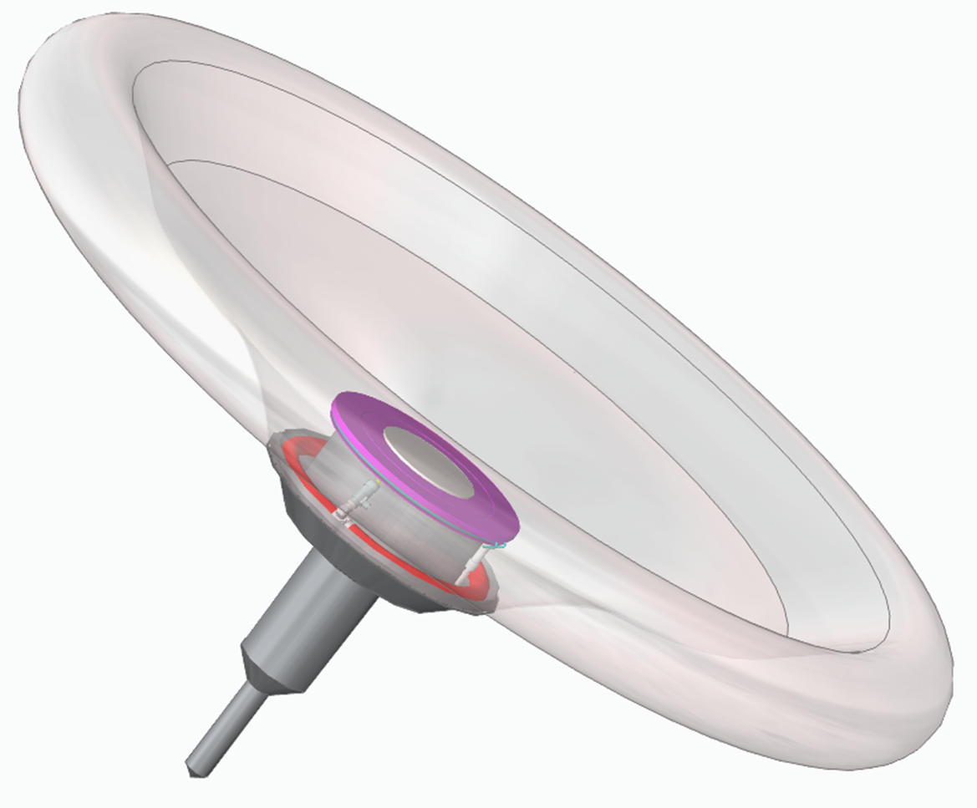
MINS EDL system – inflatable braking units
Hypersonic IBU deployment
Entry
Transonic IBU deployment
Braking by means of transonic IBU
Separation of hypersonic IBU
Landing event
Science mission
on-surface operations
MINS hypersonic IBU deployed
Penetration
MINS in stowed position
MetNet landing concept
European Space Agency is facilitating industrial development of an European inflatable deceleration system.
MINS in landing configuration with transonic IBU deployed

Slide 9
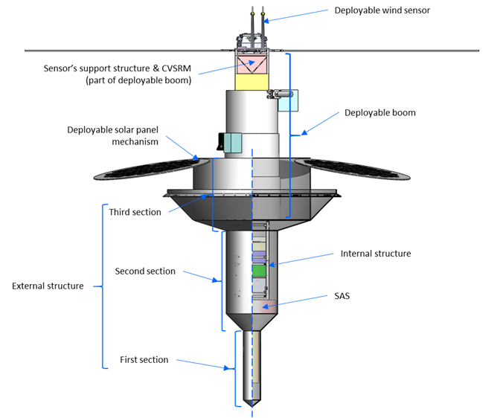
MINS penetrator design at phase B1
The geometry of MINS includes a thin section to improve penetrability to the soil, a medium section with 150 mm diameter to accommodate a 2U CubeSat structure inside, and a top section with a wider diameter to stop the penetration and avoid the top part to be buried inside the soil. The deployable boom is accommodated in the top section, together with some surface sensors. The boom is based on telescopic deploying concept. The system electronics, like OBC, radio and batteries are located inside the 2U Cubesat structure.
The electronics for the subsystems of MINS penetrator are developed using two approaches:
Using COTS with flight heritage and delta-qualification – mainly CubeSat systems
  For example, radio and batteries
In-house development
  For example, on-board data handling
~80 cm

Slide 10
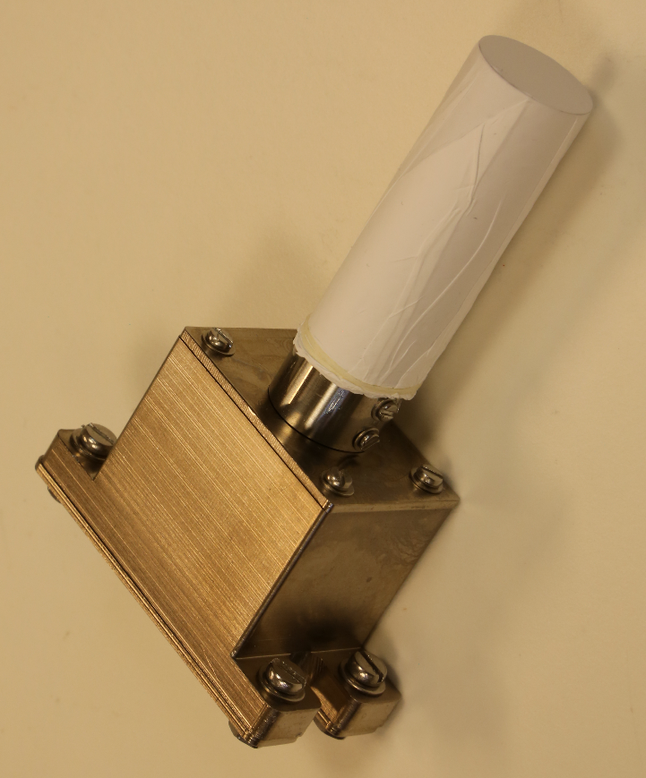
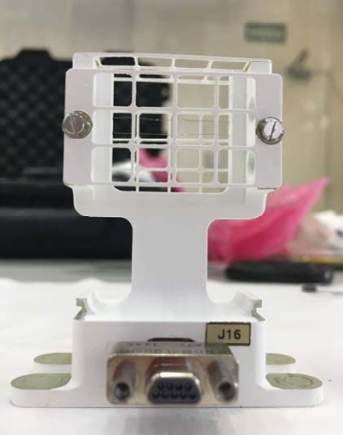
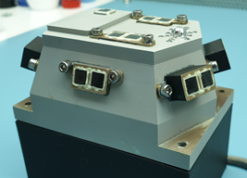
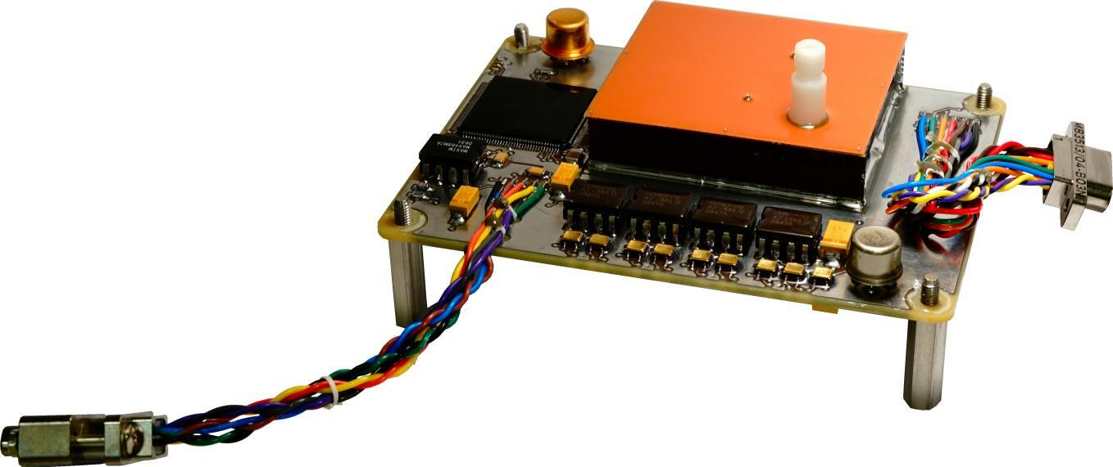
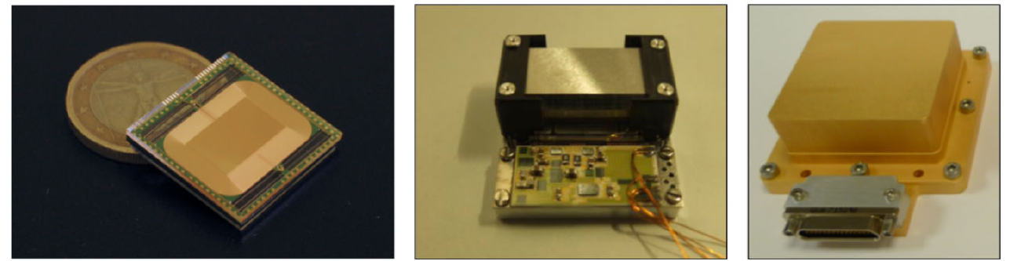
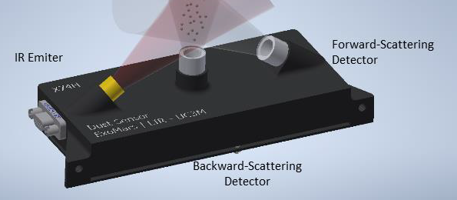
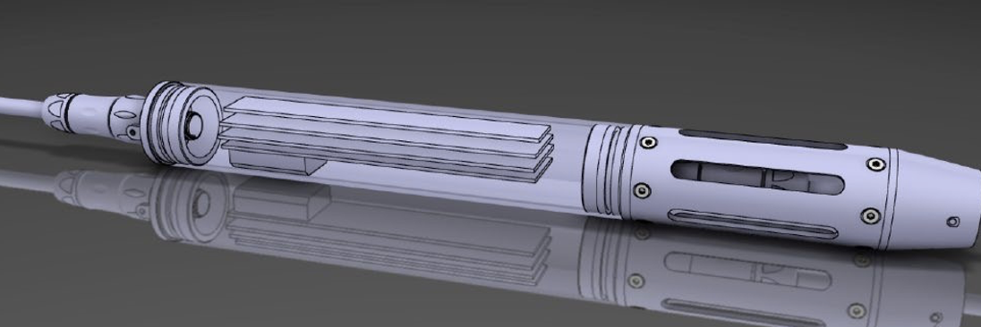
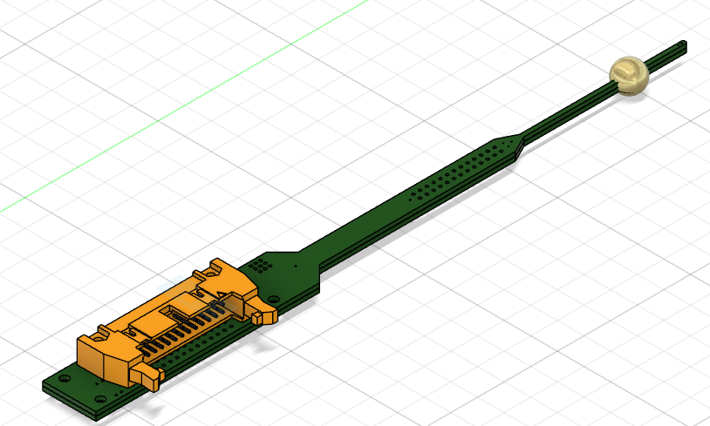
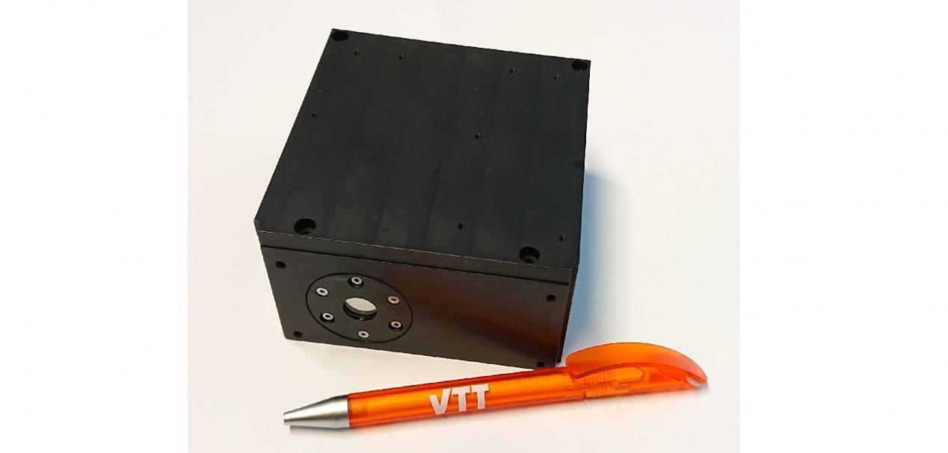
MINS science and payload
MINS peforms scientific measurements above, at, and below the surface of Mars:
  Context images, visual spectrometry
  Meteorological measurements
  Solar irradiance and dust optical properties
  Chemical and thermophysical properties of the soil below the surface
  Total ionizing dose on the surface
  Seismological measurements
Relative humidity sensor (FMI)
Solar irradiance sensor (INTA)
Air temp. sensor (CAB)
Pressure sensor (FMI)
Seismometer (Imperial College)
Chemistry package (CAB)
Dust sensor (Carlos III University)
Visual spectrometer (VTT, Finland)
Wind sensor (UPC)

Slide 11
MiniPINS Prototyping activities

Slide 12
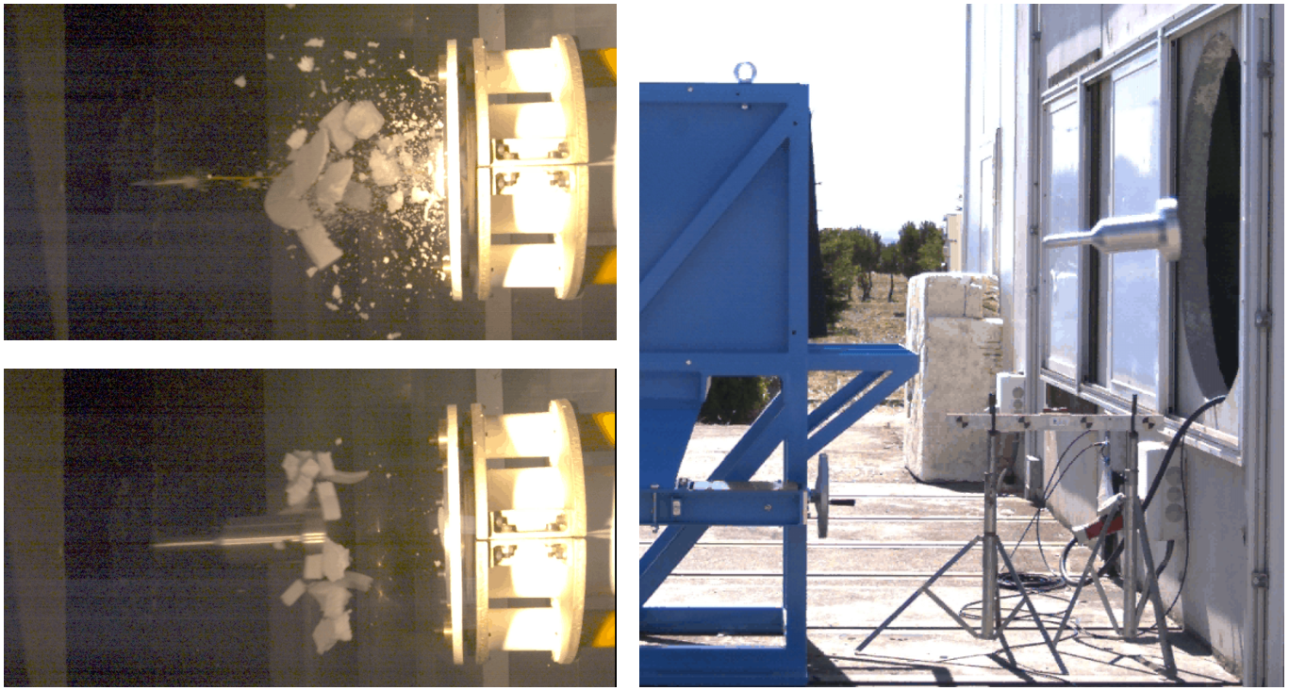
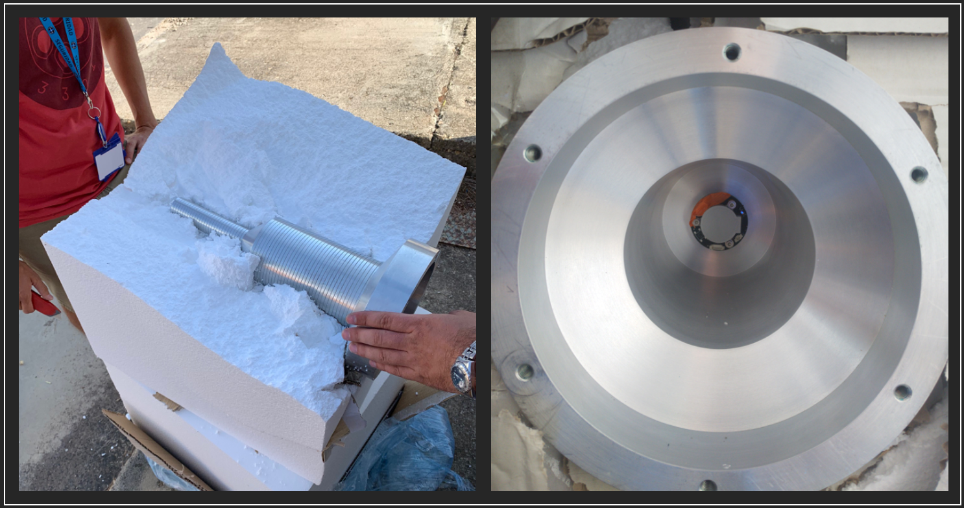
Preliminary development of test impact facility (INTA)
Preliminary penetration tests performed with scaled-down mass dummies (~2 - 4 kg) of MINS penetrator in different configurations. Photo on the right shows the accelerometer inside the projectile.
An existing air-vacuum cannon was combined with a penetration-targeting structure and a three-axis 60kg wireless accelerometer to test the penetrators with different terrains and impact velocities.

Slide 13
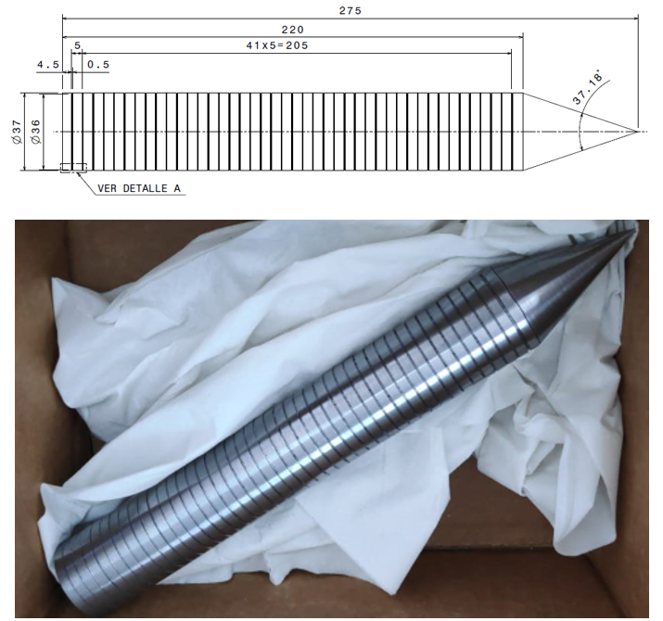
Target S-number determination
1-section projectiles were used to determine the S-numbers of different targets.
Diameter (mm) | Mass (gr) | Speed (m/s) | Target Material | Depth (cm) | S Number
55 | 1937 | 66 | Loose sand | 92 | 44
55 | 1945 | 65 | Wet sand | 78 | 38
55 | 1945 | 66 | Wood chipboard 625 Kg/m3 | 7 | 3,4
37 | 1993 | 70.2 | Plywood 429Kg/m3 | 17 | 3,7
S-number for “hard case” (3-4) was achieved.
For “soft case” the desired S-number was ~10, the target materials used in these first tests proved to be too soft. They could still be used to verify the performance of the ”stopper” of 3-section design.

Slide 14
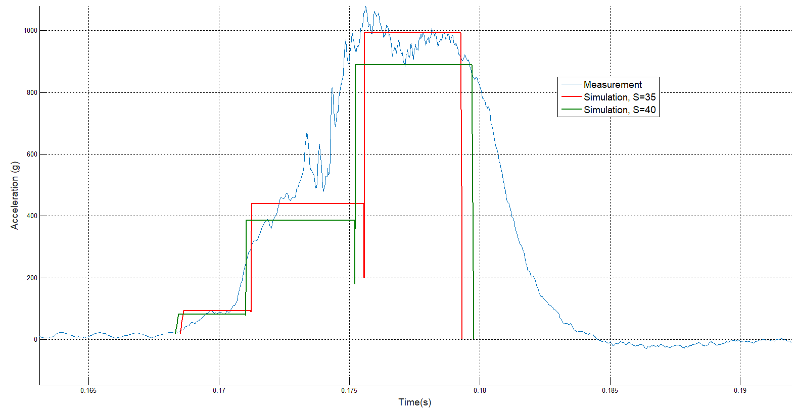
Deceleration tests with 3-section design
Tests were performed with the 3-section 4.6 kg aluminium projectiles on “soft” soils (expanded polystyrene and dry sand). There were two main conclusions:
The repeatability of the launch process is high.
The stopper section did its job, given that in all cases the penetrator was stopped at the end of this section.
Mass (gr) | Speed (m/s) | Target Material | Penetration Depth (cm)
3985 | 60 | Expanded polysterene *) | 41,9
3989 | 56 | Dry sand | 55
4660 | 55 | Expanded polysterene | 43,5
4660 | 61 | Expanded polysterene | 40,7
4656 | 60,5 | Expanded polysterene | 43,5
*) S-number estimated between 30 and 45
Deceleration profile measurement
10 ms for 600g => 60 m/s impact speed

Slide 15
Flexible solar cells (IMDEA)
COTS Perovskite Solar Cells (PVC) from SAULE technologies, with efficiency as high as 25%, were tested under Martian conditions of temperature (down to -145°C) and solar irradiance. Preliminary results:
A maximum in efficiency is around -75°C
The efficiency is not decreased after 5 thermal cycles
Unrolling tests of solar cells deployment system based on Shape Memory Alloy technology

Slide 16
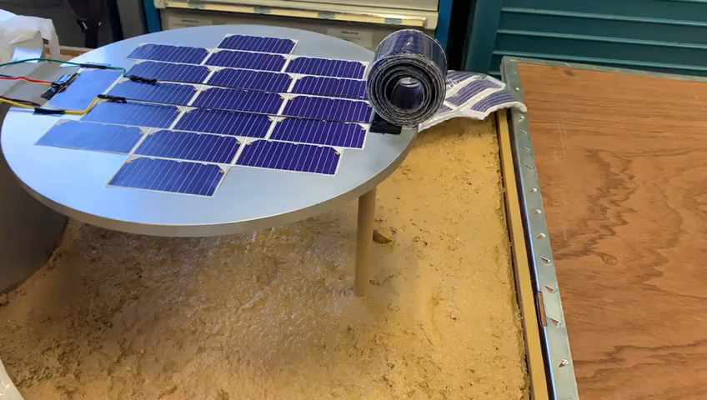
Deployment test at IMDEA

Slide 17
Thermoprobe tests (UPC)
Testing objectives: Needle-type and spherical 3D thermoprobe sensors, developed at UPC, were tested for their ability to characterize the thermophysical properties of regolith:
In buried cylinder (simulation of regolith entering MINS penetrator front chamber).
Without cylinder (simulation of LINS lunar probe).
The sensors use Fourier methods.

Slide 18
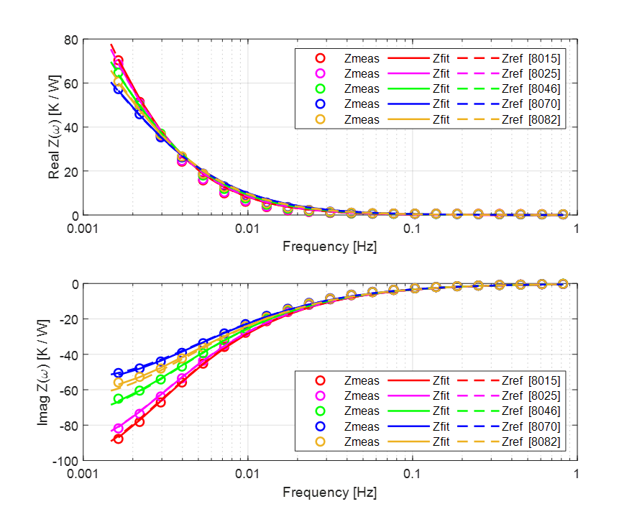
Spherical thermoprobe
Thermoprobe tested with 9 simulants of regolith made of glass microbeads.
Thermal impedance of the sphere is measured and fitted with model – Fourier methods
Measured thermal conductivity and diffusivity:
Very good match with reference values for all regolith Samples

Slide 19
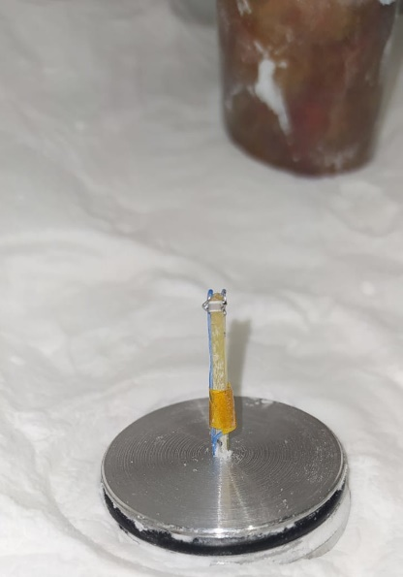
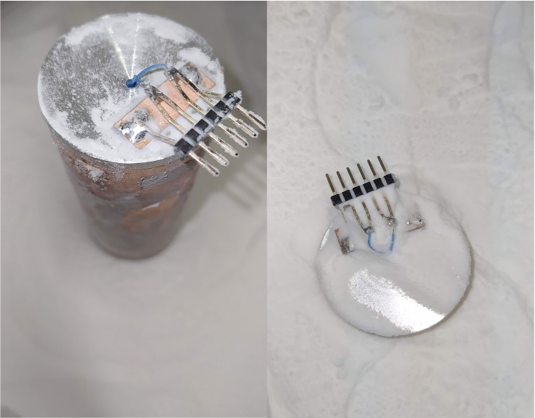
Needle type - inside cylinder
Needle-type probe. Larger frequencies (1mHz – 1Hz).
Probe present very different thermal impedances depending on the regolith simulant.

Slide 20
Low-temperature tests of ASICs in CMOS technology (IMSE)
Mixed-signal ASICs in CMOS technology developed by IMSE originally for INTA’s Solar Irradiance Sensor were tested in low temperatures required by LINS mission.
The ASIC proved to be fully operational down to -185°C (lower limit of the test chamber) without any major degradation observed.

