Slide 1




Transition from “orogenic-like” to “anorogenic” geochemical affinity
in Mesozoic post-collisional magmatism: Evidence from alkali-rich dykes from Ivrea-Verbano Zone (Southern Alps)
Abimbola Chris Ogunyele, Tommaso Giovanardi, Mattia Bonazzi,
Maurizio Mazzucchelli, Alessandro De Carlis, Anna Cipriani, Alberto Zanetti

Slide 2
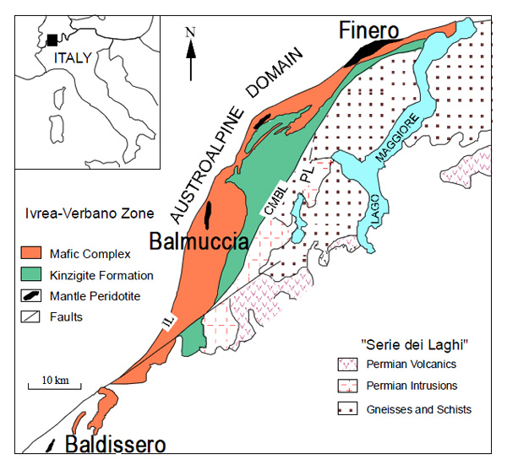
Introduction
The Late Paleozoic to Early Mesozoic tectonic evolution of the Southern Alps is complex and strongly debated.
In this study, we investigated dyke swarms, intruding the mantle–crust transition of the Adria plate as documented by the Ivrea-Verbano Zone, Southern Alps.
The studied dykes intruded the Finero Phlogopite Peridotite and represent a unique opportunity to investigate the evolution of mantle melts from Late Paleozoic to Mesozoic in the post-collisional Variscan realm.
Rivalenti & Mazzucchelli, 2000

Slide 3
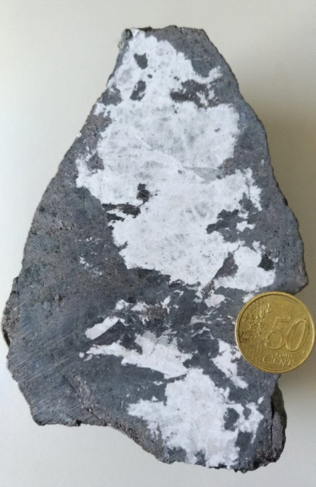
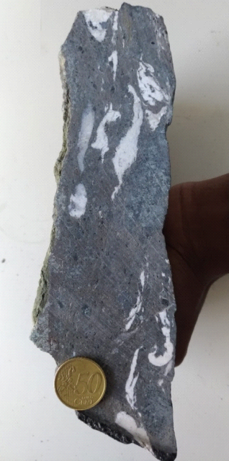
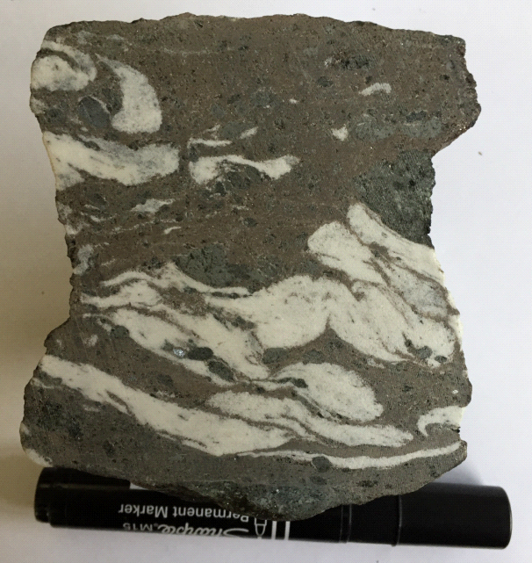
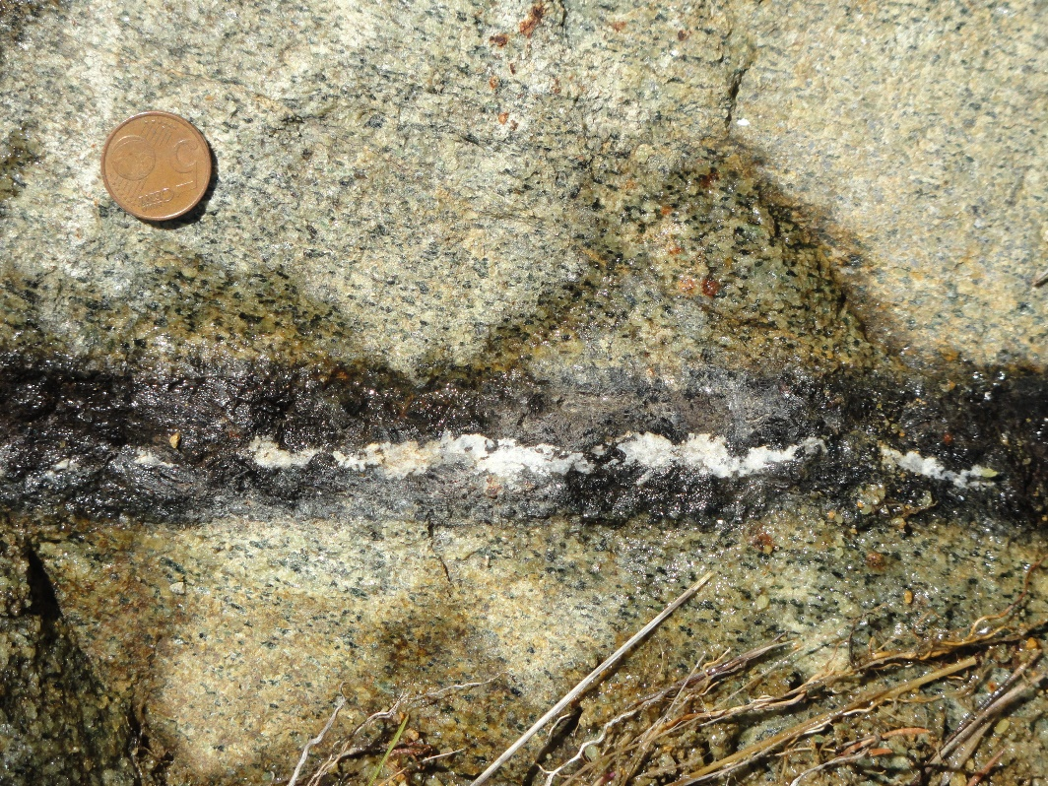
Studied dykes
(c)
(d)
(e)
e
t
a
l
u
m
u
C
FI1603
FI1604
FI1605
f
Gabbroic dyke
Giovanardi et al., 2020

Slide 4
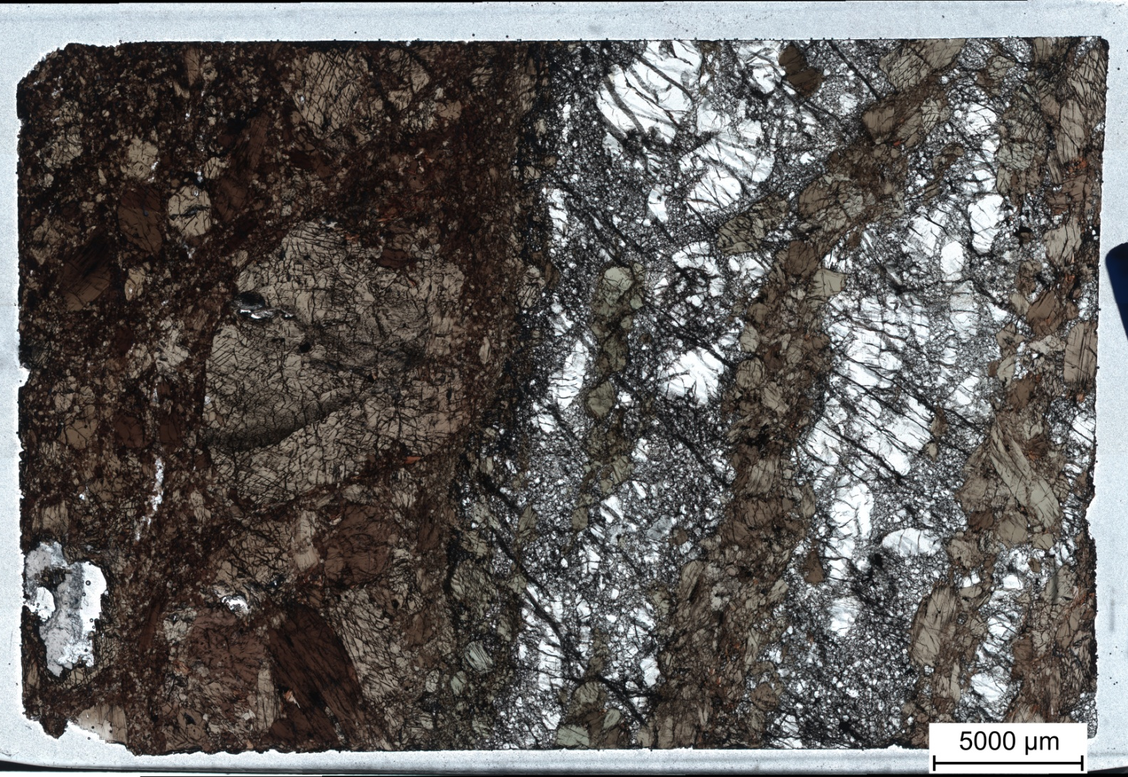
Results
Petrography
Ultramafic sample FI1607 = hornblendite (or ultramafic dyke) + cumulus hydrous peridotite + amphibole veinlets
Cumulus peridotite cut by amphibole veinlets
Hornblendite
Ol
Amph
Amph
Ol

Slide 5
Results
Petrography
Dioritic dykes = amph + phl + ab + ap ± monazite ± ilmenite ± zircon ± Nb-rich oxides ± carbonates

Slide 6
Trace Elements Mineral Chemistry: Amphiboles
Sun & McDonough, 1995
Lyube & Korenaga, 2007

Slide 7
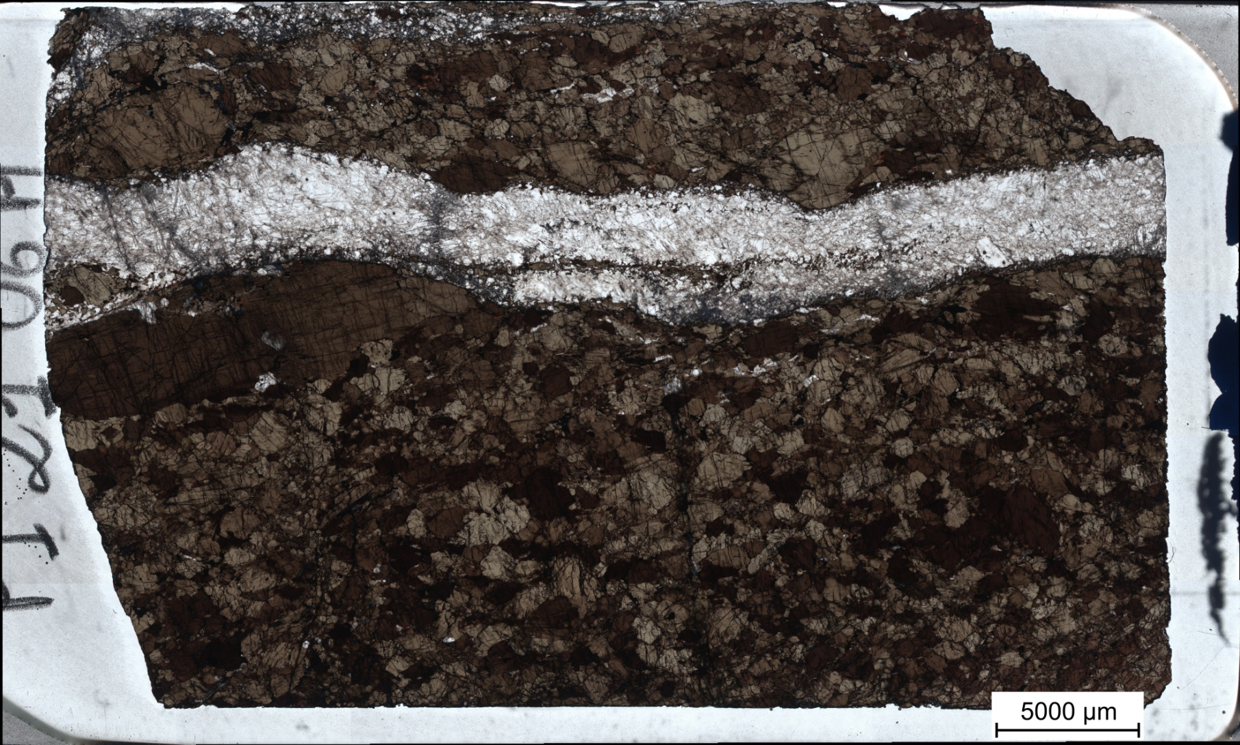
Concomitant enrichment and depletion in HFSEs recorded by a dyke sample: evidence of multiple melt injection and metasomatic
overprinting?
Nb-rich Amph
Plg
increasing HFSEs in amphs
Nb-poor Amph

Slide 8
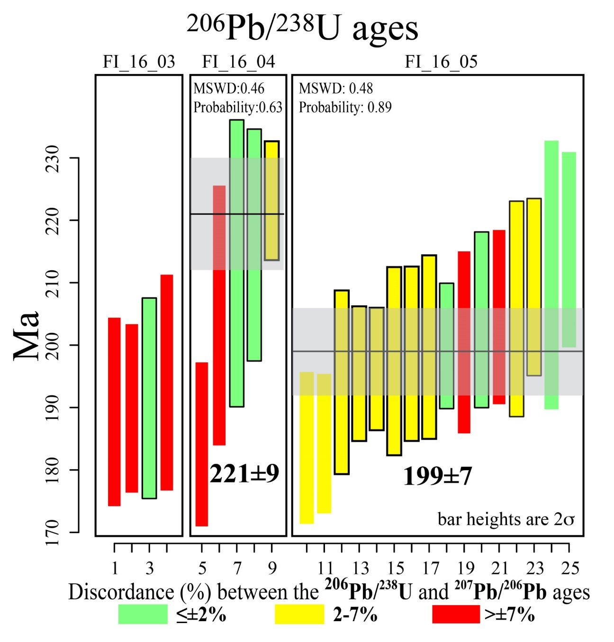
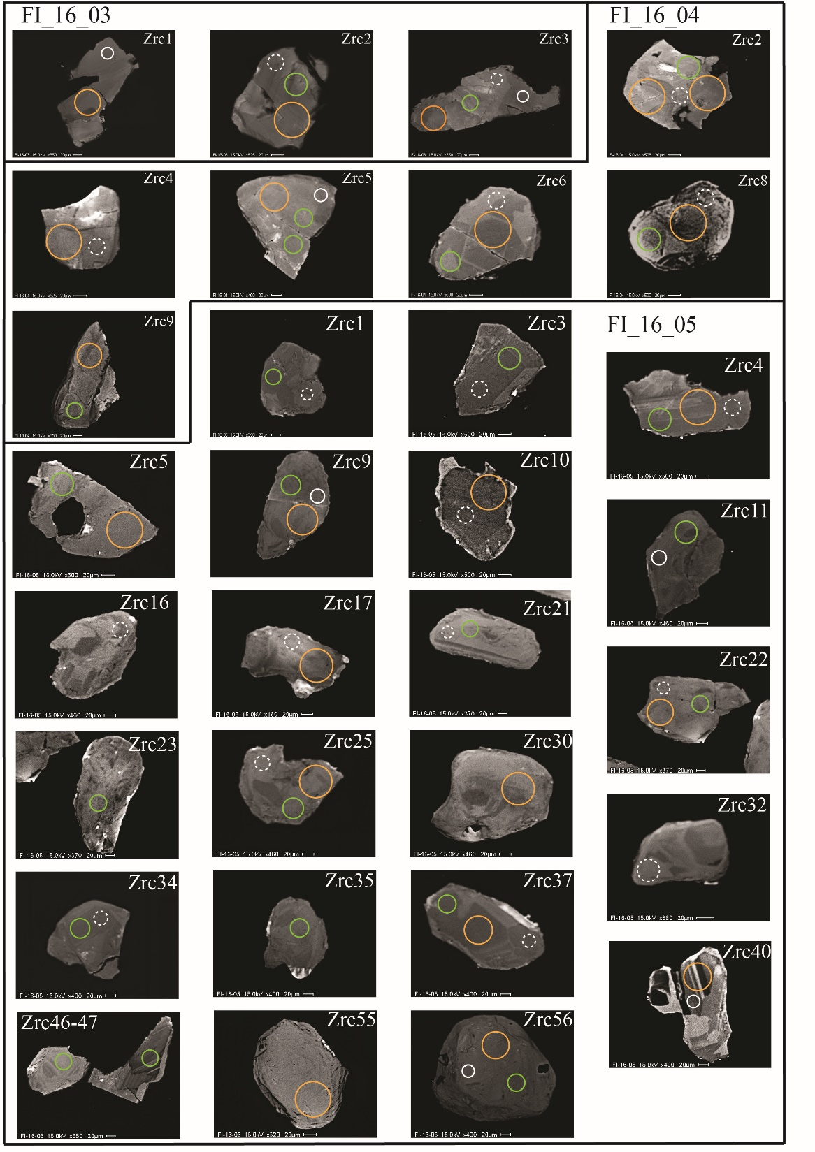
U/Pb zircon geochronology of Finero dioritic dykes
194±8
²⁰⁶Pb/²³⁸U mean age of FI2106 = 200.7 ± 6.5 Ma

Slide 9
Isotopic Hf zircon
composition of Finero
dioritic dykes

Slide 10
Take home!
As a whole, the studied alkali-rich dykes record:
a transition from “orogenic-like” to “anorogenic” magmatism during Late Paleozoic (?) to Early Mesozoic in the Southern Alps
multiple melt recharging and re-opening of dykes’ conduits
metasomatic overprinting of “older orogenic-like” magmatism by intraplate melts
progressive change and heterogeneity of the mantle sources of the Mesozoic magmatism of the Southern Alps

Slide 11
Thanks for your attention!

