Slide 1

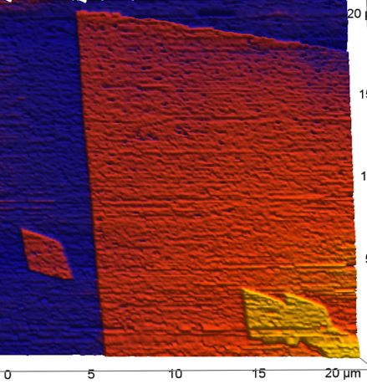
The impact of Se and Np on Calcite growth

Slide 2
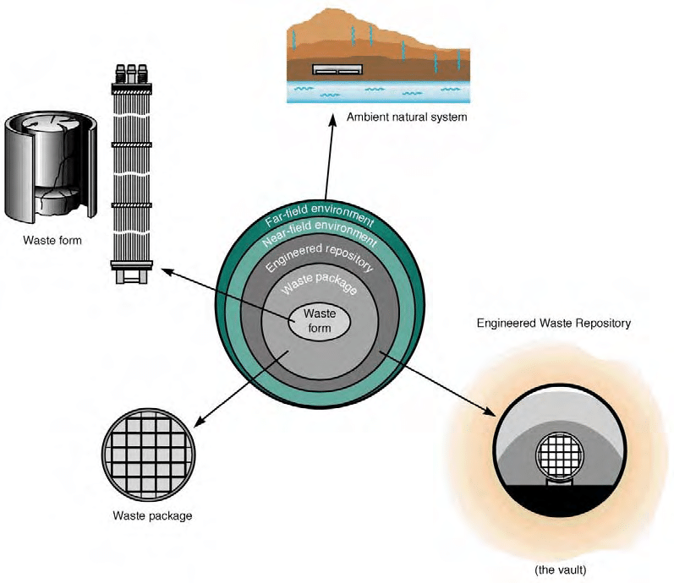

Calcite in the nearfield of nuclear waste repositories
Abundance in many environmental settings, including the nearfield of nuclear waste repositories
Calcite controls the geochemical milieu (pH, alkalinity)
Coupled with carbonate system
Local super/under-saturation promotes constant (re-)crystallization and dissolution of calcite
Cc is a mineral constituent in clay formations
(up to 20%) or, alongside with barite, fracture filling in granite rocks
Ca²⁺ is a corrosion product of concrete based materials and bentonite in the technical barrier
Walker 2003

Slide 3
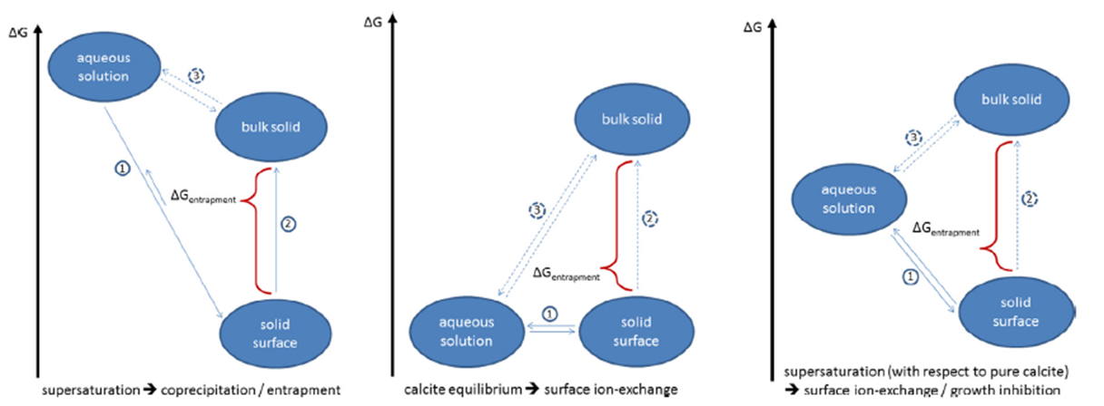
Fundamental research regarding the retention capacity of Calcite
For the retention capacity both the formation of new phases and the recrystallization of existing ones is of relevance
Ions (radionuclides) might be incorporated or released depending on solution conditions and crystallization history (surface passivation)
Fundamental research is needed in order to characterize and quantifify the retention capacity of minerals existing (or being formed) in the nearfield of radioactive waste repositories
The endothermic transformation from aragonite to trigonal calcite provides a setting for long term experiments at low. constant calcite oversaturations
Differenct incorporation mechanisms -> solid solution, coprecipitation, entrapment

Slide 4
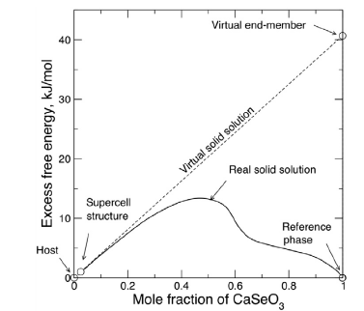
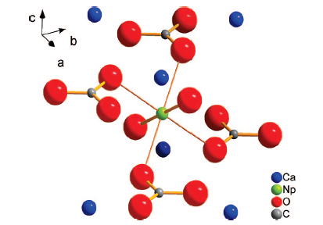
Selenite in Calcite
The incorporation of Selenite into Calcite can be described as a solid solution (for low mole fractions of the CaSeO₃ endmember)
EXAFS studies (Heberling et al., 2014) hint at a preferential orientation of the selenite molecule relative to the calcite -> structural incorporation of selenite into calcite.
Structural incorporation of the selenite ion can be understood as a replacement of the trigonal planar carbonate for the pyramidal selenite
Np(V)O₂⁺ in Calcite
Np(V) ions are known to occupy Ca lattice sites
Two axial neptunyl oxygens substitute for two adjacent carbonate ions.
substitute two calcite carbonate groups in the first coordination
The incorporation is understood as a coprecipitation event
Heberling et al., 2014
Heberling et al., 2008

Slide 5

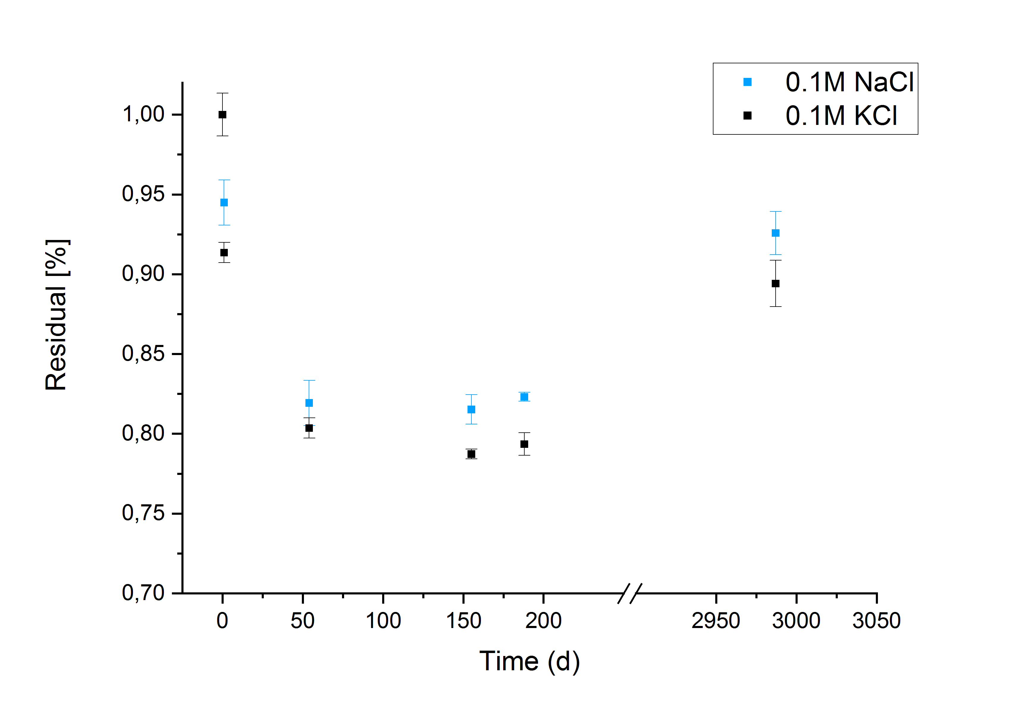
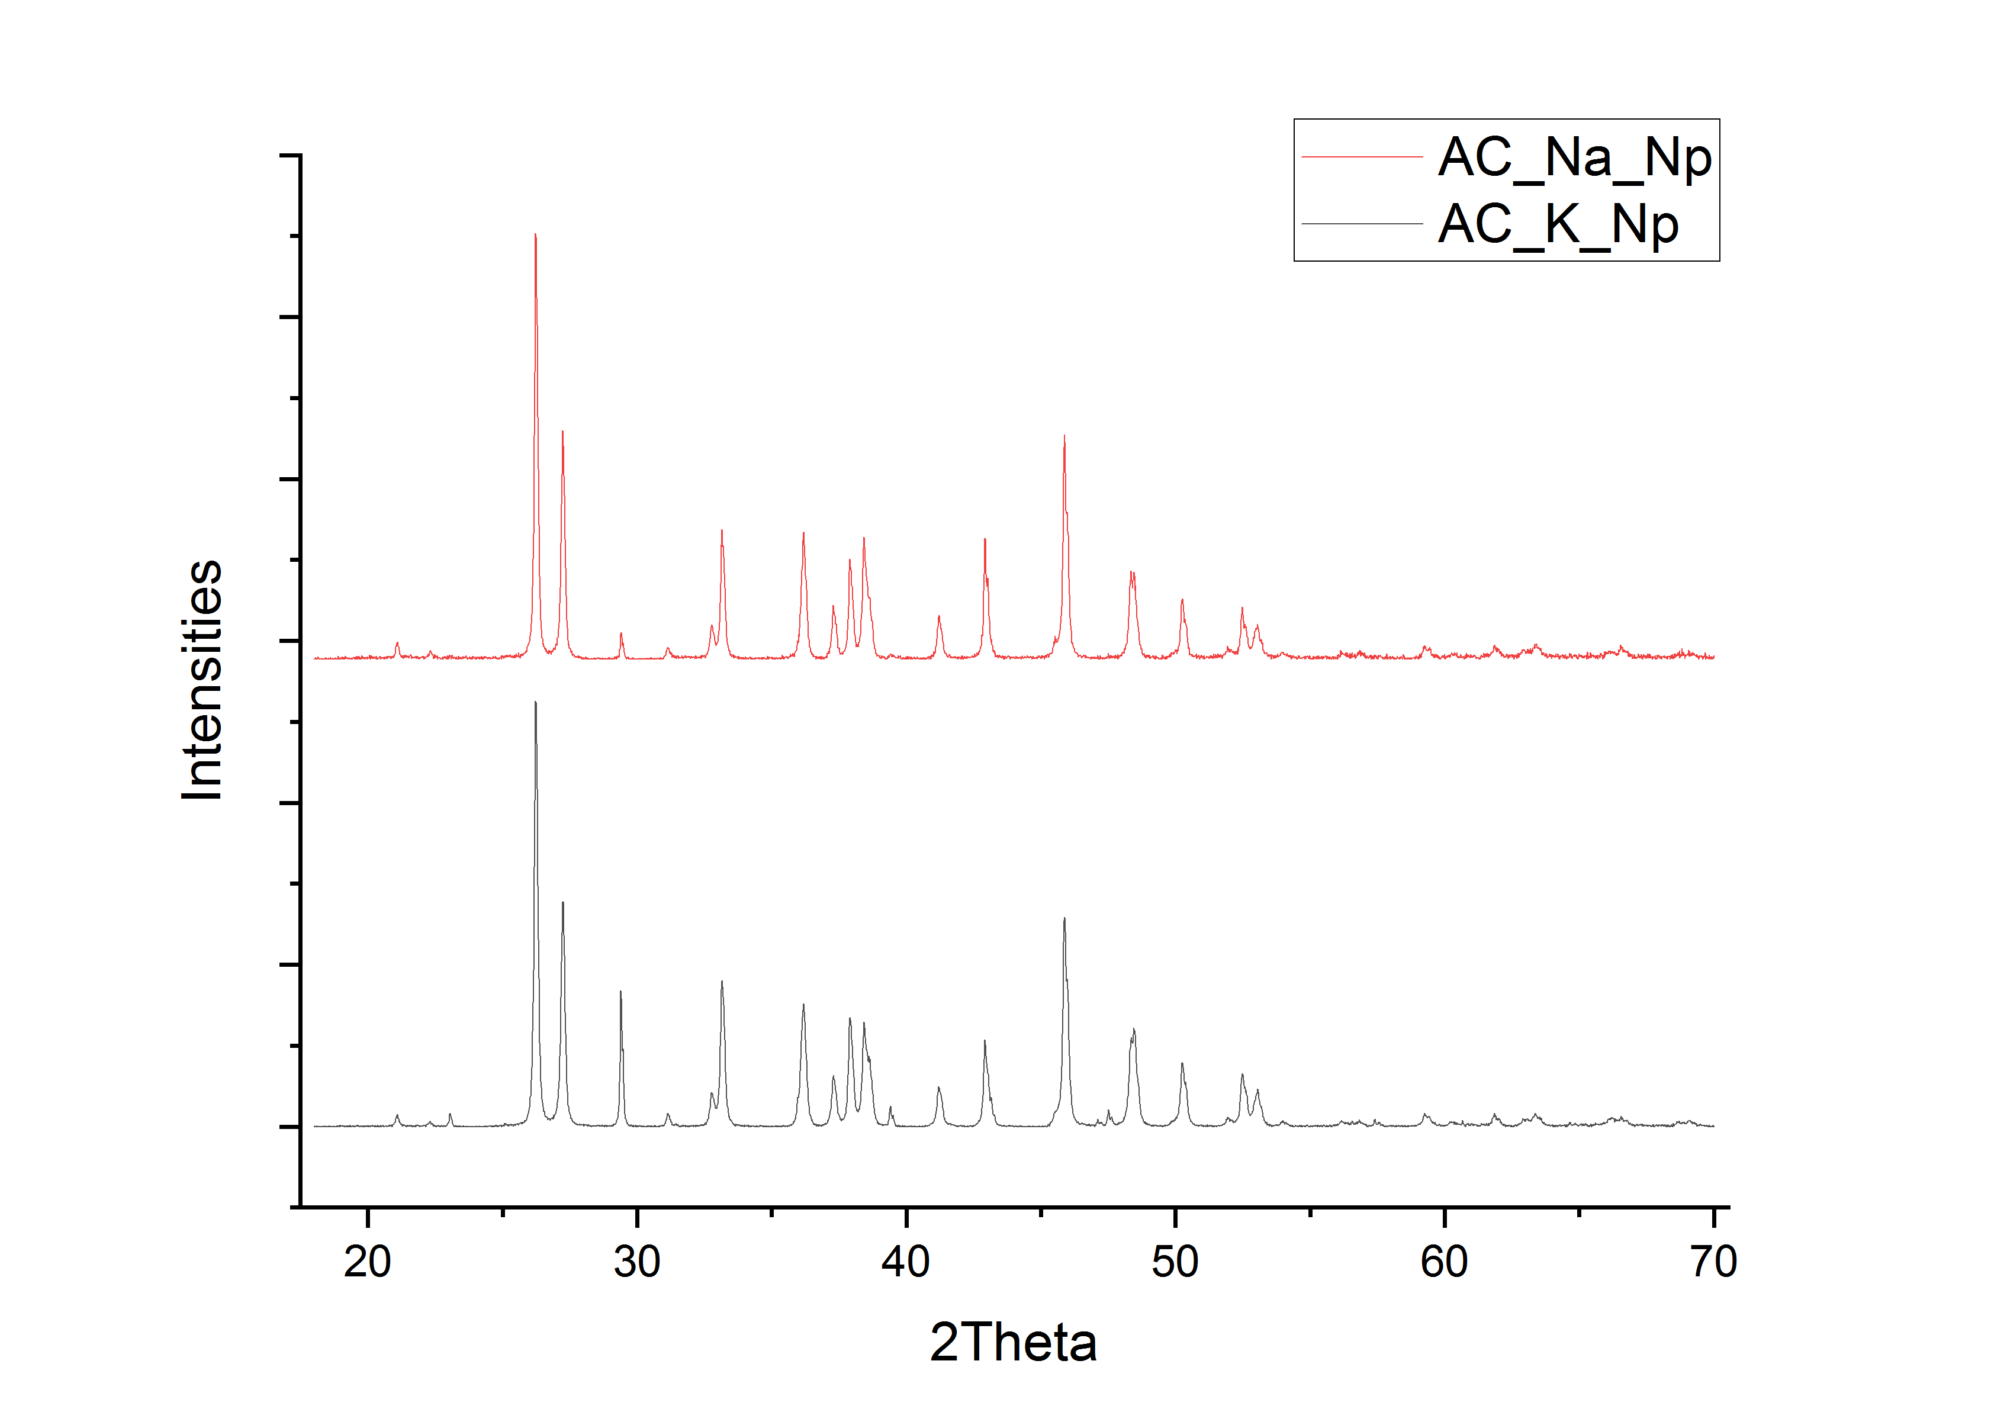
Aragonite – Calcite-Recrystallization Experinment in the presence of Np(V)
Residual Np in the liquid phase
1 L H2O (MiliQ)
1 μmol Np(V) (6 kBq)
100 mmol NaCl/KCl
2860 days
XRD spectra (t=2987d)
1.9% Calcite
Partition coefficients
6,7% Calcite
Sample | D (54d) | D (155d) | D (2987d)
AC-Na-Np | 2,2 | 2,3 | 1,7
AC-K-Np | 3,4 | 3,5 | 2,0

Slide 6
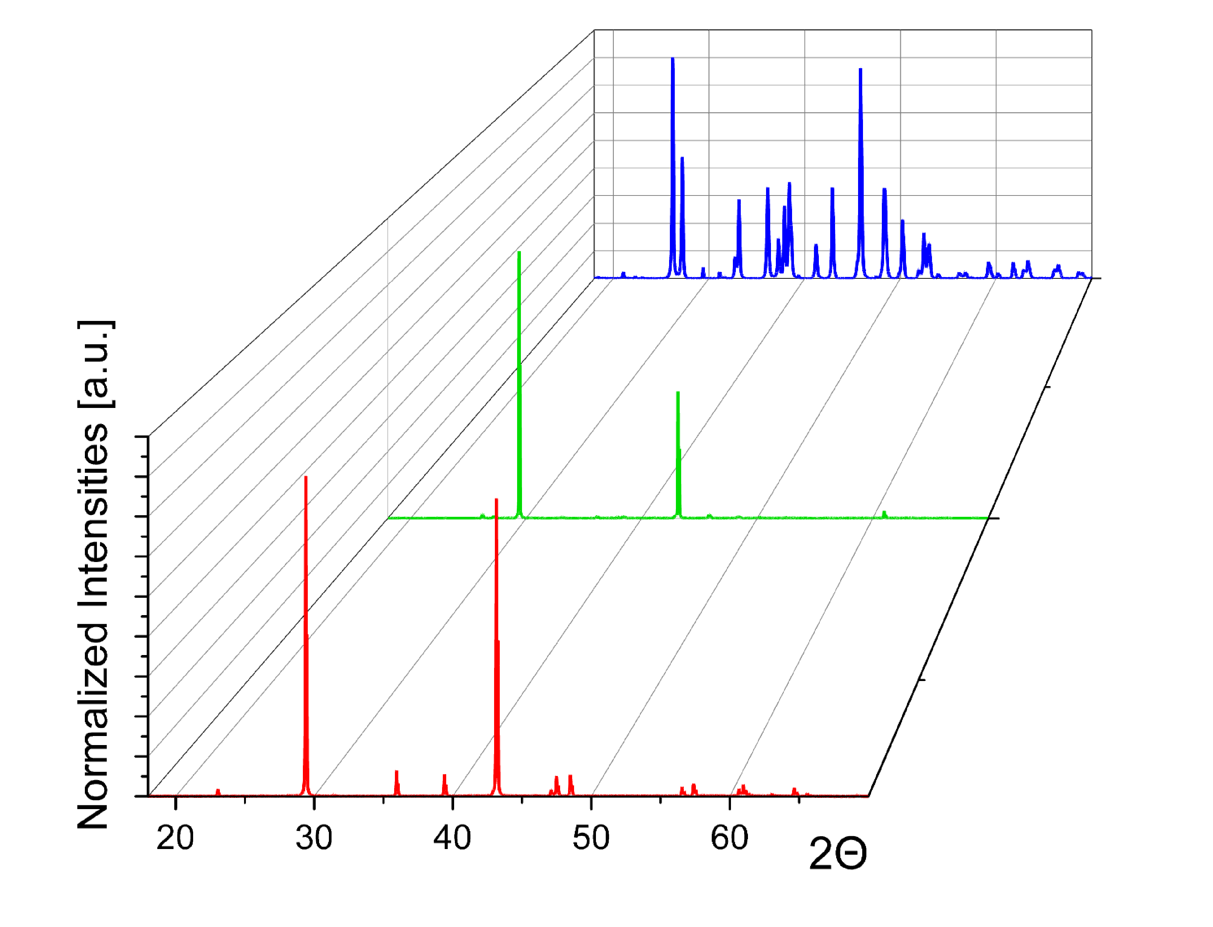
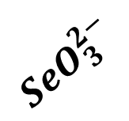
Selenite in Calcite: XRD survey
$$SeO_{3}^{2−}$$
[104]
[202]
[104]
[202]
[201]
[108]
[201]
[108]

Slide 7
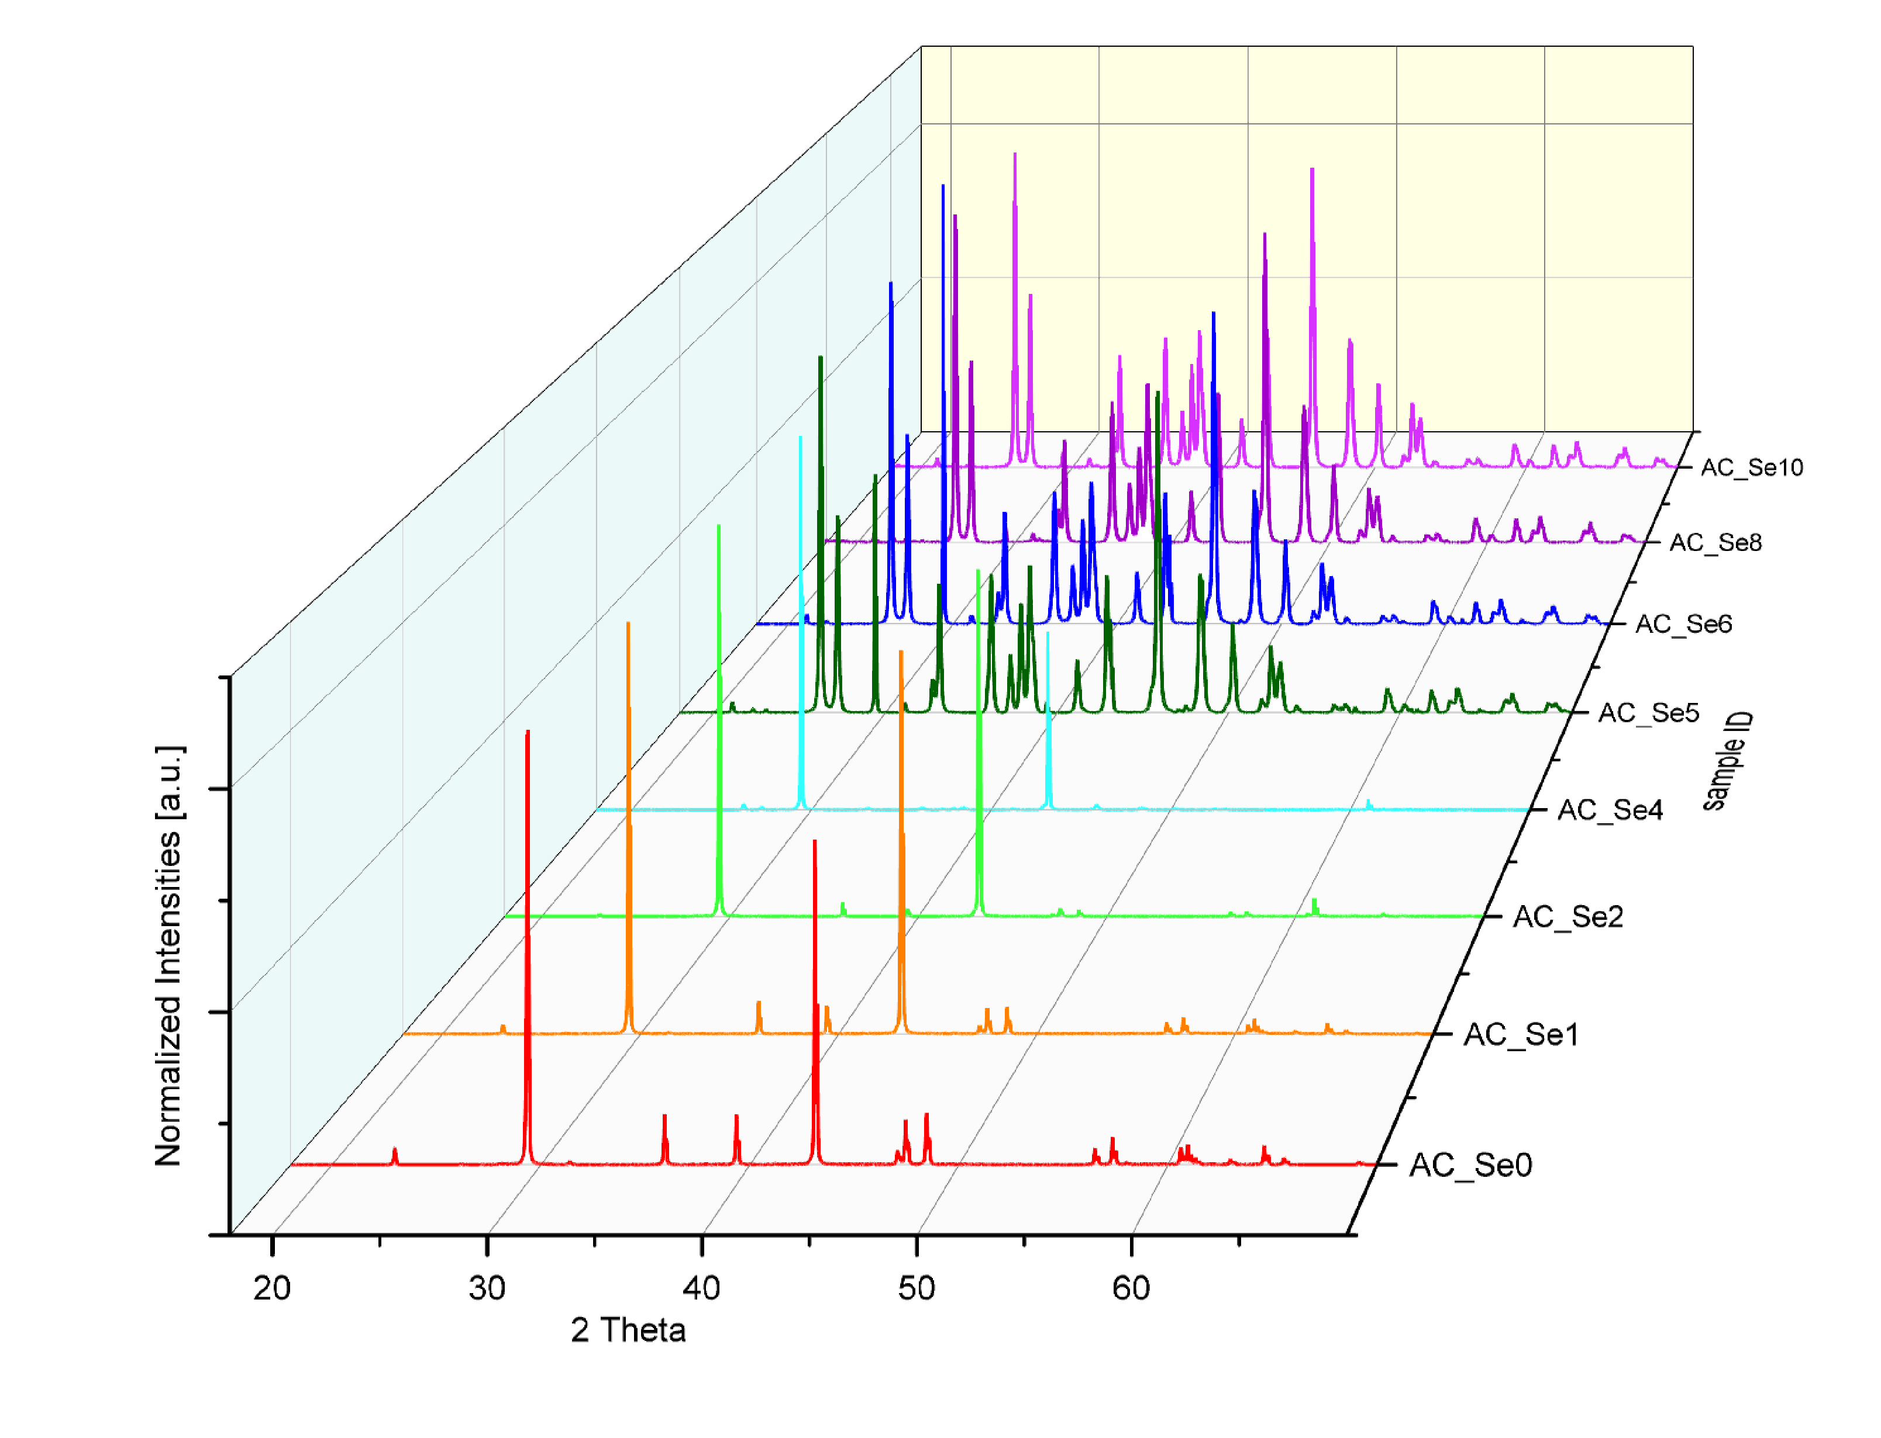
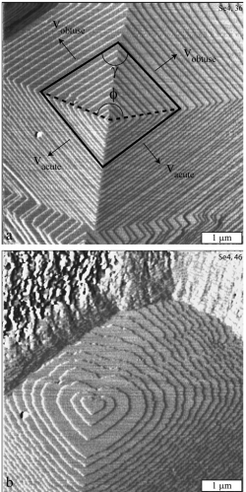
XRD analysis for Calcite-Selenite-samples
Strong [104]/[108] and [202] peaks (compared to other calcite/aragonite peaks)
In samples 4-6 (40-60 µmol/L Se), theses refelxes still dominate the XRD spectrum even for low relative amounts of Calcite (sample 6: 2.9%)
[104]/[108] and [202] signals were increasingly dominant at higher Se- concentrations
Selenite is proven to prevent growth of obtuse steps at the (104) surface (Renard et al., 2013)
Renard et al., 2013
[110]
[104]
[108]
[202]

Slide 8
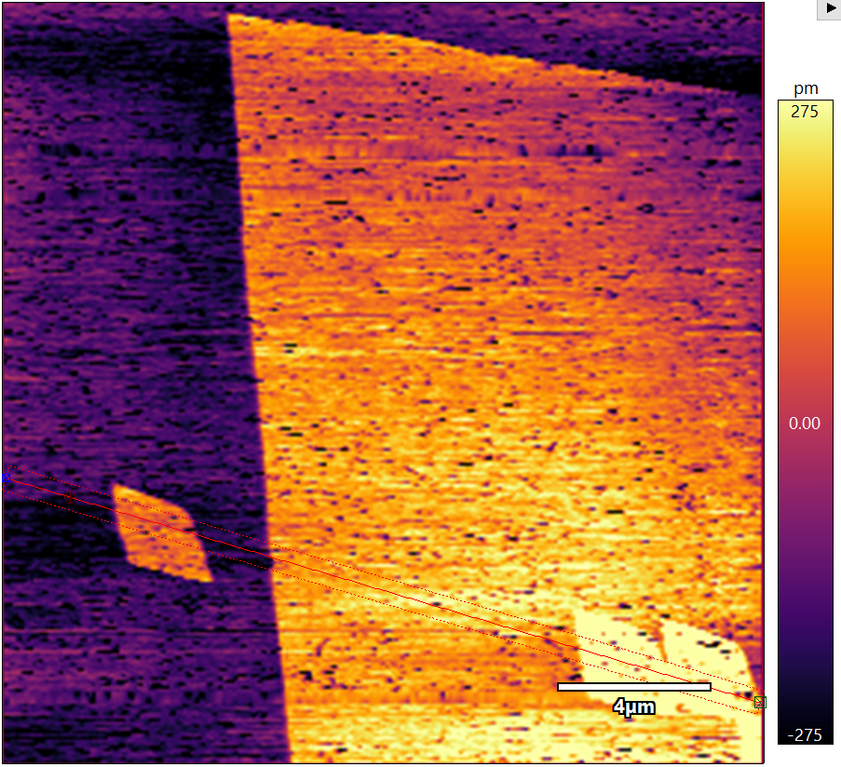
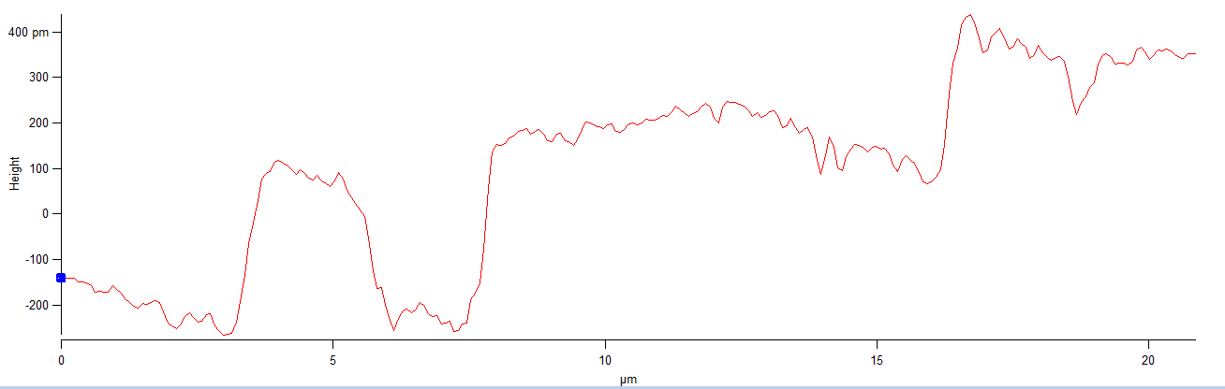
AFM as a tool for the investigation on growth on a mycro/nano scale
Se added (60 µmol/L)
Monolayer steps move at a speed of 0,5 ± 0,1 nm/s (SI(Cc) = 1; C(NaCl) = 1 mmol/L)

Slide 9
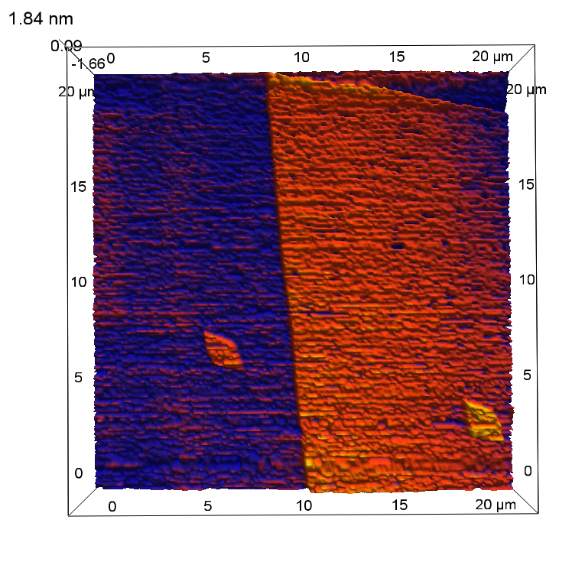
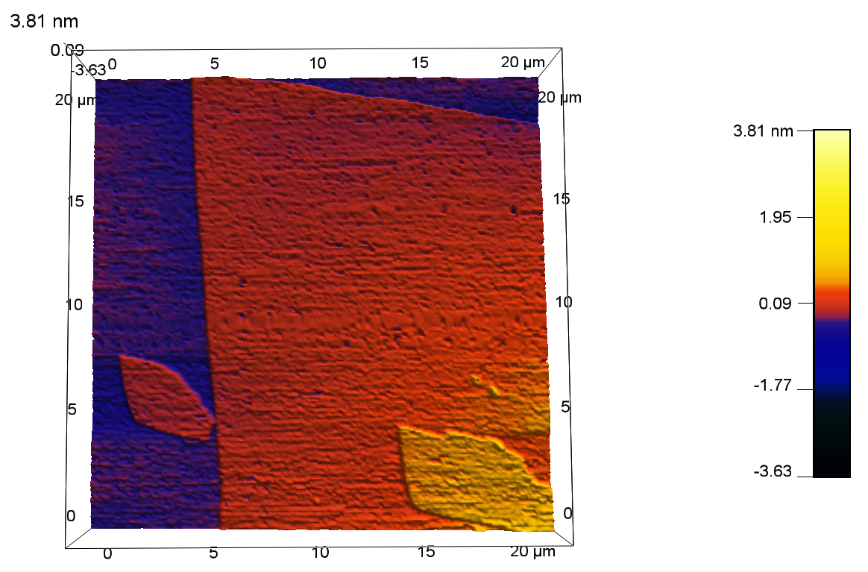
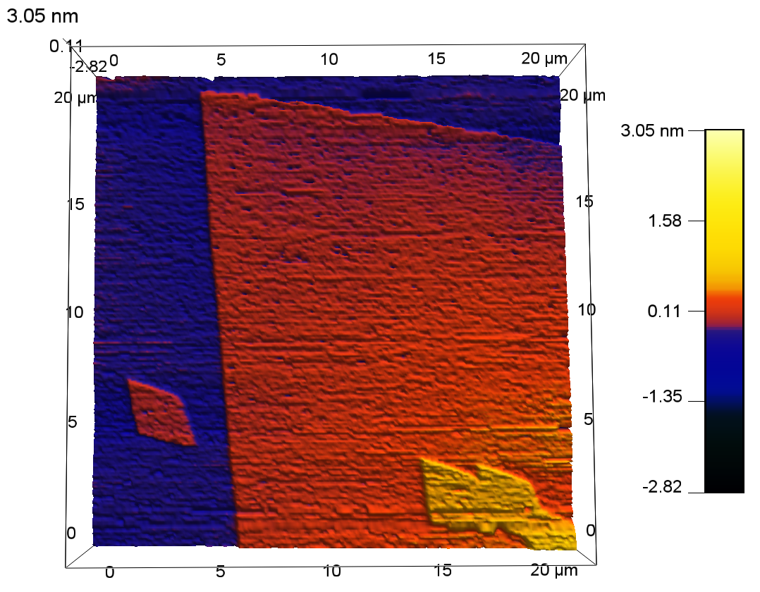
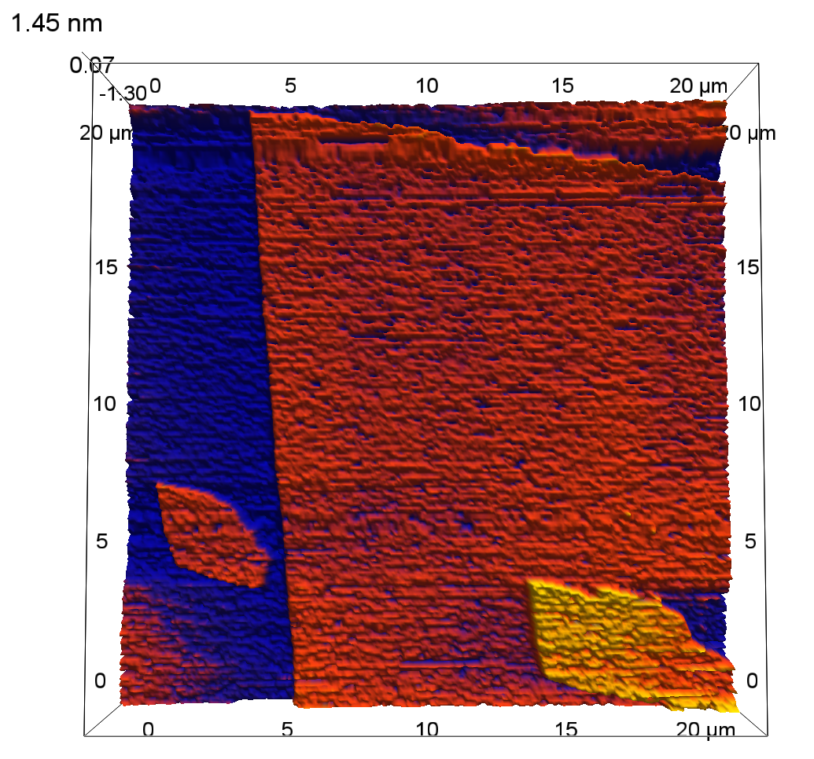
Change in the growth morphology at the presence of SeO₃²⁻
The addition of selenite lead to a change in morphology
Obtuse steps were showing a curvature and more chaotic growth features
SeO₃²⁻ added

Slide 10
Literature
Renard, François; Montes-Hernandez, German; Ruiz-Agudo, Encarnación; Putnis, Christine V. (2013): Selenium incorporation into calcite and its effect on crystal growth: An atomic force microscopy study. In: Chemical Geology 340, S. 151–161. DOI: 10.1016/j.chemgeo.2012.12.017.
Heberling, Frank; Denecke, Melissa A.; Bosbach, Dirk (2008): Neptunium(V) Coprecipitation with Calcite. In: Environmental Science & Technology 42 (2), S. 471–476. DOI: 10.1021/es071790g.
Heberling, Frank; Vinograd, Victor L.; Polly, Robert; Gale, Julian D.; Heck, Stephanie; Rothe, Jörg et al. (2014): A thermodynamic adsorption/entrapment model for selenium(IV) coprecipitation with calcite. In: Geochimica et Cosmochimica Acta 134, S. 16–38. DOI: 10.1016/j.gca.2014.02.044.
Walker, Colin S. (2003): Characterisation and solubility behaviour of synthetic calcium silicatehydrates; Dissertation at the University of Bristol; DOI: 10.13140/RG.2.2.32630.80969

Slide 11
Acknowledgements
This research was made pssible by the funding of the Federal Ministry of Education and Research (BMBF)
Grant number: 5633.0031.3438

