Slide 1
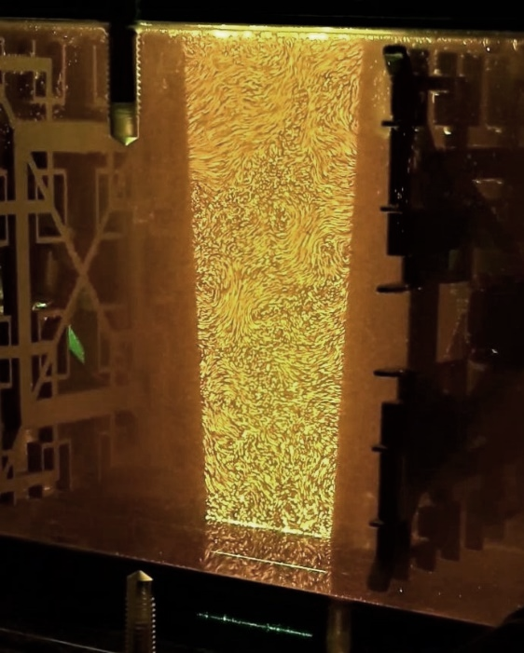

A litre-scale turbulence facility for microorganism-flow interactions
Jeanette Wheeler¹, Aaron True², François-Gaël Michalec³, Markus Holzner⁴, Roman Stocker¹, and John Crimaldi2
¹ Environmental Microfluidics Lab, Environmental Engineering, ETH Zürich
² Environmental and Ecological Fluid Mechanics Lab, CEAE, University of Colorado Boulder
³ Laboratoire d’Océanologie et de Géosciences, Univ. Lille, CNRS, Univ. Littoral Côte d’Opale
⁴ Swiss Federal Institutes for Forest, Snow and Landscape Research (WSL) and Aquatic Sciences and Technology

Slide 2
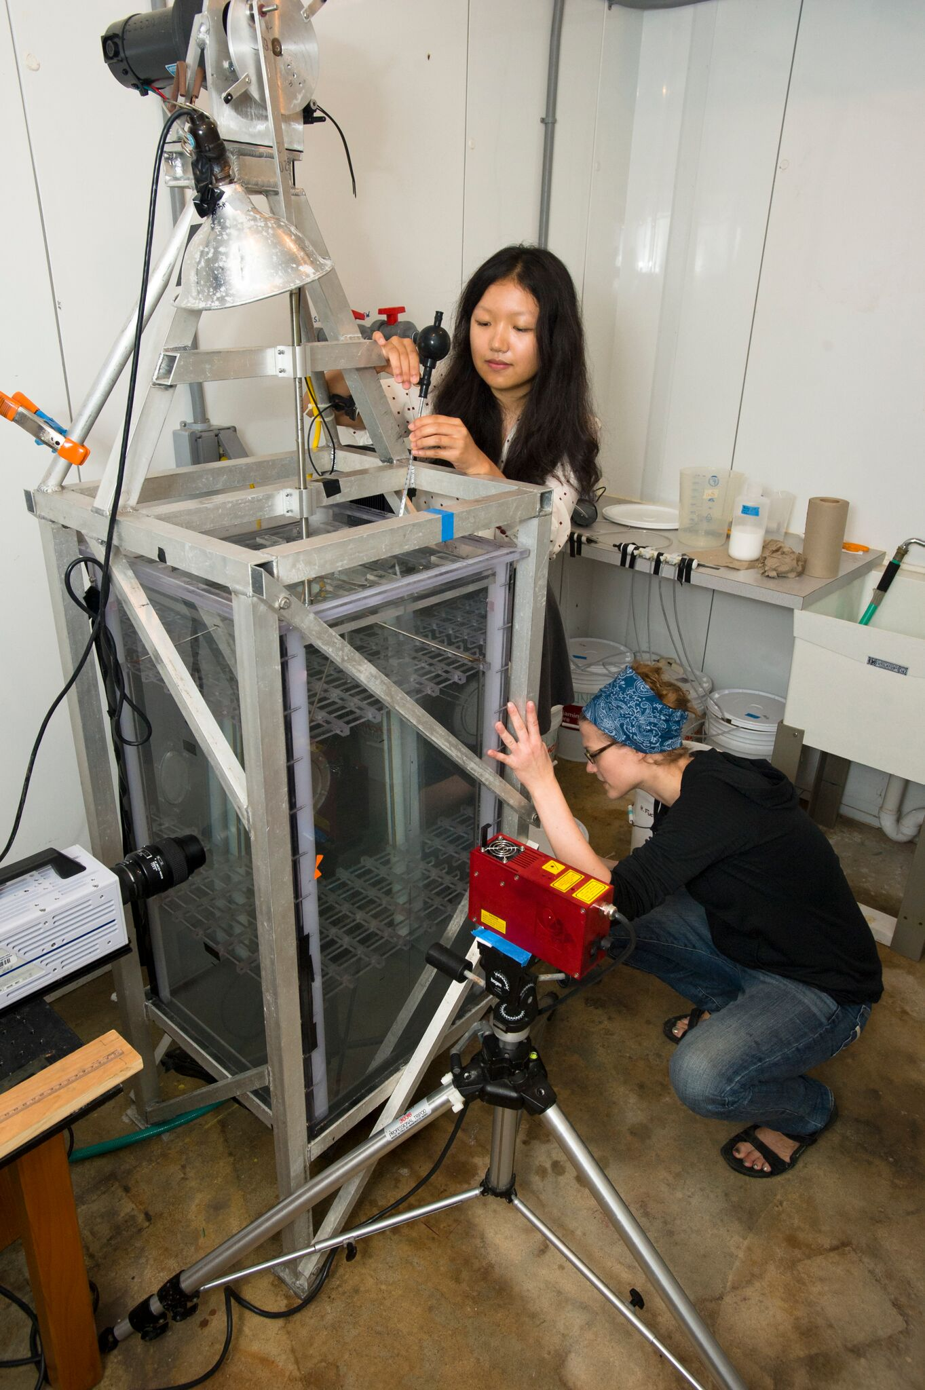
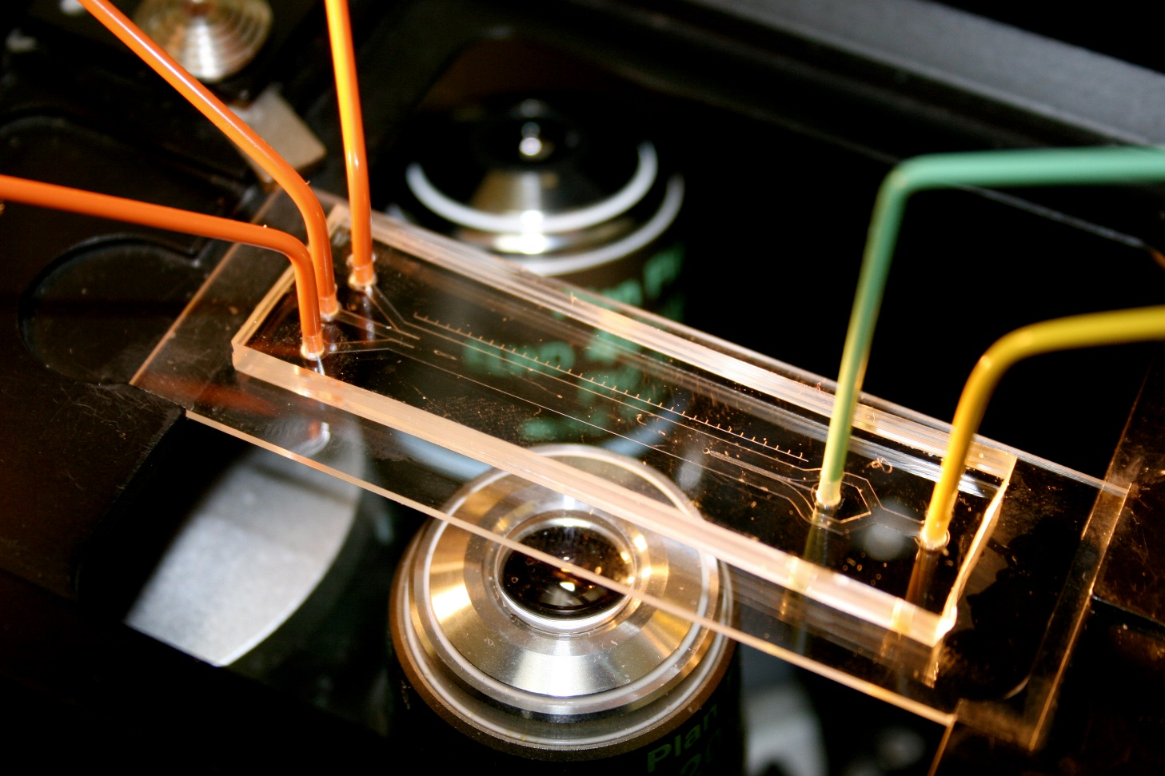
How do we capture the ocean in the laboratory?
Photo credit:
Tom Kleindinst
Photo credit: Justin Seymour
Turbulence-generating facilities:
Produce flow fields mimicking aquatic systems
Large volumes make microorganism-flow experiments challenging to undertake
Micro/millifluidic setups:
Produce idealized and highly replicable but non-turbulent flows
Small volumes facilitate biological experiments
10⁻⁴ – 10⁻³ L
10² – 10³ L

Slide 3
How do we capture the ocean in the laboratory?
Photo credit:
Tom Kleindinst
Photo credit: Justin Seymour
Significant space to develop technologies for intermediate-volume experimental work
Turbulence-generating facilities:
Produce flow fields mimicking aquatic systems
Large volumes make microorganism-flow experiments challenging to undertake
Micro/millifluidic setups:
Produce idealized and highly replicable but non-turbulent flows
Small volumes facilitate biological experiments
10⁻⁴ – 10⁻³ L
1L
10² – 10³ L

Slide 4
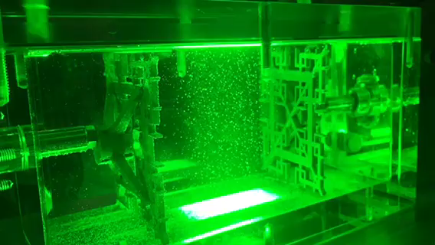
The ocean in a shoebox: the mini oscillating grid (MOG) turbulence facility
1 cm
True and Wheeler et al., in prep.
Notes:
So everything we did with this tank was done with the idea of mitigating these non-turbulent pathologies like secondary circulations and increasing the range of turbulent intensities we could capture. This is the final design 1L tank, and I will talk about how we got around these issues with our grid design and forcing schemes.

Slide 5
The ocean in a shoebox: the mini oscillating grid (MOG) turbulence facility
1 cm
Pros and cons of grid turbulence:
Cons:
Grid-organism interaction
Directional forcing drives anisotropy
Non-zero mean flows and secondary circulations
Pros:
Easy to build and maintain
Flexible operation modes
Large historical body of literature
True and Wheeler et al., in prep.
Notes:
So everything we did with this tank was done with the idea of mitigating these non-turbulent pathologies like secondary circulations and increasing the range of turbulent intensities we could capture. This is the final design 1L tank, and I will talk about how we got around these issues with our grid design and forcing schemes.

Slide 6
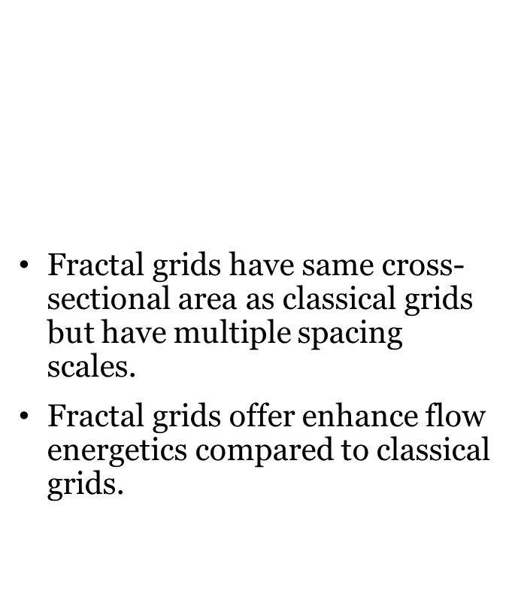
Optimizing stirring grid geometry
Decreasing the size of the tank limits the range of obtainable turbulent regimes.
Wind tunnel experiments show that ‘fractal grids’ enhance the range of obtainable $ε$ values.
Fractal grids have same cross-sectional area as classical grids but have multiple spacing scales.
Fractal grids offer enhance flow energetics compared to classical grids.

Slide 7
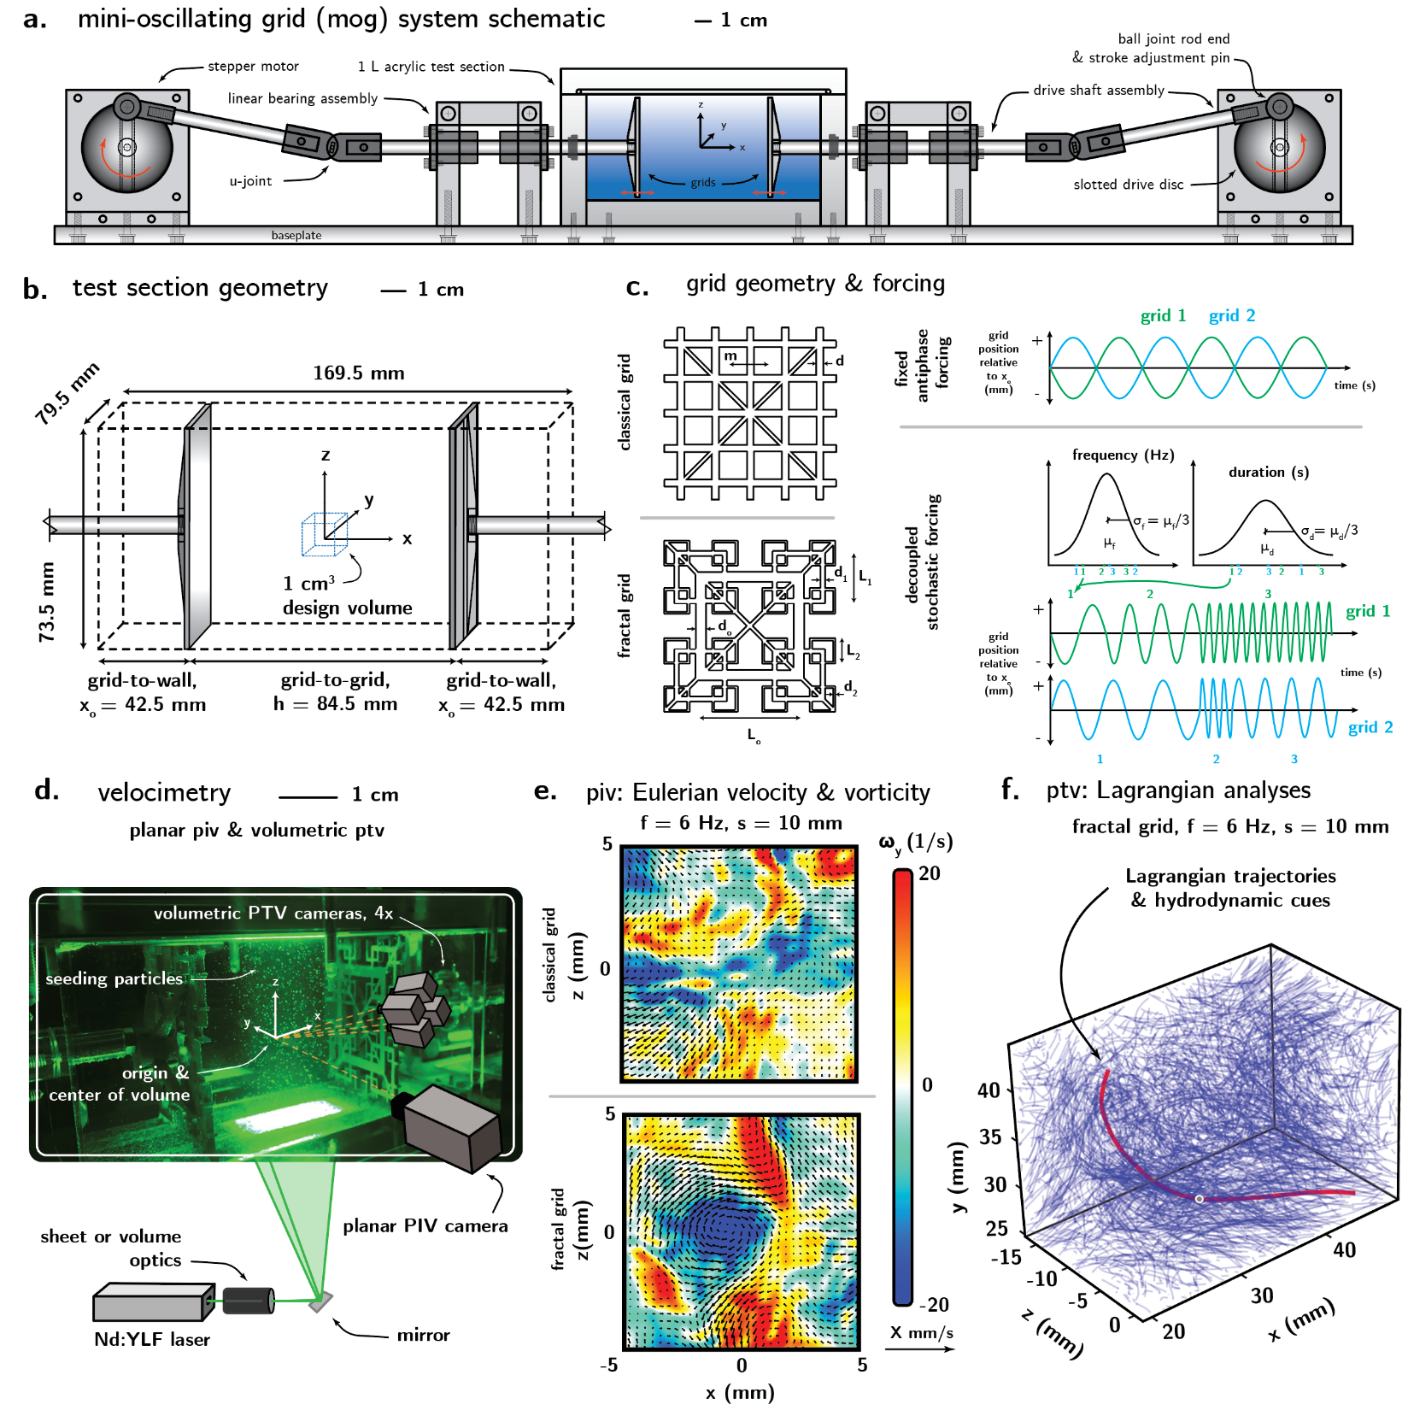

Optimizing stirring grid geometry
Decreasing the size of the tank limits the range of obtainable turbulent regimes.
Wind tunnel experiments show that ‘fractal grids’ enhance the range of obtainable $ε$ values.
Fractal grids have same cross-sectional area as classical grids but have multiple spacing scales.
Fractal grids offer enhance flow energetics compared to classical grids
True and Wheeler et al., in prep.

Slide 8

Optimizing stirring grid geometry
Decreasing the size of the tank limits the range of obtainable turbulent regimes.
Wind tunnel experiments show that ‘fractal grids’ enhance the range of obtainable $ε$ values.
Fractal grids have same cross-sectional area as classical grids but have multiple spacing scales.
Fractal grids offer enhanced flow energetics compared to classical grids.
True and Wheeler et al., in prep.

Slide 9
Optimizing grid forcing schemes
Random (rather than fixed) forcing patterns in experimental turbulence decrease mean flow strength.
The stochastic forcing regime lets both grids move independently, with random grid frequencies and duration of frequencies.
Stochastic forcing increases intensity and promotes smaller scale structures.
Notes:
Decreasing the gap between the forcing scale and the dissipation scale usually leads to pathological mean flows and secondary circulations in the tank, which bias the small scale fluctuations

Slide 10
Optimizing grid forcing schemes
Random (rather than fixed) forcing patterns in experimental turbulence decrease mean flow strength.
The stochastic forcing regime lets both grids move independently, with random grid frequencies and duration of frequencies.
Stochastic forcing increases intensity and promotes smaller scale structures.
True and Wheeler et al., in prep.
Notes:
Decreasing the gap between the forcing scale and the dissipation scale usually leads to pathological mean flows and secondary circulations in the tank, which bias the small scale fluctuations

Slide 11
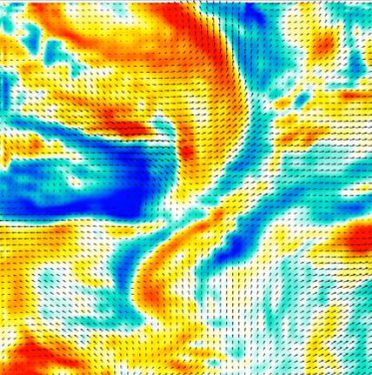
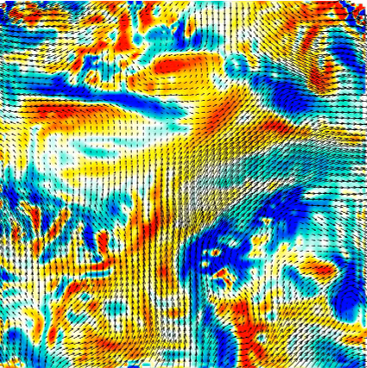
Optimizing grid forcing schemes
Random (rather than fixed) forcing patterns in experimental turbulence decrease mean flow strength.
The stochastic forcing regime lets both grids move independently, with random grid frequencies and duration of frequencies.
Stochastic forcing increases intensity and promotes smaller scale structures.
fractal, fixed forcing
fractal, stochastic forcing
-25
0
25
𝟂_{y} (1/s)
1 cm/s
True and Wheeler et al., in prep.
Notes:
Increased intensity and smaller scale structures in stochastic forcing case.

Slide 12
Mean flow · rms velocity-normalized (in-plane magnitudes)
z
y
1 mm
x
classical, fixed
fractal, fixed
fractal, stochastic
f = 6 Hz,
s = 10 mm
u/u_{rms}
0
1
0
1
0
1
< u/u_{rms} > = 0.82
< u/u_{rms} > = 0.15, 0.13
< u/u_{rms} > = 0.24
True and Wheeler et al., in prep.

Slide 13
Isotropy · u_{rms}/w_{rms}
z
y
1 mm
x
classical, fixed
fractal, fixed
fractal, stochastic
f = 6 Hz,
s = 10 mm
< u_{rms} /w_{rms} >
0.75
1
1.25
0.75
1
1.25
0.75
1
1.25
< u_{rms} /w_{rms} > = 1.035
< u_{rms} /w_{rms} > = 0.85, 0.89
< u_{rms} /w_{rms} > = 0.8
True and Wheeler et al., in prep.

Slide 14
Homogeneity and TKE dissipation rate
z
y
1 mm
x
classical, fixed
fractal, fixed
fractal, stochastic
f = 6 Hz,
s = 10 mm
𝜺 (m²/s³)
0.75
1
1.25
0.75
1
1.25
0.75
1
1.25
< 𝜺 > = 3.2 x 10⁻⁴ m²/s³
< 𝜺 > = 2.2 x 10⁻⁴ m²/s³, 2.6 x 10⁻⁴ m²/s³
< 𝜺 > = 3.9 x 10⁻⁴ m²/s³
True and Wheeler et al., in prep.
Notes:
This is the anomaly field of the TKE?
Less granularity in the fractal grid cases compared to the classical grids, which is good.

Slide 15

Turbulence across the grid frequency-amplitude parameter space
fractal grid + fixed forcing
s = 5 mm
s = 10 mm
s = 15 mm
Kolmogorov microscale
η (mm)
Taylor Reynolds number Re_{λ} = λu_{rms} / ν
η [mm]
𝜺 [m²/s³]
Re_{λ} = λu_{rms}/ν
TKE dissipation rate ε (m²s⁻³)
True and Wheeler et al., in prep.
Notes:
What is effect of temperature on low frequency stuff? Does it make the saturation better or worse?
In Guadyol paper (2009) they do total power input by grid in single oscillation – derivation shows power input ~ f^3s^3 =v^3
But viscous dissipation on grids and walls is an energy sink –not everything is going into flow kinetic energy
When you force more vigorously, you get more shearing near the walls (between grids and walls), how does this play into how much energy goes into the bulk vs the walls
SATURATION THOUGHTS:
Energy budget – total kinetic energy injected by grid forcing = mean flow + tke dissipation in the bulk + viscous dissipation of solid boundaries (grid walls + grids)
McDougall 1979 show that the characteristic rms velocity became nonlinearly related to frequency f above ~7 Hz. Interesting similarlity to what we see, but perhaps the ”cut-off” frequency for a liter-scale tank is lower. Shy 1997 found a cut-off frequency of 8 Hz.
Variano 2008 - Whether the tank is stirred with impellers, synthetic jets, or other mechanisms, more stirring does not necessarily imply better mixing. Rather, additional elements may only add to the strength of the secondary circulation and not to the turbulence itself.
PIV resolution getting too close to dissipation lengthscale for high epsilon cases?

Slide 16
How do we capture the ocean in the laboratory?
Franks et al. Limnology and Oceanography 2021

Slide 17
Conclusions + next steps
Built and optimized a facility for microorganism-flow visualization across a range of flow regimes
Flexible forcing schemes permit a wide range of oceanic conditions: near homogeneous and isotropic turbulence, intermittent pulsed events, etc.
Turbulence ‘recipes’ across a grid frequency-amplitude parameter space
Time resolved PIV animations of selected parameter cases
Open-source designs (CAD drawings and part lists)

Slide 18
Conclusions + next steps
Built and optimized a facility for microorganism-flow visualization across a range of flow regimes
Flexible forcing schemes permit a wide range of oceanic conditions: near homogeneous and isotropic turbulence, intermittent pulsed events, etc.
Turbulence ‘recipes’ across a grid frequency-amplitude parameter space
Time resolved PIV animations of selected parameter cases
Open-source designs (CAD drawings and part lists)

Slide 19
Conclusions + next steps
Built and optimized a facility for microorganism-flow visualization across a range of flow regimes
Flexible forcing schemes permit a wide range of oceanic conditions: near homogeneous and isotropic turbulence, intermittent pulsed events, etc.
Turbulence ‘recipes’ across a grid frequency-amplitude parameter space
Time resolved PIV animations of selected parameter cases
Open-source designs (CAD drawings and part lists)

