Slide 1



The VARION approach to volcanoes:
case study on 2021 Etna eruptions
Michela Ravanelli^{1,2}, Federico Ferrara³, Federica Fuso⁵, Andrea Cannata^{3,4},
Mattia Crespi¹ and Giovanni Occhipinti²
¹Geodesy and Geomatics Division, DICEA, Sapienza University of Rome, Rome, Italy
²Université de Paris, Institut de Physique du Globe de Paris, CNRS, F-75005 Paris, France
³University of Catania, Dipartimento Di Scienze Biologiche, Geologiche E Ambientali, Catania, Italy
⁴Istituto Nazionale di Geofisica e Vulcanologia, Osservatorio Etneo, Catania, Italy
⁵Department of Computer, Control and Management Engineering Antonio Ruberti (DIAG) Sapienza University of Rome, Rome, Italy

Slide 2
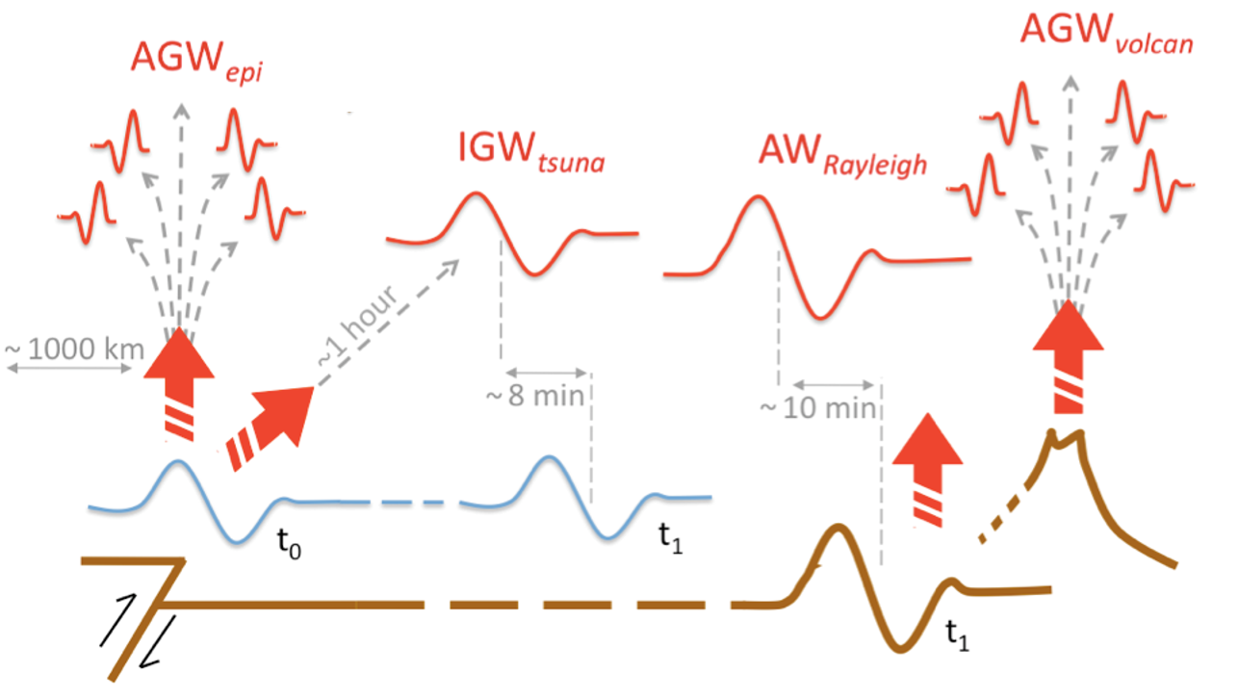
Co-Volcanic Ionospheric disturbance (CVID)
Figure adapted from Occhipinti, 2015
Background

Slide 3



Co-Volcanic Ionospheric disturbance (CVID)
Main features
About 10 to 45 minutes after the eruption onset, near the volcano and as far as 800-1000 km away from it
Quasi-periodic variations of TEC with periods of 12-30 min
The apparent velocity of propagation can vary between 550 m/s and 1.1 km/s, which corresponds to acoustic, gravito-acoustic and shock-acoustic waves.
Background

Slide 4
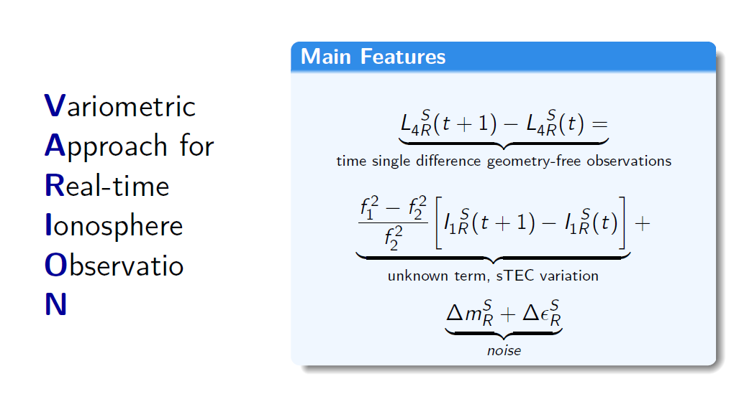
VARION fundamentals
The VARION algorithm

Slide 5
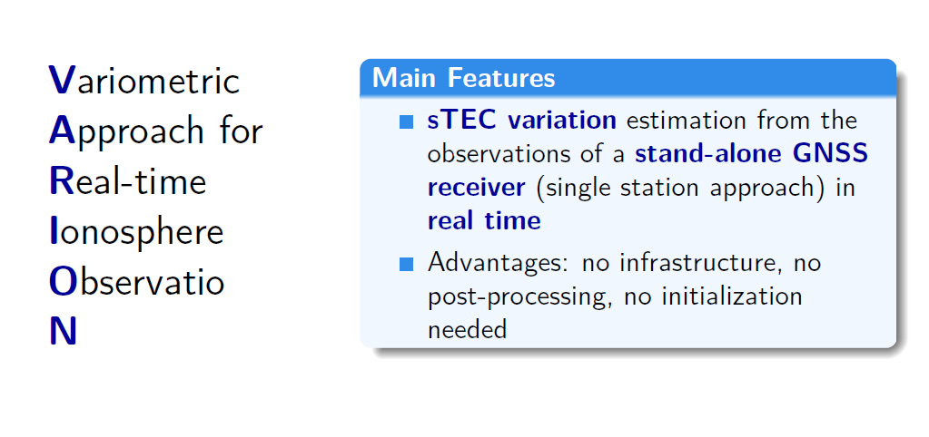
VARION fundamentals
The VARION algorithm

Slide 6
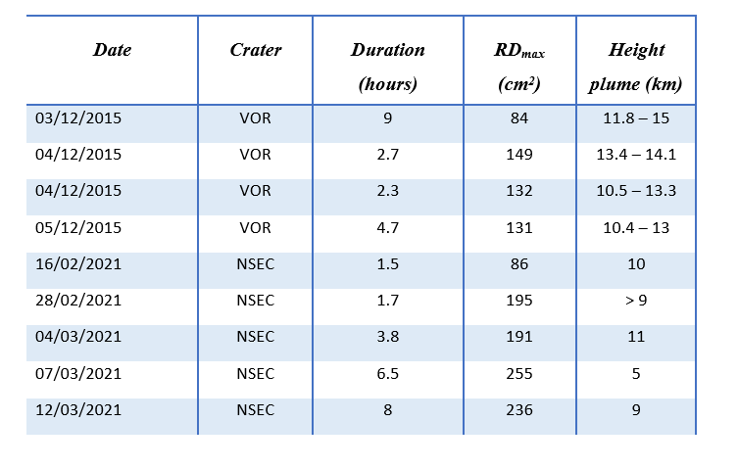
Etna case studies
Etna case studies

Slide 7
Etna case studies
2015
Voragine
High energy events (paroxysms)
Strombolian activity
High Lava fountain
Abundant tephra emission
Stroger explosive activity
Low seismic activity
2021
New South-East Crater
Lava fountain of February/March 2021
Strombolian activity
VARION processing
0.5-5 mHz bandpass filtering
Etna case studies

Slide 8
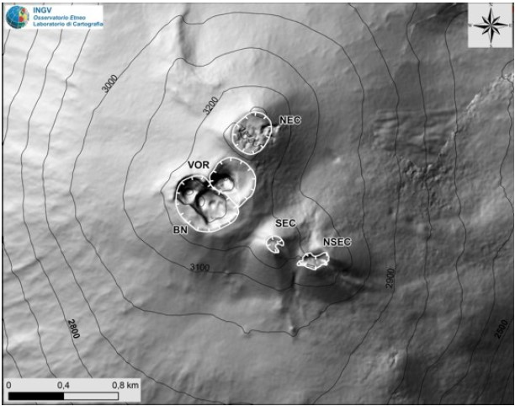
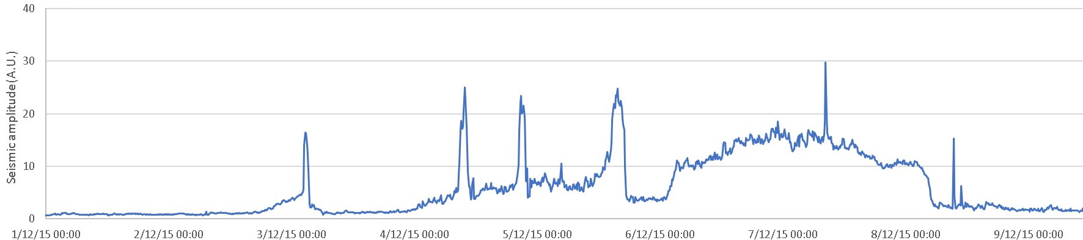
Etna case studies
2015
Voragine
High energy events (paroxysms)
Strombolian activity
High Lava fountain
Abundant tephra emission
Stroger explosive activity
Low seismic activity
VARION processing
0.5-5 mHz bandpass filtering
Etna case studies

Slide 9
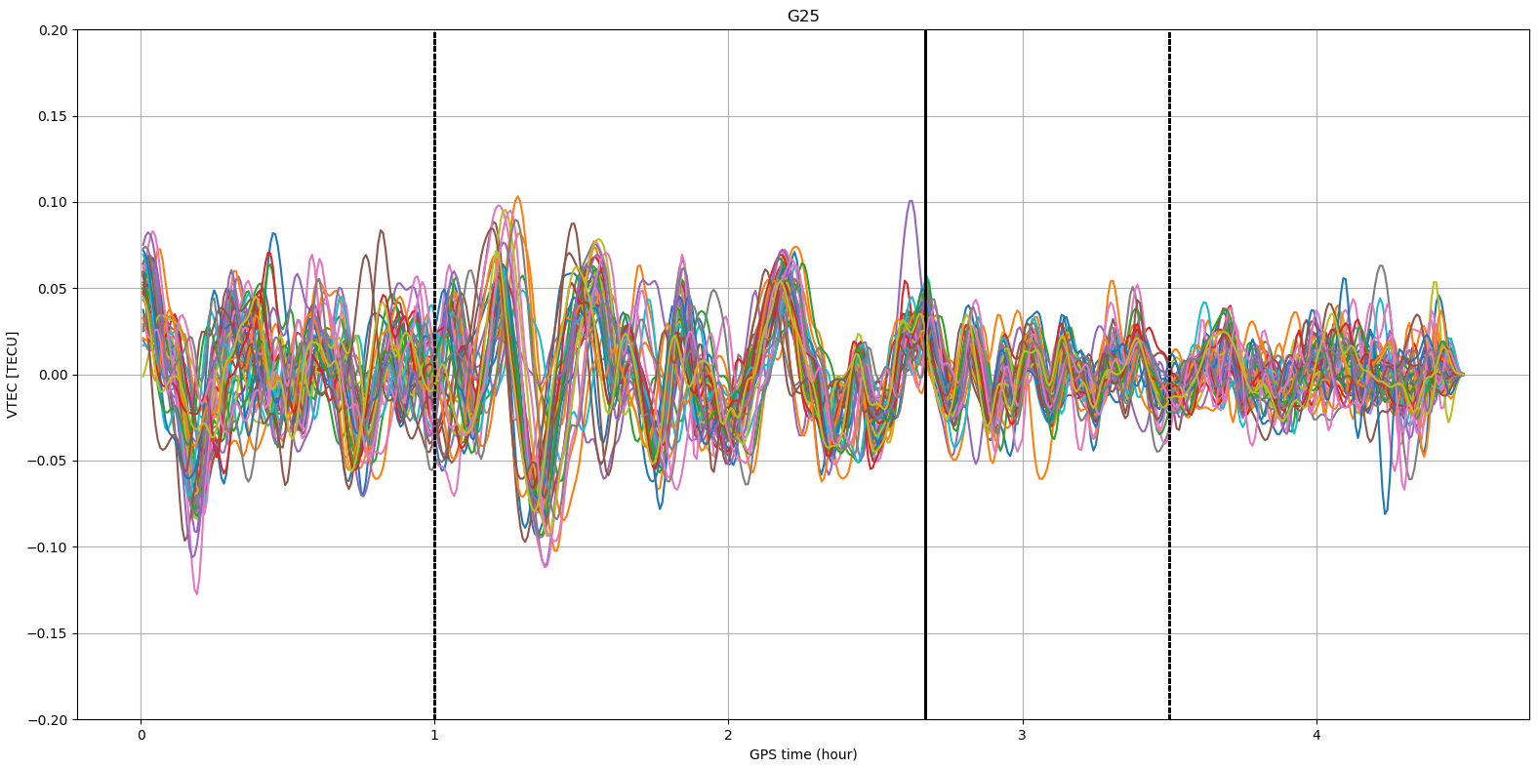
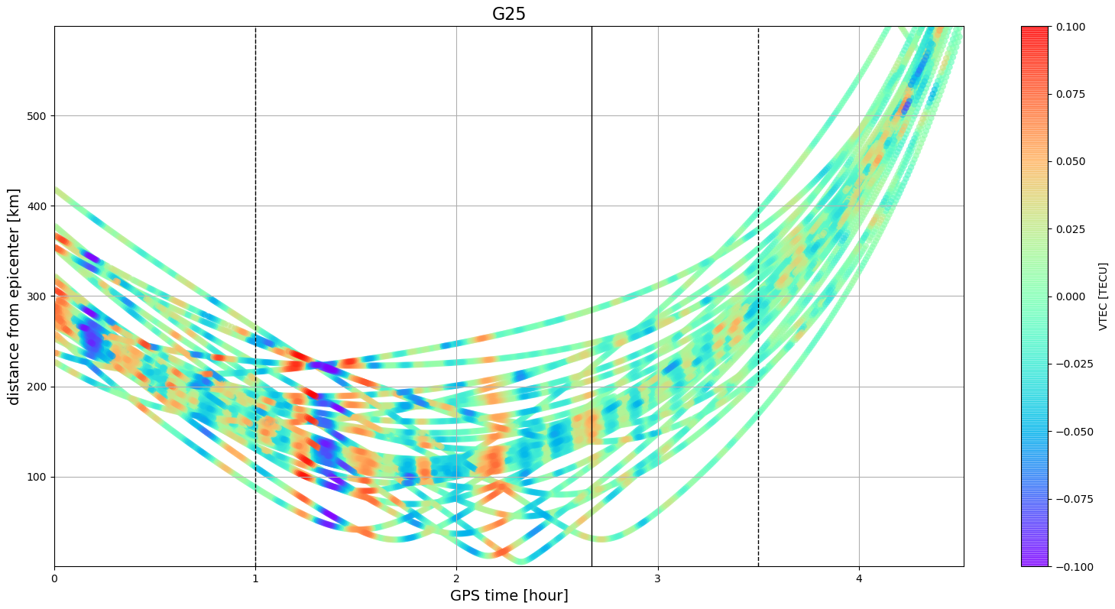
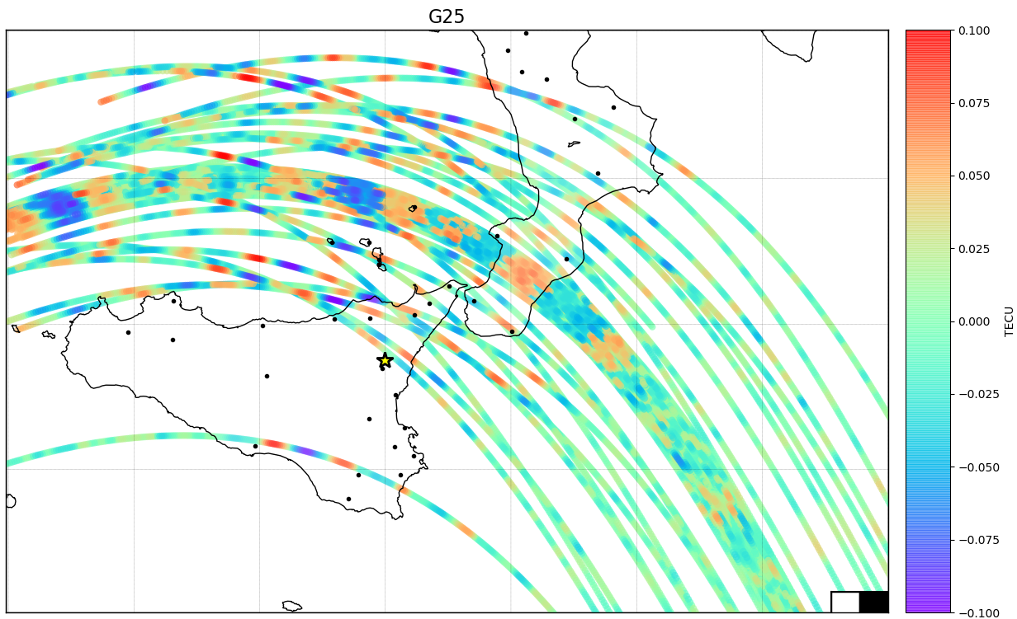
Etna case studies
2015
Etna case studies

Slide 10
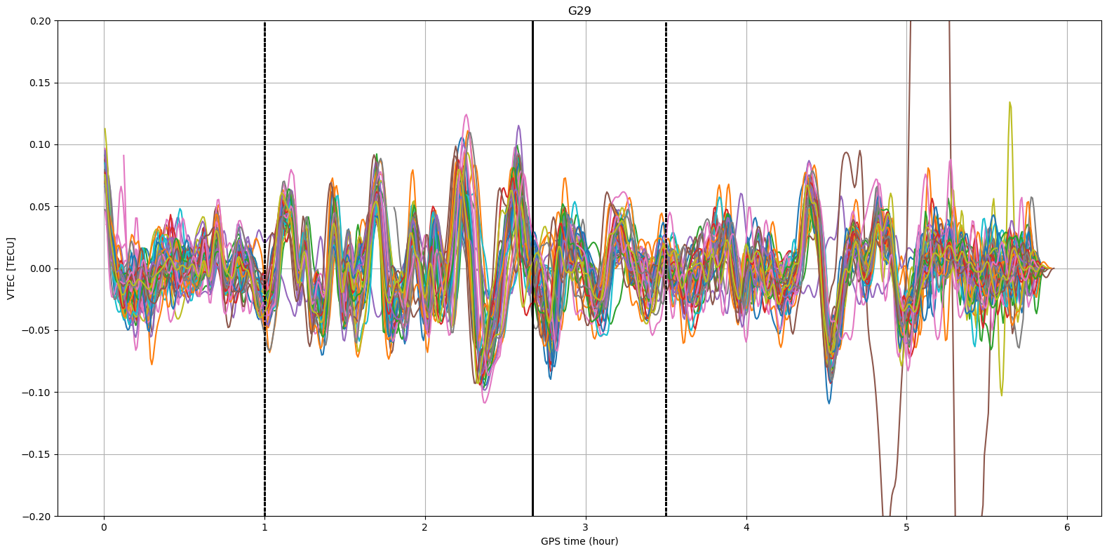
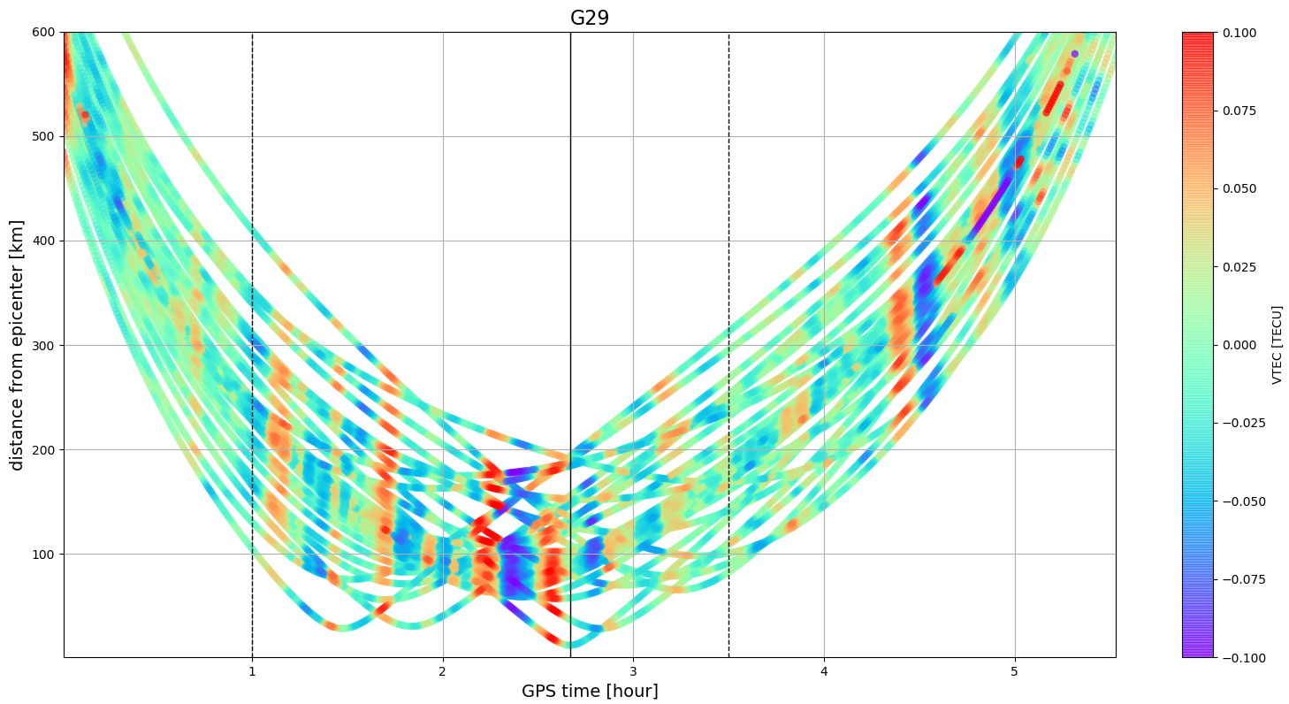
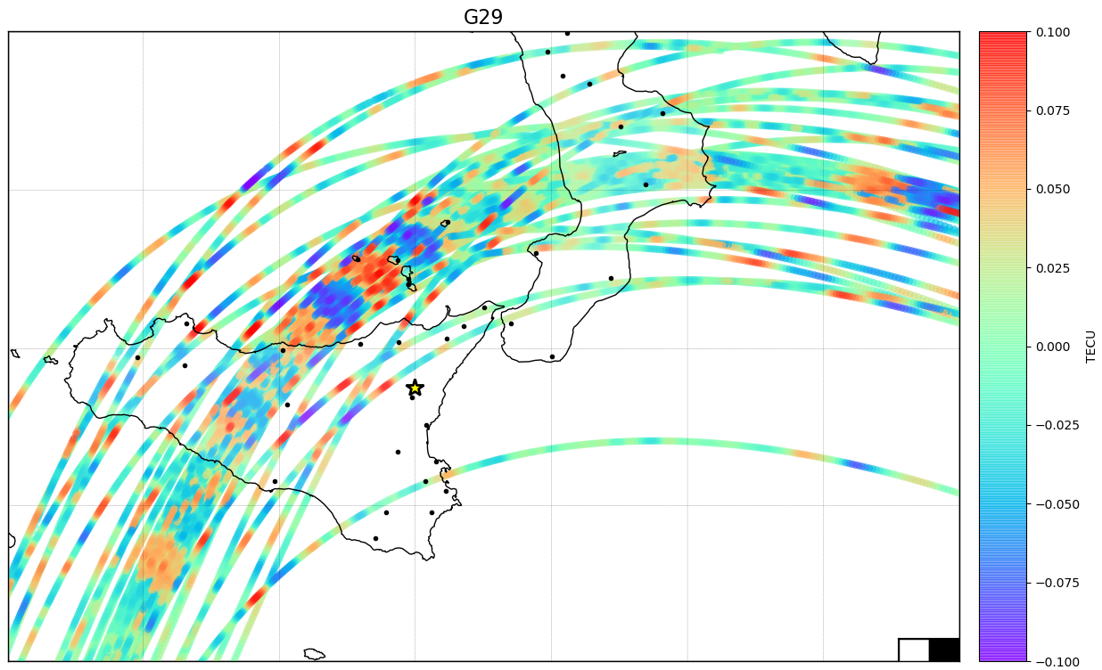
Etna case studies
2015
Etna case studies

Slide 11
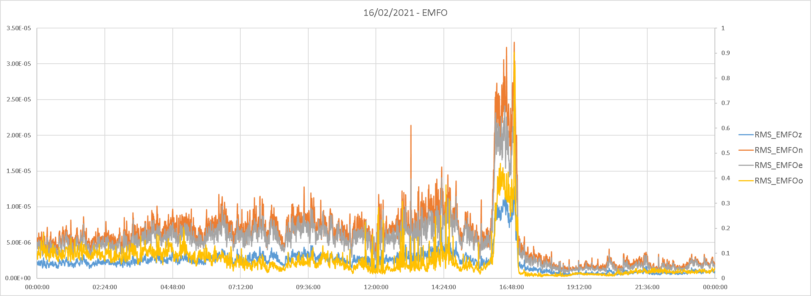
Etna case studies
2021
New South-East Crater
Lava fountain of February/March 2021
Strombolian activity
High seismic activity
VARION processing
0.5-5 mHz bandpass filtering
Etna case studies

Slide 12
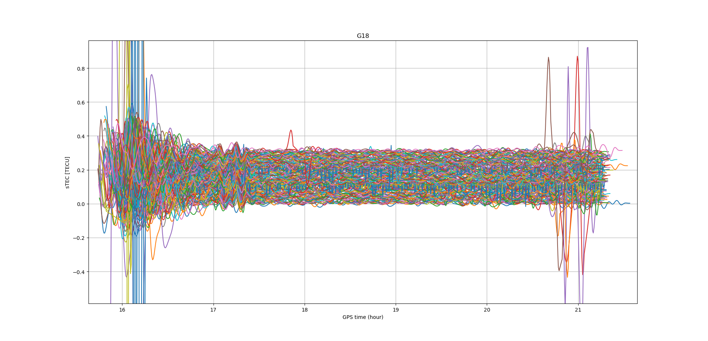
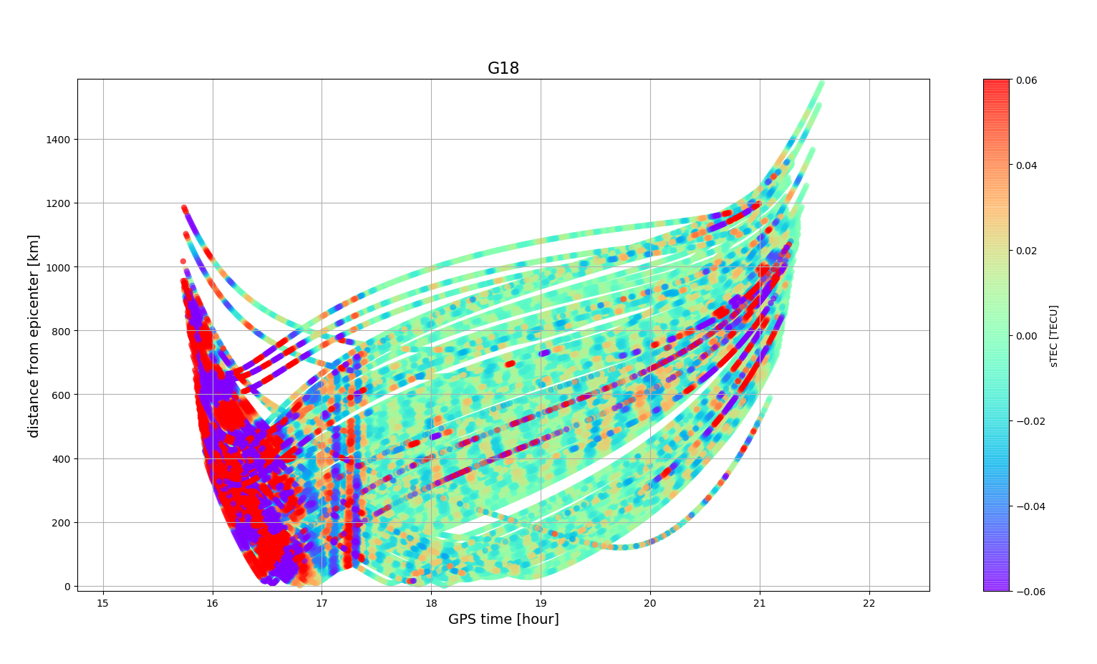
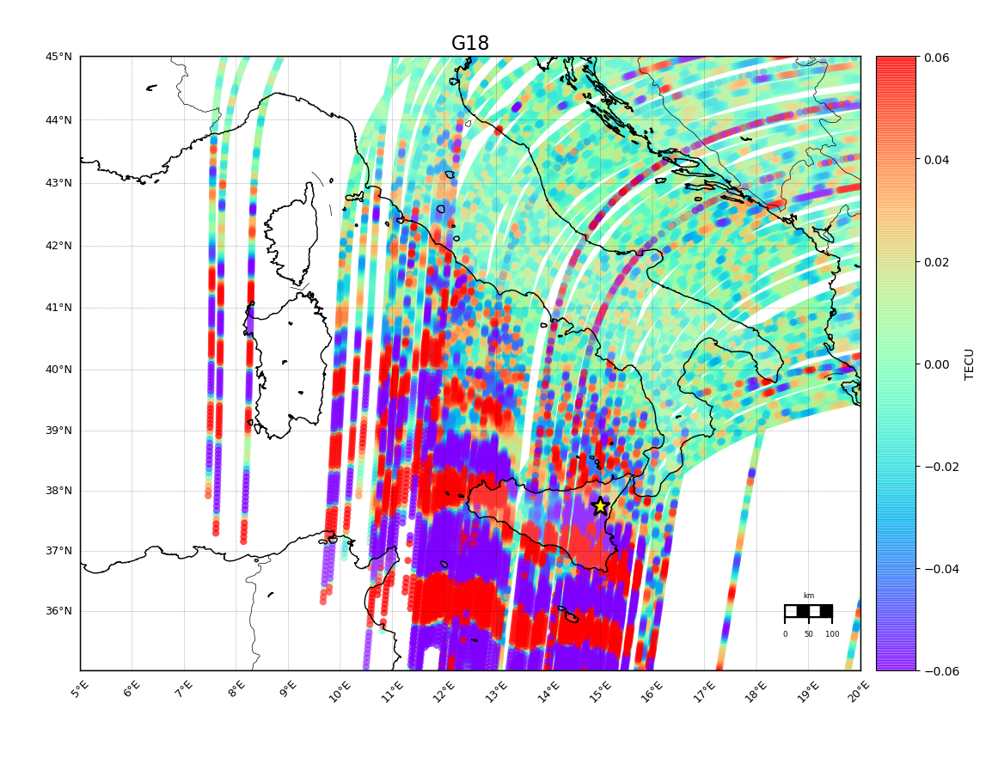
Etna case studies
2021
Etna case studies

Slide 13
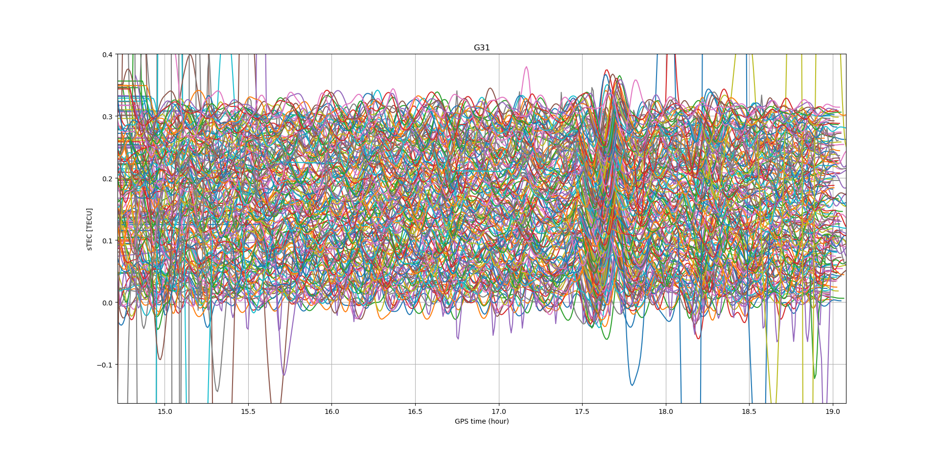
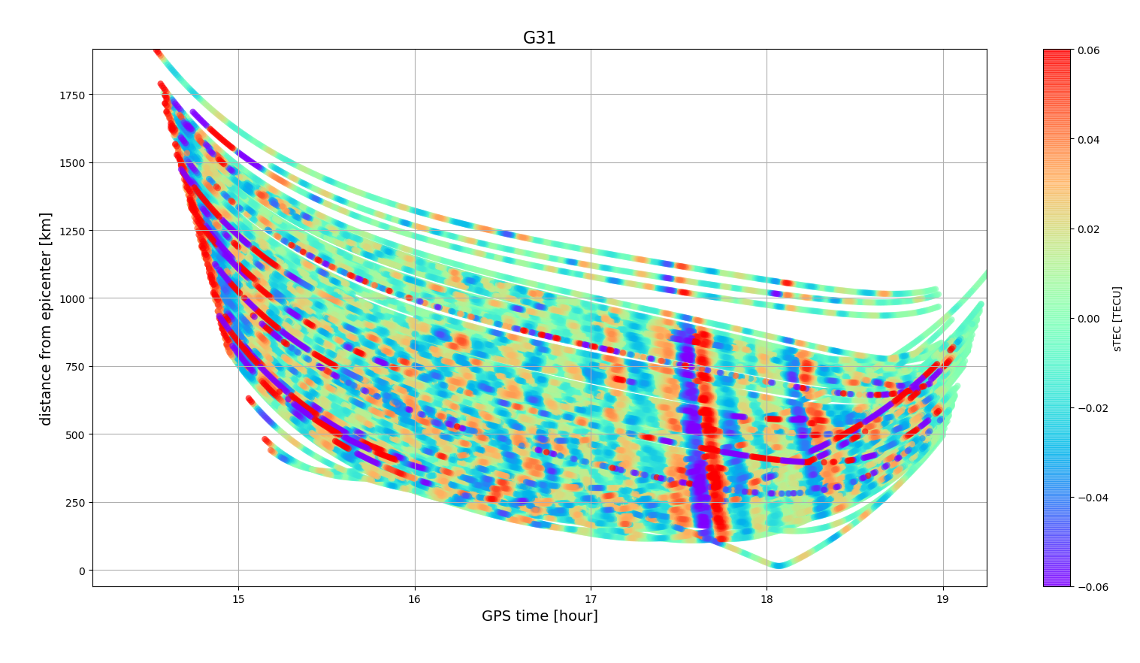
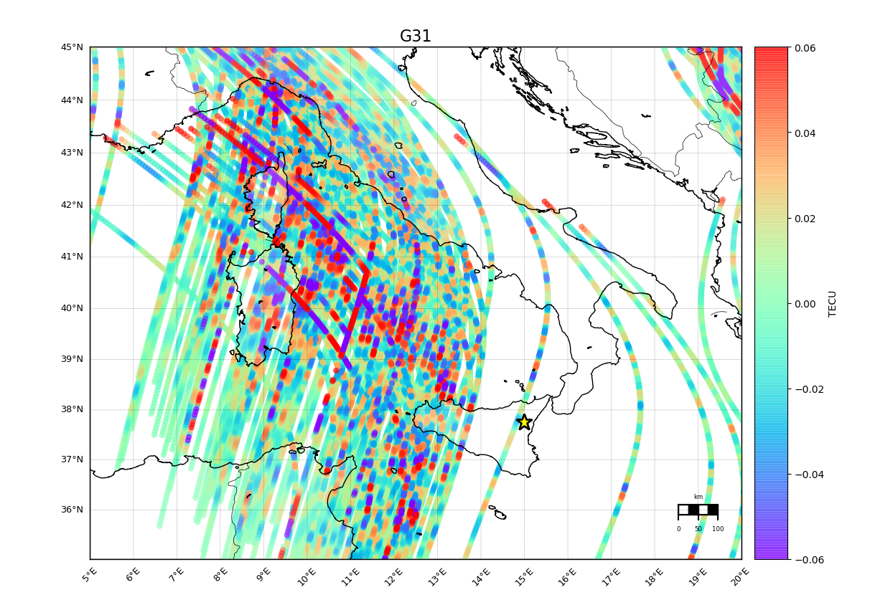
Etna case studies
2021
Etna case studies

Slide 14
Etna case studies
Differences
Different seductive character Vor in 2015 and Sec in 2021
Diameter of the vent and of the duct presumably greater in 2015 than in 2021
Maximum height of the plume in 2015 among those observed in recent years
Mass emitted (the one found on the ground after the eruption) and mass eruption rate (emission rate from the crater) greater in 2015
Etna case studies

Slide 15
Conclusions and perspectives
Preliminary studies, need more analyses
CVID linked more to what it is emitted than the tremors itself
Still difficult to characterize the ionospheric response of volcanic eruptions
Conclusions

Slide 16
Conclusions and perspectives
Other events
Comparison with infrasonic data
ML approach on events
Conclusions

Slide 17
