Slide 1
Nowcasting Flood Impacts of Convective storms in the Sahel (NFLICS) Dr Steven Cole (scole@ceh.ac.uk) EGU22, HS4.1 10:45-10:50, 23 May 2022

Slide 2
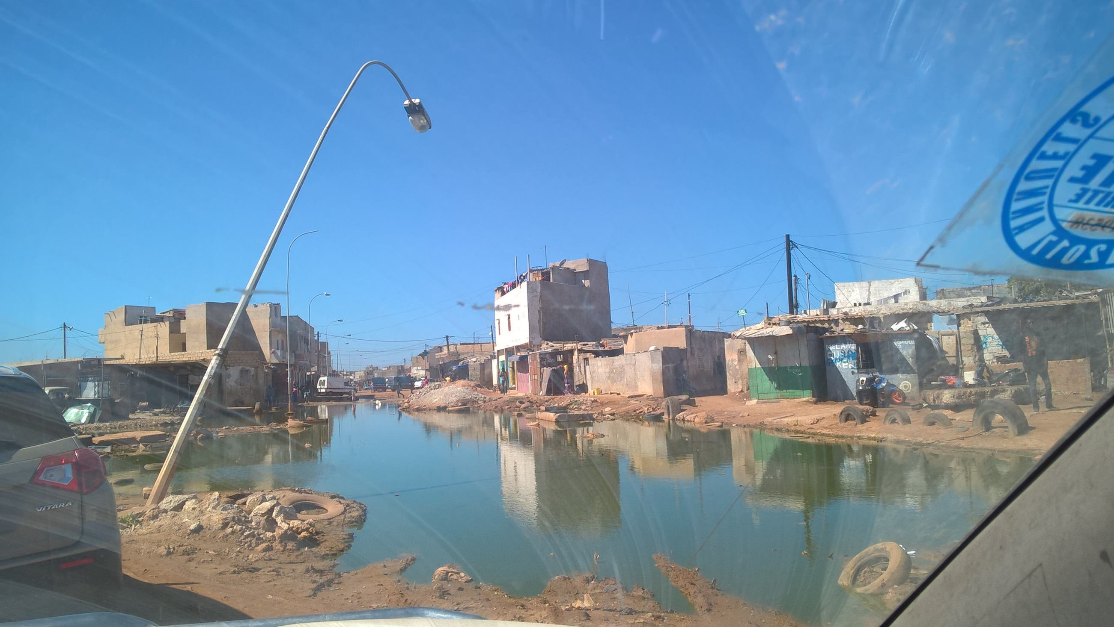

Nowcasting - Motivation
Flash flooding frequently causes major damage and loss of life across Africa
In the Sahel, the main driver is intense rainfall from Mesoscale Convective Systems (MCSs)
Senegal and Dakar used as case study region. Major floods in 2009 (140mm of rain in 1h!), 2012 and 2020
MCSs have tripled in frequency in 30 years

Slide 3
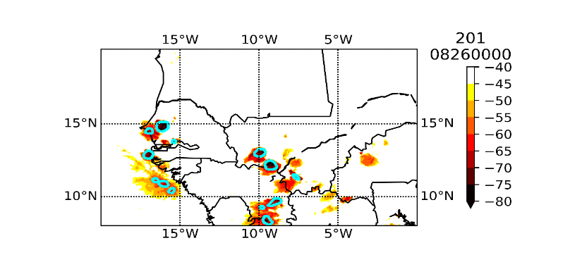
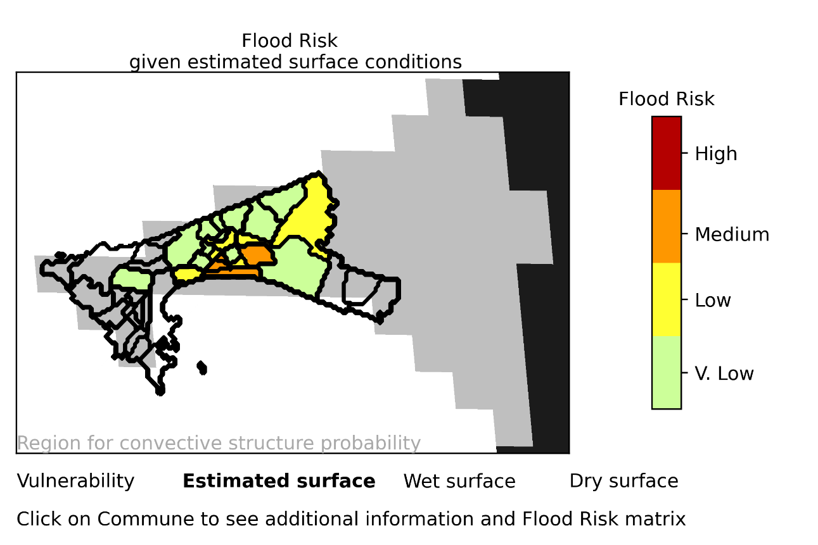

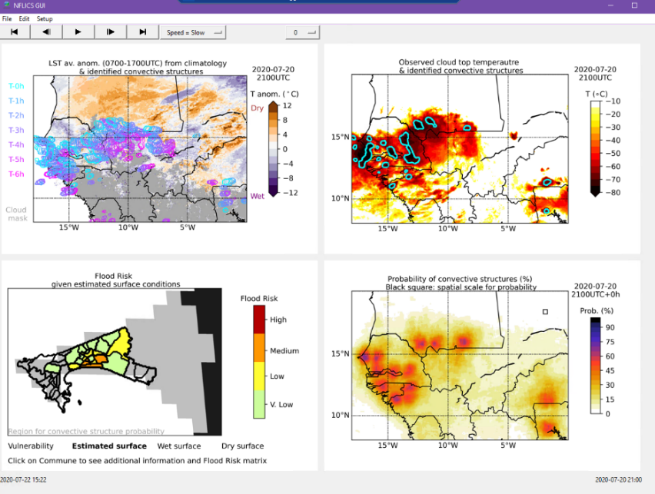
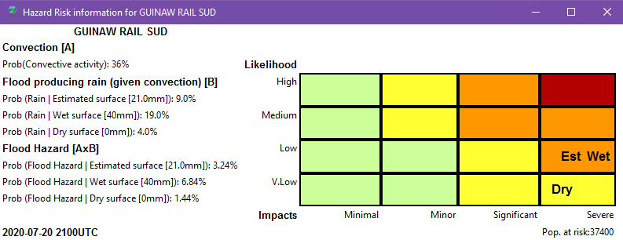
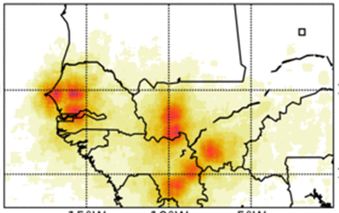
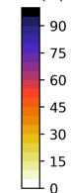
NFLICS – Forecast Based Action (0-6 hours)
Co-development of warning products and communication strategy
Engaged with recipients of warnings – what information needed and how
New satellite nowcasting methods
New rainfall and flood risk products
Real-time prototype trial and evaluation
convective structures
T (^{O}C)
Conditional probability
nowcast 0-6h (%)
Likelihood
Impacts
Warning Services
Real-time trials at ANACIM for 2020/21 rainy seasons

Slide 4
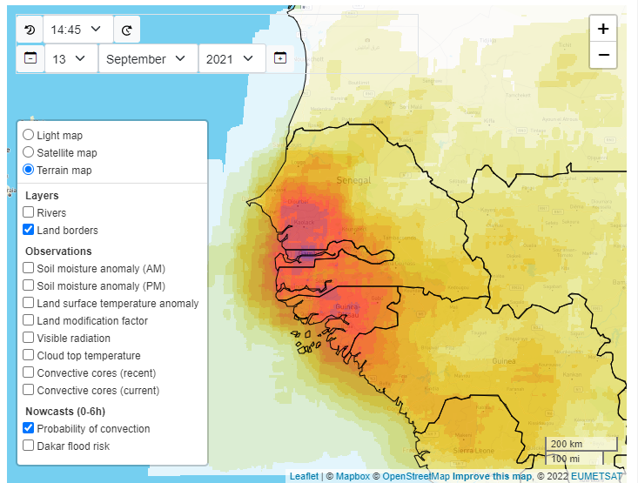
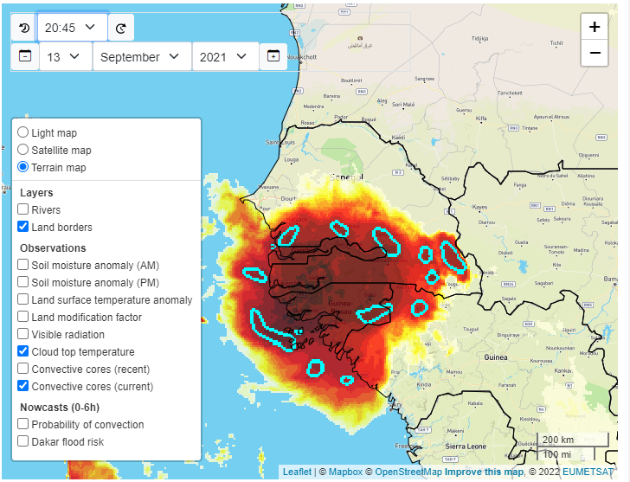
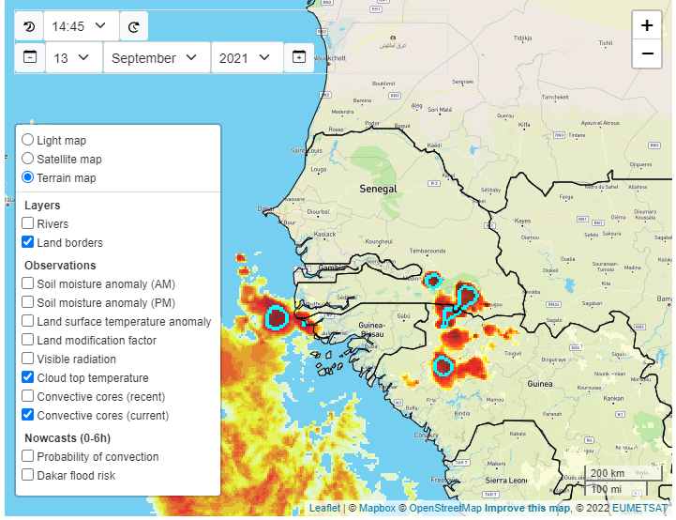
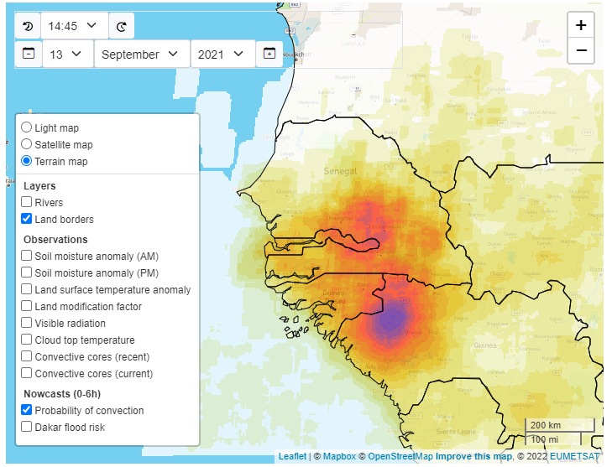
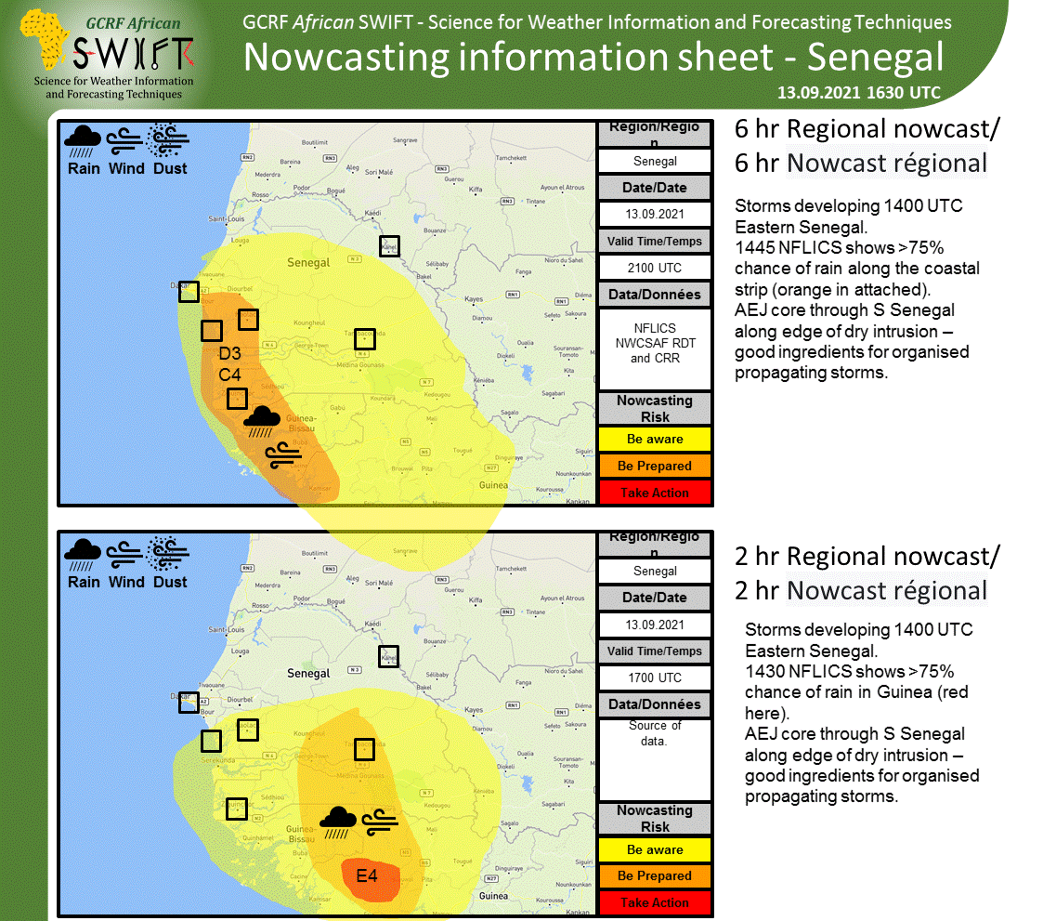
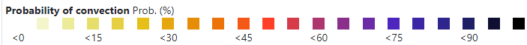
Nowcasting example: 13 September 2021
Web portal: https://eip.ceh.ac.uk/hydrology/west-africa/nowcasting/
Observations at start of nowcast
Nowcast probability of convection using historical storm climatology
What actually happened 6h later?
+6 hrs
Communication with impacts
+2 hrs
Convective features identified south east of Senegal

Slide 5
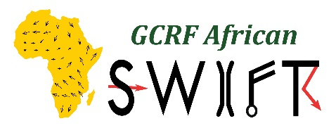


Conclusions and next steps
New satellite-based observation and nowcasting (0-6h) products co-developed for Mesoscale Convective Systems in West Africa
Methods are quick to run (minutes) and forecast verification show nowcasts have skill.
Physical insights and processes apply elsewhere so potential for approach to be applied in other regions of the world
Ease of access through web-portals vital for research and operations
Ongoing research developing methods further in W Africa and beyond

Slide 6
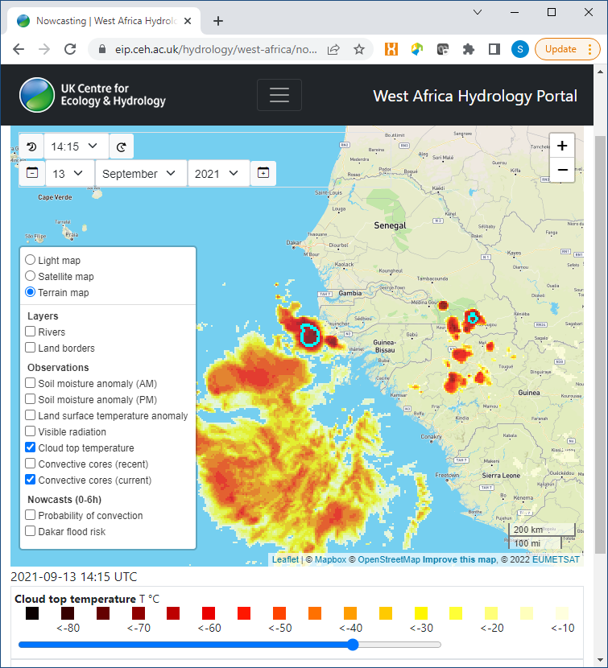
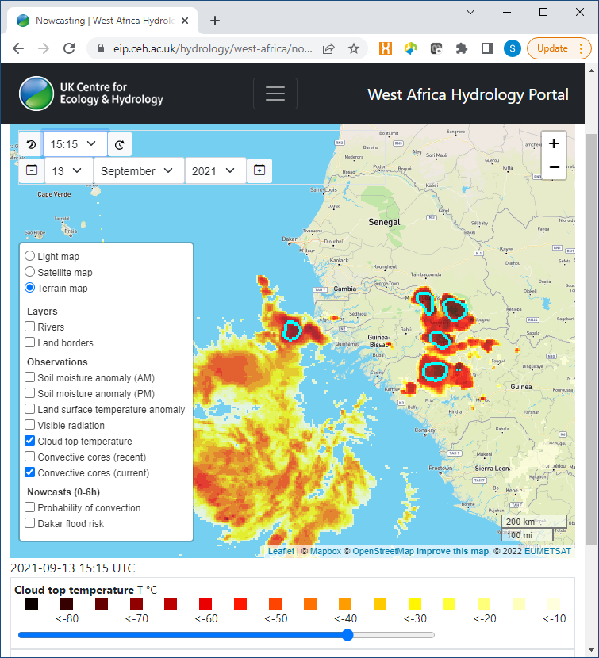
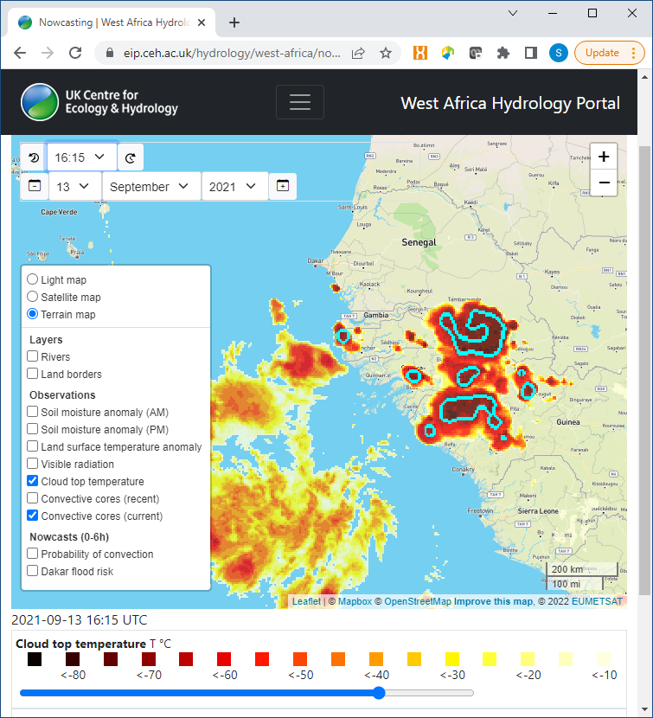
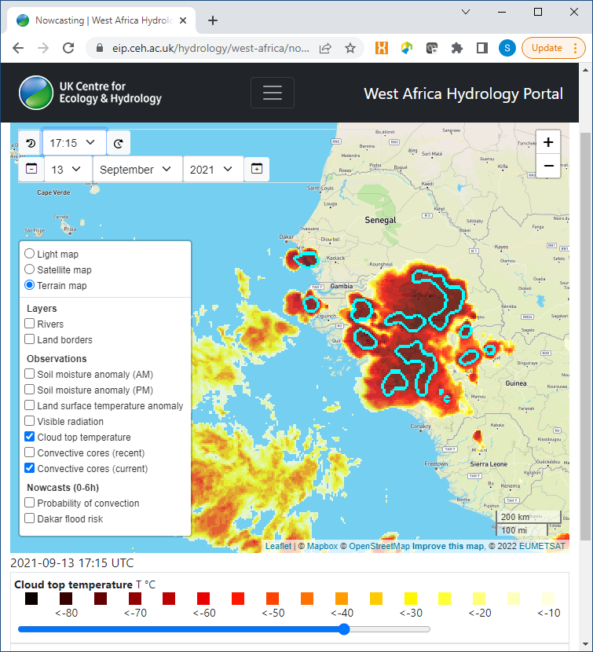
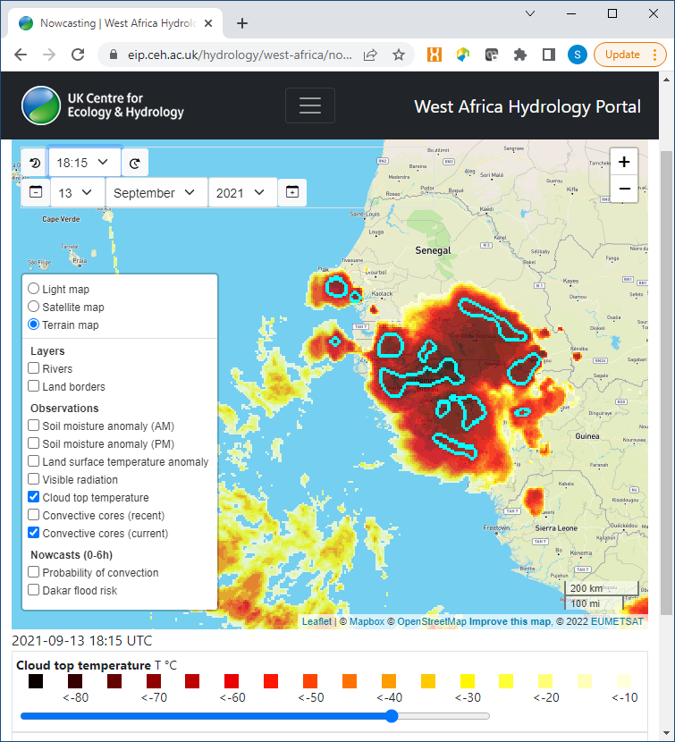
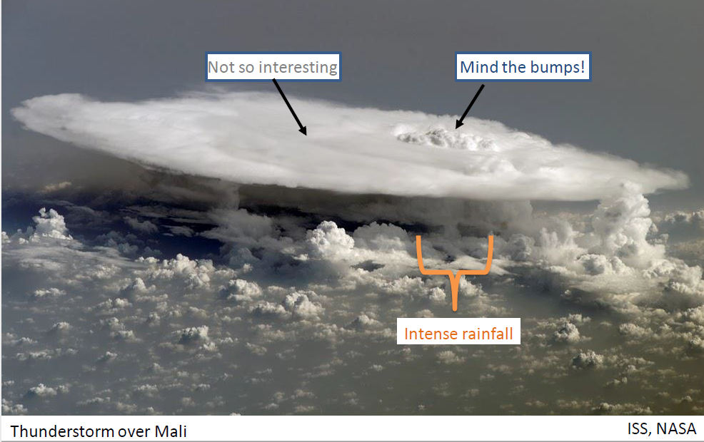
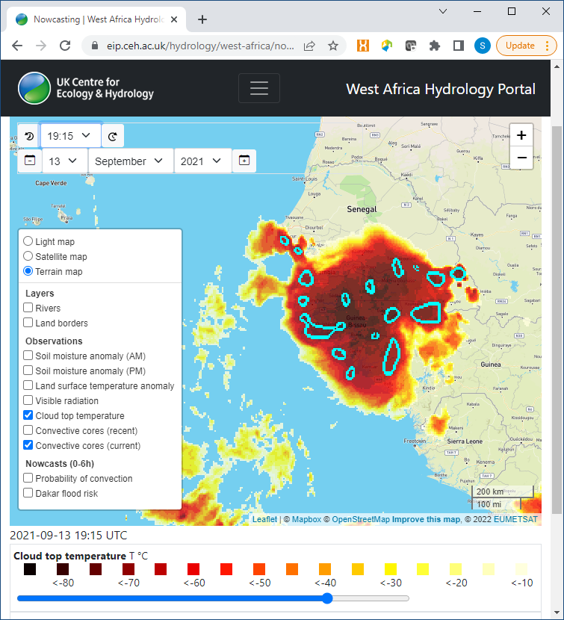
Identifying Convective activity from satellites
When cores appear, storm is growing and strengthening
Conditions for convective cores¹: 1. >25km in size, 2. <-50°C cloud top temperature
¹Klein et al. (2019), J. Geophys. Res. Atmos., doi:10.1002/2017JD027432

Slide 7
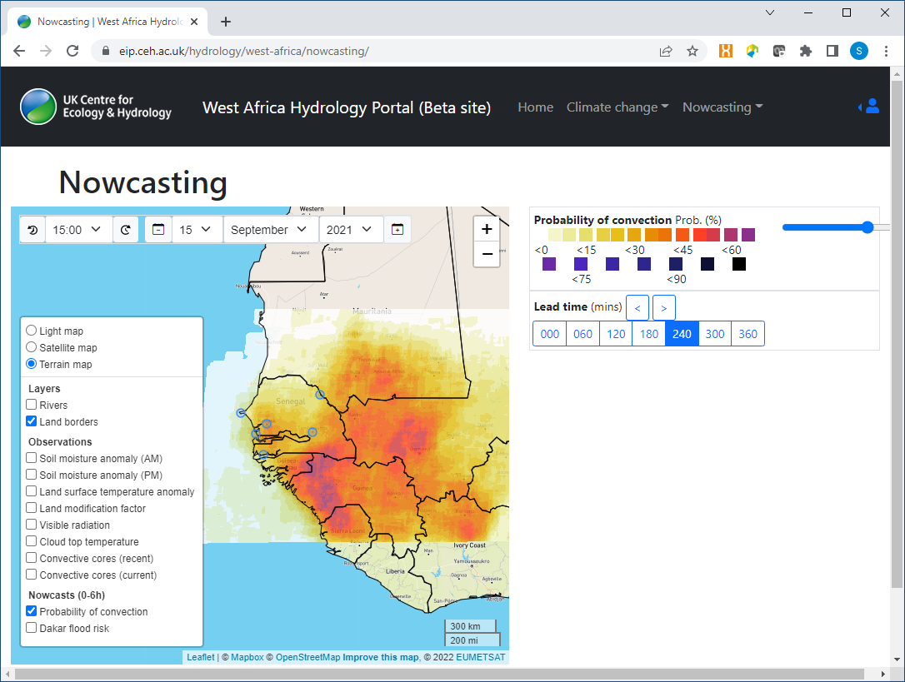
Nowcasting portal for West Africa
New nowcasting web portal co-developed for Senegal Met Agency
eip.ceh.ac.uk/hydrology/west-africa/nowcasting/
Real-time and archive products
Nowcasting methods and Graphical User Interface available for Met Agencies to use in-house
https://eip.ceh.ac.uk/hydrology/west-africa/nowcasting/

Slide 8
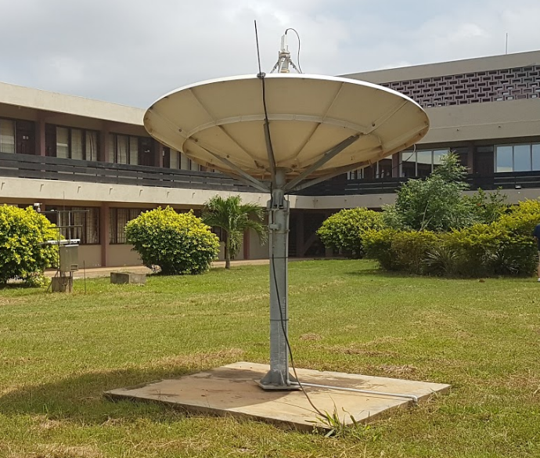
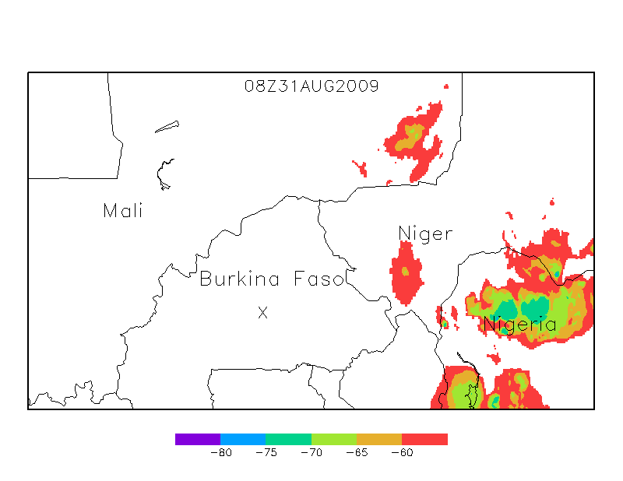
Nowcasting - Challenge
WMO¹ definition of nowcasting “forecasting with local detail, by any method, over a period from the present to six hours ahead, including a detailed description of the present weather”
Rapid updating of observations and nowcasts required (use Satellite data!)
Easy access for forecasters – simple to run in-house or available via web portals
Cloud Top Temperatures from EUMETSAT, Aug 2009
¹WMO Bulletin 68(2) (2019) Nowcasting Guidelines – A Summary

Slide 9
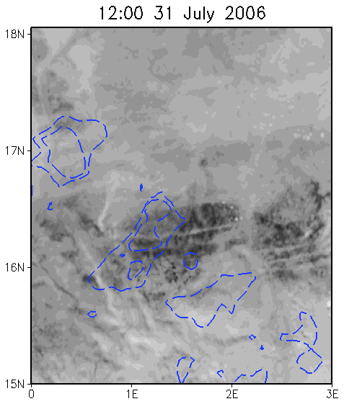
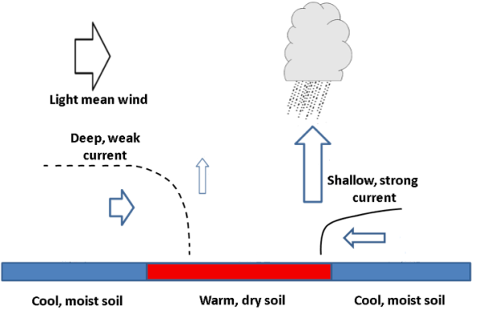
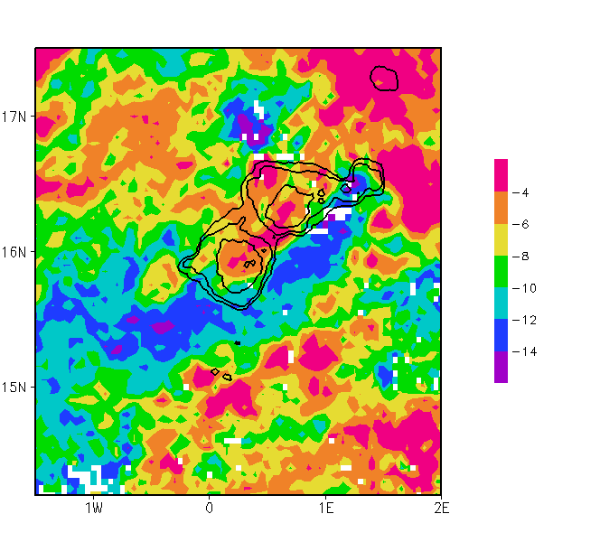
Land surface influence: convective initiation
Contours: cloud-top temperatures
Blue contours: Land Surface Temperature anomalies (LSTA)
Cold (wet) features
~100km
Dry/wet soil moisture patchiness (scales 10s km) favours convective initiation during daytime in Sahel
Land Surface Temperature anomalies (LSTA)
Visible Imagery from Meteosat
¹Taylor et al. (2011), Nature Geoscience, doi:10.1038/ngeo1173

Slide 10
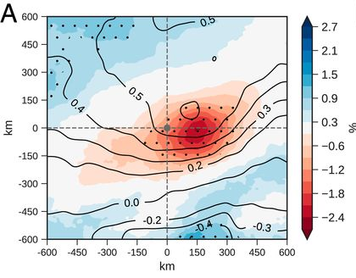
Land surface influence: convective propagation
Centred on MCS Convective Cores
Intense convection within MCSs tends to occur over and downstream of drier soil
Use this knowledge to improve convective storm nowcasts
Red: dry soil
Daytime soil moisture anomaly for all MCS storms Jun – Sep, 2006-2010
¹Klein & Taylor (2020), PNAS, doi:10.1073/pnas.2007998117

Slide 11
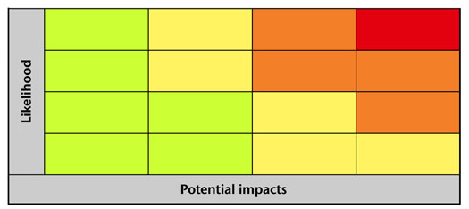
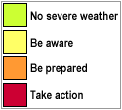
Impact-based forecasting: risk matrix
Many operational weather and flood forecasting centres are moving to Impact-based Forecasting and Warning – encouraged by WMO¹
Risk Matrix approach that combines uncertainty and impacts
Important to acknowledge and account for uncertainty
Make better, more informed, decisions
Overall Flood Risk
High
Medium
Low
Very Low
Very low
Low
Medium
High
Minimal Minor Significant Severe
¹WMO (2015) Guidelines on Multi-hazard Impact-based Forecast and Warning Services (WMO-No. 1150)

Slide 12

Impact-based Forecasting (IbF)
Many operational weather and flood forecasting centres are moving to Impact-based Forecasting and Warning – encouraged by WMO¹
Urban Flood Risk method developed for Dakar using probability of convection and chance of flood producing rainfall occuring
Overall Flood Risk
High
Medium
Low
Very Low
Very low
Low
Medium
High
Minimal Minor Significant Severe
¹WMO (2015) Guidelines on Multi-hazard Impact-based Forecast and Warning Services (WMO-No. 1150)

Slide 13
Conclusions and next steps
New satellite-based observation and nowcasting (0-6h) products co-developed for Mesoscale Convective Systems in West Africa
Methods are quick to run (minutes) and forecast verification show nowcasts have skill.
Physical insights and processes apply elsewhere so potential for approach to be applied in other regions of the world
Ongoing research developing methods further in W Africa and beyond
Ease of access through web-portals vital for research and operations

