Slide 1


Long-term trends of precipitation in Europe: a comparison across multiple datasets
Radan HUTH^{1,2}, Václav VÍT¹
¹ Faculty of Science, Charles University, Praha, Czechia
² Institute of Atmospheric Physics, Czech Academy of Sciences, Praha, Czechia

Slide 2
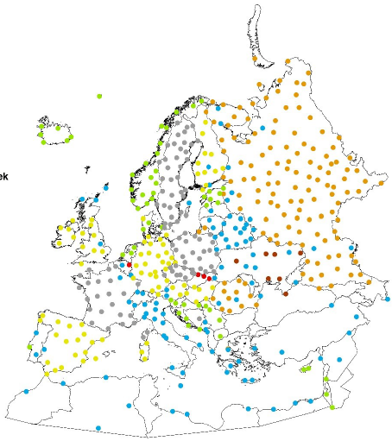
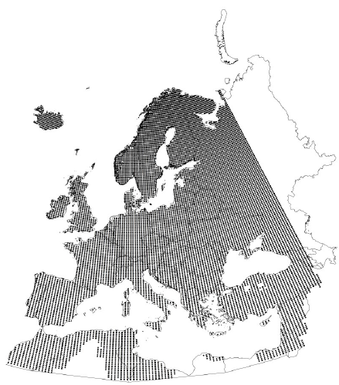
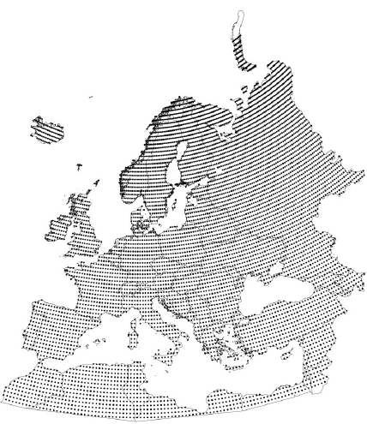
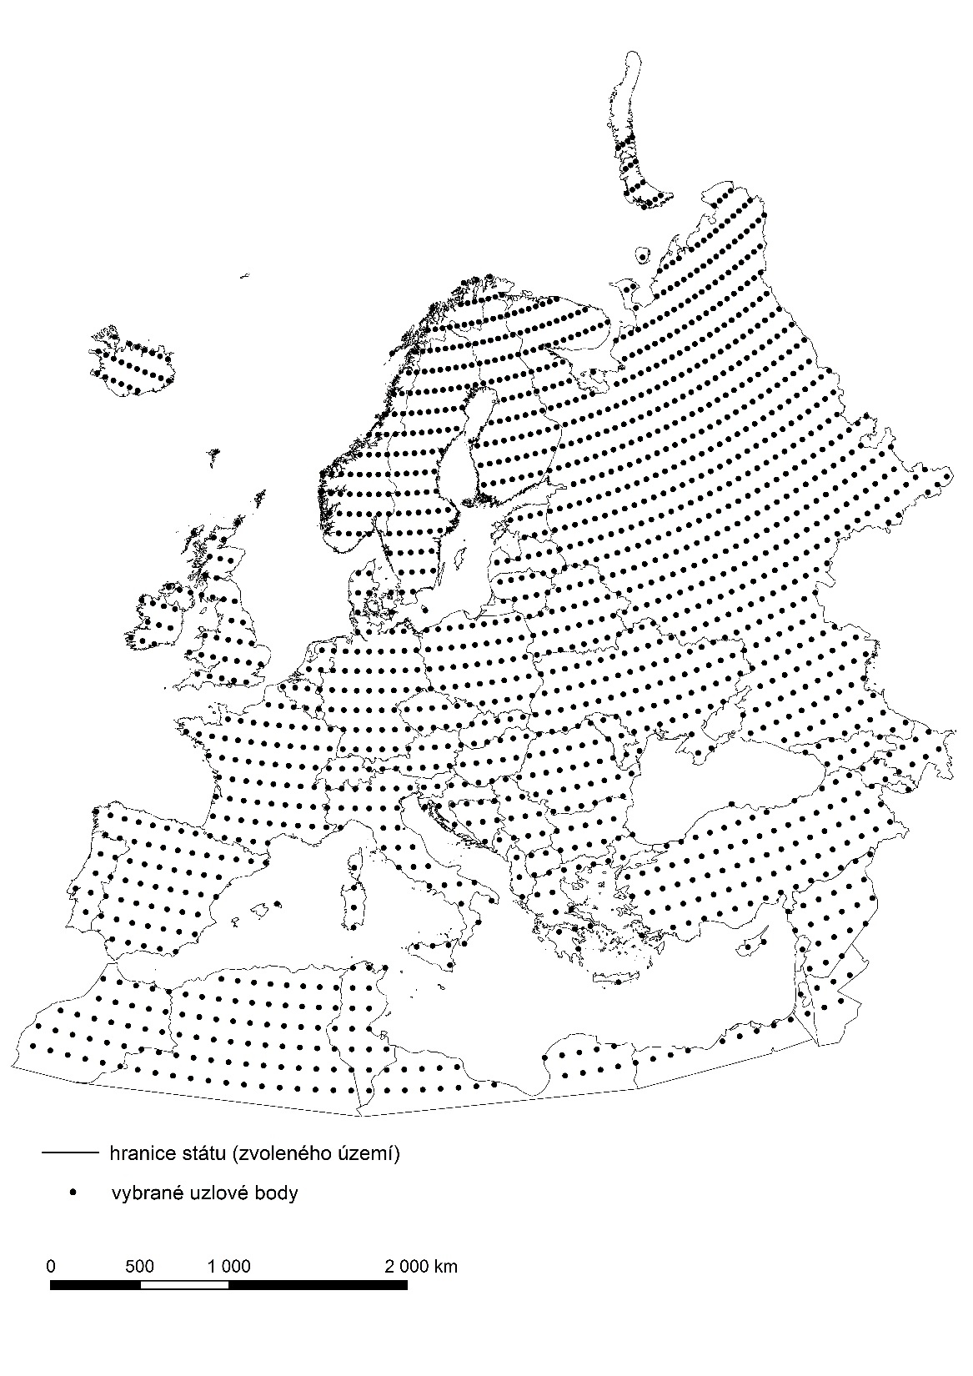
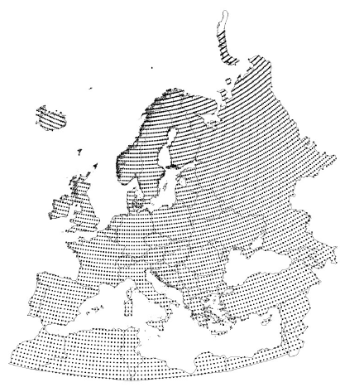
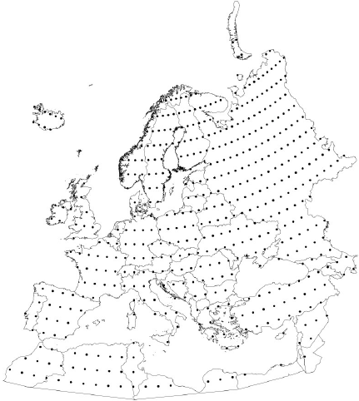
Data
daily precipitation
1961-2011
datasets
  observed
    ECA & D (507 stations)
  gridded
    E-OBS
    CRU TS v. 4.03
  reanalyses
    NCEP/NCAR
    JRA-55
    20CRv3

Slide 3
Methods
seasonal precipitation totals (DJF, MAM, …)
Theill-Sen regression (median of pairwise slopes)
significance of trends: Mann-Kendall test
significance of difference of trends: Fisher test for correlation coefficients

Slide 4
spatial mean trend (mm / 10 yr)
spring
summer
autumn
winter
annual
full-input reanalyses: strongest drying trend except winter
CRU TS & 20CRv3 (surface-input reanalysis): strongest wetting

Slide 5
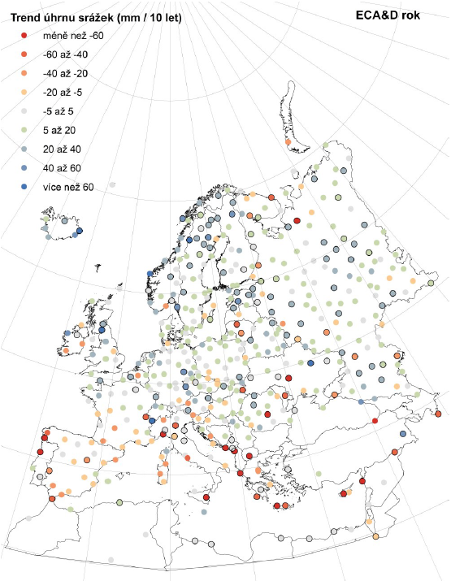
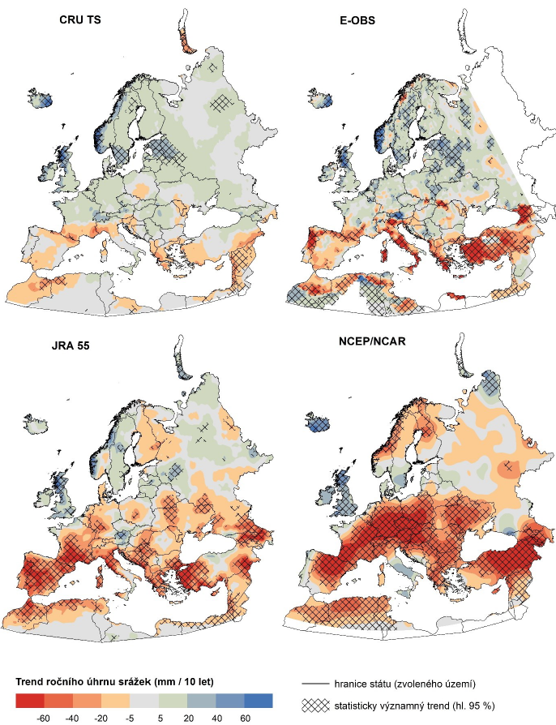
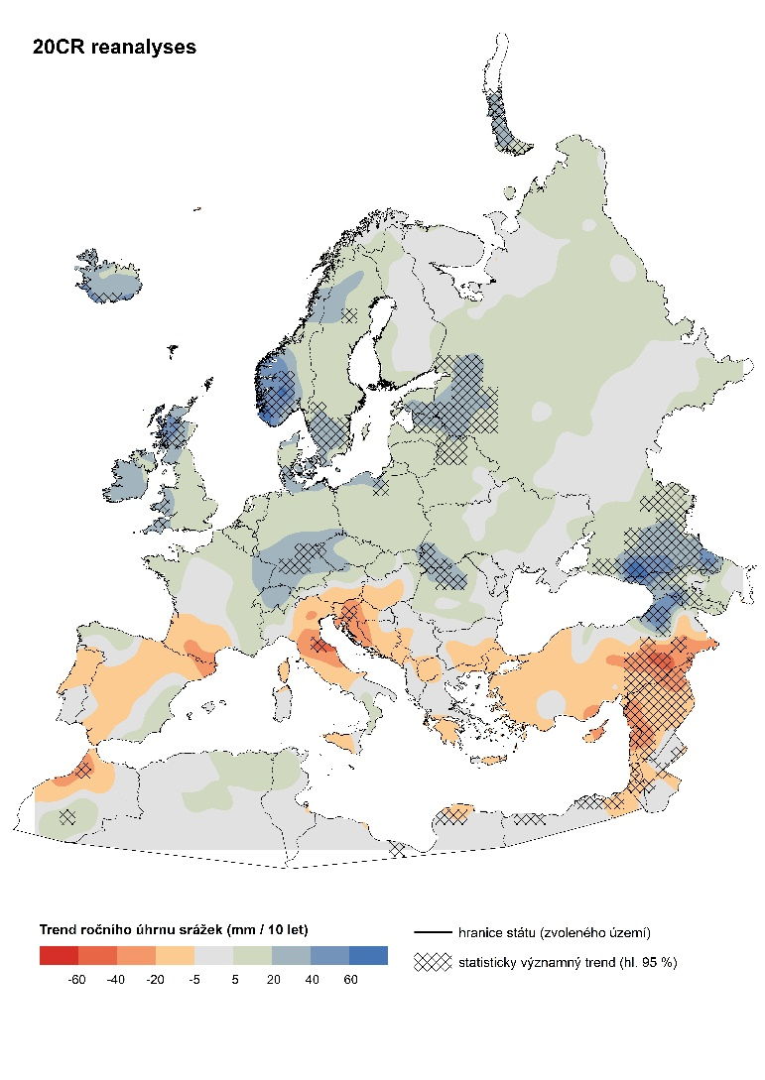
ANNUAL (mm / 10 yr)

Slide 6
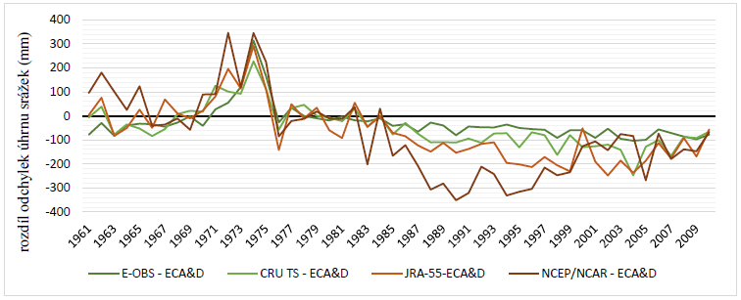
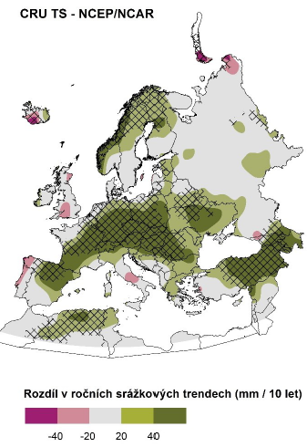
ANNUAL
Sodankylä: diff. from ECA&D
difference CRU TS – NCEP/NCAR
(mm / 10 yr)

Slide 7
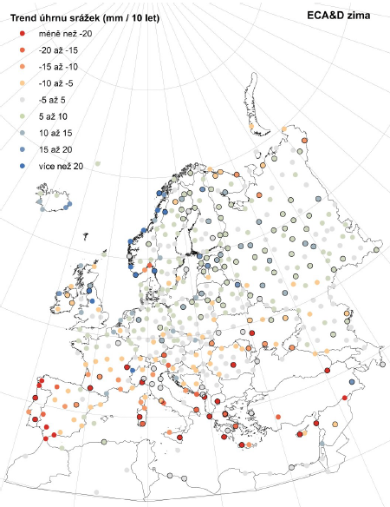
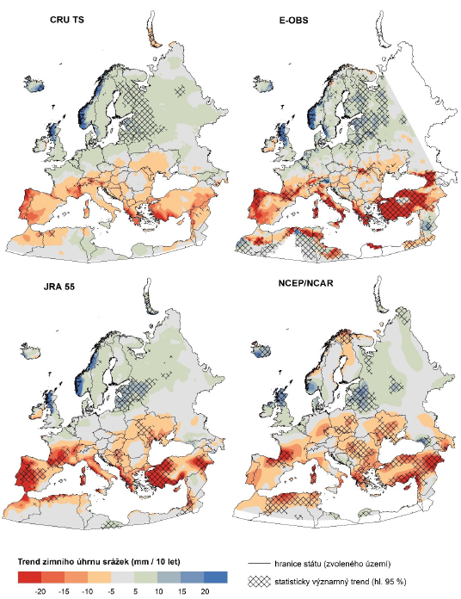
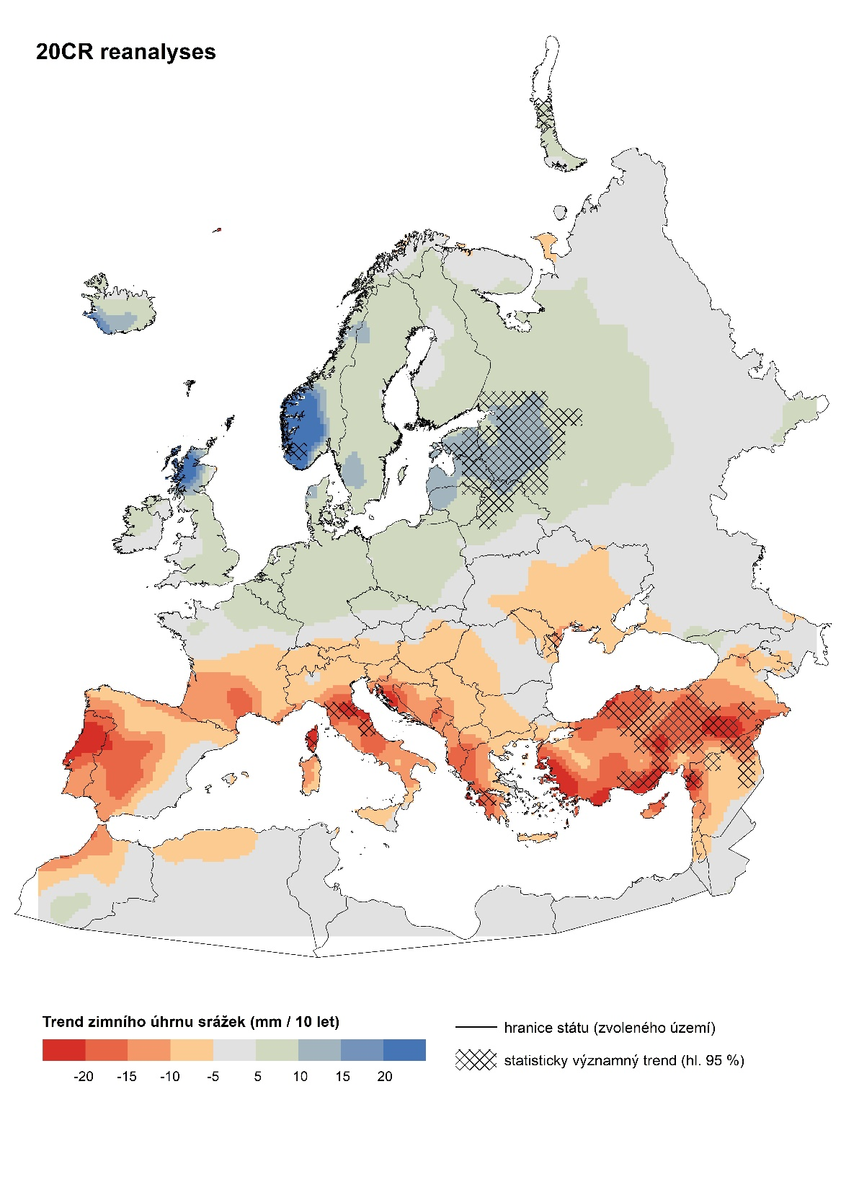
WINTER

Slide 8
Final questions (instead of answers☺)
Which database provides correct trends?
  impossible to say; each database has its own potential drawbacks
Potential drawbacks
  station data
    inhomogeneities
    measurement errors (unlikely to have much effect)
  gridded data
    inhomogeneity of stations entering interpolation
    time-varying sets of stations used for interpolation
  reanalyses
    time-varying datasets entering assimilation (e.g., satellites only from 1979)
    time-varying data quality
    model imperfections / errors

Slide 9
Final questions & remarks
detailed local / regional analysis may
  identify specific drawbacks of individual databases
  point to wrong / correct (worst / best) database(s) in each specific case
wrong / correct (good / bad) database(s) vary regionally and seasonally
behavior of reanalyses:
  strongest drying in full-input
  trends similar to gridded datasets for surface-input
  how to interpret it?
  can it be generalized to other reanalyses?
general conclusion: trend analysis based on a single database may be misleading

Slide 10
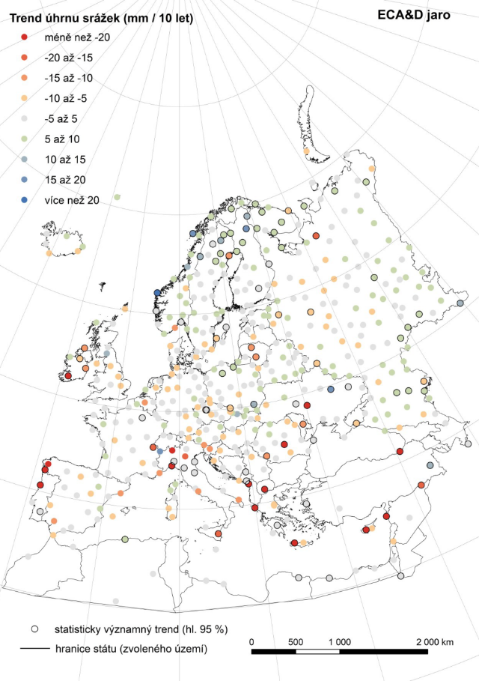
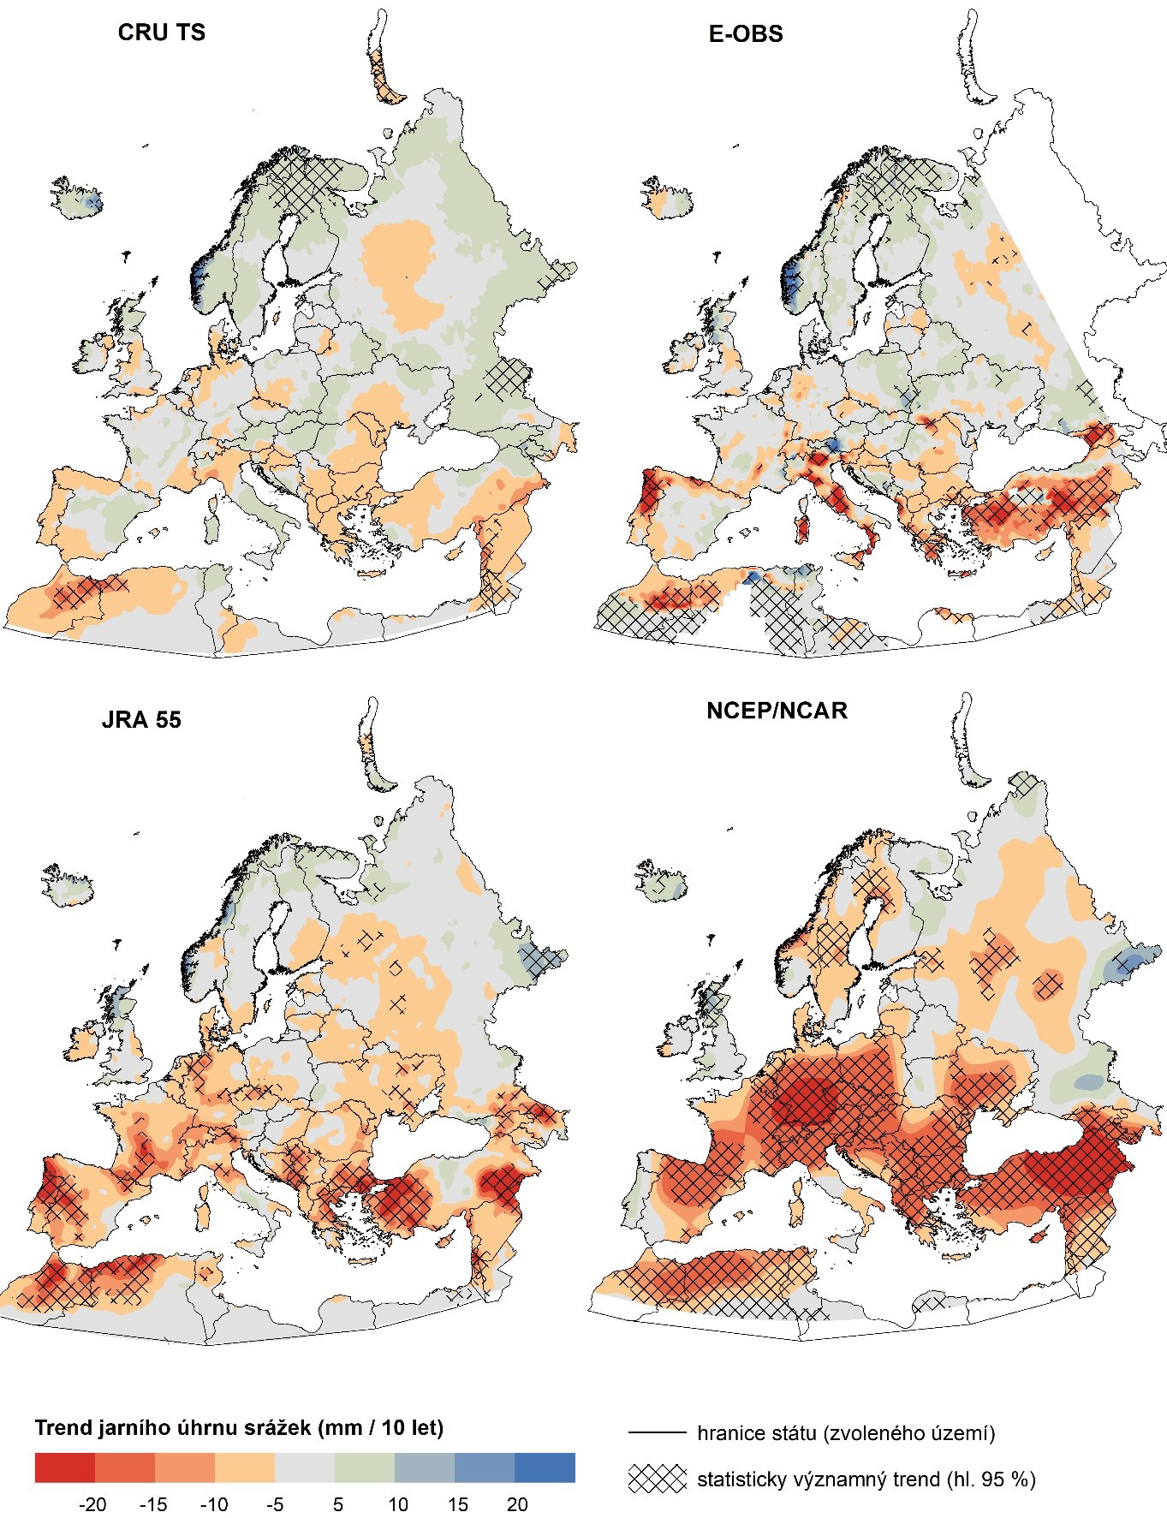
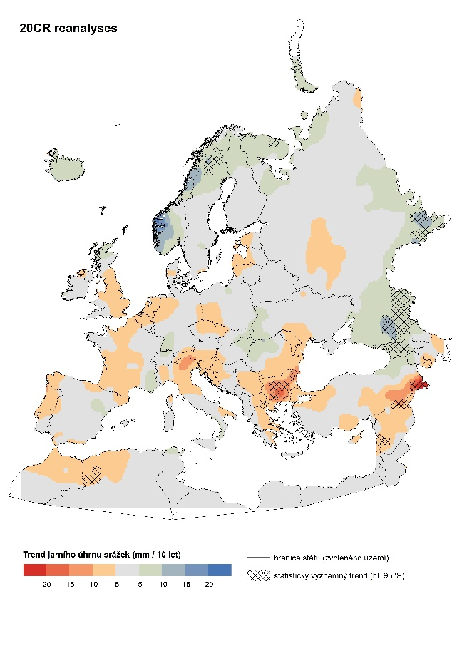
SPRING

Slide 11
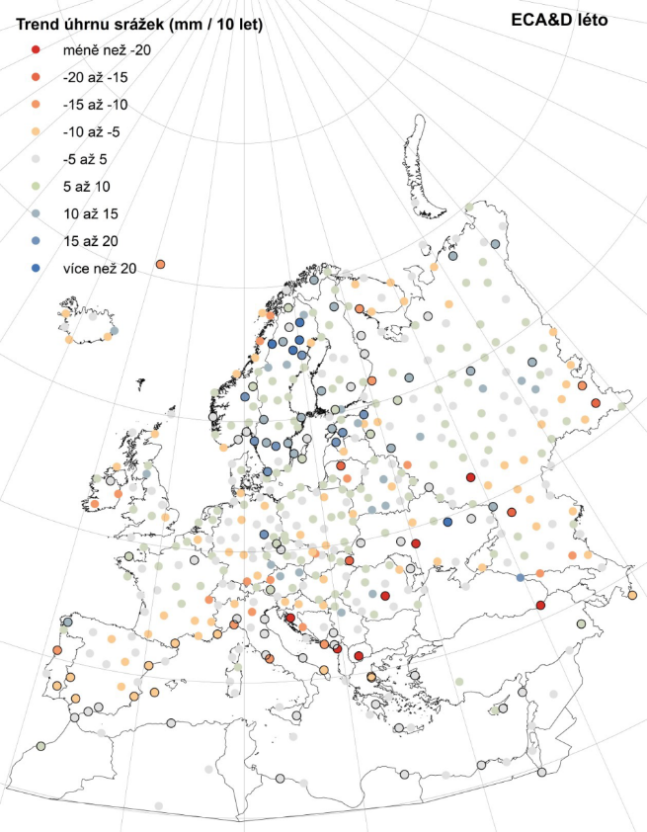
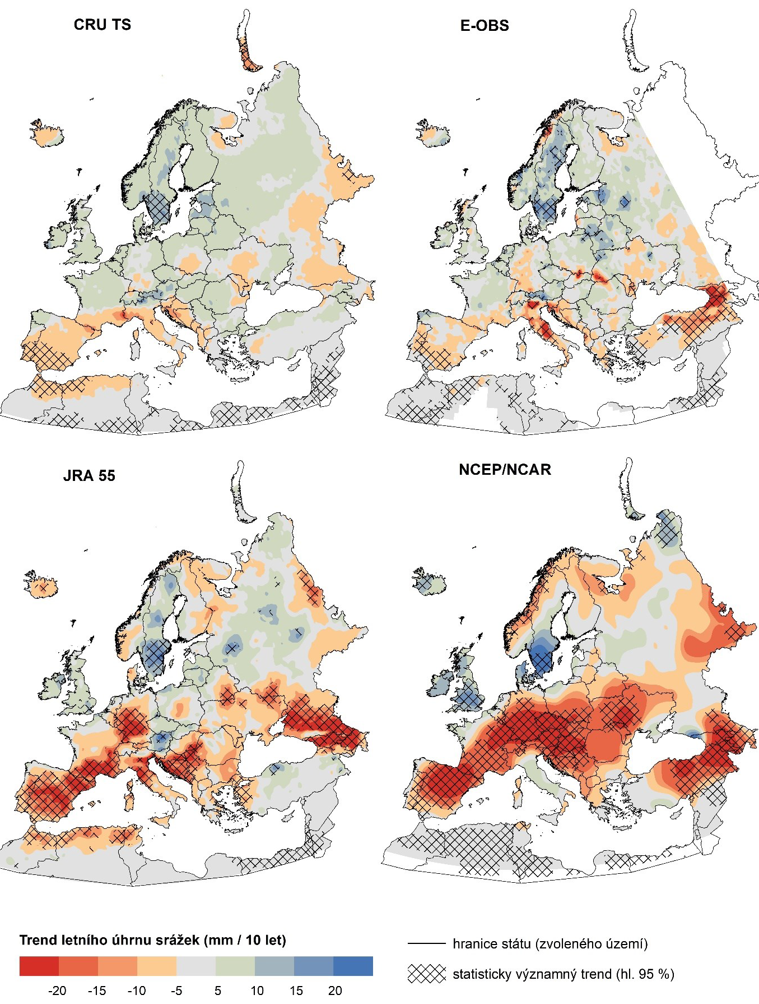
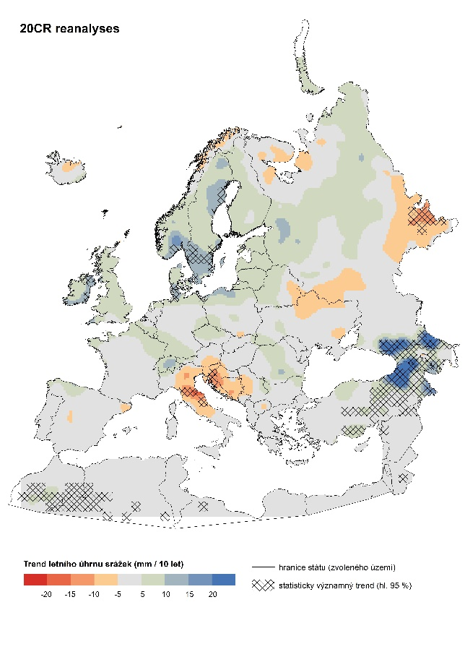
SUMMER

Slide 12
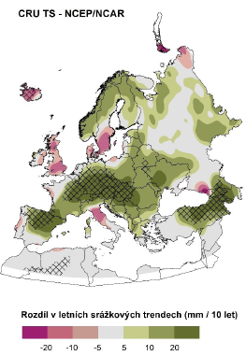
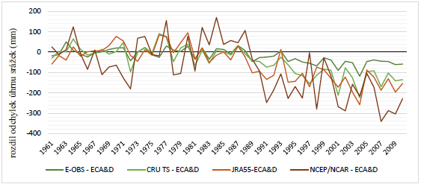
SUMMER
Poltava: diff. from ECA&D
difference CRU TS – NCEP/NCAR
(mm / 10 yr)

Slide 13
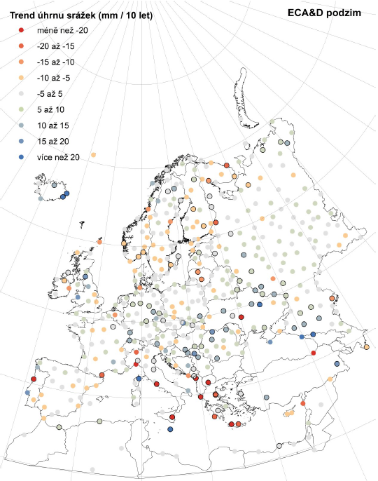
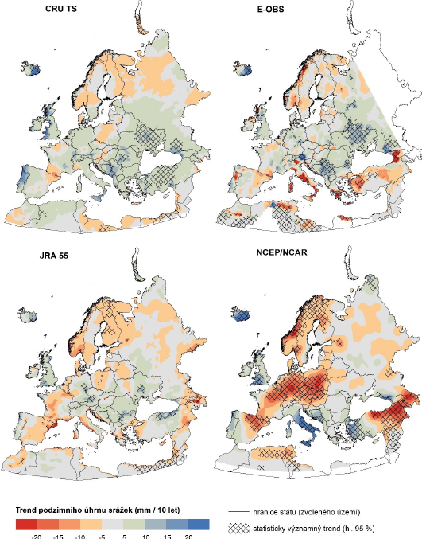
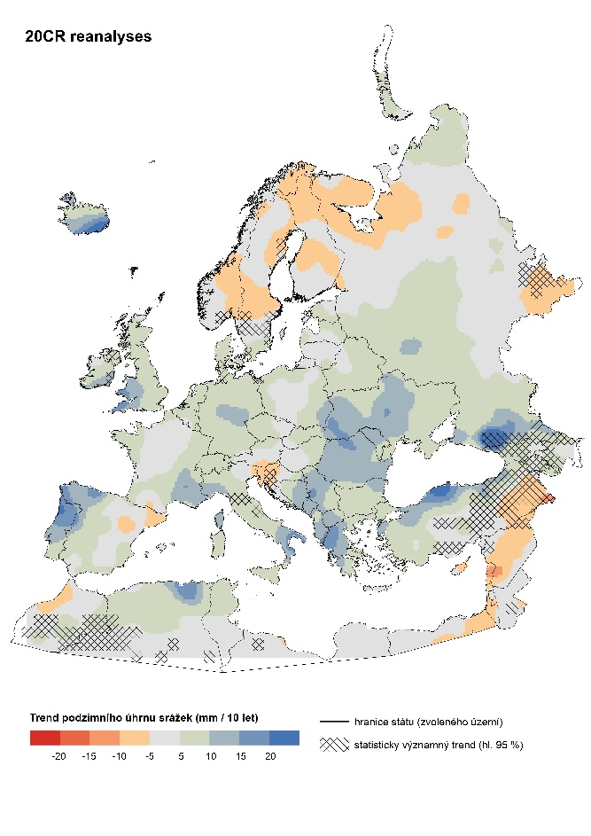
AUTUMN

Slide 14
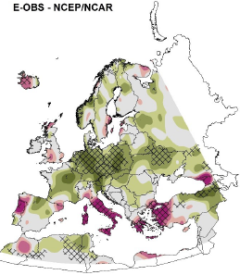
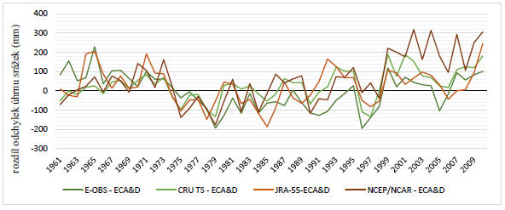
AUTUMN
Roma-Ciampino: diff. from ECA&D

