Slide 1





Residence time of groundwater in porous aquifers by estimating Ra retardation factor
EGU22-13477
Alessandra Briganti¹, Mario Voltaggio¹, Paola Tuccimei², and Michele Soligo²
¹National Research Council (CNR), Institute of Environmental Geology and Geoengineering (IGAG Montelibretti),
Monterotondo, Rome, Italy
²Science Department, Roma Tre University, Rome, Italy
alessandra.briganti@igag.cnr.it
EGU General Assembly 2022, Vienna 23-27/05/2022

Slide 2
Natural and anthropogenic radioisotopes
INTRO
Radionuclides
Environmetal tracers
Time tracers
Pollution indicators
EGU General Assembly 2022, Vienna 23-27/05/2022
alessandra.briganti@igag.cnr.it

Slide 3
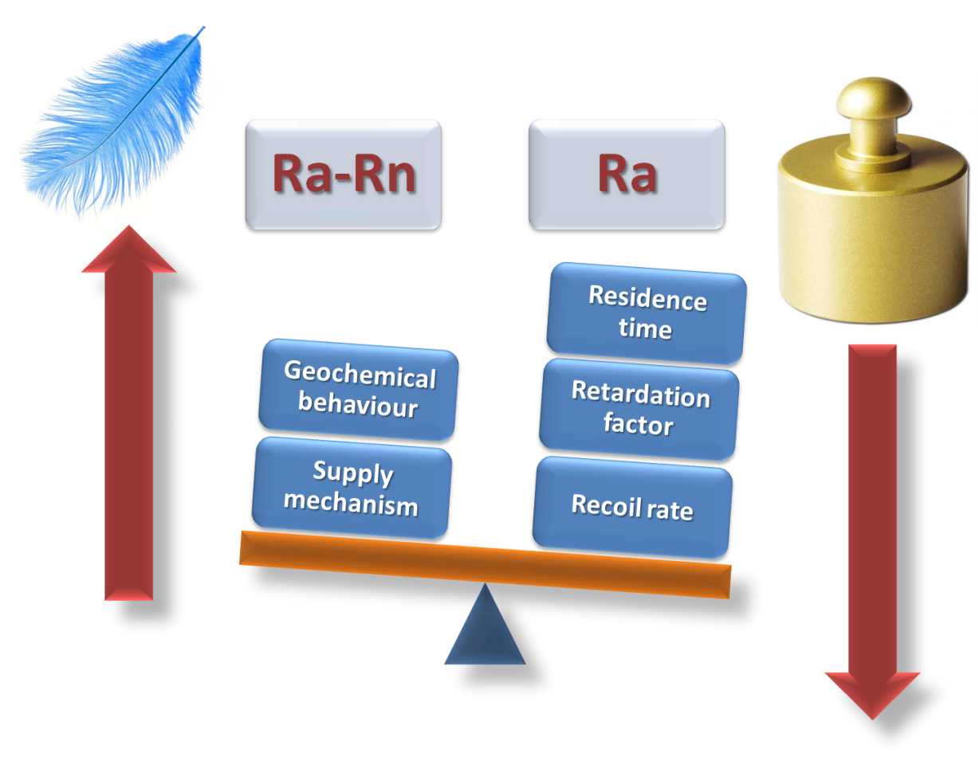
Ra retardation factor :
Method 1
Krishnaswami et al. 1982 proposed to correct the Ra retardation factor in groundwater using Rn.
EGU General Assembly 2022, Vienna 23-27/05/2022
alessandra.briganti@igag.cnr.it

Slide 4
Method 1
According to the theory of Krishnawami et al. (1982):
The retardation factor of Ra isotopes (²²⁴Ra, ²²⁸Ra, ²²⁶Ra) in groundwater are calculated in relation of their ratio with Rn present in the aquifer.
Conservative element
Non-conservative element
V_{Rn}= V_{ground water}
V_{Ra} ≠ V _{ground water}
t_{Rn}= t _{ground water}
V_{Ra} = V _{ground water} / R
t_{Ra} = t _{ground water}* R
EGU General Assembly 2022, Vienna 23-27/05/2022
alessandra.briganti@igag.cnr.it

Slide 5
Intro 2
Ra-Rn supply mechanisms in groundwater
Dissolution
Diffusion
α-recoil
EGU General Assembly 2022, Vienna 23-27/05/2022
alessandra.briganti@igag.cnr.it

Slide 6
Intro 2
Ra and Rn in groundwater
SOLID
GAS
Ra
LOW
α recoil/dissolution
Negligible diffusion
Rn
HIGH
α recoil/dissolution
Diffusion
EGU General Assembly 2022, Vienna 23-27/05/2022
alessandra.briganti@igag.cnr.it

Slide 7
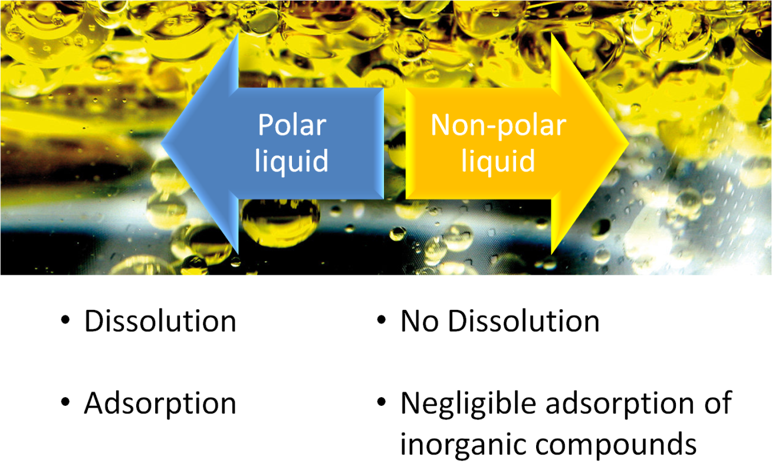
Ra retardation factor :
Method 2
Briganti et al. 2020 proposed a new method to measure the retardation factor in porous media directly in laboratory.
EGU General Assembly 2022, Vienna 23-27/05/2022
alessandra.briganti@igag.cnr.it

Slide 8
Water Residence time
Method 2
Retardation factor
Dissolution rate
Recoil rate
²²⁴Ra_{Liq}=[(Δ+Γ₂₂₄)/(Φ·λ₂₂₄·R₂₂₄)]·[1-exp(-λ₂₂₄·R₂₂₄·T)]·²²⁴Ra_{rock}·ρ_{rock}
EGU General Assembly 2022, Vienna 23-27/05/2022
alessandra.briganti@igag.cnr.it

Slide 9
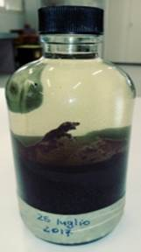
Recoil rate
Method 2
NAPL METHOD
Decay constant
Recoil factor
²²⁴Ra_{NAPL}=[(f_{α224})/(Φ)]·²²⁴Ra_{rock}·ρ_{rock}
fα₂₂₄ ₌ ²²⁴Ra_{NAPL} · ml of NAPL in immersion test / ²²⁴Ra_{rock}·grams of rock in immersion test
Retardation factor
R₂₂₄ = ²²⁴Ra_{NAPL}/²²⁴Ra_{w}
EGU General Assembly 2022, Vienna 23-27/05/2022
alessandra.briganti@igag.cnr.it

Slide 10


Water
Residence time
Method 2
Retardation factor
Dissolution rate
Recoil rate
/
²²⁴Ra_{Liq}=[(Δ+Γ₂₂₄)/(Φ·λ₂₂₄·R₂₂₄)]·[1-exp(-λ₂₂₄·R₂₂₄·T)]·₂₂₄Ra_{rock}·ρ_{rock}
EGU General Assembly 2022, Vienna 23-27/05/2022
alessandra.briganti@igag.cnr.it

Slide 11
Thanks for your attention
ANY QUESTIONS?
alessandra.briganti@igag.cnr.it
EGU General Assembly 2022, Vienna 23-27/05/2022

