Slide 1



Estimation of cloud motion vectors: exploring different approaches using a dense network of solar radiation sensors
Y.M. Saint-Drenan¹ (yves-marie.saint-drenan@minesparis.psl.eu)
R. Amaro e Silva¹, H. Deneke², P. Blanc¹
¹O.I.E. Centre Observation, Impacts, Energy, MINES Paris - PSL Research University, France
²Leibniz Institute for Tropospheric Research, Germany

Slide 2
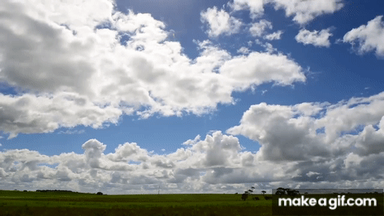
Surface solar irradiance can be seen as a spatio-temporal process
An intuitive concept: clouds advect in space through time
Advection characterization is key for
Variability analysis
Forecasting applications
But it is challenging :
There are several approaches
In general, no “ground truth”
Notes:
https://www.youtube.com/watch?v=Qu7mcKZgqv0
https://makeagif.com/i/UDQxge

Slide 3
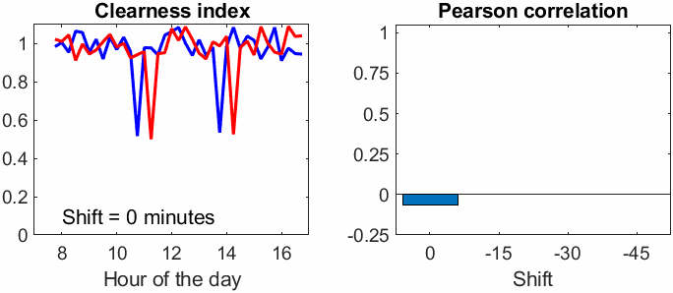

Our goal
Build a preliminary setup for analyzing and cross-comparing different cloud advection methods
Cross-correlation of neighboring ground sensors
δx
$$τ$$

Slide 4

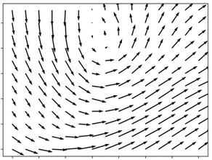
Our goal
Build a preliminary setup for analyzing and cross-comparing different cloud advection methods
Cross-correlation of neighboring ground sensors
Optical flow using consecutive satellite images
Clear-sky index (kc = GHI/GHIcs) calculated using CAMS-Radiation data
TV-L1 algorithm with different regularization parameters
Sánchez Pérez et al. (2012), DOI: 10.5201/ipol.2013.26
Zach et al. (2007), DOI: 10.1007/978-3-540-74936-3_22

Slide 5

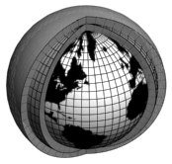
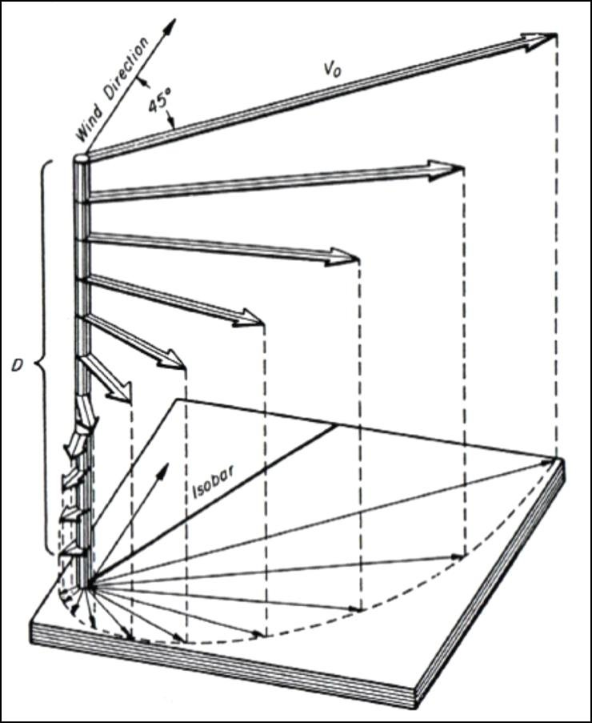
Our goal
Build a preliminary setup for analyzing and cross-comparing different cloud advection methods
Cross-correlation of neighboring ground sensors
Optical flow using consecutive satellite images
Wind speed from ERA5 reanalysis
At different pressure levels (from 800 to 1000 hPa)
Hersbach et al. (2020), DOI: 10.1002/qj.3803

Slide 6
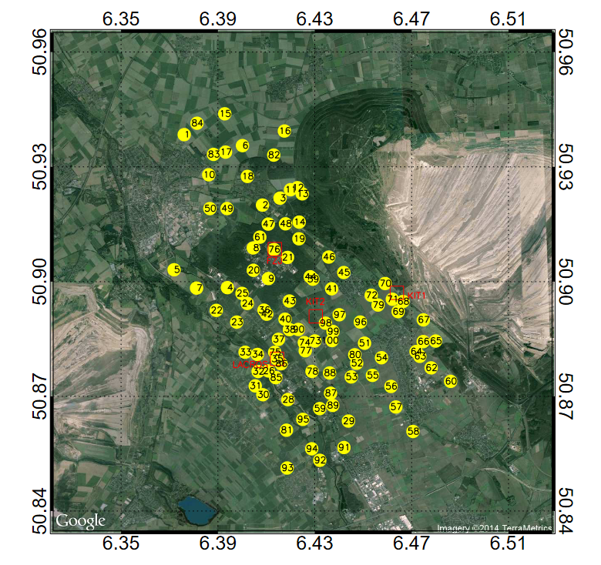
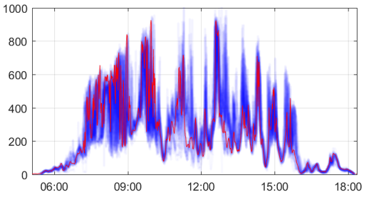

Our testbed location – HOPE-Jülich campaign
Ground irradiance data from the HOPE-Jülich* campaign
99 sensors, 10x12 km²,
15 sec measurements between April and August 2013
SSI (W/m2)
HD(CP)2 Observational Prototype Experiment, Macke et al. (2017) DOI: 10.5194/acp-17-4887-2017 https://www.tropos.de/aktuelles/messkampagnen/blogs-und-berichte/hdcp2-hope-2013

Slide 7
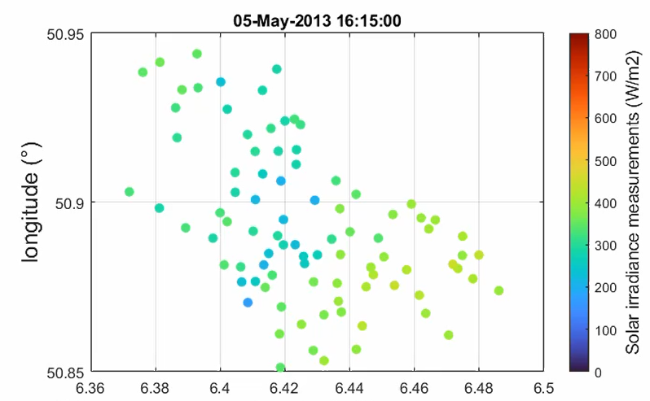
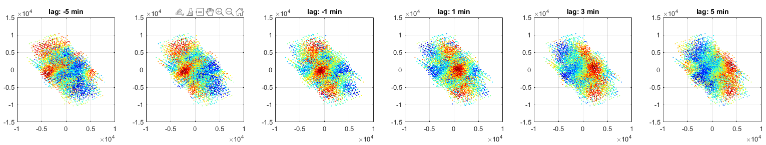







From sensor network to advection
The correlation is calculated between all pairs of sensors
A time window of 15 min is used for the calculation of the correlation
The correlations are represented as a function of the spatial lags (δx and δy)
G(si)
δy
G(sj)
δx
$$τ=−5 min$$
$$τ=+1 min$$
$$τ=−5 min$$
$$τ=−3 min$$
$$τ=−1 min$$
$$τ=+3 min$$
$$τ=+5 min$$
δy
δx
δx
δx
δx
δx
δx

Slide 8
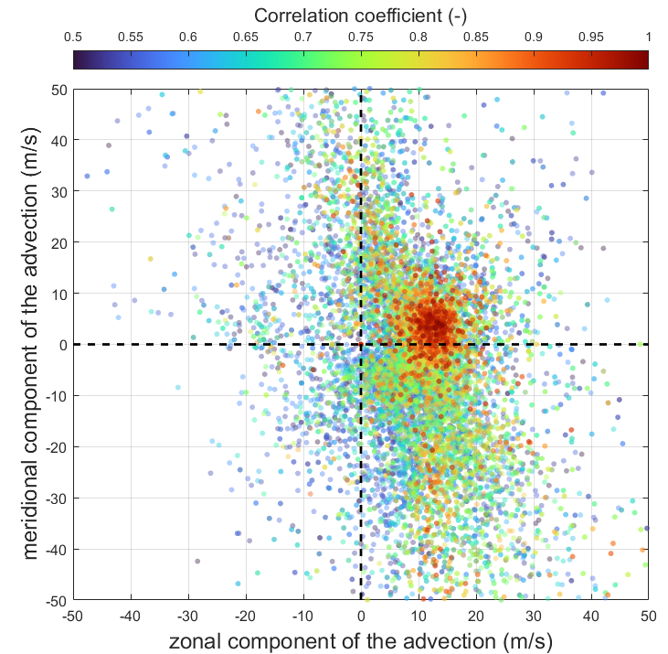

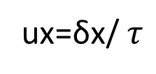





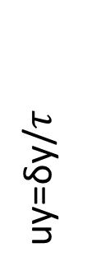

From sensor network to advection
$$τ=−5 min$$
$$τ=+1 min$$
$$τ=−5 min$$
$$τ=−3 min$$
$$τ=−1 min$$
$$τ=+3 min$$
$$τ=+5 min$$
δy
δx
δx
δx
δx
δx
δx
8
uy=δy/$τ$
Results can be merged if spatial and temporal lags are converted to speed
ux=δx/ $τ$
Notes:
2013/05/10 09:50

Slide 9
Preliminary results
Estimating the advection with the ST autocorrelation function can be very effective
pure advection
homogeneous flow
no cloud formation/dissipation
clear patterns to track
… but it can also lead to unsharp ACF and undetermination
Notes:
2013/05/10 09:50

Slide 10
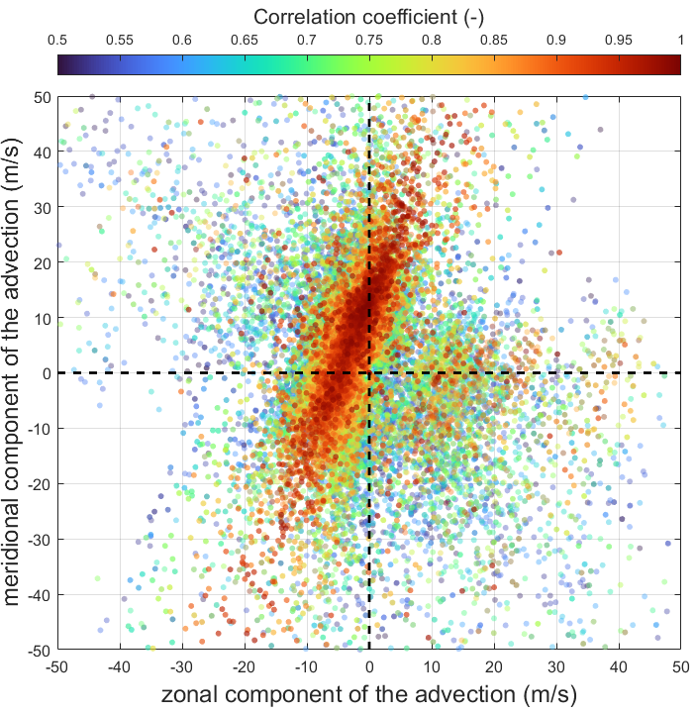
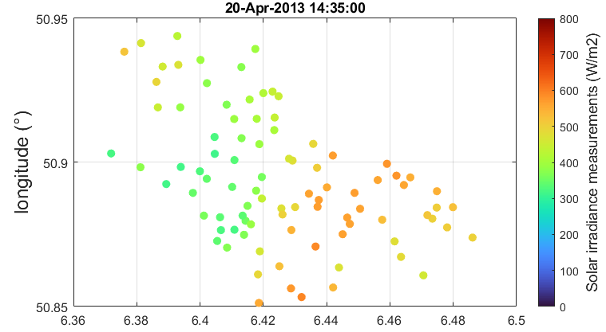
Preliminary results
The spatio-temporal structure of the irradiance field can lead to undetermination
-> All pairs of sensors sensors along the cloud edge will behave synchronously
Notes:
Unsharp: 2013/05/11 16:15

Slide 11
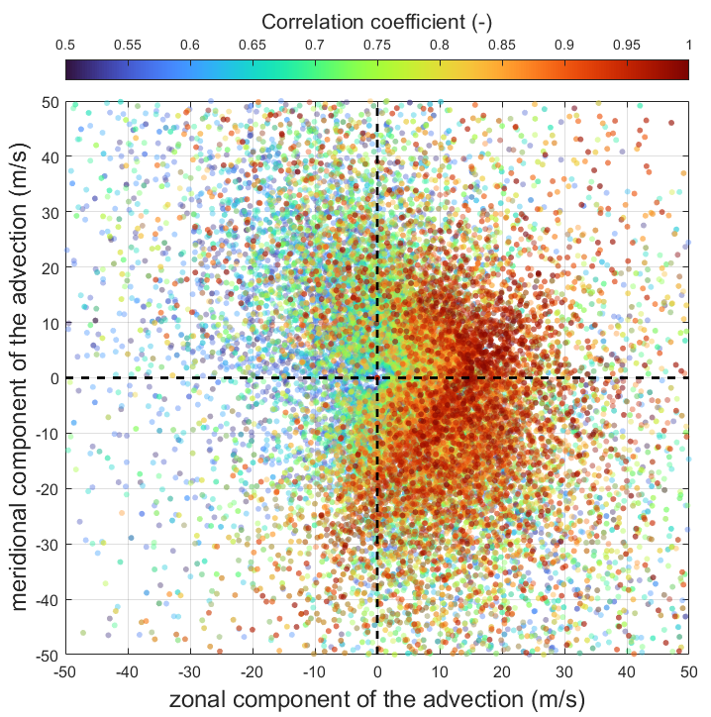
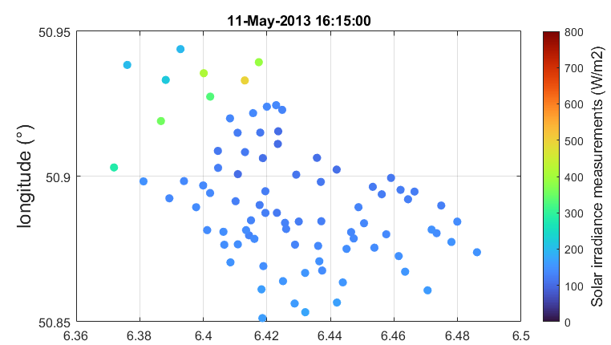
Preliminary results
Blurry autocorrelation functions are very frequent:
- no feature to track (clear sky or overcast)
no pure advection (e.g. presence of different flows)
- …
-> all pairs of sensors below a stationnary cloud have similar correlations
Notes:
Unsharp: 2013/05/11 16:15

Slide 12
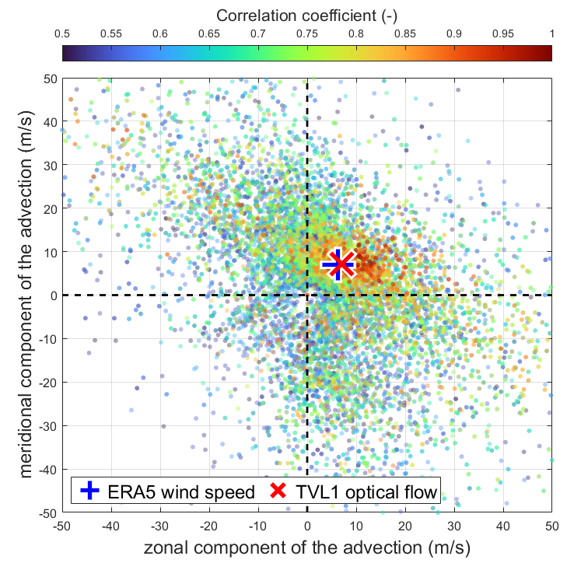
Conclusion and outlook
Lessons learned:
The performances of the spatial-autocorrelation method vary with the structure of the irradiance field
Understanding the performances of ACF is an important prerequisite for our analysis
Next steps:
Use of the ST ACF as a reference for the evaluation of ERA5 wind speed and optical flow
Understand the effect of the spatial scale & weather situation on the performance of the different approaches
Notes:
Little variation of ERA5 wind speed between 800 and 1000 hPa
The performance of the spatio-temporal autocorrelation approach depends on the structure of the irradiance field (aperture problem & aliasing)
No systematic results

Slide 13
Additional slides

Slide 14
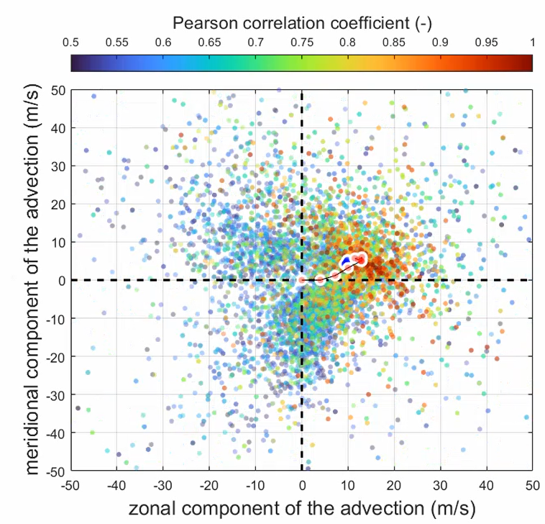
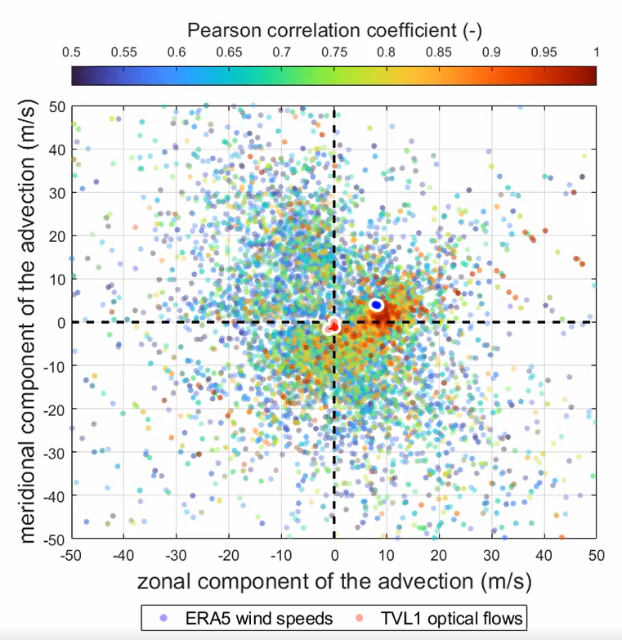
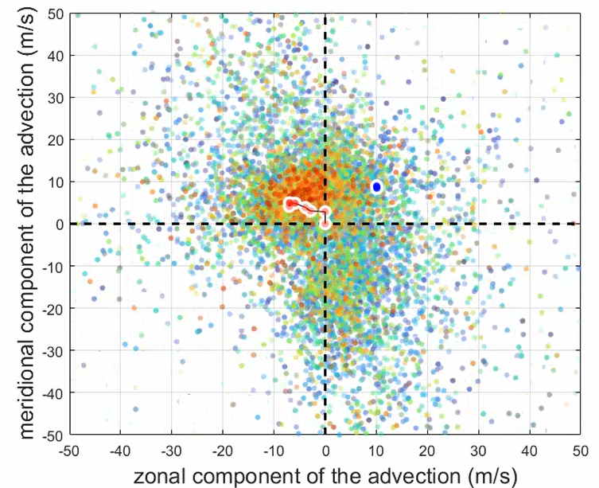
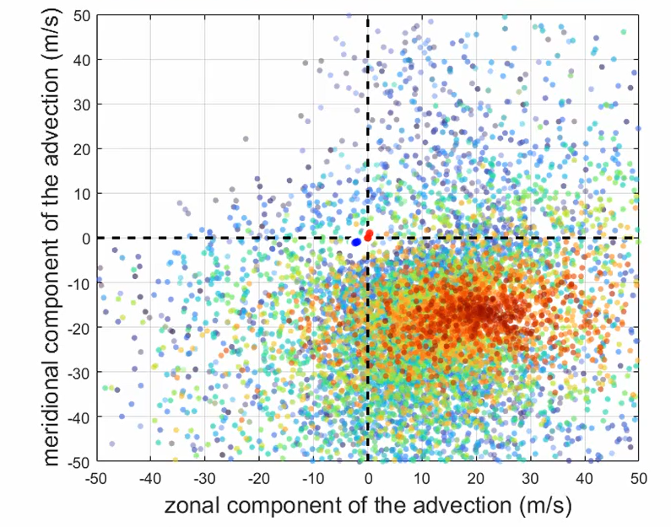
Preliminary results
No systematic results:
(a) OF and ERA5 can both perform well
(b) ERA5 can be better than OF
(c) OF can be better the ERA5
(d) Both approach can fail
Questions:
Does this depend on the meteorological situation?
For Optical Flow, how do we choose the regularisation parameter?
(a) OF, ERA5
(a) OF, ERA5
(b) OF, ERA5
(c) OF, ERA5
(d) OF, ERA5
(c)
Notes:
2013/05/11 16:00
2013/04/19 09:15
2013/05/07 07:40
2013/04/24 07:30

