Slide 1



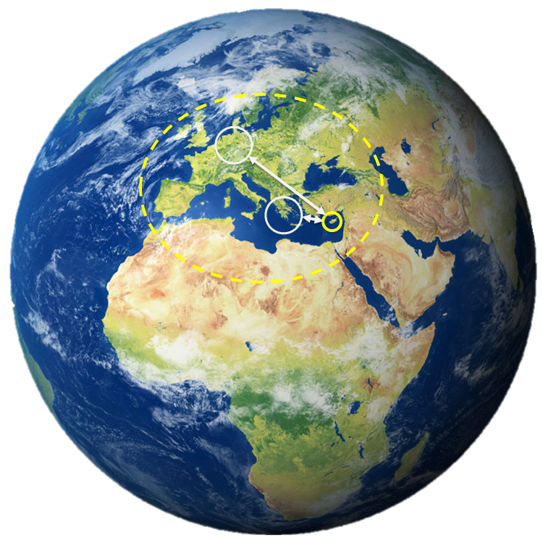











THE IMPORTANCE OF INTEGRATING ‘DIGITAL TWINS’ AND ‘EARTH OBSERVATION’ TO SUPPORT RESILIENT SOCIETY APPLICATIONS IN CYPRUS
Demetris Christofi (1,2) , Chris Danezis (1,2), Kyriacos Themistocleous (1,2), Haris Zacharatos 3, Nicholas Kyriakides (1,2), & Diofantos Hadjimitsis (1,2)
1) Cyprus University of Technology, Department of Civil Engineering and Geomatics, P.O.BOX 3036, Lemesos, Cyprus
2) Eratosthenes Centre of Excellence, Saripolou 2, 3036,Lemesos, Cyprus
3) Cellock, Nicosia, Cyprus
CONSORTIUM
This project has received funding from the European Union’s Horizon 2020 research and innovation programme under Grant Agreement No 857510.
AFFILIATED ENTITIES
This project has received funding from the Government of the Republic of Cyprus through the Directorate General for the European Programmes, Coordination and Development.

Slide 2
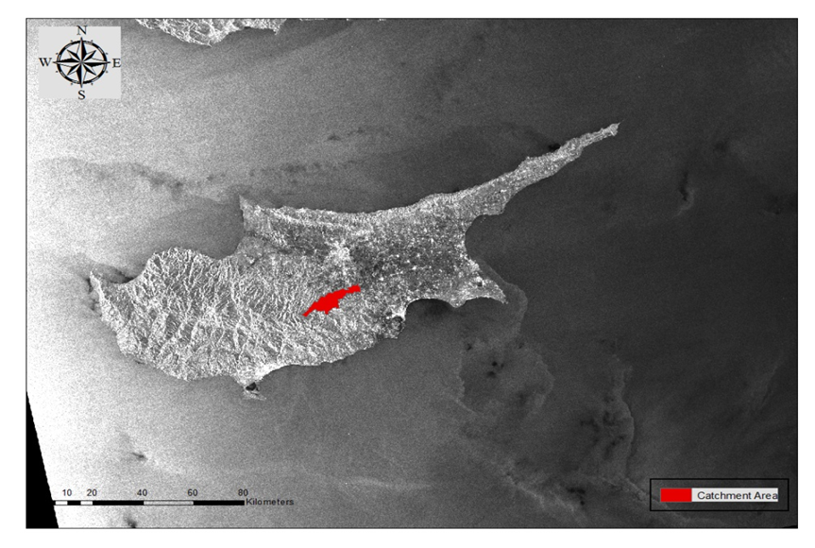


Abstract
This abstract explores the importance of integrating Digital Twins and earth observation for supporting natural disasters management in Cyprus. Indeed, this study shows how a digital twin will be developed based on existing sources of data like satellite imagery, maps, in situ data and other auxiliary data such as meteorological, hydrological data etc.
This digital twin will be used to predict future conditions of a certain area of interest in Pafos District in Cyprus. The main aim is to update the proposed digital twin using satellite images such as Copernicus data for efficient decision making from the key stakeholders such as government and public authorities.
Several natural disasters have been identified in the national risk assessment of Cyprus as the main priorities such as floods, earthquakes, fires, landslides etc. In the proposed digital twin these four hazards will be considered. However, this abstract shows some results retrieved by examining the impact of floods in an area of interest in Pafos District area in Cyprus by integrating several data and techniques such as earth observation and hydrological modeling.

Slide 3

Previous Experience & What is missing?
Ecosystem and floods are closely related and any changes in the ecosystem, such as urbanization across the catchment’s area, may trigger off a sequence of flood occurrence causes. However, earth observation techniques such as satellite remote sensing can contribute toward a more efficient flood risk mapping according to EU Directives of 2007/60. During the last decades the integration of different geospatial methodologies such as Geographical Information Systems (GIS) and satellite remote sensing has lead to flexible and timely analysis in the scientific areas of flood mitigation, forecasting and assessment.
Cyprus University of Technology & Eratosthenes Centre of Excellence contributed in the Cyprus area on monitoring and developing risk assessment for floods on three main funded projects: ‘The SATFLOOD’ project , the ‘DECAT’ project and the ‘NATIONAL RISK ASSESSMENT FOR THE REPUBLIC OF CYPRUS’ tender for the Civil Defence in Cyprus. One of the missing tools in the Cyprus region is the development of integrated tools / services to support the local authorities for floods (e.g. preparedness, risk reduction) as well to contribute to the next Flood Risk Maps 2016-2021 with the main aim to be able to develop a Digital Twin for floods in Cyprus. Indeed, the main goal of the next year activities is to integrate the following technologies to achieve such goal: earth Observation (passive & active); Hydraulics; Hydrology, In-situ techniques (laser scanning, GPS, UAVs, Spector radiometer), GIS, Crowdsourcing.

Slide 4
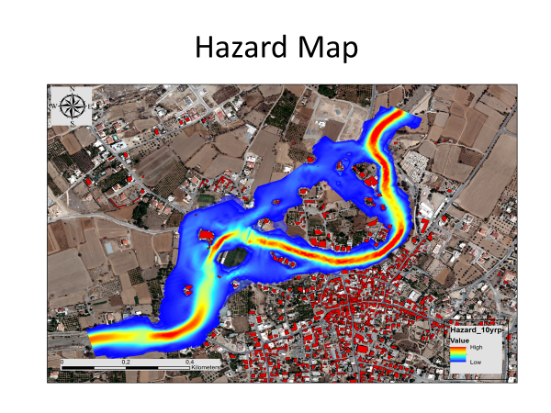
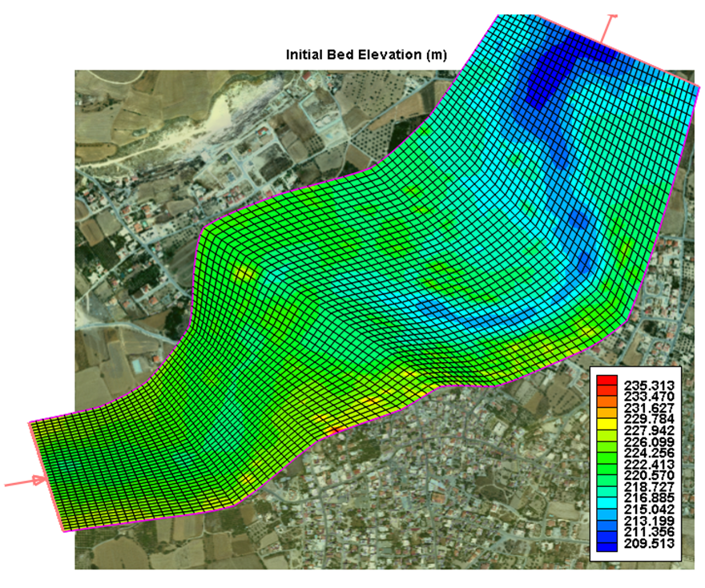
‘Satflood funded project’

Slide 5
Digital Twin
‘A digital twin is a digital representation of a physical asset, process, or system, as well as the engineering information that allows people to understand and model its performance. Typically, digital twins can be continuously updated from multiple sources, including sensors and continuous surveying, to represent near real-time status, working condition, or position. A digital twin enables users to visualize the asset, check the status, perform analyses, and generate insights to predict and optimize asset performance’
‘The Importance of Digital Twins for Resilient Infrastructure, A Bentley White Paper’

Slide 6
Methodology (Step 1: Floods Risk)
Flood Risk Maps
Urbanization activities/land-use/land cover using RS
Digital Elevation Models
Geomorphology of the catchment area
Hydraulic Analysis
Flood Hazard Maps

Slide 7
Methodology (Step 2: Integration of techniques and data)
Earth Observation
In-situ Techniques (e.g. UAV, laser scanning, spectroscopy etc.)
GIS and Artificial Intelligence
Sensors
Crowdsourcing
Hydraulic and Hydrological analysis

Slide 8

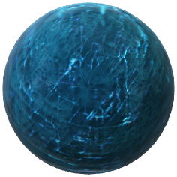
Methodology (3)
The Digital Twin is an archive: an archive of the past, present, and future!
It consists of three key components: visualization , forecasting, and diagnostics.
It offers an opportunity for modifications to the cityscape to be simulated and tested before they are put into effect.
It can potentially forecast how changes to a structure can impact its surroundings..
GIS and Artificial Intelligence
Crowd
-sourcing
Action
Sensors
Earth Observation and In-Situ Techniques
Analysis
Insight
Physical object
Digital Object
Digital twin

Slide 9

Case Study: Preliminary Results
A case study in 2006 and 2011 that included hydrological modelling to determine the outflow rate was a result of an overflooded road bridge with a great social impact for the communities of the area.
The study investigated the urbanization factors through the years 1984, 1999 and 2009 and the effect on the water runoff factors of the hydrological model that would allow the investigation of the flood and the actual reasons of contribution in the area of interest.
As a check test of the initial area, another area of interest in a radius of 15 km was chosen that would verify our results , as there were indications of flood events.
The hydrological model indicated flood risk was in agreement with the results, verifiying the changes that occurred during the years had a contribution to flood risk in populated areas.

Slide 10
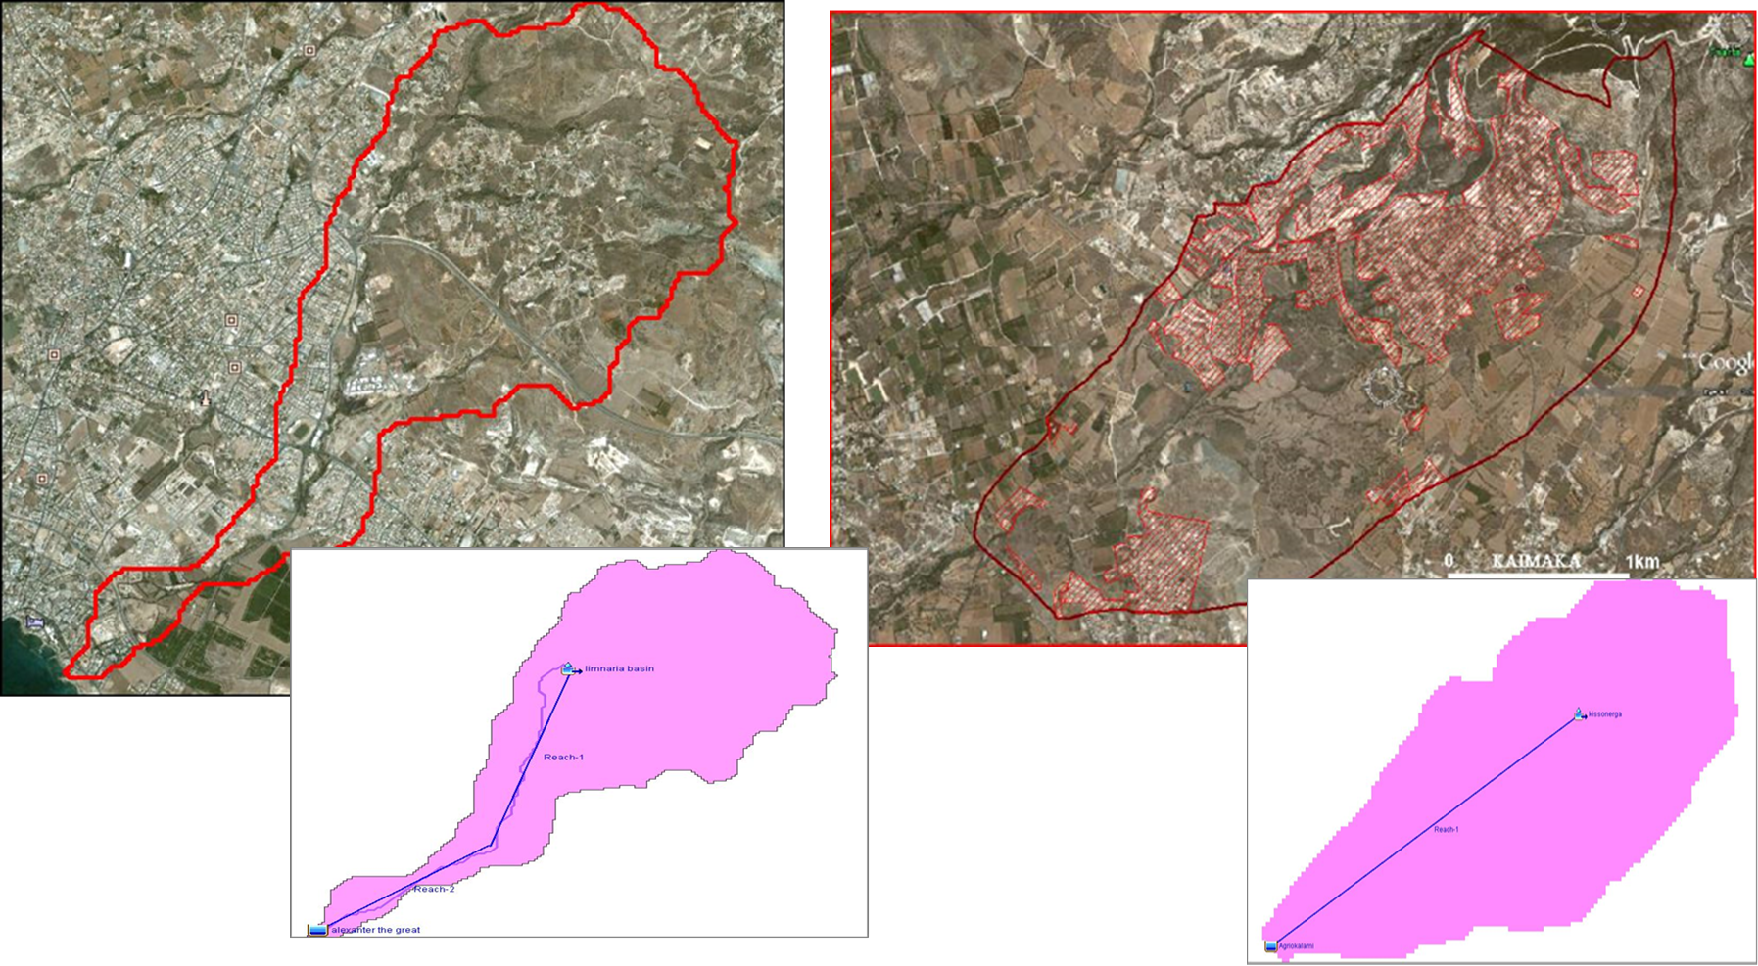
Area ( Basin ) of Interest
Limnaria hydrological model / Watershed
Agriokalami hydrological model / Watershed

Slide 11
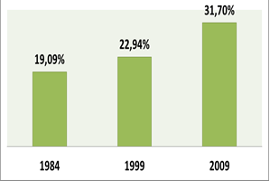
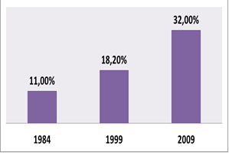
Agriokalami watershed Urbanization percentage
Limnaria watershed Urbanization percentage
Results were produced from the processing of Satellite Images Landsat TM/ETM+

Slide 12
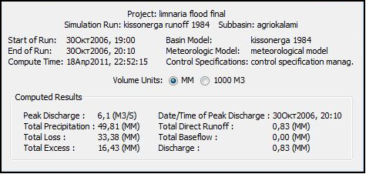
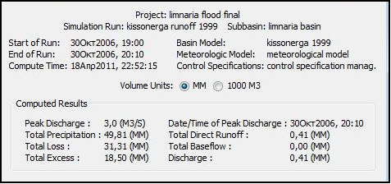
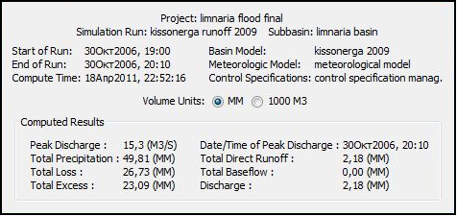
Outflow results
2009
1999
1984

Slide 13
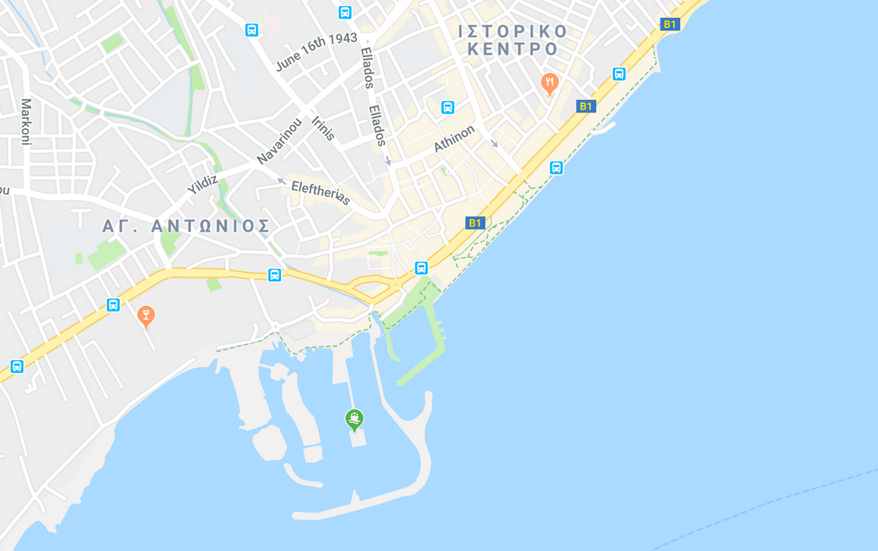


CONTACT US
We are here
ERATOSTHENES CENTRE OF EXCELLENCE &
Cyprus University of Technology Department of Civil Engineering & Geomatics
Professor Diofantos G. Hadjimitsis, Coordinator of Excelsior
PHONE
+357 25 002548 (direct line)
or 25002542 (through secretary)
Fax. +357 25 002661
EMAIL
d.hadjimitsis@cut.ac.cy
Address 2-8 Saripolou, Achilleos I Building, 1st Floor, 3036 Lemesos, Cyprus
http://www.eratosthenes.org.cy/
Email: info@excelsior2020.eu
@excelsior2020eu
www.excelsior2020.eu
www.eratosthenes.org.cy

Slide 14













Acknowledgements
Call: Topic: | H2020-WIDESPREAD-2018-01 WIDESPREAD-01-2018-2019 Teaming Phase 2
Project full title: | ERATOSTHENES: Excellence Research Centre for Earth Surveillance and Space-Based Monitoring of the Environment
Project acronym: | EXCELSIOR
The EXCELSIOR project has received funding from the European Union’s Horizon 2020 research and innovation programme under Grant Agreement No 857510.
CONSORTIUM
CONSORTIUM
The EXCELSIOR project has received funding from the Government of the Republic of Cyprus through the Directorate General for the European Programmes, Coordination and Development.
Copyright © 2019 |EXCELSIOR, All rights reserved.

