Slide 1
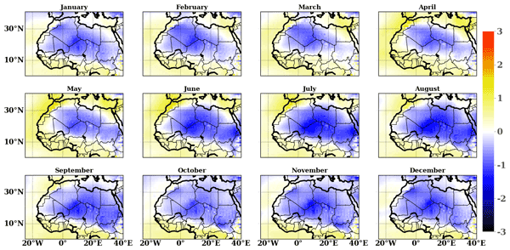
Seasonal forecasts of the Saharan heat low characteristics : a multi-model assessment.
Cedric G. Ngoungue Langue, Christophe Lavaysse, Mathieu Vrac, Philippe Peyrillé and Cyrille Flamant
1 Laboratoire Atmosphères, Milieux, Observations Spatiales (LATMOS) – UMR 8190 CNRS–Sorbonne Université–UVSQ, 78280 Guyancourt, France
2 Laboratoire des Sciences du Climat et de l’Environnement, CEA Paris-Saclay l’Orme des Merisiers, UMR 8212, CEA–CNRS–UVSQ, Université Paris-Saclay & IPSL, 91191 Gif-sur-Yvette, France
3 Centre National de Recherches Météorologiques (CNRM) – Université de Toulouse, Météo-France, CNRS, 31057 Toulouse CEDEX 1, France
4 Université Grenoble Alpes, CNRS, IRD, G-INP, IGE, 38000 Grenoble, France
5 European Commission, Joint Research Centre (JRC), 21027 Ispra, VA, Italy
Weather Clim. Dynam., 2, 893–912, 2021: https://doi.org/10.5194/wcd-2-893-2021
Correspondence: cedricgarcial49@gmail.com / cedric-gacial.ngoungue-langue@latmos.ipsl.fr
23/05/2022
EGU, 2022, Vienna
‹#›

Slide 2
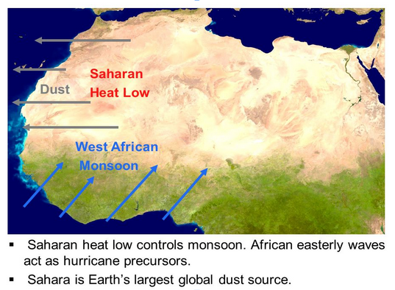

Introduction
Introduction
Methods
Data
Results
Conclusion
Motivation of the study
WA is a region of strong convective activity and large climate variability
climate models suffer in reproducing the variability of the WAM system;
During the AMMA-CATCH project, the SHL has been used to assess the variability in the WAM system.
SHL is a key component of the WAM (Lavaysse et al., 2009)
Lavaysse et al., 2009 : Climatological state of the SHL;
Taylor et al. 2017 : SHL and extreme precipitations in the Sahel
How seasonal forecasts models represent the evolution of the Saharan heat low
23/05/2022
EGU, 2022, Vienna
‹#›

Slide 3
Introduction
Introduction
Methods
Data
Results
Conclusion
Forecast strategy
Target period : JJAS
Re-forecasts initialized on 1 April, 1 May and 1 June for JJAS
Bias correction
CDF-t
QMAP
SHL metric of evaluation
Temperature field at 850 hPa ( very correlated to the Low Level Atmospheric Thickness)
Ensemble forecast Verification (CRPS, BRIER, RANK, Reliability)
23/05/2022
EGU, 2022, Vienna
‹#›

Slide 4
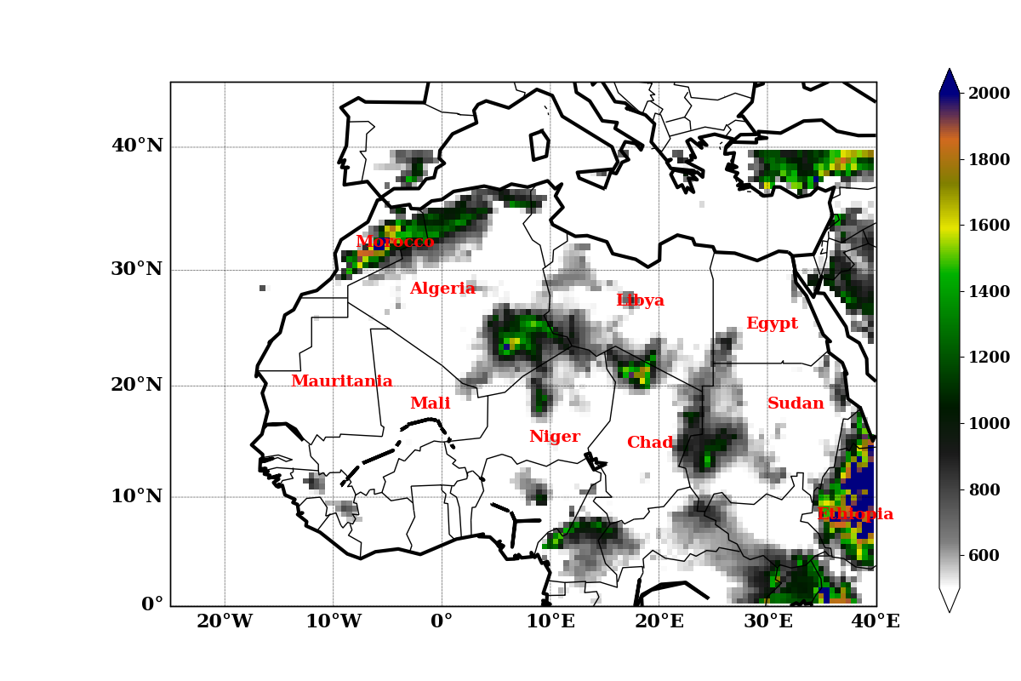
Introduction
Introduction
Methods
Data
Results
Conclusion
Data
Reanalyses :
ERA5 from ECMWF
MERRA-2 from NASA
Seasonal forecast simulations:
SESA5 from ECMWF
MF7 from Météo-France
Spatial resolution : 1°x1°
Temporal coverage: 1993-2016
WS
CS
ES
SAH
SAH: SAHARA (Taylor et al., 2017)
CS: CENTRAL SHL (Lavaysse et al. 2009)
WS: WEST SHL (Roehrig et al.,2011)
ES: EAST SHL (Roehrig et al.,2011)
23/05/2022
EGU, 2022, Vienna
‹#›

Slide 5
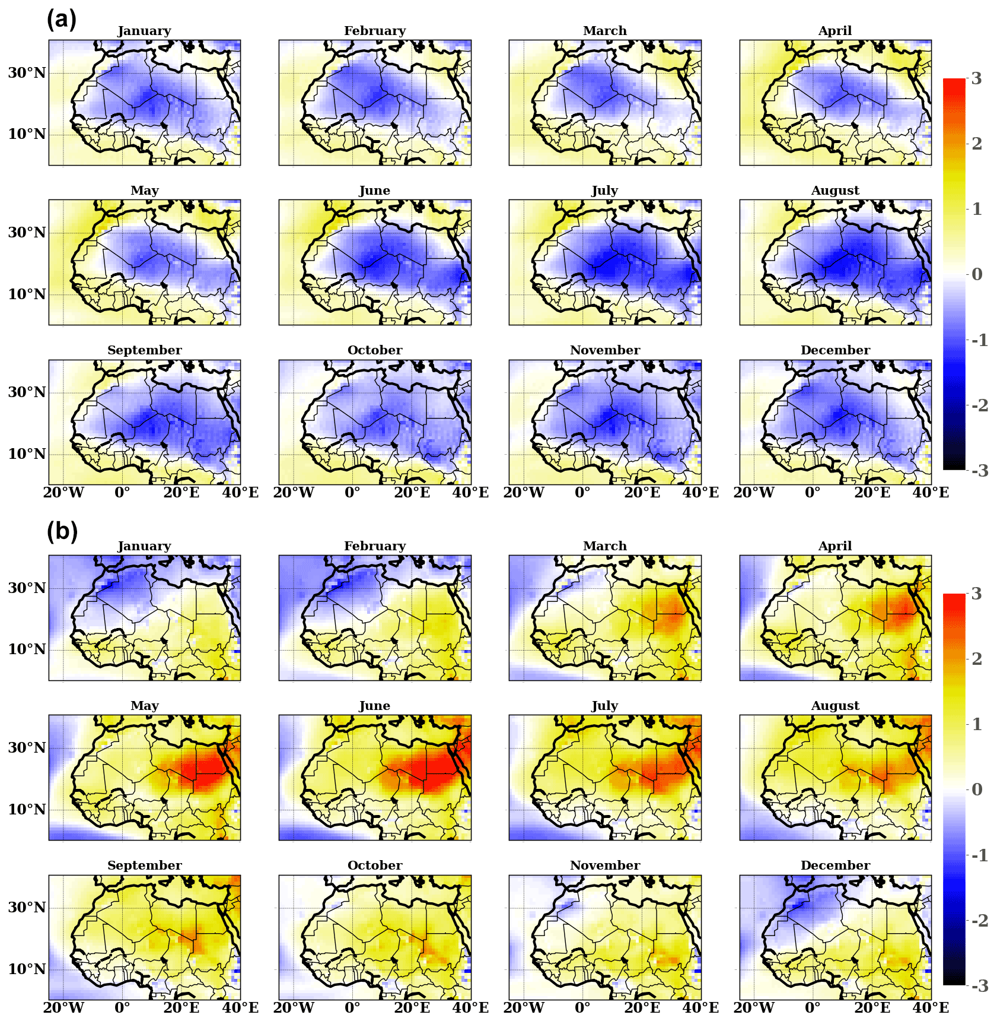
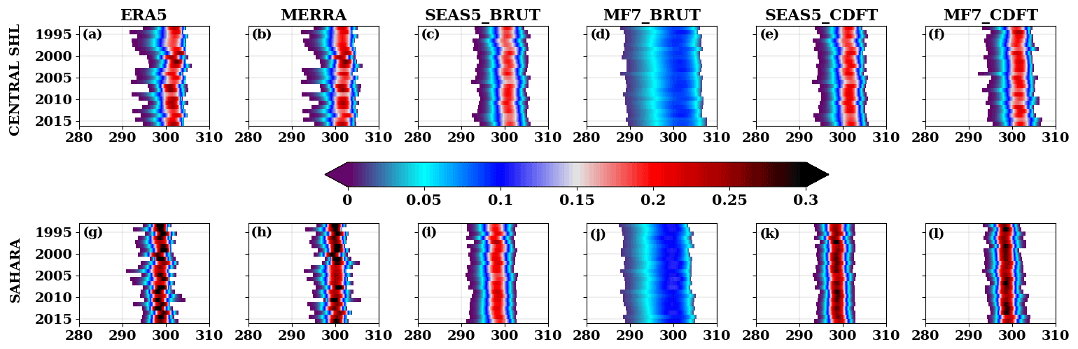
Introduction
Methods
Data
Results
Conclusion
Is there any bias in the representation of the SHL in Seasonal forecast models ?
What is there added value of bias correction compared to raw forecasts?
similar behavior between ERA5 and MERRA
Underestimation of the interannual variability of the T850 hPa in raw forecasts; SEAS5 looks closer to ERA5 than MF7
CDF-t considerably improved the interannual variability of T850 hPa in the forecasts
Cold bias of SEAS5 wrt ERA5 over the Sahara;
Intensification of the cold bias during the monsoon period (June to September).
23/05/2022
EGU, 2022, Vienna
‹#›

Slide 6
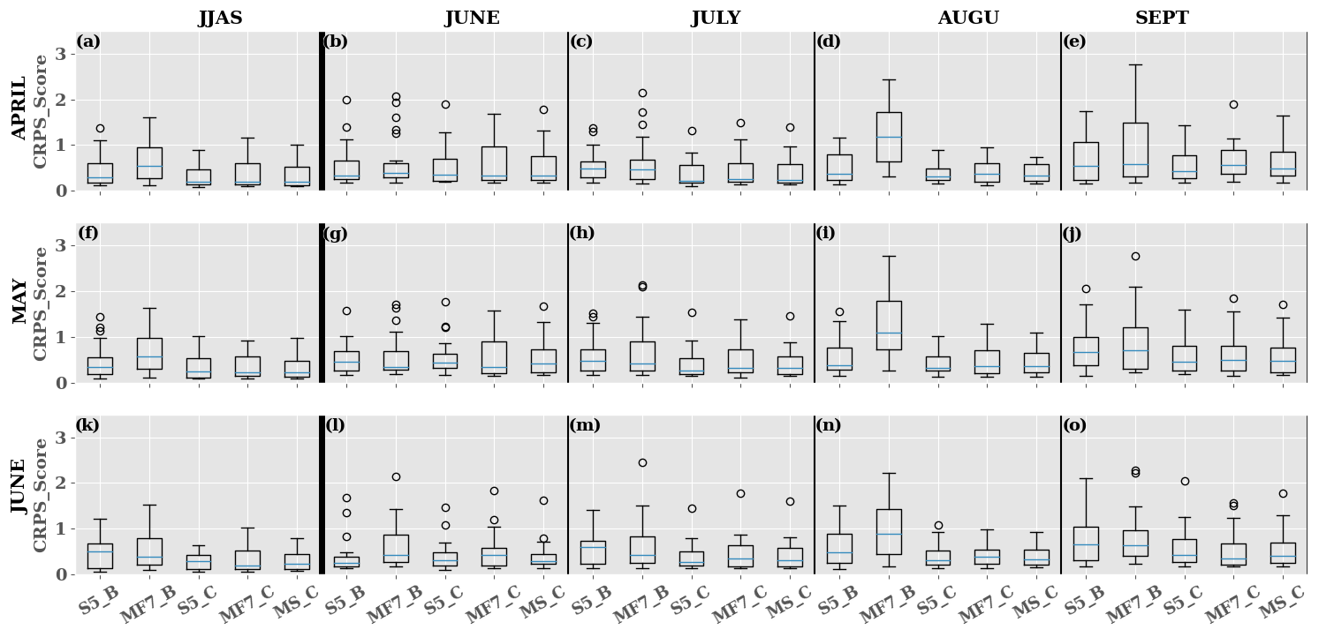
Introduction
Methods
Data
Results
Conclusion
What is the relative error of the seasonal forecasting models compared to the observations (ERA5)?
No amelioration of the skills of raw forecasts with the lead times
Bias correction brings an added value to the skills of the forecasts
S5 shows more skills than MF7 for short lead times (0-2)
Loss of skills when going from seasonal time scale to monthly time scale
Seasonal forecast models show predictive skills at an intraseasonal timescale for short periods;
Bias correction contributes to improving the ensemble forecast score (CRPS), but the forecast skill remains weak for a lead time beyond 1 month.
23/05/2022
EGU, 2022, Vienna
‹#›

Slide 7
Thank you for kind attention !!!
23/05/2022
EGU, 2022, Vienna
‹#›

Slide 8
Annexe
23/05/2022
EGU, 2022, Vienna
‹#›

Slide 9
Is there any bias in the representation of the SHL in Seasonal forecast models ( MF7 ) ?
23/05/2022
EGU, 2022, Vienna
‹#›

