Slide 1

Application of ground penetrating radar (GPR) in look-ahead detection of slurry balance shield machine
Speaker：Weiwei Duan¹
Co-authors: Xiongyao Xie¹, Yong Yang², Kun Zeng¹, Huiming Wu², Li Zeng¹, Kang LI¹
Affiliations: ¹Department of Geotechnical Engineering, College of Civil Engineering, Tongji University and ²Shanghai Tunnel Corporation
2022.05.23
Notes:
Hi, professors and researchers, I'm Weiwei Duan, from Tongji University in Shanghai.
Today I want to report to you the application of GPR in look-ahead detection of slurry balance shield machine.
The main content is numerical simulation about GPR circular detection of typical obstacles.

Slide 2
1
Introduction
2
Method
3
Results
4
Discussion
Notes:
My presentation will follow this order.

Slide 3
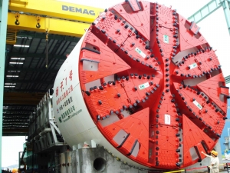
1 Introduction
Development of subway construction
50 cities in China
8939 km
Notes:
By the end of 2021, China has 50 cities with rail transportation system, with a total mileage of nearly 9000 km.
Subway tunnels construction mainly use the shield machine.
But with the development of cities, environment of shield tunnel construction is becoming more and more complex.

Slide 4
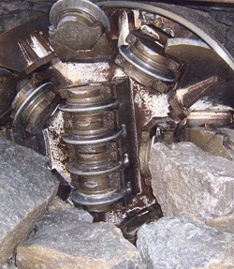
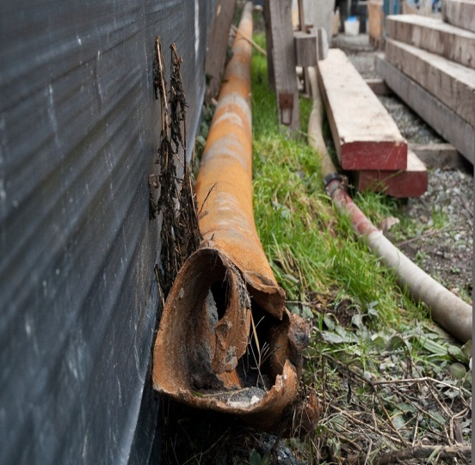
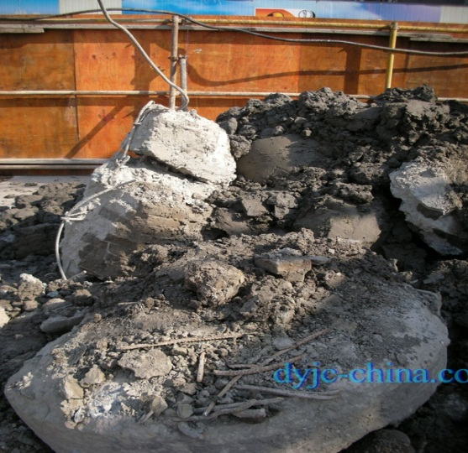
1 Introduction
(a) boulders
(b) Steel pipes
(c) Concrete pile foundations
Typical obstacles causing shield machine sticking accidents
Notes:
Through investigation of some south-China slurry balance shield tunnel accidents in recent years, we found that slurry balance shield machines often encounter various obstacles,
such as large boulders, steel pipes and concrete pile foundations.
The cutter head cannot cut up them. So these obstacles will be pushed forward and finally get the machine stuck.

Slide 5
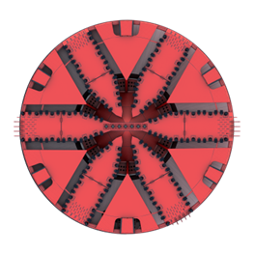
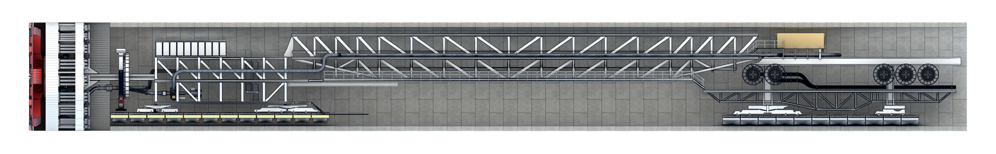
1 Introduction
Ground penetrating radar (GPR) is a method widely used in engineering geological exploration. It has advantages of small working space, high efficiency and no damage compared with other detecting methods.
Notes:
Therefore, we consider using GPR to quickly detect distribution of obstacles in advance.
Antennas can be put in cutter head.
So we want to see the response of the typical obstacle under GPR circular detection.

Slide 6
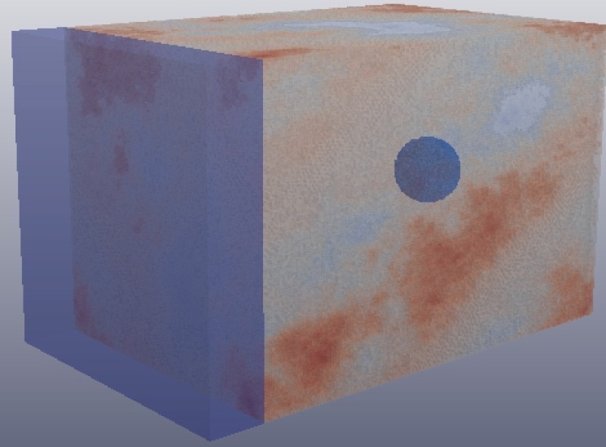
2 Method
Numerical simulations of GPR circumferential detection
domain: 16m x 16m x 4.5m dx: 0.01m
sources: ricker, 100MHz
measure line radius: 4.5m and 7.5m
interval: 2°
Materials | εr | σ (S/m) | μr | σ* (S/m)
Concrete | 5 | 0.01 | 1 | 0
Water | 80 | 0 | 1 | 0
sand | 3.5 | 0.01 | 1 | 0
Clay | 16 | 0.01 | 1 | 0
Pec | built in
Numerical simulation modeling
Notes:
Based on FDTD Method, we use GPRMAX to numerically simulate GPR circular detection when antennas rotate with the cutter head.
Here shows the simulation setting information like model size, grid size, waveform, center frequency and the radius of measuring lines.
The scanning interval is 2°. So 180 measuring points are recorded in a circle.
Materials and their parameters are shown in the table.

Slide 7
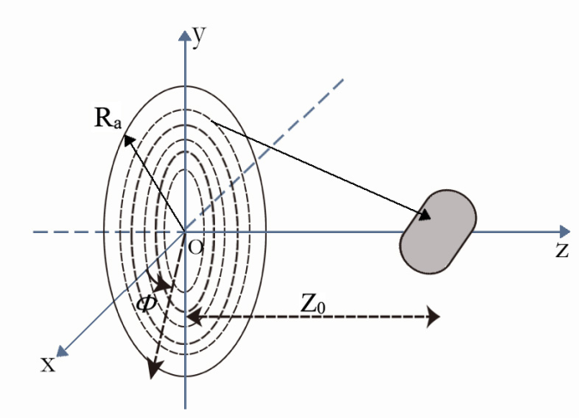
2 Method
Raw data
Data procession
Data pre-procession
Coordinate transformation
Stolt migration (F-K migration)
Adjust zero point
Manual gain
Remove background
2D FFT
Stolt interpolation
3D IFFT
Reconstructed 3D image
Notes:
The original data we obtained from GPRMAX was pre-processed to improve the target signal.
The scanning is recorded in polar coordinate. Data are converted to Cartesian coordinate.
Then use Stolt migration algorithm, we obtain the reconstructed three-dimension image.
Then I will show the results.

Slide 8
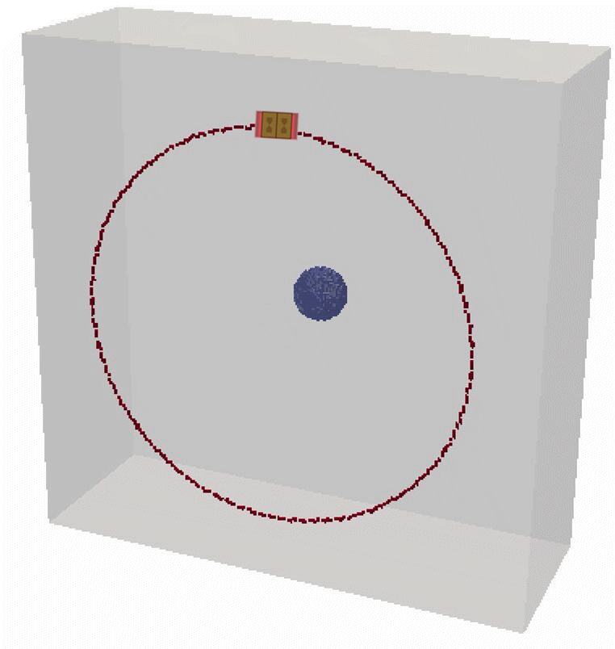
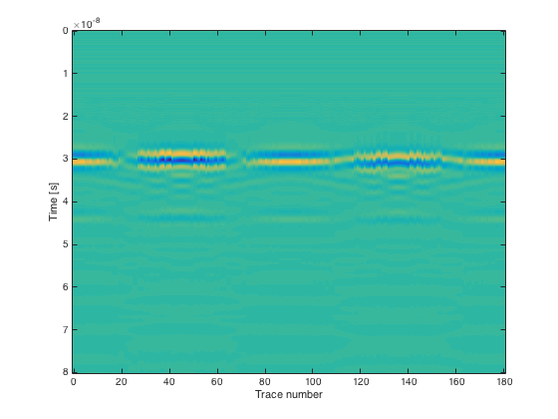
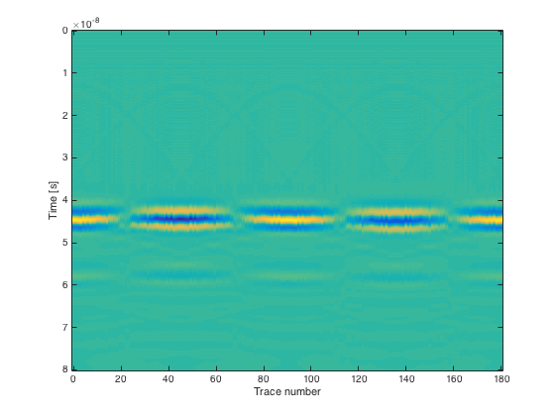


3 Results
One boulder in the center (3.5m away)
$r_{1}$= 4.5m B-scan
$r_{2}$= 7.5m B-scan
Notes:
Here is the B-scan when only one boulder is 3.5 meters straight ahead of the detection surface.
After the pre-procession, the reflection image of the target tends to be a horizontal straight line.

Slide 9
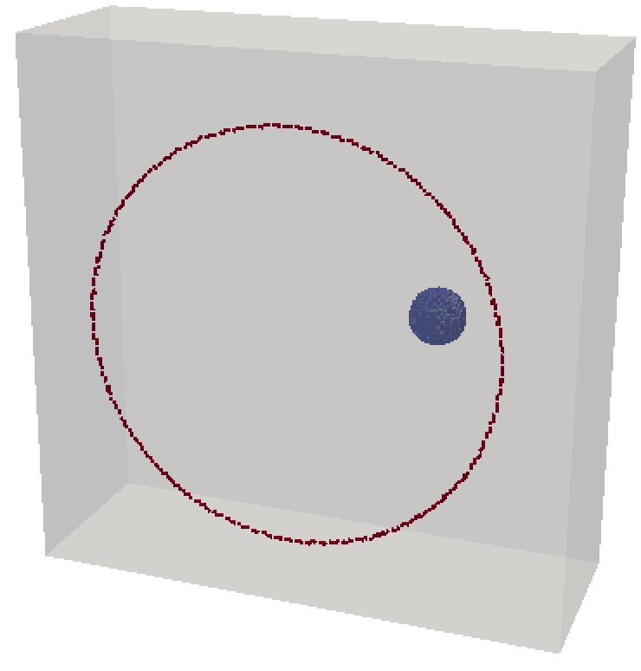
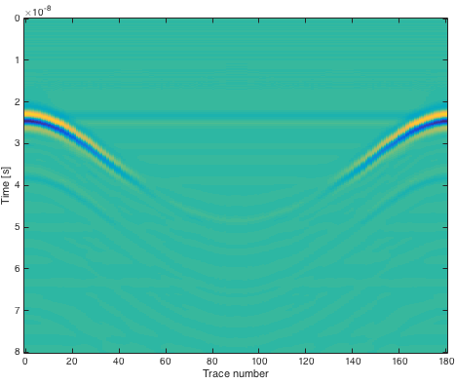
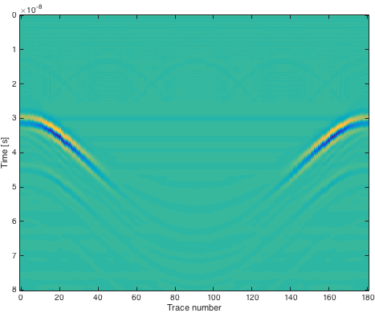


3 Results
One boulder on the right
0°
0°
180°
0°
180°
180°
$r_{1}$= 4.5m B-scan
$r_{2}$= 7.5m B-scan
Notes:
When a boulder is on the right ahead, target images are close to a hyperbola curve.

Slide 10
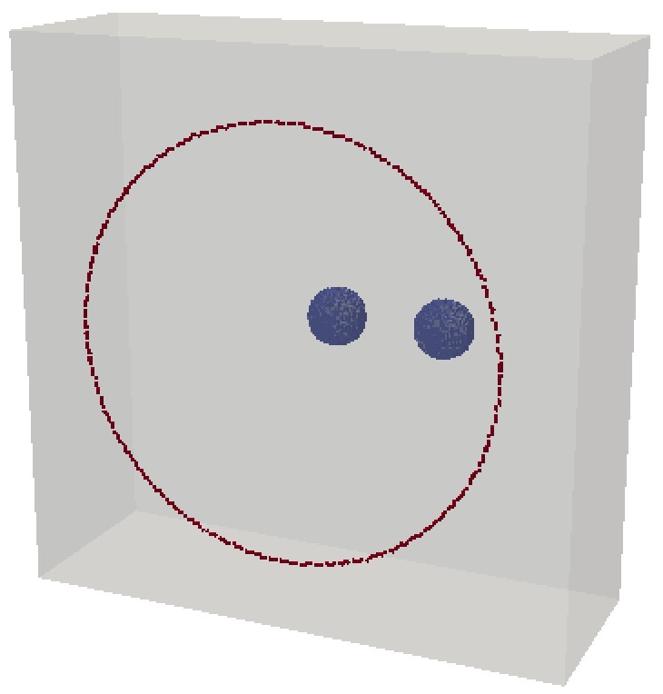
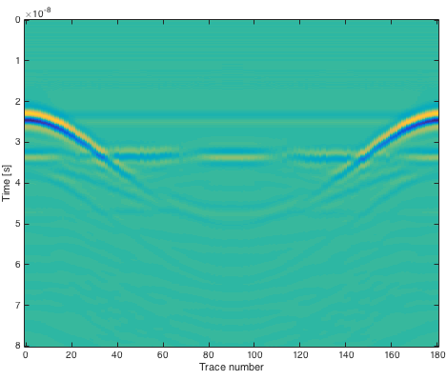
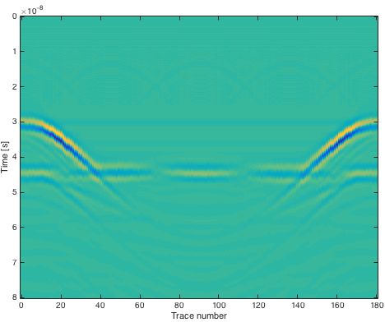
3 Results
One boulder in the center and the other on the right
0°
0°
180°
0°
180°
180°
$r_{1}$= 4.5m B-scan
$r_{2}$= 7.5m B-scan
Notes:
When there are two boulders at two different positions, reflected image is a combination of above two.

Slide 11
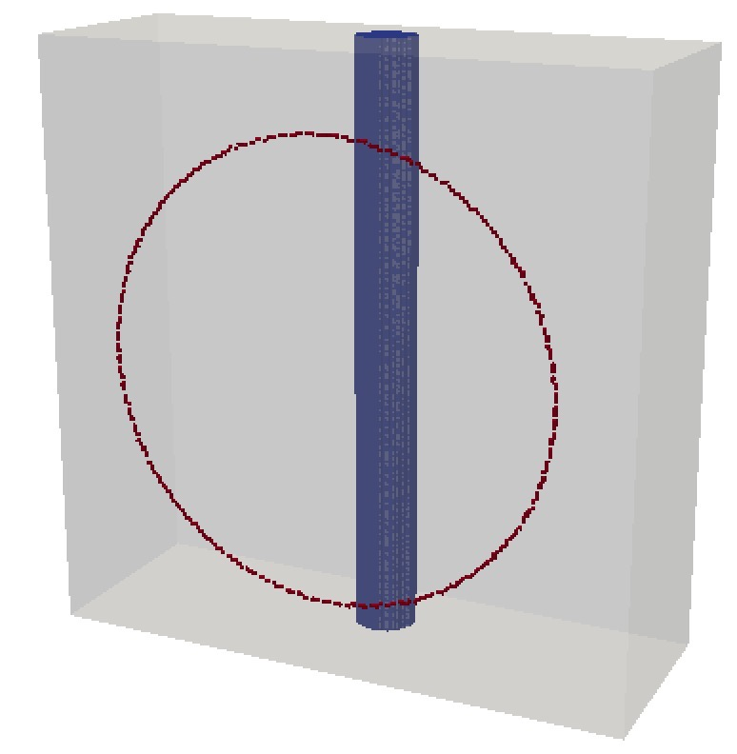
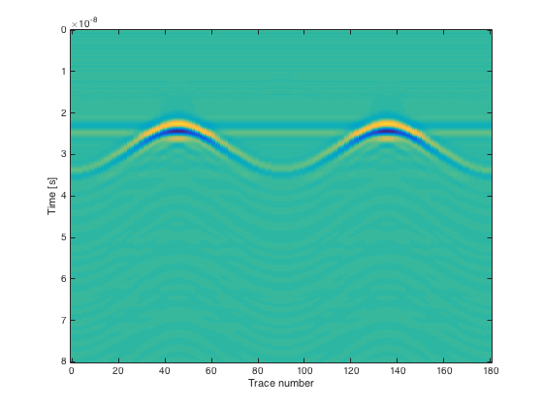
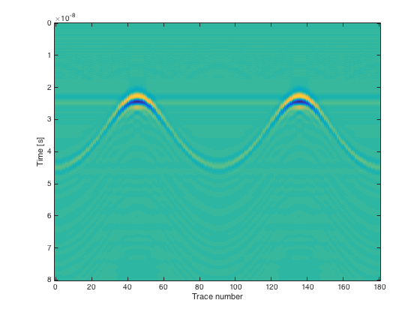
3 Results
Concrete pile foundation in the center
90°
270°
90°
270°
90°
0°
180°
180°
0°
0°
180°
270°
$r_{1}$= 4.5m B-scan
$r_{2}$= 7.5m B-scan
Notes:
When a concrete pipe foundation is in the center, there are two hyperbola curves. And peaks are at these angles for antenna is close to the obstacle.

Slide 12
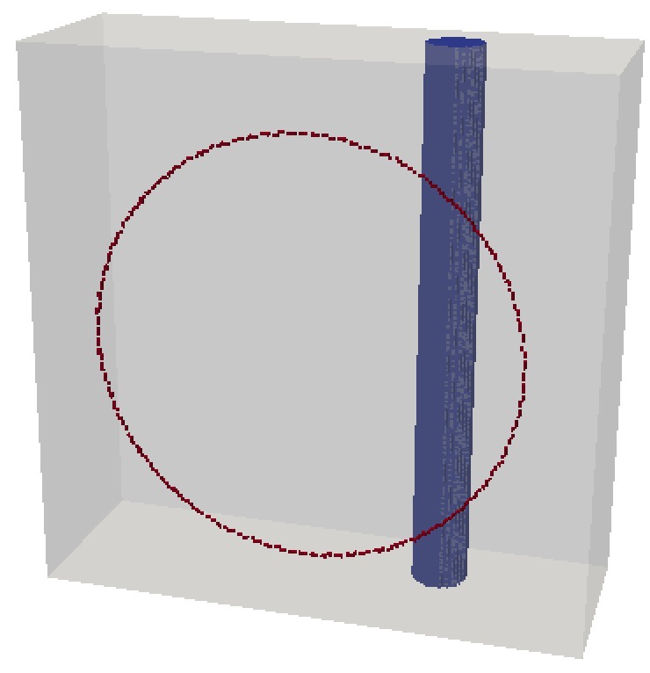
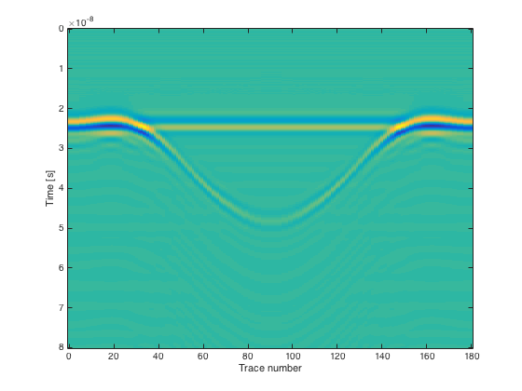

3 Results
Concrete pipe foundation on the right
70°
290°
70°
290°
70°
180°
180°
180°
290°
$r_{1}$= 4.5m B-scan
$r_{2}$= 7.5m B-scan
Notes:
When the foundation is on the right, the peak of two hyperbola curves are at these two position.

Slide 13
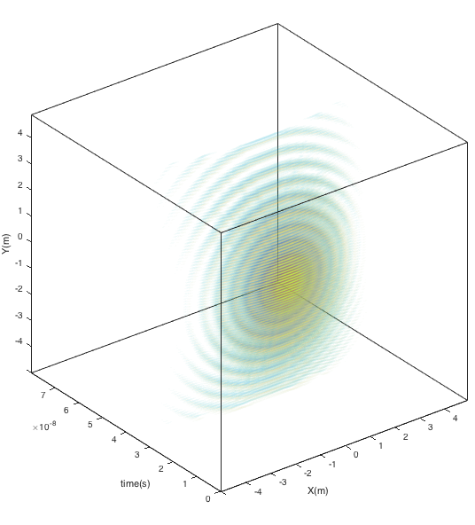
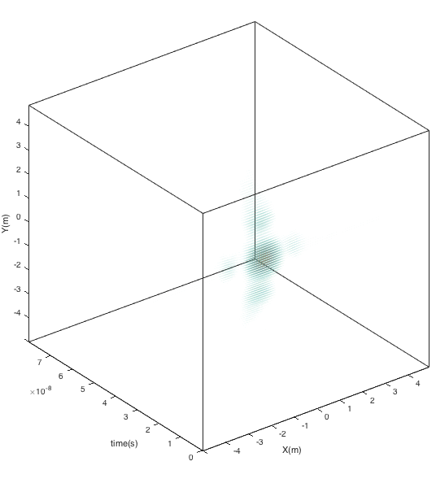
3 Results
3D image of one boulder in the center (xoy: ±5m）
focused in the center
before
after
Notes:
Then I will show three-dimension image after Stolt migration.
Take the range of X-Y plane ±5m in the model for study. After migration process, the radar image is focused in the center.
The other cases are similar, I will show you quickly.

Slide 14
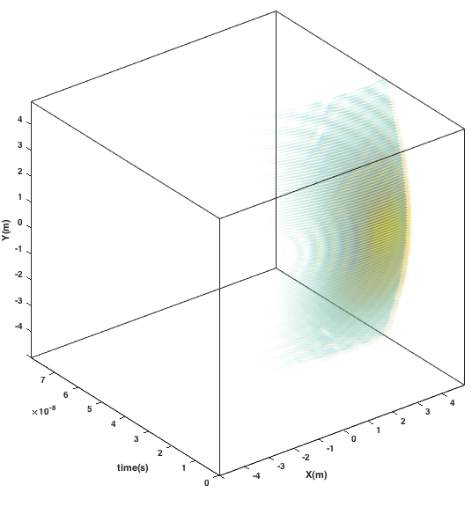
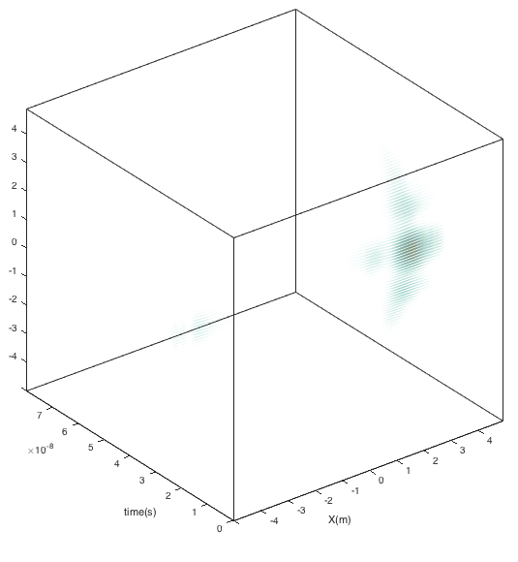
3 Results
3D image of one boulder on the right
focused on the right
before
after
Notes:
This is only one boulder on the right.

Slide 15
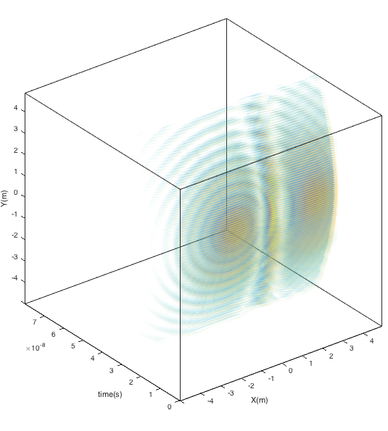
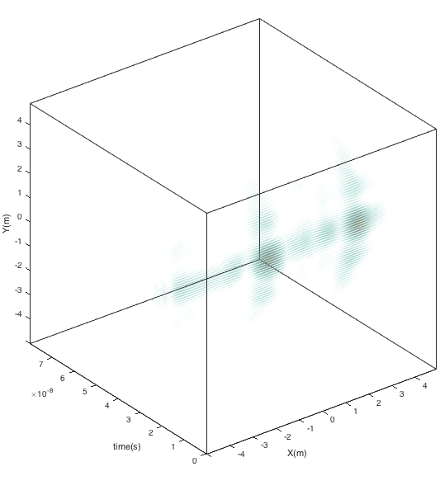
3 Results
One boulder in the center and the other on the right
focused on the center and right
before
after
Notes:
Here are two boulders.

Slide 16
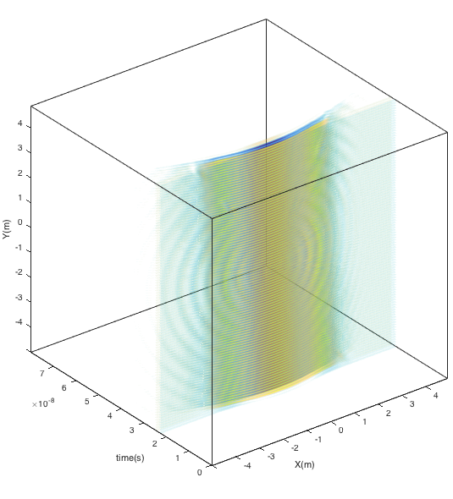
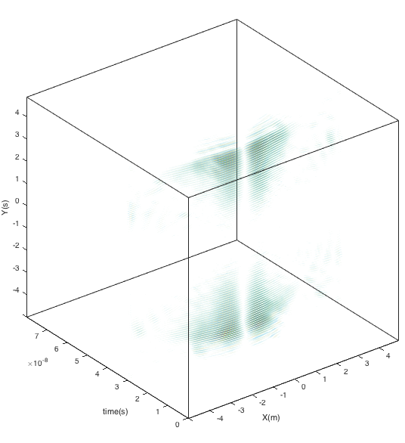
3 Results
Concrete pile foundation in the center
focused in the center
before
after
Notes:
This is the case of a concrete pile foundation in the center.

Slide 17
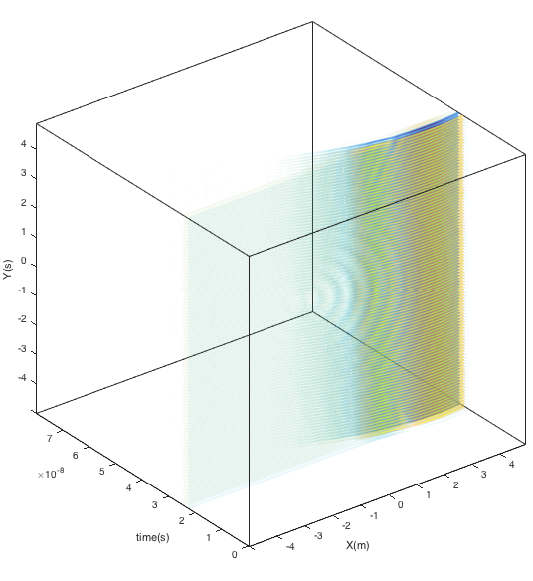
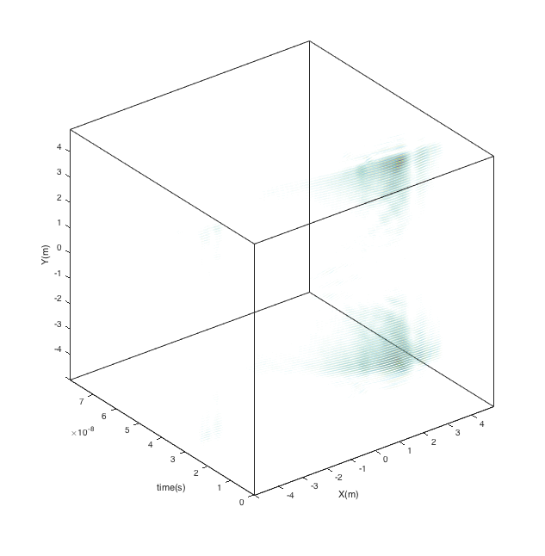
3 Results
Concrete pipe foundation on the right
focused on the right
before
after
Notes:
Here is the foundation on the right.

Slide 18
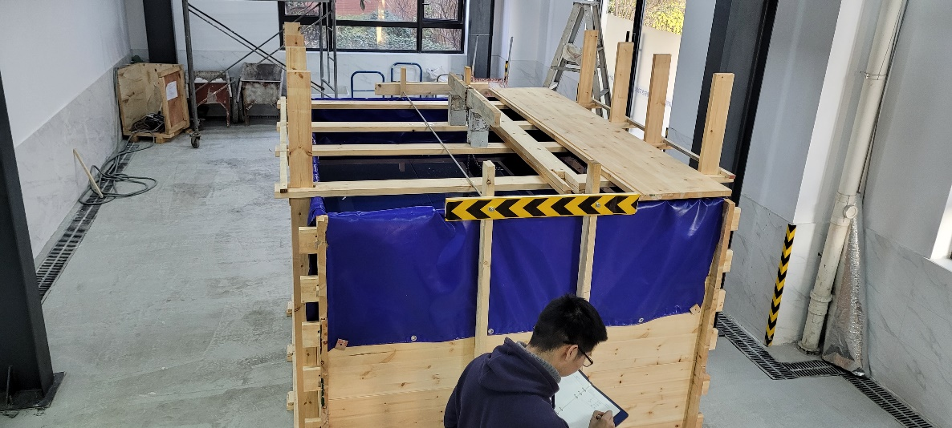
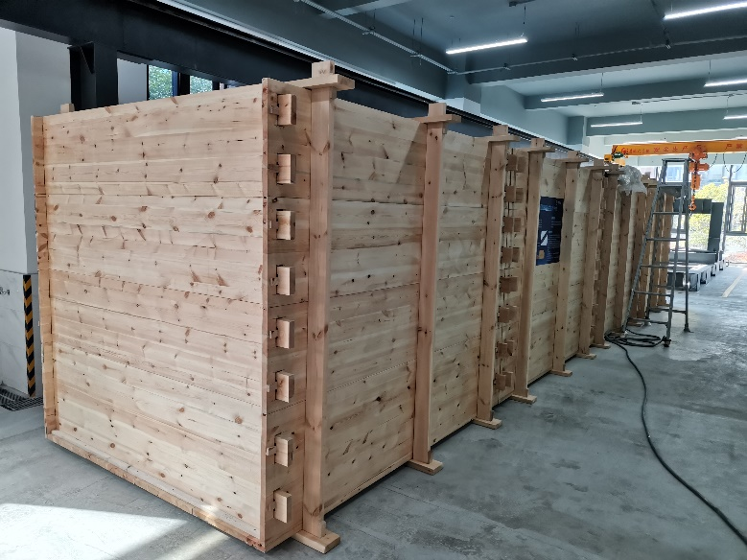
4 Discussion
Conclusion: By simulating radar emission and reflection pattern of electromagnetic wave, we study the propagation pattern of the reflect wave after encountering the obstacles and conclude the image pattern to establish the foundation for image recognition of obstacles.
Limits: measure line, detection range, noise, the mud membrane
Future research: experiment research
Notes:
Above numerical simulation results prove the feasibility of using GPR to distinguish obstacles like boulders and concrete pile foundation. It has a good effect.
However, there are some limits. To have a better image and higher solution, how to use more detection lines. We also consider how to have farer detection distance. The models can also be perfected. In the model there will be more noise setting like field condition. For slurry balance machine the mud membrane formed before the cutter head are needed to be considered.
We have built a wooden box without nails. Our next research is to conduct an indoor model test to obtain the field data and compare it with the numerical simulation results.

Slide 19
Thanks for your attention!
Notes:
That’s all my presentation. Thanks for your attention!

