Slide 1



Langmuir Probe observations during eclipses of Cassini with Saturn and the Main Rings: ring optical depths and photoelectrons
EGU 2022 – Vienna (finally!)
Georgios Xystouris, Christopher Stephen Arridge, Michiko Morooka, and Jan-Erik Wahlund
g.xystouris@lancaster.ac.uk

Slide 2
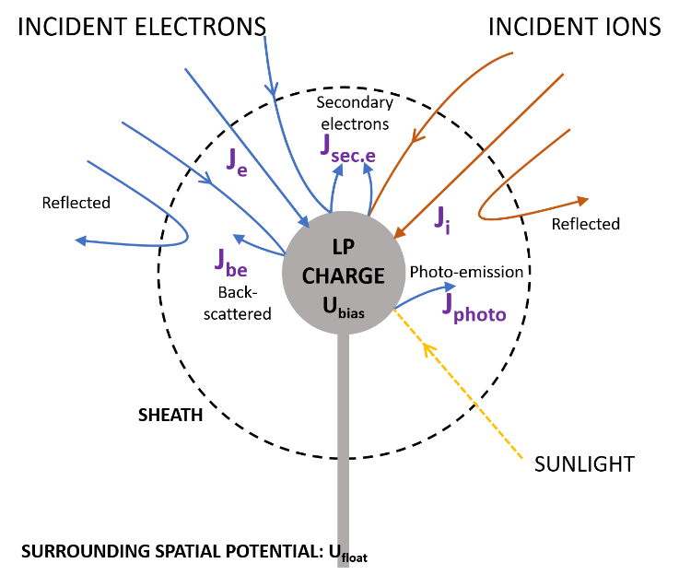
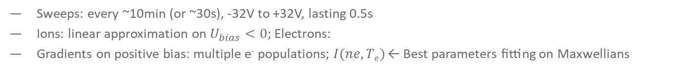
LP and I-V curves
Sweeps: every ~10min (or ~30s), -32V to +32V, lasting 0.5s
Ions: linear approximation on $U_{bias}<0$; Electrons:
Gradients on positive bias: multiple e⁻ populations; $I(ne, Te)$ ← Best parameters fitting on Maxwellians
1
Notes:
Gradiend of the current with respect to the bias voltage
Ufloat is the potential at the distance of the LP. Ufloat is not Usc

Slide 3
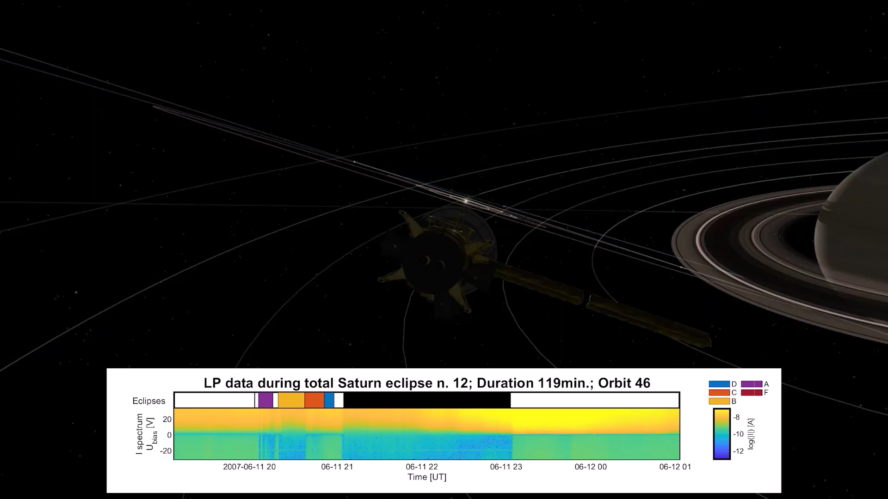
Example of eclipses in an orbit
Eclipses:
118 by Saturn
163 by the main rings
2

Slide 4
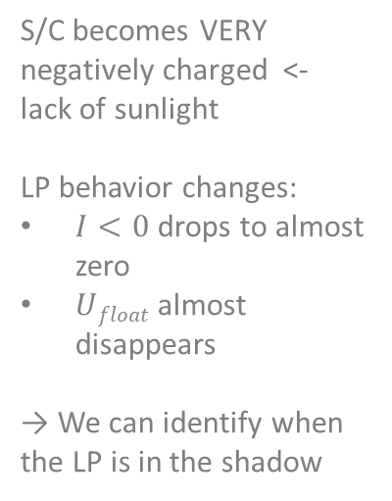
IV curves during an eclipse
S/C becomes VERY negatively charged <- lack of sunlight
LP behavior changes:
$I<0$ drops to almost zero
$Ufloat$ almost disappears
→ We can identify when the LP is in the shadow
3
Notes:
Sweeps in shadow are different than sweeps in sunlight.
CURRENT GOES TO ZERO IN SHADOW.
THERE IS NO U_FLOAT VISIBLE
LP SHOWS when Cassini is in Shadow -> useful to attack the photoelectrons issue

Slide 5
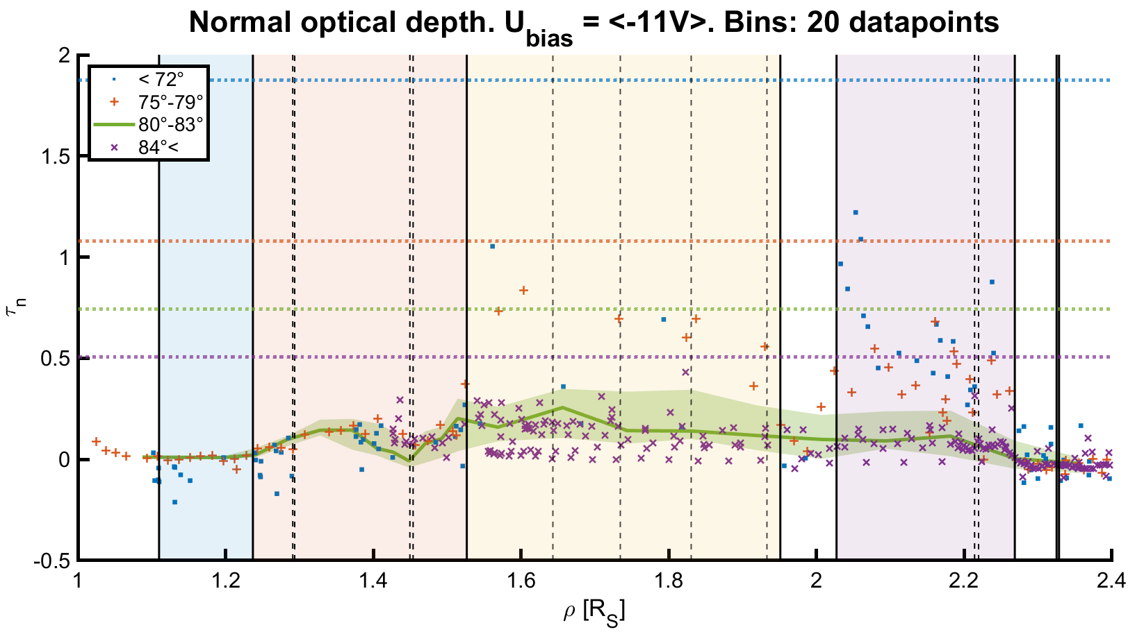
Rings opacity
Rings:
A, B: optically thick (B: thickest)
C, D: optically thin (D: thinnest)
Able to identify structures (Encke Gap, Maxwell Gap)
In agreement with previous studies (e.g. Wahlund+ 2018, Hadid+ 2018, Colwell+ 2010)
Colombo
Gap
Maxwell
Gap
Encke
Gap
Xystouris et al. (in prep.)
4
Notes:
Combining the IV curve changes with: LP surface photoelectron yield

Slide 6
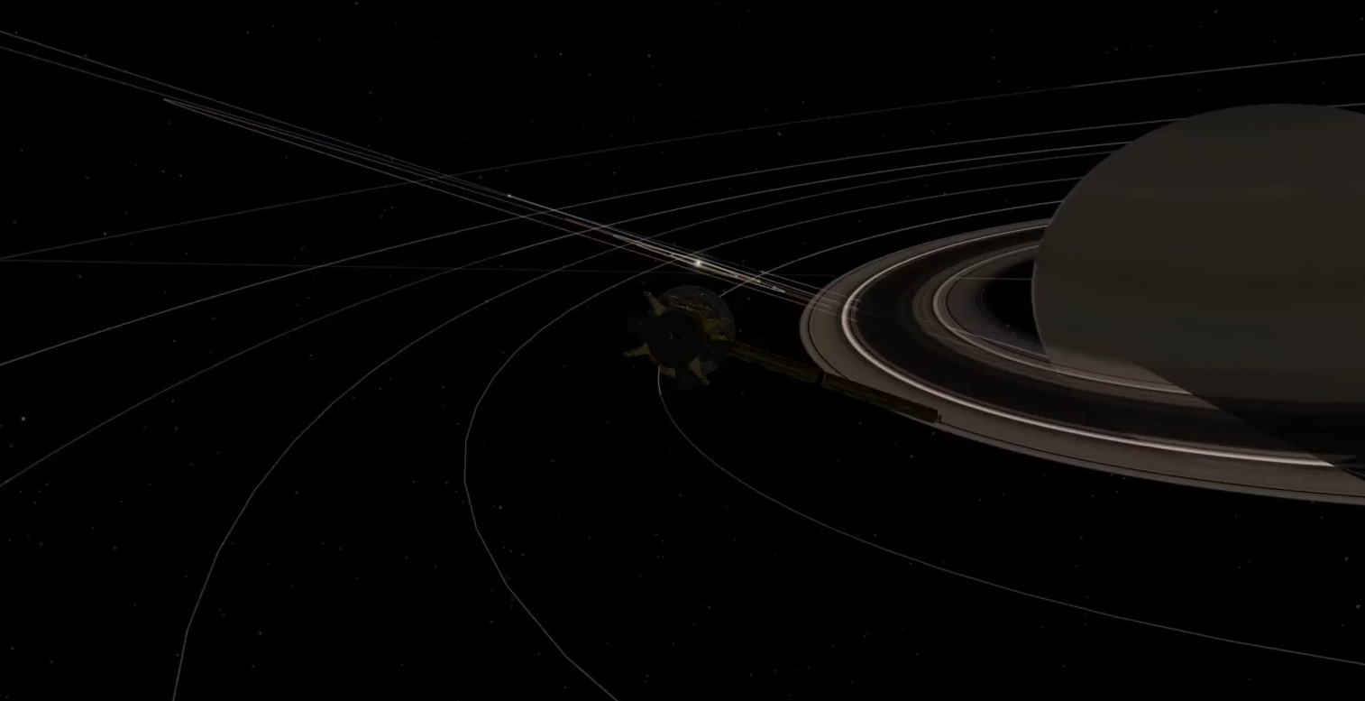
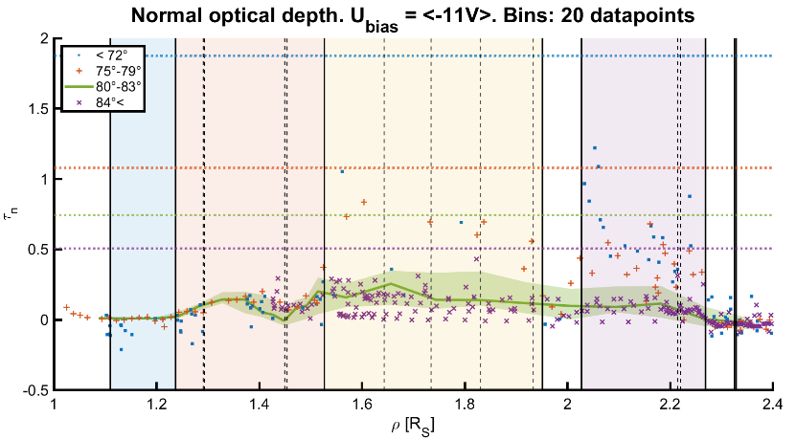
Thank you
“Langmuir Probe observations during eclipses of Cassini with Saturn
and the Main Rings: rings optical depths and photoelectrons”
G. Xystouris, C. S. Arridge, M. Morooka, and J-E. Wahlund
g.xystouris@lancaster.ac.uk
Notes:
Eclipses: 118 by Saturn, 163 by the main rings

Slide 7
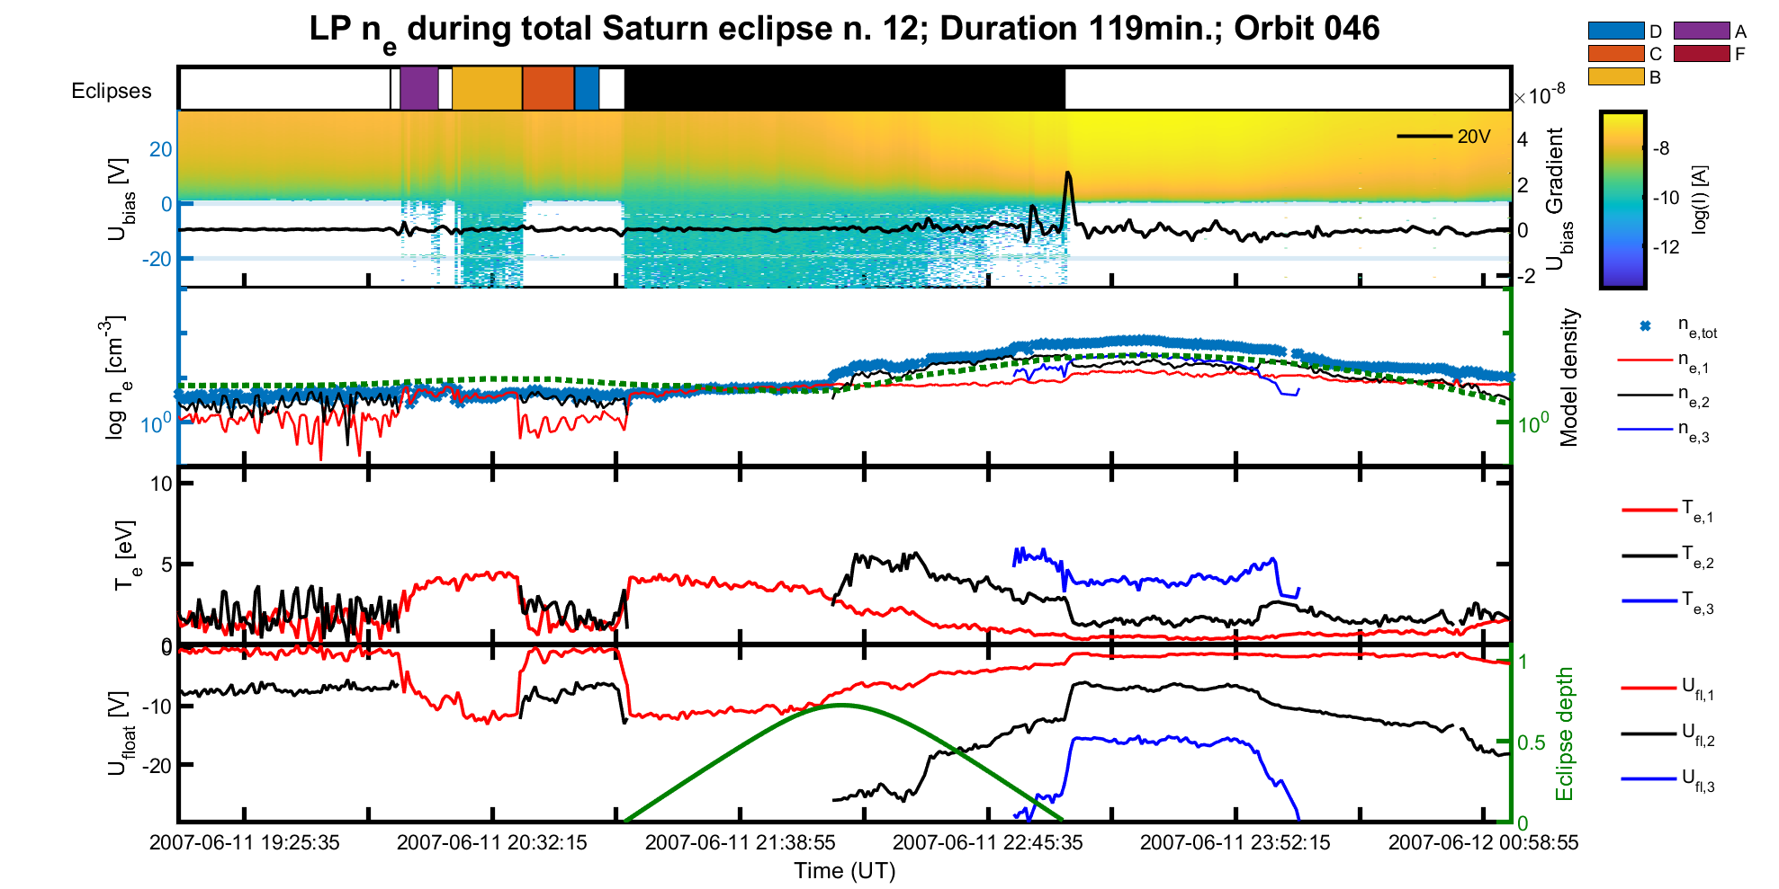
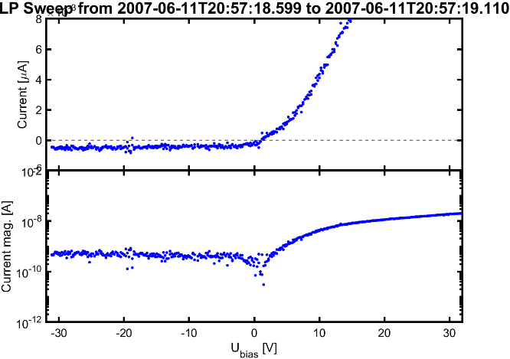
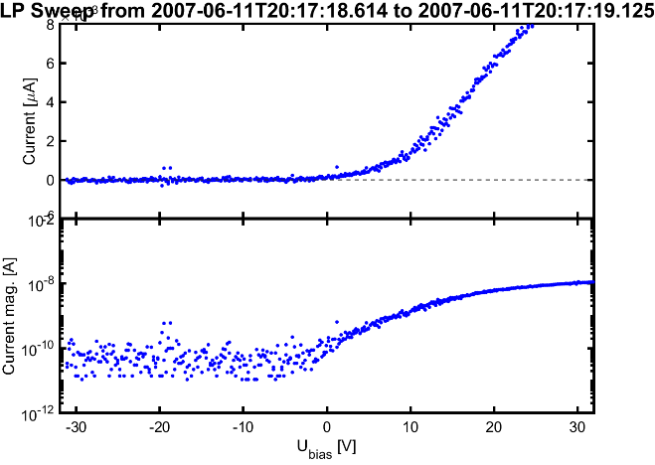
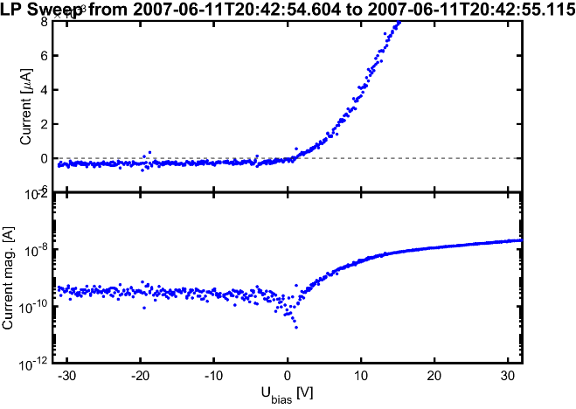
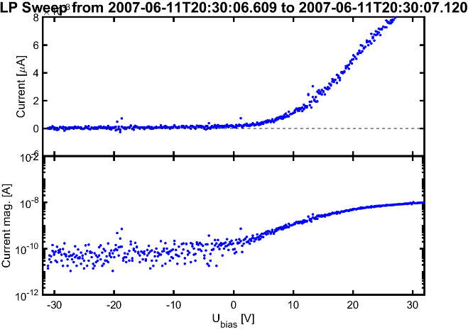
Extras: Rings and shadowing
D-ring
A-ring
C-ring
B-ring
6
Notes:
2 groups: A-B: cast shadow -> EUV optically thick
C-D: optically thin
C-ring: more optically thick than D-ring

Slide 8
Extras: Results
LP I-V curves change dramatically in eclipses
A I-V curve can tell when we’re in the shadow
Maybe we need a better way to analyse data during eclipses?
Rings appear variable EUV (sunlight) opaqueness:
A- and B-ring optically thick; B-ring is the most optically thick
C- and D-ring optically thin; C-ring a bit more optically thick than D-ring?
Some rings features are visible (Maxwell Gap, Encke Gap)
In agreement with previous studies, e.g. Wahlund+(2018), Hadid+(2018), Colwell+(2010)
Photoelectrons complicate data analysis for many missions → knowledge from this work to be used in future missions data analysis and planning
Demonstration of using a magnetospheric instrument to study planetary features
7

Slide 9
Extra: Future work
Investigate additional parameters; e.g. secondary electrons, high energy electrons, PPOs etc.
Investigate any asymmetries
9

Slide 10
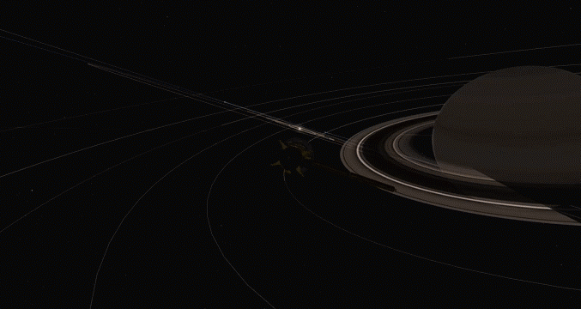

Extras: Backup example of eclipses in an orbit
Eclipses:
118 by Saturn
163 by the main rings
8

