Slide 1

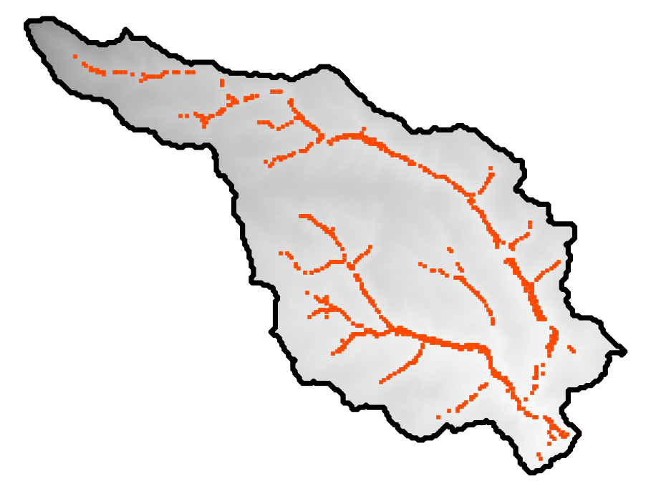
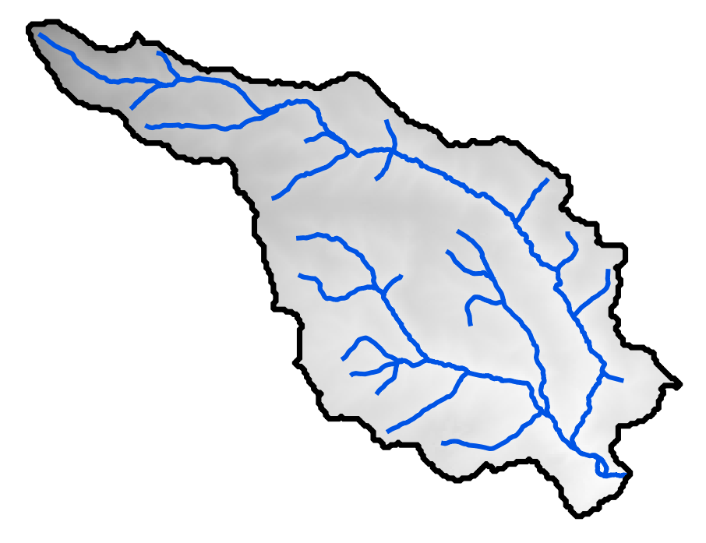
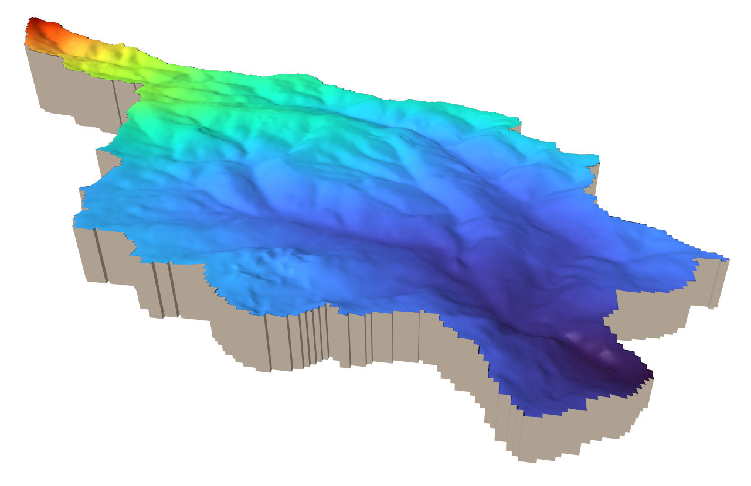





Chaire Eaux et Territoires
EGU 2022
May 24, 2022
Assessment of hydraulic conductivity from the hydrographic network in shallow crystalline aquifers
Ronan Abhervé, Alexandre Gauvain, Clément Roques, Laurent Longuevergne, Luc Aquilina, and Jean-Raynald de Dreuzy
Matching
K [m/s]
Groundwater flow model
Watertable elevation
Seepage areas simulated
Stream network observed
Barrage de la Chèze

Slide 2
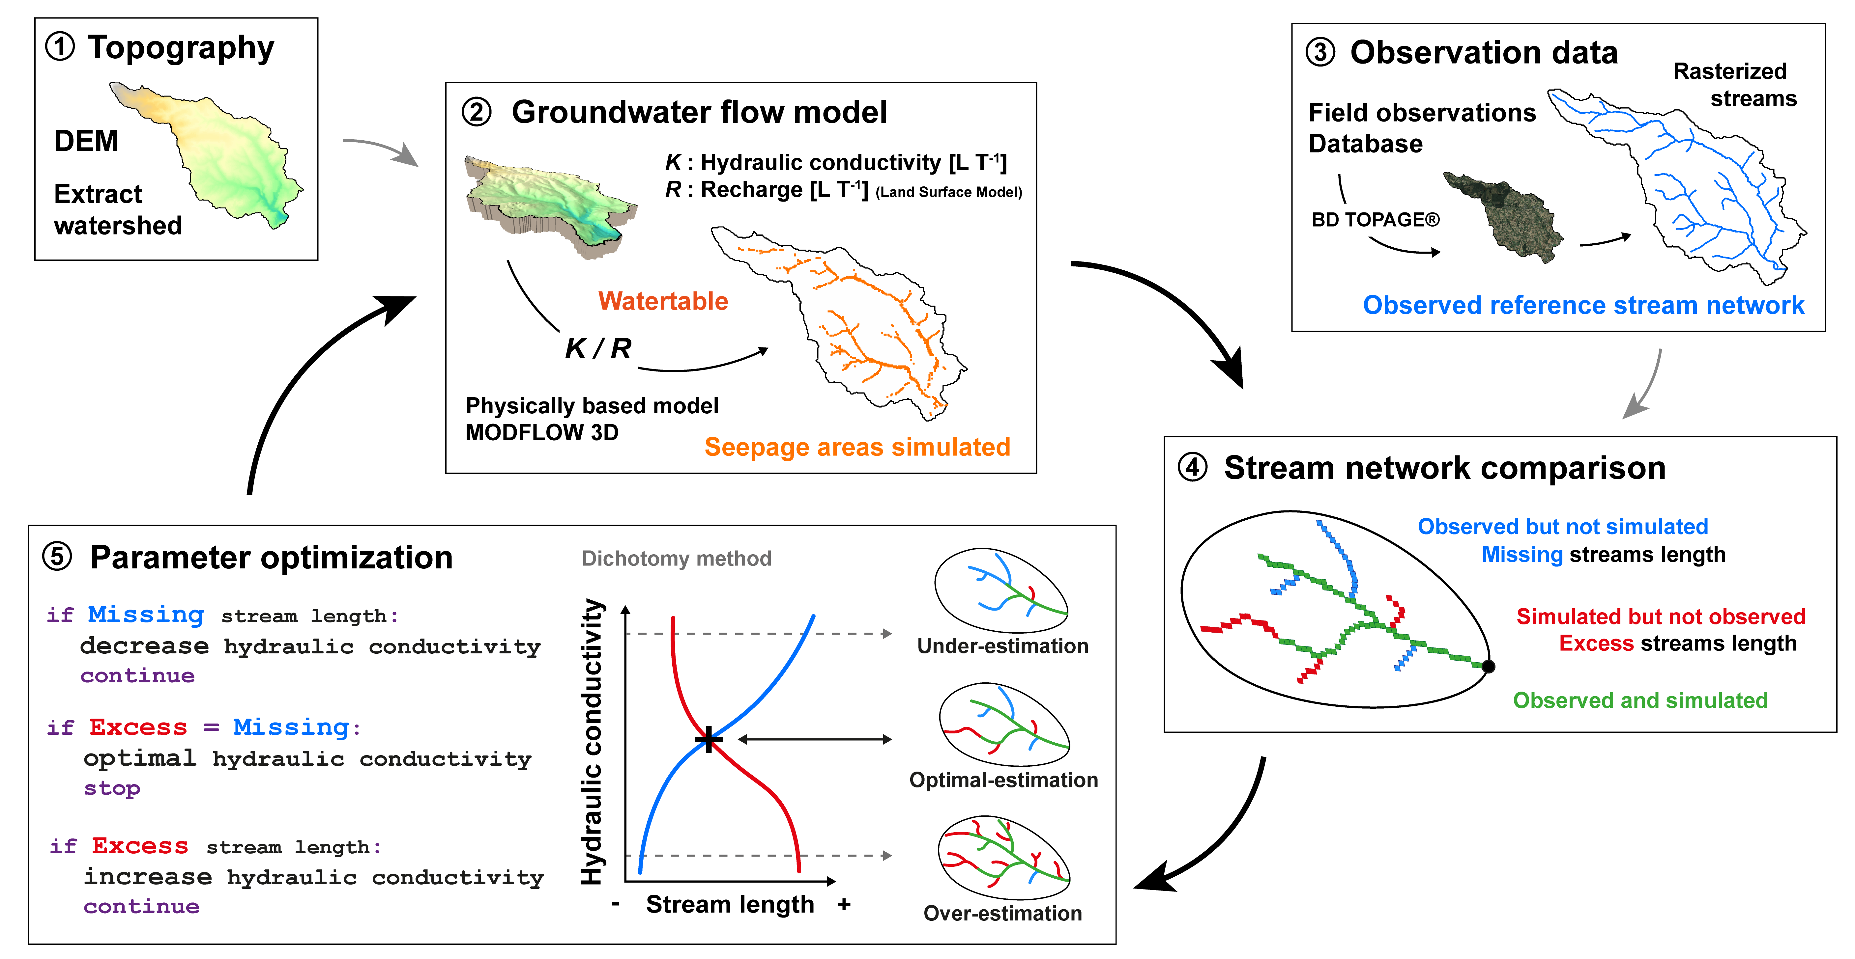
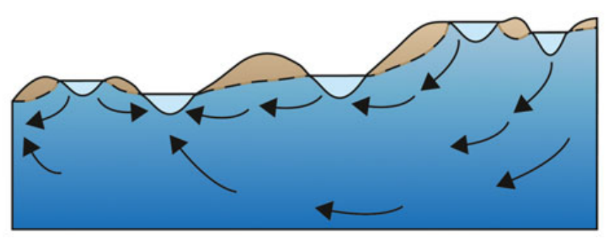
Methodology
Seepage areas
Watertable
Leibowitz et al., 2018

Slide 3
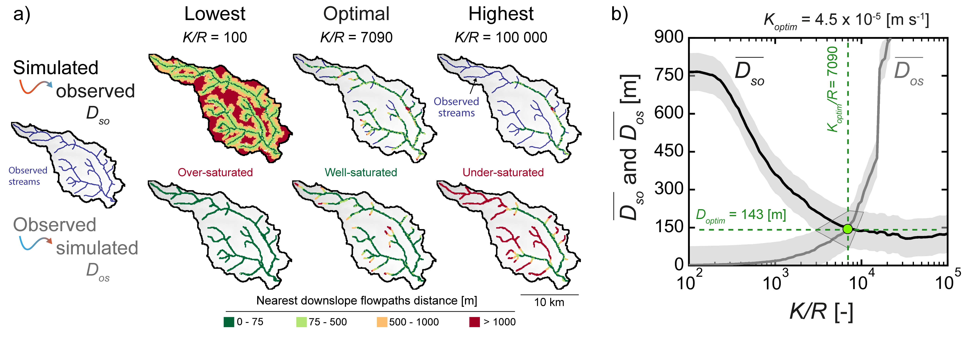
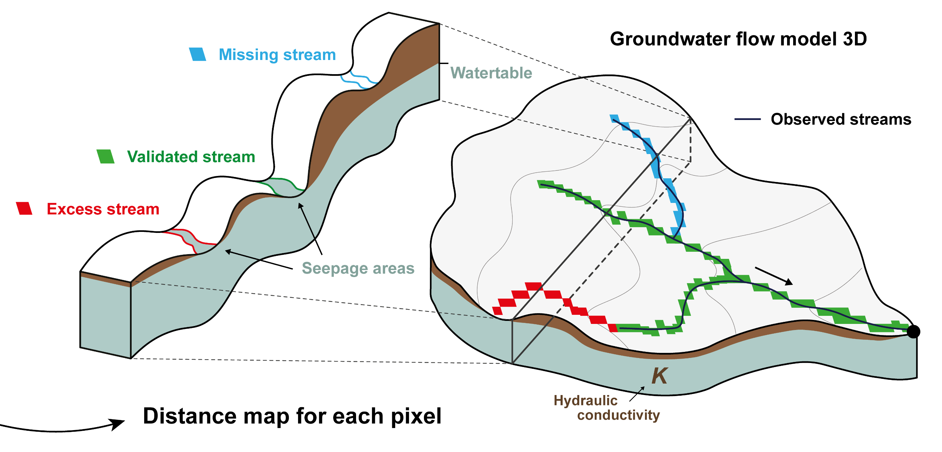
Indicator of the calibration performance
DEM
The calibration criterion expressing the closest match of the observed and simulated streams
Sim.
Obs.
Simulated
Observed
Simulated
Excess ≈ Missing
D_{so}
D_{os}

Slide 4
Methodology

Slide 5
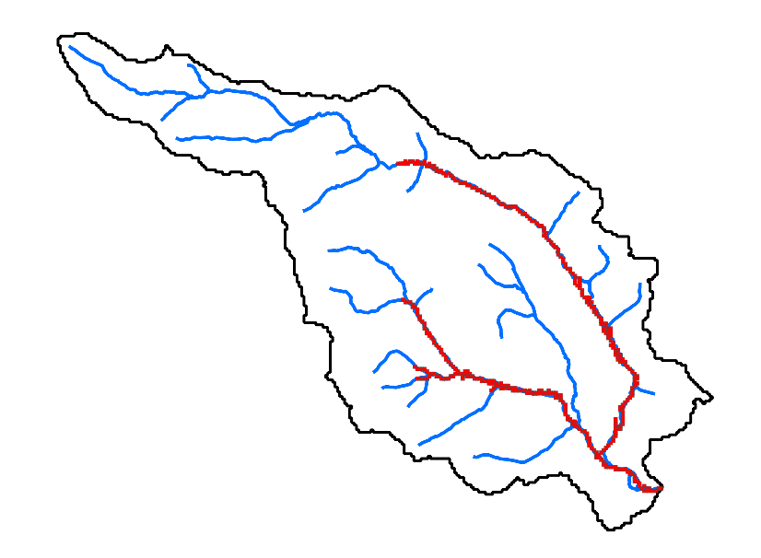

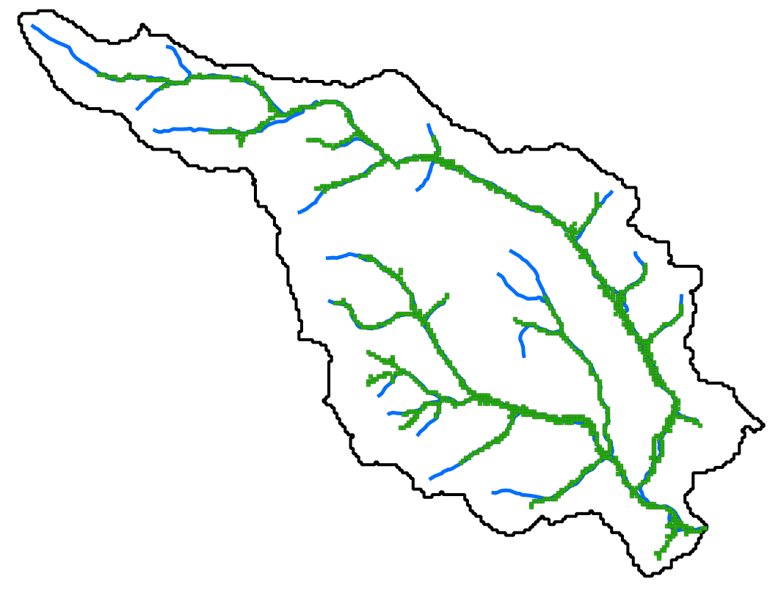
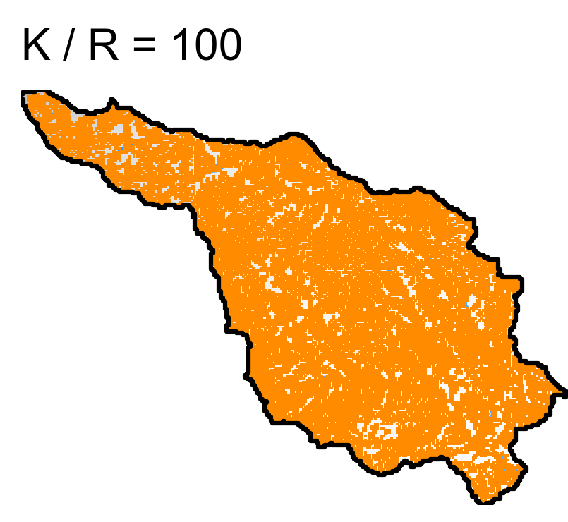
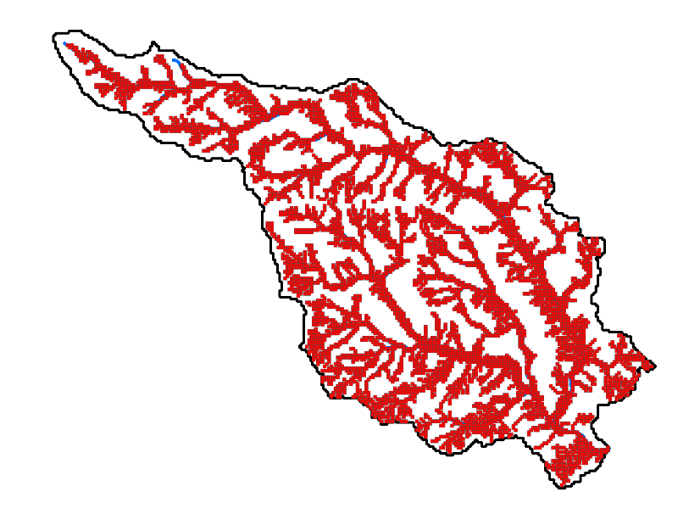
Automatic optimzation
if Sim. < Obs.:
decrease K
K_{high}
if Sim. ≈ Obs.:
stop
print(‘Found!’)
K_{optimal}
if Sim. > Obs.:
increase K
K_{low}

Slide 6
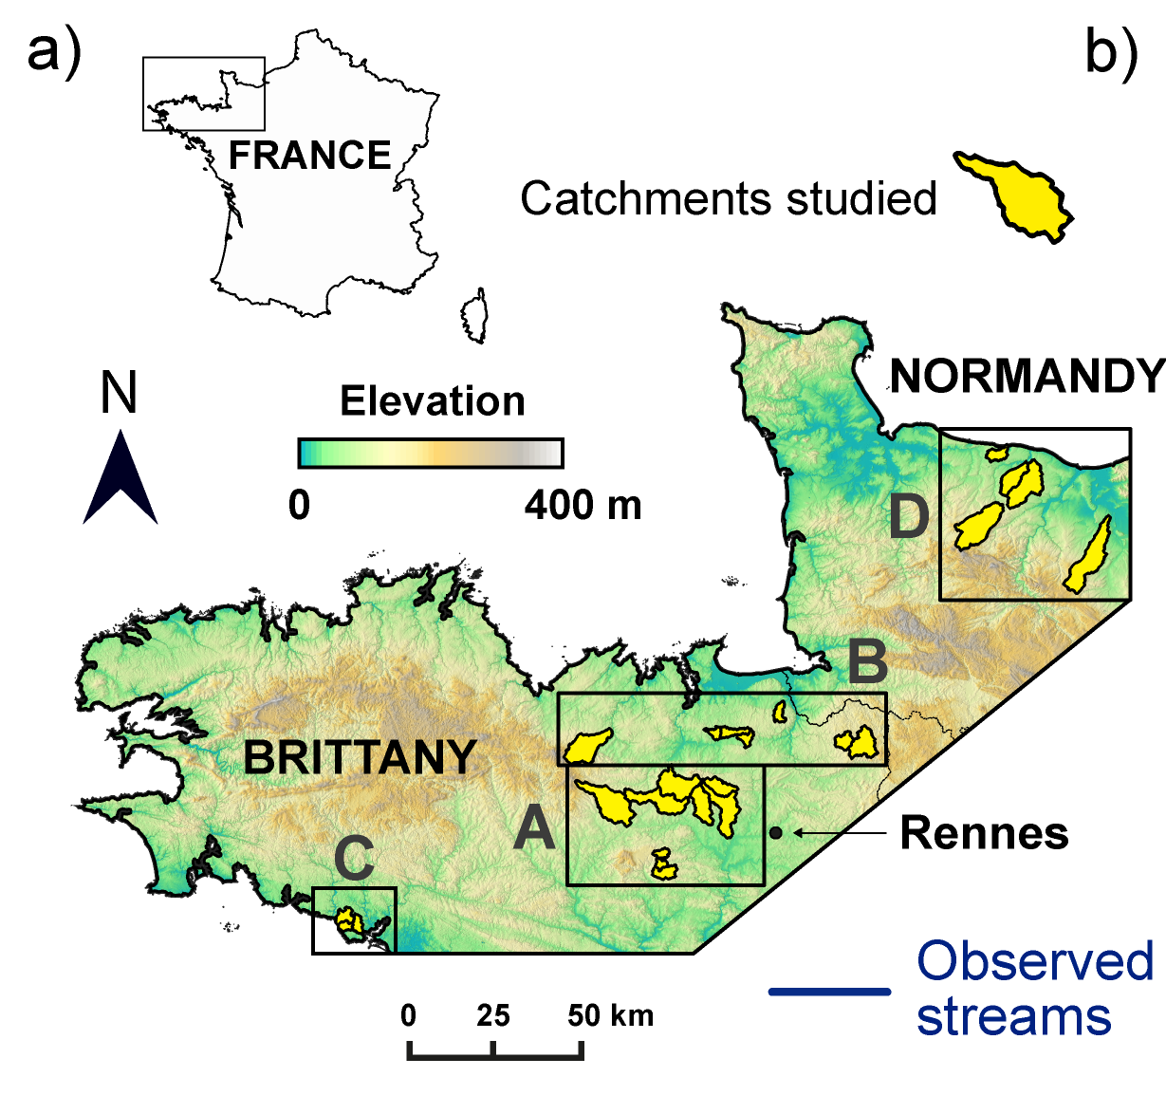
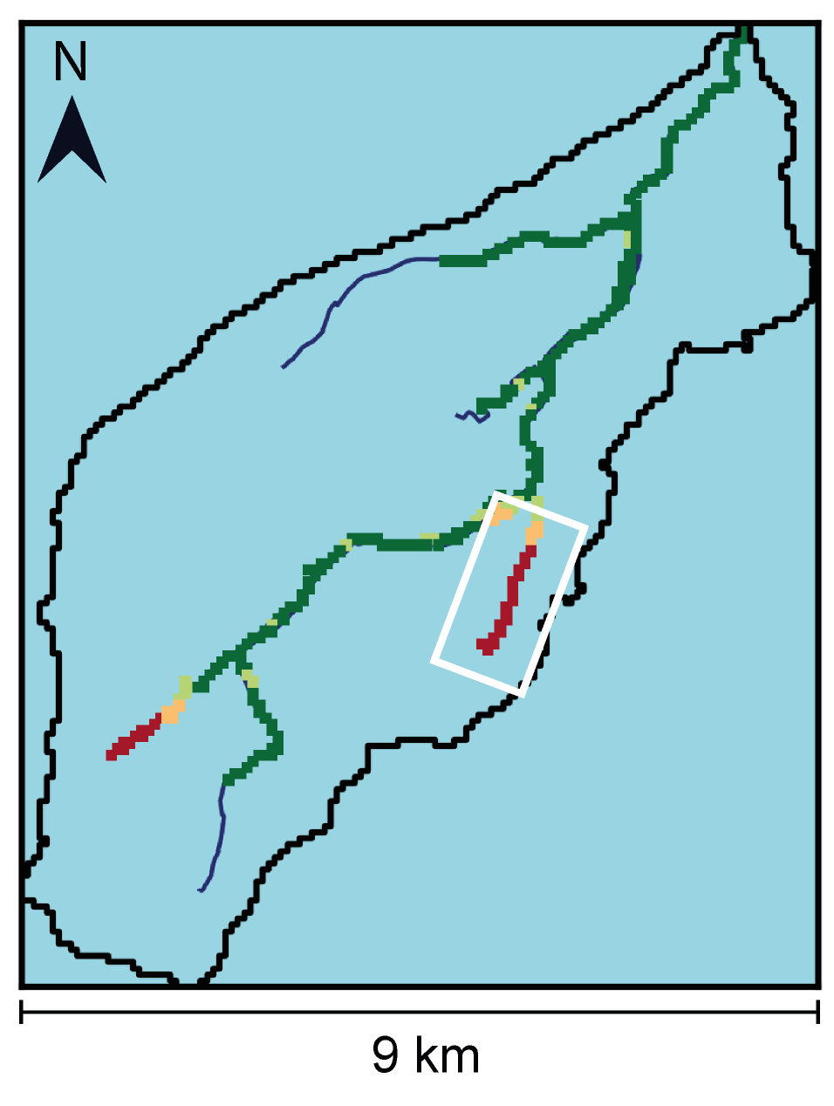
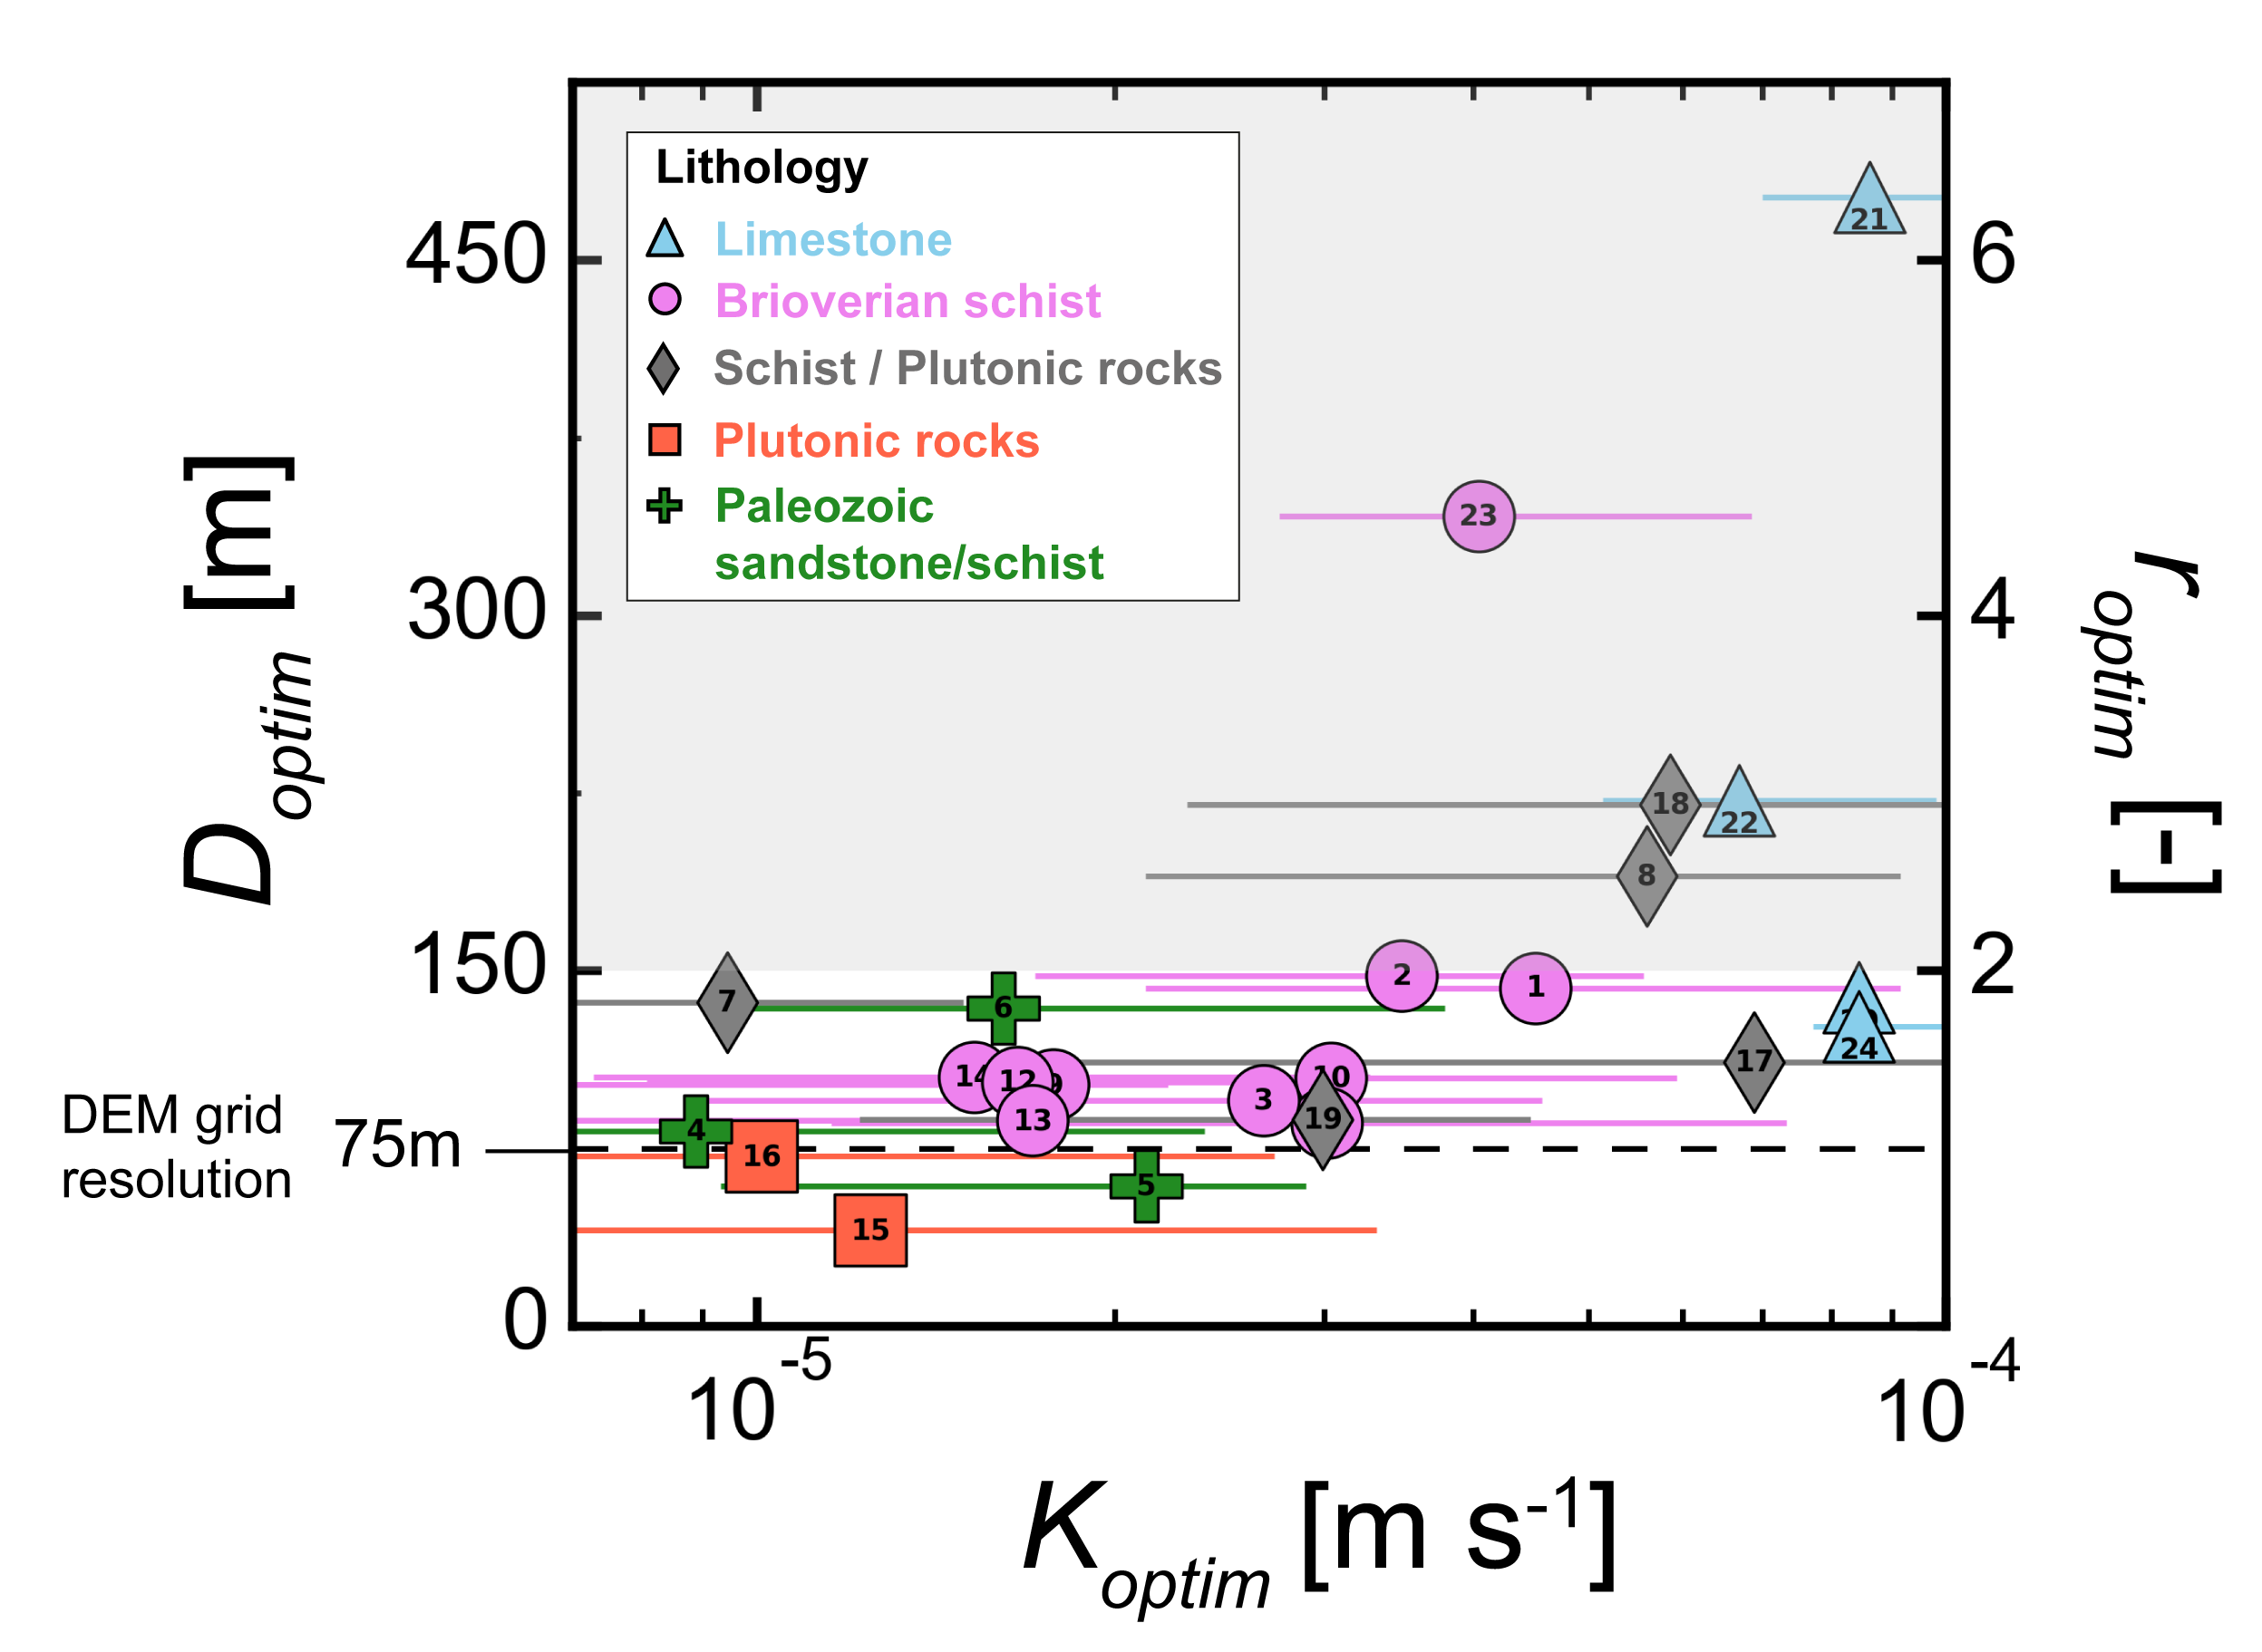


Application
Specific errors due to the mismatch bewteen the observed stream network and the DEM
$$\overline{D_{so}} ≈ \overline{D_{os}}$$
$$\frac{D_{optim}}{{DEM}_{res}}$$
The smaller the value D_{optim}, the better is the match of the simulated seepage pattern and the observed stream network
Compared to the DEM resolution: reported in number of pixels

Slide 7
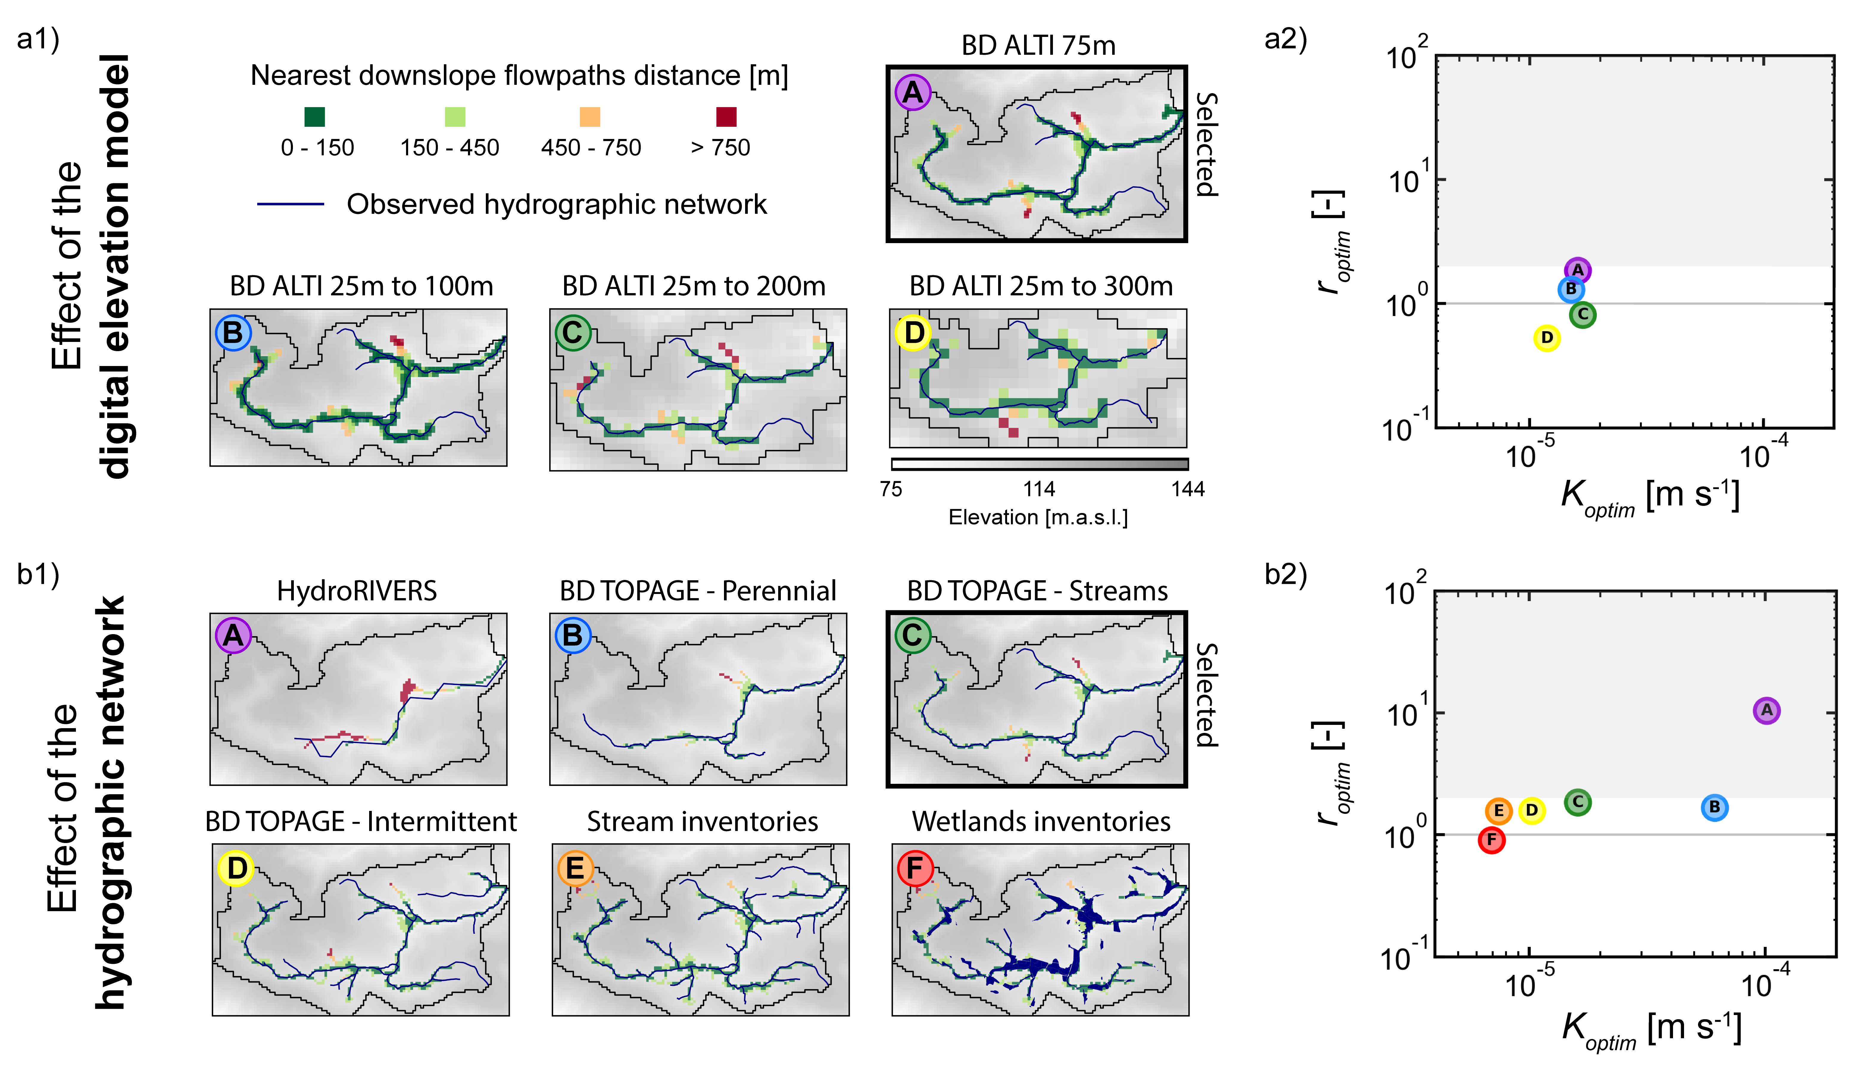
Sensitivity
-
+
Spatial extent and distribution of the stream network
K is highly sensitive to the hydrographic density
The hydrographic network can be used to inform the hydraulic conductivity
Average number of error pixels

Slide 8
Conclusion
We propose to use a surface spatial information, the hydrographic network, to calibrate a groundwater flow model.
The developed method allows to automatically evaluate the hydraulic conductivity at the catchment scale.
Requiring only information on the density and spatial extent of the stream network, this new approach is an alternative method for characterizing ungauged basins.
It aims to be deployed by leveraging current innovations in remote sensing and crowdsourcing that provide high-resolution surface products and perennial stream network mapping.
Preprint in interactive discussion available on HESS: https://hess.copernicus.org/preprints/hess-2022-175/
Abhervé et al., 2022.
Calibration of groundwater seepage on the spatial distribution of the stream network to assess catchment-scale hydraulic conductivity

Slide 9
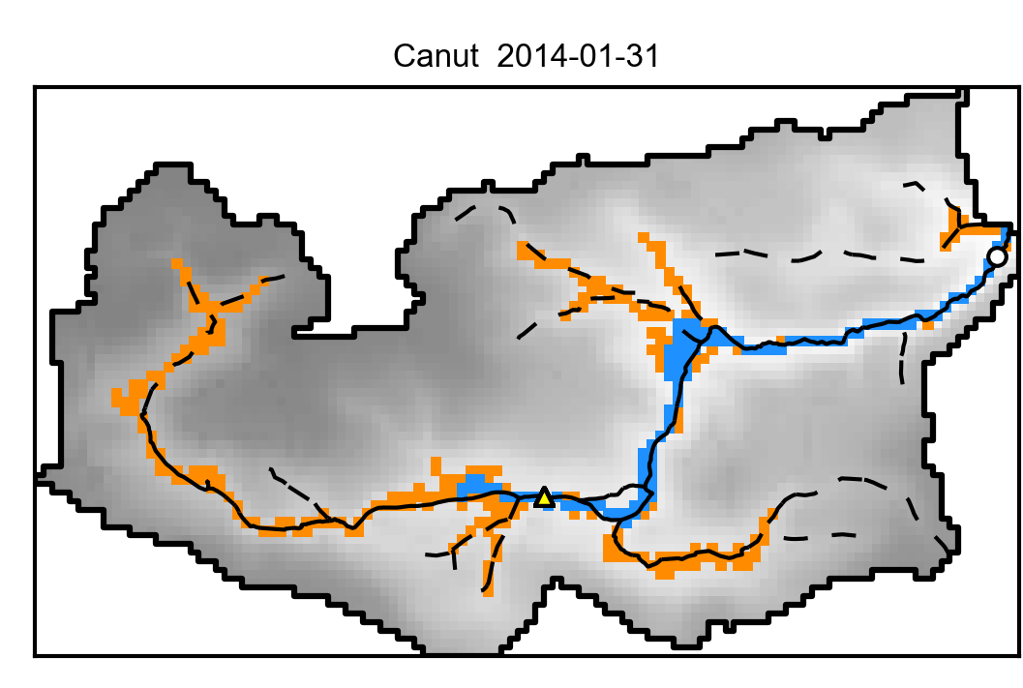
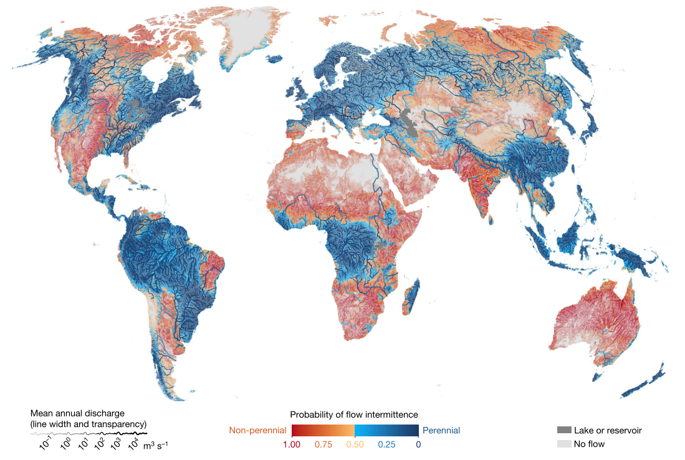
Perspectives
Development of the method for transient simulations
5 km
N
Observed
Simulated
Intermittent
Perennial
Messager et al., 2021
Modeling stream intermittency and using this type of observed data to constrain models
« water ceases to flow for at least one day per year along 51–60 per cent of the world’s rivers by length »

