Slide 1
A comparative analysis of urban environmental quality of developing cities of India: A geospatial approach
EGU22-13558
ERE1.8 – 'Geospatial analysis for sustainable development' combined with 'Carbon emissions/removals estimates under Land use, land-use change and forestry (LULUCF) sector‘
Srashti Singh and Kamal Jain
Affiliation: Indian Institute of Technology Roorkee, India

Slide 2
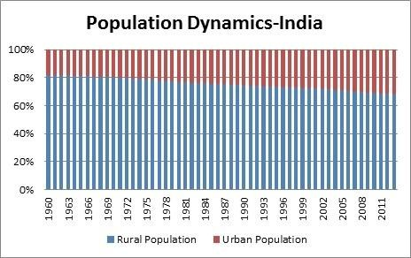
Introduction
In 1900, only 10% of the world population lived in urban areas. The percentage reached 55% in 2018, and is expected to reach 68% by 2050 (United Nations, 2017).
India is experiencing excessive urban growth at an ever increasing rate.
Figure 1. Temporal Dynamics of Population of India
Source: https://qphs.fs.quoracdn.net/main-qimg-d6db6c301b8f85b33edea7b1a1963676

Slide 3
Ill-effects of rapid urbanization
Indicators of rapid urbanization
Uncontrolled urbanization leads to dramatic local environmental changes, such as land-use and land-cover changes, local and regional climate changes, shortages of housing and green areas, worsening water quality, air pollution, noise, odour and the problems of disposal of solid wastes and hazardous wastes.
The information gathered by composite environmental indexes can be used to detect changes and trends and to identify actions for remediation in the environment. Fine particulate matter (PM2.5) concentration, land surface temperature (LST), and normalized difference vegetation index (NDVI) prove to be the major indicators.

Slide 4
Objective
The objective of this study is to study the spatio-temporal pattern of urban environmental changes by using multi-spectral remote-sensing data products from various sources in the 10 rapidly developing cities of India from 2010 to 2020.
The urban environmental conditions were evaluated by a Comprehensive Environmental Quality Index (CEQI) and the comparative environmental quality of the cities is discussed.

Slide 5
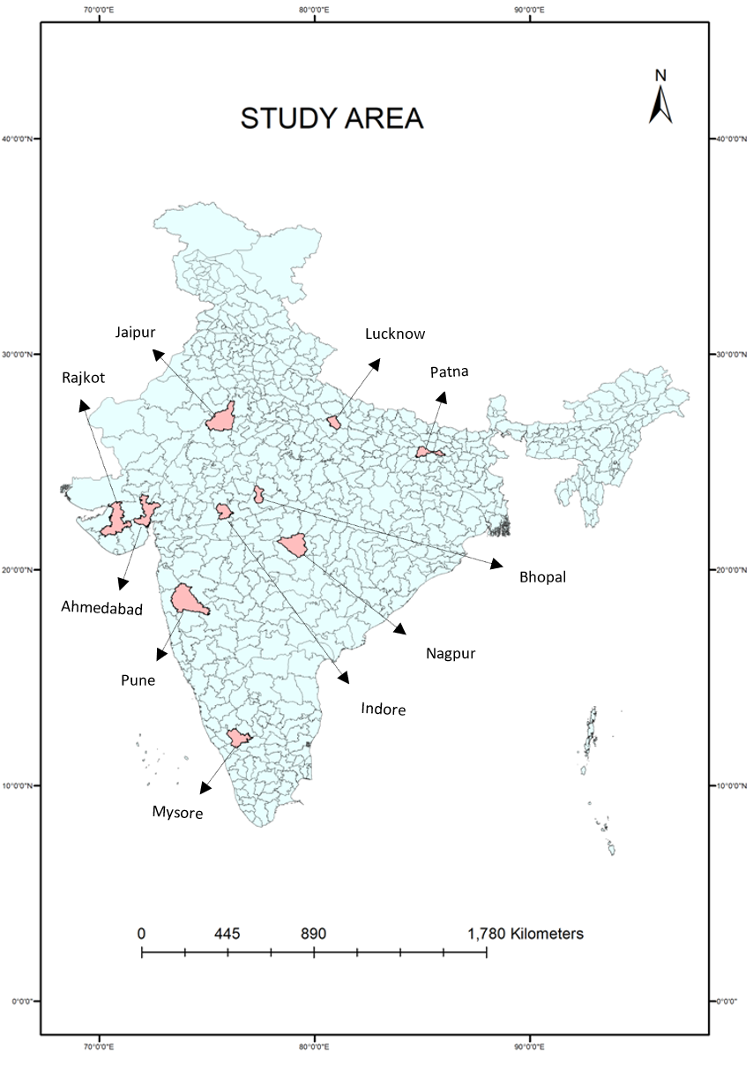
Study Area
For this study, we have selected 10 rapidly developing cities distributed in 7 states of India namely, Bhopal, Indore, Jaipur, Lucknow, Patna, Nagpur, Pune, Mysore, Ahmadabad and Rajkot.
We kept the district boundary for all 10 study areas in order to find the scope of further expansion of the city.
Figure 2. Location map depicting study areas

Slide 6
Data Used
The following data is used in this study-
  District shapefiles of the 10 selected study areas.
  Satellite-derived data
    MODIS NDVI data to study vegetation cover - MOD09GA-006
    MODIS LST data MOD11A1-006
  NDVI and LST data were downloaded for 2010 and 2020 using the Google Earth Engine code editor.
    PM 2.5 data is downloaded from the website of ‘Washington University in St. Louis’, for 2011 and 2021.
  All the data used is annual data, for 1km spatial resolution.

Slide 7

Method
The annual average LST and NDVI at each pixel for the year 2010 and 2020 was computed using Google Earth Engine.
The vegetation coverage (VC) value at each pixel was calculated using the following formula.
  VC_{i} = (N_{i} – N_{min}) / (N_{max} – N_{min})
  where VCi =VC value at pixel i, Ni =NDVI value at pixel i,
  Nmin, Nmax = minimum and maximum values of the NDVI respectively.
A composite index was used to assess the urban environmental change which subsequently gives an idea of the urban environmental quality of the area. The CEQI here is the geometric mean value of the change in PM2.5 concentration, LST, and VC and can be calculated using the following formula.
Here, ΔPM_{i ,} ΔLST_{i} and ΔVC_{i} represent the normalized changes in the PM2.5 concentration, LST and VC at pixel i from 2010 to 2020. This was done in ArcGIS.

Slide 8


Contd..
ΔPM_{i ,} ΔLST_{i} are calculated using the following formula.
  ΔV_{i} is the normalized variation in PM2.5 concentration and LST from 2010 to 2020.
ΔVC_{i was} calculated based on the following formula.
    ‘max’ and ‘min’ represent the maximum and minimum changes in these parameters respectively.
The CEQI values were mapped to depict the spatial pattern of environmental conditions in these 10 study areas.

Slide 9
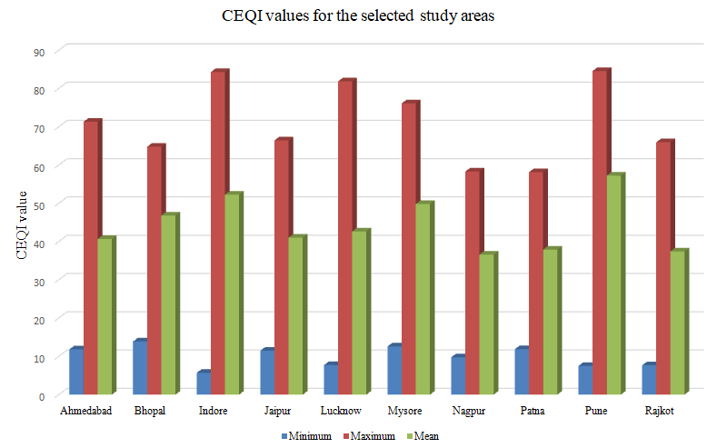
Results
The maximum, minimum and mean of the CEQI values are represented here for each study area.
A higher value of CEQI indicates a higher degree of environmental degradation.
Figure 3. Variation in CEQI values for each area under study

Slide 10
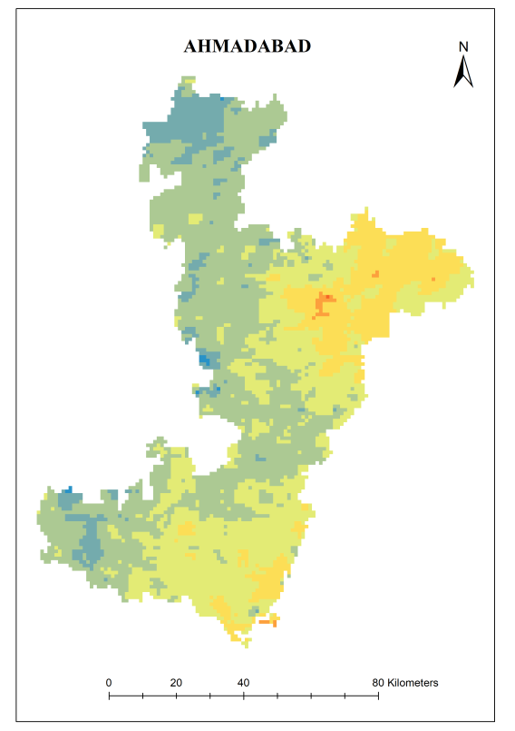
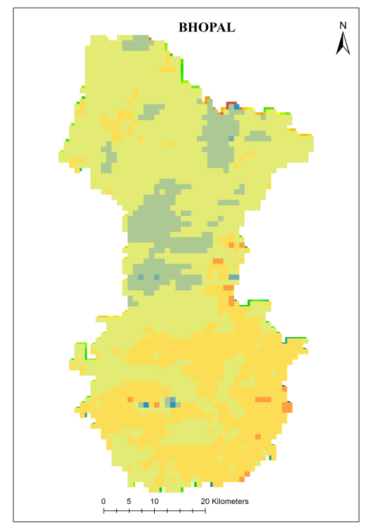
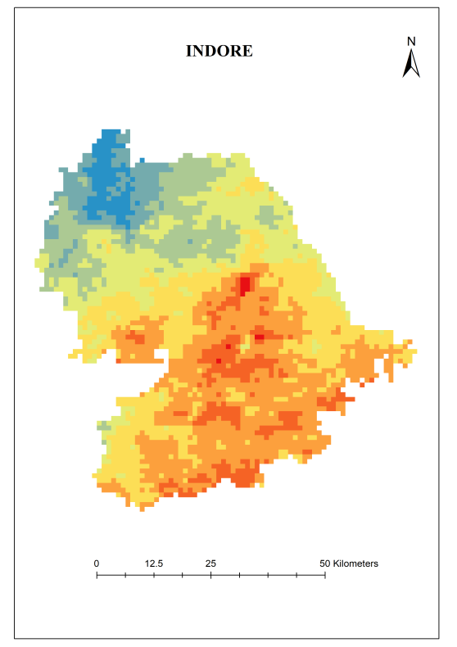
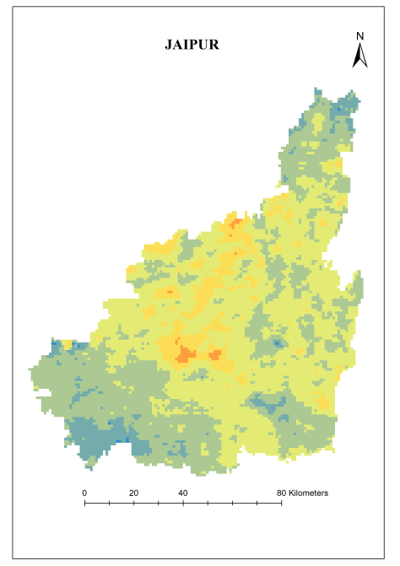
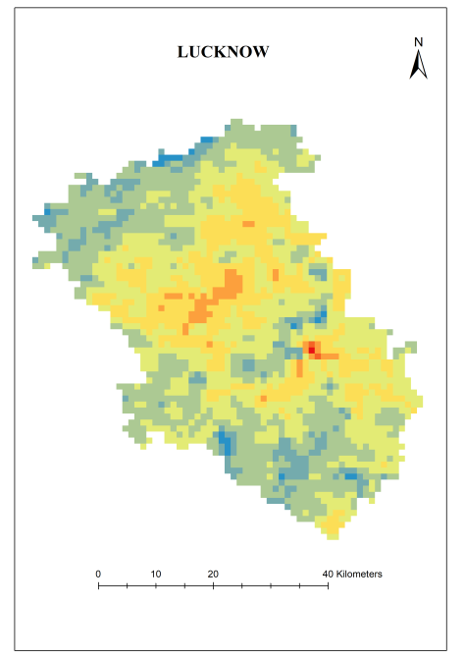
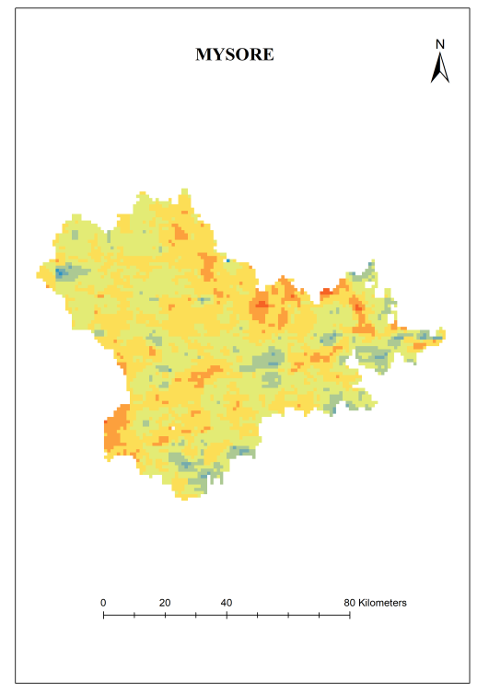
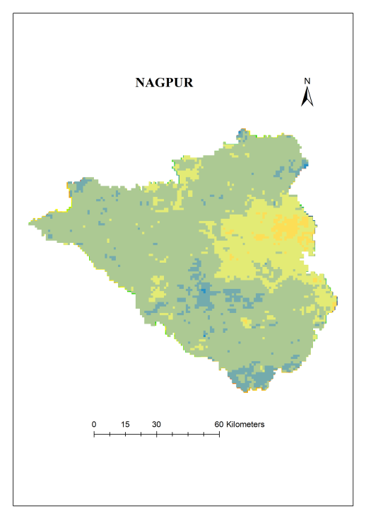
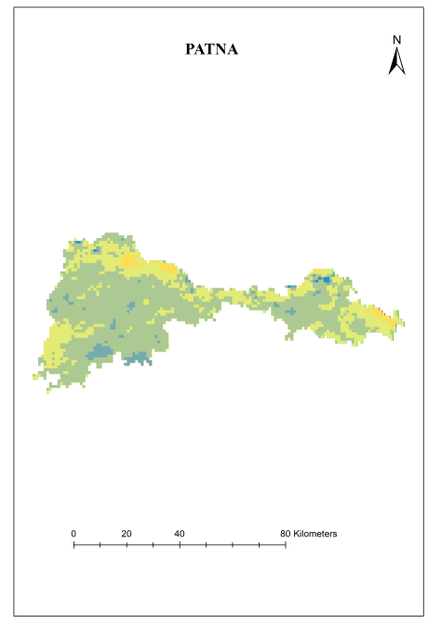
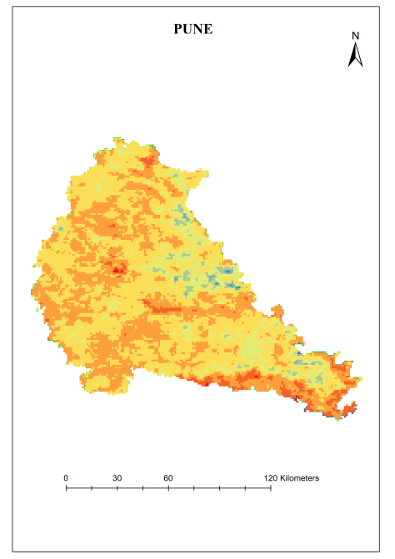
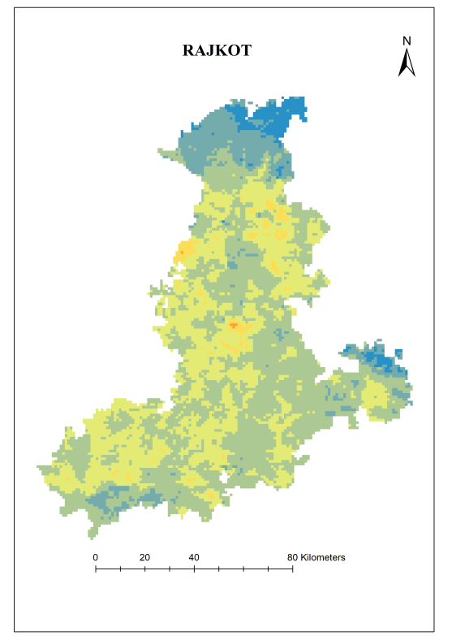
CEQI
Figure 4. Spatio-temporal Variation in CEQI values for each area under study

Slide 11
Discussion
The spatial pattern of the CEQIs can be classified into 4 types.
  High annual CEQI values were distributed in Indore and Pune. This indicates that the majority of urban areas in these cities have experienced environmental deterioration.
  Medium and high annual CEQI values were distributed in Bhopal, Lucknow and Mysore. The maps indicate that the newly developed urban areas surrounding the urban cores of these cities experienced environmental deterioration in this decade.
  Low and medium CEQI values appeared in Ahmadabad and Jaipur.
  Low CEQI values occurred in Nagpur, Patna and Rajkot.
The maps also make it easier to analyse that in which direction the cities should expand so as to avoid saturation beyond the capacity of the cities.
The future directions of developments will only define the sustainability of the cities.

Slide 12
Conclusion
Using multi-source remote sensing data, this study conducted a comprehensive assessment of urban environmental changes from 2010 to 2020 in selected rapidly developing Indian cities by combining three factors that influenced urban environmental quality.
The map results make it easier to analyse that in which direction the cities should expand so as to avoid saturation beyond the capacity of the cities.
The future directions of developments will only define the sustainability of the cities.
The result suggests that greening and strong emission control strategies will significantly contribute to urban environmental quality enhancement in rapidly developing cities.

Slide 13
References
He, C., Gao, B., Huang, Q., Ma, Q., Dou, Y., 2017. Environmental degradation in the urban areas of China: evidence from multi-source remote sensing data. Remote Sens. Environ. 193, 65–75.
L. Lu, Q. Weng, H. Guo, S. Feng, and Q. Li, “Assessment of urban environmental change using multi-source remote sensing time series (2000–2016): A comparative analysis in selected megacities in Eurasia,” Sci. Total Environ., vol. 684, pp. 567– 577, 2019.
M. A. Musse, D. A. Barona, and L. M. Santana Rodriguez, “Urban environmental quality assessment using remote sensing and census data,” Int. J. Appl. Earth Obs. Geoinf., vol. 71, no. May, pp. 95–108, 2018.
M. M. Hassan and J. Southworth, “Analyzing land cover change and urban growth trajectories of the mega-urban region of Dhaka using remotely sensed data and an ensemble classifier,” Sustain., vol. 10, no. 1, pp. 1–24, 2017.
B. Lin and J. Zhu, “Changes in urban air quality during urbanization in China,” J. Clean. Prod., vol. 188, pp. 312–321, 2018.
L. Lu, H. Guo, C. Corbane, and Q. Li, “Urban sprawl in provincial capital cities in China: evidence from multi-temporal urban land products using Landsat data,” Sci. Bull., vol. 64, no. 14, pp. 955–957, 2019.
P. Verma and A. S. Raghubanshi, “Urban sustainability indicators: Challenges and opportunities,” Ecol. Indic., vol. 93, no. May, pp. 282–291, 2018.

