Slide 1
Carbon assimilation and water use efficiency increases in undisturbed core forest areas may not compensate carbon losses
Bruno Montibeller¹, Michael Marshall², Ülo Mander¹, Evelyn Uuemaa¹
¹Department of Geography, Institute of Ecology and Earth Sciences, University of Tartu, Tartu, Estonia
²Department of Natural Resources, Faculty of Geo-information Science and Earth Observation (ITC), University of Twente, Enschede, The Netherlands

Slide 2



Intro
Approach
Findings
Take home
CO₂
CO₂
CO₂
CO₂
Gross Primary production
(GPP)
H₂O
H₂O
H₂O
Water-use-efficiency
WUE=GPP/ET
Evapotranspiration
(ET)
H₂O
H₂O
H₂O
Deforestation
Degradation (e.g., fires)
Long-term undisturbed forest areas
CO₂
CO₂
CO₂
CO₂
CO₂
CO₂
CO₂
CO₂
CO₂
CO₂
CO₂
CO₂
CO₂
CO₂
CO₂
CO₂
H₂O
H₂O
H₂O
H₂O
H₂O
H₂O
H₂O
H₂O
H₂O
H₂O
H₂O
H₂O
H₂O
H₂O
H₂O
H₂O
H₂O
H₂O
H₂O
H₂O
H₂O
H₂O
H₂O
H₂O
H₂O
H₂O
1986
2000
2020

Slide 3
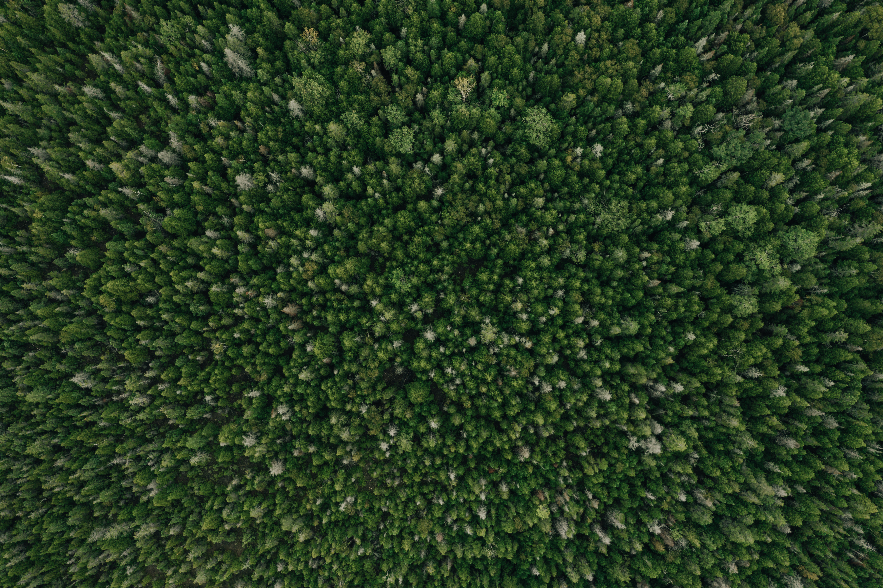
Intro
Approach
Findings
Take home
GPP and ET (MODIS products)
WUE=GPP/ET
  Monthly trends from 2000-2020
  Changing rates of the trends
Forest core area (FCA)
1986-2020
March
April
November
...
GPP
GPP
GPP
2000
2020
2000
2020
2000
2020
-Croplands
-Pasturelands
-Water bodies
Annual net GPP balance (gain or loss)
Forest edge (500m)
1
GPP+
GPP+
GPP
0
GPP-
-1
-GPP
Mar
Apr
May
Jun
Jul
Aug
Sep
Oct
Nov

Slide 4
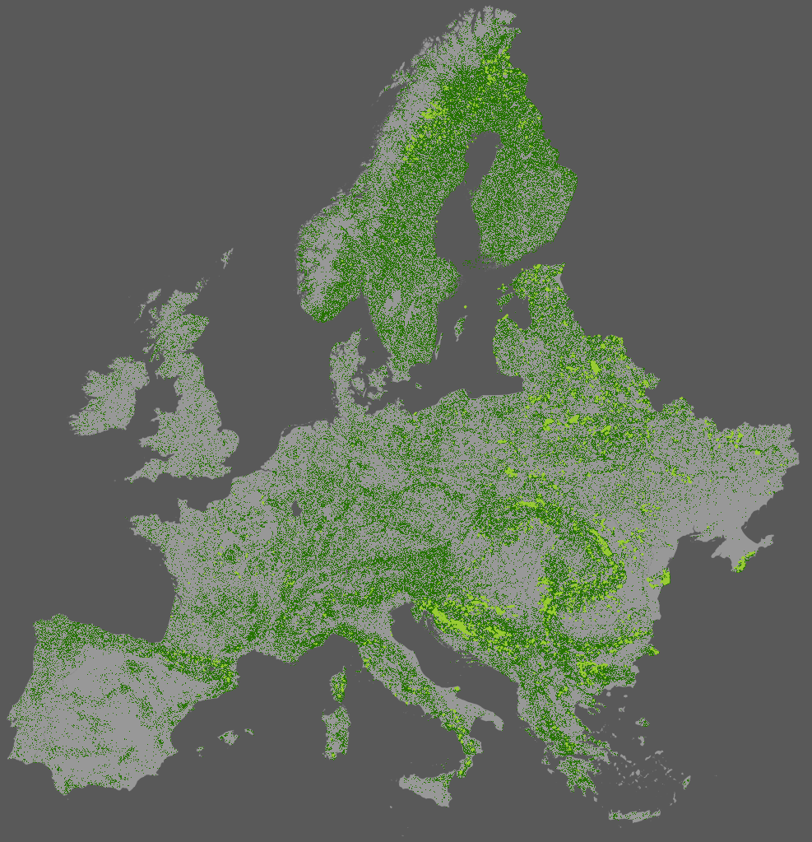
Intro
Approach
Findings
Take home
Undisturbed forest core areas
Undisturbed forest
>1.8 × 10⁶ km² of unchanged forest (1986-2020)
99.6% were located within 500m from the edge
Only 6468.9 km² were considered FCA (0.004% of the total)
  3601.5km² were analyzed (covered >50% of MODIS pixel area)
Poland, Croatia, Ukraine, Bosnia and Herzegovina, Belarus and Romania housing >70% of the FCAs

Slide 5
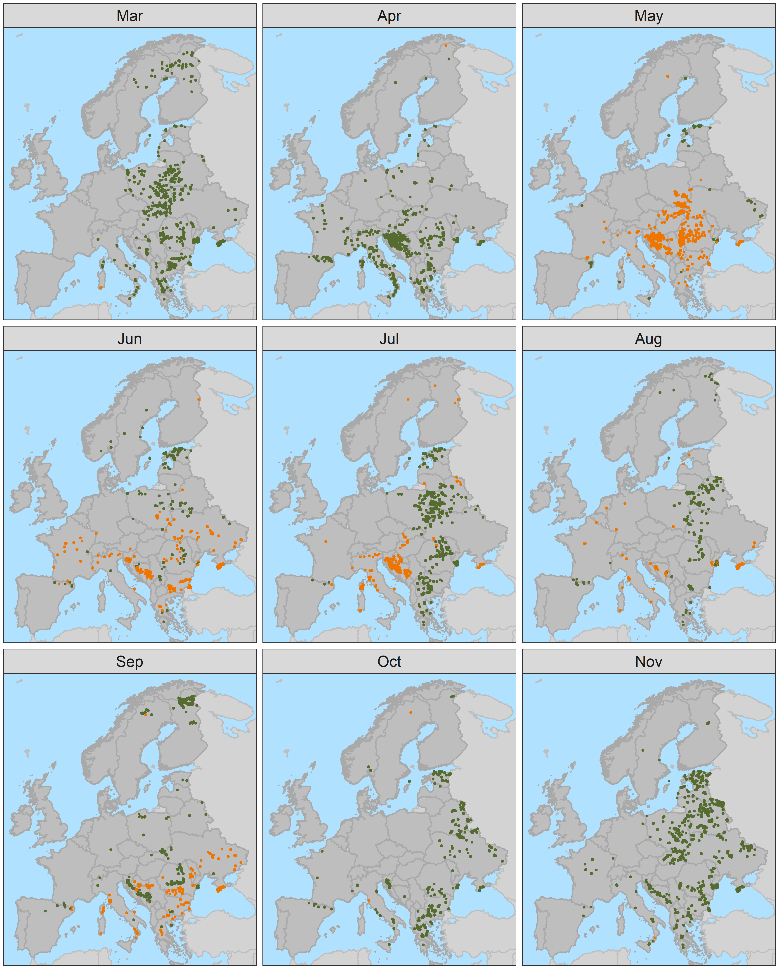
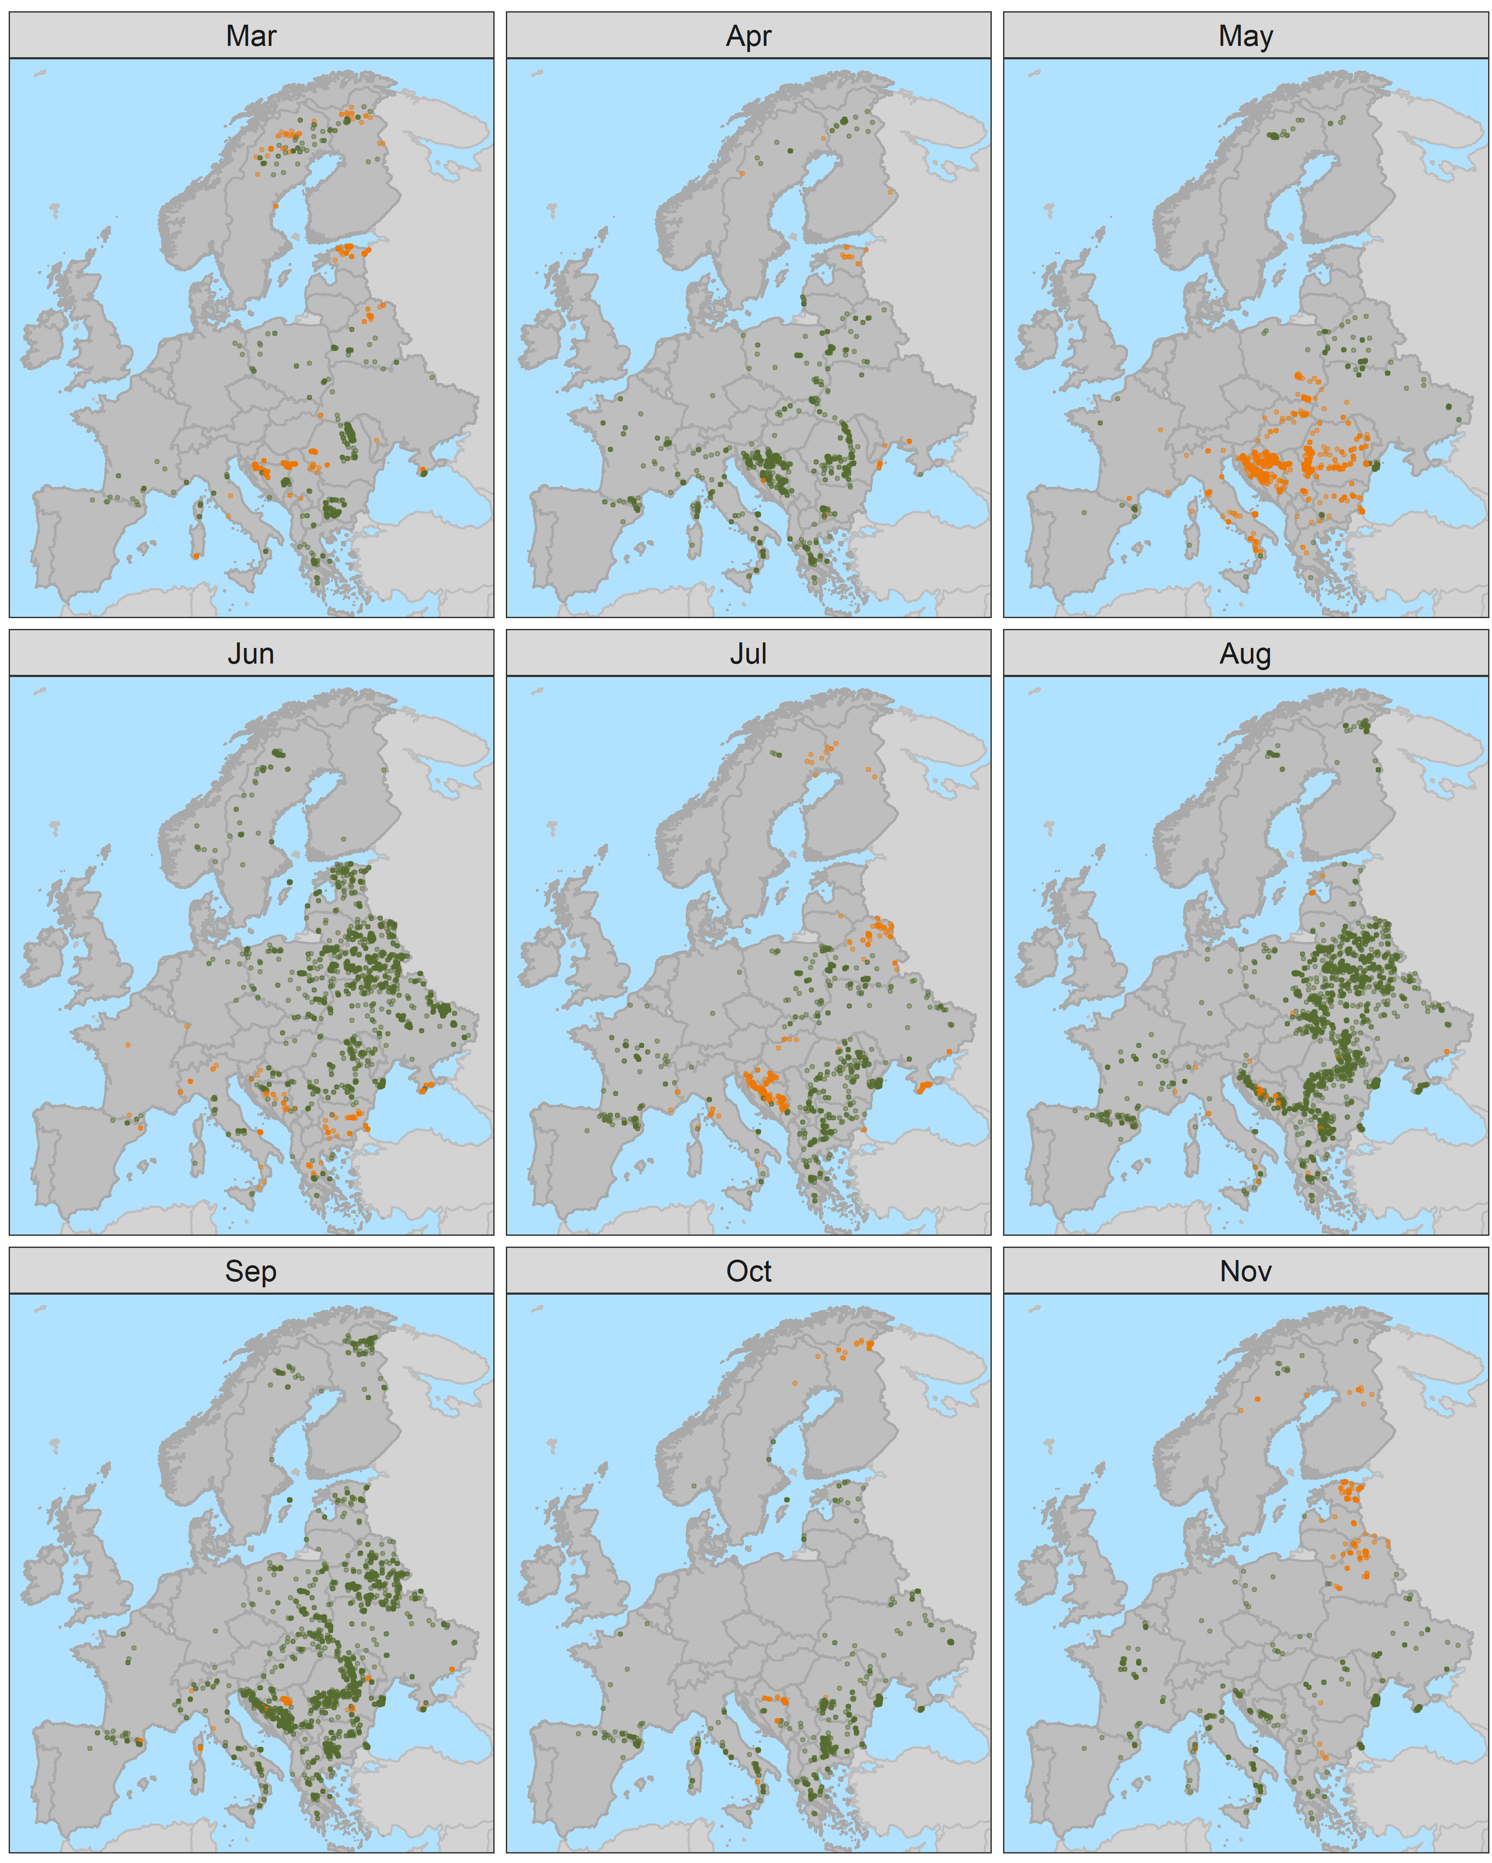
Intro
Approach
Findings
Take home
GPP)
ET)
Decrease
Increase
Notes:
GPP - Increasing trends temporally concentrated in March, April, October and November, but spatially scattered

Slide 6
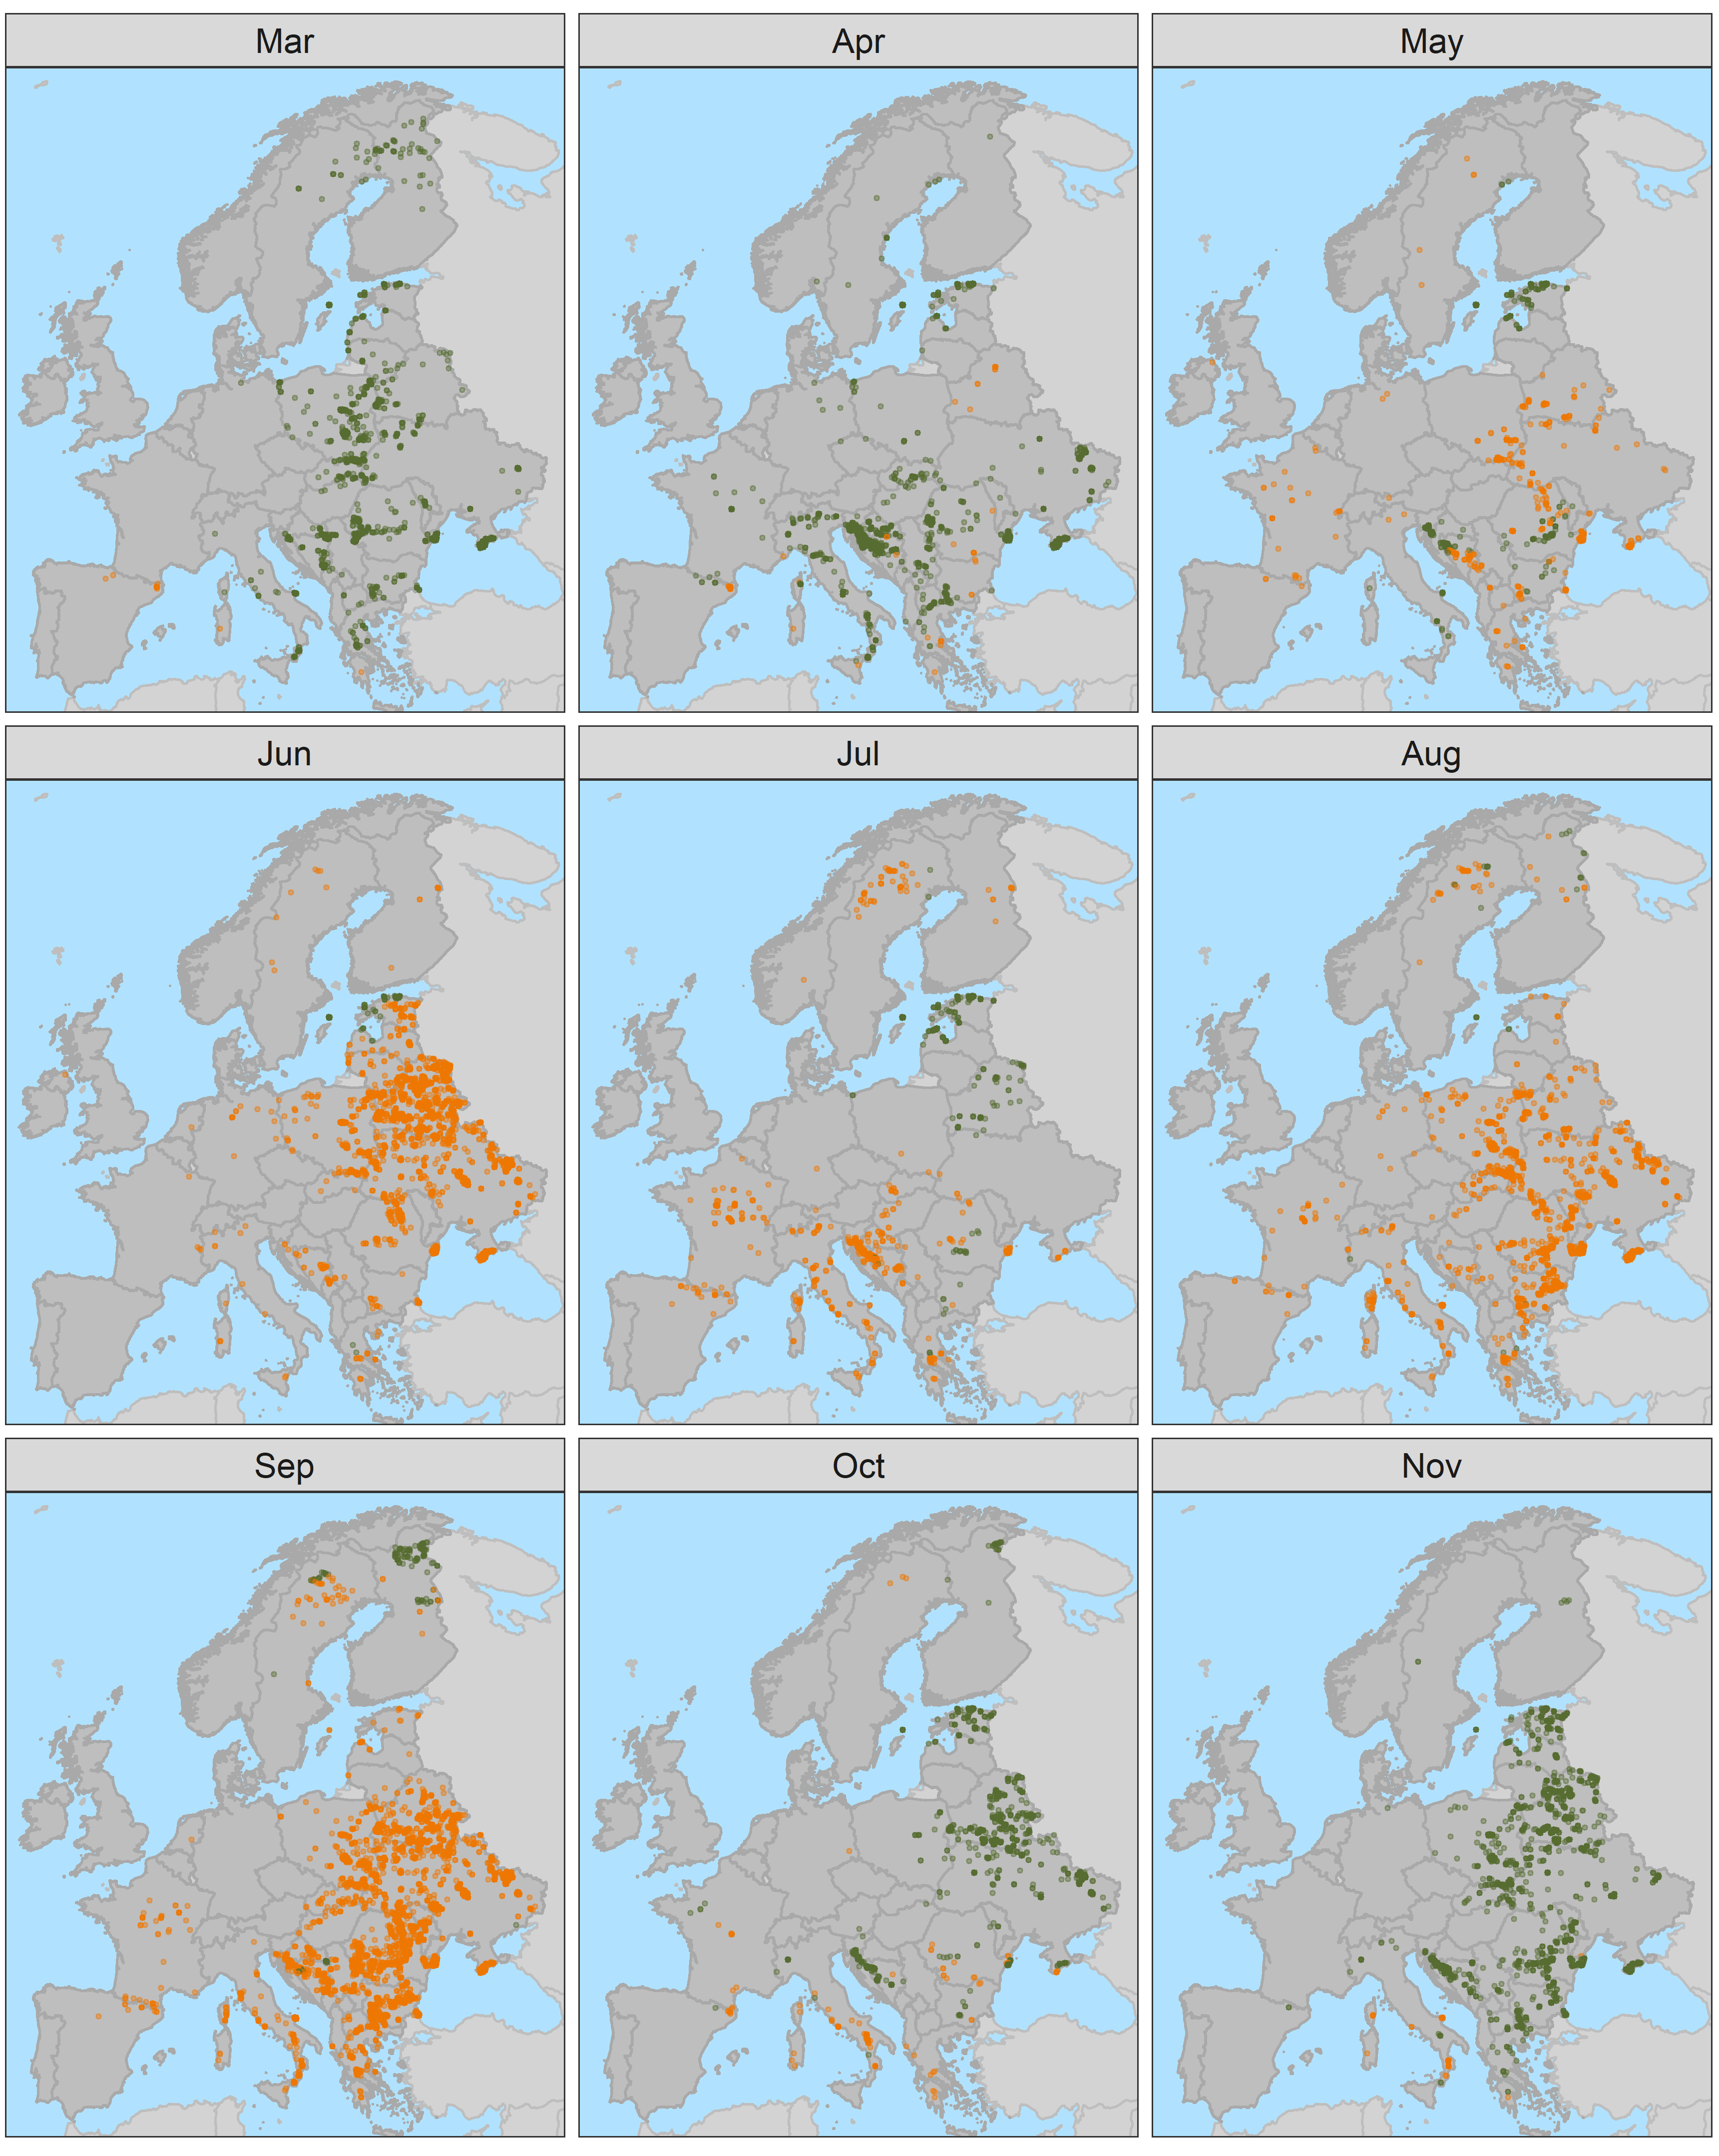
Intro
Approach
Findings
Take home
WUE)
Decrease
Increase
Notes:
GPP - Increasing trends temporally concentrated in March, April, October and November, but spatially scattered

Slide 7
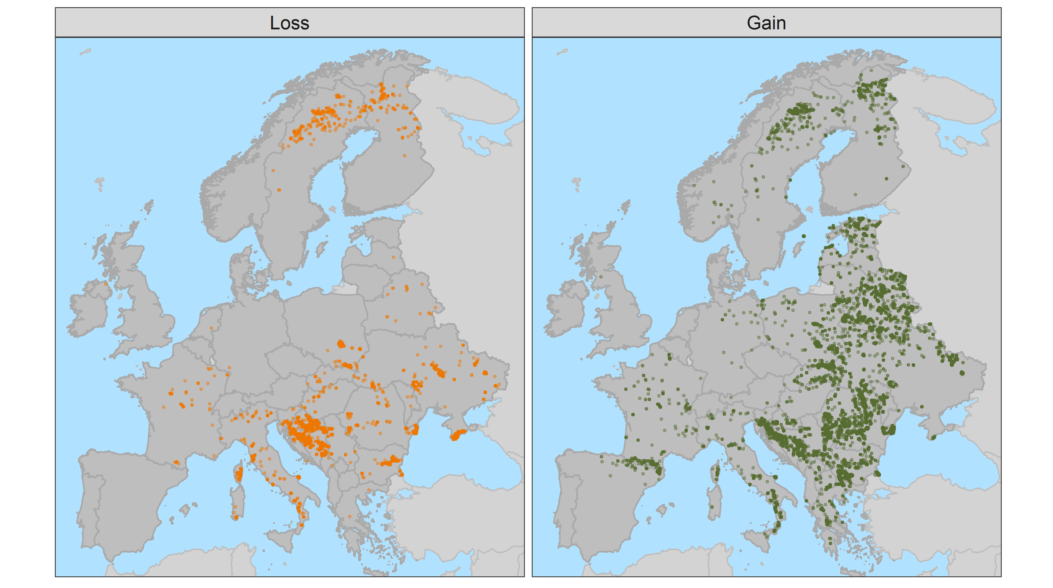
Intro
Approach
Findings
Take home
-1980.8 t C / year
+9538.7 t C / year
25% of FCAs
75% of FCAs
+7577.9 t C / year
This only offsets 0.00001% of
EU CO₂ emissions in 2020
Notes:
E.g. 1kg of CO2 can be expressed as 0.27kg of carbon
https://www.statista.com/statistics/450017/co2-emissions-europe-eurasia/#:~:text=The%20European%20Union%20produced%20approximately,at%203.99%20billion%20metric%20tons.

Slide 8
Intro
Approach
Findings
Take home
Limitations:
  GPP ≠ assimilated carbon (e.g., NPP)
  Modelled ET and GPP
  Resolution of GPP and ET data
  Forest types
~50% of FCAs showed concomitant increase in GPP and WUE
  Not due to decrease in ET
Most FCAs are still acting as carbon sink
  ~25% of FCAs are not showing GPP compensation across seasons
  the total GPP loss is responsible for offsetting 20% of total GPP gain
  the FCAs with GPP loss are spatially spread

Slide 9
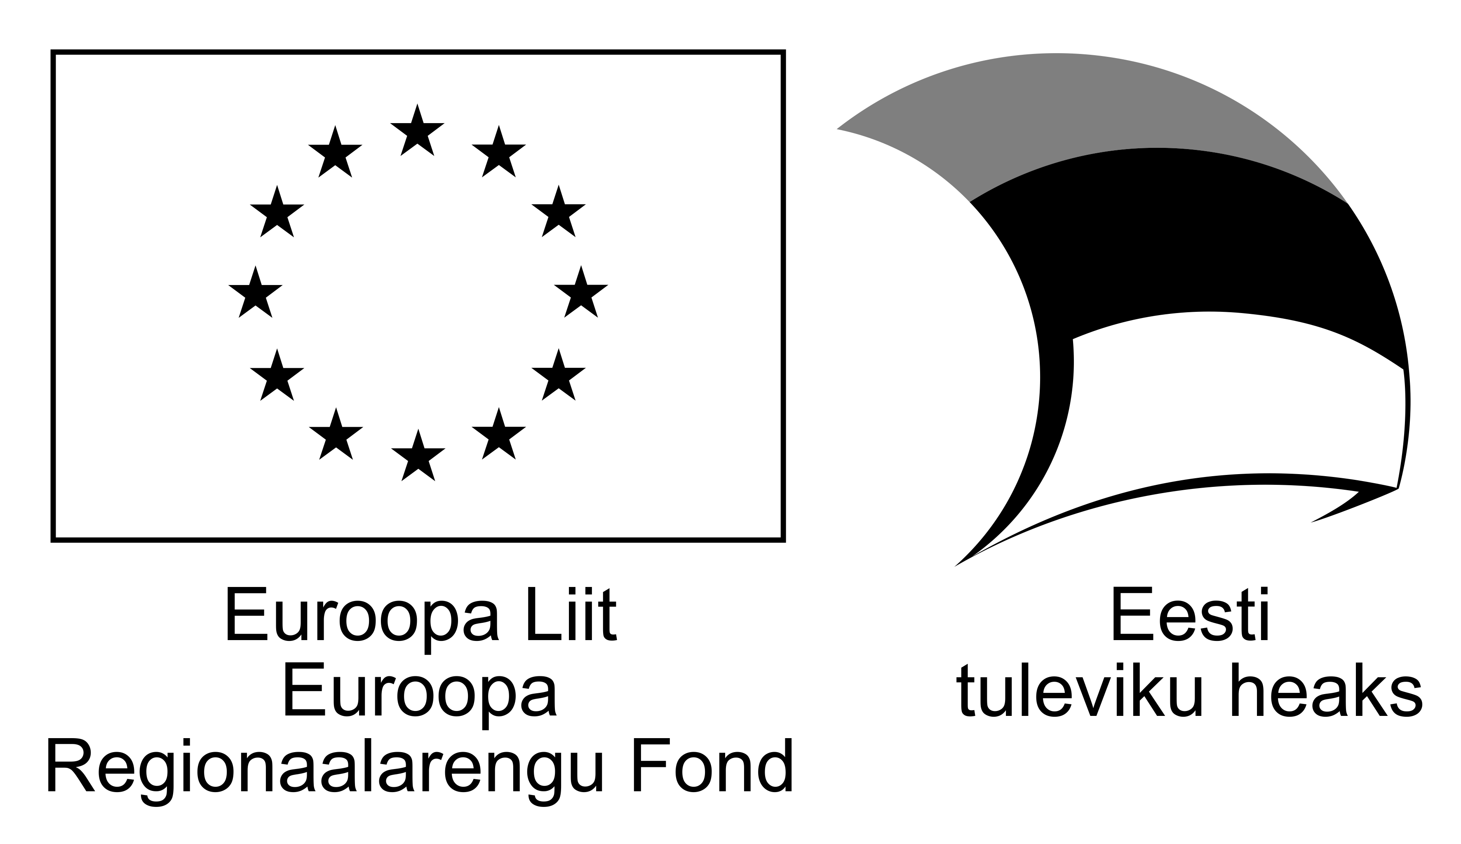
Thanks!
bruno.montibeller@ut.ee

