Slide 1


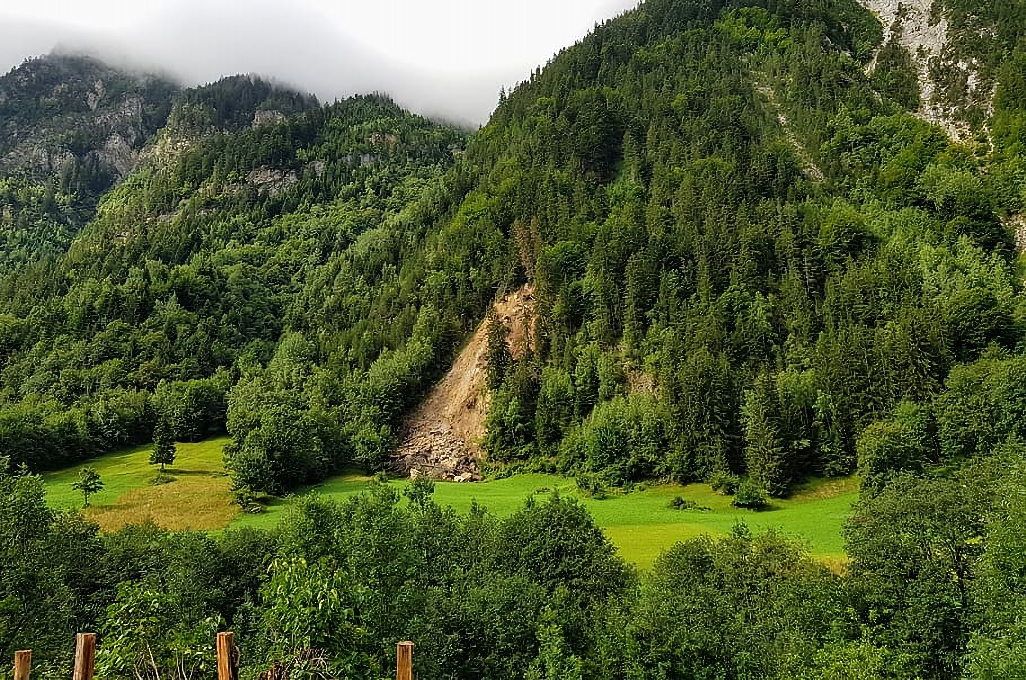



EGU22-1356
Session NH3.6
Multi-spatiotemporal landslide mapping for landslide evolutionary investigation
Kushanav Bhuyan^{1,2}, Hakan Tanyas², Lorenzo Nava¹, Silvia Puliero¹, Sansar Raj Meena^{1,2}, Mario Floris¹, Filippo Catani¹, Cees Van Westen², and Tanuj Pareek²
¹ Machine Intelligence and Slope Stability Laboratory, Department of Geosciences, University of Padova. Padova, Italy.
² Faculty of Geo-information Science and Earth Observation (ITC), University of Twente, Enschede, Netherlands.

Slide 2

RESEARCH
INTRODUCTION

Slide 3
EGU22-1356
Session NH3.6
Background
RESEARCH
INTRODUCTION
What are multi-temporal landslide inventories??
“Recurrent documentation of past landslides” (Behling, Roessner, Golovko, & Kleinschmit, 2016).
Enables the identification of spatiotemporal patterns in landslide occurrences.
Probabilistic landslide hazard assessment, landslide mobility, and evolution studies.

Slide 4

EGU22-1356
Session NH3.6
Problems
Automated mapping endeavours via Artificial Intelligence is limited
Spatial and temporal scale of mapping
Resource or data expensive
RESEARCH
INTRODUCTION

Slide 5



EGU22-1356
Session NH3.6
Background
Automated mapping endeavours via Artificial Intelligence is limited
Scale of mapping
Temporal dimension
Resource or data expensive

Slide 6
Research Objective
The main objective is to detect and map co-seismic landslides over very large scales and temporal windows for landslide evolution studies.
Sub-objectives-
S-O1: To design deep learning modelling strategies to detect landslides over varying large scales for Asia-Pacific (APAC) countries.
S-O2: To detect landslides APAC countries over different temporal windows using the same deep learning model.
S-O3: To utilise the outputs from S-O1 and S-O2 for evolution mechanism studies.

Slide 7

EGU22-1356
Session NH3.6
Research Objective
RESEARCH
INTRODUCTION
The main objective is to detect and map landslides over very large areas at different temporal windows for landslide evolution studies.

Slide 8

RESEARCH
METHODOLOGY

Slide 9
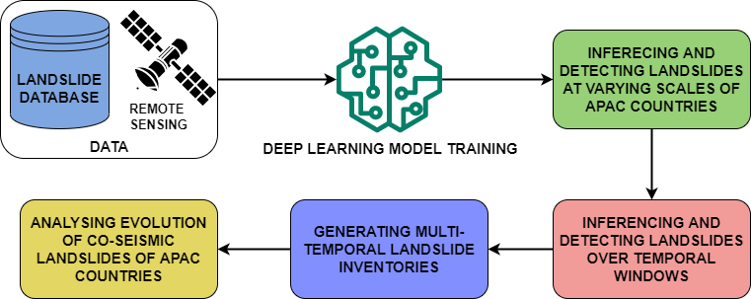
EGU22-1356
Session NH3.6
Methodology
RESEARCH
METHODOLOGY
*
*Asia-Pacific (APAC) countries

Slide 10
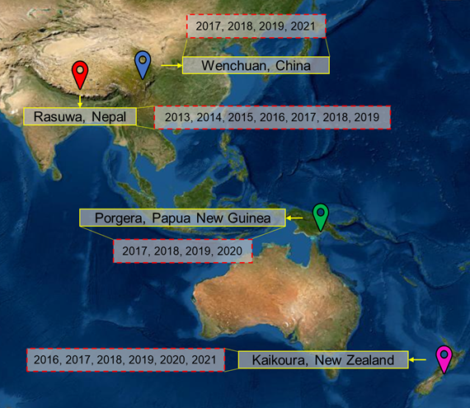
EGU22-1356
Session NH3.6
Test Sites
RESEARCH
METHODOLOGY
Investigation areas:
Nepal
China
Papua New Guinea
New Zealand

Slide 11

RESEARCH
RESULTS

Slide 12
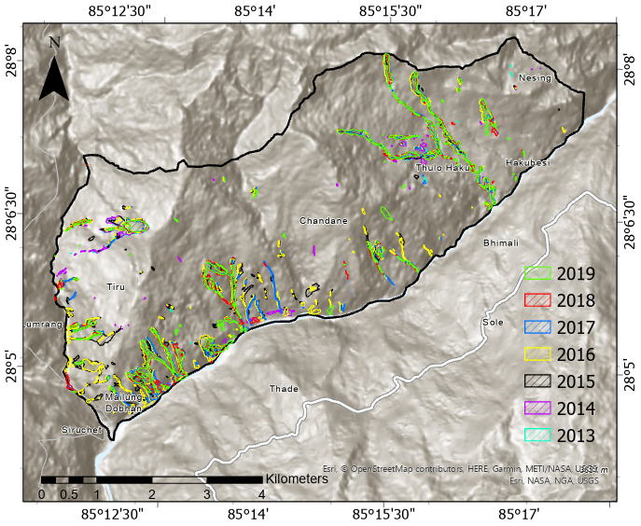
EGU22-1356
Session NH3.6
Results - Nepal
RESEARCH
RESULTS
Area mapped
~ 30 km²
Temporal window
= 2013 till 2019

Slide 13
EGU22-1356
Session NH3.6
Results - Nepal
RESEARCH
RESULTS
Area mapped
~ 30 km²
Temporal window
= 2013 till 2019

Slide 14
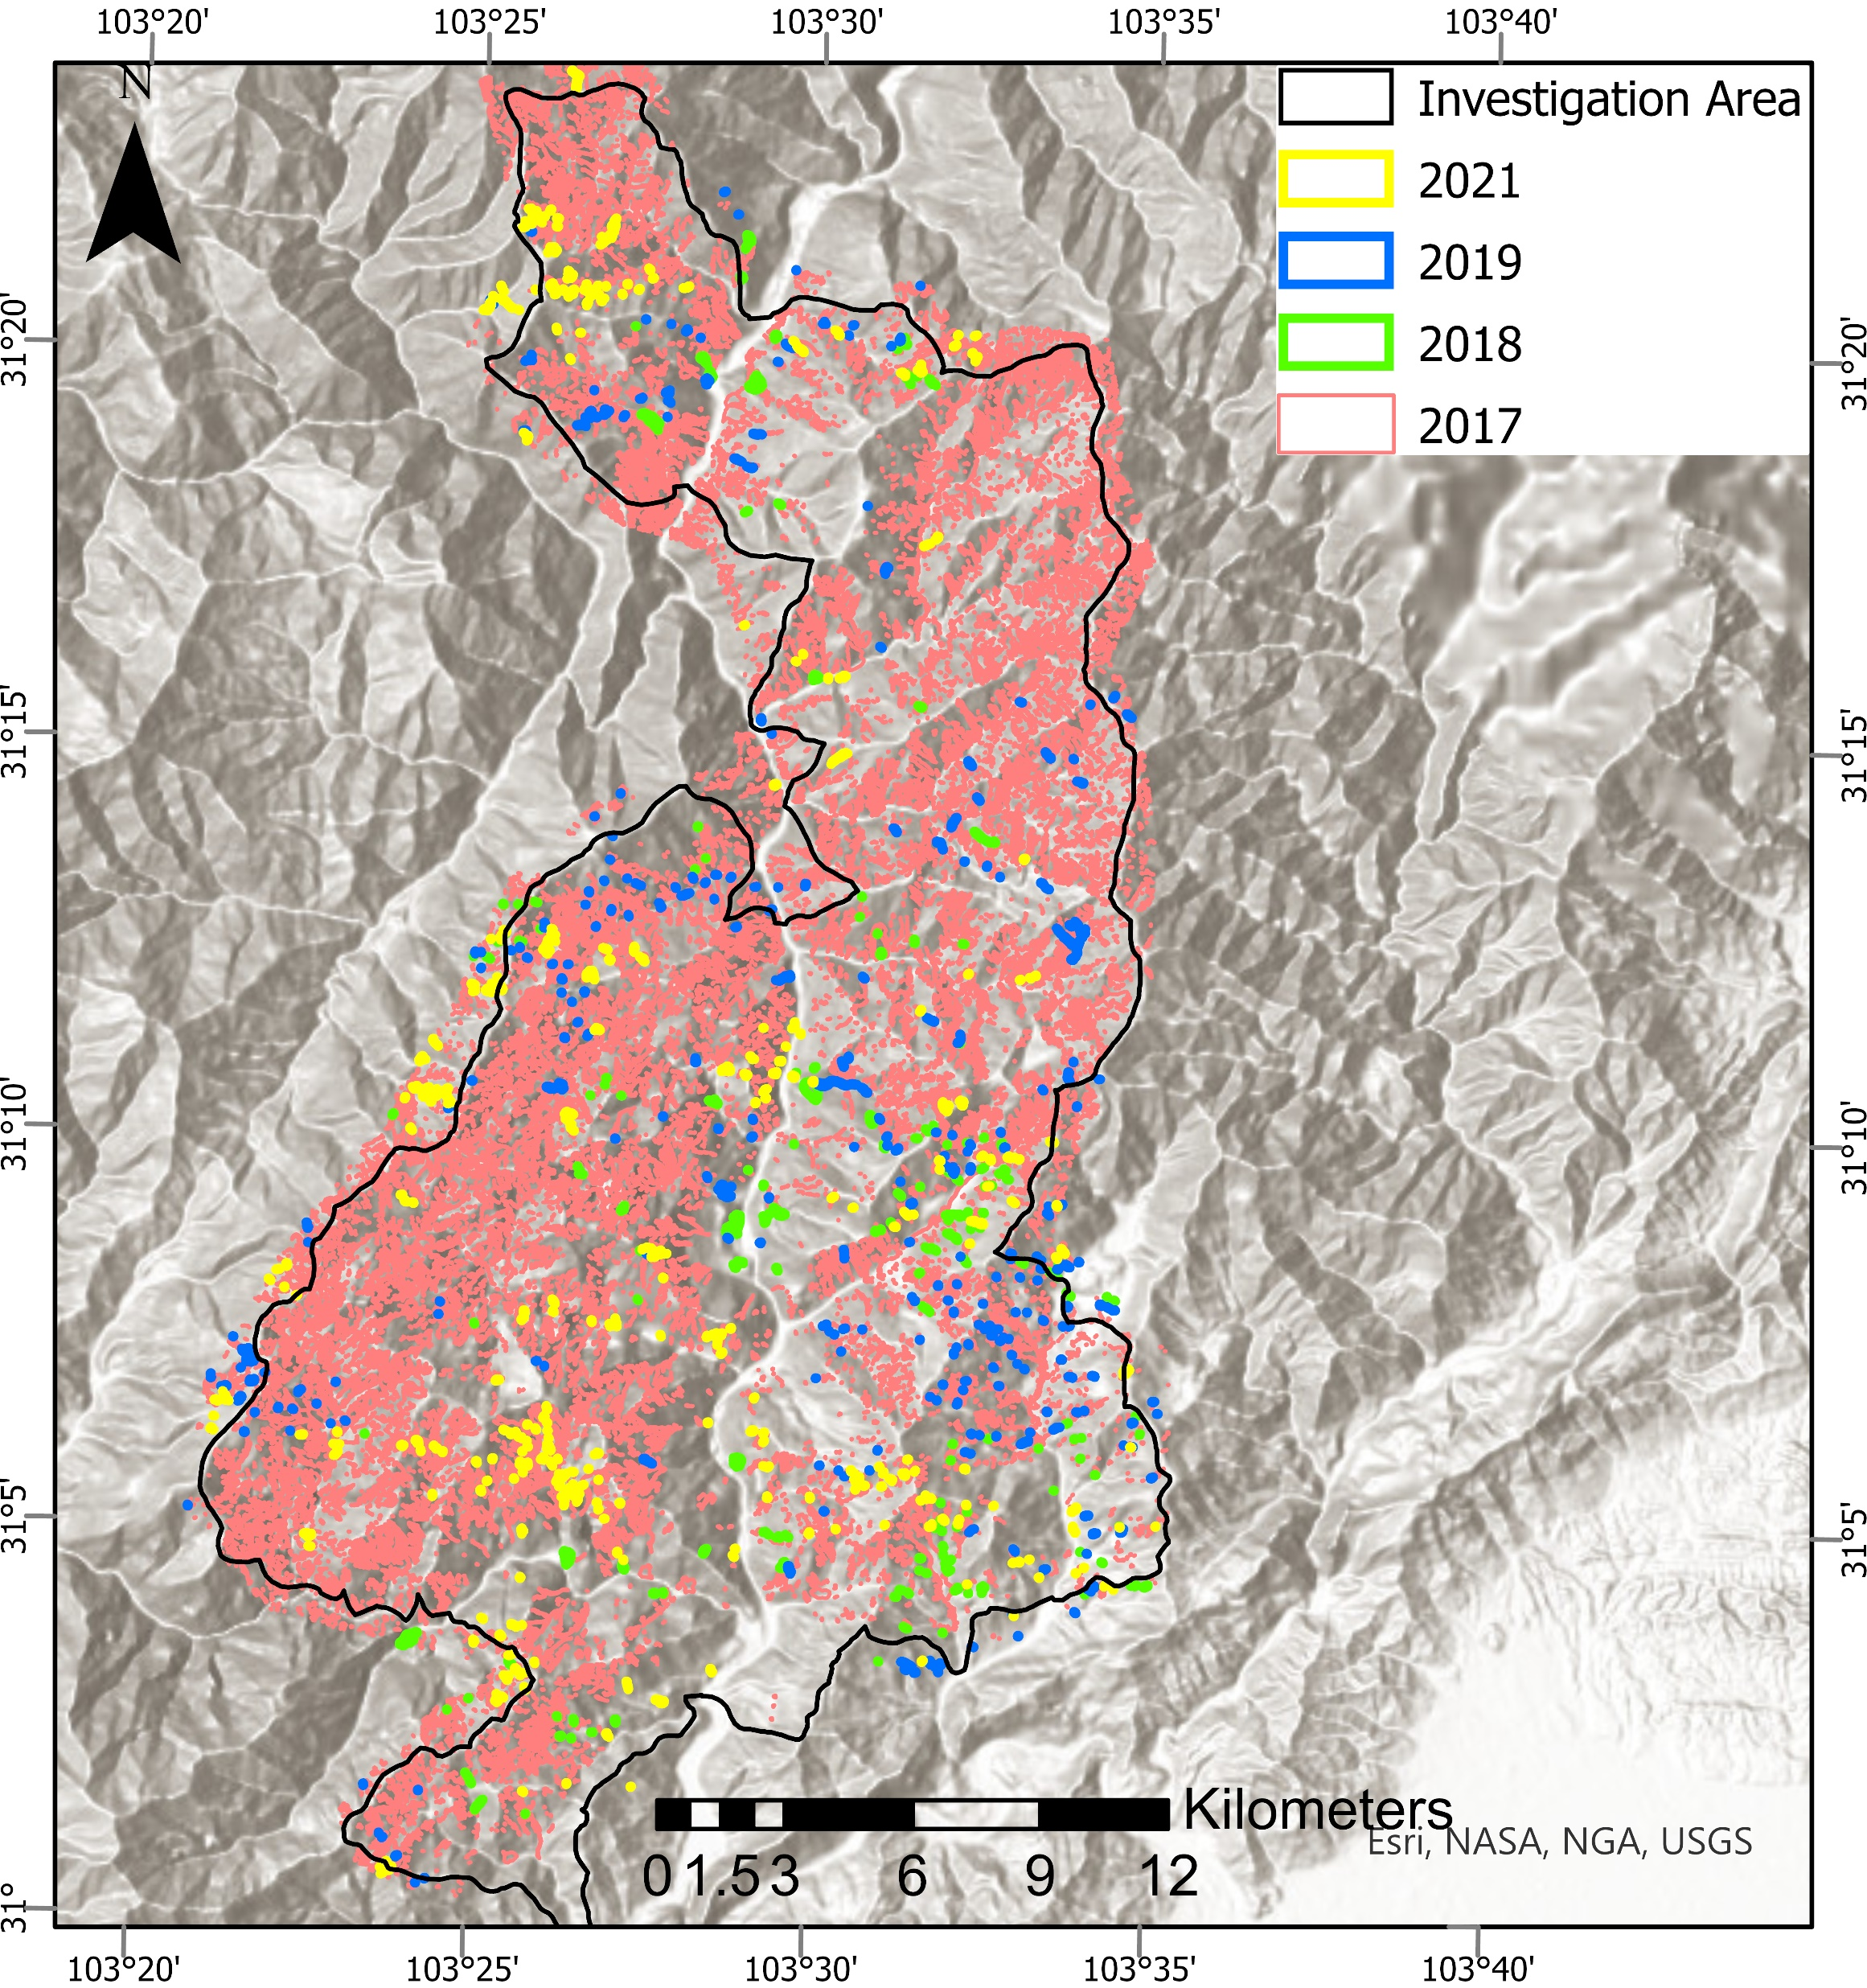
EGU22-1356
Session NH3.6
Results - China
RESEARCH
RESULTS
Area mapped
~ 600 km²
Temporal window
= 2017 till 2021*
*Cloud free images were not available for 2020

Slide 15
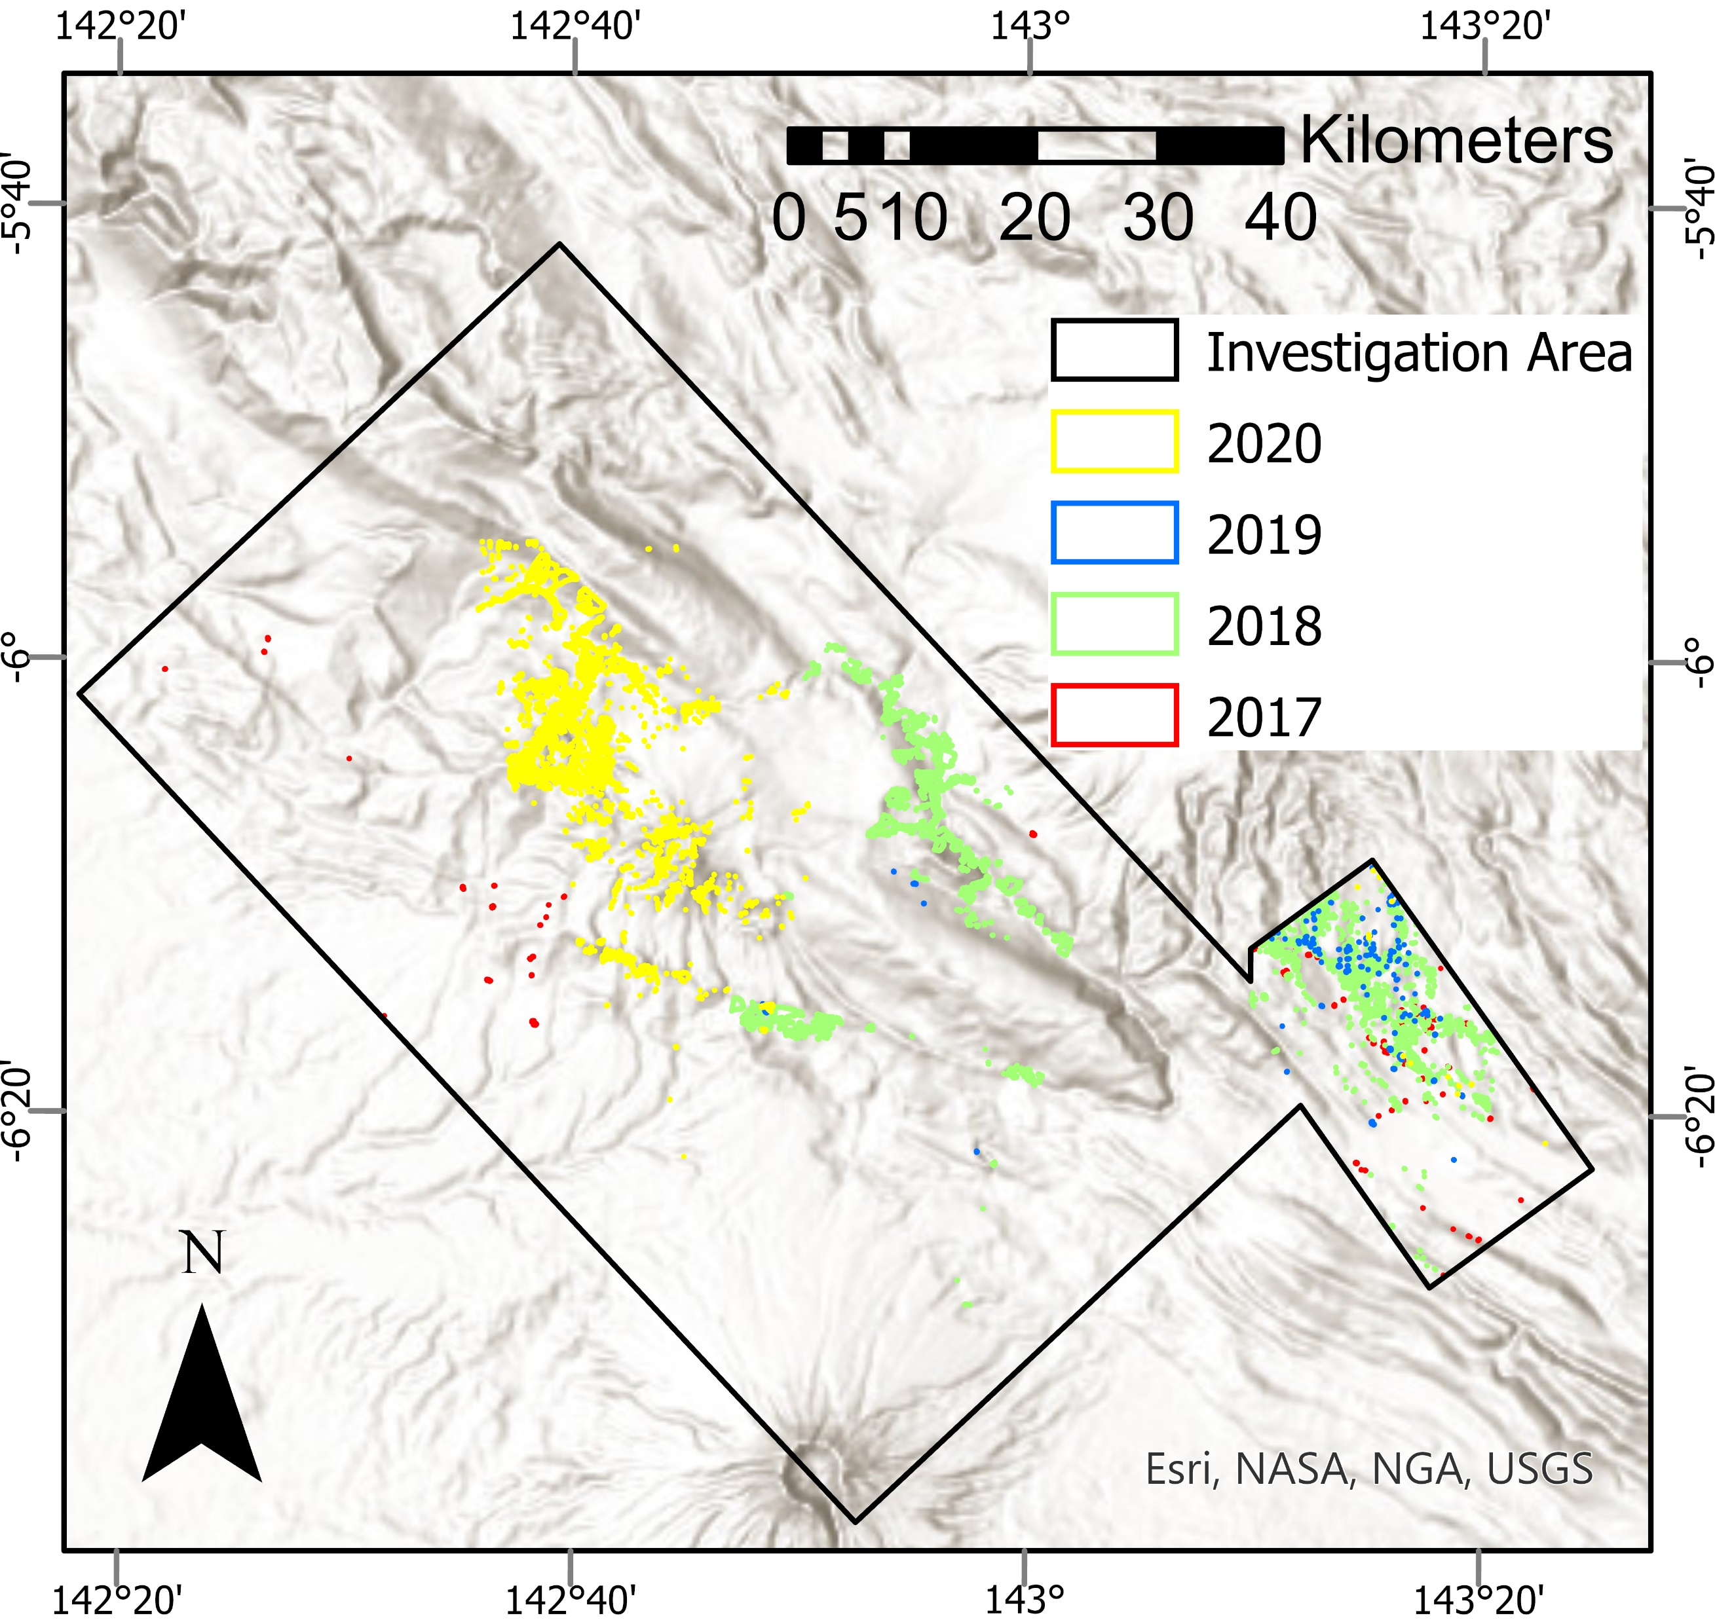
EGU22-1356
Session NH3.6
Results - Papua New Guinea
RESEARCH
RESULTS
Area mapped
~ 5391 km²
Temporal window
= 2017 till 2020

Slide 16
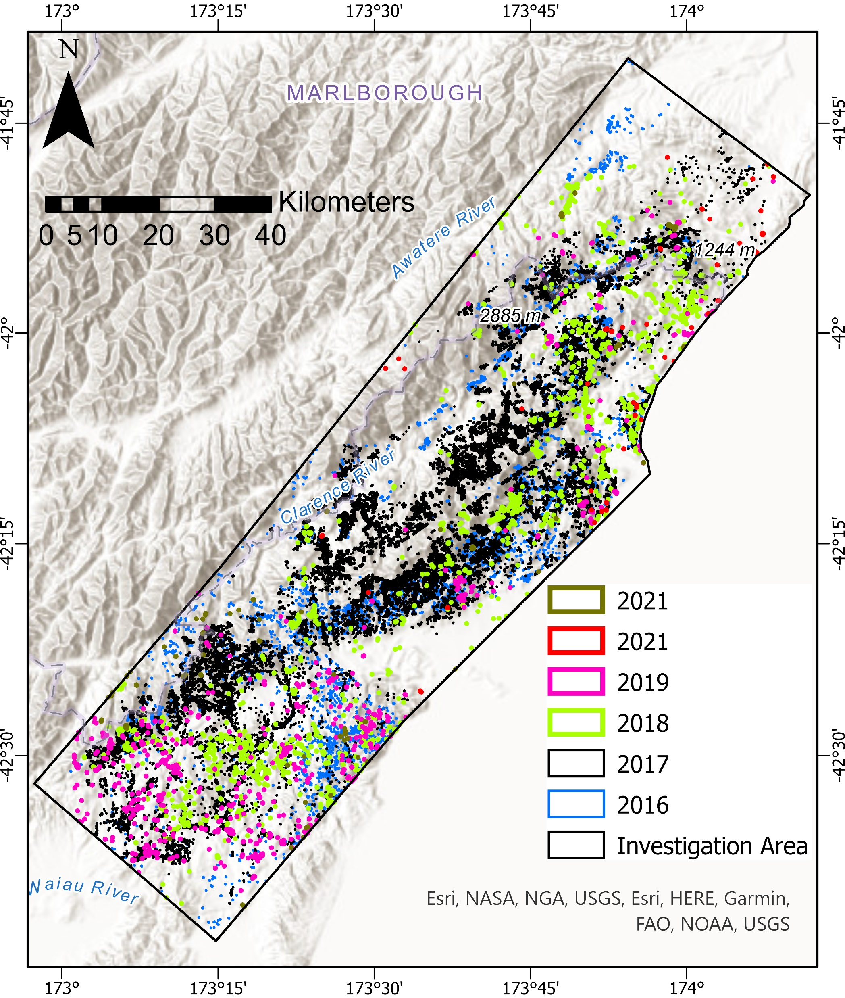
EGU22-1356
Session NH3.6
Results –
New Zealand
RESEARCH
RESULTS
Area mapped
~ 7296 km²
Temporal window
= 2016 till 2021

Slide 17
EGU22-1356
Session NH3.6
Results - China
RESEARCH
RESULTS
Area mapped
~ 600 km²
Temporal window
= 2017 till 2021*
*Cloud free images were not available for 2020

Slide 18
EGU22-1356
Session NH3.6
Results - Papua New Guinea
RESEARCH
RESULTS
Area mapped
~ 5391 km²
Temporal window
= 2017 till 2020

Slide 19
EGU22-1356
Session NH3.6
Results – New Zealand
RESEARCH
RESULTS
Area mapped
~ 7296 km²
Temporal window
= 2016 till 2021

Slide 20
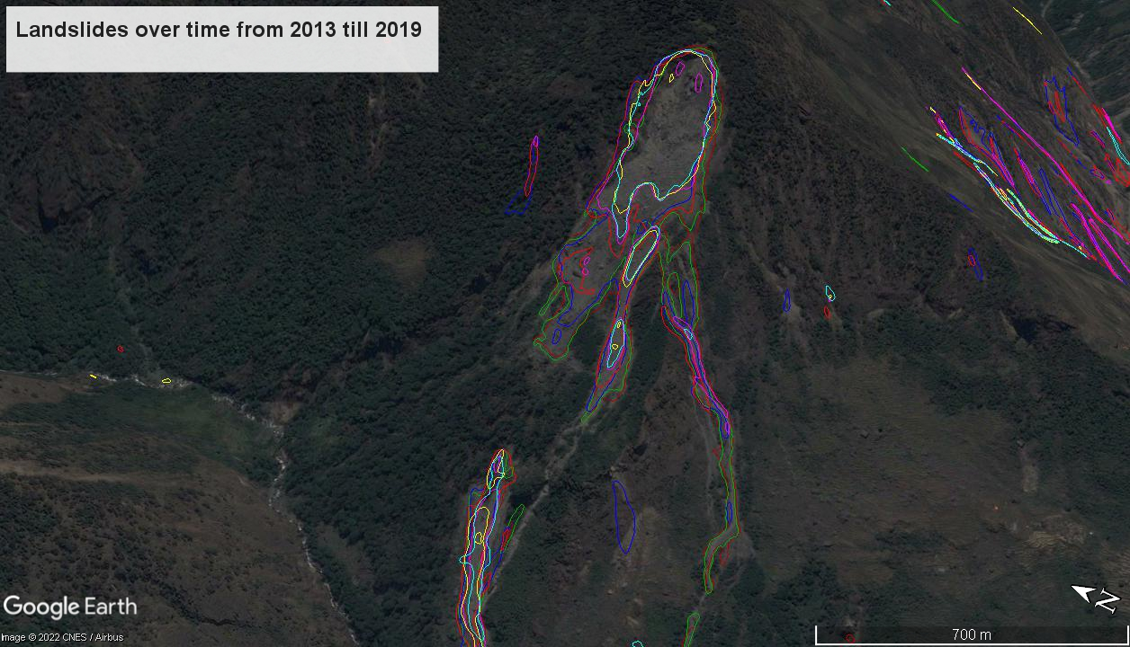
EGU22-1356
Session NH3.6
Example – 1 (Nepal)
RESEARCH
RESULTS
2013
2014
2015
2016
2017
2018
2019

Slide 21
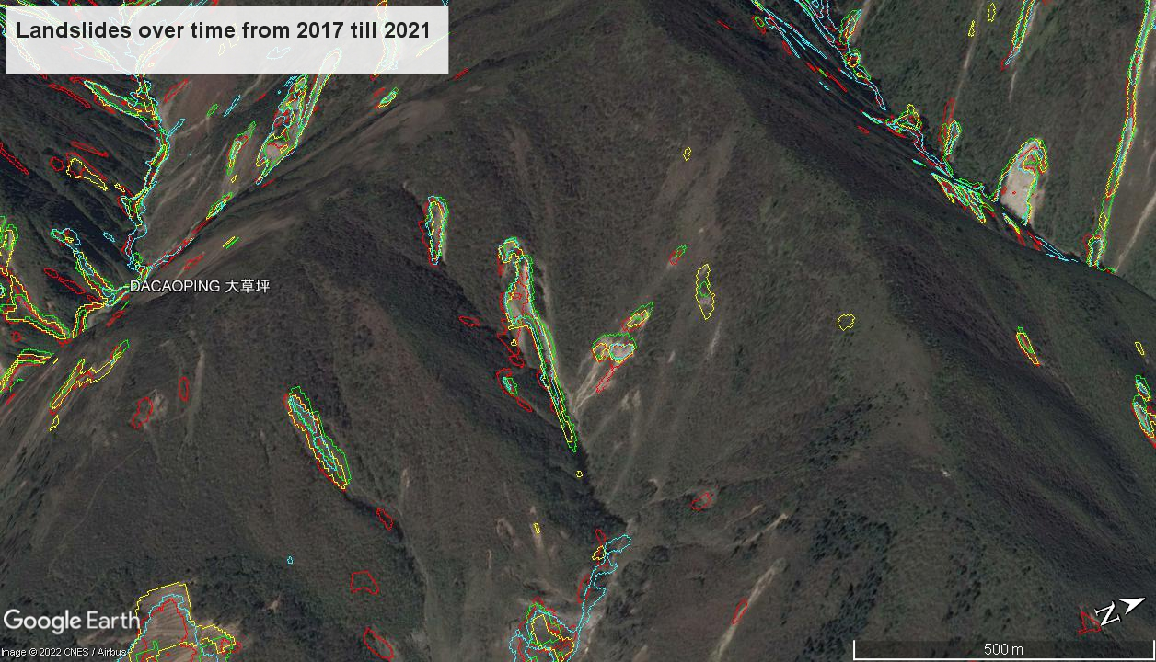
EGU22-1356
Session NH3.6
Example – 2 (China)
RESEARCH
RESULTS
2017
2018
2019
2021

Slide 22

CAVEATS AND FUTURE DIRECTION

Slide 23



EGU22-1356
Session NH3.6
Caveats
CAVEATS AND FUTURE DIRECTION
Cloud obscuration
Satellite image artefacts
Landslide state-of-activity

Slide 24


EGU22-1356
Session NH3.6
Future Directions
CAVEATS AND FUTURE DIRECTION
Synthetic Aperture Radar for cloud penetration
Implementation on
evolution studies
Implementation on
hazard modelling

Slide 25
शुक्रिया
谢谢
Grazie
Merci
Thank you
Danke
شكرًا لك
Gracias
Danku
ধন্যবাদ
Obrigado
고맙습니다
ありがとうございました
For questions and feedback: kushanav.bhuyan@phd.unipd.it

