Slide 1

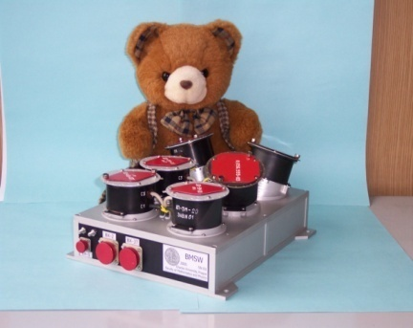
Evolution of power spectral density of magnetic field fluctuations in the inner heliosphere
Jana Safrankova, Zdenek Nemecek, Frantisek Nemec, Tereza Durovcova, Alexander Pitna
Charles University, Faculty of Mathematics and Physics, Prague, Czech Republic
Luca Franci
School of Physics and Astronomy, Queen Mary University of London, London, UK
EGU General Assembly, May 26, 2022
Moscow, February 16–20, 2015

Slide 2
Objective
The paper analyzes magnetic field fluctuations around the break between inertial and kinetic scales. Using Parker Solar Probe (PSP) and Wind data, it discusses evolution of power spectral density (PSD) shapes in different distances from the Sun (PSP) to 1 AU (Wind).
Outline
Averaged PSDs in different distances through heliosphere
- inertial and kinetic scales
Variations of parameters related to magnetic field fluctuations (PSP)
Dependence of spectral slopes in the kinetic range on several parameters
Spectral slopes in two distances (R<0.3 AU and R>0.3 AU from the Sun) and their comparison with 1 AU

Slide 3
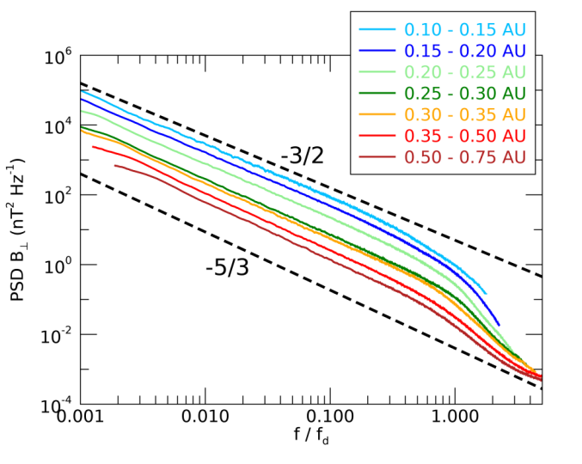
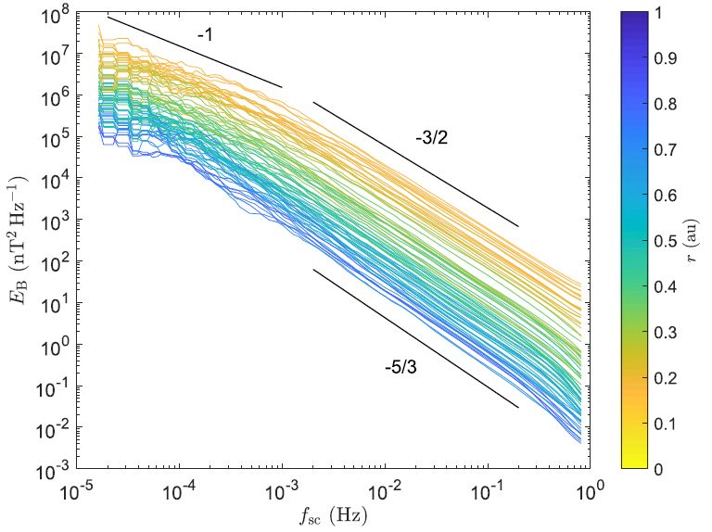
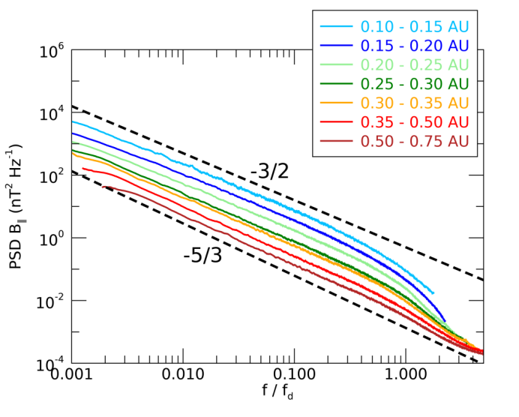
Motivation
Magnetic field power spectrum at different heliocentric distances over first two PSP orbits (adopted from Chen et al., 2020)
PSDs within 9 PSP encounters
Spectra are normalized to characteristic plasma scale, fd
The median spectrum in each distance bin is calculated
The slope in the inertial range evolves from -3/2 to -5/3
It is true for both compressive and perpendicular fluctuation components
Kinetic range was not discussed so far
As a first step, we present radial evolution of parameters connected to the magnetic field - plasma beta, magnetic field magnitude, standard deviations in perpendicular and parallel directions and their normalized values

Slide 4
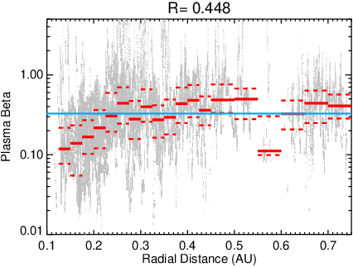
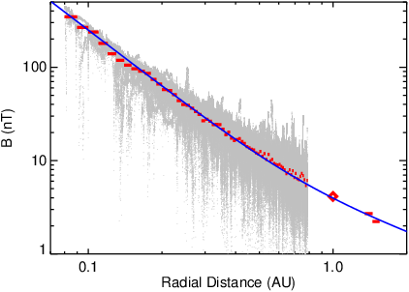
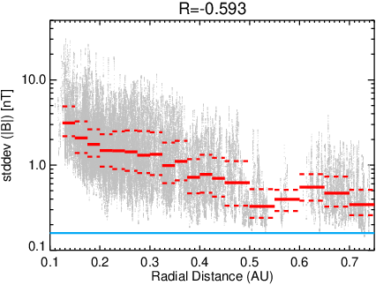
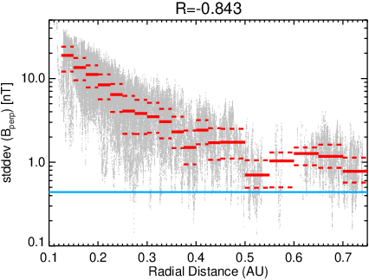
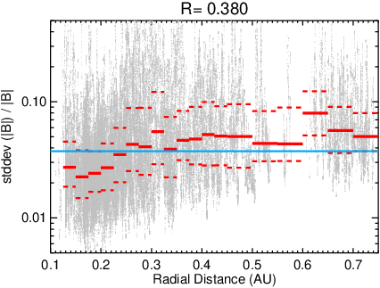
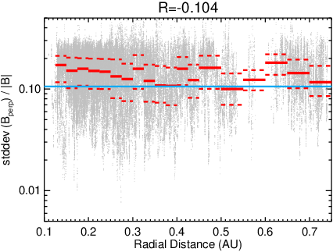
Evolution of parameters from the Sun
With increasing distance, beta increases till 0.3 AU and it is nearly constant afterward
Magnetic field strength follows Parker spiral prediction
Power of both compressive and perpendicular fluctuations decreases with the distance from the Sun
Normalized power of compressive fluctuations increases till 0.3 AU and it is nearly constant afterward
Normalized power of perpendicular fluctuations is roughly constant and equal to 1 AU value
Note - blue horizontal lines in panels indicate the values of particular parameters at 1 AU (measured by Wind)
Beta
B
σ|B|
σB_{perp}
σ|B|/|B|
σB_{perp}/|B|

Slide 5
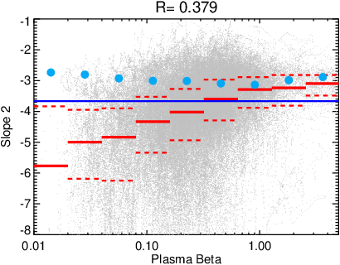
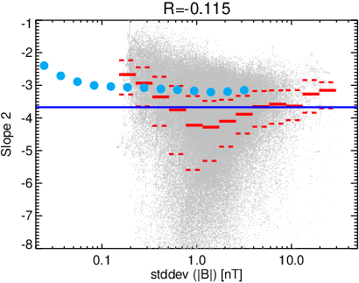
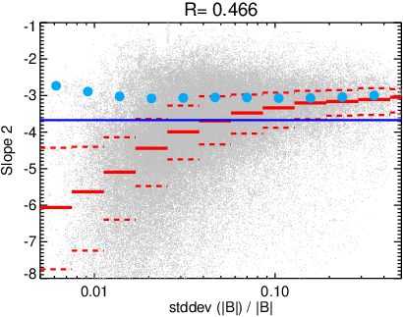
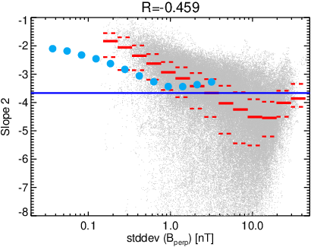
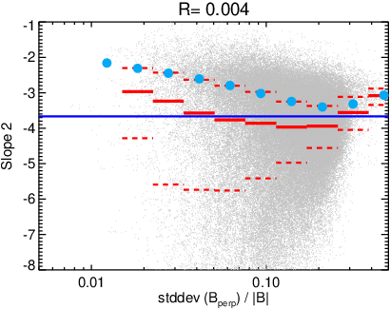
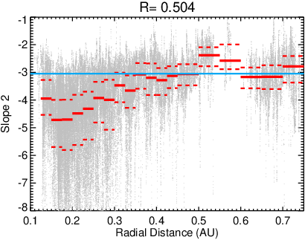
Dependence of spectral slope 2
Spectral slopes 2 in different PSP distances differ significantly from those determined at 1 AU from Wind data for all studied quantities (light blue dots). Dark blue lines in panels mark power law index -11/3 predicted by Franci et al. arXiv:2010.05048
Beta
Nevertheless, the dependence of slope 2 on the radial distance shows that mean slope increases with the distance and becomes about equal to the Wind value at 0.3 AU
σ|B|
σ|B|/|B|
R
σB_{perp}
σB_{perp}/|B|

Slide 6
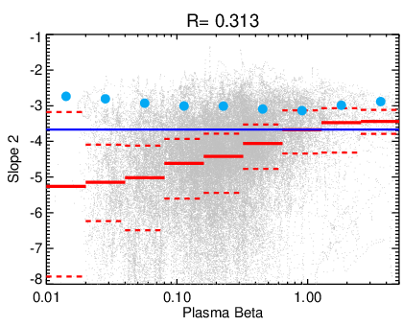
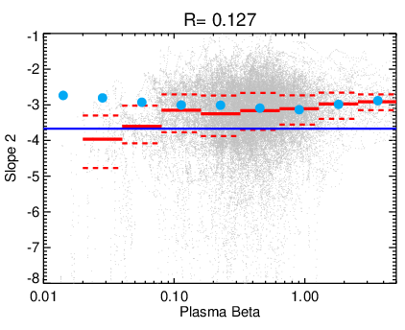
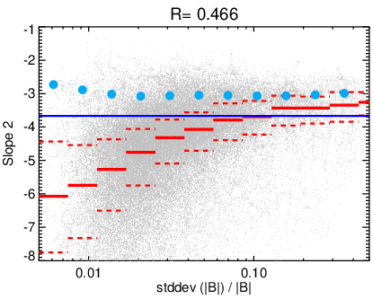
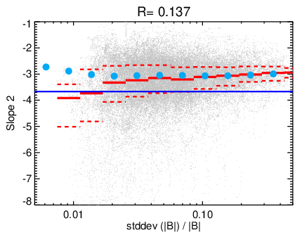
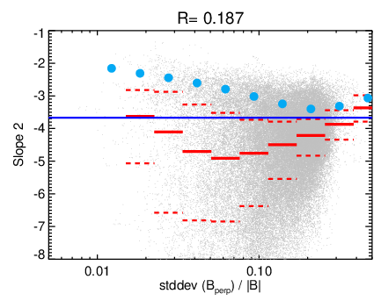
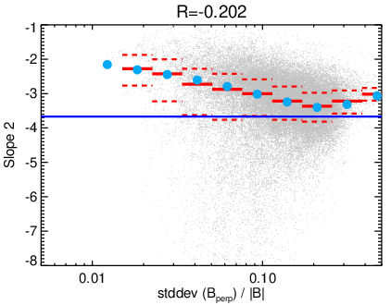
Spectral slope in two distances from Sun
R<0.3 AU
R>0.3 AU
The behavior of the spectral slope 2 above 0.3 AU resembles that observed approximately at 1 AU (blue points)
There is a principal difference between variations of slopes below and above 0.3 AU
Evolution of turbulence below ~0.3 AU is controlled by different processes than that at larger distances
Beta
Beta
σ|B|/|B|
σ|B|/|B|
Safrankova et al. (2022, ApJL)
σB_{perp}/|B|
σB_{perp}/|B|

Slide 7
Conclusion
We present the statistical analysis of compressive and perpendicular magnetic field fluctuations from 0.1 to 1 AU. The results can be summarized as it follows:
Mean ion beta increases from ~0.1 at 0.1 AU to ~0.4 at 0.3 AU and becomes constant and about equal to 1 AU value farther
Mean magnetic field strength follows the Parker spiral prediction from 0.1 to 1.5 AU
The level (standard deviation) of compressive as well as perpendicular magnetic field fluctuations decreases with the distance from the Sun
The level of perpendicular fluctuations normalized to the mean magnetic field strength does not depend on the radial distance, whereas normalized level of compressive fluctuations increases with distance till ~0.3 AU and then becomes about constant
At kinetic range, the power-law exponent of slopes lies between -3 to -6 depending on the relative level of compressive fluctuations in PSP data but it is around -3 in Wind through the full range of compressive fluctuation level
Trends found in PSP observations at distances larger than 0.3 AU agree very well with observations at 1 AU whereas the dependences of the spectral slope on plasma beta and/or on the level of magnetic field fluctuations are opposite at lower distances
Combining above points, we can conclude that the evolution of turbulence is controlled by different process(es) close to the Sun and at larger distances.

Slide 8
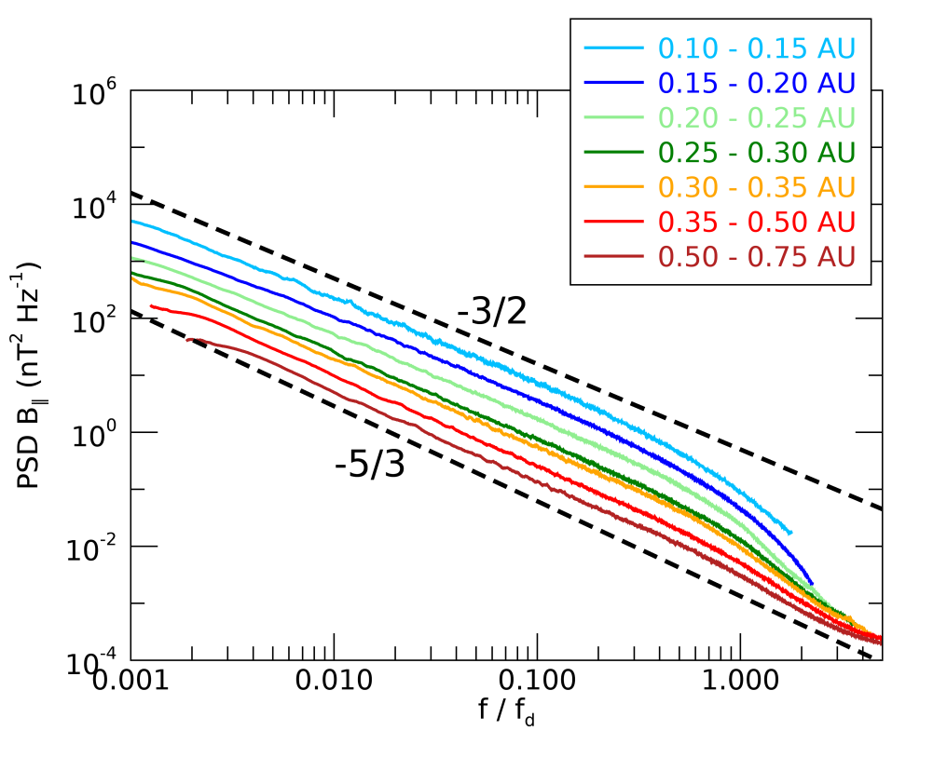
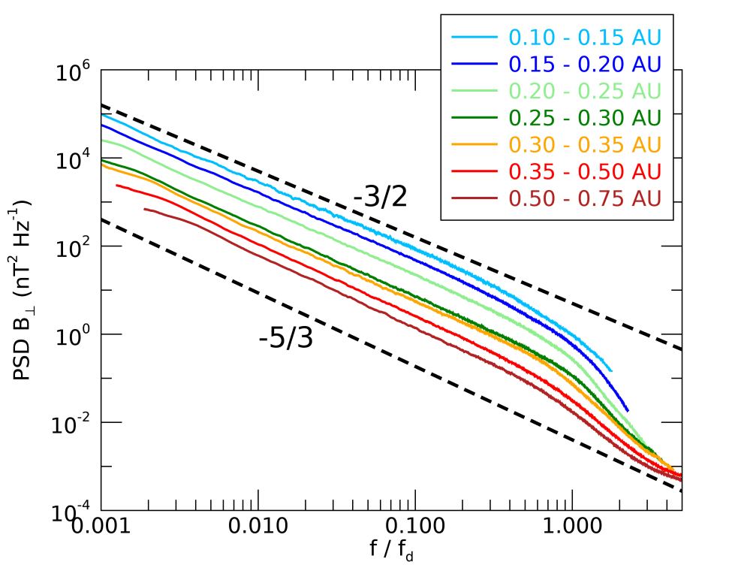
Mean PSDs in different distances
B_{perp}
B||
All spectra are normalized to characteristic plasma scale f_{d}
The median spectrum in each distance bin is calculated
Perpendicular fluctuations are by an order of magnitude larger than the parallel ones
The slope in the inertial range evolves from -3/2 to -5/3
It is true for both, compressive and perpendicular fluctuation components
Safrankova et al. (2022, ApJL)

