Slide 1
The global reach of the 2022 Tonga volcanic eruption
Isaac Fine, Igor Medvedev, Jadranka Šepić, Alexander Rabinovich, and Richard Thomson

Slide 2
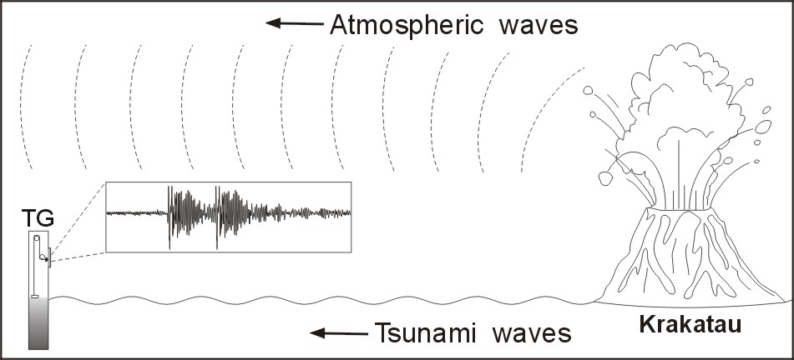
Introduction
From Monserrat, Vilibić and Rabinovich [2006]

Slide 3
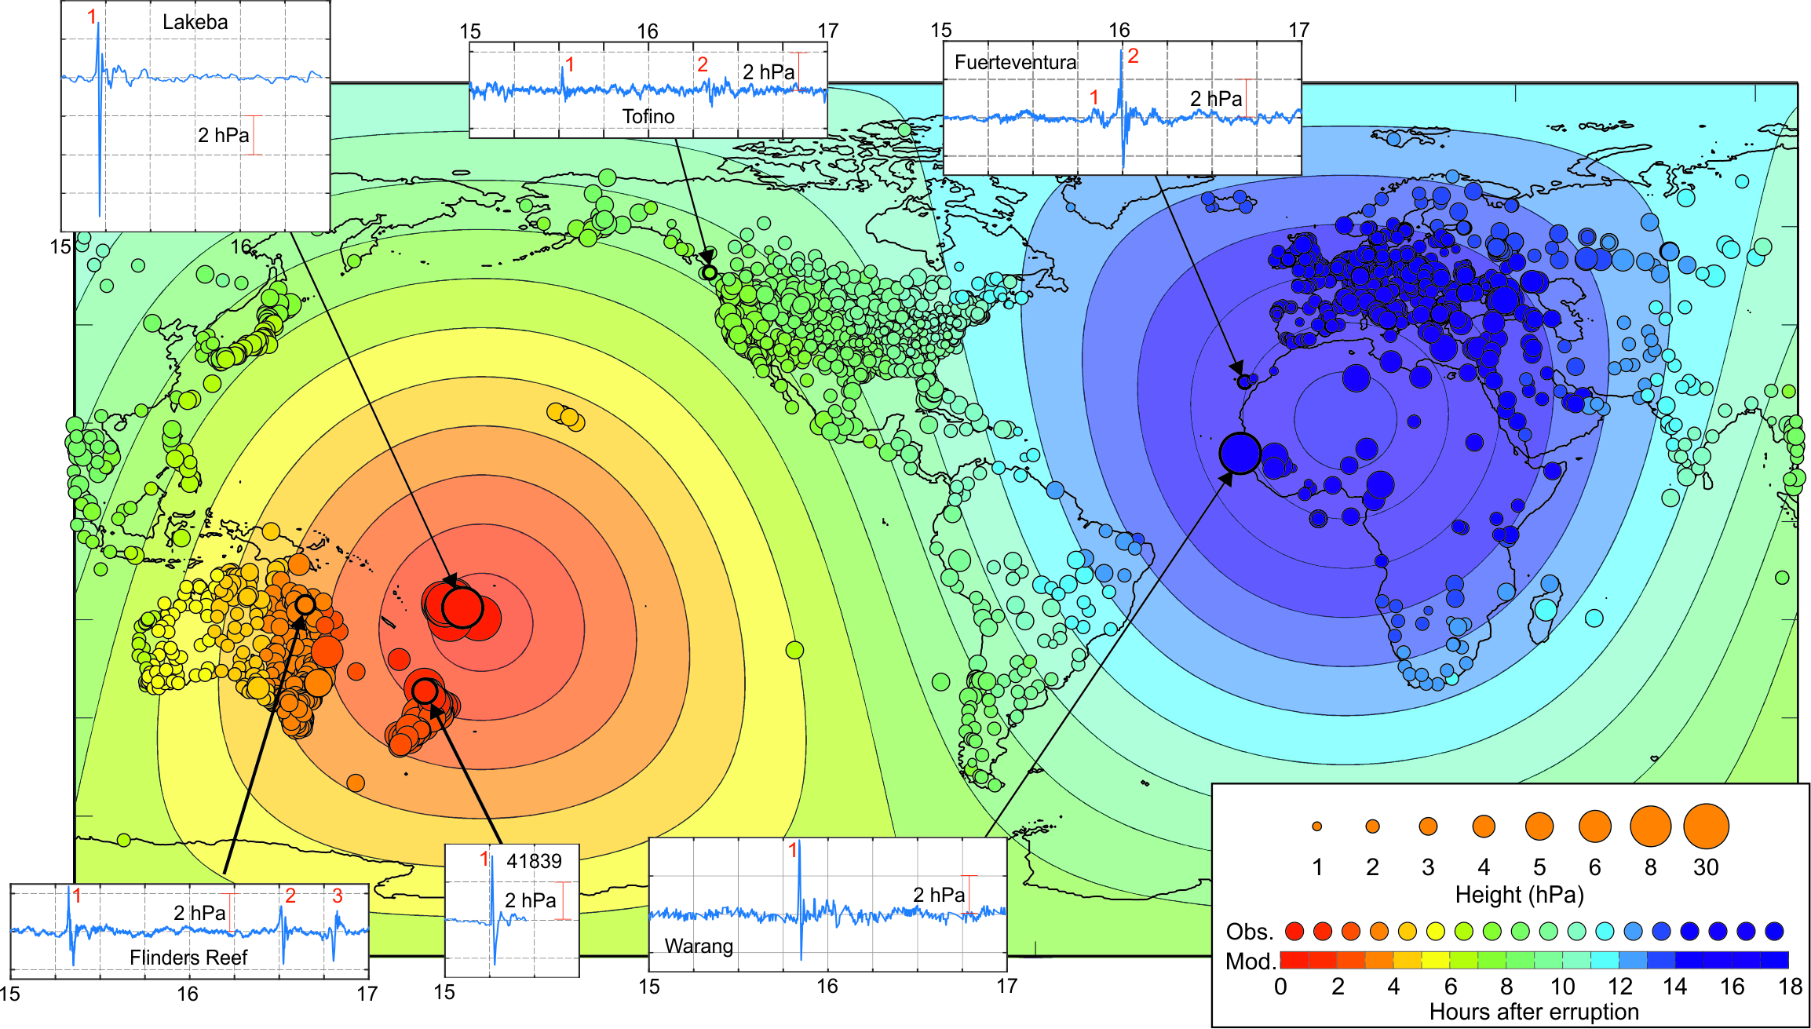
Atmospheric waves

Slide 4
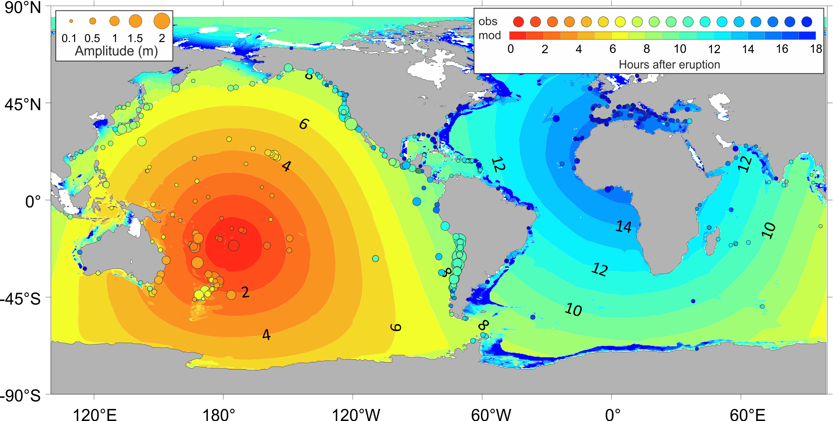
Tsunami waves
Constructed by Igor Medvedev

Slide 5
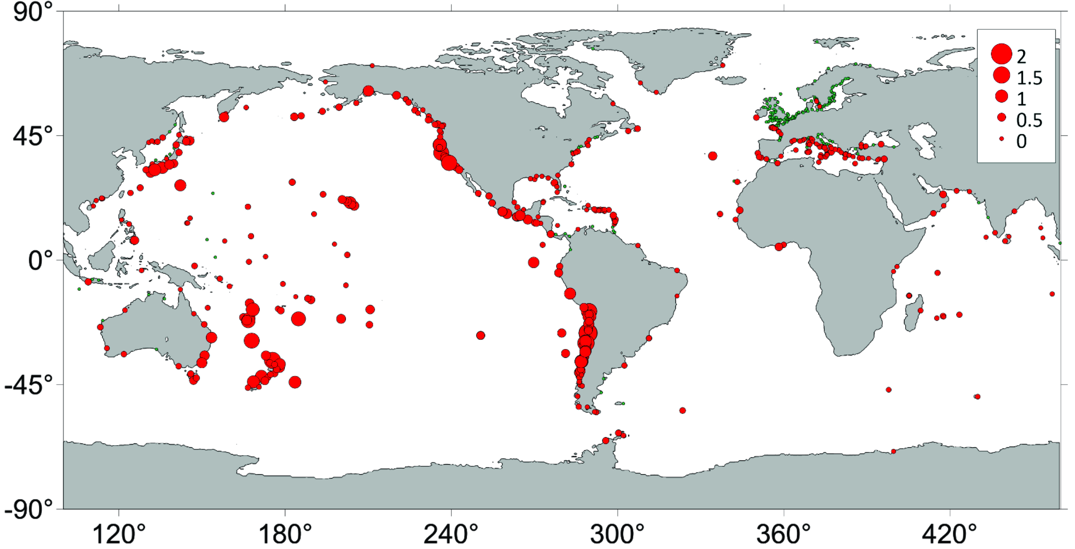
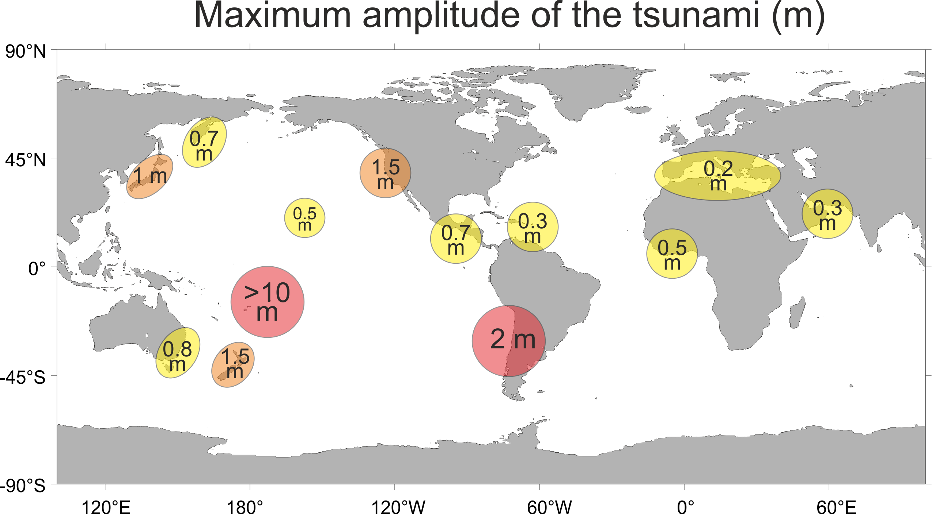
Tsunami waves
Constructed by Igor Medvedev

Slide 6
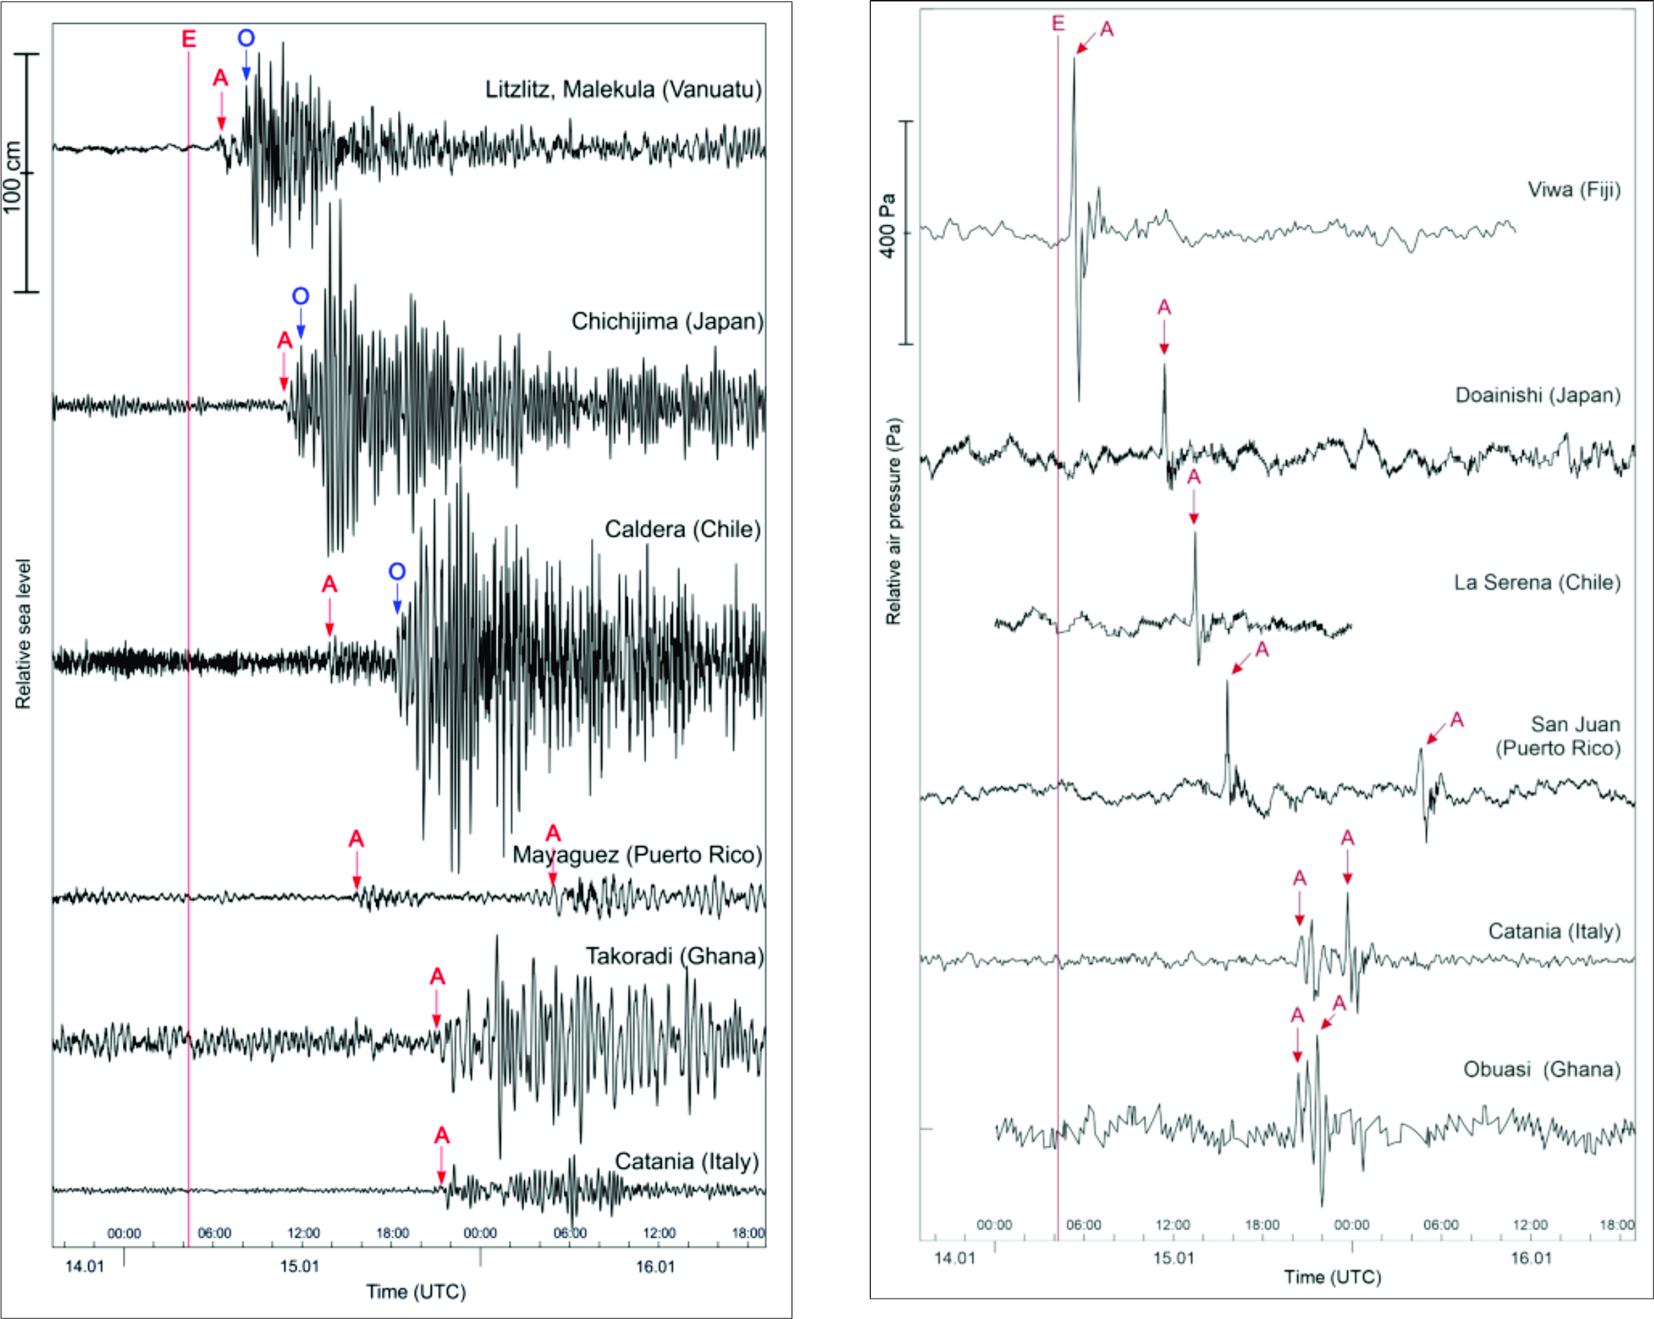
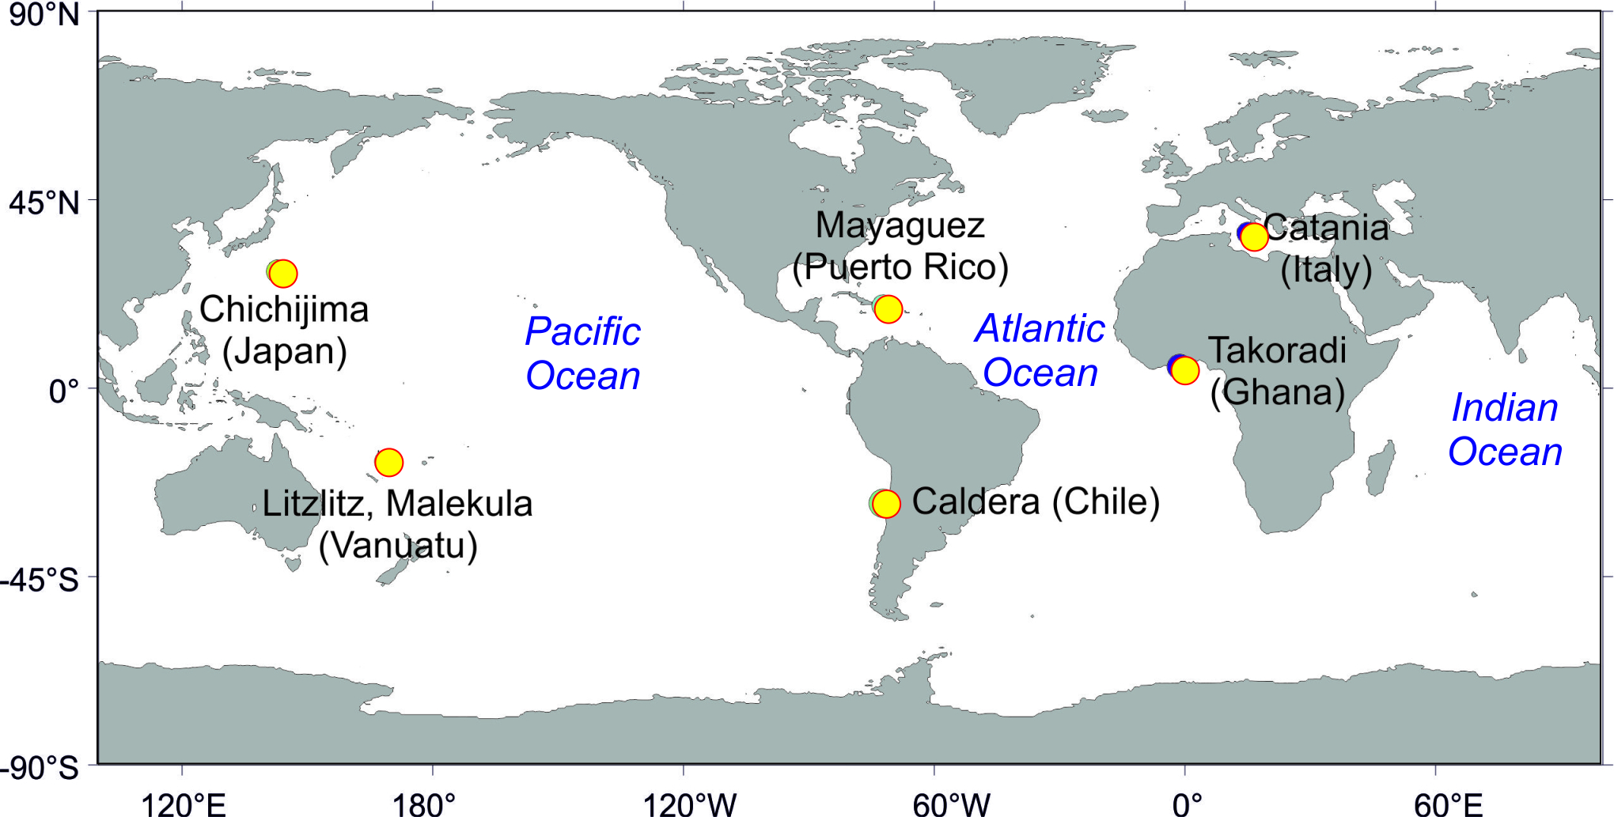
Simultaneous sea level and air pressure measurements
Simultanoues arrival of air pressure and tsunami waves to stations throughout the ocean

Slide 7
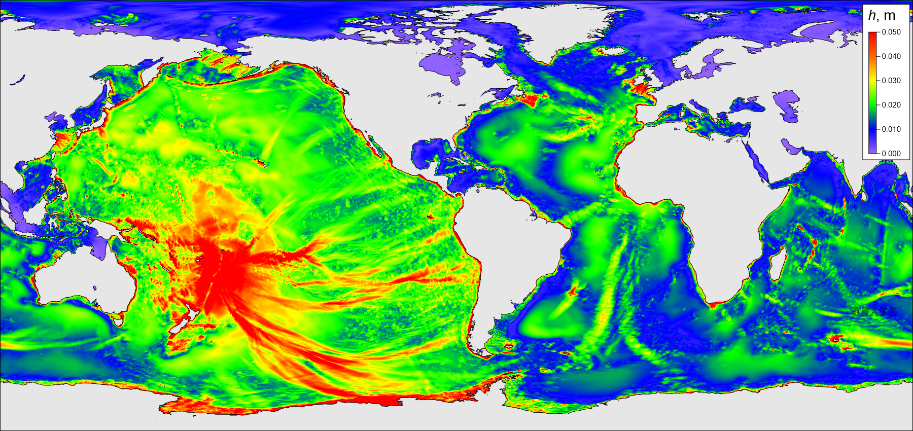
Numerical modelling
Constructed by Isaac Fine

Slide 8
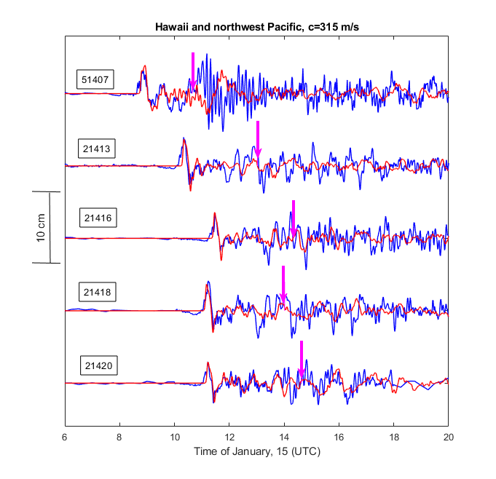
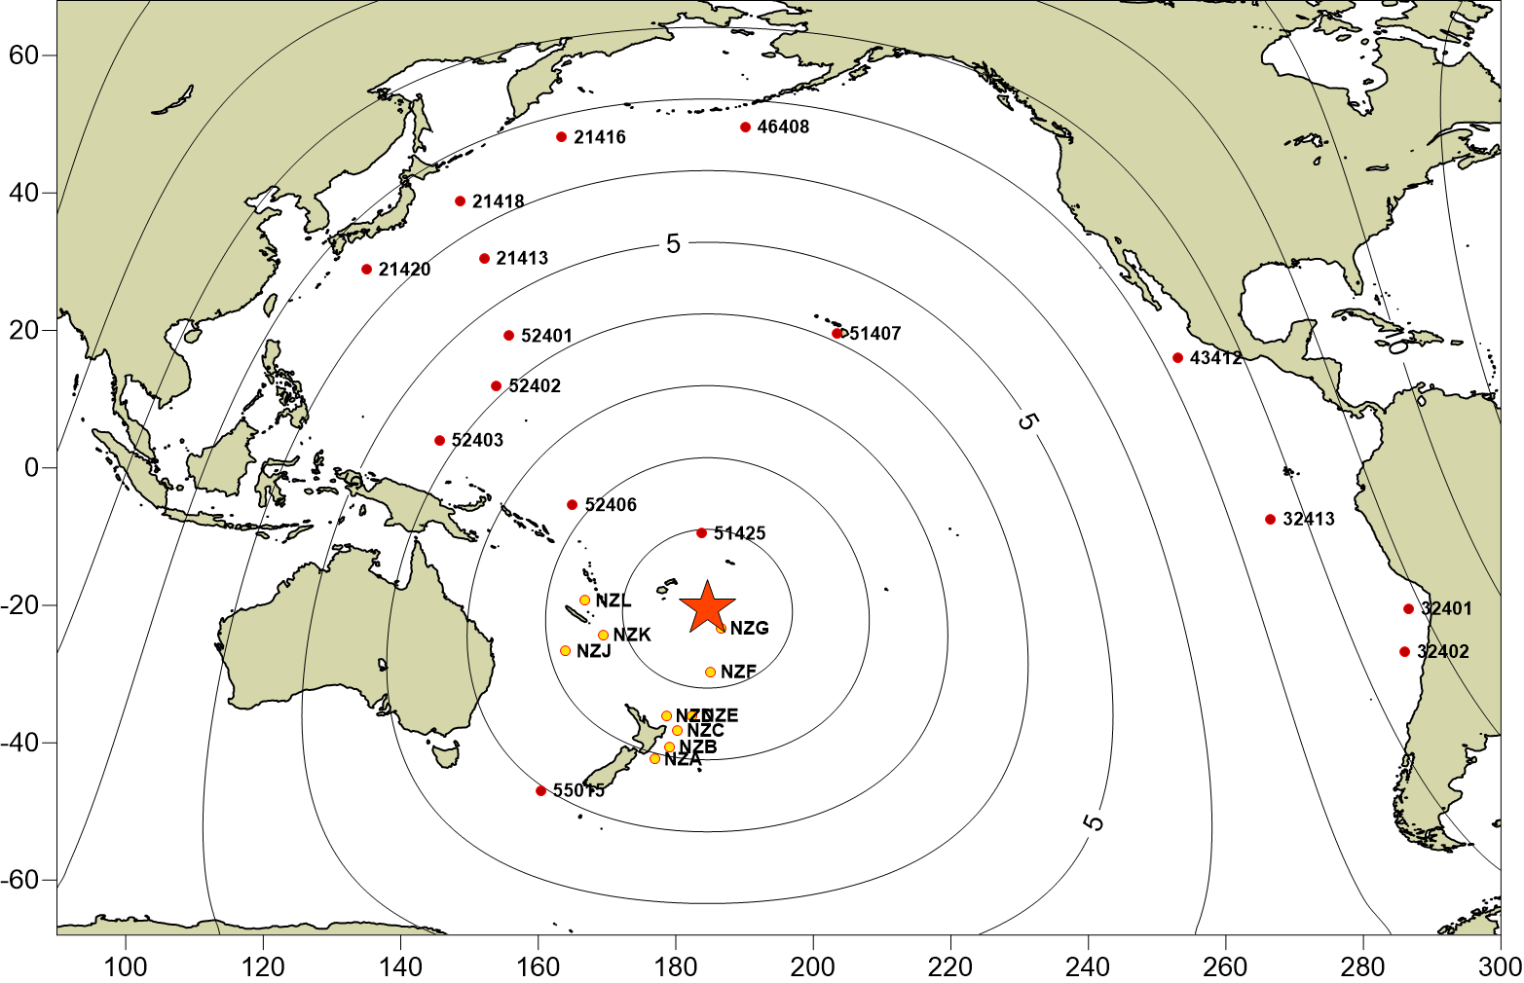
Model verification – DART stations
Constructed by Isaac Fine

Slide 9
Conclusions
Underwater volcanic eruption generated atmospheric pressure waves
Atmospheric pressure waves generated long ocean tsunami waves through Proudman resonance
Atmospherically generated tsunami waves were recorded at tide gauge stations throughout the ocean

