Slide 1

Assimilating cloudy visible & infrared satellite images for convective-scale NWP
An idealized study using observation system simulation experiments
Lukas Kugler, Nicola Pierotti, Stefano Serafin, Martin Weissmann
AS1.9 Developments in storm and convective scale data assimilation and observations
Friday 27 May 2022

Slide 2
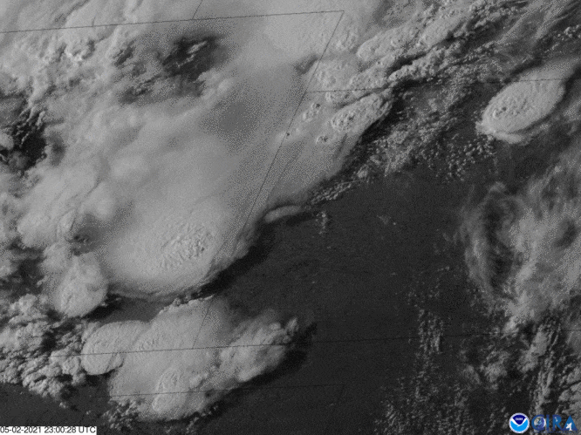
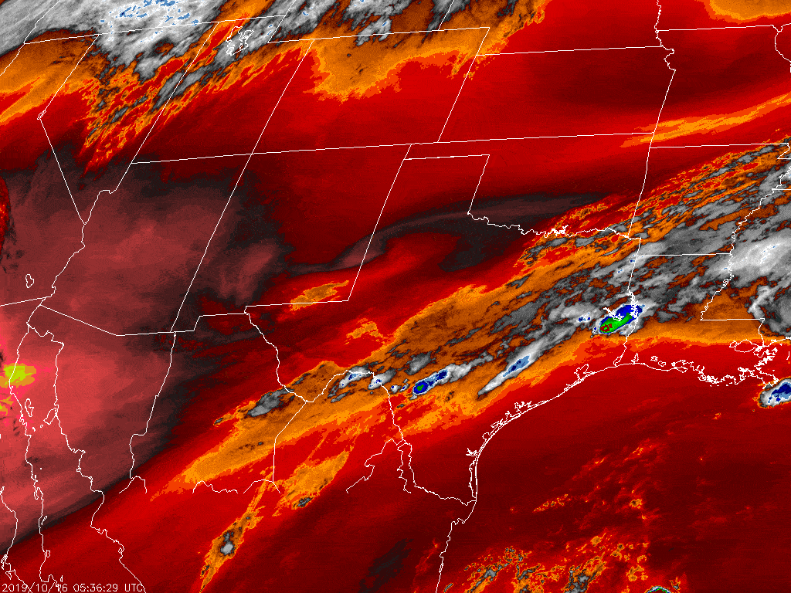
Motivation
0.6 µm channel
Clouds are the first sign of convection
Visible & infrared satellite images tell us about
  shallow convective clouds
  tropospheric moisture gradients
  cloud top temperature (→ cloud top height)
  cloud thickness
Yet, cloud-affected pixels are mostly not assimilated
since clouds violate algorithm assumptions
7.3 µm channel
How much can we benefit from assimilating visible & infrared satellite observations?
How much can we benefit from assimilating visible & infrared satellite observations
compared to 3D radar reflectivity?
Image credit: RAMMB-CIRA/CSU

Slide 3
Method: Observing system simulation experiment
We simulate nature (true state x^{t})
We observe nature y = H(x^{t}), adding observation error
We assimilate observations to improve our forecast
state x^{b} using y – H(x^{b}) and ensemble covariances Cov(x^{b}, H(x^{b}))
using
WRF (2 km grid, doubly periodic boundary)
Observation operator from RTTOV
Ensemble Adjustment Kalman Filter from DART
Python for remaining tasks
Nature
simulation
assimilate
assimilate
Forecast system
simulation
simulation
simulation
time

Slide 4
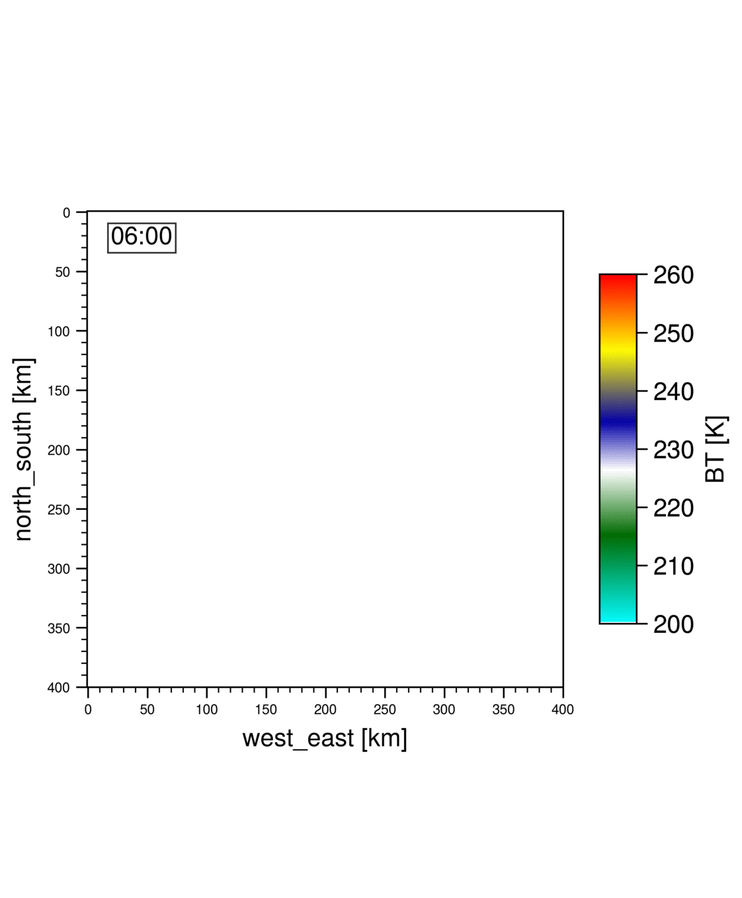
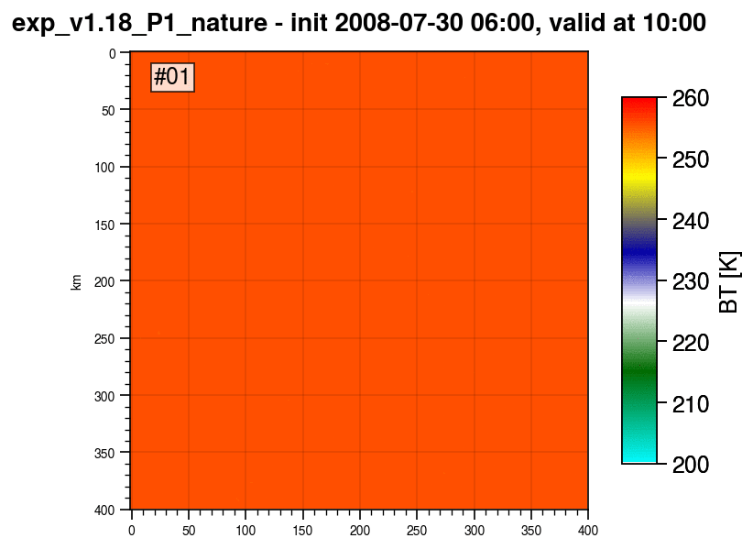
Nature run
We show the impact for these two cases
Case “warm-bubble”
Case “random”
periodic boundary
Simulated satellite images; Brightness temperature 7.3 µm

Slide 5
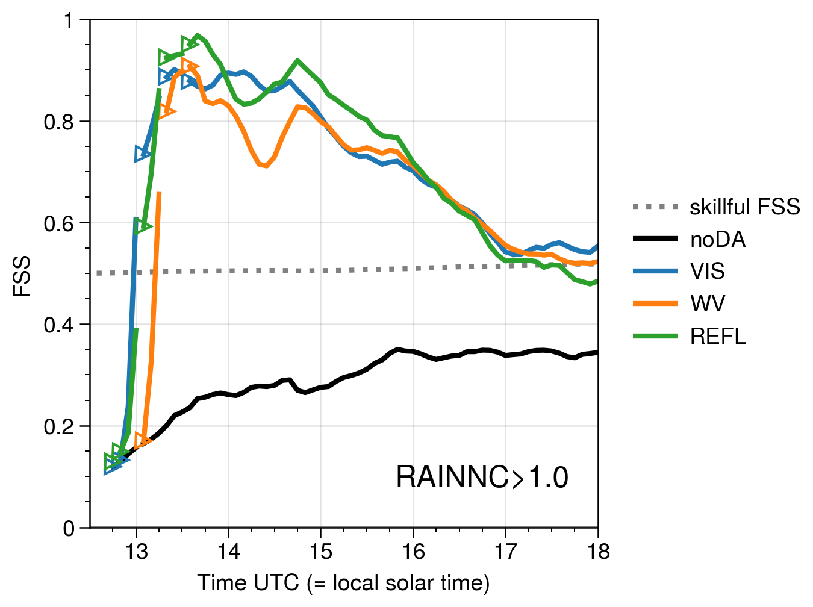
Results – Case “warm-bubble”
Fraction skill score of precipitation rate > 1 mm/h; window = 12 km
Improved spatial accuracy of
  Precipitation
  Radar reflectivity*
  Cloudiness*
* not shown
better
worse

Slide 6
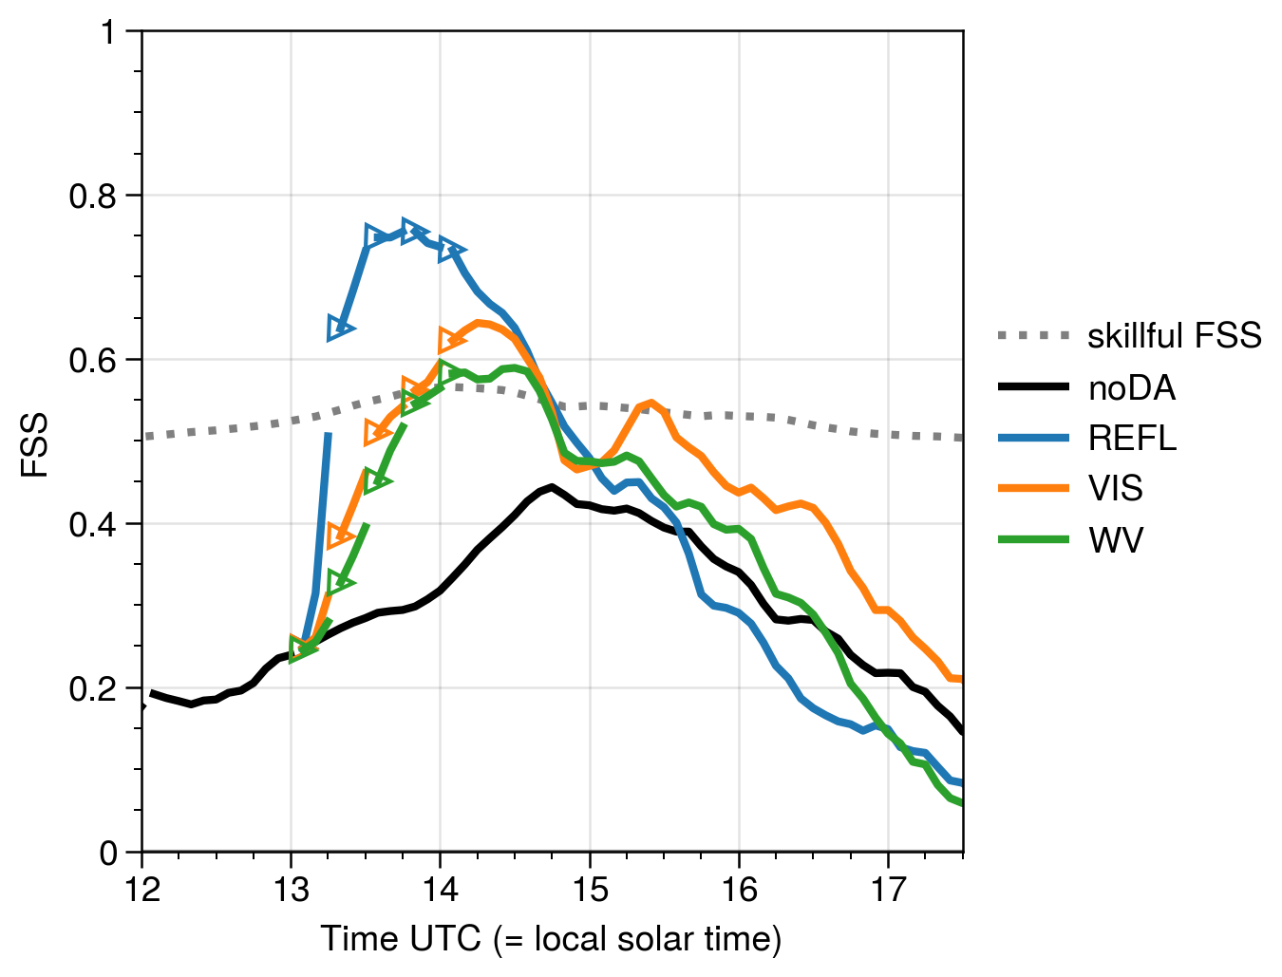
Results – Case “random”
Fraction skill score of precipitation rate > 1 mm/h; window = 12 km
Scattered convection case
Most impact by 3D radar reflectivity
Comparable impact of VIS & WV
Details depend on tuning
Other cases with less impact possible
better
worse

Slide 7
Results – Challenges
Assimilation in an EnKF works best for linear observation operators H
Nonlinear H can lead to unexpected and dramatic changes in the posterior
→ Solution: Rejecting observations with close to prior or assigning larger errors
Other violations of algorithm assumptions
Assimilating bounded, non-gaussian variables, non-linear relationships
→ Solution: Mitigation approaches, variable transforms, different algorithms
Localization: How far can information spread?
→ Answers from 1000 member ensemble (see talk T. Necker afterwards)
Notes:
To create clouds, increase QC above zero in any level
To remove clouds, remove QC to zero in all levels

Slide 8
Conclusions
EnKF is able to extract information from VIS & IR observations despite nonlinearity
Impact of VIS & IR observations in some cases comparable to radar DA,
less impact in other cases
VIS & IR can be valuable tools for earlier detection and forecast of storms
Outlook
Describe cases in which VIS & IR observations are more or less impactful
Study the adverse effect of observation operator nonlinearity
Estimate of systematic errors using a high-res nature run

Slide 9
Results: Ensemble perturbations
Observation system simulation experiments using WRF, RTTOV & DART
Case "warm-bubble"
Horizontal position +/- 60 km
Amplitude +/- 1 K
But constant shape:
Gaussian
Scale horizontal/vertical: 15/2 km
3 K Amplitude
Case "random"
Horizontally uncorrelated T noise
σ = 0.02 K; to break up homogenous initial conditions
Vertically correlated profile perturbations
  Perturbed variables: T' ~ (σ = 0.25 K),
  Horizontal wind U', V' ~ σ = 0.25 m/s
  RH' ~ σ = 2 % of RH
At 2 km grid resolution

Slide 10
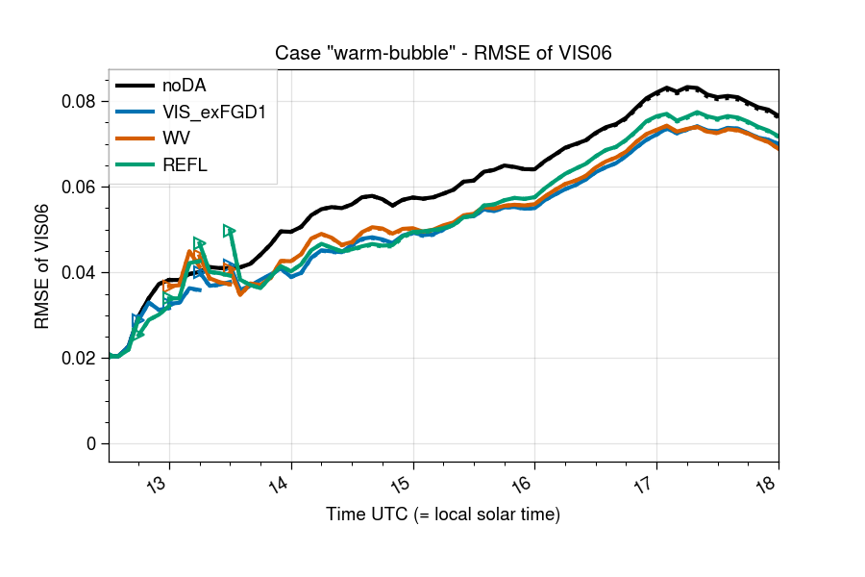
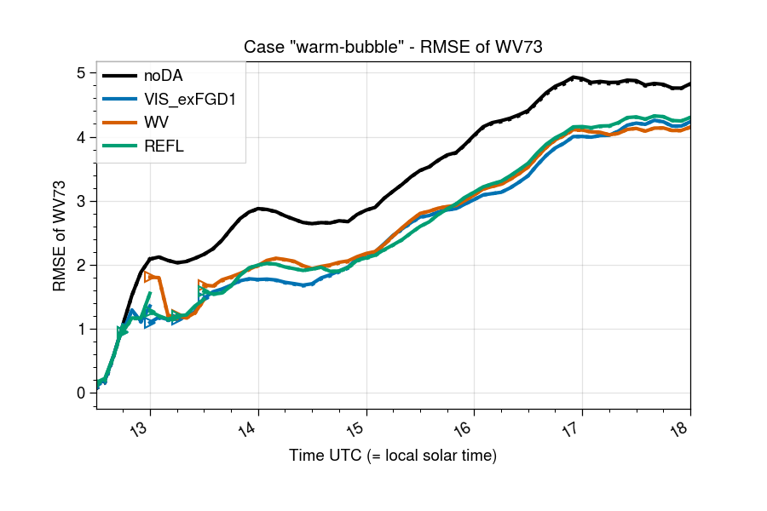
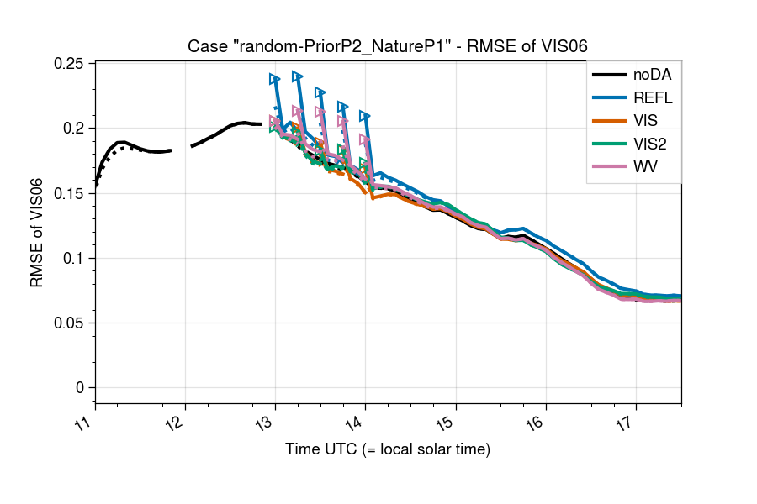
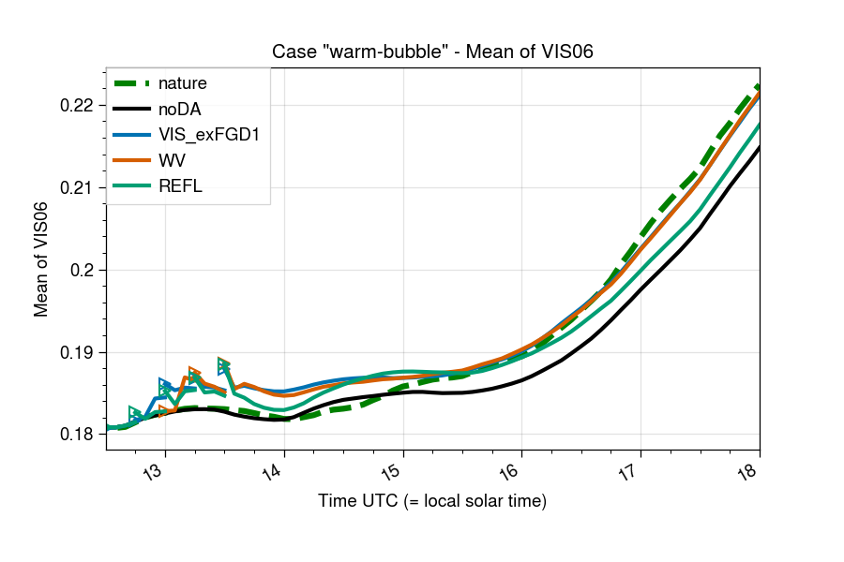
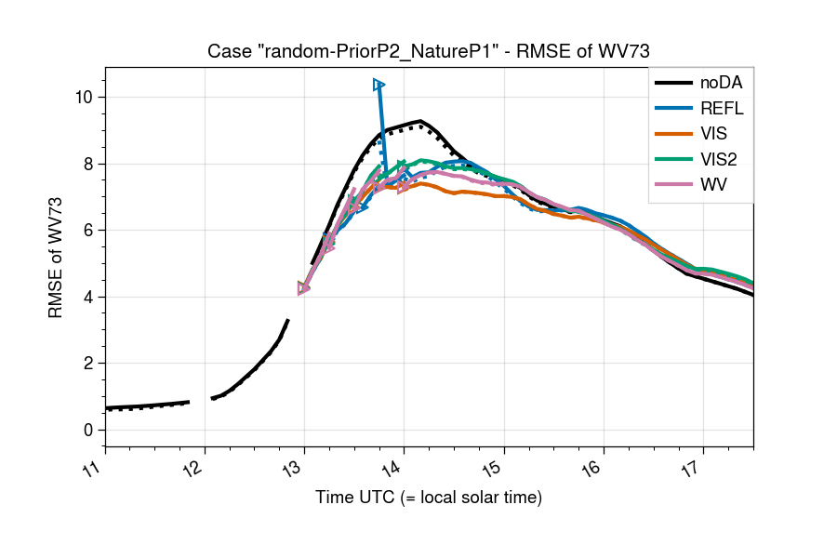
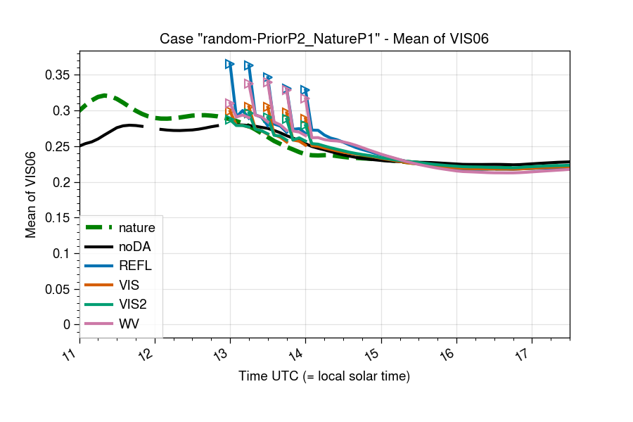
Results: RMSE timeseries

