Slide 1
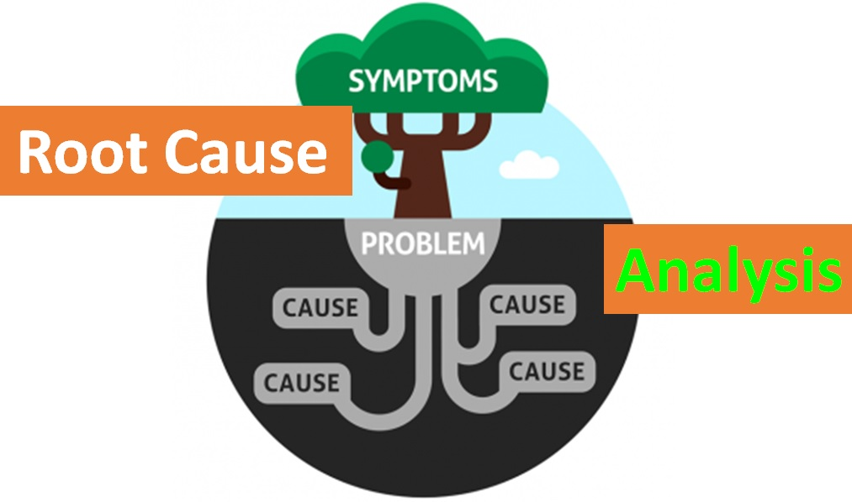

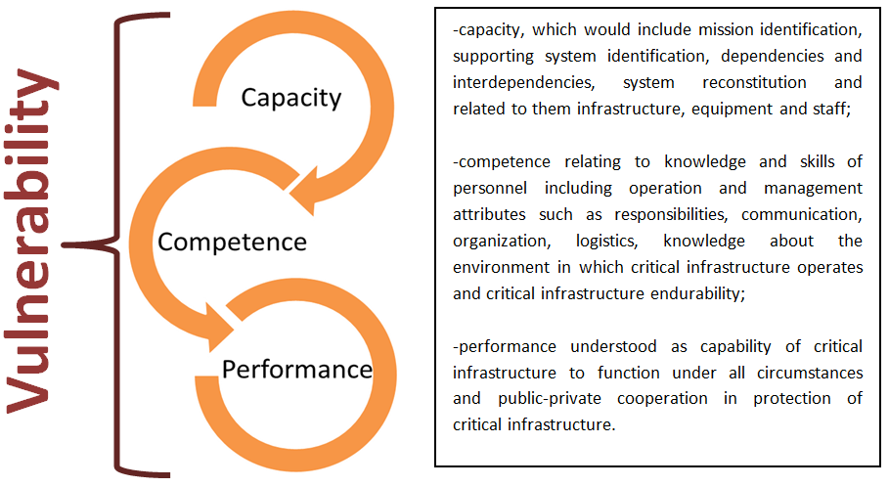
Vulnerability of Critical Infrastructure to biological threats
Amelia Tomalska
University of Warsaw
Faculty of Political Science and International Studies
EGU 22 – SESSION NH10.3- "Advancing critical infrastructure modelling in a complex world"
Multidimensional nature of vulnerability
Biological threats
Pre-pandemic approach
Biological hazards, whether originating from nature, deliberate attack or accidental release are potentially extremely disruptive to the critical infrastructure.
They have a constant, permanent character, which might be a new normal to which we have to adjust to.
They can cause supply chain (cascading) disruptions across sectoral boundaries due to high connectivity, dependence on global suppliers and obstacles in production or transportation of goods and movement of the people (essential workers).
The impact of biological threats may be felt more directly on the staffing of critical infrastructure facilities.
They are usually accompanied by other threats such as cyberattacks or hybrid threats (disinformation, fake news).
Strategies based on scenarios that are a mix of threat analysis and rough definition of exposed assets with limited or inexistent consideration of vulnerabilities.
Vulnerability understood mostly in terms of physical feature, as a physical impairment, that makes critical infrastructure more susceptible to exploitation by a threat.
Ineffectiveness of prevention-based approach to critical infrastructure protection with threat-centric perception of vulnerability due to fast changing threat landscape, including the unpredictability of future impacts of biological threats, climate change, state-sponsored hybrid actions, or new technologies on critical infrastructure.
Identification of contributors to vulnerability of critical infrastructure limited to pre-event actions without considering post-event mitigation, response and recovery actions.
The identification of root causes of vulnerability should consider broader scope of critical infrastructure domains where vulnerabilities might be embedded at different stages of operating, namely before as well as after the occurrence of the adverse event.
Vulnerability should be understood as an attribute of the system, of the dual nature: physical, technical dimension relating to the vulnerabilities of the hard components and its operational, social character referring to established procedures and management capabilities.
Considering critical infrastructure as a complex system, composed of various, interacting components, the root causes of vulnerability can be divided into following factors:
The management of emerging risks shares some commonalities with the management of catastrophic and systemic risks. This unpredictability may create additional vulnerability that may be managed with adaptability and flexibility.
VULNERABILITY
Prevention/Protection/ Pre-event mitigation | Post-event Mitigation/ Response/Recovery
determines the probability and scale of consequences and damages in respect of a threat event. It includes capabilities to successfully detect the possible threats such as dependence on remote sources, overreliance on single or few factories for supplies. | influences the degree of loss and the probability of the damage after an adverse event occurs. It relates mostly to internal procedures, plans and to capabilities of the system to respond and recover.
FINDINGS
Conclusion
R E L A T E D L I T E R A T U R E
-Baker, G.(2005) “A Vulnerability Assessment Methodology for Critical Infrastructure
Sites”, DHS Symposium: R&D Partnerships in Homeland Security; Boston, Massachusetts
-Linkov, I., Keenan, J., Trump, B.(2021) “COVID-19: Systemic risk and resilience” Springer International Publishing; doi: 10.1007/978-3-030-71587-8
-McGill, W., Ayyub, B.(2007) “The meaning of vulnerability in the context of critical
infrastructure protection”, Critical infrastructure protection: Elements of risk,George Mason University, Fairfax
-National Preparedness Report, U.S. Department of Homeland Security, Federal Emergency Management Agency, 2020
-Petit, F., Bassett, G., Black, R., Buehring, W., Collins, M., Dickinson, D., et al.: Resilience measurement index: An indicator of critical infrastructure resilience, Office of Scientific and Technical Information (OSTI), Argonne National Laboratory (2013)
-Tomalska A.: Preparing critical infrastructure for the future: Lessons learnt from
the Covid-19 pandemic. Security and Defence Quarterly (2022); doi:10.35467/sdq/146603
-Whalley R.(2010) Chapter Five: Critical Infrastructure, Adelphi Series, 50:414-415; doi: 10.1080/19445571.2010.539443
-Zio, E. (2016) “Challenges in the vulnerability and risk analysis of critical infrastructures”,
Reliability Engineering and System Safety, 152; doi: 10.1016/j.ress.2016.02.009

