Slide 1
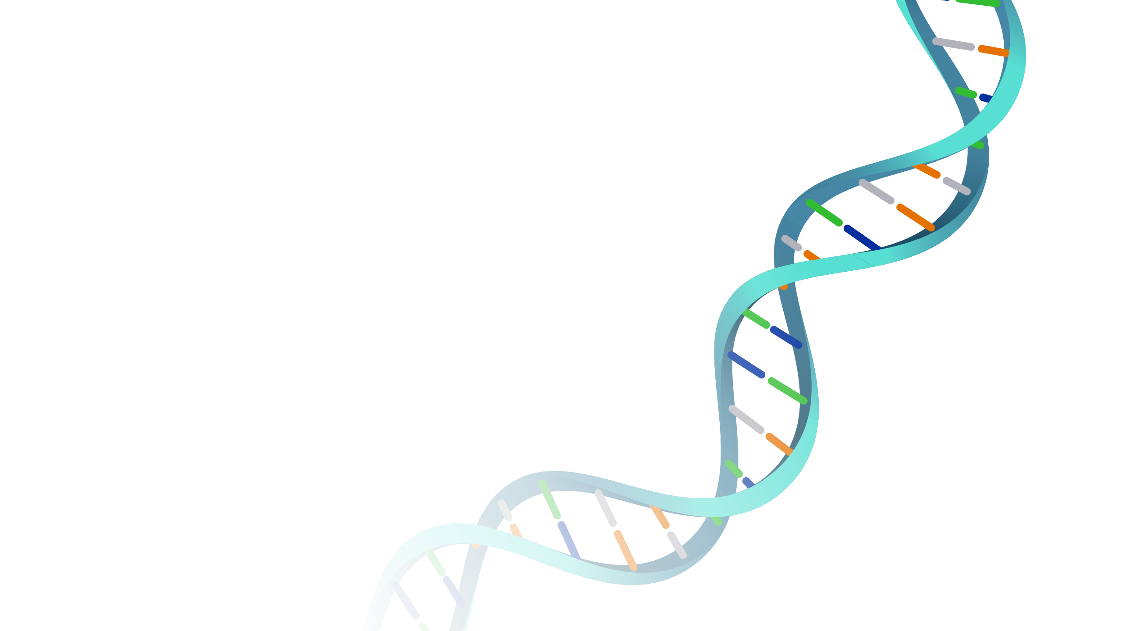


On the Origins of Life’s Homochirality: 5W 1H S. Furkan Ozturk EGU22, 5/27/22
Notes:
I am a physics PhD student at Harvard University, working on the origins of life.
As we are presenting in a different short format, I will try something new and explain my work through a series of questions.

Slide 2
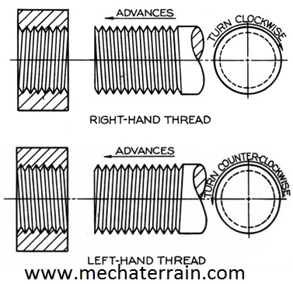
Chirality?
Notes:
Chirality is a geometric property and objects are said to be chiral if their mirror-images are distinguishable from each other.
We are familiar with many chiral objects in our daily lives. Screws are for instance are usually right-handed.

Slide 3
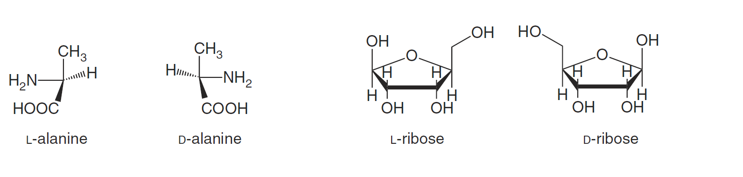
WHAT is Biological Homochirality?
Biological aminoacid
left-handed
Biological sugar
right-handed
Notes:
Chirality is also present in chemistry and many biologically interesting molecules are chiral.
However, life is extremely picky when it comes to chirality. It selectively uses left-handed amino acids and right-handed sugars. And this behavior is omnipresent in all living systems.
This is biological homochirality.
The mystery is that we don’t know what triggered this symmetry-breaking. What is the physical reason behind this feature of life on Earth?
This is one of the biggest questions not just in biology but in all sciences.

Slide 4
We propose that spin-polarized electrons can induce chiral excess and facilitate the homochiral assembly of biological molecules.
Spin-polarized electrons can be provided by magnetic minerals.
Notes:
In my talk, I will offer a solution to this problem and introduce spin-polarized electrons as agents that can trigger this chiral imbalance.
I will explain the mechanism and put things in a plausible geochemical context available on prebiotic Earth.

Slide 5
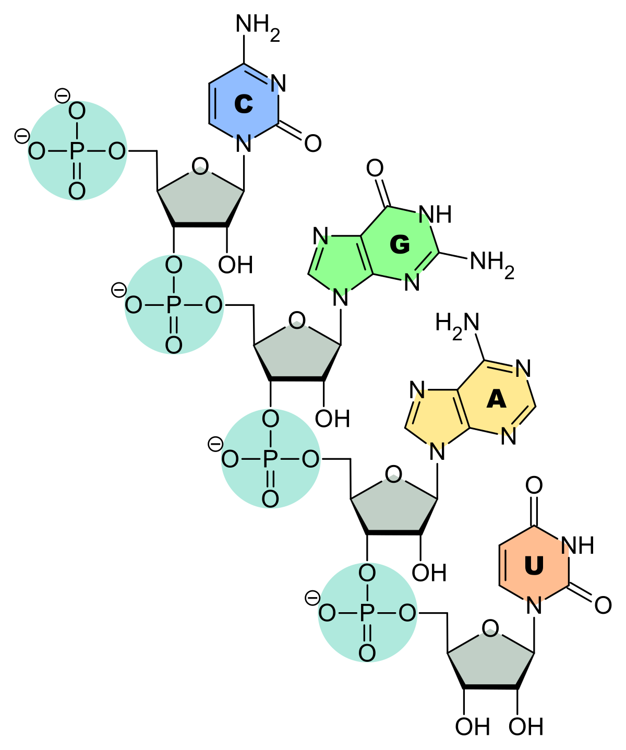
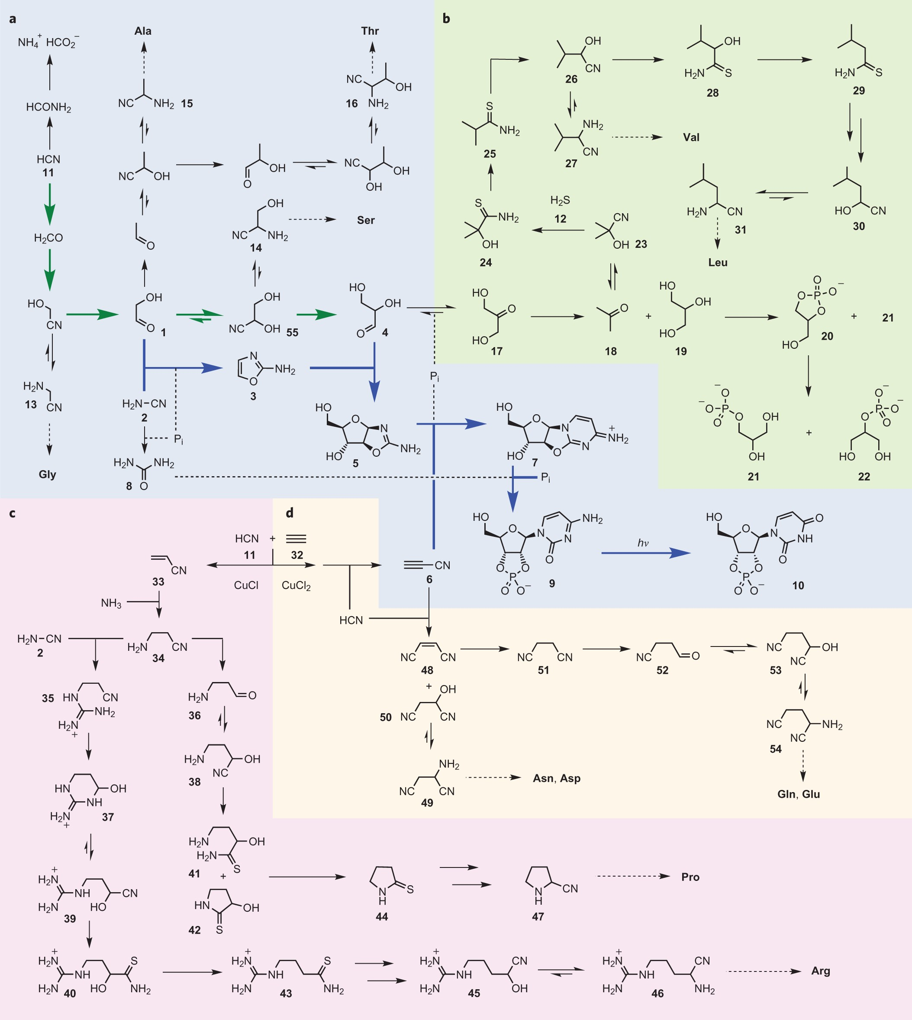
WHY does it matter?
“The Arithmetic Demon”
No homochirality, no RNA!
Patel et al. (2015)
Goyce et al. (1984)
Notes:
So, after explaining WHAT the problem is let’s ask WHY does it even matter to have homochirality.
First, it is a no brainer that the origin of life did not happen due to a simple chemical reaction. It probably was a consequence of series of reactions, like the network you see on the left. And once chirality emerges in such a network, if you cannot figure out chirally selective synthesis, you start throwing out half of your products. This quickly gives yields converging to 0 in several steps. This the arithmetic argument forcing us to figure out chirally selective synthesis as early as possible.
The second problem is that it is experimentally shown that you cannot polymerize RNA from a chirally mixed pool of nucleotides. Therefore, without achieving a homochiral state one cannot realize the RNA world.

Slide 6
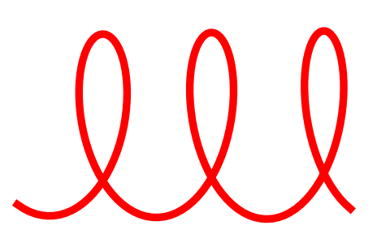
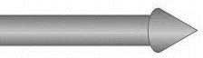
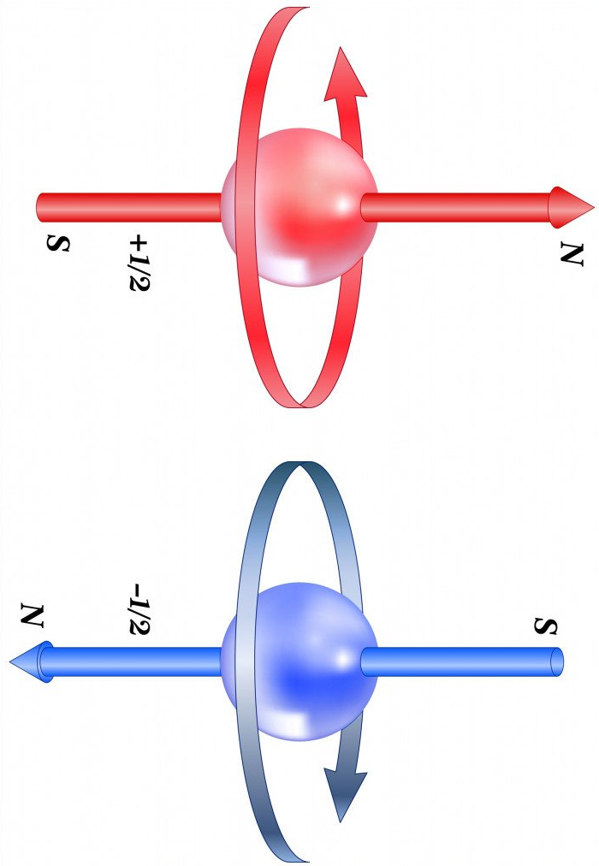
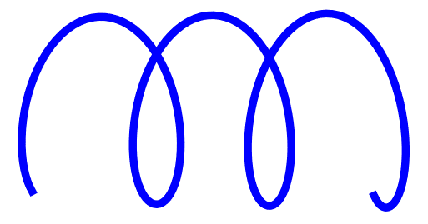
WHO are Spin-Polarized Electrons?
velocity
right-handed
velocity
left-handed
Electrons can be chiral
Notes:
Now, we came to our candidate as a chiral agent: electrons with a well-defined spin orientation.
By an analogy I can try to explain what they are. Just as electric field orients charged particles, magnetic field interacts with particles through their spin. So, electrons under magnetic field orient their spin along the direction of the field.
And an electron moving along the direction of its spin, provides a field which traces out a helical path. And the handedness of this field is defined by the spin orientation of the electron.
Therefore, spin-polarized electrons have a chiral property and because of this they interact with chiral molecules selectively. So electrons can be a chiral agent.

Slide 7
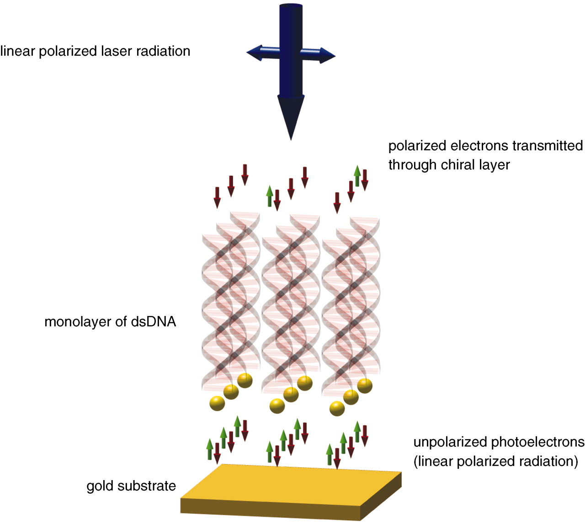
HOW does it work?
Chiral molecules interacts with the electron spin!
Gohler et al. (2011)
Notes:
This is actually an experimentally demonstrated coupling.
It has been shown that chiral molecules filter out a stream of electrons ejected from a surface based on their spin orientation.

Slide 8
HOW does it work?
Reductive synthesis
A + e⁻
A⁻
B
chiral precursor
racemic
chiral product
chiral excess
Ozturk et al. (2022)
Notes:
Therefore, motivated by the strong interaction of chirality and electron spin, we suggest doing chemistry with spin-polarized electrons.
As seen here, if a chiral molecule, A, is reduced by a spin-polarized electron then one can chirally enrich the reduction product, B, based on the electron’s spin.
This is our main idea.

Slide 9
WHERE do chiral electrons come from?
Notes:
And now we turn back to geochemistry and ask ourselves how can we find these electrons.

Slide 10
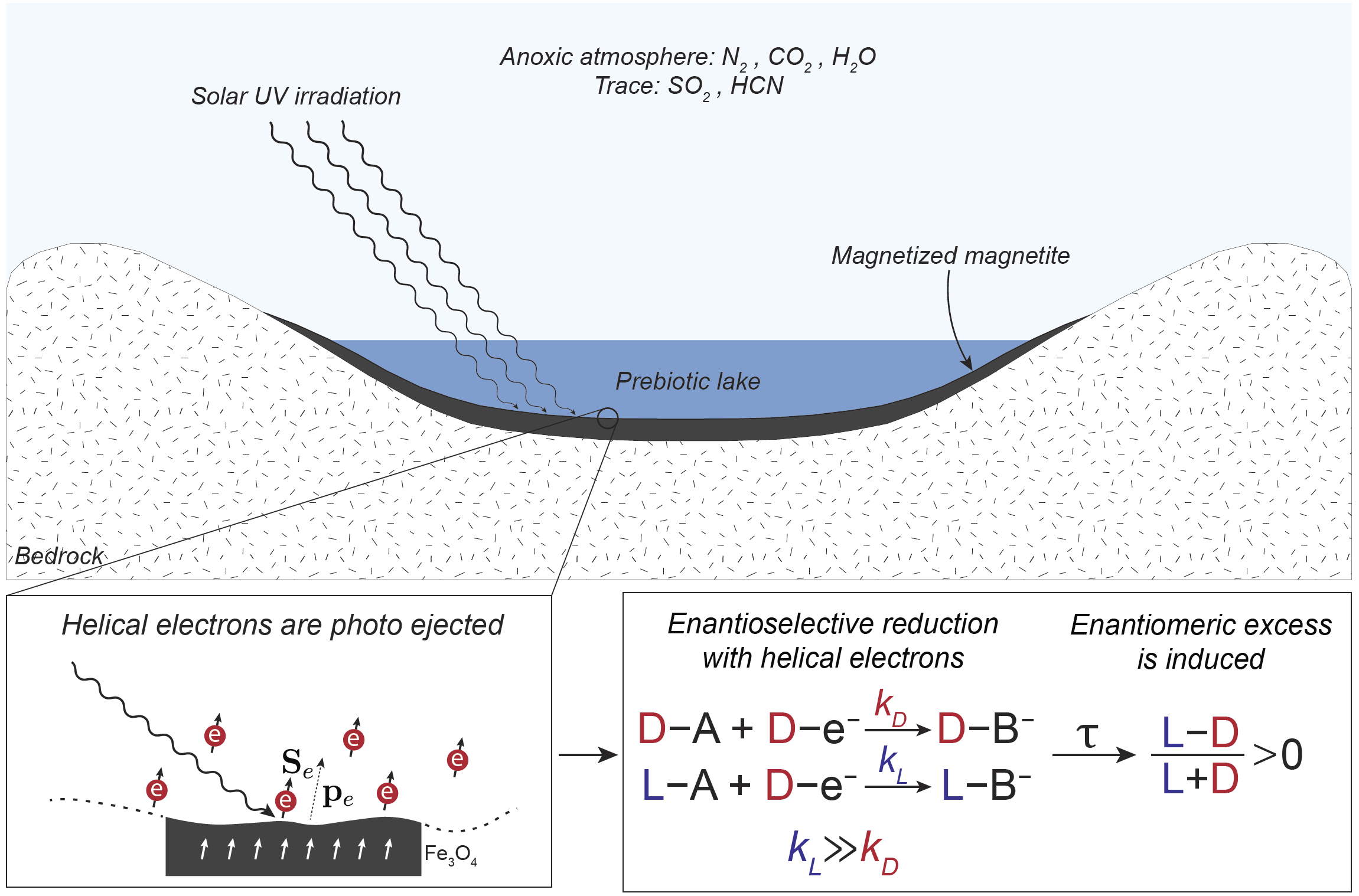
Chiral electrons are photoejected
Reduction chemistry near magnetic surfaces can be chirally selective!
Ozturk et al. (2022)
Notes:
Turns out that, if you shine light on magnetic minerals, such as iron-oxides, you can get spin-polarized electrons.
We consider a surface lake which was rich in dissolved iron. It is known that under anoxic conditions, iron-oxides like hematite and magnetite form as authigenic sediments under the bottom of these lakes.
And these sediments carry the magnetization of the field under which they are magnetized. Therefore, the symmetry is broken by the field magnetizing these minerals and the magnetized minerals provide the chiral electrons when they are exposed to UV irradiation.

Slide 11
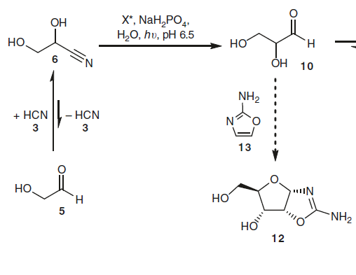
WHEN to break the symmetry?
Reduction
2e⁻
1st Chiral Sugar
glyceraldehyde
1st Chiral Molecule
Racemic
nucleotide precursor
Ritson et al. (2018)
Powner et al. (2009)
Notes:
The last question is when does it happen? Of course, the easy answer is during prebiotic chemistry. But we can do better and suggest a more specific reaction.
There is a very well-known prebiotic reaction for the synthesis of nucleotides, the building blocks of RNA. And this reaction uses the 1st chiral sugar, glyceraldehyde, as its reagent and the chirality of this molecule directly dictates the chirality of the nucleotide.
Moreover, this chiral molecule itself, is synthesized through a reduction reaction. Meaning, it gets formed when a chiral molecule absorbs electrons.
Hence, we consider this reductive synthesis of glyceraldehyde as the most suitable reaction to apply our idea.

Slide 12
Electrons can be chiral agents.
Chiral electrons can induce chirally selective synthesis of biomolecules.
Magnetic minerals can provide chiral electrons.
Notes:
So here are the main takeaway messages.

Slide 13

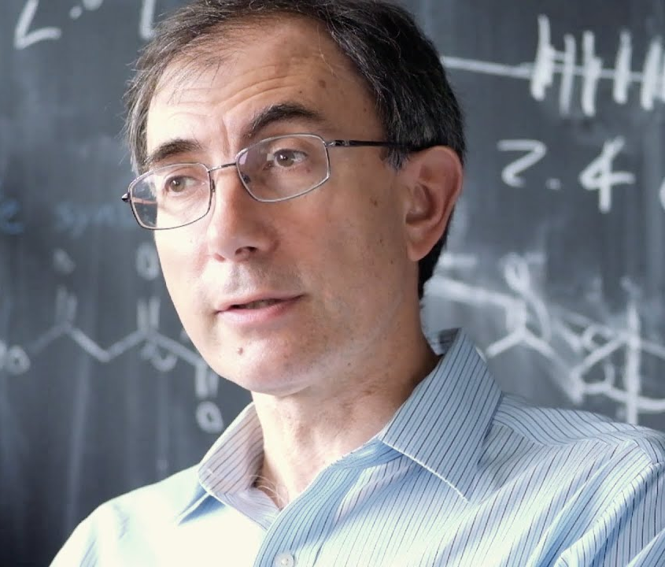


Dimitar D. Sasselov
Please reach out to me at sukrufurkanozturk@g.harvard.edu
or on Twitter @SFurkanOzturk61

Slide 14
Homochirality Problem
Symmetry
breaking
agent
50% L
and
50% D
51% L
and
49% D
Chemical
amplification
100 %L
Initial bias
Homochiral
Equal mixture
Small
chiral excess

Slide 15
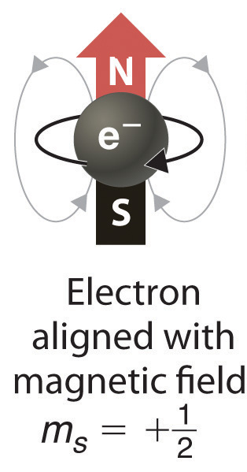

Spin-Polarized Electrons

Slide 16
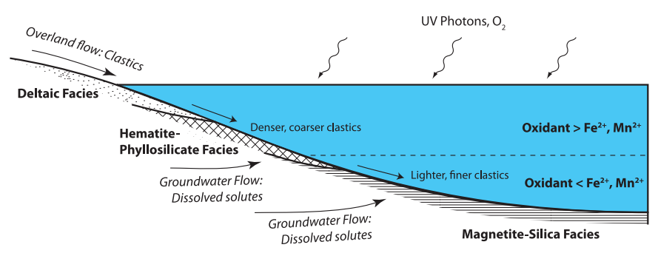
Magnetite Formation
Hurowitz et al. (2017)
Notes:
Abundant in an Fe⁺² rich environment
The most magnetic mineral (M_{r} ~ 100G)
High Curie Temperature (T_{c} = 580C)
Evidence from Mars
to do prebiotic chemistry you need to wait for the dry phase
when it dries it happens on top of the magnetite
uniform deposition of magnetite like a slab
magnetization that comes due to that
CISS effect is real!
Deterministic generation of ee
Robust at room temperature
Possibility to induce ee at an early stage
Independent of the chiral molecule
Inducing ee by synthesis not by destruction
In-situ
Steady

Slide 17
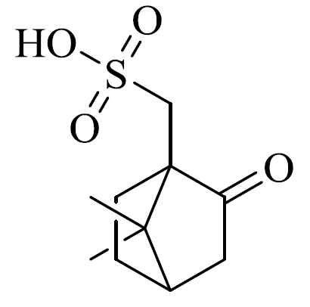
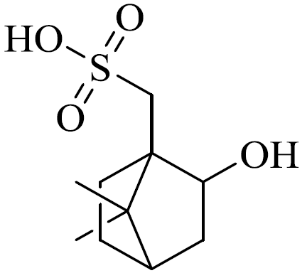
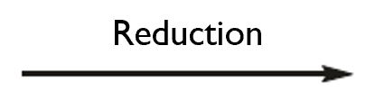
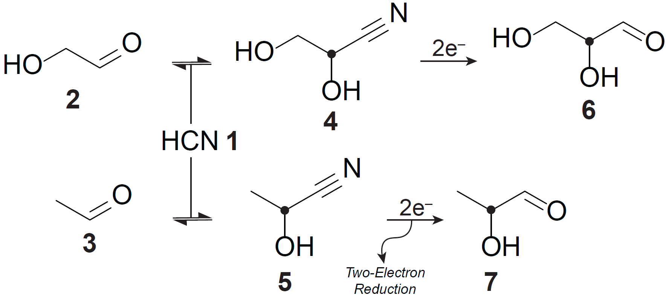
Experimental Work: Outlook
Previous:
Racemic
10% chiral excess
Ongoing project:
Racemic
Metzger et al. (2020)
Notes:
Our collaborators have previously shown that electron spin can be a chiral agent out of the prebiotic context, with the reaction shown here, which was done on a magnetized surface.
Now, our ongoing project is to do a similar synthesis, however, this time for this prebiotically relevant reaction, where the chirality of nucleotides and hence RNA is determined.

