Slide 1

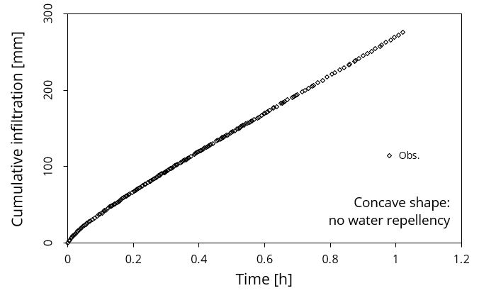
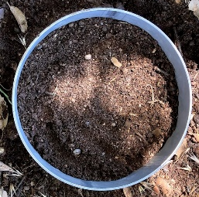
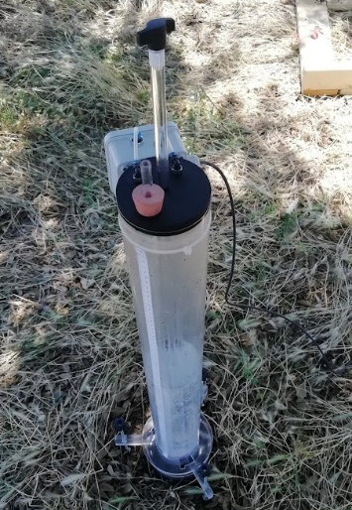
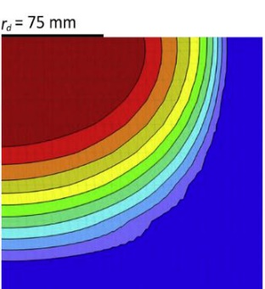
BEST
BEST-WR for the hydraulic characterization of hydrophilic and water-repellent soils
Simone Di Prima , Ryan D. Stewart, Majdi R. Abou Najm, Ludmila Ribeiro Roder, Filippo Giadrossich, Rafael Angulo-Jaramillo, Deniz Yilmaz, Pier Paolo Roggero, Mario Pirastru and Laurent Lassabatere
Regular soil
Di Prima, S., Stewart, R.D., Abou Najm, M.R., Ribeiro Roder, L., Giadrossich, F., Campus, S., Angulo-Jaramillo, R., Yilmaz, D., Roggero, P.P., Pirastru, M., Lassabatere, L., 2021. BEST-WR: An adapted algorithm for the hydraulic characterization of hydrophilic and water-repellent soils. Journal of Hydrology 603, 126936. https://doi.org/10.1016/j.jhydrol.2021.126936

Slide 2
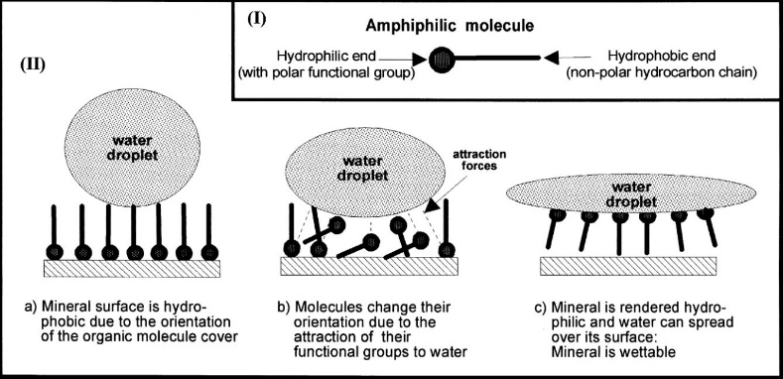
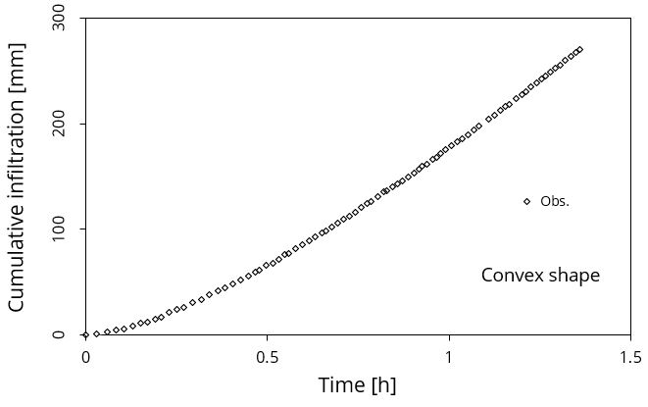
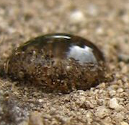
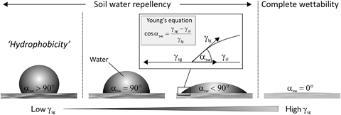
BEST
BEST-WR for the hydraulic characterization of hydrophilic and water-repellent soils
Simone Di Prima , Ryan D. Stewart, Majdi R. Abou Najm, Ludmila Ribeiro Roder, Filippo Giadrossich, Rafael Angulo-Jaramillo, Deniz Yilmaz, Pier Paolo Roggero, Mario Pirastru and Laurent Lassabatere
Figure from Doerr et al. (2000)
Figure from Goebel et al. (2011)
Di Prima, S., Stewart, R.D., Abou Najm, M.R., Ribeiro Roder, L., Giadrossich, F., Campus, S., Angulo-Jaramillo, R., Yilmaz, D., Roggero, P.P., Pirastru, M., Lassabatere, L., 2021. BEST-WR: An adapted algorithm for the hydraulic characterization of hydrophilic and water-repellent soils. Journal of Hydrology 603, 126936. https://doi.org/10.1016/j.jhydrol.2021.126936

Slide 3
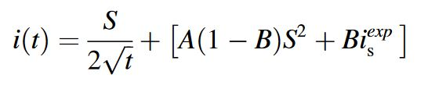

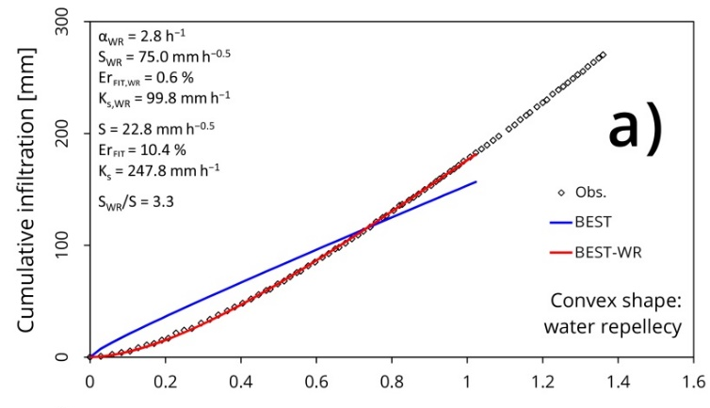

BEST
BEST-WR for the hydraulic characterization of hydrophilic and water-repellent soils
Simone Di Prima , Ryan D. Stewart, Majdi R. Abou Najm, Ludmila Ribeiro Roder, Filippo Giadrossich, Rafael Angulo-Jaramillo, Deniz Yilmaz, Pier Paolo Roggero, Mario Pirastru and Laurent Lassabatere
Haverkamp’s explicit transient expansion for infiltration rate
Empirical exponential scaling factor proposed by Abou Najm et al. (2021)
Infiltration rates
Original Haverkamp model included in BEST
Cumulative infiltration
Modified Haverkamp model included in BEST-WR
Di Prima, S., Stewart, R.D., Abou Najm, M.R., Ribeiro Roder, L., Giadrossich, F., Campus, S., Angulo-Jaramillo, R., Yilmaz, D., Roggero, P.P., Pirastru, M., Lassabatere, L., 2021. BEST-WR: An adapted algorithm for the hydraulic characterization of hydrophilic and water-repellent soils. Journal of Hydrology 603, 126936. https://doi.org/10.1016/j.jhydrol.2021.126936

Slide 4
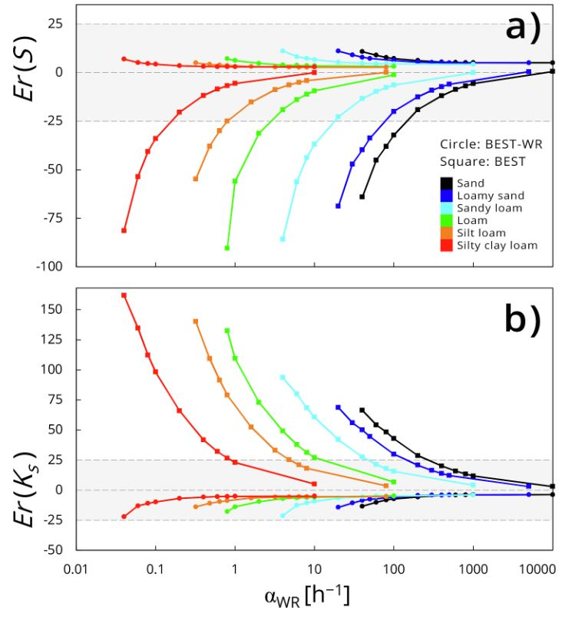
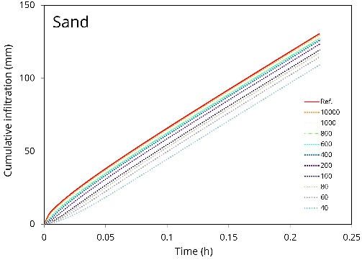
(2ΔK^2)/S^2 t=1/(1-β) [2ΔK/S^2 (I_1D (t)-K_i t)-ln((exp(2β ΔK/S^2 (I_1D (t)-K_i t))+β-1)/β)]
BEST-WR for the hydraulic characterization of hydrophilic and water-repellent soils
Simone Di Prima , Ryan D. Stewart, Majdi R. Abou Najm, Ludmila Ribeiro Roder, Filippo Giadrossich, Rafael Angulo-Jaramillo, Deniz Yilmaz, Pier Paolo Roggero, Mario Pirastru and Laurent Lassabatere
3D cumulative infiltration (Smettem et al., 1994)
Analytical validation
1D implicit model by Haverkamp et al. (1990)
Sorptivity estimation (Parlange, 1975)
Synthetic curves
BEST-WR
$$α_{WR}$$
Haverkamp’s model extended to water repellent soils
Errors of the parameters estimated inverting the analytical curves
Di Prima, S., Stewart, R.D., Abou Najm, M.R., Ribeiro Roder, L., Giadrossich, F., Campus, S., Angulo-Jaramillo, R., Yilmaz, D., Roggero, P.P., Pirastru, M., Lassabatere, L., 2021. BEST-WR: An adapted algorithm for the hydraulic characterization of hydrophilic and water-repellent soils. Journal of Hydrology 603, 126936. https://doi.org/10.1016/j.jhydrol.2021.126936

Slide 5
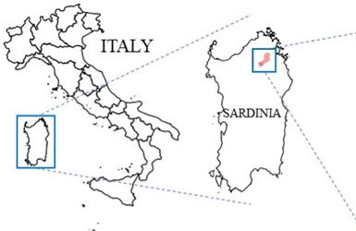
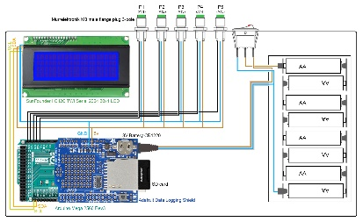
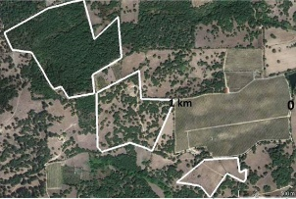
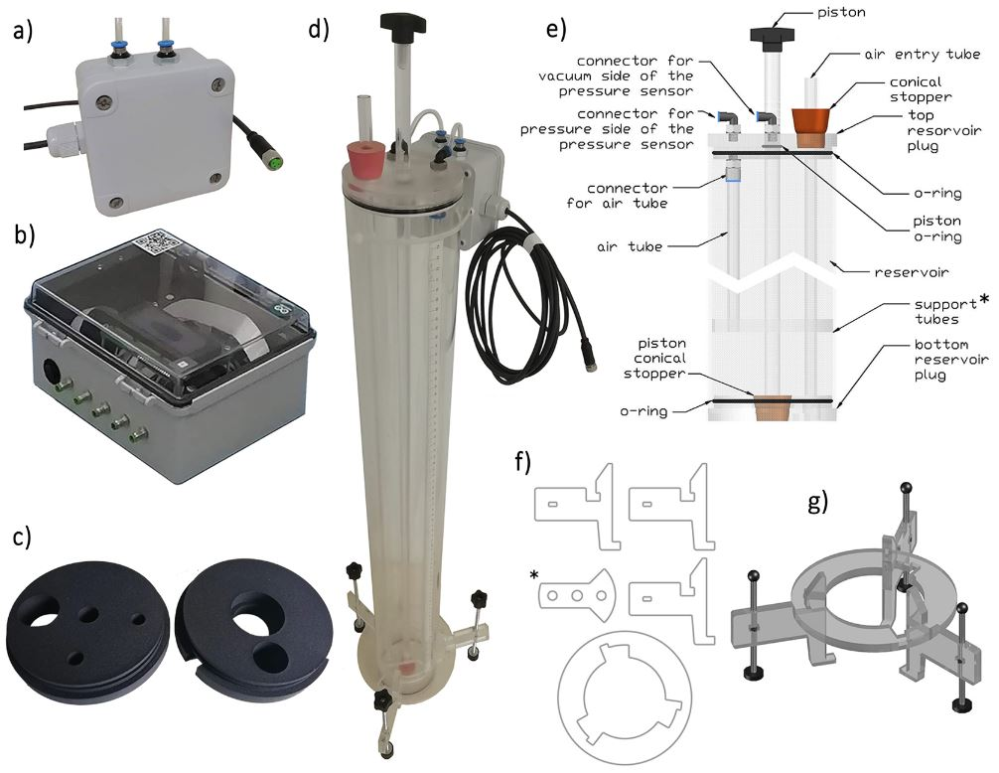
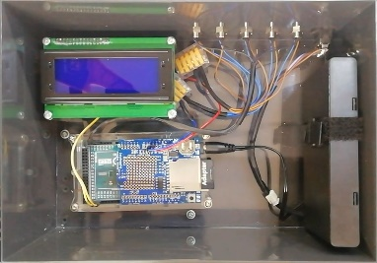
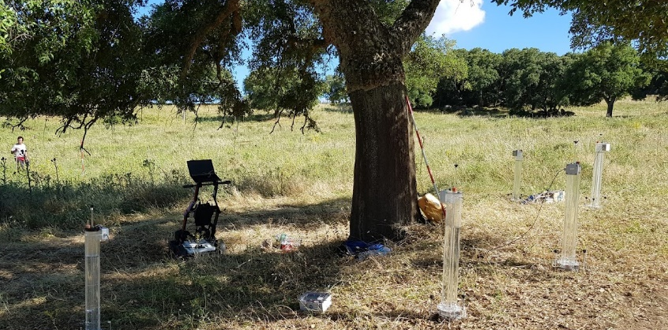

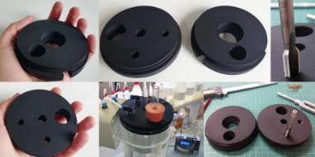

BEST
BEST-WR for the hydraulic characterization of hydrophilic and water-repellent soils
Simone Di Prima , Ryan D. Stewart, Majdi R. Abou Najm, Ludmila Ribeiro Roder, Filippo Giadrossich, Rafael Angulo-Jaramillo, Deniz Yilmaz, Pier Paolo Roggero, Mario Pirastru and Laurent Lassabatere
An open-source instrumentation package for intensive
soil hydraulic characterization (Concialdi et al., 2020)
bestsoilhydro.net
Di Prima, S., Stewart, R.D., Abou Najm, M.R., Ribeiro Roder, L., Giadrossich, F., Campus, S., Angulo-Jaramillo, R., Yilmaz, D., Roggero, P.P., Pirastru, M., Lassabatere, L., 2021. BEST-WR: An adapted algorithm for the hydraulic characterization of hydrophilic and water-repellent soils. Journal of Hydrology 603, 126936. https://doi.org/10.1016/j.jhydrol.2021.126936

Slide 6
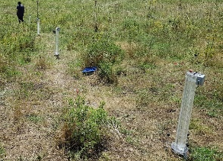
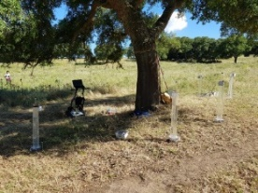
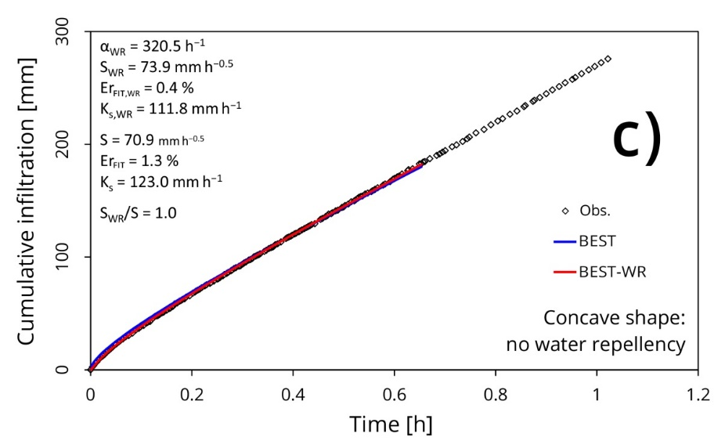
BEST
BEST-WR for the hydraulic characterization of hydrophilic and water-repellent soils
Simone Di Prima , Ryan D. Stewart, Majdi R. Abou Najm, Ludmila Ribeiro Roder, Filippo Giadrossich, Rafael Angulo-Jaramillo, Deniz Yilmaz, Pier Paolo Roggero, Mario Pirastru and Laurent Lassabatere
Di Prima, S., Stewart, R.D., Abou Najm, M.R., Ribeiro Roder, L., Giadrossich, F., Campus, S., Angulo-Jaramillo, R., Yilmaz, D., Roggero, P.P., Pirastru, M., Lassabatere, L., 2021. BEST-WR: An adapted algorithm for the hydraulic characterization of hydrophilic and water-repellent soils. Journal of Hydrology 603, 126936. https://doi.org/10.1016/j.jhydrol.2021.126936

Slide 7
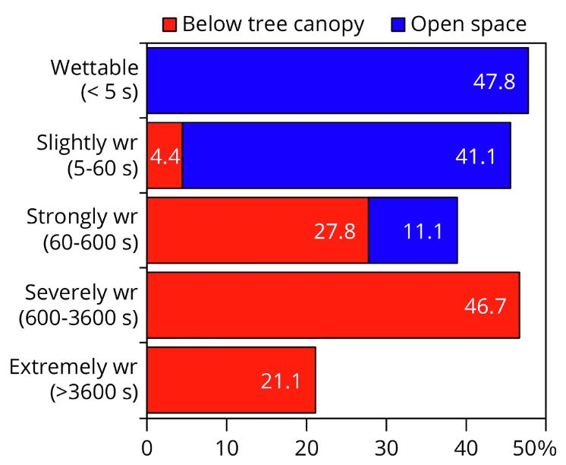
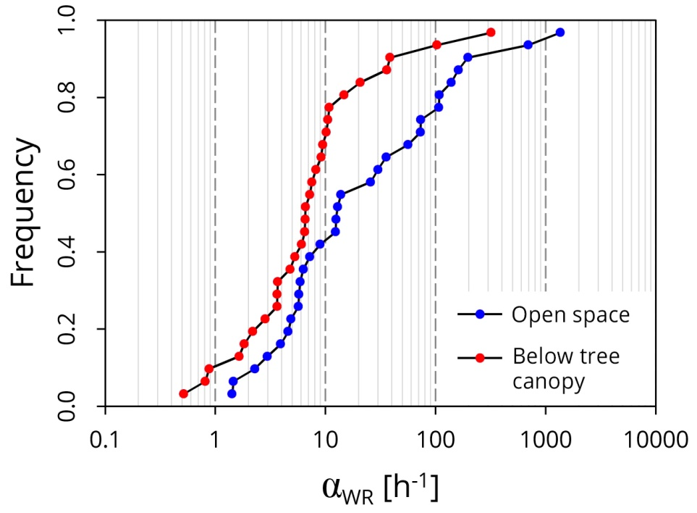

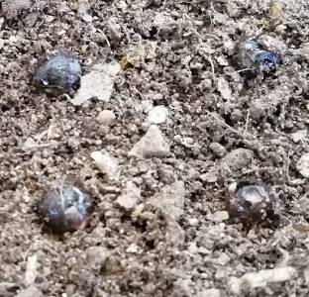
BEST
BEST-WR for the hydraulic characterization of hydrophilic and water-repellent soils
Simone Di Prima , Ryan D. Stewart, Majdi R. Abou Najm, Ludmila Ribeiro Roder, Filippo Giadrossich, Rafael Angulo-Jaramillo, Deniz Yilmaz, Pier Paolo Roggero, Mario Pirastru and Laurent Lassabatere
WDPT
Di Prima, S., Stewart, R.D., Abou Najm, M.R., Ribeiro Roder, L., Giadrossich, F., Campus, S., Angulo-Jaramillo, R., Yilmaz, D., Roggero, P.P., Pirastru, M., Lassabatere, L., 2021. BEST-WR: An adapted algorithm for the hydraulic characterization of hydrophilic and water-repellent soils. Journal of Hydrology 603, 126936. https://doi.org/10.1016/j.jhydrol.2021.126936

Slide 8
BEST
BEST-WR for the hydraulic characterization of hydrophilic and water-repellent soils
Simone Di Prima , Ryan D. Stewart, Majdi R. Abou Najm, Ludmila Ribeiro Roder, Filippo Giadrossich, Rafael Angulo-Jaramillo, Deniz Yilmaz, Pier Paolo Roggero, Mario Pirastru and Laurent Lassabatere
Thanks for your attention.

