Slide 1
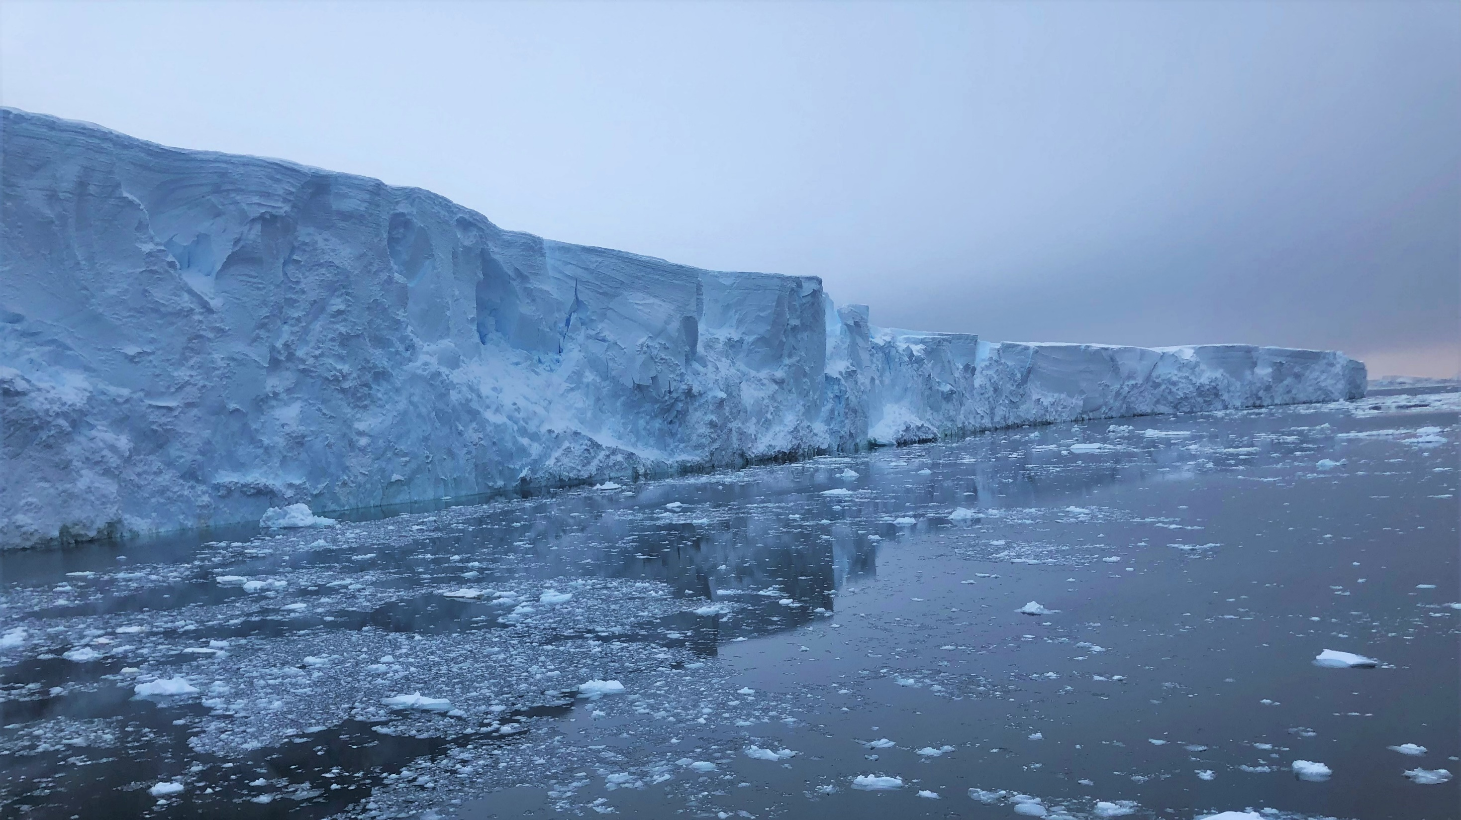
Temporal and Spatial Variability of Basal Melting beneath Getz Ice Shelf
Salar Karam¹, Elin Darelius², Keith Nicholls³ and Anna Wåhlin⁴
¹ Department of Earth Sciences, University of Gothenburg, Gothenburg, Sweden
² Geophysical Institute, University of Bergen, Bergen, Norway
³ British Antarctic Survey, Natural Environment Research Council, Cambridge, UK
⁴ Department of Marine Sciences, University of Gothenburg, Gothenburg, Sweden
Email: salar.karam@gu.se

Slide 2
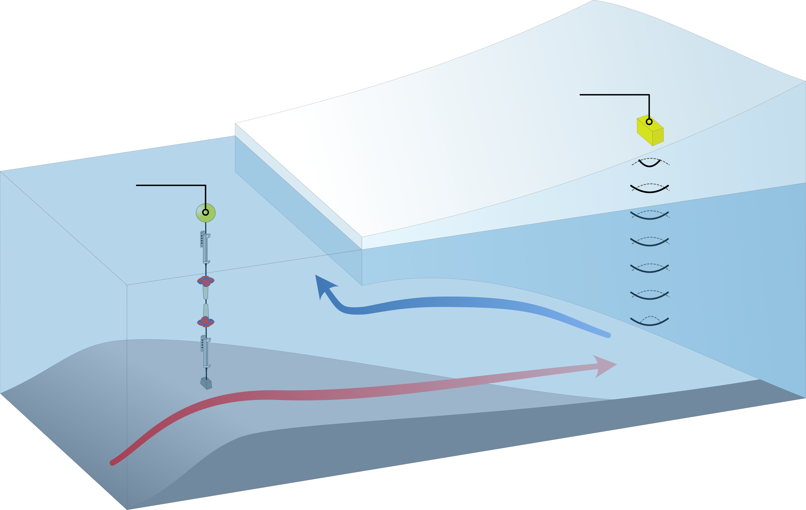
Introduction
Study area
Thermocline variability
Melt rates
Conclusions
1
Inflow of warm CDW causes basal melting
ApRES
3
Mooring data from outside the cavity for oceanographic context
2
Mooring
2
Time series of basal melt rate from “ice radars”
1
3
Melting

Slide 3
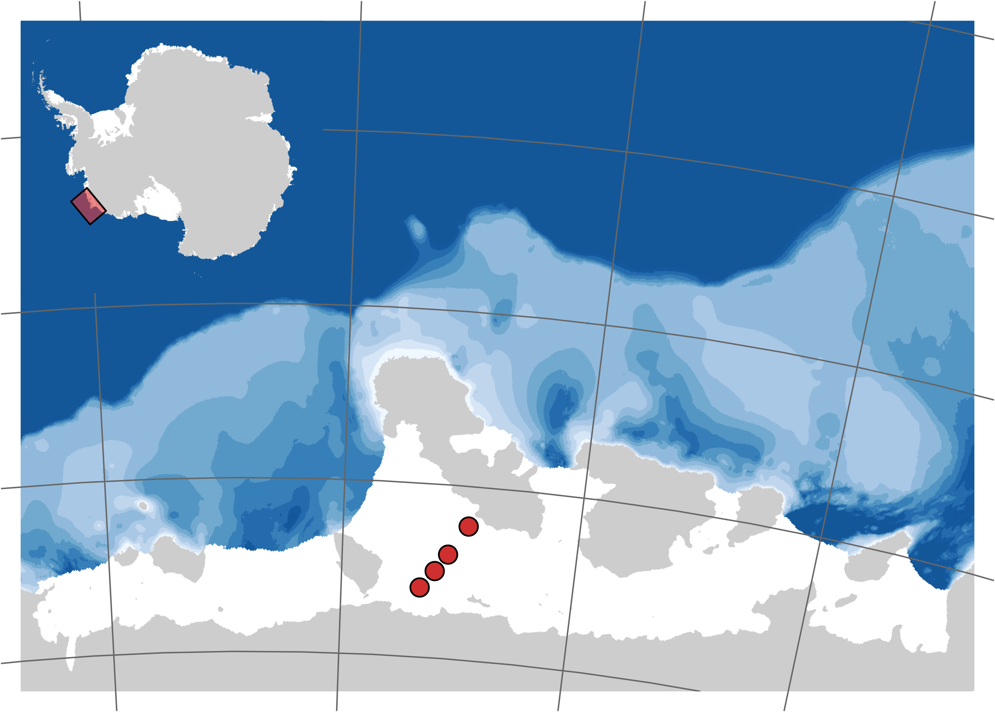




Introduction
Study area
Thermocline variability
Melt rates
Conclusions
133° W
127° W
123° W
117° W
1
Warm CDW crosses the shelf break through deep troughs
71° S
Depth (m)
1000
500
0
ApRES
The site GW1 is located close to a grounding line
72° S
2
Mooring
1
73° S
S6
GW1
2
GW2
GW3
74° S
GW4

Slide 4
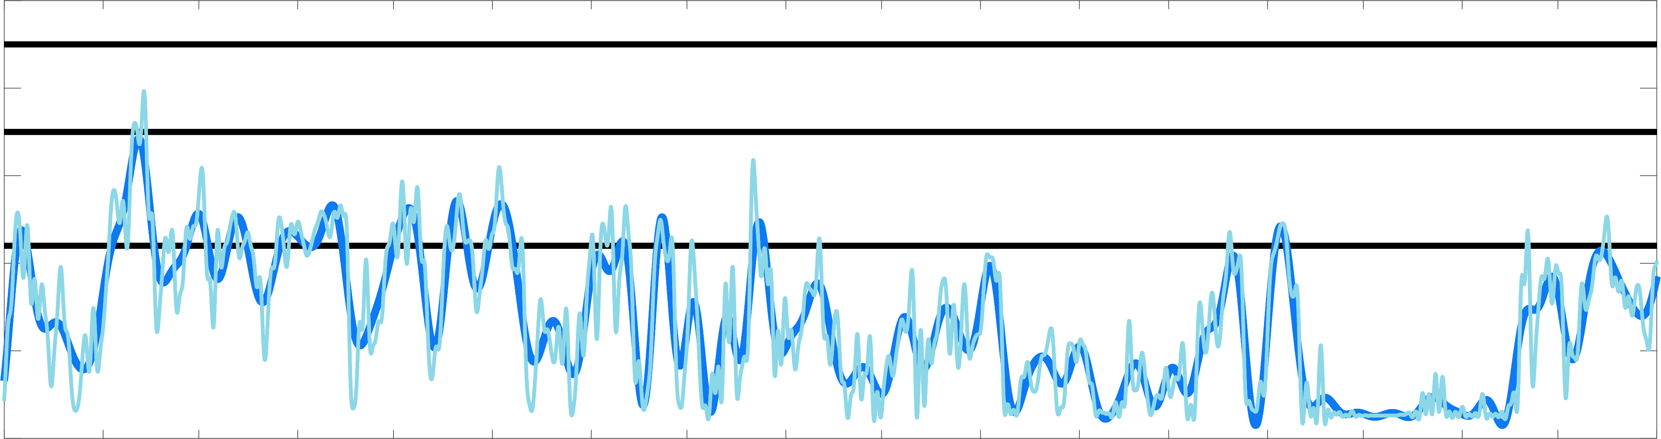
Introduction
Study area
Thermocline variability
Melt rates
Conclusions
Ice draft at GW2 and GW3 is outside the range of the thermocline
350
1
1
GW3
400
GW2
450
Depth (m)
GW1, GW4
Much deeper thermocline in 2017 compared to 2016
500
2
2
550
600
Mar
May
Jul
Sep
Nov
Jan
Mar
May
Jul
2016
2017

Slide 5
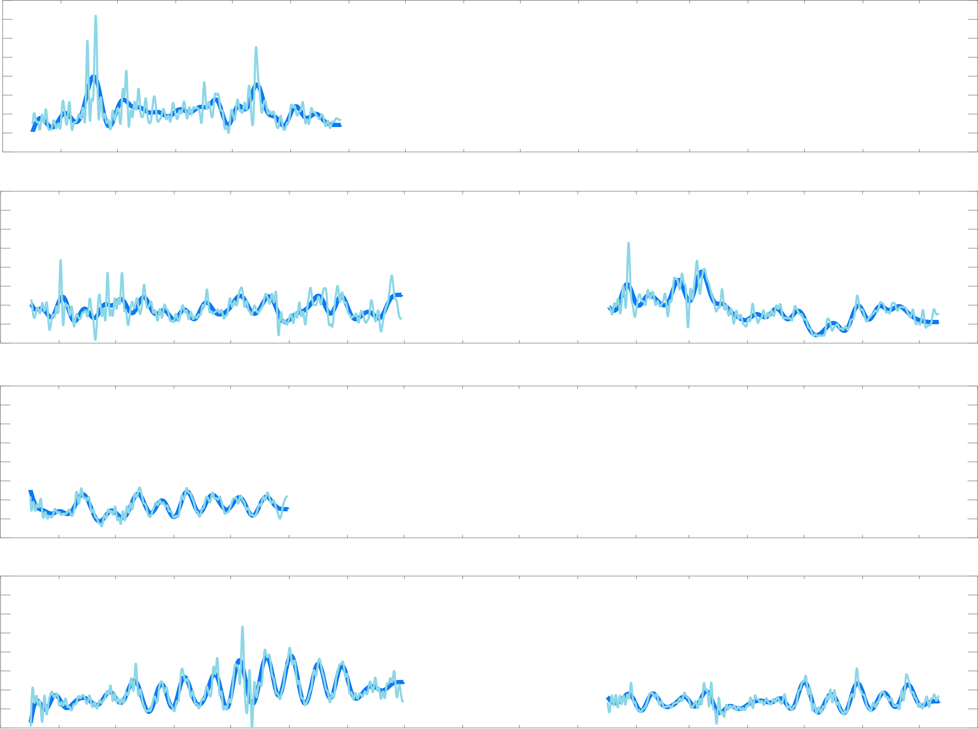
Introduction
Study area
Thermocline variability
Melt rates
Conclusions
Fortnightly oscillations at GW2, GW3 and GW4 arising from spring-neap tidal cycle
8
GW1
1
2
4
0
8
No fortnightly oscillations visible at GW1, close to the grounding line
GW2
2
4
4
0
8
Melt rate (m/year)
Melt rate at GW4 is 30% lower in 2017 compared to 2016
GW3
1
3
4
0
8
No reduction in melt rates at GW2 in 2017 compared to 2016
GW4
4
4
3
0
Mar
May
Jul
Sep
Nov
Jan
Mar
May
Jul
2016
2017

Slide 6
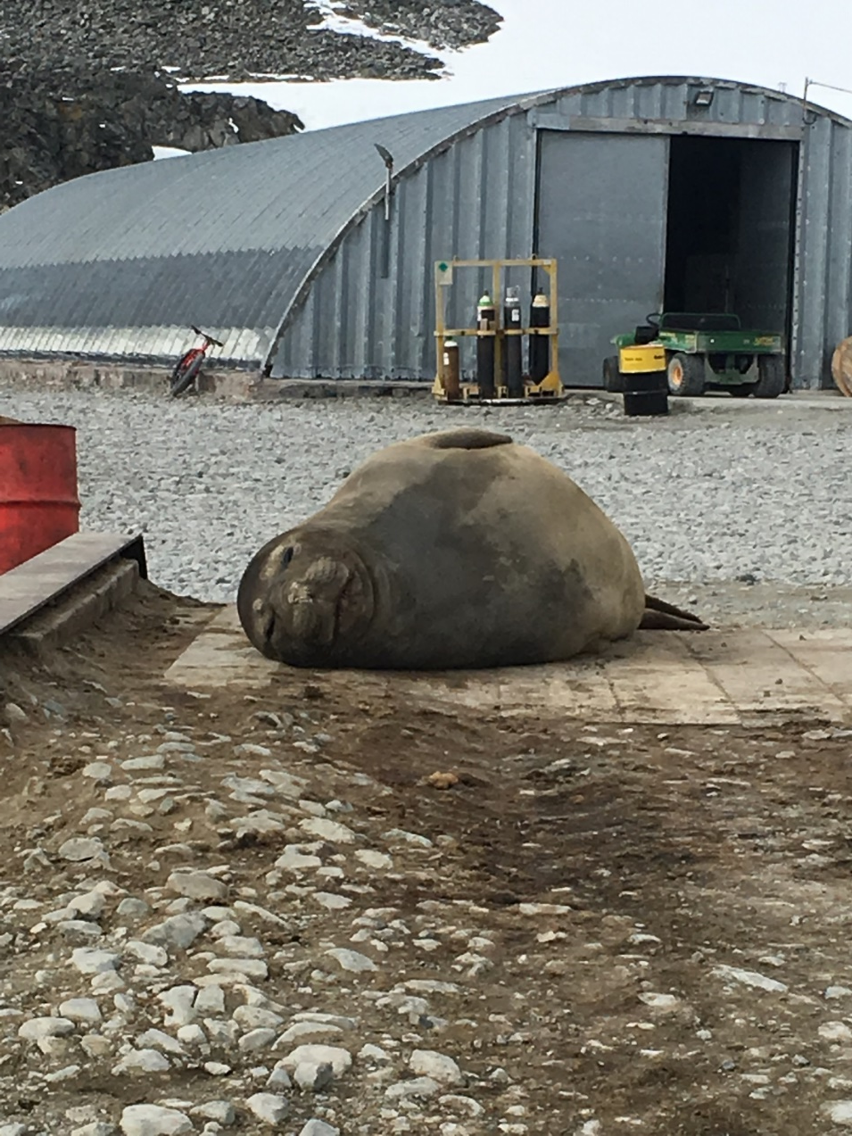
Introduction
Study area
Thermocline variability
Melt rates
Conclusions
Thanks for your attention!
Far from the grounding line, melt rates display strong variability at fortnightly frequencies
1
Well-mixed conditions at the grounding line reduce the effect of added turbulence from the spring-neap tidal cycle
2
On longer time scales, the melt rate at GW4 shows sensitivity to the depth of the thermocline
3
Melt rate at GW2 shows no sensitivity to thermocline depth. Implies that there is a lower bound too.
4

