Slide 1
Quantitative evaluation of gypsum-salt caprock sealing capacity based on analytic hierarchy process:
a case study of the Cambrian in the Tarim Basin, western China
Shan Zhao
China University of Petroleum (Huadong)

Slide 2
CONTENTS
Introduction
Geological setting
Evaluation methods
Application & results
Conclusions & References

Slide 3
/01
Introduction
Influencing factors of sealing capacity of gypsum-salt caprock
Evaluation of sealing ability of gypsum-salt caprock

Slide 4
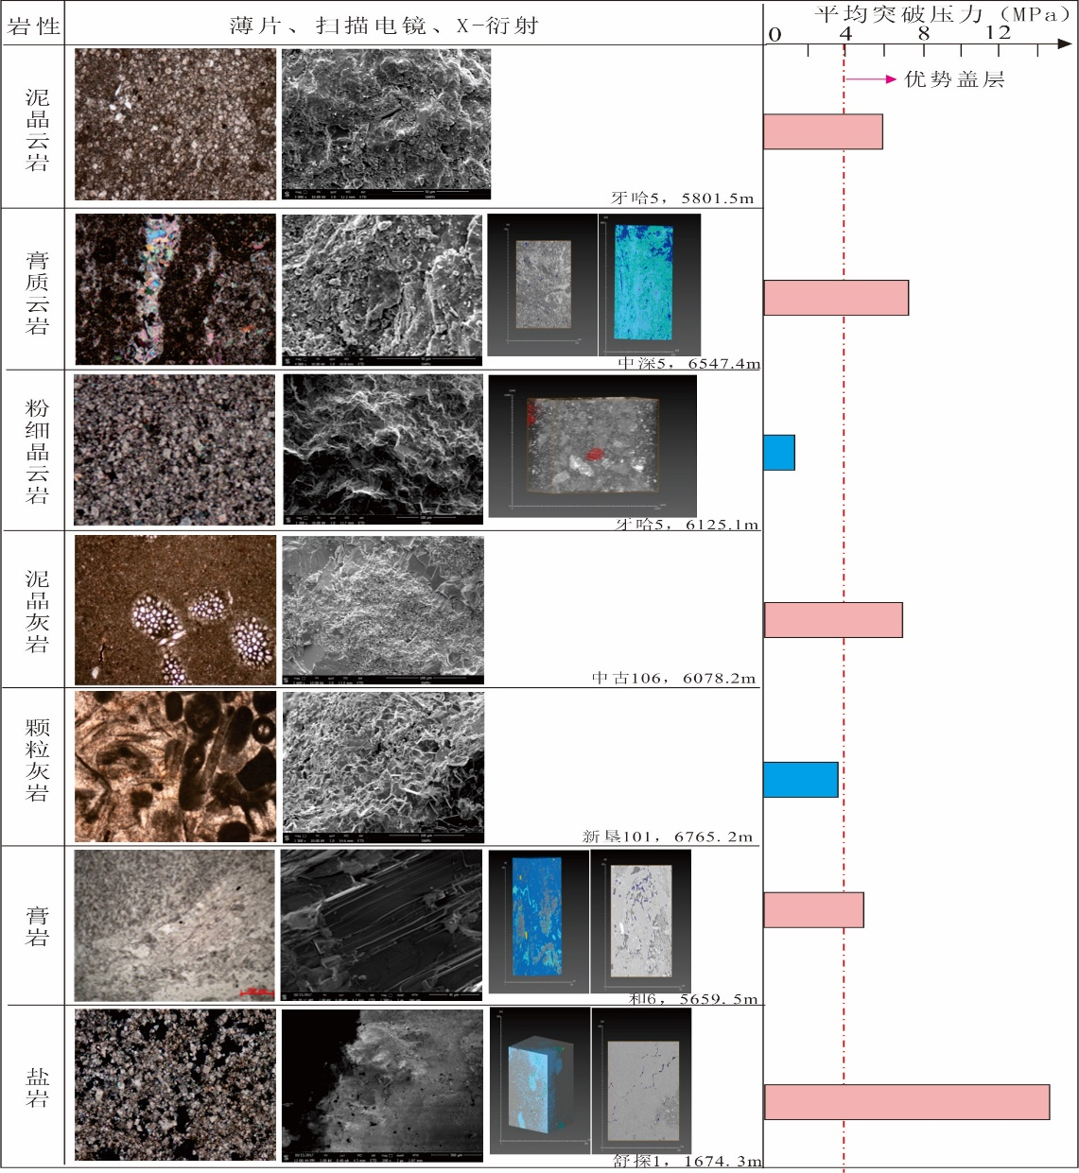
Influencing factors of sealing capacity of gypsum-salt caprock
Breakthrough pressure
Macro Influencing Factors
Dolomite
Lithology, thickness, distribution continuity, burial depth, compaction, diagenesis, fluid pressure
Micro influencing factors
Breakthrough pressure, permeability, porosity, specific surface area and micro pore structure
Limestone
Mechanical properties
Evaporite rock
Internal friction coefficient, tensile strength, peak strength
Porosity and permeability characteristics of main lithology of
Middle Lower Cambrian caprock in Tarim Basin

Slide 5
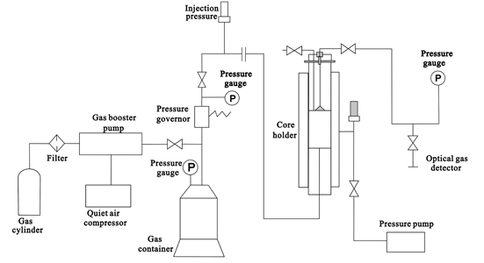
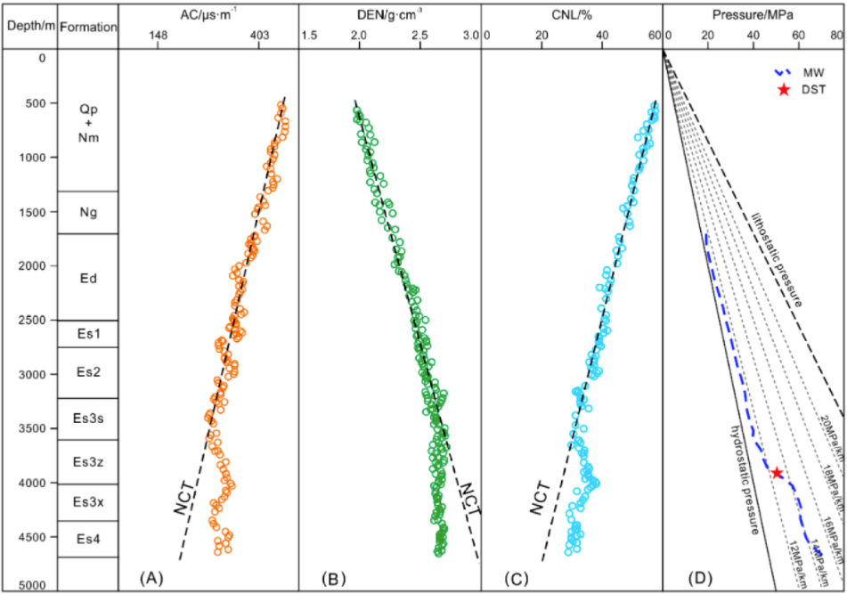
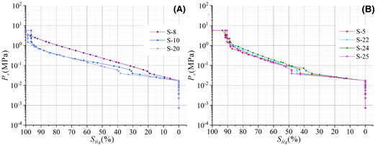
Evaluation of sealing ability of gypsum-salt caprock
Qualitative
Quantitation
Dynamic evolution
Main parameter: displacement pressure
Common methods:
Experimental methods: Adsorption method, Mercury injection method , Direct displacement method
Schematic diagram of the breakthrough pressure detection apparatus
（A）acoustic, （B）density, （C） neutron logs, （D） mud weights （MW）
Mercury injection curve(Wu Jun,2021)
(Li Chao,2019)

Slide 6
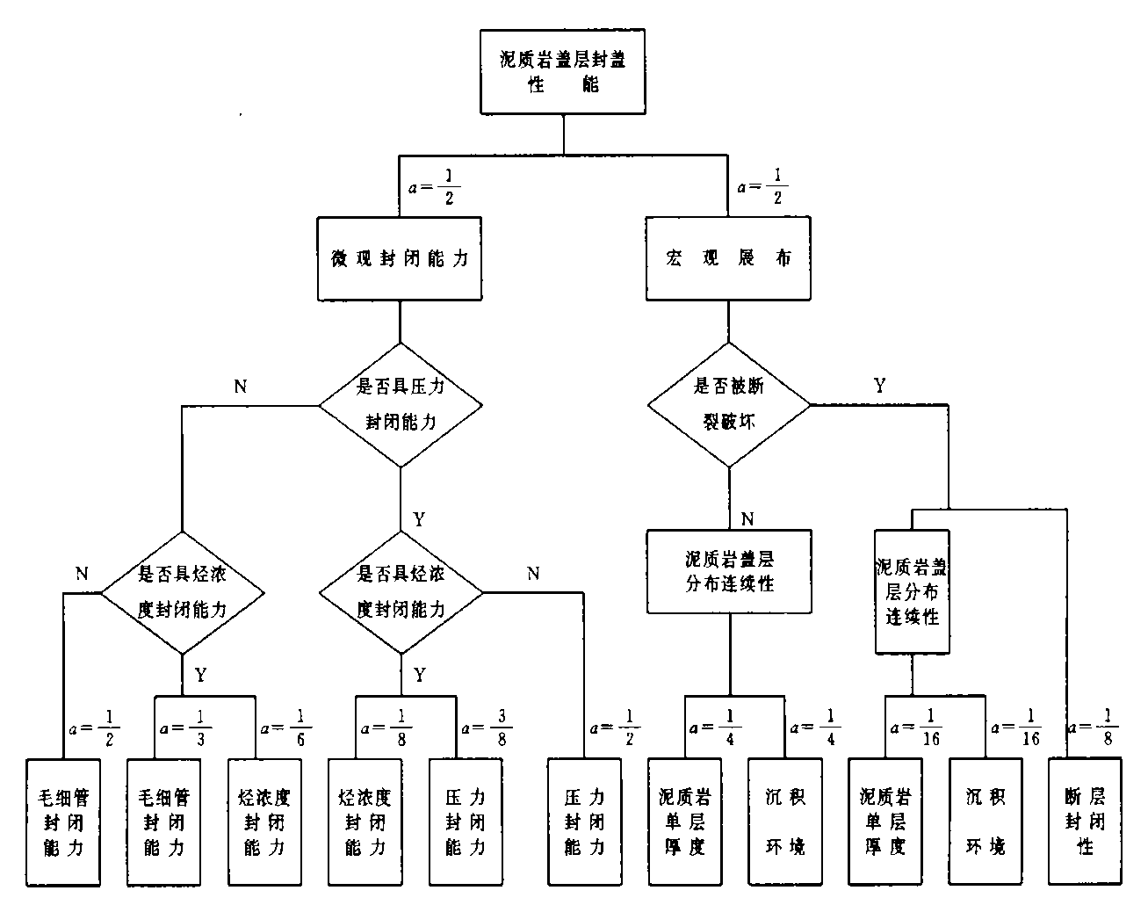
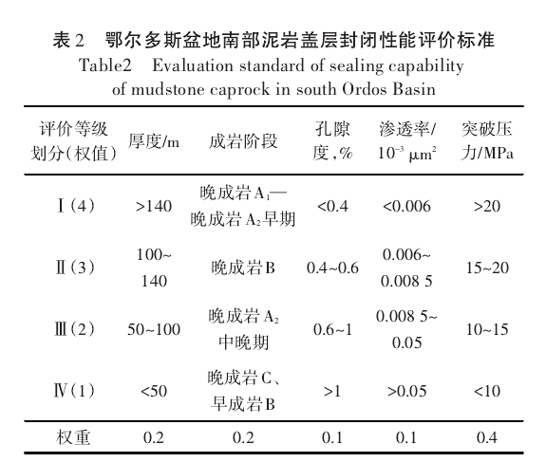
Evaluation of sealing ability of gypsum-salt caprock
Qualitative
Quantitation
Dynamic evolution
Conduct comprehensive evaluation with multiple parameters, give corresponding weights to different parameters, add and evaluate caprock , or establish evaluation formula 。
Relationship between sealing performance of argillaceous rock caprock and its evaluation parameters (Fu Guang, 1998)
Sealing property of mudstone caprock in southern Ordos Basin Energy evaluation criteria (Shi Hongcui, 2015)

Slide 7
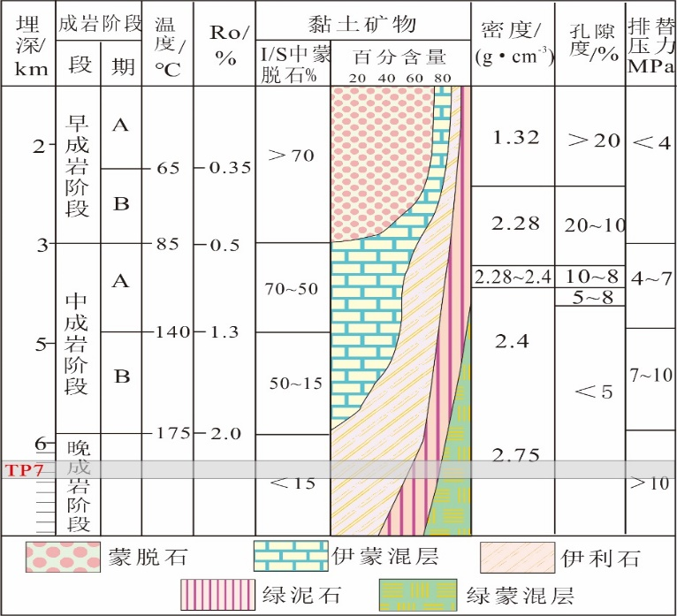
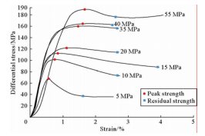
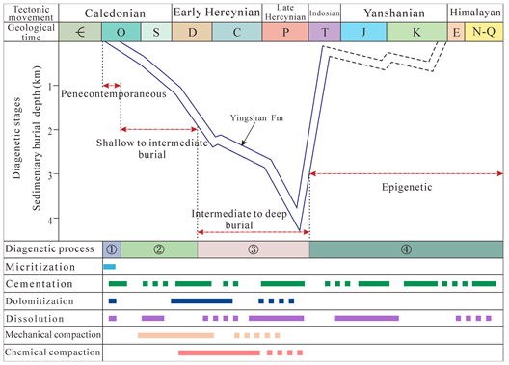
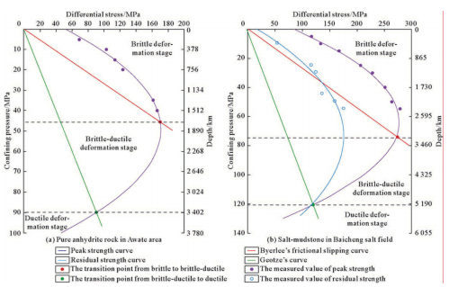
Evaluation methods
Qualitative
Quantitation
Dynamic evolution
D_{po}—Critical depth of sealing capacity formation
D_{B–P}—Critical depth of brittle plastic transition
Dynamic evolution
2100m
Diagenetic evolution model of mudstone
(according to Ma Li, 2004)
Brittle-ductile transition of different lithology caprocks
（FU Xiaofei, 2015）
Dynamic evolution diagram of caprock
(Wu Jun,2021)

Slide 8
CONTENTS
Introduction
Evaluation methods
Geological setting
Application & results
Conclusions & References

Slide 9
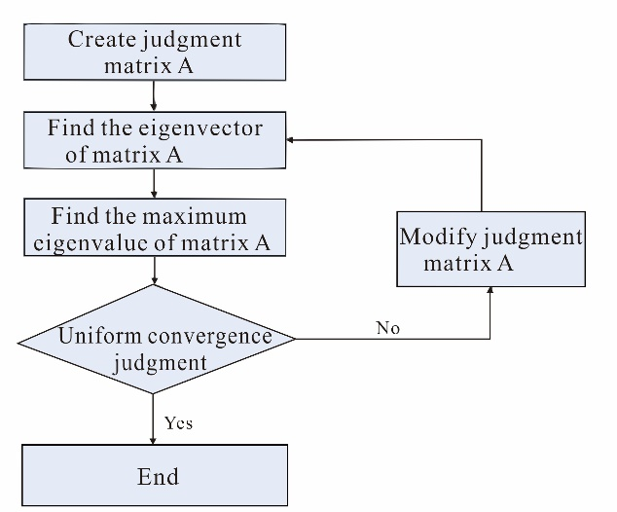
Analytic Hierarchy Process （AHP）
Problems to be solved：Caprock is an essential part of hydrocarbon formation that is controlled macroscopically by factors like capping distribution, thickness, lithology, ratio of caprock to stratum, and continuity. However, the evaluation of caprock sealing capacity based on the weight of each factor has not been realized, which limits the credibility of the evaluation results based on multi factor caprock.
Definition：The Analytic Hierarchy Process (AHP) is a multilevel weighting analysis method proposed in the 1980s (Saaty, 1987) for multi-objective, multi-criteria, multi-factor, multi-level unstructured complex decision problems (Dyer, 1990; Vaidya, 2006; Vargas, 1990).
Basic principle：the problem can be decomposed into different constituent factors based on the nature of the problem and the overall goal to be achieved, and the factors are assembled and combined at different levels based on their interrelated influence and affiliation, forming a multi-level analysis structure model. Finally, defining the proportional relevance or ranking of the respective qualities of the lowest level (options, measures, etc. for decision) in relation to the highest level (overall goal) is the crux of the problem (Forman, 2001; Saaty, 2008; Ho, 2008).

Slide 10


Evaluation of sealing ability of gypsum-salt caprock
④
The ranking weighting value of each layer is established after the consistency test passes, and the judgment matrix must be readjusted if the test fails.
A=$\left(\begin{matrix}\frac{W1}{W1} & ⋯ & \frac{W1}{Wn} \\ ⋮ & ⋱ & ⋮ \\ \frac{Wn}{W1} & ⋯ & \frac{Wn}{Wn}\end{matrix}\right)$
②Construct judgment matrix
The relative importance of any two factors is judged and quantified by scaling method.
⑤The total hierarchical
ranking is returned
③Calculate the judgment
matrix's eigenvectors
①Establish a hierarchical
structure model:
Divide the problem into three layers: a general objective, a sub-objective layer, and a program layer

Slide 11
CONTENTS
Introduction
Evaluation methods
Geological setting
Application & results
Conclusions & References

Slide 12
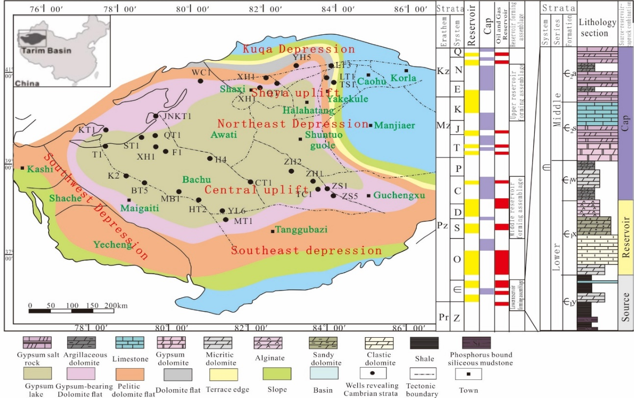
Geological setting
Sedimentary phases, tectonic positions and tectonic profiles of the Middle-Lower Cambrian in the Tarim Basin (modified after Jia et al., 2021).
Є₁y= Yuertusi Formation,Є₁x= Xiaoerbulake Formation,Є₁w= Wusonger Formation, Є₂s=Shayilike Formation, Є₂a= Awatag Formation.

Slide 13
CONTENTS
Introduction
Evaluation methods
Geological setting
Application & results
Conclusions & References

Slide 14
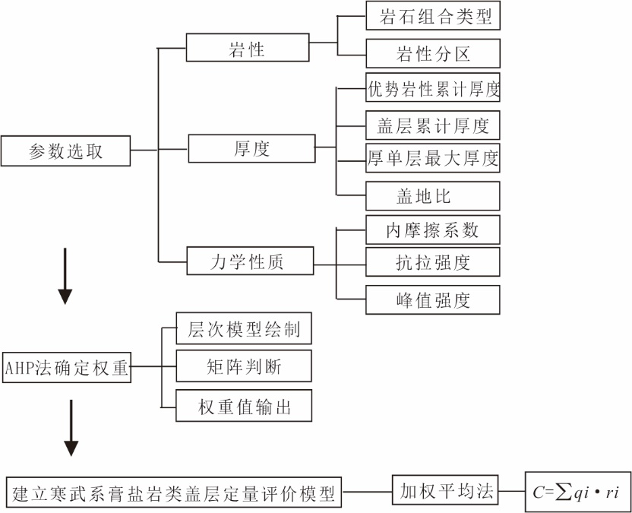
Evaluation process
lithology
Rock association type
Lithologic zoning
Dominant lithology
Cumulative thickness
①
Parameter
selection
thickness
Thick single layer
Ratio of caprock to stratum
Internal friction coefficient
mechanical
property
tensile strength
Peak intensity
②
hierarchical model
Determining weight
by AHP method
Weight output
Weight output
③
evaluation model
weighted mean

Slide 15
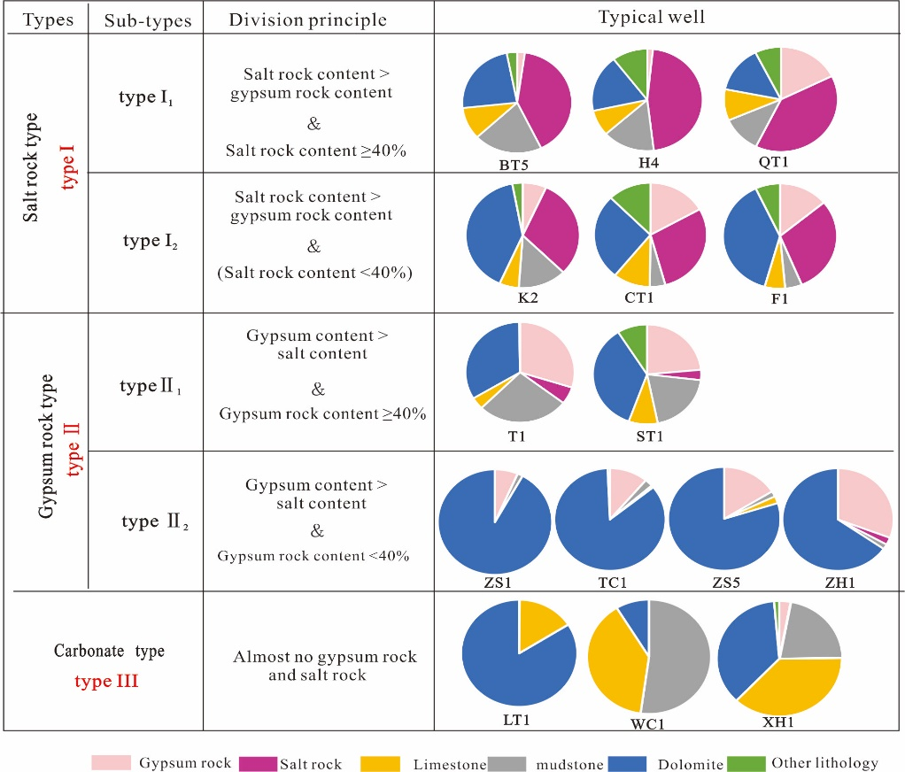
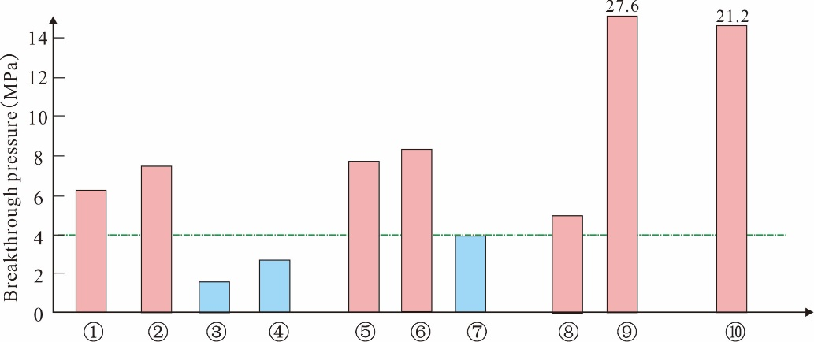
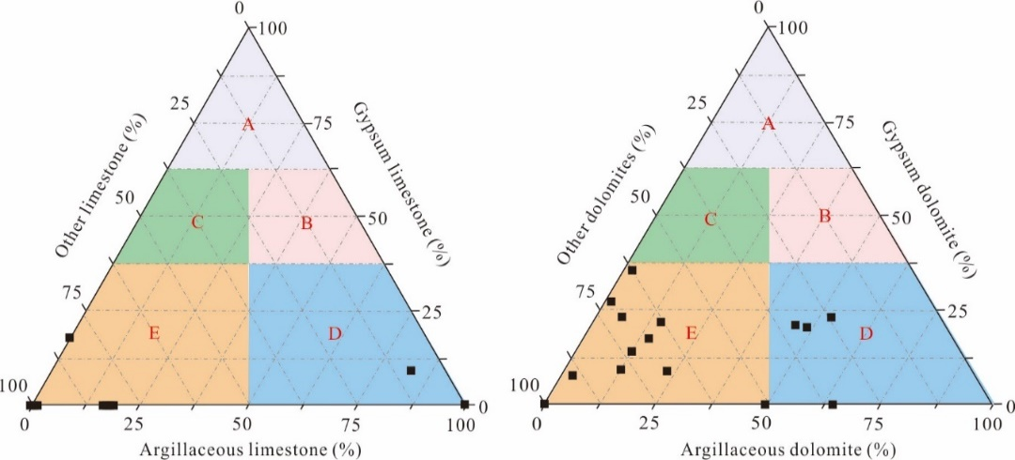
Step1：Parameter selection
Lithology of the caprock
Comparison of the average breakthrough pressure of different lithological caprock layers. ①=micritic dolomite, ②=gypsum dolomite, ③=fine crystalline dolomite, ④=granular dolomite, ⑤=micrite limestone, ⑥=gypsum limestone, ⑦=granular limestone, ⑧=gypsum rock, ⑨=salt rock, ⑩=mudstone. Take 4MPa as the boundary, and those greater than 4MPa are the dominant lithology, which are marked with red columns.
Classification of the Middle-Lower Cambrian (Є2a- Є1w) rock assemblage types in the Tarim Basin
Lithological zoning evaluation triangle plate.
(a) Limestone plate, (b) Dolomite plate.

Slide 16
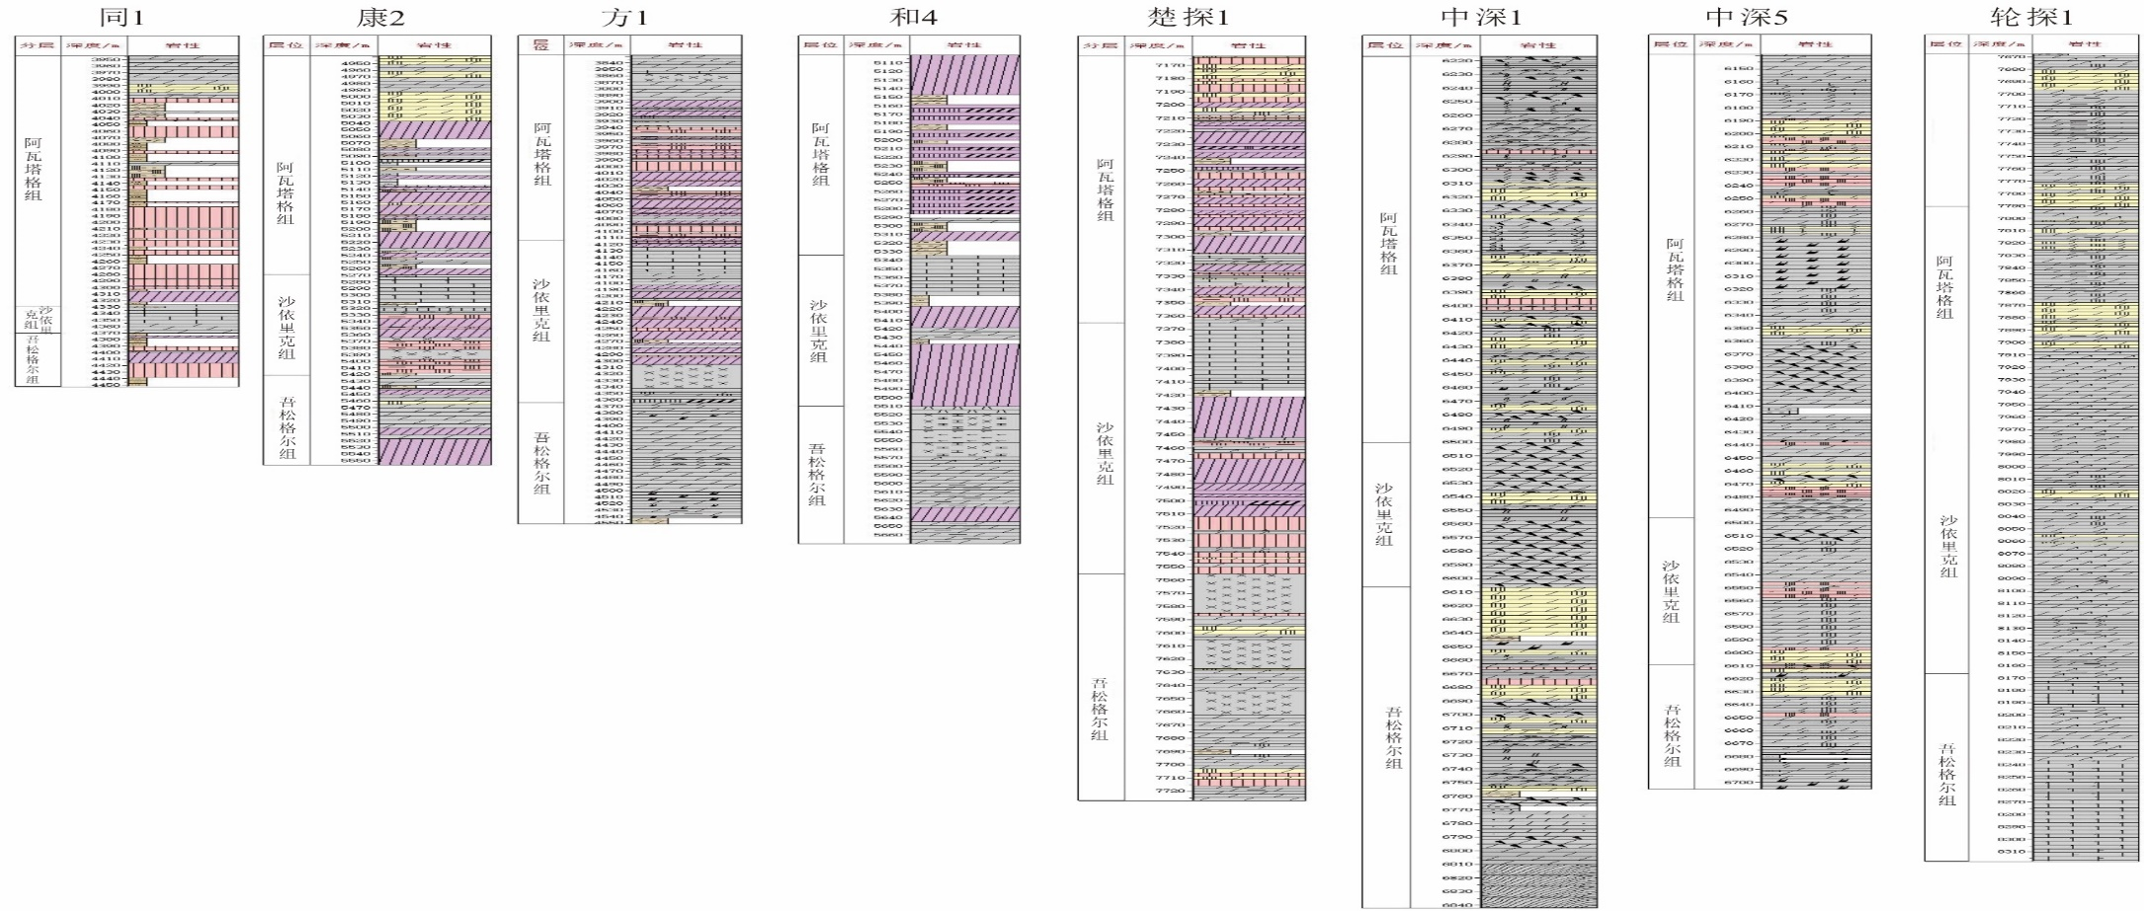

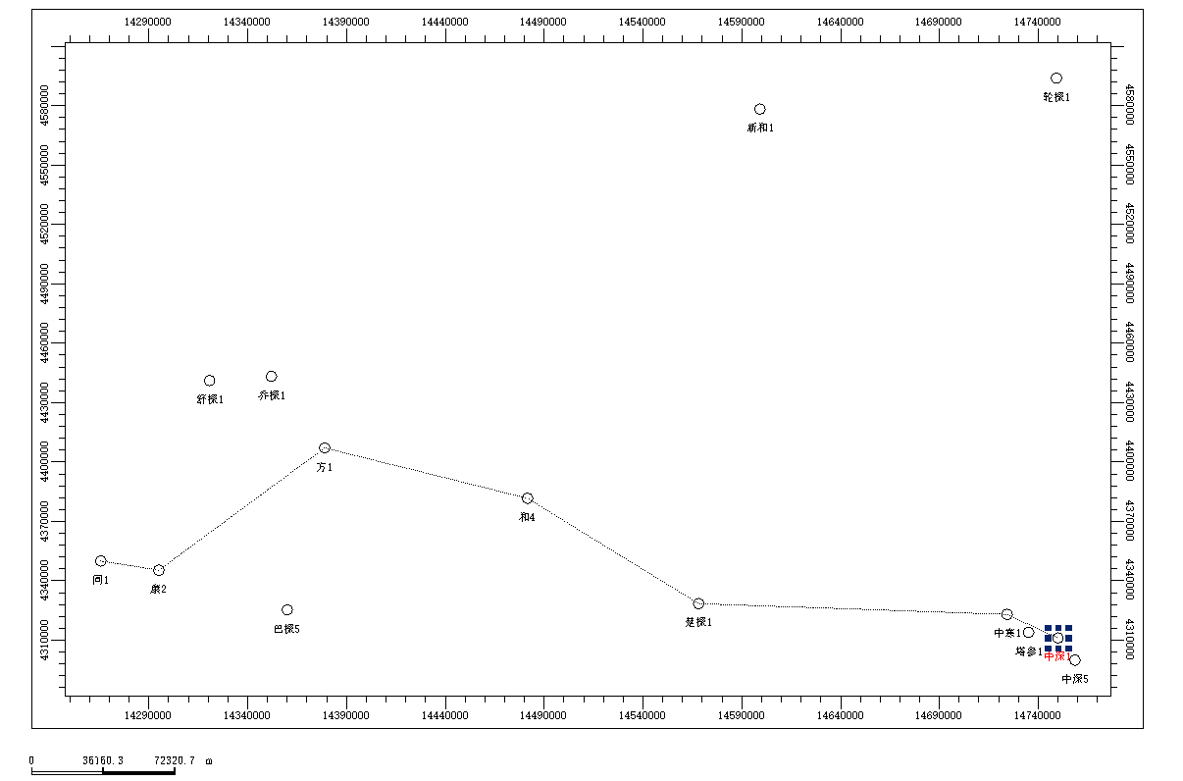

Step1：Parameter selection
Thickness of caprock
轮探1
方1
和4
同1
楚探1
康2
中深1
中深5
Thick layer (> 10m) is distributed, and the horizon gradually deepens; And the number is reduced.

Slide 17
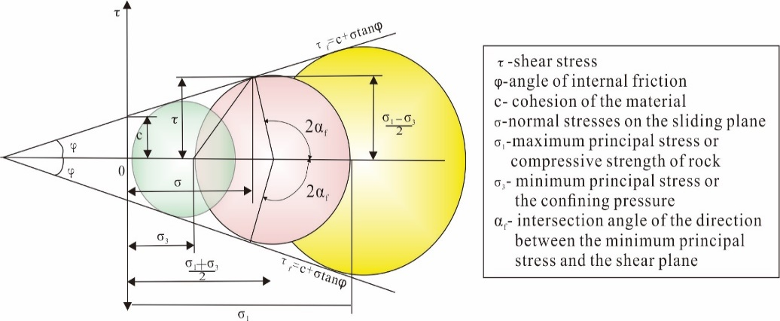
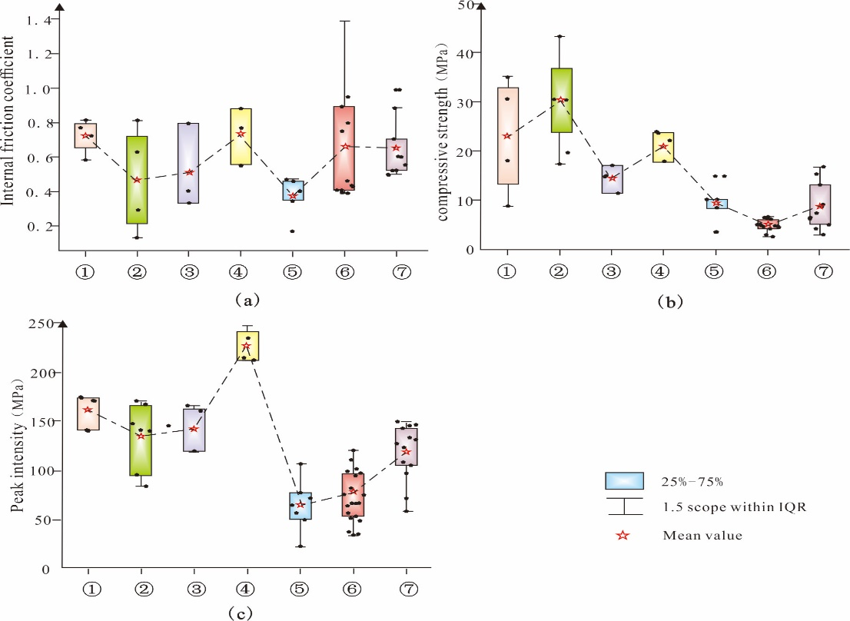
Step1：Parameter selection
Mechanical parameters of the caprock
According to the test results of 190 groups of cover triaxial mechanical test analysis in this study, the surrounding pressure and corresponding peak strength on the stress-strain curve are read, the Mohr circle is drawn, and the corresponding internal friction coefficient and tensile strength are calculated according to the modified Griffith criterion.
Comparison diagram of lithology and mechanical properties. （a）coefficient internal friction, （b）compressive strength, （c）peak intensity .①=gypsum dolomite,②=micritic dolomite,③=micrite

Slide 18
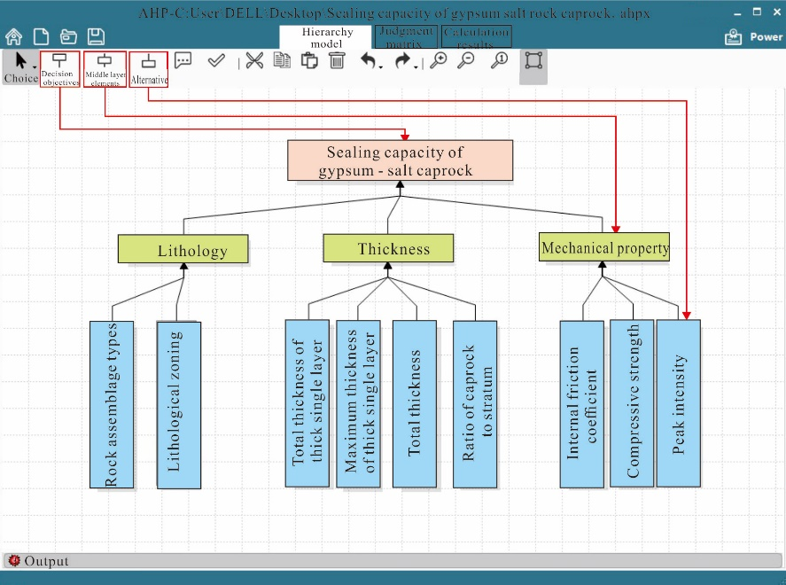
Step2：AHP method to determine factor weights
Hierarchical model drawing
Hierarchy modeling in AHP software. The red line in the figure is the identification, lick the corresponding icon to establish the hierarchical relationship

Slide 19
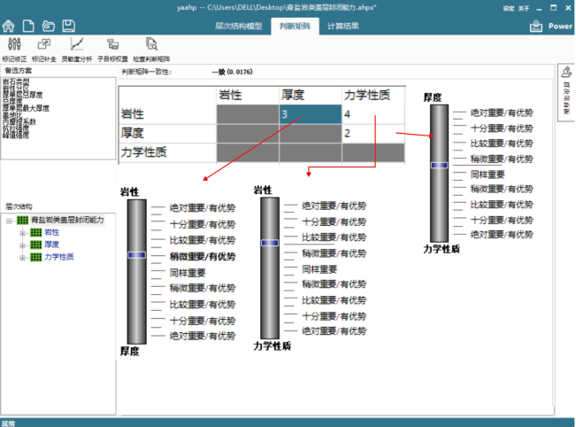
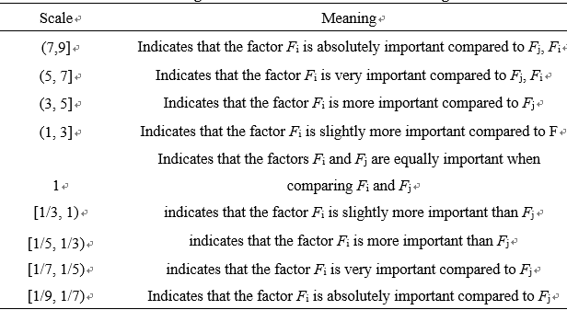
Step2：AHP method to determine factor weights
Matrix judgment
Judgment matrix scales and their meanings

Slide 20
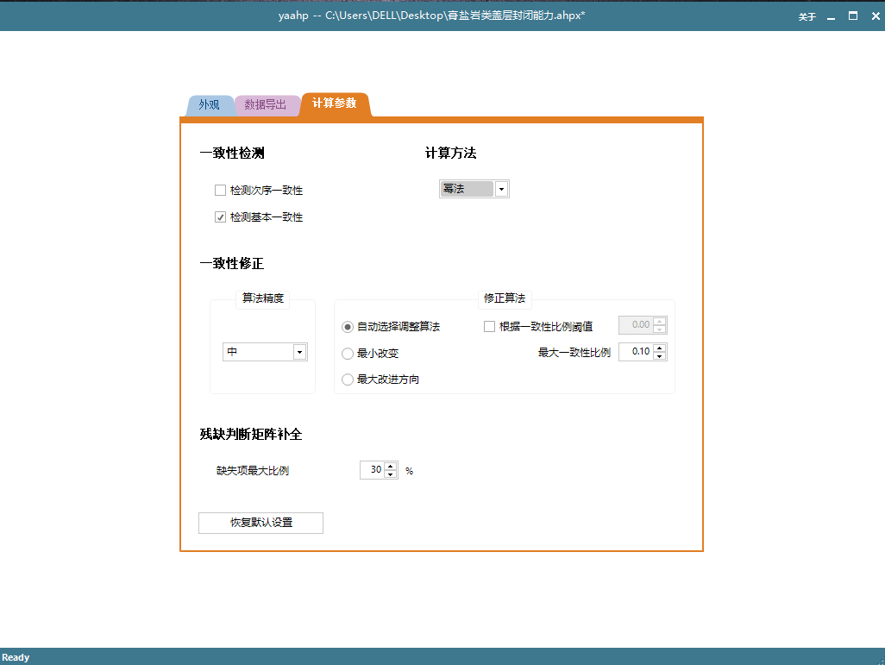
Step2：AHP method to determine factor weights
Matrix calculation and consistency test
Matrix calculation and consistency test
Evaluation parameter weight value of sealing capacity of Cambrian gypsum-salt caprock
Evaluation Parameters |  | Weight value
Rock assemblage type |  | 0.5208
Lithological zoning | Limestone type | 0.0521
 | Dolomite type | 0.0521
Total thickness |  | 0.0311
Total thickness of thick single layer |  | 0.1098
Maximum thickness of thick single layer |  | 0.0625
Ratio of cap rock to stratum |  | 0.0350
Peak intensity |  | 0.0720
Compressive strength |  | 0.0454
Internal friction coefficient |  | 0.0191
Set the matrix calculation method to "power method" and the consistency correction to "automatic selection adjustment methodology".

Slide 21
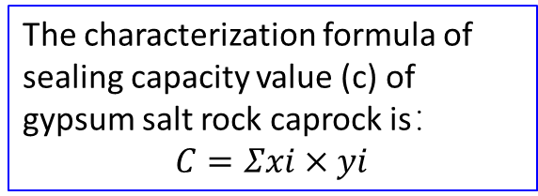
Step3：Evaluation Model and Results
Fuzzy language is used to describe and quantify the above factors.
Evaluation Parameters |  | Parameter assignment
 |  | 4-5 | 3-4 | 2-3 | 1-2 | 0-1
Lithological assemblage type |  | Salt rock type I | Salt rock type II | Gypsum rock type Ⅰ | Gypsum Rock type II | Carbonate rock type
Lithological zoning | Limestone | Zone A | Zone B | Zone C | Zone D | Zone E
 | Dolomite | Zone A | Zone B | Zone C | Zone D | Zone E
Thick single layer total thickness/m |  | ＞350 | 350-300 | 300-250 | 250-200 | <200
Total thickness/m |  | ＞750 | 600-750 | 450-600 | 300-450 | <300
Thick single layer maximum thickness / m |  | ＞40 | 35-40 | 35-30 | 30-25 | <25
Caprockage Ratio % |  | ＞60 | 50-60 | 40-50 | 30-40 | <30
Peak intensity |  | ＞45 | 35-45 | 25-35 | 15-25 | <15
Compressive strength |  | 70-85 | 55-70 | 40-55 | 25-40 | <25
Coefficient Internal friction |  | 70-85 | 55-70 | 40-55 | 25-40 | <25
According to the weight of each factor determined by analytic hierarchy process and the assignment of each factor quantified by fuzzy language, a quantitative evaluation method of sealing capacity of gypsum salt rock caprock is established
X is the evaluation parameter of item I, and Y is the weight of the evaluation parameter of item I.
When the comprehensive evaluation weight of caprock is 3-4, 2-3 and 1-2, the caprock quality is good, average and poor.
The characterization formula of sealing capacity value (c) of gypsum salt rock caprock is：
$C=Σxi×yi$

Slide 22
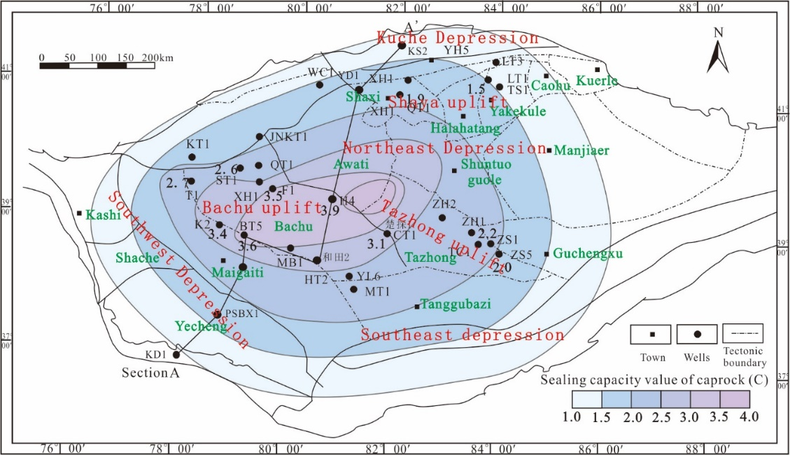
Step3：Evaluation Model and Results
Evaluation of sealing ability of Cambrian gypsum salt rock type caprock in Tarim Basin
Region | Well name | Lithological combination type |  | Lithological zoning |  |  |  | Thick single layer total thickness m |  | Total thickness/m |  | Thick single layer maximum thickness / m |  | Caprockage Ratio % |  | Peak strength (Mpa) |  | Compressive strength (Mpa) |  | Coefficient Internal friction |  | c -value
 |  |  |  | Limestone type |  | Dolomite type
 |  | Data | Assignment | Zone | Assignment | Zone | Assignment | Data | Assignment | Data | Assignment | Data | Assignment | Data | Assignment | Data | Assignment | Data | Assignment | Data | Assignment
Bachu | T1 | type II₁ | 3.0 | E | 0.3 | E | 0.4 | 488.6 | 4.8 | 698.6 | 3.7 | 28.0 | 1.8 | 69.9 | 4.2 | 22.0 | 1.7 | 17.0 | 0.3 | 70.7 | 4.1 | 2.7
 | ST1 | type II₁ | 3.0 | E | 0.6 | D | 1.9 | 294.0 | 2.9 | 391.0 | 1.7 | 21.0 | 0.8 | 75.2 | 4.6 | 30.0 | 2.5 | 38.5 | 1.8 | 63.5 | 3.5 | 2.6
 | F1 | type I₂ | 4.0 | D | 1.9 | E | 0.7 | 481.1 | 4.8 | 723.0 | 4.2 | 37.9 | 3.9 | 66.5 | 4.1 | 18.6 | 1.4 | 28.6 | 1.4 | 38.2 | 1.8 | 3.5
 | H4 | type I₁ | 5.0 | E | 1.5 | D | 1.3 | 427.5 | 4.3 | 569.5 | 2.6 | 72.5 | 5.0 | 75.1 | 4.6 | 13.8 | 0.9 | 30.0 | 1.5 | 21.6 | 0.7 | 3.9
 | CT1 | type I₂ | 4.0 | E | 0.3 | E | 0.7 | 340.0 | 3.8 | 564.0 | 2.6 | 34.0 | 2.8 | 60.3 | 4.0 | 13.9 | 0.9 | 23.7 | 0.9 | 39.6 | 2.0 | 3.1
 | BT 5 | type I₁ | 5.0 | D | 0.3 | D | 1.8 | 349.0 | 2.4 | 389.5 | 1.6 | 30.9 | 2.1 | 89.6 | 5.0 | 22.2 | 1.7 | 32.8 | 1.7 | 32.3 | 1.7 | 3.6
 | K2 | type I₂ | 4.0 | E | 0.3 | E | 0.9 | 437.5 | 4.3 | 696.5 | 3.6 | 78.0 | 5.0 | 62.8 | 4.2 | 19.1 | 1.4 | 26.0 | 1.1 | 42.9 | 2.3 | 3.4
 | QT 1 | type I₁ | 5.0 | E | 0.6 | D | 1.8 | 496.0 | 4.9 | 622.0 | 3.1 | 38.0 | 3.6 | 79.7 | 4.8 | 13.6 | 0.9 | 23.0 | 0.8 | 35.5 | 1.6 | 3.9
Bachu | ZS1 | type II₂ | 2.0 | E | 0.9 | E | 0.7 | 177.8 | 0.8 | 508.8 | 2.5 | 42.5 | 4.1 | 34.9 | 1.4 | 46.7 | 4.2 | 60.8 | 3.6 | 81.4 | 4.7 | 2.2
 | ZS5 | type II₂ | 2.0 | E | 0.9 | E | 0.3 | 223.2 | 1.4 | 833.7 | 5.0 | 380.0 | 3.6 | 26.8 | 0.6 | 26.7 | 2.2 | 27.2 | 1.2 | 80.0 | 4.7 | 2.0
 | ZH 1 | type II₂ | 2.0 | E | 0.3 | E | 0.8 | 335.0 | 2.3 | 565.0 | 2.6 | 31.0 | 2.1 | 59.3 | 3.9 | 30.0 | 2.5 | 31.8 | 1.7 | 82.5 | 4.8 | 2.0
 | TC 1 | type II₂ | 2.0 | E | 0.3 | E | 0.6 | 121.0 | 0.2 | 296.0 | 0.9 | 31.0 | 2.1 | 40.9 | 2.0 | 36.9 | 3.2 | 62.5 | 3.4 | 57.0 | 3.1 | 1.8
Tabei | XH 1 | type Ⅲ | 1.0 | E | 0.6 | D | 1.0 | 375.0 | 4.2 | 551.0 | 4.1 | 38.0 | 3.6 | 68.1 | 2.9 | 37.8 | 3.3 | 48.8 | 2.4 | 53.0 | 2.9 | 1.9
 | LT 1 | type Ⅲ | 1.0 | E | 0.3 | E | 0.7 | 146.9 | 0.4 | 650.0 | 3.4 | 27.8 | 1.7 | 22.6 | 0.4 | 52.2 | 4.8 | 85.0 | 5.0 | 62.6 | 3.5 | 1.5
According to the evaluation results, the C value of Bachu-Tazhong-Tabei area gradually decreases, and the sealing capacity of caprock gradually deteriorates.
Sealing capacity value of Cambrian gypsum-salt caprock in Tarim Basin

Slide 23
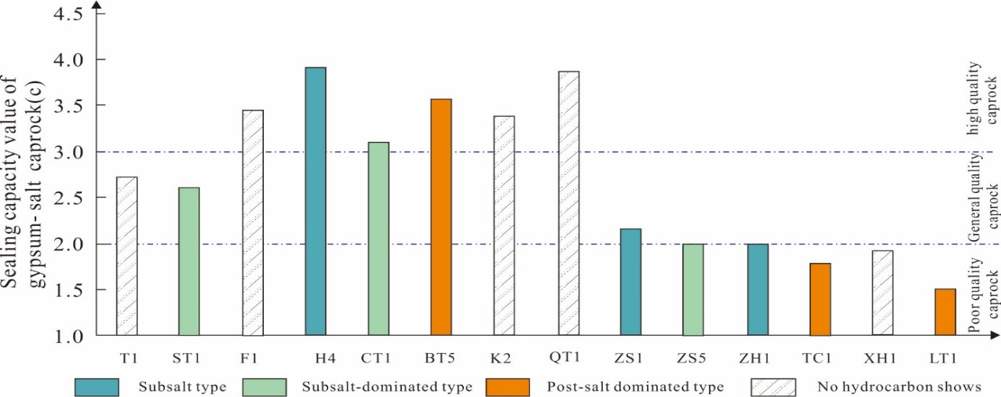
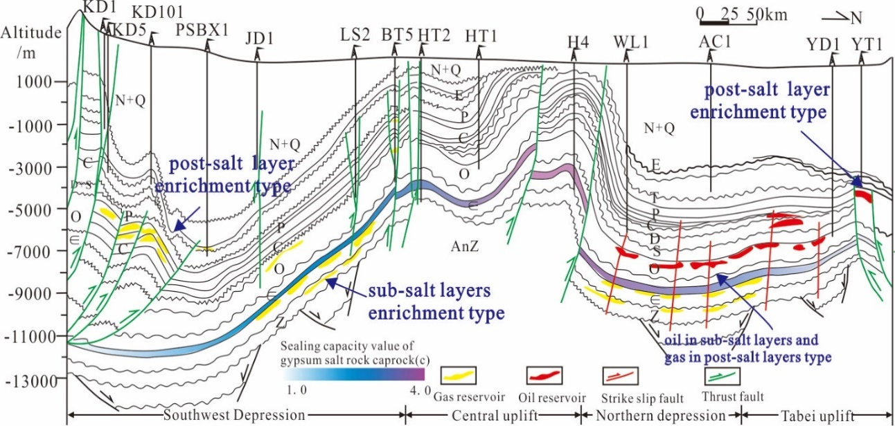
Step3：Evaluation Model and Results
Generally, the vertical display types of oil and gas in good caprocks are mainly under salt type and under salt type, and the distribution position of oil and gas corresponding to poor caprocks is above salt;It shows that the evaluation results have a certain positive correlation with the vertical distribution of deep oil and gas in Tarim Basin.
Evaluation results of Cambrian gypsum salt rock sealing ability and analysis diagram of oil and gas display in Tarim Basin
The fault is undeveloped or strike slip fault activity is early strong and late weak, and the C value reaches 2, which is a favorable area for oil and gas accumulation under salt.
Comprehensive analysis of Cambrian gypsum salt rock caprock, fault and oil and gas distribution in Tarim Basin

Slide 24
CONTENTS
Introduction
Evaluation methods
Geological setting
Application & results
Conclusions & References

Slide 25
Conclusions
In this paper, three major influencing factors of lithology, thickness, and mechanical properties are selected and refined into nine sub-categories of parameters based on the characteristics of the gypsum-salt caprock in the Tarim Basin, and the weights of each factor are determined by introducing AHP to establish a closure capacity evaluation system of the gypsum-salt caprock of the Cambrian in the Tarim Basin.
The quantitative evaluation results of caprock of 14 wells in the study area show that the evaluation value (c) of sealing capacity of Cambrian gypsum salt rock caprock in Tabei- Tazhong- Bachu area gradually increases and the sealing capacity gradually becomes better; Combined with the analysis of fault type and activity, it is proposed that the sealing capacity of caprock C reaches 2 and the f fault activity is poor or strong in the early period and weak in the late period, which is a favorable area for undersalt oil and gas accumulation in Tarim Basin.

Slide 26
References
[1] Amirsaman Rezaeyan, Seyyed Alireza Tabatabaei-Nejad, Elnaz Khodapanah, et al. A laboratory study on capillary sealing efficiency of Iranian shale and anhydrite caprocks[J]. Marine and Petroleum Geology,2015,66(04): 817-828.
[2]Behzad Mehrgini, Hossein Memarian, Maurice B. Dusseault, et al. Geomechanical characteristics of common reservoir caprock in Iran (Gachsaran Formation), experimental and statistical analysis[J]. Journal of Natural Gas Science and Engineering,2016,34: 898-907.
[3]Bing Bai, Guangzhong Lü, Xiaochun Li, et al. Quantitative Measures for Characterizing the Sealing Ability of Caprock with Pore Networks in CO2 Geological Storage[J]. Energy Procedia,2014,63: 5435-5442.
[4]Cheng Zhang, Milei Wang. A critical review of breakthrough pressure for tight rocks and relevant factors[J].2022,100: 104456.
[5]Chengzao Jia, Debo Ma, Jingyi Yuan et al. Structural characteristics, formation & evolution and genetic mechanisms of strike-slipfaults in the Tarim Basin[J]. Natural Gas Industry B, 2022. 9(1):51-62.
[6]Deyang Wang, Yuanping Cheng, Liang Wang, et al. Controlling factors of coalbed methane occurrence below redbeds in Xutuan mine: Caprock thickness below redbeds[J]. Journal of Natural Gas Science and Engineering,2021,96: 104323.
[7]Dyer J S. Remarks on the analytic hierarchy process[J]. Management science, 1990, 36(3): 249-258.
[8]Fan Q, Fan T L, Li Q P, et al. Sedimentary characteristics and developmental patterns of Cambrian gypsum salt rocks in the Tarim Basin[J]. Petroleum Experimental Geology,2021,43(02):217-226（in Chinese with English Abstract）.
[9]Forman E H, Gass S I. The analytic hierarchy process-an exposition[J]. Operations research, 2001, 49(4): 469-486.
[10]Fu X, Yan L, Meng L, et al. Deformation Mechanism and Vertical Sealing ability of Fault in the Mudstone Caprock[J]. Journal of Earth Science, 2019, 30(2):367-375.
[11] FU Xiaofei, JIA Ru, WANG Haixue, et al. Quantitative evaluation of fault-caprock sealing ability: A case from Dabei-Kelasu structural belt in Kuqa Depression, Tarim Basin, NW China[J]. Petroleum Exploration and Development, 2015, 42(3):329-338.
[12] Fuwei Wang, Dongxia Chen, Qiaochu Wang, et al. Quantitative evaluation of caprock sealing controlled by fault activity and hydrocarbon accumulation response: K gasfield in the Xihu Depression, East China Sea Basin [J]. Marine and Petroleum Geology,2021,134:105352.

Slide 27

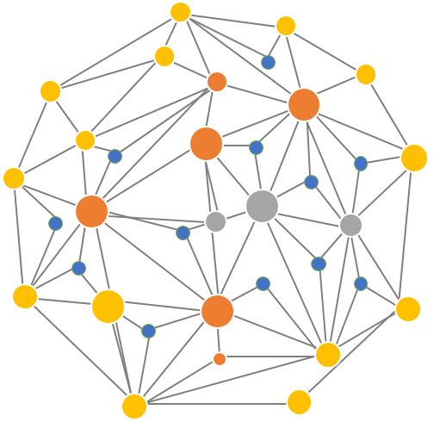
Thanks for listening.
Shan ZHAO
China University of Petroleum (Huadong)

