Slide 1


EGU2022
ST3.5
Local time and longitudinal variation of ionospheric radial current: Swarm observation and TIE-GCM simulation
Hao Xia (2021202120021@whu.edu.cn)
C.Y Qian
2022.05.23

Slide 2
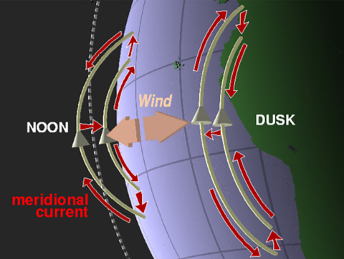
1. Motivation
The zonal winds in the F region of the thermosphere above the magnetic equator drive the ionospheric radial currents (IRCs).
There is a significant local time and longitudinal variation in the distribution of the IRC.
The physical mechanism of the MLT and longitudinal distributions of IRC remains unclear.
IRC
Schematic illustration of the F region dynamo over the dip equator driven by thermospheric winds.
(Lühr et al. 2019)

Slide 3
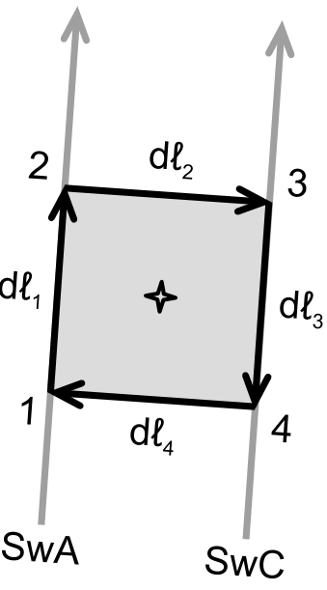
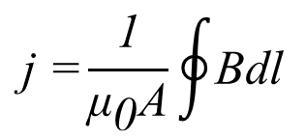
2. Data and Model
Swarm satellites observation
TIE-GCM simulations
1. Local time and longitudinal variation of IRC.
Ampere’s circuit law
$$\text{j}\text{ =}\frac{\text{1}}{{\text{μ}}_{\text{0}}\text{A}}\oint{\text{Bdl}}$$
2. Effects of lower atmospheric tides on IRC.
Sketch of the four measurement points for calculating the average current density.
(Lühr et al. 2015)
3. Contribution of F region dynamo current and vertical polarization current to IRC.

Slide 4
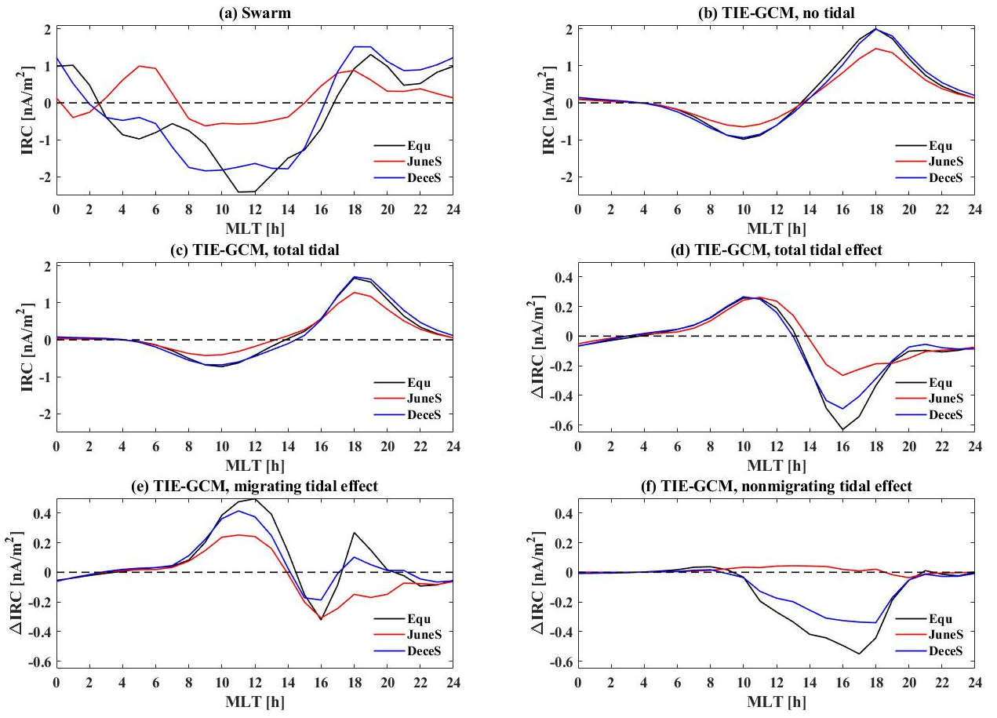
3. Results
Diurnal variation of IRC
The noon IRC is radially outward, the dusk IRC is radially inward.
The low altitude tides effect the IRC seasonal reverse time in the afternoon.
The migrating tides weaken the noontime IRC. The nonmigrating tides weaken the dusk-time IRC.

Slide 5
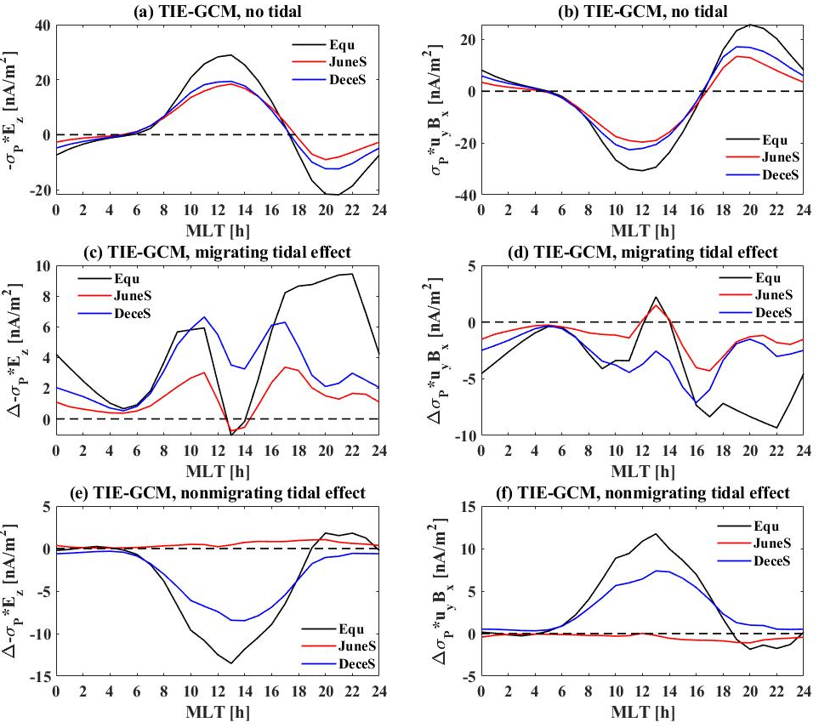
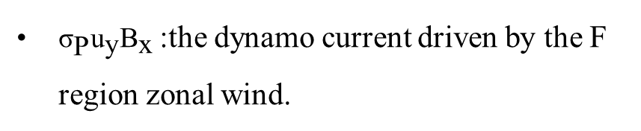
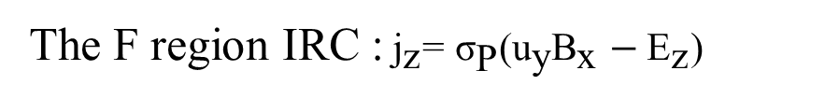
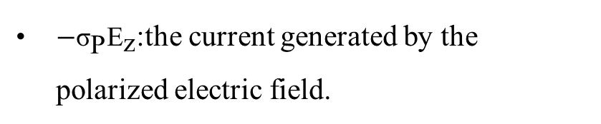
3. Results
Diurnal variation of IRC
The F region IRC :${\text{j}}_{\text{z}}\text{= }{\text{σ}}_{\text{P}}\text{(}{\text{u}}_{\text{y}}{\text{B}}_{\text{x}}−{\text{E}}_{\text{z}}\text{)}$
${\text{σ}}_{\text{P}}{\text{u}}_{\text{y}}{\text{B}}_{\text{x}}$:the dynamo current driven by the F region zonal wind.
$−{\text{σ}}_{\text{P}}{\text{E}}_{\text{z}}$:the current generated by the polarized electric field.
The IRC is mainly controlled by the dynamo current.
The ∆IRC caused by tidal effect is controlled mainly by the polarization current.

Slide 6
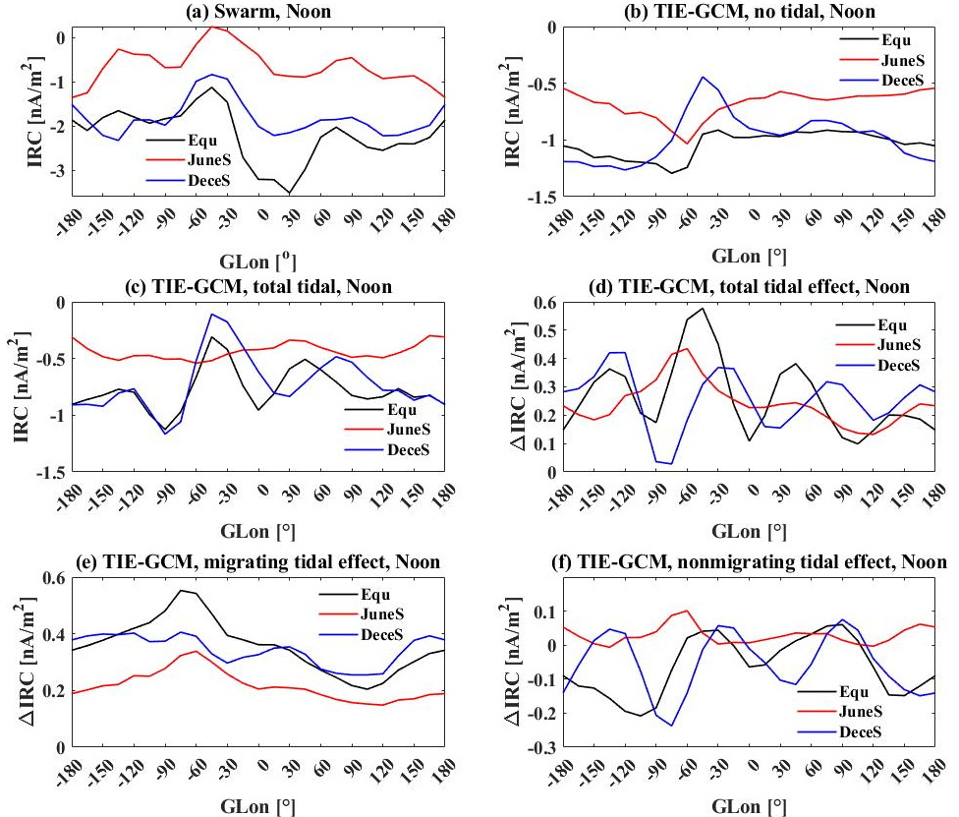
3. Results
Wave-4 longitudinal structure of noontime IRC
1. Noontime IRC has obvious wave-4 zonal structure, which is caused by lower atmospheric tides.
2. The wave-4 structure is mainly controlled by nonmigrating tides and influenced by migrating tides.

Slide 7
4. Conclusion
The low altitude tides have an important effect on IRC seasonal change of the reverse time.
The lower atmospheric tides tend to weaken IRC, mainly through the effect on the polarization current.
There is an obvious wave-4 zonal structure in the observed and simulated IRC in the noontime, which is related to both migrating and nonmigrating tides.

